Slide 1


Kaggle Passenger Screening Competition Michael Avendi PhD
Notes:
<number>

Slide 2
Agenda
Background
Summary
Model Architecture
Training methods
Important findings
Simple model
Notes:
<number>

Slide 3
Summary
End-to-end convolutional neural networks.
Model input: 16 images per subject.
Model output: 17 probabilities per zone.
Ensemble of 11 models.
Only APS data format was used.
Training on Titan X GPUs.
Training time: ~48 hours per model.
Notes:
<number>

Slide 4
Summary
TOOLS
Anaconda with Python 2.7
Jupyter notebook
Numpy: 1.12.1
Keras 1.1.1
Theano 0.9.0
Cv2 3.1.0
Sklearn 0.18.1
Notes:
<number>

Slide 5
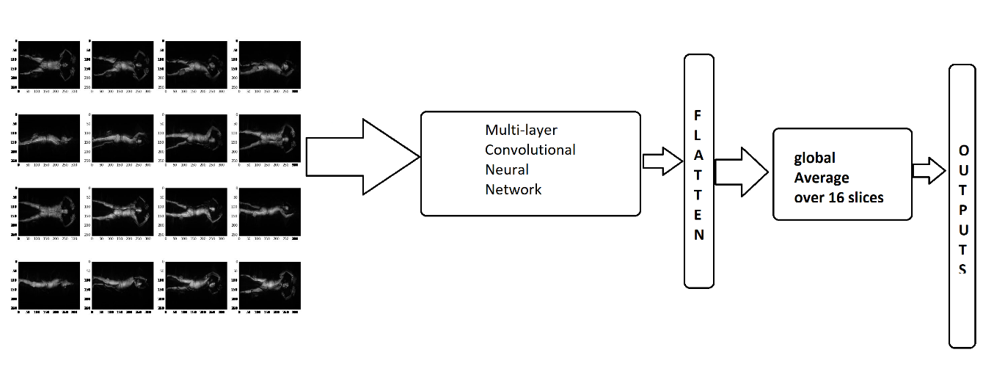
Model Architecture
Single Model Architecture
Notes:
Model architecture as seen in the figure consists of a multi-layer conv2D to extract features from 16 image slices one at a time, flattening features, average over 16 image slices and then generating 17 Sigmoid outputs (one per zone).
<number>

Slide 6
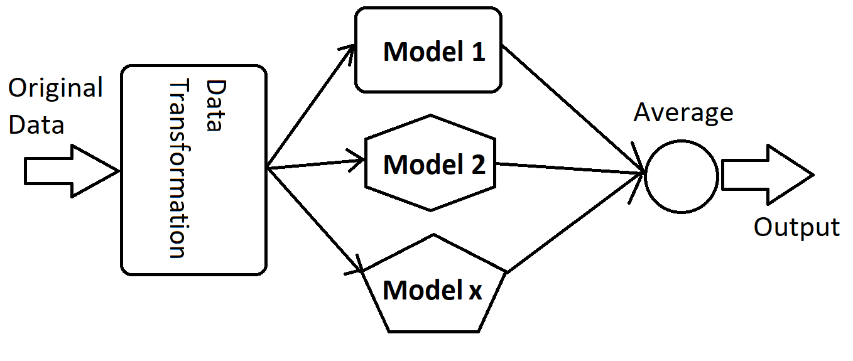
Model Architecture
Ensemble Models
Notes:
Model architecture as seen in the figure consists of a multi-layer conv2D to extract features from 16 image slices one at a time, flattening features, average over 16 image slices and then generating 17 Sigmoid outputs (one per zone).
<number>

Slide 7
Data transformation
Convert APS data to Numpy float32 arrays
Down-sampled to 256 by 330 for nine models
Original 512 by 660 for two models
Rotate data by 90, 180 and 270 degrees
Global zero-mean and unit-variance normalization
Notes:
<number>

Slide 8
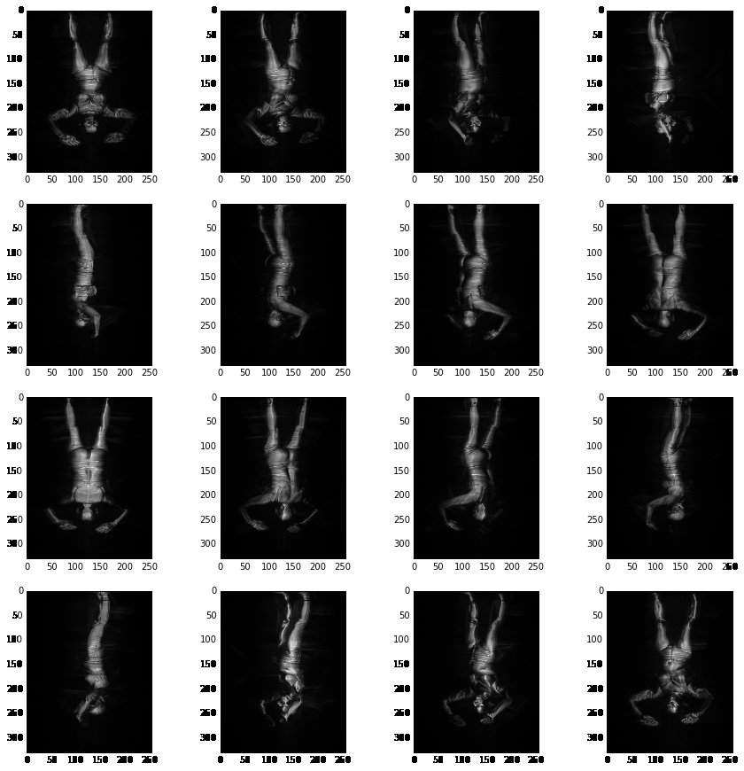
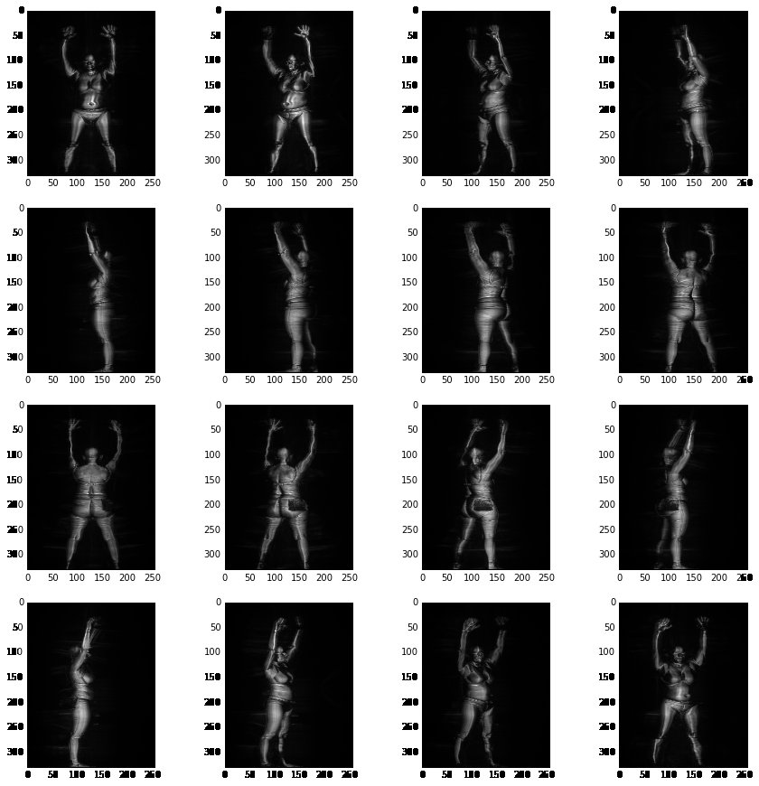
Data Transformation
Rotated data 90 and 270 degrees
Notes:
<number>

Slide 9
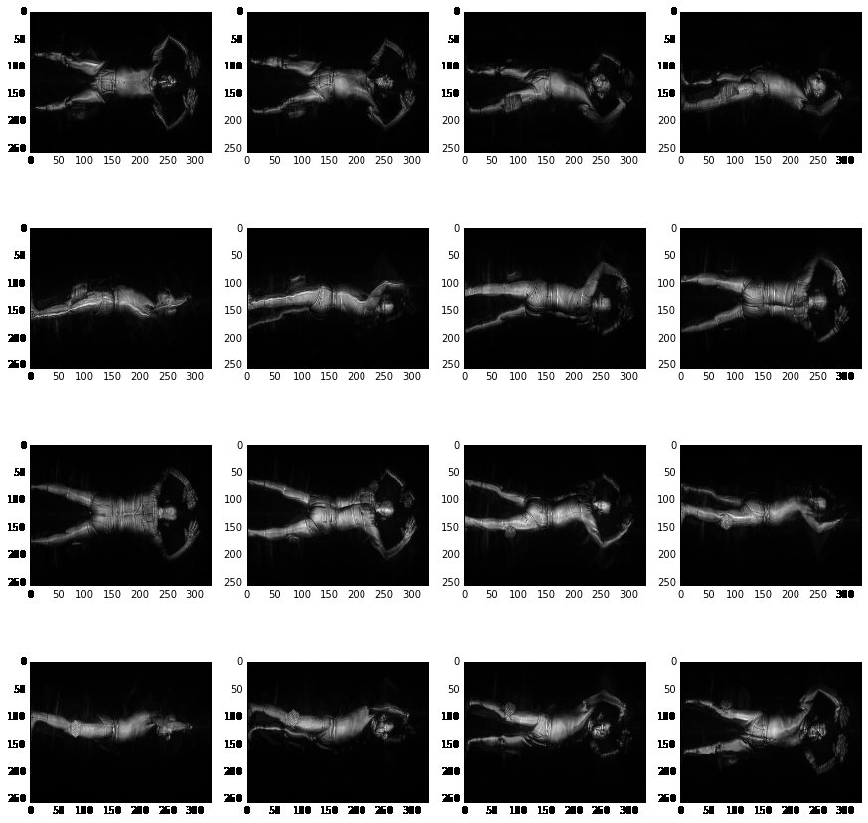
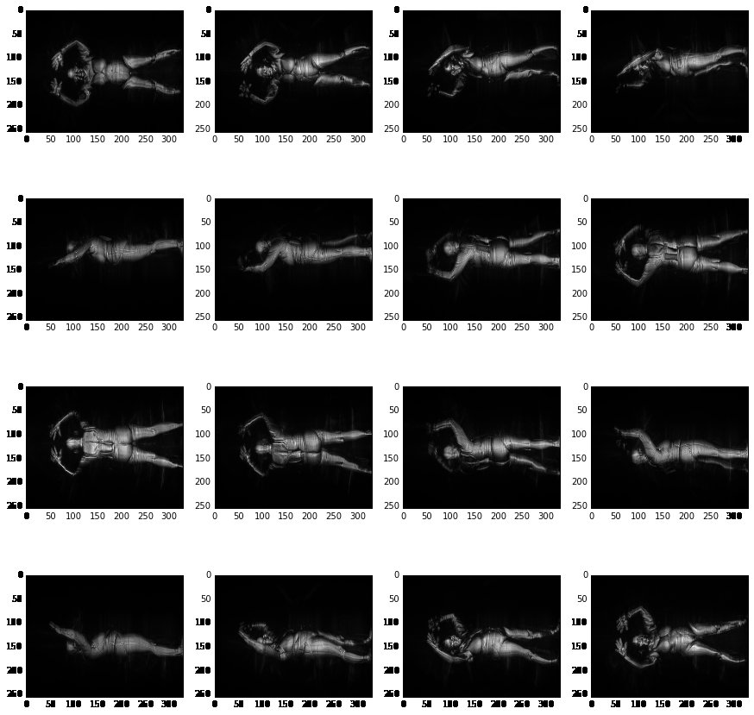
Data Transformation
Rotated data 0 and 180 degrees
Notes:
<number>

Slide 10
Training Methods
Stage1-train: 1047 subjects for training and 100 subjects for local validation.
Stochastic gradient descent algorithm
Optimizer: Nadam
Loss: Binary cross entropy
Batch size: 8
Epochs: 1000
Initial learning rate: 3E-4
Drop learning rate by factor of 2 at saturation
Notes:
<number>

Slide 11
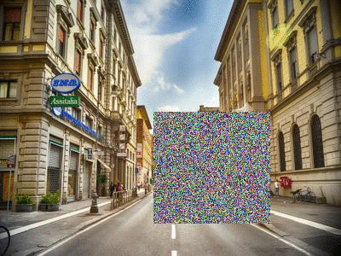
Training Methods
Various image augmentations techniques:
Rotation (10-15 degrees)
Width and height shift (10-15%)
Shear, zoom (10-15 %)
Random erasing [Ref1]
Notes:
Ref1 Zhun Zhong, Liang Zheng, Guoliang Kang, Shaozi Li, Yi Yang “Random Erasing Data Augmentation”
<number>

Slide 12
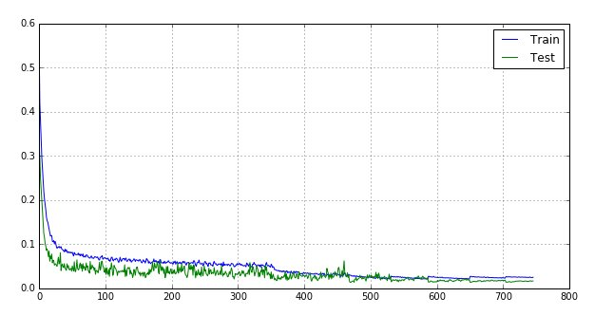
Single Model
Models performed almost similarly!
Single model on stage1-leaderboard ranged from 0.0157 to 0.0297
Notes:
<number>

Slide 13
Insights and findings
Building separate models on 90,180,270 rotated dataset was very effective.
Random erasing augmentation provided some improvements.
Using the original data size.
Using batch normalization.
Fine-tuning models after releasing labels for stage1-test data.
Notes:
<number>

Slide 14


