Slide 1
The Q.U.E.E.R. Tour
11.14.15

Slide 2
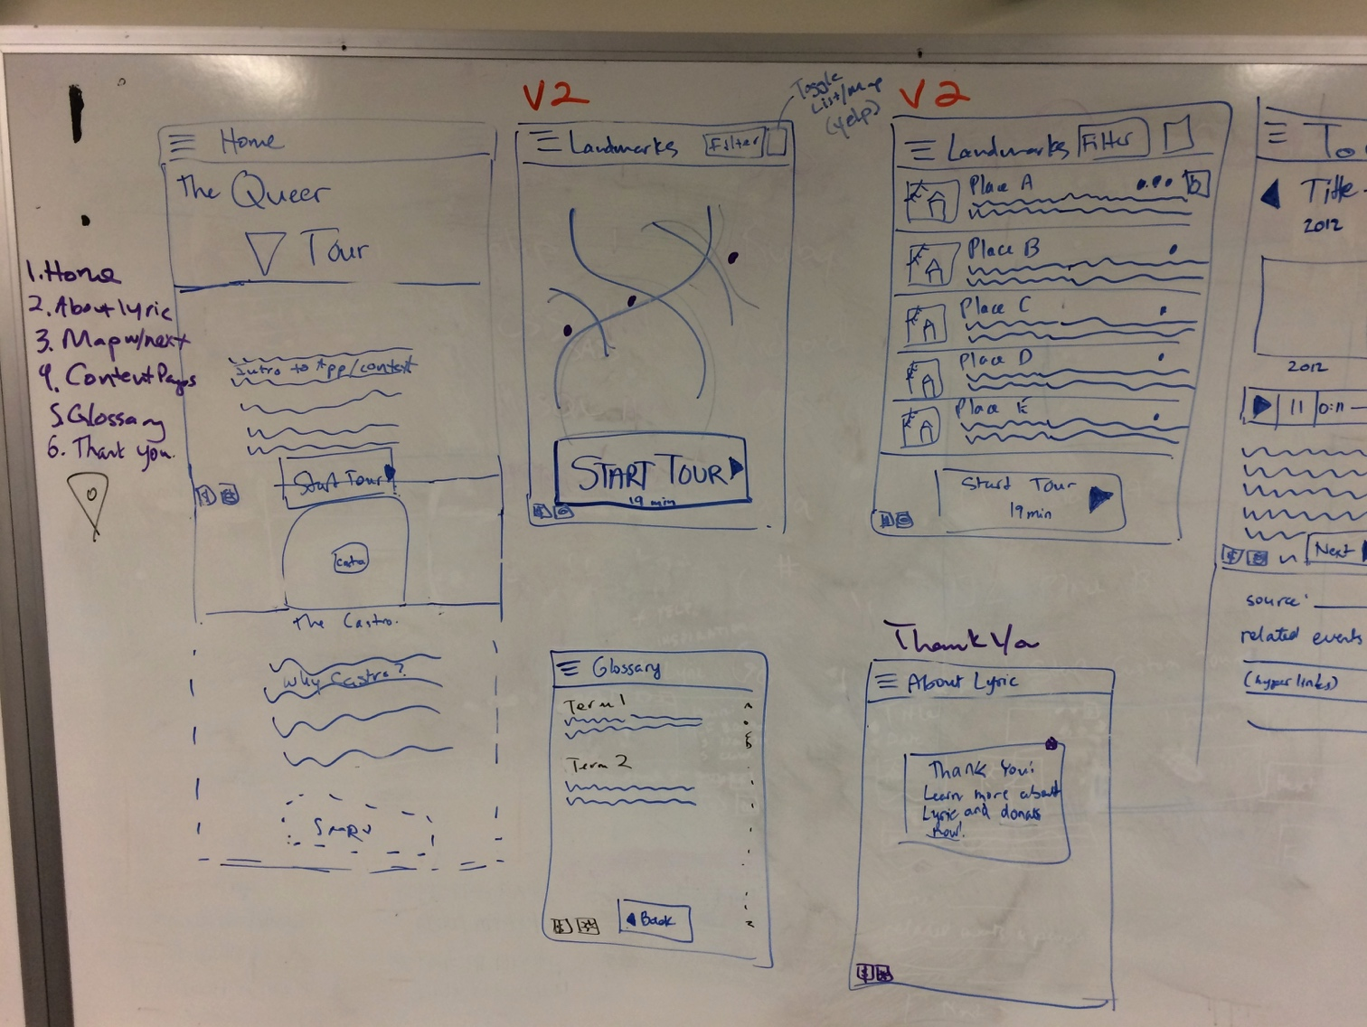
Universal Elements
Hamburger menu shows all pages, including Home, Tour, Glossary, and About Lyric. V2 will include the Landmarks page
Persistent Donate icon ($) and Settings icon (gear) floating on bottom left of all pages. Settings will not appear until V2 (language, text size)
Persistent floating button on all screens except Thank You and About Page. On this page, the button starts the tour.
Remember to build some extra space at the bottom of each page for that floating persistent button that appears above ☺

Slide 3
Home
Graphic header, similar to postcard flyer
Intro to Lyric, context for the tour, idea of illuminating the Castro’s invisible queer history.
On this page, the floating Start Tour button starts the tour at the first POI (point of interest).
Zoomable Google map showing all POI’s and borders of Castro. Allow screen to break map at bottom, encouraging user to scroll down.
Description of Castro neighborhood and why the viewer should care about it’s history.

Slide 4
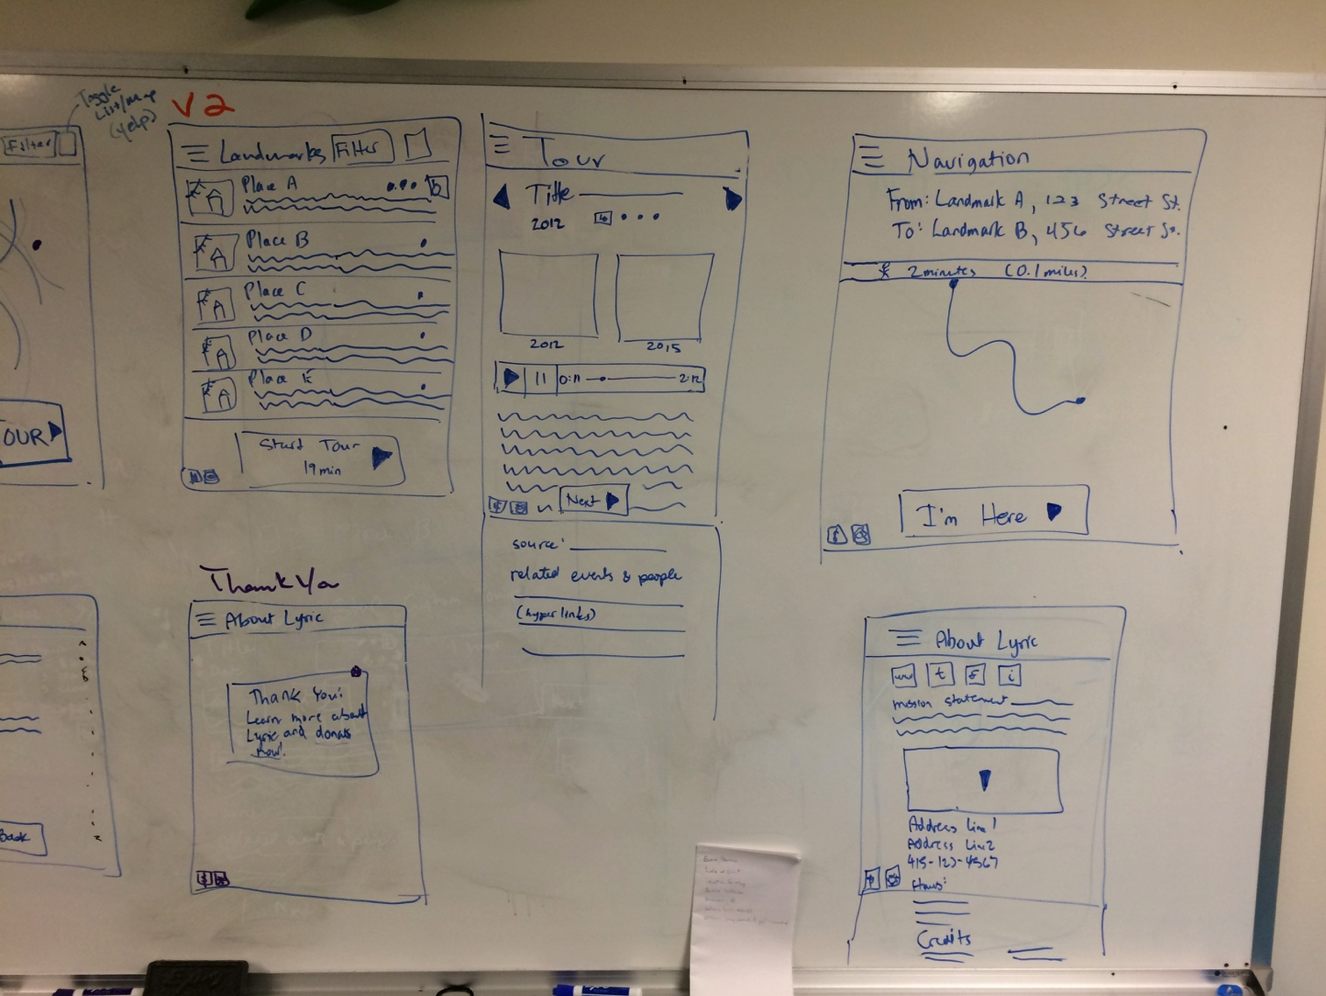
Tour
Title of POI on first line, year on second line, both left aligned. Icons for wheelchair accessibility. In V2, color coding dots for type of POI based on filters. Left arrow for back, right arrow to Navigation screen.
Pair of pictures - one from event date, one from today.
Audio player including length of audio clip.
On this page, the floating Next button goes to the Navigation screen.
Below the screen break will appear the source link(s) and related events and people. Hyperlink when possible.

Slide 5
Navigation
Navigation screen helps user get from current location to next POI. Left arrow to previous screen, right arrow to next POI.
Estimate walking travel time and miles (see google maps app).
Show map from current location to next POI.
On this page, the floating I’m Here button goes to the next POI.

Slide 6
Thank You
The last POI of any tour is Lyric, which makes the call to donate more “real” - now you’re standing in front of queer history in progress.
Thank you popup overlays the About Lyric page and can be closed with the X in the top right corner of the popup.
“donate now” should be a hyperlink

Slide 7
About Lyric
Social media icons: www (to lyric), twitter, facebook, instagram
Lyric’s mission statement
Google map of lyric location
Lyric’s address, phone, email, hours
Credits

Slide 8
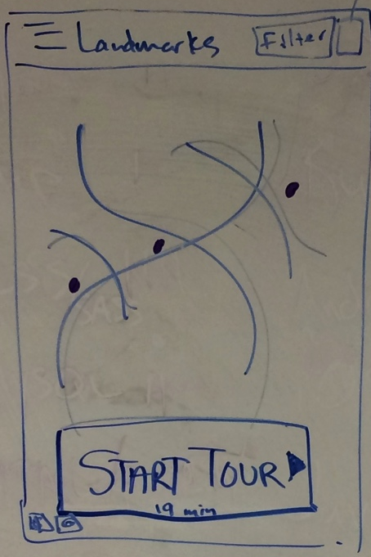
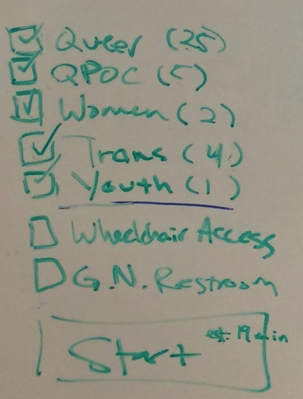
V2 Landmarks Views
Landmarks with filter button and toggle between list view (left) and map view (middle). Filter popup can hide POI’s (right).

Slide 9
V2 Future Needs
Queer glossary
Testing and housing resources
Text size and language settings
Connection banner to Lyric home page

