Slide 1

Player Action Recognition on Broadcast Soccer Videos
Fifth Summer School on
Computer Vision, Graphics, and Image Processing
Presented by:
Anirban Saha
Shahil Barnwal
Soumen Sinha Mahapatra
Supervised by:
Prof. Dipti Prasad Mukherjee and Mr. Saikat Sarkar,
Electronics & Communication Sciences unit, ISI Kolkata

Slide 2
Contents
Introduction
Goal
Challenges Faced !!!
Methodology
Experimental Results
Application over Broadcast Soccer Videos
Conclusions
References

Slide 3
Introduction

Slide 4
Goal
Provided a long-shot broadcast soccer video, we want to recognize the action of players .

Slide 5
Challenges Faced !!!
Dataset
Different Camera Shots
Sudden Zoom
Camera Motion
Movement of players relative to camera motion

Slide 6
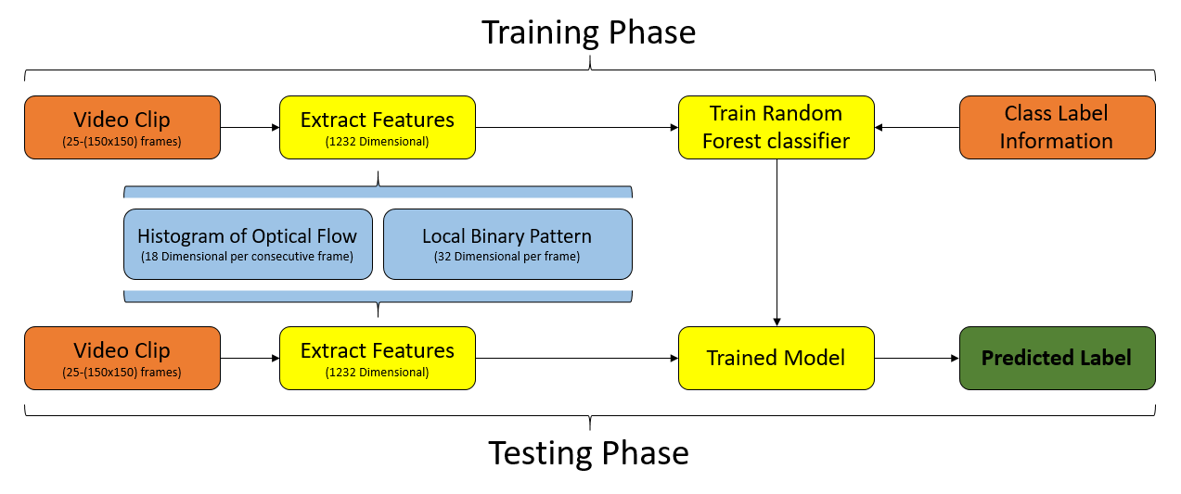
Methodology
Fig 1. Overview of Model

Slide 7
Methodology
Datset

Slide 8
Experimental Results

Slide 9
Application over Broadcast Soccer Videos

Slide 10
Conclusions

Slide 11
References

