Slide 1

A Drift-Aware Scheduling in 5G RAN
NAME
USN
Akshat Dodwad
01FE23BCI045
Naveen Huggi
01FE23BCI056
Abhishek M
01FE23BCI116
Riya M
01FE23BCI096
Guided By : Nagaratna Kulenavar

Slide 2
Motivation
The shift from 4G to 5G and now toward 6G has pushed networks into a highly dynamic state, with dense deployments, heterogeneous devices, and strict latency requirements. This complexity makes network behavior far less predictable than in earlier generations.
Static schedulers, which rely on fixed rules or predefined configurations, cannot keep up with such variability. They fail to respond effectively to fluctuating traffic loads, mobility patterns, and interference levels, leading to suboptimal performance.
AI/ML-driven schedulers leverage real-time data to continuously adjust resource allocation based on current network state. This enables fine-grained optimization of spectrum, power, and user scheduling, providing better QoS and responsiveness than rule-based methods.
When drift sets in, the scheduler may allocate resources inefficiently, causing SLA violations, drops in throughput, and delays in latency-critical applications. Real-time services like AR/VR, autonomous systems, or massive IoT are especially vulnerable.
This creates a clear requirement for a drift-aware scheduling —one that detects drift, adapts or retrains models proactively, and keeps the scheduler aligned with current network realities to ensure stable, high-quality performance.

Slide 3
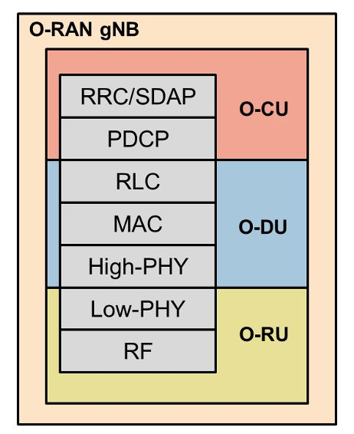
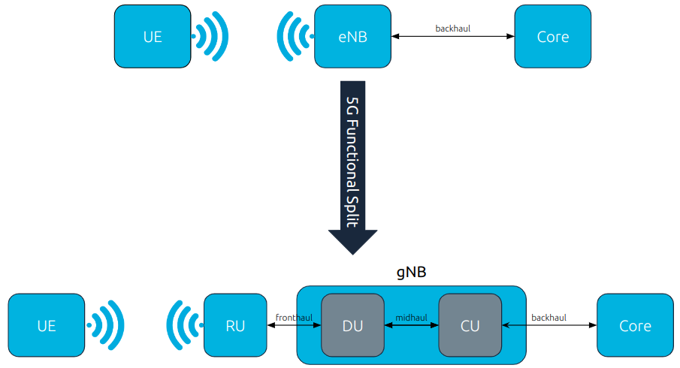
5g Standalone Architecture
Fig. 1 Simplified overview of move from 4G architecture to 5G architecture with functional split.

Slide 4
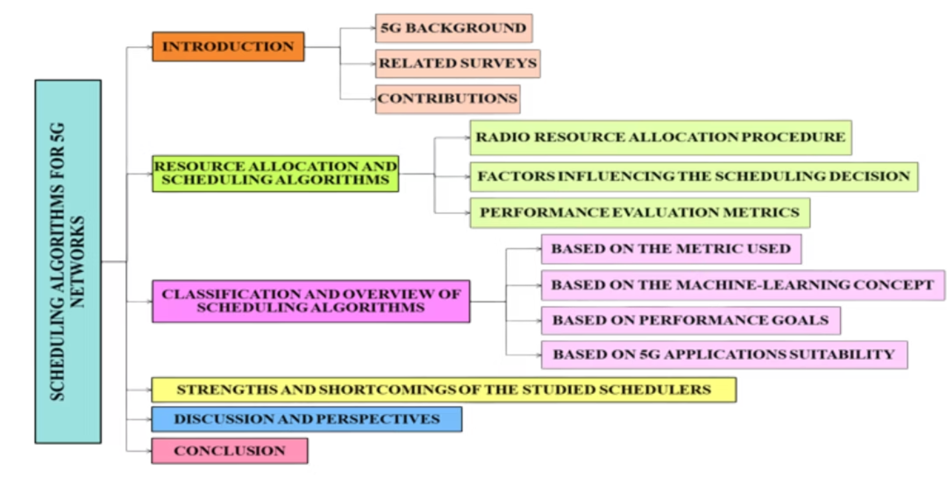
Walkthrough

Slide 5
Literature Survey
1. 5G Scheduling Algorithm for Capacity Improvement Using Beam Division at Congested Traffic, Journal of Engineering Science and Technology, 2021
Methodology: Introduces a BDMA-based scheduling algorithm activated under congestion, where user count exceeds available beams. The method dynamically splits a beam into two narrower sub-beams, allowing a single antenna to serve both an existing and a nearby new user simultaneously, optimizing beam utilization.
Key Results: Simulation results show up to 50% increase in total cell throughput and improved system fairness under heavy load. Although individual user throughput slightly decreases when beams are split, the overall cell capacity and service accessibility improve significantly.
Limitations: Effective only when users are spatially close and near the base station, since beam splitting divides transmit power. The evaluation ignores noise and interference, which may impact real-world performance and limit scalability in practical deployments.

Slide 6
Literature Survey
2. The drift handling framework for open radio access networks: An experimental evaluation, Computer Networks, 2024
Methodology: Proposes a three-stage drift handling framework for Open RAN: (1) drift detection—monitors AI/ML model performance (RMSE) against a threshold; (2) drift analysis—identifies drift type (sudden or incremental); (3) drift adaptation—selects an appropriate response, such as retraining the current model or replacing it from a pre-certified model list. Evaluated experimentally on OSC and OAI FlexRIC platforms.
Key Results: Outperforms state-of-the-art methods (OCDD, CNDH) across QoS, CQI, and user traffic prediction tasks. Achieves higher accuracy, precision, and F1-score in drift detection. By analyzing drift promptly, it selects effective adaptation strategies, reducing SLA violations and improving resource utilization in dynamic network conditions.
Limitations: Relies on the availability of pre-certified replacement models, which may not always be optimal. Model retraining and deployment times can impact RAN control loop responsiveness. Future work is needed to predict the optimal retraining timing and location (edge vs. cloud) to minimize performance impact.

Slide 7
Literature Survey
3. Optimizing 5G Network Slices: LSTM and Game Theory Synergy, 2025 International Conference on Computing, Networking and Communications (ICNC), 2025
Methodology: Proposes a two-stage 5G slice optimization approach—first, an LSTM model predicts traffic for eMBB, mMTC, and URLLC slices; second, a game theory-based algorithm dynamically allocates shared resources (memory, bandwidth) based on predicted demand. Resource updates occur only when demand changes exceed a defined threshold.
Key Results: The LSTM achieves low MSE values (eMBB 0.0082, mMTC 0.0097, URLLC 0.0178), and the hybrid LSTM + game theory approach ensures fair, adaptive resource allocation among NFs. The method supports customization for varying service-level objectives.
Limitations: Based on simulated traffic, not real-world traces; assumes a single cluster instead of a full E2E (RAN–TN–CN) network; serves as a conceptual framework rather than a deployable solution.

Slide 8
Literature Survey
4. Channel-Aware 5G RAN Slicing with Customizable Schedulers, 20th USENIX Symposium on Networked Systems Design and Implementation (NSDI), 2023
Methodology: Introduces RadioSaber, a RAN slicing framework enabling channel-aware resource allocation at inter- and intra-slice levels. It resolves scheduler cyclic dependencies by using greedy algorithms and provides enterprises with a parameterized interface to implement customizable policies like Proportional Fair (PF) or Max Throughput (MT).
Key Results: Trace-driven simulations show 17%-72% higher throughput than the channel-agnostic NVS scheduler, while maintaining fairness and isolation. RadioSaber reduces Flow Completion Times and packet delays by leveraging complementary channel quality distributions across slices.
Limitations: Evaluated only in a simulator (not real-world testbed), limited to downlink allocation, and restricts enterprise policies to greedy algorithms, potentially excluding more optimal non-greedy strategies.

Slide 9
Literature Survey
5. ColO-RAN: Developing Machine Learning-based xApps for Open RAN Closed-loop Control on Programmable Experimental Platforms, IEEE Transactions on Mobile Computing, 2023
Methodology: Focuses on the practical implementation and evaluation of a Machine Learning-based scheduler as an xApp on a real-world O-RAN testbed. The work details the process of integrating the ML model with the Near-Real-Time RIC to enable closed-loop control and optimization of RAN parameters.
Key Results: Successfully demonstrates the feasibility of deploying an ML-powered xApp for RAN control. The experimental platform validates that the xApp can adapt to changing network conditions and improve performance metrics like spectral efficiency.
Limitations: The performance is evaluated on a specific experimental platform, and results may not directly translate to large-scale, multi-vendor commercial deployments. The study primarily focuses on the framework rather than proposing a novel ML algorithm.

Slide 10
Literature Survey
6. Open RAN LSTM Traffic Prediction and Slice Management using Deep Reinforcement Learning, arXiv, 2024
Methodology: Proposes an O-RAN slicing framework combining an LSTM-based predictive rApp in the non-real-time RIC with a deep reinforcement learning (DRL) xApp in the near-real-time RIC. The LSTM forecasts network traffic, and the DRL agent dynamically manages slice resources to minimize QoS violations.
Key Results: Accurate LSTM predictions improve DRL-based slice management, reducing QoS violations and achieving up to 7.7% higher final reward in simulations compared to DRL without traffic prediction.
Limitations: Evaluated only in simulations using synthetic traffic data, focuses primarily on QoS violations (not throughput), and does not address real-world communication overhead or scalability in large-scale O-RAN deployments.

Slide 11
Literature Survey
7. An Optimal Scheduling Technique for Smart Grid Communications over
5G Networks, Applied Sciences, 2023
Methodology: Proposes Optimal Usage and Dropping (OUD), a scheduling algorithm for 5G-enabled smart grid communications. It prioritizes packets based on their throughput ratio (reward/size) and uses a "schedule and drop" strategy—discarding the lowest-value packet when a higher-value one arrives that could otherwise miss its deadline.
Key Results: In simulations, OUD outperforms deadline-aware schedulers like Improved Earliest Deadline First (I-EDF), achieving higher total reward, greater throughput, and fewer missed deadlines under increasing network load and user density.
Limitations: The OUD algorithm is a rule-based heuristic, lacking adaptivity or learning capability. It also assumes static beamforming, not reflecting the dynamic beam management present in real 5G systems, limiting real-world applicability.

Slide 12
Literature Survey
9. ALLSTaR — Automated LLM-Driven Scheduler Generation and Testing for
Intent-Based RAN, arXiv, 2024
Methodology: Explores a cutting-edge approach using a Large Language Model (LLM) to automatically generate and test RAN scheduling code. The system translates high-level "intents" (e.g., "prioritize video streaming quality") into functional scheduler logic, representing a novel paradigm in network automation.
Key Results: Demonstrates the potential for LLMs to accelerate the development and customization of RAN schedulers. It shows that generated code can be functional and can adapt to different intents specified in natural language.
Limitations: This approach is in its early stages and currently has lower performance and reliability compared to human-engineered or DRL-based schedulers. The LLM's ability to generate truly optimal and bug-free scheduling logic for complex scenarios is not yet proven.

Slide 13
Literature Survey
10. 5G-TPS: A Two-Phase Real-Time Scheduling and Adaptation Framework for 5G Radio Access Networks, IEEE Transactions on Mobile Computing, 2025
Methodology: Introduces 5G-TPS, a two-phase scheduling framework that first computes static, channel-efficient schedules and then uses remaining resources to schedule unsatisfied flows. It includes an online adaptation mechanism to adjust schedules dynamically under varying channel conditions.
Key Results: 5G-TPS achieves schedulability close to the optimal SMT-based approach while outperforming existing schedulers like PF and RR in meeting flow deadlines, especially under fluctuating channel conditions.
Limitations: The evaluation is conducted entirely through simulation, as the authors state that their physical testbed (OAI-based) lacked the necessary scale and software features (subband CQI reporting) for a hardware-based evaluation. The framework's heuristic approach means it may fail to find a valid schedule for a flow set that is theoretically schedulable.

Slide 14
Research Gaps
Current 5G networks are becoming increasingly complex, yet most schedulers used today still rely on fixed-rule logic. This creates a research gap because these traditional approaches cannot handle the real-time variability, dense deployments, and strict latency demands of modern networks.
Although AI-powered schedulers show strong potential, most existing research evaluates them only in controlled simulations. There is a clear gap in rigorous testing within realistic emulation or near-production environments. Without this, their robustness, scalability, and practical deployment challenges remain underexplored.
Model drift remains an unresolved problem in AI-based scheduling. As network conditions evolve, the model’s performance degrades, yet current research rarely provides lightweight, fast, and continuous drift-management techniques suited for live 5G/O-RAN systems. This gap limits the long-term reliability of intelligent schedulers.
Existing drift-handling strategies are computationally expensive, slow to respond, or disruptive to live networks. This exposes a gap in designing drift-mitigation methods that operate seamlessly, with minimal overhead, and without compromising service quality.
The development of intelligent schedulers requires expertise across wireless systems, real-time optimization, and AI/ML. Research rarely addresses how to simplify this design pipeline or provide frameworks that lower the barrier to entry. This creates a gap in practical methodologies, tools, and standardized processes for building deployable AI-driven schedulers.

Slide 15
Problem Statement
To design and develop a novel drift-aware scheduling algorithm for the Radio Access Network (RAN) system that adaptively optimizes radio resource allocation, aiming to achieve a balance between system throughput, user fairness, and latency when compared to latest scheduling techniques.
Objectives
To analyze factors influencing scheduling performance at the MAC layer of 5G RAN systems, focusing on improving system’s throughput , user fairness and latency.
To design and deploy AI/ML models that can learn scheduling patterns and adaptively optimize resource allocation strategies.
To evaluate the proposed scheduling approach against currently available AI/ML based 5G schedulers, highlighting improvements in system’s throughput, user fairness and latency.

Slide 16

Functional Requirements:
The system shall collect real-time KPI metrics such as PRB utilization and throughput for both Uplink and Downlink from the OAI gNB through the E2 interface.
The system shall train an LSTM-based model using the generated dataset to learn scheduling patterns.
The system shall enforce scheduling decisions (DL/UL resource allocation) for active UEs based on model predictions.
The system shall detect model drift using RMSE deviation and other statistical drift indicators.
Upon detecting drift, the system shall perform adaptation by either:
Retraining the model in case of sudden drift, or
Adjust certain parameters as to improve scheduling in place in case drift is gradual.
The system shall provide scheduling decisions to the gNB via a custom xApp deployed on FlexRIC.

Slide 17
Non-Functional Requirements:
The scheduler shall compute scheduling decisions within 1–10 ms, matching 5G NR TTI constraints.
Drift detection shall run with less than 5% CPU overhead on the RIC host.
The xApp shall handle at least 20 simultaneous UEs during experiments.
The ML inference engine shall utilize no more than 30% GPU/CPU resources during runtime.
Database queries for KPI retrieval shall respond within 100 ms.
The scheduler shall achieve at least 99% availability during continuous testing.
The system must recover from xApp failure within 2 seconds by restarting automatically.

Slide 18
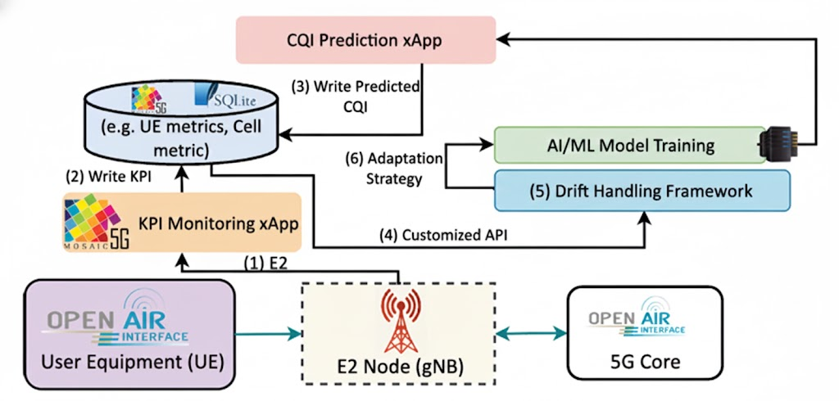
System Model

Slide 19
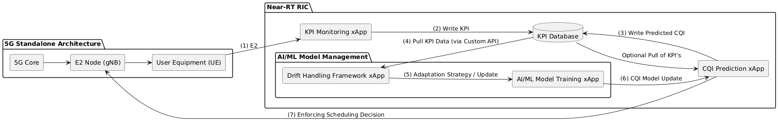
System Model:

Slide 20
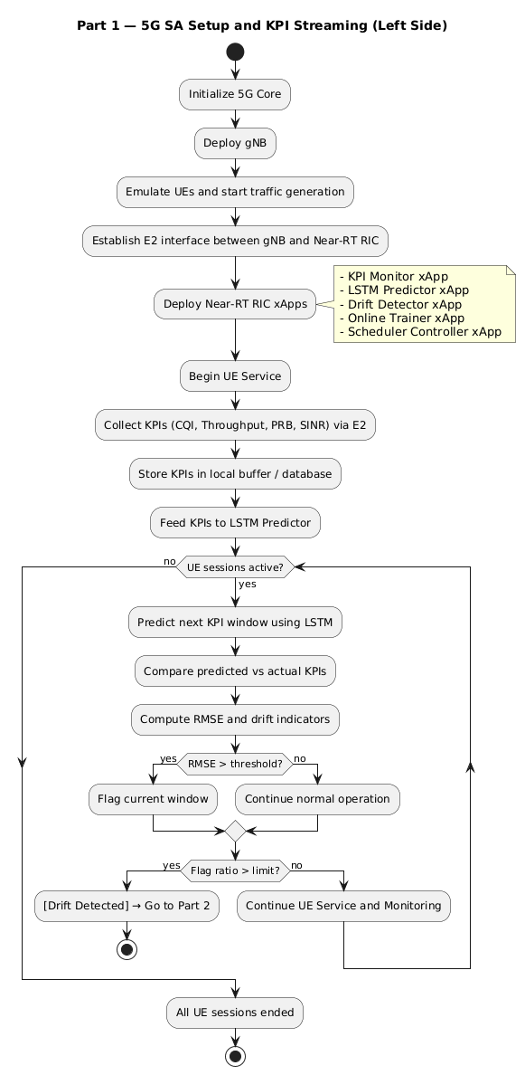
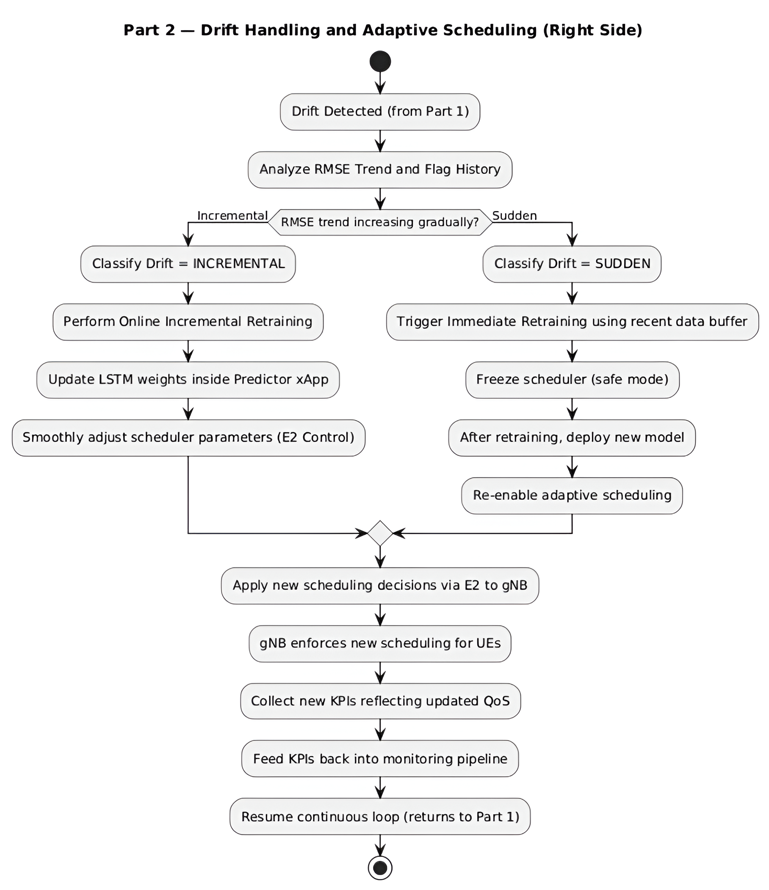
Flowchart

Slide 21
Feasibility Study
Successful OAI Setup:
Installed and configured OpenAirInterface (OAI) — a full 5G open-source RAN and Core Network stack.
Verified connectivity and functionality between gNB (base station) and UE (user equipment).
2. Deployment on Kubernetes:
Deployed the OAI components (gNB, AMF, SMF, UPF, UEs) using Kubernetes for cloud-native, scalable orchestration.
This setup enables flexible testing, containerization, and real-time management of network components.
3. FlexRIC Installation:
Successfully installed and integrated FlexRIC, a lightweight and flexible Near-Real-Time RAN Intelligent Controller (RIC).
This establishes the foundation for developing and testing custom xApps, enabling real-time, closed-loop control of RAN functions like scheduling.

Slide 22
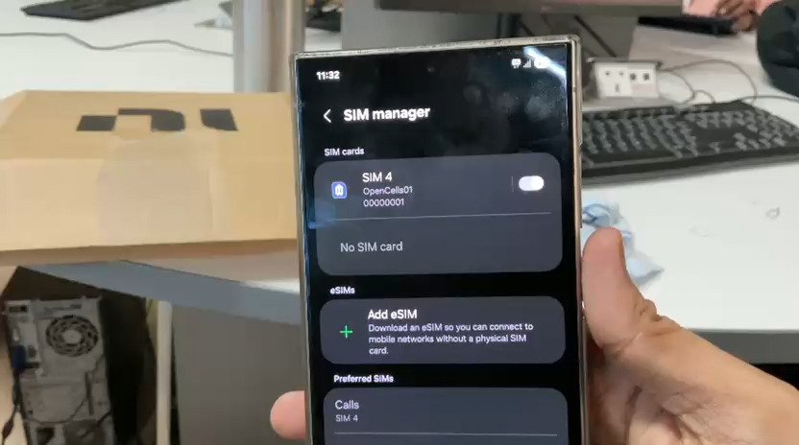
Successful Environmental Setup of OAI

Slide 23
Feasibility Study
4. Scheduler Modification:
File paths modified:
openair2/LAYER2/NR_MAC_gNB/gnb_scheduler_dlsch.c (Downlink Scheduling)
openair2/LAYER2/NR_MAC_gNB/gnb_scheduler_ulsch.c (Uplink Scheduling)
Implemented new algorithms:
True Round Robin (RR) — Equal time/frequency resource allocation among all active UEs.
Weighted Round Robin (WRR) — Resource allocation based on priority weights or channel conditions.
This allowed for comparative evaluation between PF, RR, and WRR scheduling strategies.
5. Dataset Generation:
Captured network traffic and scheduling data using OAI logs and packet captures (.pcap files).
Extracted and processed more than 80 network-level and user-level features relevant for RAN scheduling (e.g., CQI, MCS, throughput, PRB usage, buffer status, delay, etc.).
Converted the .pcap data into a structured CSV dataset, enabling further ML model training and analysis.

Slide 24
References
AL_ZUBAIDY, M. A., AO, A. J., & Ameen, S. Y. (2021). 5g scheduling algorithm for capacity improvement using beam division at congested traffic. Journal of Engineering Science and Technology, 16(3), 1977-1990.
Gudepu, V., Chintapalli, V. R., Castoldi, P., Valcarenghi, L., Tamma, B. R., & Kondepu, K. (2024). The drift handling framework for open radio access networks: An experimental evaluation. Computer Networks, 243, 110290.
E. J. Samson, K. Hasan, L. Hong, I. Ahmed, H. Onyeka and S. Shetty, "Optimizing 5G Network Slices: LSTM and Game Theory Synergy," 2025 International Conference on Computing, Networking and Communications (ICNC), Honolulu, HI, USA, 2025, pp. 282-287
Chen, Y., Yao, R., Hassanieh, H., & Mittal, R. (2023). {Channel-Aware} 5g {RAN} slicing with customizable schedulers. In 20th USENIX Symposium on Networked Systems Design and Implementation (NSDI 23) (pp. 1767-1782).
M. Polese, L. Bonati, S. D'Oro, S. Basagni and T. Melodia, "ColO-RAN: Developing Machine Learning-Based xApps for Open RAN Closed-Loop Control on Programmable Experimental Platforms," in IEEE Transactions on Mobile Computing, vol. 22, no. 10, pp. 5787-5800, 1 Oct. 2023
Lotfi, F., & Afghah, F. (2023, October). Open RAN LSTM traffic prediction and slice management using deep reinforcement learning. In 2023 57th Asilomar Conference on Signals, Systems, and Computers (pp. 646-650). IEEE.
Orumwense, E. F., & Abo-Al-Ez, K. (2023). An Optimal Scheduling Technique for Smart Grid Communications over 5G Networks. Applied Sciences, 13(20), 11470.
Gudepu, V., Chirumamilla, B., Chintapalli, V. R., Castoldi, P., Valcarenghi, L., Tamma, B. R., & Kondepu, K. (2025). GEN-DRIFT: Generative AI-driven drift handling for beyond 5G networks. Computer Networks, 263, 111237.
Elkael, M., Polese, M., Prasad, R., Maxenti, S., & Melodia, T. (2025). ALLSTaR: Automated LLM-Driven Scheduler Generation and Testing for Intent-Based RAN. arXiv preprint arXiv:2505.18389.
T. Zhang, J. Wang, X. S. Hu and S. Han, "5G-TPS: A Two-Phase Real-Time Scheduling and Adaptation Framework for 5G Radio Access Networks," in IEEE Transactions on Mobile Computing

Slide 25
THANK YOU

