Slide 1

Mass Material Maintenance
ZMM_MATERIAL_MAINTENANCE - Create, Update and Extend material masters from one Excel file
Development walkthrough
Notes:
Welcome. Today I walk through the mass material maintenance program: what it does, how it is configured, how users run it, and the safeguards built in.

Slide 2





Agenda
01
02
03
Why this development
Selection screen and template
Create / Update / Extend
Problem and the solution at a glance
How users start a run
The three operations in detail
04
05
Run and results
Safeguards and deliverables
Test run, ALV, result file, e-mail
Limits, number protection, documentation
Notes:
Five blocks: why, how users start a run, the three operations, results, and the safeguards.

Slide 3


From one-by-one maintenance to one controlled upload
Without the tool
With ZMM_MATERIAL_MAINTENANCE
Materials created and changed one at a time in MM01 / MM02
Field rules depend on the person entering data
Errors found only after posting
Failed postings can waste material numbers
No single log of what was done
Up to 2000 rows per file - Create, Update or Extend
Mandatory fields, defaults and rules come from configuration tables
Every row is simulated before anything is saved
Number drawn only after a successful simulation
ALV log, result Excel file on the server and e-mail
Notes:
Left: how material maintenance works without the tool. Right: what the program changes. Key message: one file, configured rules, full simulation before anything is saved.

Slide 4



One program, three operations
CREATE
UPDATE
EXTEND
ACTION = C / CREATE
ACTION = U / UPDATE / CHANGE
ACTION = E / EXTEND
New materials with internal or external numbers
Copy views from a reference material
Defaults filled from configuration
Change existing materials
Only filled cells are sent
An empty cell never clears a field
Add plants, storage locations, sales areas
Basic data is never changed
Optional copy from a reference
Notes:
The operation is chosen on the selection screen and also written in the ACTION column of each row. Create builds new materials, Update changes existing ones, Extend adds new organisational levels.

Slide 5






End-to-end flow
Select
Upload
Configure
Validate & map
Simulate
Post & report
Operation, material type, industry sector, business profile, views
Excel from local PC or application server
Field rules for the selected variant
Mandatory, rules, formats, reference copy
BAPI_MATERIAL_SAVEREPLICA in test mode
Commit, ALV, result file, e-mail
Test run stops after Simulate. Actual run simulates first, then draws the number and posts.
Notes:
Walk through the flow left to right: select, upload, configuration is loaded, rows are validated and mapped, simulated with the BAPI, and finally posted and reported.

Slide 6
Selection screen and template
01
How a user starts a run

Slide 7
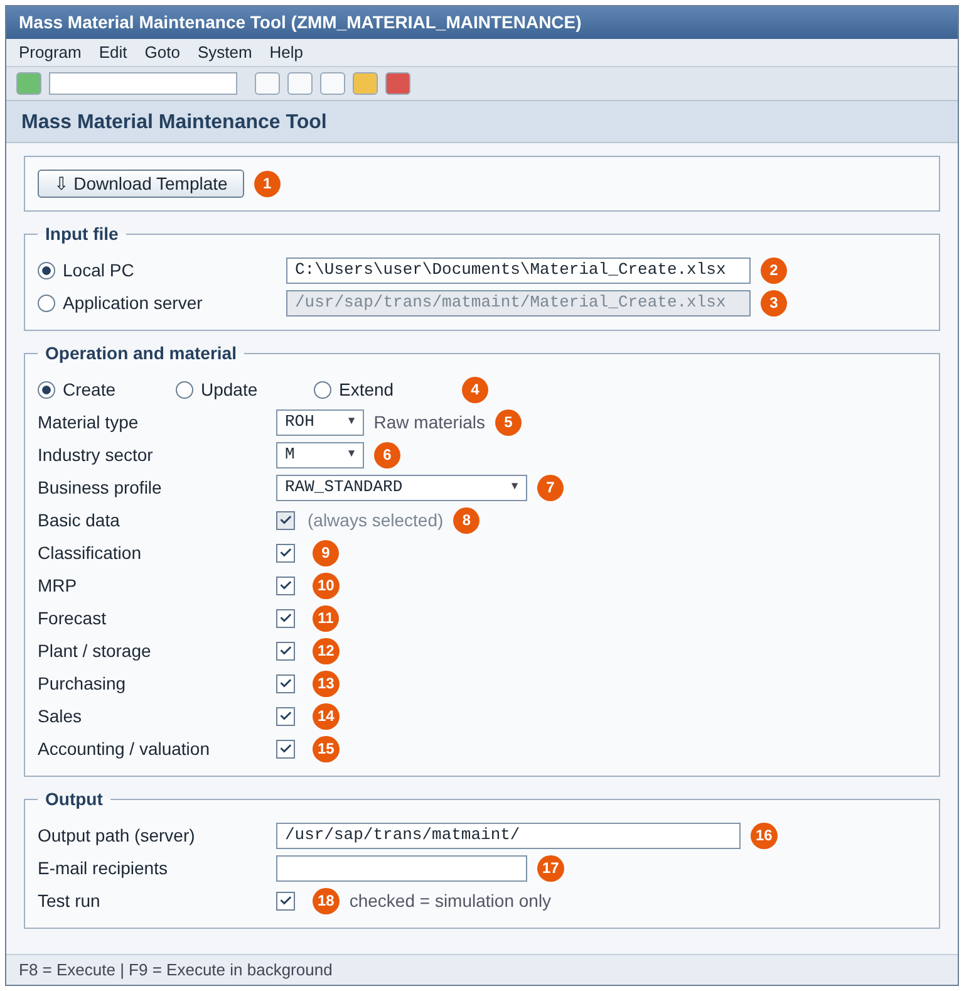
Selection screen
1
Download the template for the operation (SMW0)
2-3
File from local PC or application server
4
Operation: Create, Update or Extend
5-7
Material type, industry sector, business profile - only allowed values
8-15
Views to process (basic data always)
16-17
Server output path and e-mail recipients
18
Test run (default on) = simulation only
Notes:
Walk through the numbers on the screen. The dropdowns show only values allowed for the chosen operation.

Slide 8
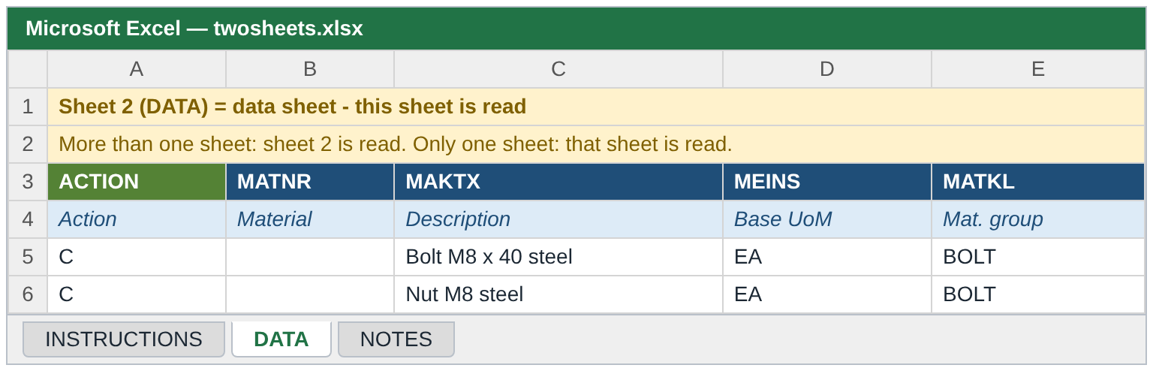
Excel template and instruction sheet
Rules
Row 3 = technical field names, row 4 = descriptions, data from row 5
More than one sheet: 2nd sheet is the data
One sheet: that sheet is the data
One row = one material and org. level
Save as .xlsx
Operation | SMW0 object
Create | ZMMCREATE_CRT_XLSX
Update | ZMMCREATE_UPD_XLSX
Extend | ZMMCREATE_EXT_XLSX
Notes:
Templates are stored in SMW0 per operation. Each template now has an instruction sheet first; the program reads the second sheet. With a single sheet, that sheet is read.

Slide 9
Control columns - steering each row
Column | Meaning
ACTION | C / U / E - must match the selected operation
MATNR | Material number (blank in Create = internal number)
MESSAGE | Ignored on upload
REFERENCE_MATNR + REF_WERKS / LGORT / VKORG / VTWEG | Reference material and its org. levels
COPY_BASIC PURCH MRP FRCST SALES ACCOUNTING CLASS | X / Y / YES / 1 / TRUE = copy that area
PRODH_LVL1..5 or PRDHA | Product hierarchy by level or complete
CLASS_TYPE, CLASS_NAME, CHAR_NAME_n / CHAR_VALUE_n | Classification (default class type 001)
PO_TEXT / SALES_TEXT | Purchase order text / sales text
Notes:
Besides the material fields, a few control columns steer the processing of each row.

Slide 10
Create, Update, Extend
02
The three operations in detail

Slide 11
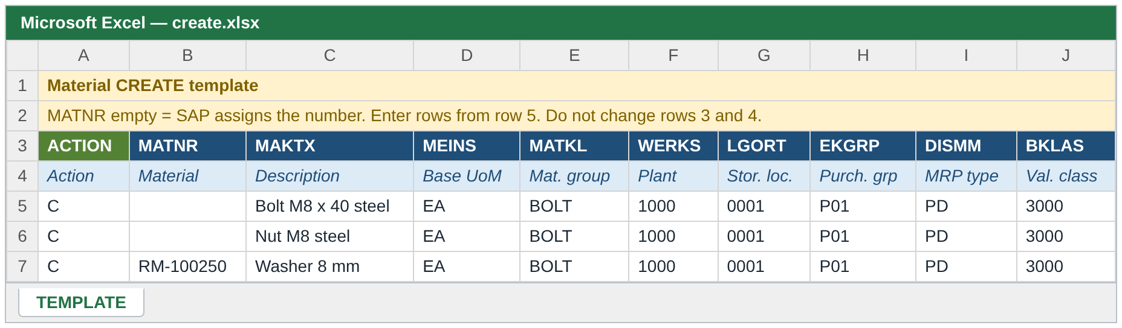




CREATE - new materials
Numbering
Reference copy
Defaults
Duplicate check
MATNR blank = internal number per row; filled = external number or same material on several org. levels
REFERENCE_MATNR + COPY_ flags copy whole areas; typed values win
Empty fields filled with configured default values
"Material already exists - use Update or Extend"
Notes:
Create is the richest operation: reference copy, defaults, number protection and classification all apply.

Slide 12


Material number protection
Simulate
Clean?
Draw number
Post
Row checked with TEMPMATNR_<row>
No errors in the simulation
BAPI_MATERIAL_GETINTNUMBER
SAVEREPLICA + commit
Simulation fails -> no number is drawn, the row is reported as "Posting skipped - material has validation errors". The number range has no gaps from bad data.
Notes:
In an actual run every Create row is first simulated with a temporary number. Only if the simulation is clean does the program draw a real number and post. A row with errors never consumes a number.

Slide 13
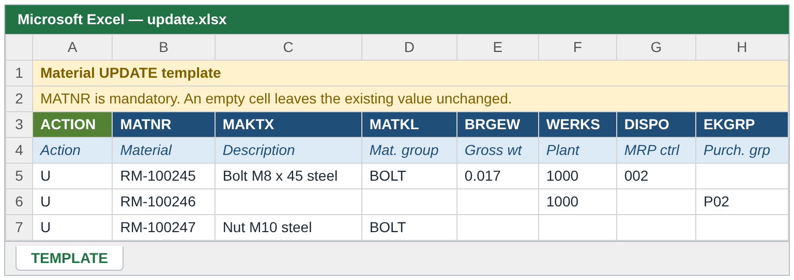
UPDATE - change existing materials
Key behaviour
MATNR must exist - otherwise error
Only filled cells are sent (X-flag set per field)
Empty cell = no change, never a delete
Org. level must already exist - new ones go through Extend
Classification, texts and product hierarchy can be changed too
Reference copy and defaults are not used
Example
Row: ACTION = U, MATNR = 100245, WERKS = 1000, MINBE = 50
-> only the reorder point of plant 1000 changes.
All other fields of the material stay as they are.
Notes:
Update is deliberately conservative: only cells with a value are sent with their X-flag. A blank cell is never interpreted as delete.

Slide 14
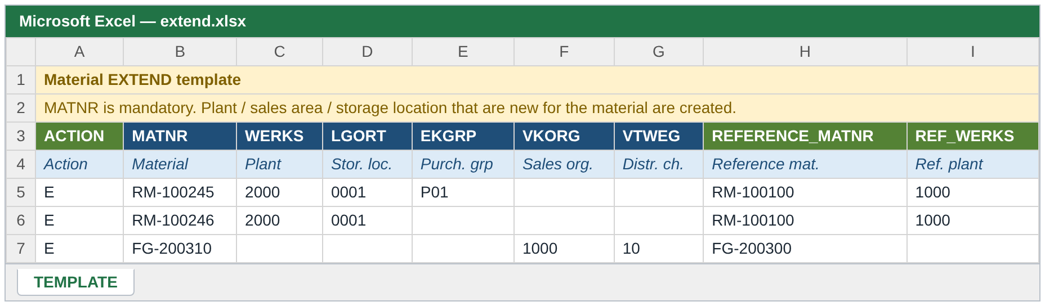



EXTEND - add new org. levels
Plant / storage
Sales area
From reference
Already there?
WERKS, LGORT - MRP, purchasing, plant data
VKORG + VTWEG together
REFERENCE_MATNR + REF_ levels + COPY_ flags
"Nothing to extend - all org. levels of the row already exist (use Update)"
Notes:
Extend adds plants, storage locations or sales areas to an existing material. Basic data is untouched. If everything in the row already exists, the program tells the user to use Update.

Slide 15






Functions shared by all operations
Classification
Product hierarchy
Long texts
Class type (default 001), class, up to 5 characteristics. Material is kept if only classification fails.
PRODH_LVL1..5 combined, or complete PRDHA
PO_TEXT (purchasing) and SALES_TEXT (sales), max. 132 characters per line
Dates and units
Format checks
Status dates
Excel dates or YYYYMMDD / DD.MM.YYYY; units converted to SAP format
Length, type and value checks before the BAPI is called
Valid-from of material status (MSTDV / VMSTD) = today when empty (Create)
Notes:
These functions are available wherever the variant contains the fields.

Slide 16
Run and results
03
Test run, actual run, output

Slide 17
Test run vs actual run
Test run (default)
Actual run
All checks and BAPI simulation
Temporary numbers TEMPMATNR_<row>
Nothing saved, no number drawn
No file written, no e-mail sent
ALV shows what would happen
Same checks and simulation first
Real number only for clean rows
Commit per material
Result file on the server
E-mail with the result file
Notes:
Always start with a test run. It does exactly the same checks and simulation, but saves nothing. The actual run additionally draws numbers, commits, writes the result file and sends the e-mail.

Slide 18
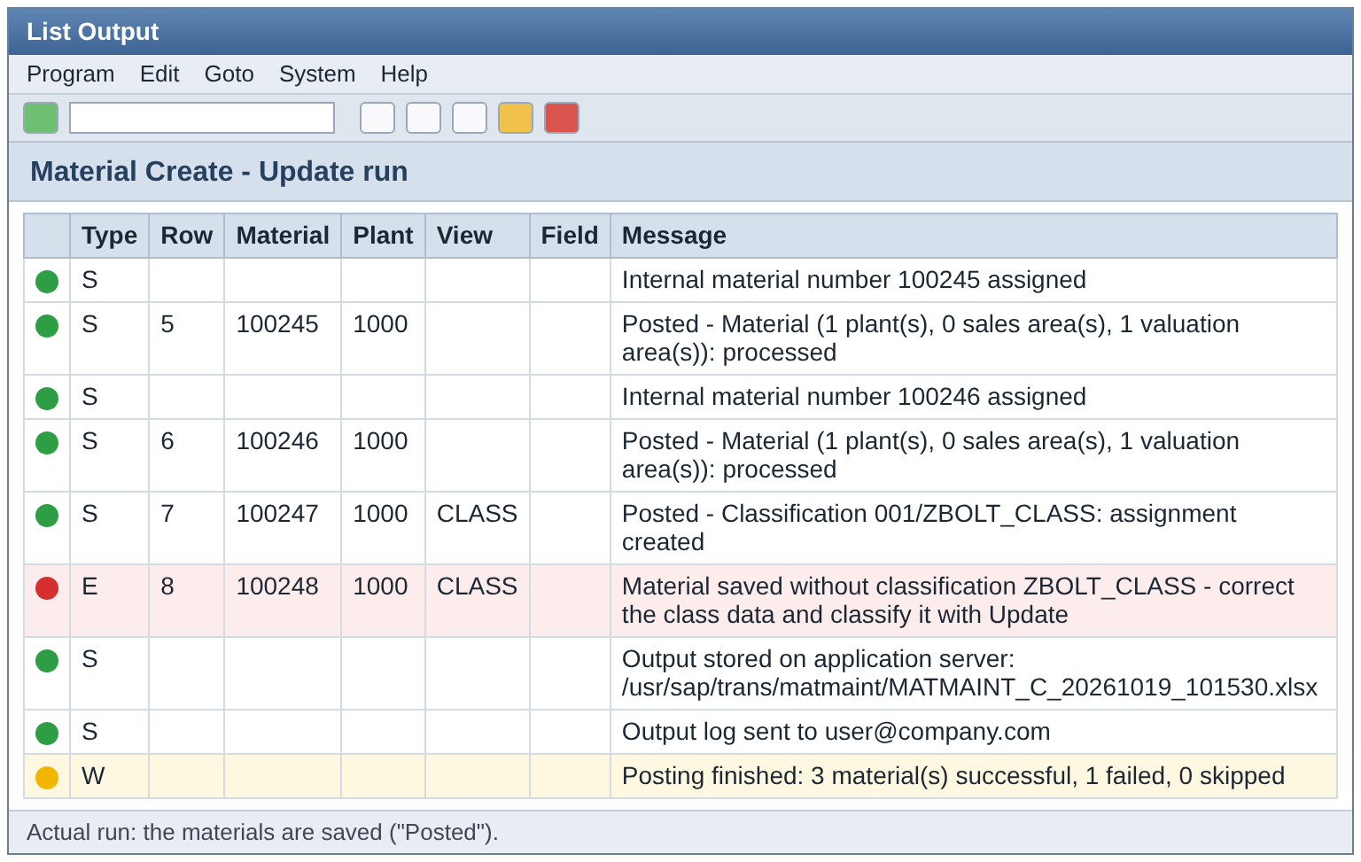
Result list (ALV)
Reading the list
S Success - posted or simulated OK
W Warning - check, not blocking
E Error - row not posted
Row number points back to the Excel row
Summary line: successful / failed / skipped
Download the list with the ALV toolbar
Notes:
Every message has a type, row number, material, org. level, view and field. Green is success, yellow warning, red error. The last line summarises the run.

Slide 19
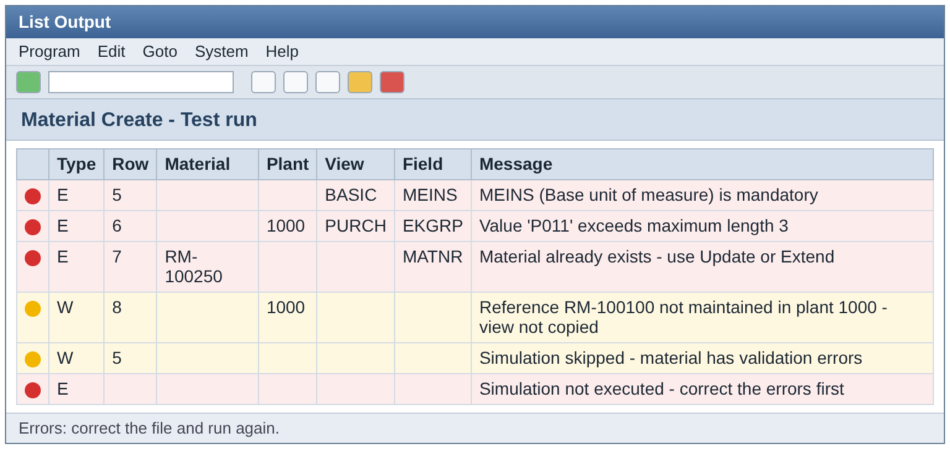
Error handling
Errors are collected for each row - one run shows all problems
A row with errors is skipped, the other rows continue
Messages name row, field and description
Fix the Excel, run the test again
Training guide has a full message catalogue
Classification only failed? The material is saved; the log says so - classify it later with Update.
Notes:
Errors are collected per row. A row with errors is not posted, but the other rows continue. The user corrects the Excel and runs again.

Slide 20
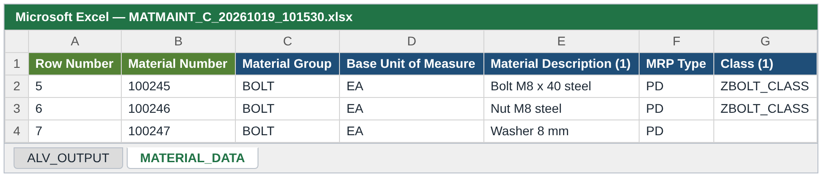


Result file and e-mail
Sheet ALV_OUTPUT
Sheet MATERIAL_DATA
Server + e-mail
The same messages as the ALV list
Successful materials read back from SAP (BAPI_MATERIAL_GET_ALL), incl. classification, headers with field descriptions
MATMAINT_<C|U|E>_<date>_<time>.xlsx to the output path and to all recipients - actual run only
Notes:
In an actual run the program writes one Excel file with two sheets to the server path and mails it to the recipients. The second sheet reads back the material from SAP so the user sees what was actually saved.

Slide 21
Safeguards and deliverables
04
Limits, performance and documentation

Slide 22

Volume limits and performance
1000
2000
1
rows in foreground
rows maximum
file = 1 operation
More rows: error "run in background"
Hard error in foreground and background
ACTION must match the selection
Existence checks, reference data and descriptions are read in bulk before the loop
Constants per operation: foreground and hard limit can be tuned separately
Large files: application server + background job (F9)
Notes:
Limits are constants per operation (gc_max_rows) and can be changed in one place. The program prefetches master data in bulk to keep runtime low.

Slide 23
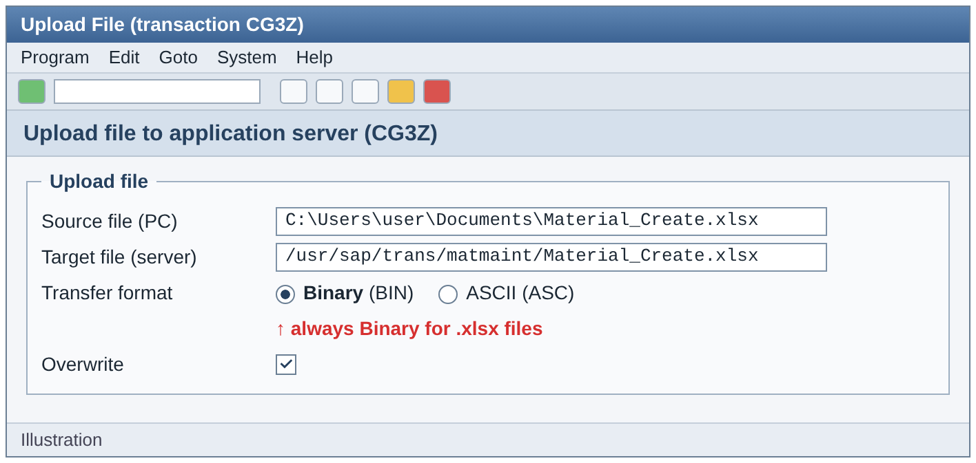


Local PC or application server
Local PC
Simple, for daily use up to 1000 rows
Foreground only
Application server
Needed for background runs
Copy in BINARY mode (e.g. CG3Z) - ASCII damages the xlsx
Notes:
Local files work only in dialog. For background runs the file must be on the application server, copied in binary mode - text mode damages an xlsx.

Slide 24



Deliverables
Program
Training guide
ZMM_MATERIAL_MAINTENANCE with includes D01 (data), S01 (screen), C01 / C02 (classes)
36-page Word guide: Create, Update, Extend, messages, Q&A
Instruction sheets
README
One per template - first sheet of each template
Operations, input rules, repository contents
Notes:
Everything is in the Git repository: code, README, the user training guide and the instruction sheets for the templates.

Slide 25

Thank you - questions?
One file | Configured rules | Simulated before saved | Fully logged
Notes:
Summary: one program, three operations, rules in configuration, everything simulated before saving, and a complete log and result file. Open for questions.

