Slide 1

Mass Material Maintenance
ZMM_MATERIAL_MAINTENANCE - Create, Update and Extend material masters from one Excel file
Development walkthrough
Notes:
Welcome. Today I walk through the mass material maintenance program: what it does, how it is configured, how users run it, and the safeguards built in.

Slide 2






Agenda
01
02
03
Why this development
Configuration tables
Selection screen and template
Problem and the solution at a glance
Variant, view tables, defaults, rules
How users start a run
04
05
06
Create / Update / Extend
Run and results
Safeguards and deliverables
The three operations in detail
Test run, ALV, result file, e-mail
Limits, number protection, documentation
Notes:
Six blocks. The configuration tables are the heart of the solution - most rules live there, not in code.

Slide 3


From one-by-one maintenance to one controlled upload
Without the tool
With ZMM_MATERIAL_MAINTENANCE
Materials created and changed one at a time in MM01 / MM02
Field rules depend on the person entering data
Errors found only after posting
Failed postings can waste material numbers
No single log of what was done
Up to 2000 rows per file - Create, Update or Extend
Mandatory fields, defaults and rules come from configuration tables
Every row is simulated before anything is saved
Number drawn only after a successful simulation
ALV log, result Excel file on the server and e-mail
Notes:
Left: how material maintenance works without the tool. Right: what the program changes. Key message: one file, configured rules, full simulation before anything is saved.

Slide 4



One program, three operations
CREATE
UPDATE
EXTEND
ACTION = C / CREATE
ACTION = U / UPDATE / CHANGE
ACTION = E / EXTEND
New materials with internal or external numbers
Copy views from a reference material
Defaults filled from configuration
Change existing materials
Only filled cells are sent
An empty cell never clears a field
Add plants, storage locations, sales areas
Basic data is never changed
Optional copy from a reference
Notes:
The operation is chosen on the selection screen and also written in the ACTION column of each row. Create builds new materials, Update changes existing ones, Extend adds new organisational levels.

Slide 5





End-to-end flow
Select
Upload
Configure
Validate & map
Simulate
Post & report
Operation, material type, industry sector, business profile, views
Excel from local PC or application server
Variant + field catalogue from ZTMM tables
Mandatory, rules, formats, reference copy
BAPI_MATERIAL_SAVEREPLICA in test mode
Commit, ALV, result file, e-mail
Test run stops after Simulate. Actual run simulates first, then draws the number and posts.
Notes:
Walk through the flow left to right: select, upload, configuration is loaded, rows are validated and mapped, simulated with the BAPI, and finally posted and reported.

Slide 6
Configuration tables
01
Rules live in tables, not in code
Notes:
This is the most important part for the support team: how the program knows which fields exist, which are mandatory and where each value goes in the BAPI.

Slide 7
How the configuration fits together
Selection screen
Material type | Industry sector | Business profile | Operation
ZTMM_MATMAS_MAST -> active VARIANT_VIEW
View tables (8)
ZTMM_DEFLT_DATA
ZTMM_COND_MAND
ZTMM_BASIC_DATA ZTMM_CLASS_DATA
ZTMM_PURCH_DATA ZTMM_MRP_DATA
ZTMM_FRCST_DATA ZTMM_PLNTST_DATA
ZTMM_SALES_DATA ZTMM_VAL_DATA
Default values per field
Conditional mandatory rules
Field catalogue: template column, BAPI target, mandatory flags
Fills empty fields (Create only)
If field A is filled, field B is required
Notes:
The selection on the screen picks exactly one active variant in ZTMM_MATMAS_MAST. The variant then selects the field rows in the eight view tables, the default values and the conditional rules.

Slide 8

ZTMM_MATMAS_MAST - the variant master
Field | Meaning
MAT_TYPE | Material type (e.g. ROH, FERT)
IND_SEC | Industry sector
BUS_PROF | Business profile
OPERATION_ID | C = Create, U = Update, E = Extend
ACTIVE_FLAG | X = variant is active
VALID_FROM / VALID_TO | Validity period (VALID_TO blank = open)
VARIANT_VIEW | Variant key used by all other tables
How it is used
Selection screen dropdowns show only values that exist for the chosen operation
Only ACTIVE rows valid today are read
Several matches: latest VALID_FROM wins
No match = hard error: "No active variant in ZTMM_MATMAS_MAST for ..."
Notes:
One row per combination. The program reads only active rows valid today; if several match, the one with the latest VALID_FROM wins. If none matches, the run stops with an error. The same table also fills the dropdowns on the selection screen.

Slide 9








Eight view tables - one per material view
Basic data
Classification
Purchasing
MRP
ZTMM_BASIC_DATA
ZTMM_CLASS_DATA
ZTMM_PURCH_DATA
ZTMM_MRP_DATA
Forecast
Plant / storage
Sales
Accounting / valuation
ZTMM_FRCST_DATA
ZTMM_PLNTST_DATA
ZTMM_SALES_DATA
ZTMM_VAL_DATA
Same structure in all eight -> read dynamically -> one field catalogue per run. No rows for a selected view = warning; no rows at all = error.
Notes:
All eight tables have the same structure, so the program reads them dynamically. Each one is switched on or off with its checkbox on the selection screen. Basic data is always selected.

Slide 10
Inside a view table - one row per template field
Column | Purpose
VARIANT_VIEW | Variant from ZTMM_MATMAS_MAST
TEMP_FIELD_NAME | Column name in the Excel template (row 3)
DESCRIPTION | Text shown in messages and output
BAPI_STRUCT_NAME | BAPI structure, e.g. CLIENTDATA, PLANTDATA
BAPI_FIELD_NAME | Target field(s) in the BAPI
MANDATORY | X = must be filled
COND_MANDATORY | X = rule in ZTMM_COND_MAND
OPTIONAL / SYSTEM_DERIVED | Optional, or set by the system (value ignored)
Mapping syntax
target{,target}
target = [STRUCT-]FIELD{;QUAL=VALUE}
One column can feed several BAPI fields (comma separated)
A qualifier selects a table line, e.g. a unit of measure or language
Mandatory field without BAPI mapping = configuration error
Flags drive the mandatory checks per row
Notes:
Each row links one Excel column to one or more BAPI fields and sets its flag. The BAPI mapping is a short syntax, so new fields usually need configuration only.

Slide 11


Default values and conditional rules
ZTMM_DEFLT_DATA
ZTMM_COND_MAND
Key: MTART + BUS_PROF + VARIANT_VIEW + TEMP_FIELD_NAME
Value: DEF_FIELD_VALUE
Key: MAT_TYPE + IND_SEC + BUS_PROF + VARIANT_VIEW
Rule: SOURCE_FIELD -> CONDMAT_FIELD
Create only
Used only when the cell is empty and no value came from the reference material
Field does not need to be a template column
Checked like a typed value (conversion, validation)
Wrong entries (key / control field, field not in variant) are reported
If SOURCE_FIELD is filled, CONDMAT_FIELD becomes mandatory
Descriptions SOURCE_DEC / CONDMAT_DEC appear in the message
Field flagged COND_MANDATORY but no rule = warning
Message: "<B> (<desc>) is mandatory when <A> (<desc>) is maintained"
Notes:
ZTMM_DEFLT_DATA fills fields that are still empty - only in Create. ZTMM_COND_MAND makes a field mandatory only when another field is filled. Both are keyed by the selection and the variant.

Slide 12
Where does a value come from?
1
2
3
4
Template
Reference material
ZTMM_DEFLT_DATA
System
Value typed in the Excel row
Copied when a COPY_ flag is set
Configured default (Create)
e.g. current date, unit 1:1
Rule of thumb: the first source that has a value wins. Update sends only typed values - no reference, no defaults - so nothing is changed by accident.
Notes:
For each field the program applies a fixed priority. What the user types always wins. Then the reference material, then the configured default, and finally a few system values such as the current date for status valid-from or 1:1 for units.

Slide 13


Setting up a new variant - checklist
1. Variant
2. Fields
Add a row in ZTMM_MATMAS_MAST per operation (C / U / E), active and valid
Add field rows to the needed view tables: column name, BAPI mapping, flags
3. Defaults
4. Rules
Optional: default values in ZTMM_DEFLT_DATA (Create)
Optional: conditional rules in ZTMM_COND_MAND
5. Template
6. Test
Make sure the template in SMW0 has the columns (row 3)
Run a Test run with a few rows and check the ALV log
Notes:
This is the order the functional consultant follows to add a new material type or business profile.

Slide 14
Selection screen and template
02
How a user starts a run

Slide 15
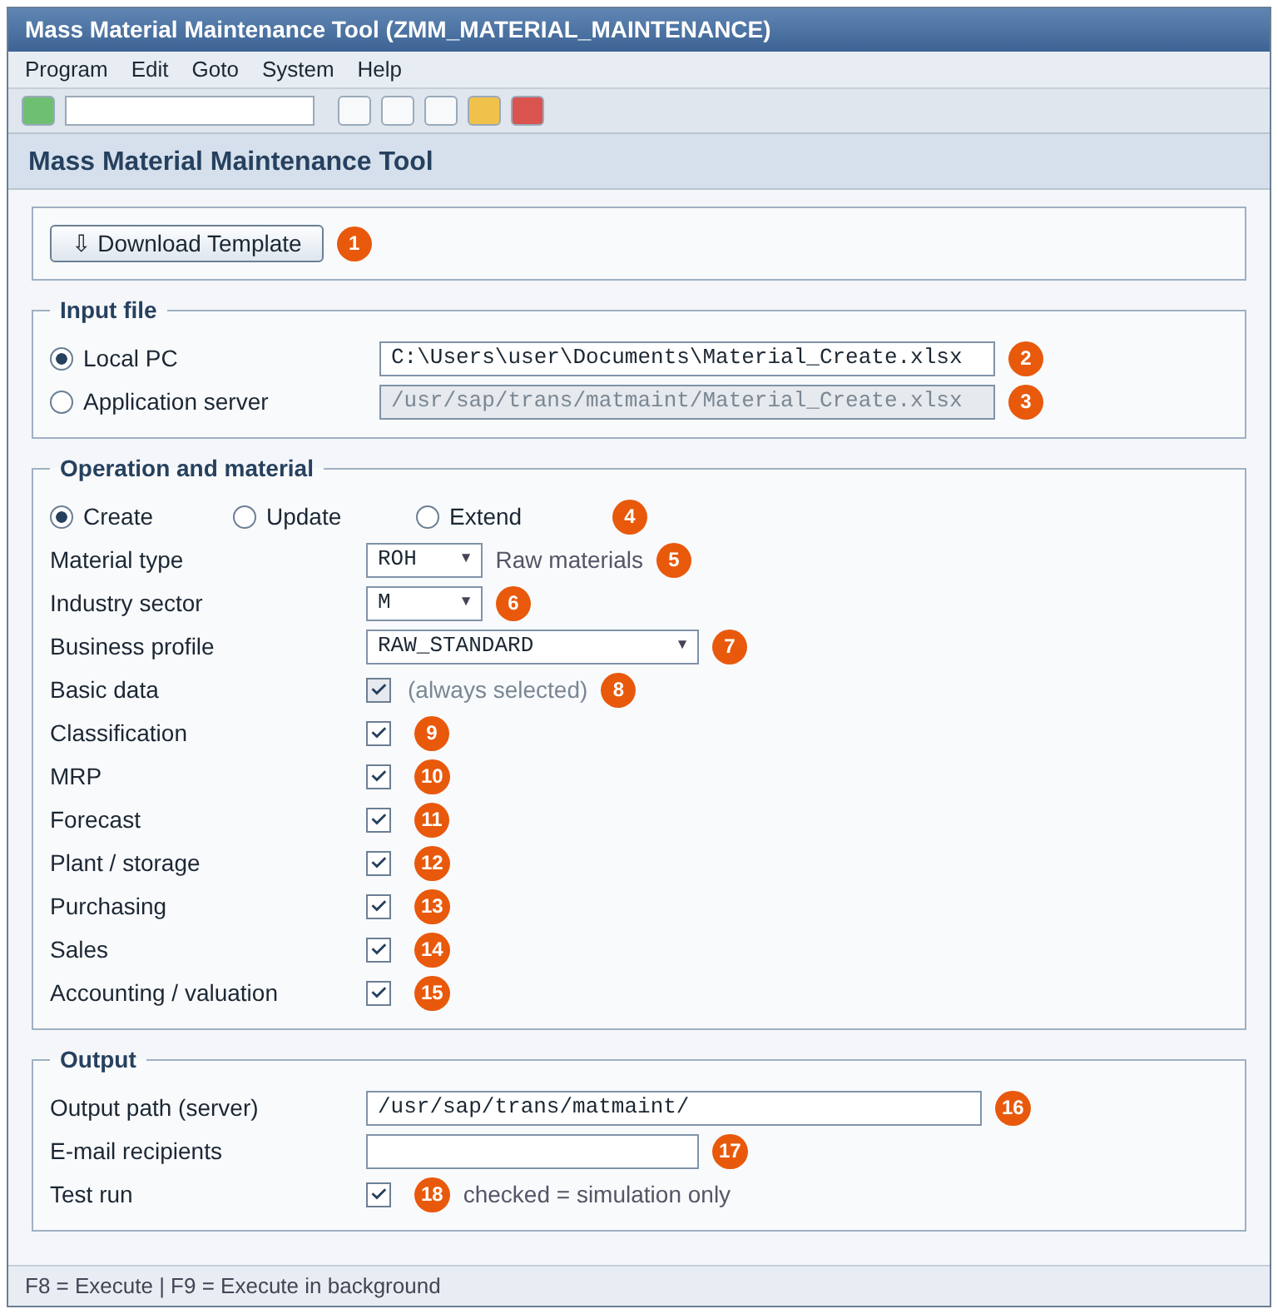
Selection screen
1
Download the template for the operation (SMW0)
2-3
File from local PC or application server
4
Operation: Create, Update or Extend
5-7
Material type, industry sector, business profile - values from ZTMM_MATMAS_MAST
8-15
Views to process - each switches one view table
16-17
Server output path and e-mail recipients
18
Test run (default on) = simulation only
Notes:
Walk through the numbers on the screen. Point out that the dropdowns are driven by ZTMM_MATMAS_MAST and the view checkboxes switch the view tables on or off.

Slide 16
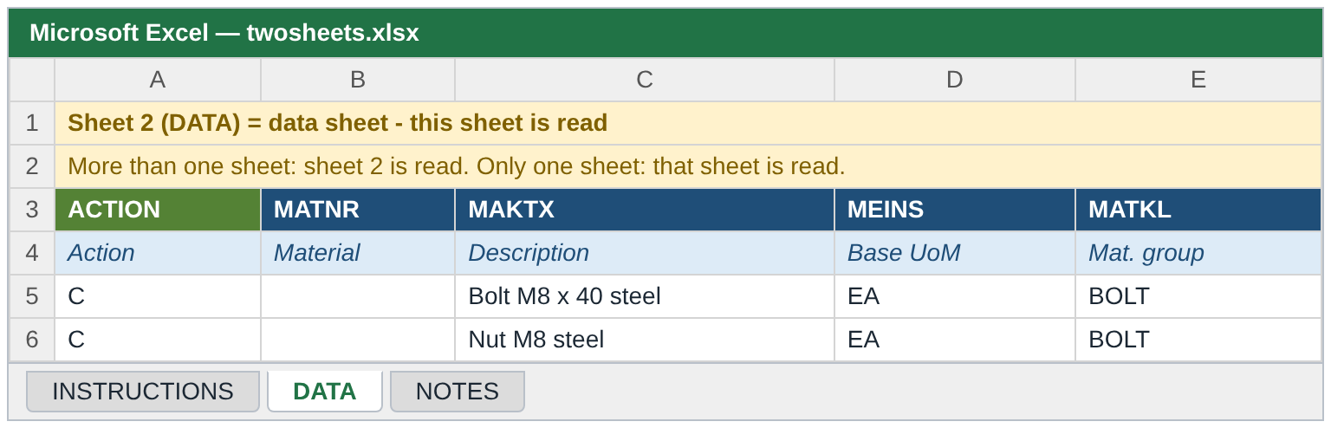
Excel template and instruction sheet
Rules
Row 3 = technical field names, row 4 = descriptions, data from row 5
More than one sheet: 2nd sheet is the data
One sheet: that sheet is the data
One row = one material and org. level
Save as .xlsx
Operation | SMW0 object
Create | ZMMCREATE_CRT_XLSX
Update | ZMMCREATE_UPD_XLSX
Extend | ZMMCREATE_EXT_XLSX
Notes:
Templates are stored in SMW0 per operation. Each template now has an instruction sheet first; the program reads the second sheet. With a single sheet, that sheet is read.

Slide 17
Control columns - steering each row
Column | Meaning
ACTION | C / U / E - must match the selected operation
MATNR | Material number (blank in Create = internal number)
MESSAGE | Ignored on upload
REFERENCE_MATNR + REF_WERKS / LGORT / VKORG / VTWEG | Reference material and its org. levels
COPY_BASIC PURCH MRP FRCST SALES ACCOUNTING CLASS | X / Y / YES / 1 / TRUE = copy that area
PRODH_LVL1..5 or PRDHA | Product hierarchy by level or complete
CLASS_TYPE, CLASS_NAME, CHAR_NAME_n / CHAR_VALUE_n | Classification (default class type 001)
PO_TEXT / SALES_TEXT | Purchase order text / sales text
Notes:
Besides the material fields, a few control columns steer the processing of each row.

Slide 18
Create, Update, Extend
03
The three operations in detail

Slide 19
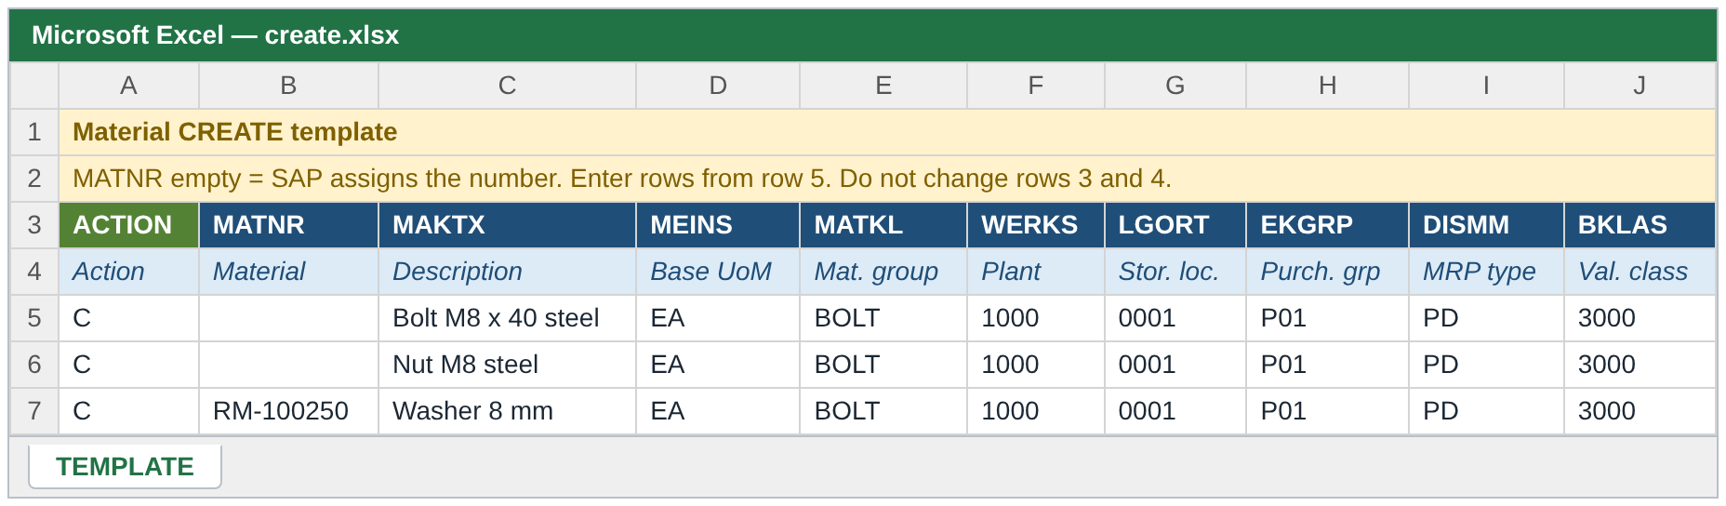



CREATE - new materials
Numbering
Reference copy
Defaults
Duplicate check
MATNR blank = internal number per row; filled = external number or same material on several org. levels
REFERENCE_MATNR + COPY_ flags copy whole areas; typed values win
Empty fields filled from ZTMM_DEFLT_DATA
"Material already exists - use Update or Extend"
Notes:
Create is the richest operation: reference copy, defaults, number protection and classification all apply.

Slide 20


Material number protection
Simulate
Clean?
Draw number
Post
Row checked with TEMPMATNR_<row>
No errors in the simulation
BAPI_MATERIAL_GETINTNUMBER
SAVEREPLICA + commit
Simulation fails -> no number is drawn, the row is reported as "Posting skipped - material has validation errors". The number range has no gaps from bad data.
Notes:
In an actual run every Create row is first simulated with a temporary number. Only if the simulation is clean does the program draw a real number and post. A row with errors never consumes a number.

Slide 21
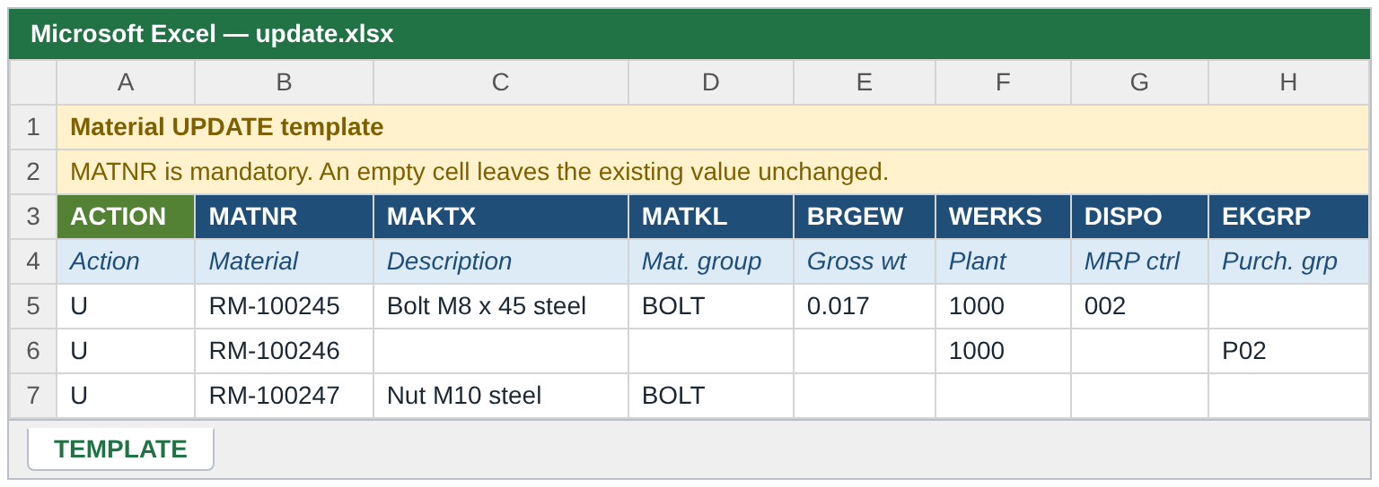
UPDATE - change existing materials
Key behaviour
MATNR must exist - otherwise error
Only filled cells are sent (X-flag set per field)
Empty cell = no change, never a delete
Org. level must already exist - new ones go through Extend
Classification, texts and product hierarchy can be changed too
Reference copy and defaults are not used
Example
Row: ACTION = U, MATNR = 100245, WERKS = 1000, MINBE = 50
-> only the reorder point of plant 1000 changes.
All other fields of the material stay as they are.
Notes:
Update is deliberately conservative: only cells with a value are sent with their X-flag. A blank cell is never interpreted as delete.

Slide 22
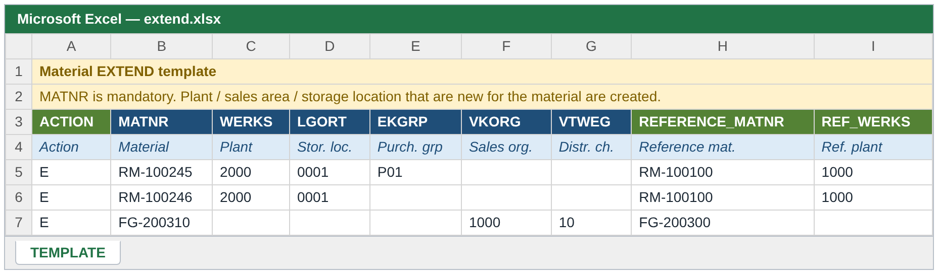
EXTEND - add new org. levels
Plant / storage
Sales area
From reference
Already there?
WERKS, LGORT - MRP, purchasing, plant data
VKORG + VTWEG together
REFERENCE_MATNR + REF_ levels + COPY_ flags
"Nothing to extend - all org. levels of the row already exist (use Update)"
Notes:
Extend adds plants, storage locations or sales areas to an existing material. Basic data is untouched. If everything in the row already exists, the program tells the user to use Update.

Slide 23





Functions shared by all operations
Classification
Product hierarchy
Long texts
Class type (default 001), class, up to 5 characteristics. Material is kept if only classification fails.
PRODH_LVL1..5 combined, or complete PRDHA
PO_TEXT (purchasing) and SALES_TEXT (sales), max. 132 characters per line
Dates and units
Format checks
Status dates
Excel dates or YYYYMMDD / DD.MM.YYYY; units converted to SAP format
Length, type and value checks before the BAPI is called
Valid-from of material status (MSTDV / VMSTD) = today when empty (Create)
Notes:
These functions are available wherever the variant contains the fields.

Slide 24
Run and results
04
Test run, actual run, output

Slide 25
Test run vs actual run
Test run (default)
Actual run
All checks and BAPI simulation
Temporary numbers TEMPMATNR_<row>
Nothing saved, no number drawn
No file written, no e-mail sent
ALV shows what would happen
Same checks and simulation first
Real number only for clean rows
Commit per material
Result file on the server
E-mail with the result file
Notes:
Always start with a test run. It does exactly the same checks and simulation, but saves nothing. The actual run additionally draws numbers, commits, writes the result file and sends the e-mail.

Slide 26
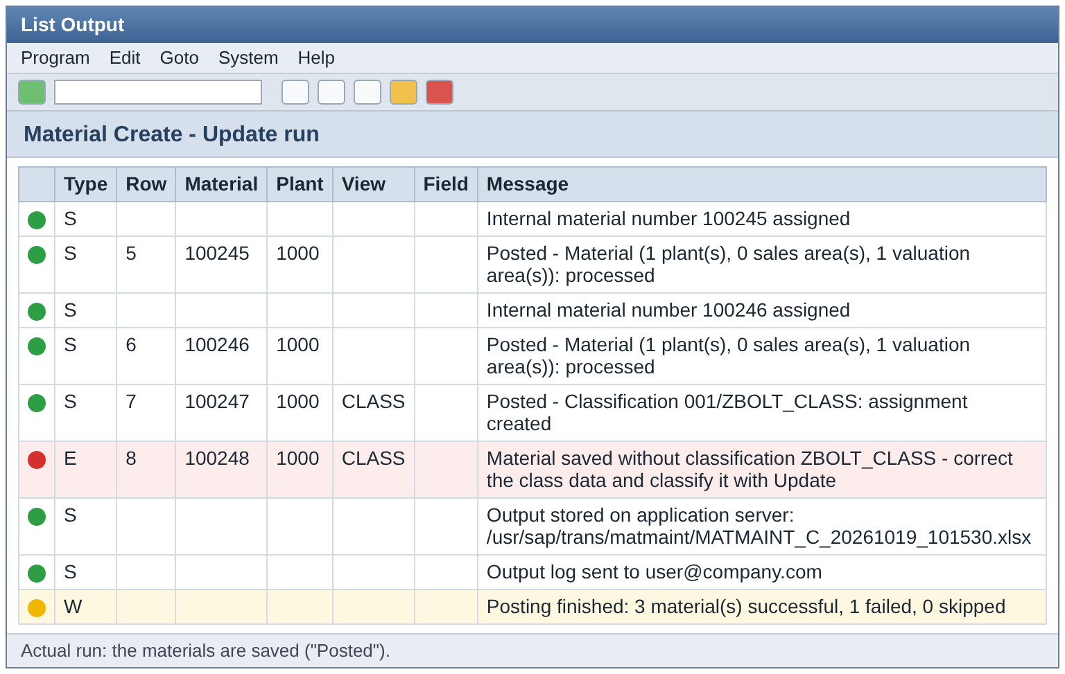
Result list (ALV)
Reading the list
S Success - posted or simulated OK
W Warning - check, not blocking
E Error - row not posted
Row number points back to the Excel row
Summary line: successful / failed / skipped
Download the list with the ALV toolbar
Notes:
Every message has a type, row number, material, org. level, view and field. Green is success, yellow warning, red error. The last line summarises the run.

Slide 27
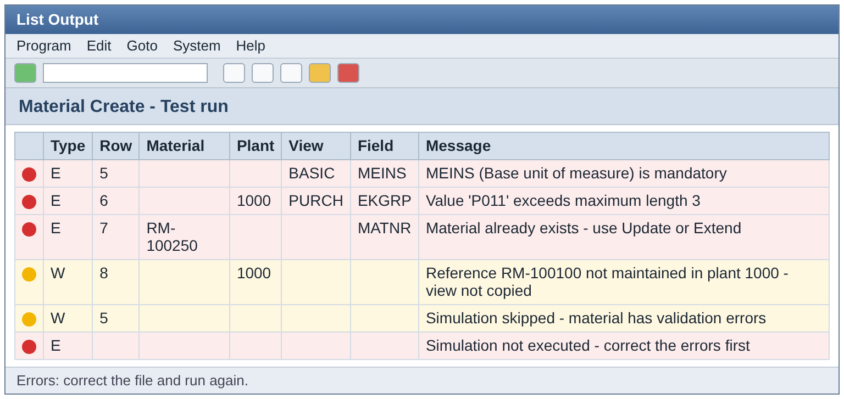
Error handling
Errors are collected for each row - one run shows all problems
A row with errors is skipped, the other rows continue
Messages name row, field and description
Fix the Excel, run the test again
Training guide has a full message catalogue
Classification only failed? The material is saved; the log says so - classify it later with Update.
Notes:
Errors are collected per row. A row with errors is not posted, but the other rows continue. The user corrects the Excel and runs again.

Slide 28
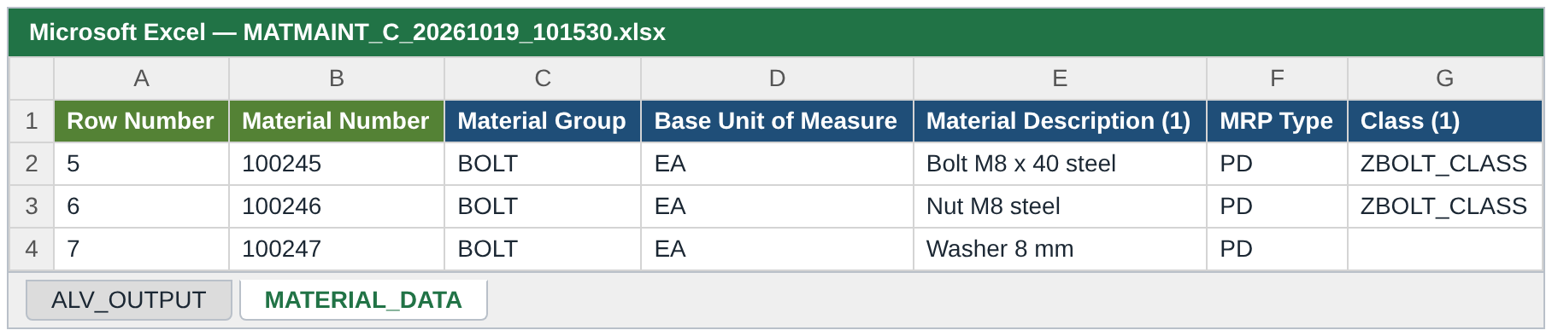

Result file and e-mail
Sheet ALV_OUTPUT
Sheet MATERIAL_DATA
Server + e-mail
The same messages as the ALV list
Successful materials read back from SAP (BAPI_MATERIAL_GET_ALL), incl. classification, headers with field descriptions
MATMAINT_<C|U|E>_<date>_<time>.xlsx to the output path and to all recipients - actual run only
Notes:
In an actual run the program writes one Excel file with two sheets to the server path and mails it to the recipients. The second sheet reads back the material from SAP so the user sees what was actually saved.

Slide 29
Safeguards and deliverables
05
Limits, performance and documentation

Slide 30

Volume limits and performance
1000
2000
1
rows in foreground
rows maximum
file = 1 operation
More rows: error "run in background"
Hard error in foreground and background
ACTION must match the selection
Existence checks, reference data and descriptions are read in bulk before the loop
Constants per operation: foreground and hard limit can be tuned separately
Large files: application server + background job (F9)
Notes:
Limits are constants per operation (gc_max_rows) and can be changed in one place. The program prefetches master data in bulk to keep runtime low.

Slide 31
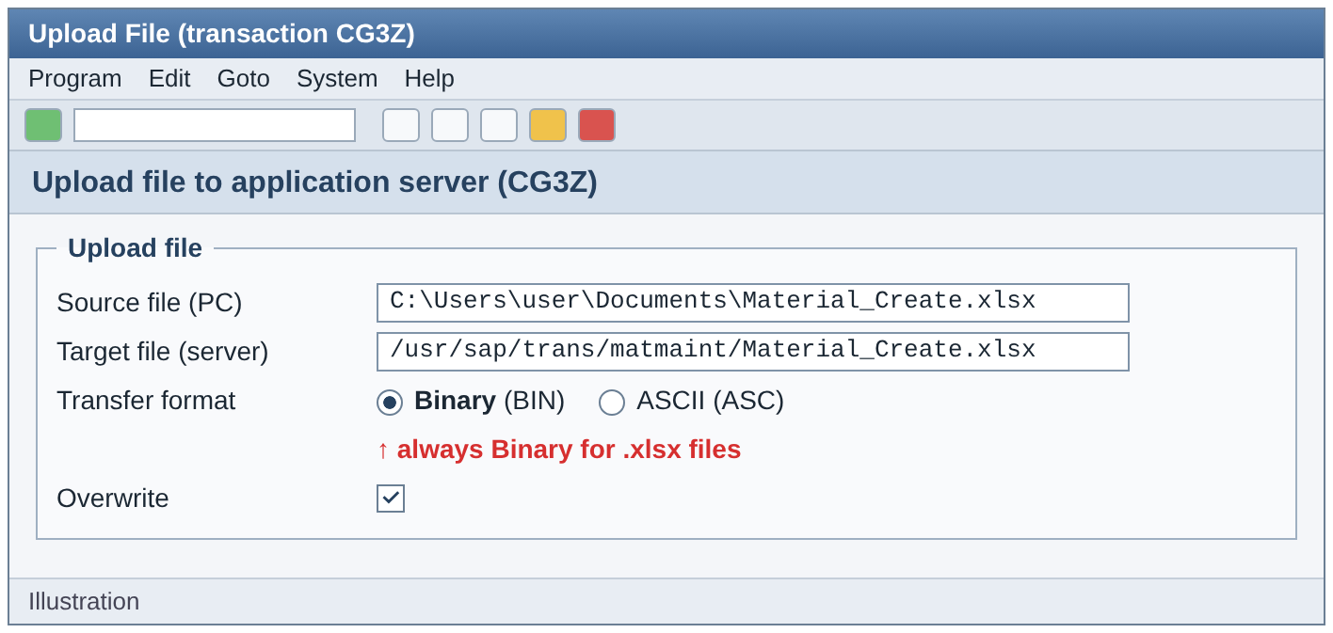


Local PC or application server
Local PC
Simple, for daily use up to 1000 rows
Foreground only
Application server
Needed for background runs
Copy in BINARY mode (e.g. CG3Z) - ASCII damages the xlsx
Notes:
Local files work only in dialog. For background runs the file must be on the application server, copied in binary mode - text mode damages an xlsx.

Slide 32



Deliverables
Program
Training guide
ZMM_MATERIAL_MAINTENANCE with includes D01 (data), S01 (screen), C01 / C02 (classes)
36-page Word guide: Create, Update, Extend, messages, Q&A
Instruction sheets
README
One per template - first sheet of each template
Operations, input rules, repository contents
Notes:
Everything is in the Git repository: code, README, the user training guide and the instruction sheets for the templates.

Slide 33

Thank you - questions?
One file | Configured rules | Simulated before saved | Fully logged
Notes:
Summary: one program, three operations, rules in configuration tables, everything simulated before saving, and a complete log and result file. Open for questions.

