Slide 1
Frequent Patterns and Association Rules
Data Mining
Summer 2017
Presented by:
Shubhraj Arsekar
Ravi Teja Neela
Professor: Dr. Longhuang Li

Slide 2
Outline
Data Set Description
Attributes
Apriori Algorithm
Pre-Processing
Process Design
Association rule mining using Apriori Algorithm
Results

Slide 3
Data Set Description
Context
During the 2016 US presidential election, the phrase “fake news” found its way to the forefront in news articles, tweets, and fiery online debates the world over after misleading and untrue stories proliferated rapidly.
BuzzFeed News analyzed over 1,000 stories from hyperpartisan political Facebook pages selected from the right(conservative), left(liberal), and mainstream(neutral) media to determine the nature and popularity of false or misleading information they shared.
Content
This dataset supports the original story “Hyperpartisan Facebook Pages Are Publishing False And Misleading Information At An Alarming Rate” published October 20th, 2016.

Slide 4
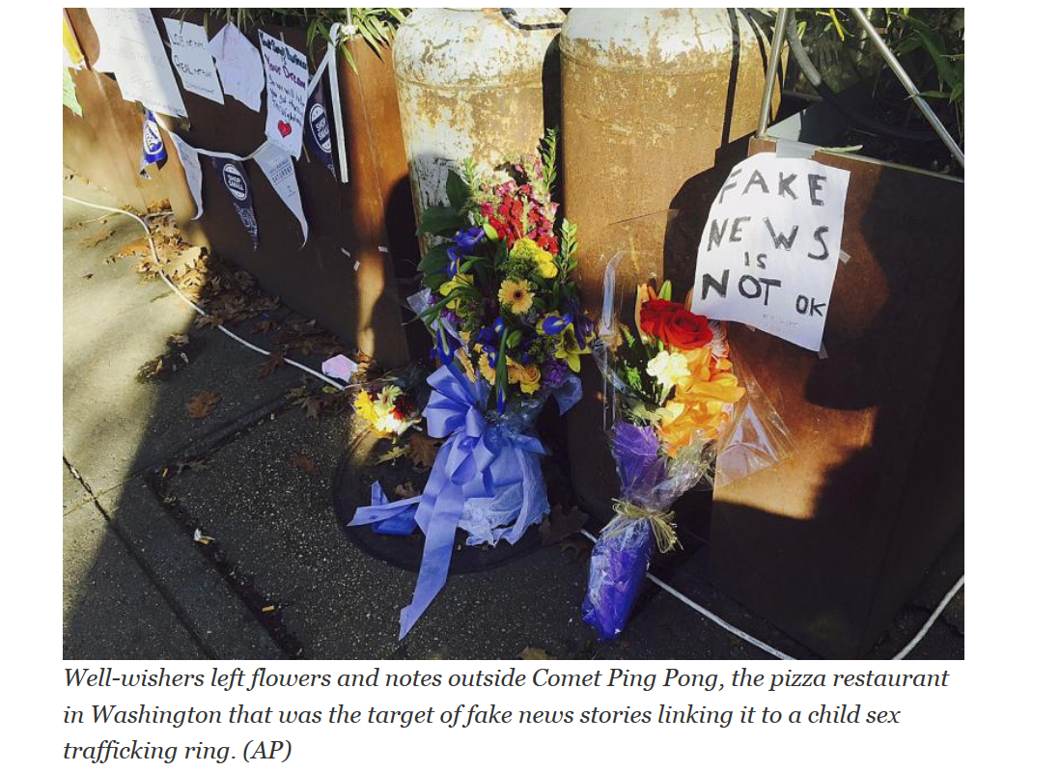
Data Set Description
Fake news: Hillary Clinton is running a child sex ring out of a pizza shop.
Fake news: Democrats want to impose Islamic law in Florida.
Fake news: Thousands of people at a Donald Trump rally in Manhattan chanted, "We hate Muslims, we hate blacks, we want our great country back."
Source: Internet-http://www.politifact.com/truth-o-meter/article/2016/dec/13/2016-lie-year-fake-news/

Slide 5
Attributes
Name | Description | Datatype
Account_Id | Facebook page account ID | Numeric
Post_Id | POST_ID | Numeric
Category | Type of Source (Left, Right & Mainstream) | String
Page | Name of the page | String
Post_URL | URL where the post was found | String
Date Published | Date the post was published | Datetime
Post_Type | Type of post shared (Video or Link) | String
Rating | “Truth” rating made by Buzz feed | String
Debate | Video showing a debate | String
Share_Count | Number of Shares | Numeric
Reaction_Count | Number of Reactions (Likes) | Numeric
Comment_Count | Number of Comments | Numeric

Slide 6
Apriori Algorithm:
The Apriori Algorithm is an influential algorithm for mining frequent item sets for Boolean association rules.
Apriori uses a "bottom up" approach, where frequent subsets are extended one item at a time (a step known as candidate generation, and groups of candidates are tested against the data.
Apriori is designed to operate on database containing transactions (for example, collections of items bought by customers, or details of a website frequentation).
Confidence is an indication of how often the rule has been found to be true.

Slide 7
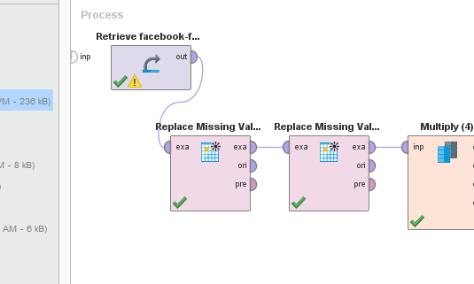
Pre-Processing
There are were four preprocessing step performed:
Replace missing values : It was performed twice on the attribute of Comment_count, share_count, and reacation_count replacing it with average values
The other missing value was for Debate attribute and was replaced with “no”

Slide 8
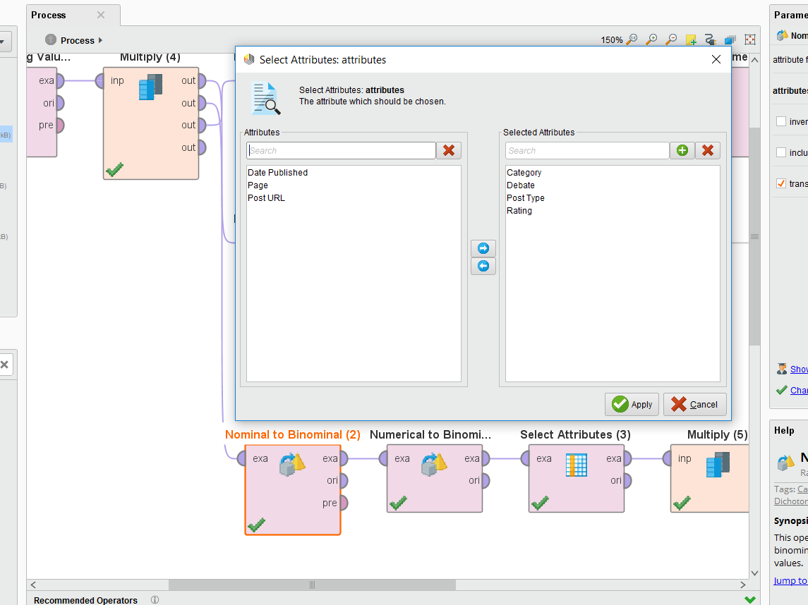
Pre-Processing
Nominal(Polynomial) to Binomial
Category = right, left and mainstream
Debate = Yes or No
Post Type = link, text, video, photo
Rating = Mostly true, Mostly false, no factual content, Mixture of true and false.

Slide 9
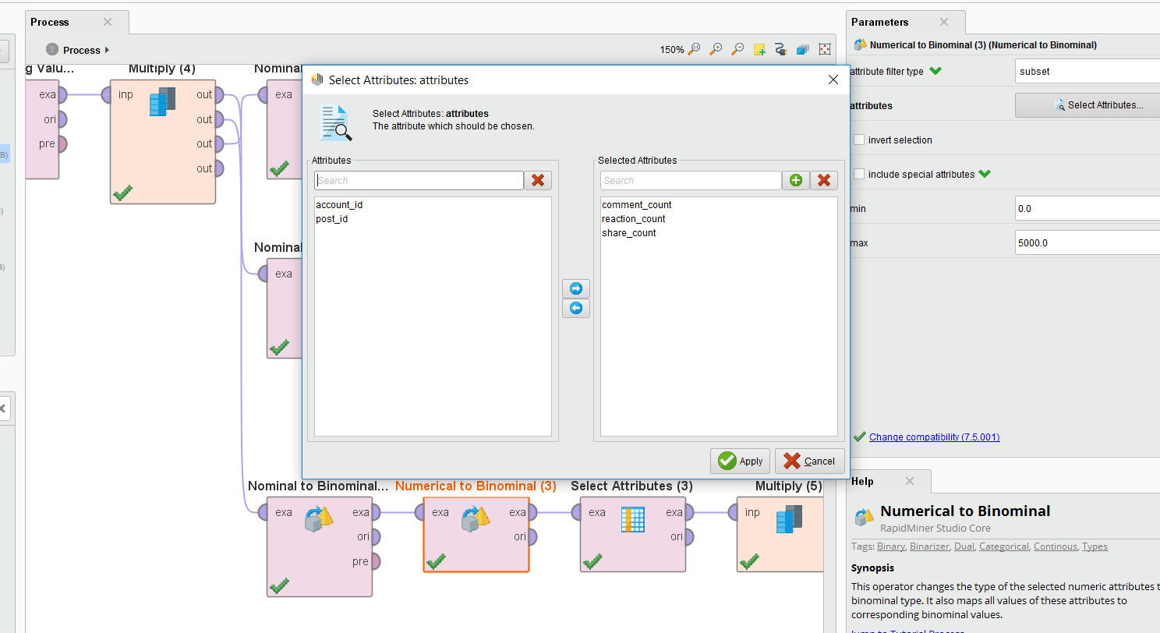
Pre-Processing
Numerical to Binomial →Use average to calculate to set the binomial values in the attributes
comment_count, reaction_count, share_count

Slide 10
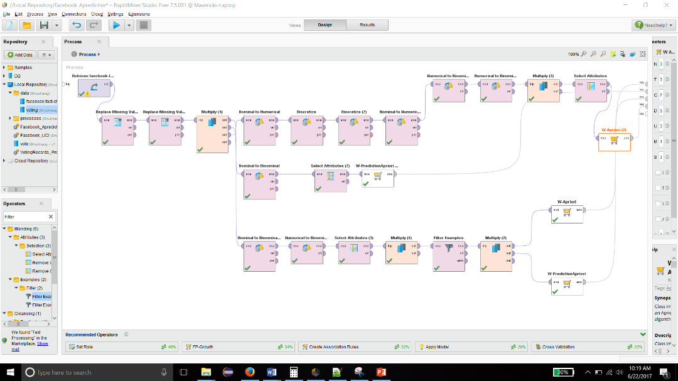
Process Design

Slide 11
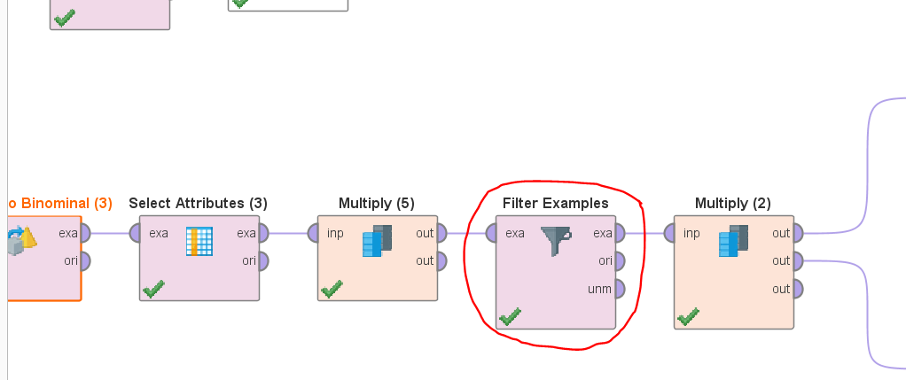
Association rule mining using Apriori Algorithm
1.)Fake Data
If Ratings = Mostly True = False 440 ==> Category = Right=True 347 confidence:(0.79)
If Rating = Mostly True = False 613 ==> Category = Mainstream=False 553 confidence:(0.9)
If Rating = Mostly True = False 340==> Category = Left=False 553 confidence:(0.9)
→ When the post is false we found that left and Mainstream posted fake data having a confidence of 0.9

Slide 12
Association rule mining using Apriori Algorithm
2.) Sharing and Reaction
Filters: Category = left; Rating = Mostly True;
If Category = Left=True, Post-type = Link=True and Rating = Mostly True=True
==> Share-Count = True 227 ==> Reaction-Count = True 220 confidence:(1)
If Category = Left=True, Post-type = Video=True and Rating = Mostly True=True
==> Share-Count= True 192 ==> Reaction-Count=true 190 confidence: (0.99)
If Category = Left=True, Post-type = Photo=True and Ratings = Mostly True = True
==> Share-Count= False 215 ==> Reaction-Count=true 209 confidence: (0.97)
If Category = Left=True, Post-type = Text=True and Ratings = Mostly True = True
==> Share-Count =True 206 ==> Reaction-Count =True 202 confidence: (0.98)
If the Post type was link or video there were more chances of it being shared and therefore higher reaction to the post.

Slide 13
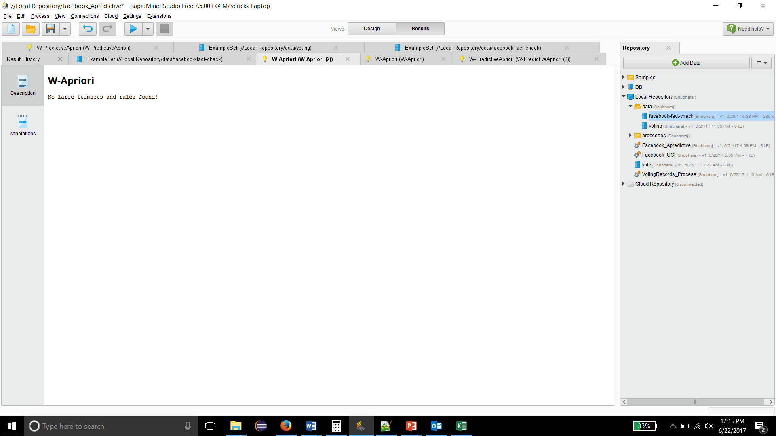
Association Rules(continued):
2.) Sharing and Reaction
Filters: Category = Right; Rating = Mostly True;
If Category = Right=True and Post-type = Link and Rating = Mostly True =True
==> Share-Count =False 291==> Reaction-Count =True 73 confidence: (0.79)
If Category = Right=True and Post-type = Video and Rating = Mostly True =True
==> Share-Count =True 301==> Reaction-Count =False 234 confidence: (0.81)

Slide 14
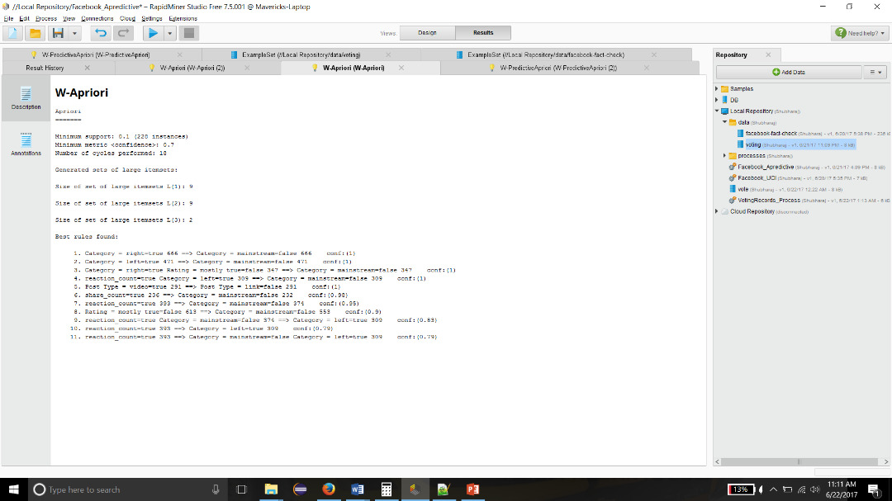
Results

Slide 15
THANK YOU

