Slide 1

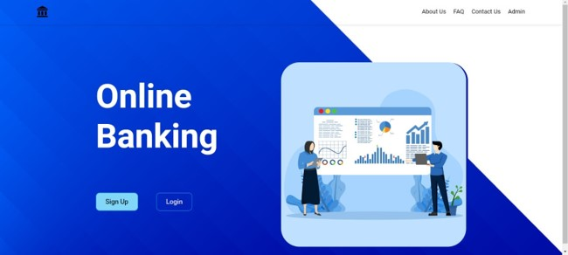
Computer Science and Engineering
Course Code: E1UA307C Course Name: JAVA
Online Banking System
Team Details:
Prem Kumar (23SCSE1180534)
Aditya Gupta (23SCSE1180231)
Swastik Mandal(23SCSE1180257)
Gaurav (23SCSE1180306)
SECTION: 7 CSE- (AI ,ML)

Slide 2


Computer Science and Engineering
Course Code: E1UA307C Course Name: JAVA
Objective
1
Convenience
2
Security
Provide customers with a user-friendly and accessible way to manage their finances anytime, anywhere.
Ensure the highest levels of data protection and privacy for all financial transactions and customer information.
3
Efficiency
Streamline banking processes and reduce the need for in-person visits, saving time and resources for both customers and the bank.

Slide 3
Computer Science and Engineering
Course Code: E1UA307C Course Name: JAVA
Problem Statement
Customer Needs
Security Challenges
Competitive Landscape
Customers today expect a seamless and intuitive online banking experience, with features that cater to their evolving financial needs.
Ensuring the security of customer data and transactions is a critical concern, as cyber threats continue to evolve.
The online banking market is highly competitive, requiring continuous innovation and improvement to stay ahead of the curve.

Slide 4




Computer Science and Engineering
Course Code: E1UA307C Course Name: JAVA
System Architecture
User Interface
Intuitive and responsive web and mobile applications that provide customers with easy access to banking services.
Application Server
Handles the processing and management of customer requests, transactions, and data storage.
Database Server
Securely stores and retrieves customer account information,
transaction history, and other critical data.

Slide 5
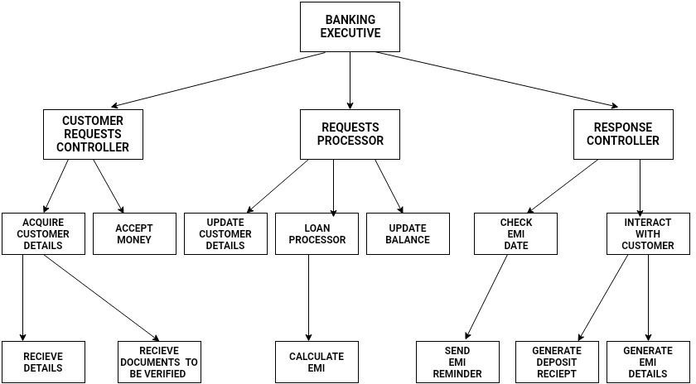
Computer Science and Engineering
Course Code: E1UA307C Course Name: JAVA
System Architecture

Slide 6





Computer Science and Engineering
Course Code: E1UA307C Course Name: JAVA
Technical Stack :
JavaScript
Java
MySQL
Spring Framework
Powering the dynamic user interface and client-side functionality
Implementing the server-side logic and application processing
Serving as the relational database management system for storing and managing customer data
Providing a comprehensive application development framework for the backend

Slide 7
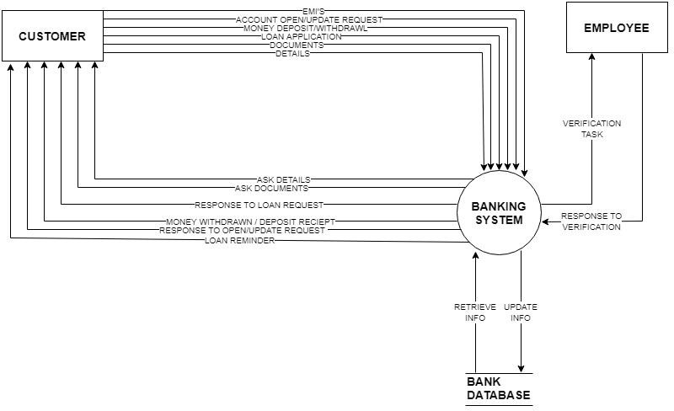
Computer Science and Engineering
Course Code: E1UA307C Course Name: JAVA
DATA FLOW DIGRAM:

Slide 8
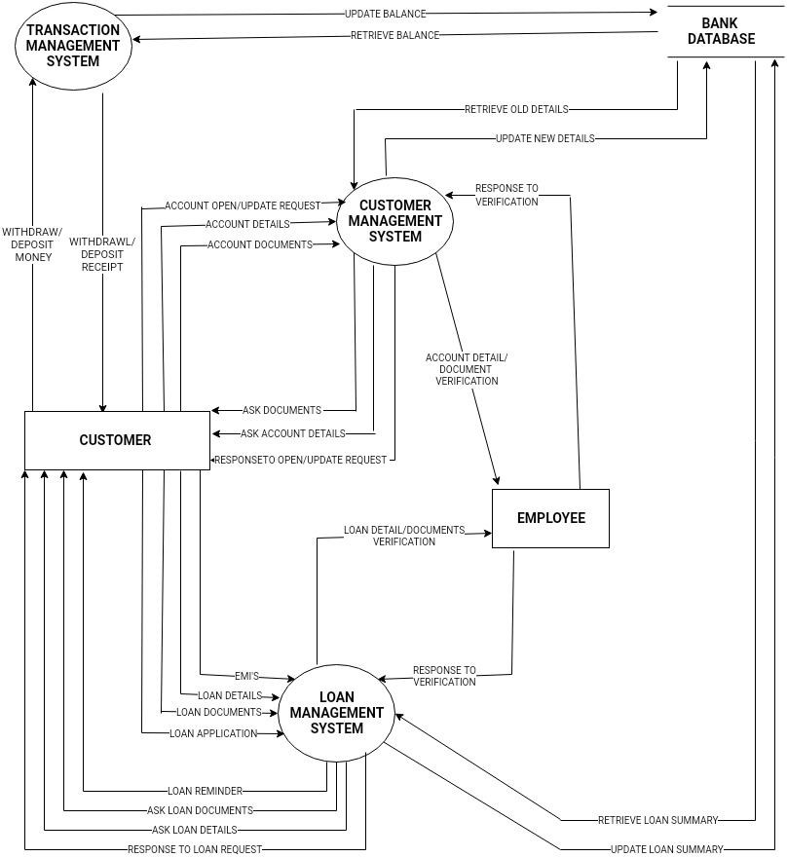
Computer Science and Engineering
Course Code: E1UA307C Course Name: JAVA
DFD Level 1:

Slide 9
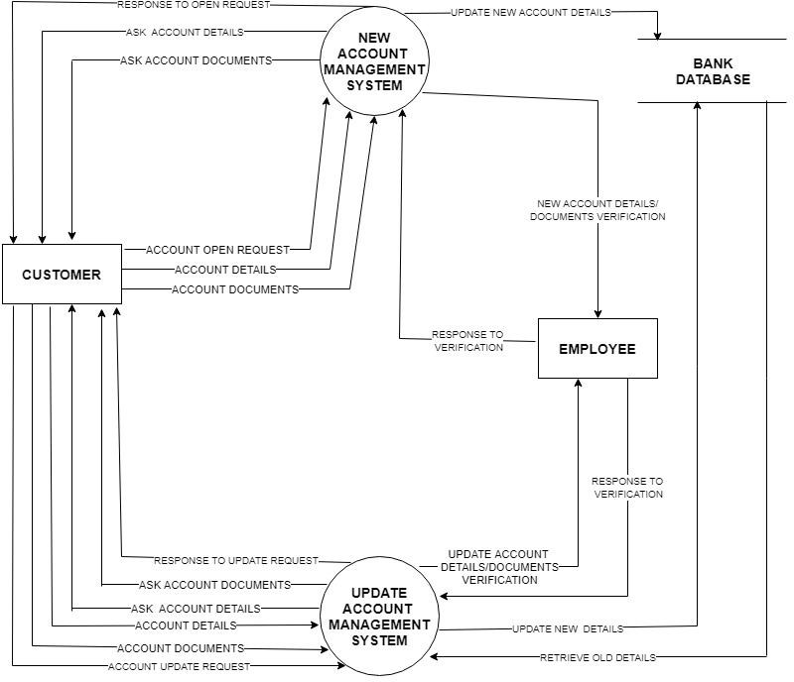
Computer Science and Engineering
Course Code: E1UA307C Course Name: JAVA
Level 2 Customer Management

Slide 10
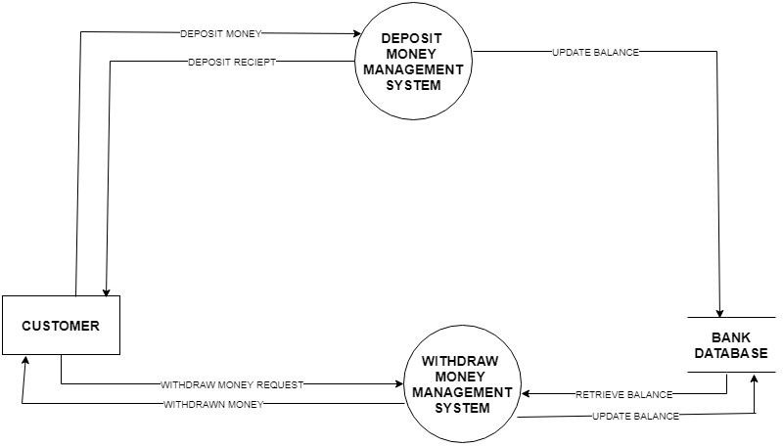
Computer Science and Engineering
Course Code: E1UA307C Course Name: JAVA
Level 3 Transaction System

Slide 11
Computer Science and Engineering
Course Code: E1UA307C Course Name: JAVA
Data Design
OPEN ACCOUNT DETAIL’S :
FIRST NAME | VARCHAR(15)
MIDDLE NAME | VARCHAR(15)
LAST NAME | VARCHAR(15)
HOUSE NUMBER | VARCHAR(4)
VILLAGE | VARCHAR(15)
STATE | VARCHAR(15)
PIN | VARCHAR(10)
PHONE NUMBER | VARCHAR(10)
INITIAL AMOUNT | INT

Slide 12
Computer Science and Engineering
Course Code: E1UA307C Course Name: JAVA
UPDATE ACCOUNT DETAIL’S :
FIRST NAME | VARCHAR(15)
MIDDLE NAME | VARCHAR(15)
LAST NAME | VARCHAR(15)
HOUSE NUMBER | VARCHAR(4)
VILLAGE | VARCHAR(15)
STATE | VARCHAR(15)
PIN | VARCHAR(10)
PHONE NUMBER | VARCHAR(10)
ACCOUNT NUMBER | INT

Slide 13
Computer Science and Engineering
Course Code: E1UA307C Course Name: JAVA
Conclusion and Future Enhancements
1
Continuous Innovation
2
Emerging Technologies
The online banking system will continue to evolve, incorporating the latest technologies and features to meet the changing needs of customers.
Exploring the integration of emerging technologies, such as artificial intelligence, blockchain, and biometrics, to enhance the security, personalization, and overall user experience.
3
Ecosystem Expansion
Expanding the online banking ecosystem to include seamless integration with other financial services and third-party applications, further enhancing the customer's financial management capabilities.

Slide 14
Computer Science and Engineering
Course Code: E1UA307C Course Name: JAVA

