Slide 1
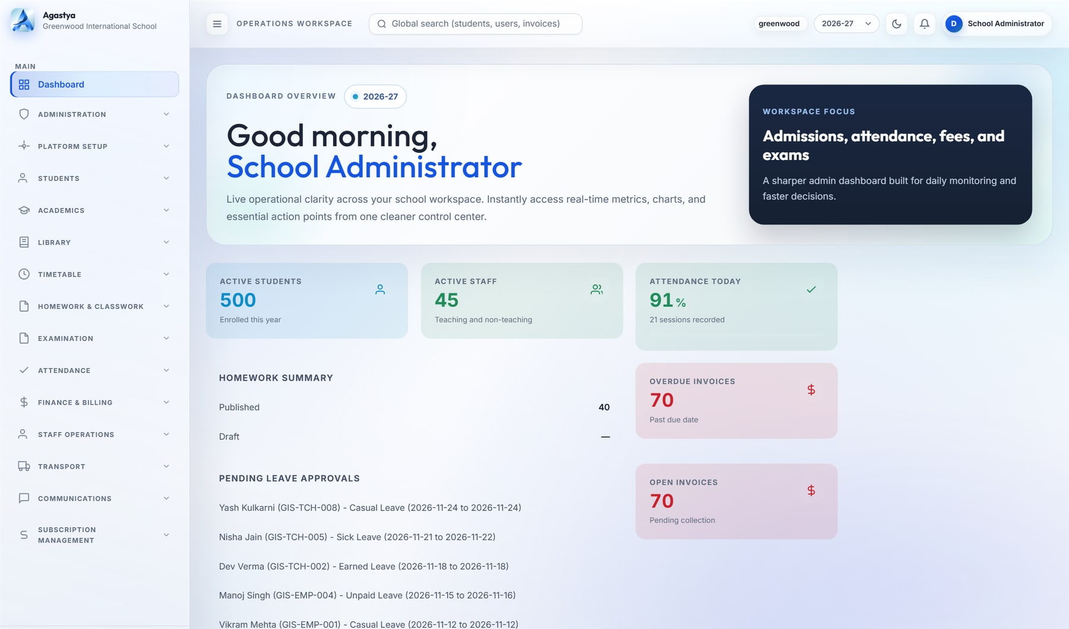
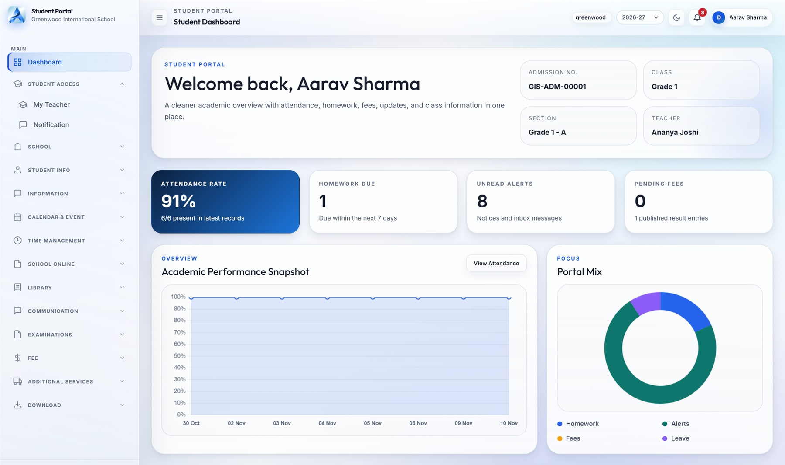
Agastya
app.agastya · Dashboard
ENTERPRISE SALES OVERVIEW
CLOUD SCHOOL ERP
One operating system for every school in your group
From admission to report card, fee to fleet: every department, persona and campus on one governed platform, with each school's data in its own database.
19 integrated modules
8 role cockpits
Database per school
Notes:
Cover. Agastya is MavionTech's multi-tenant cloud school ERP. Screens: school administrator dashboard and student portal (demo school: Greenwood International School).

Slide 2

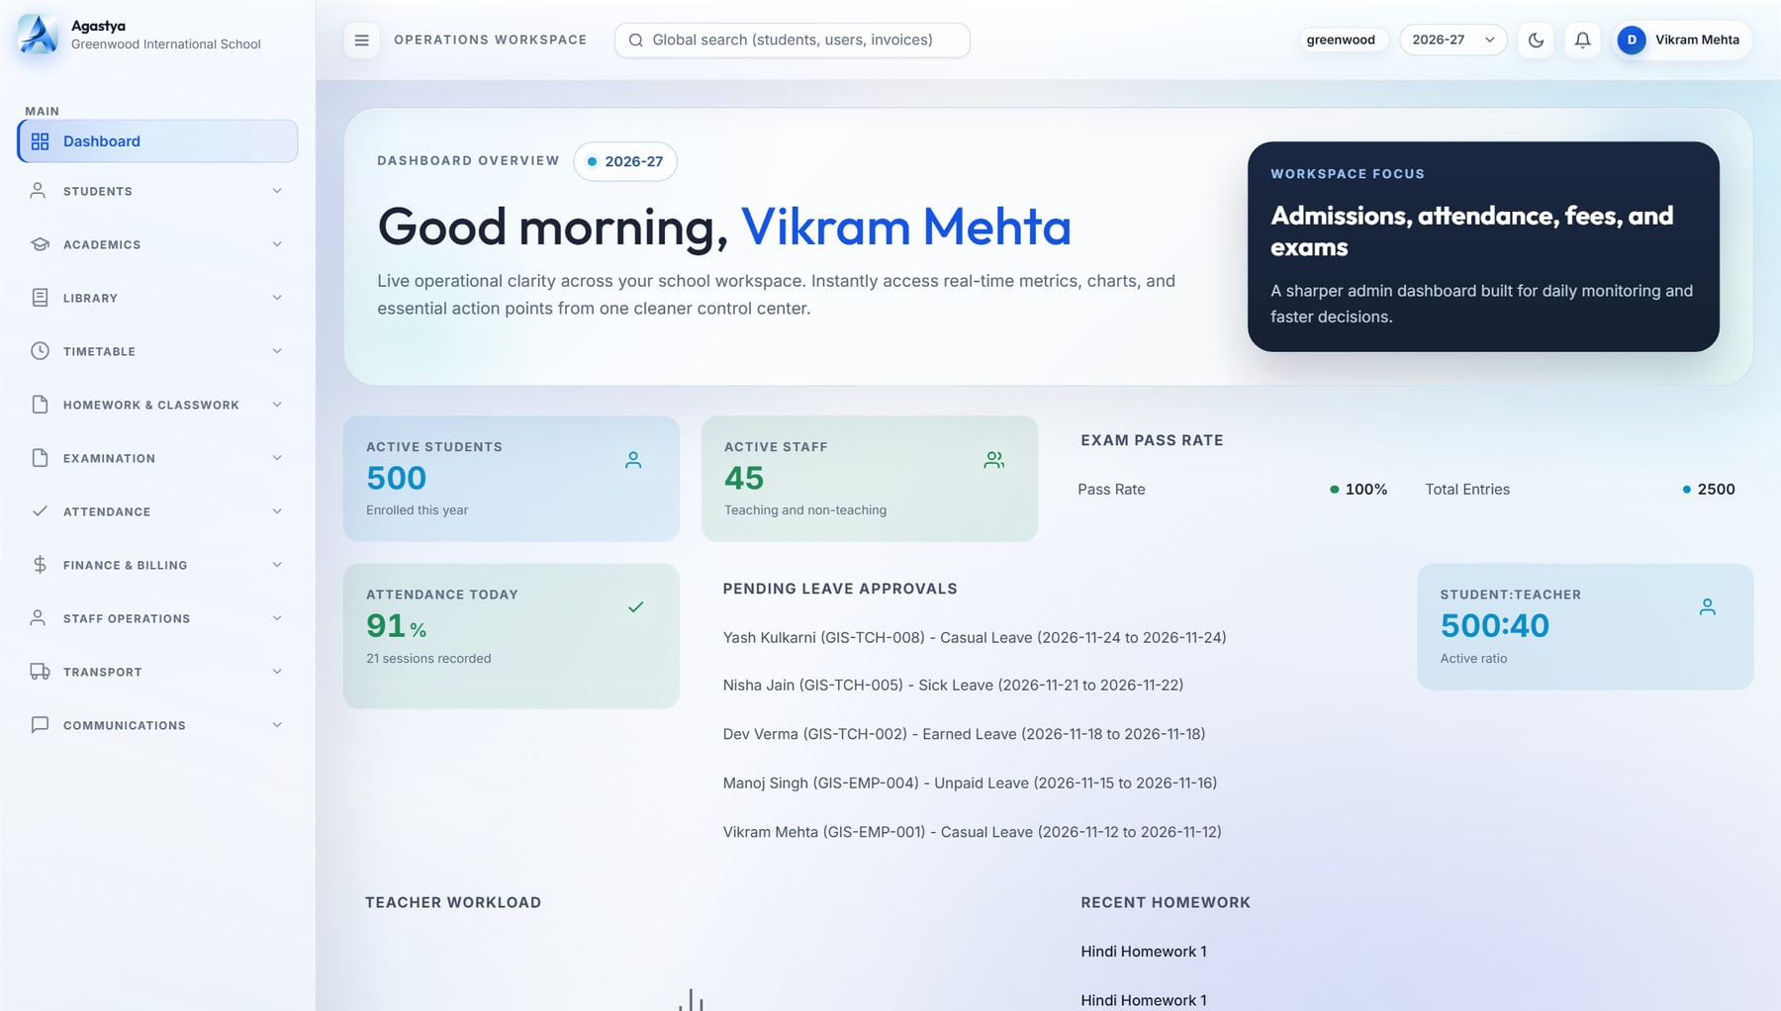


Run every operation, see every school, govern every record
THE PLATFORM
Run every operation
app.agastya · Principal dashboard
Admissions, academics, attendance, exams, fees, HR, transport, library, hostel, inventory and front office on one data model.
See every school
Live, role-specific cockpits for group heads, principals, teachers, accountants, parents and students.
Govern every record
A dedicated database per school, 96 permission codes and a before/after audit trail.
19
integrated modules
8
built-in roles
96
permission codes
257
automated tests
Principal cockpit: school-wide KPIs, pass rate, approvals and teacher workload (demo data).
Source: Agastya source review, Nov 2026.
Notes:
Agastya in one sentence: run every operation, see every school, govern every record. Metrics come from the code review (Nov 2026).

Slide 3






19 modules across six pillars, on one data model
PRODUCT MAP
Command & governance
Academics
Operations & finance
3 modules
6 modules
5 modules
Role dashboards & builder
Administration & RBAC
Platform setup & branding
Admissions & student lifecycle
Academics & syllabus
Timetable & substitution
Attendance
Homework & classwork
Exams & report cards
Fees & billing
Staff operations & HR
Transport
Inventory & procurement
Service desk & front office
Campus life
Engagement
Platform
2 modules
2 modules
1 module
Library
Hostel, health & discipline
Communications & WhatsApp inbox
Student & parent portals, student app
Multi-tenant SaaS console, plans & billing
One data model. Attendance feeds report cards, fee plans feed invoices, routes feed manifests, and every role sees the same live record.
Notes:
The product map. Every module shares one student, staff and academic-year model: attendance feeds report cards, fee plans feed invoices, routes feed manifests.

Slide 4
Database-per-school isolation, enforced on every request
ARCHITECTURE
CLIENTS
DAPHNE ASGI · REQUEST PIPELINE
DATA
INTEGRATIONS
Web app
Staff, parents, students
Control database
Tenants · plans · billing
Razorpay
Subscription billing
1
Tenant database context
Meta WhatsApp
Inbox & templates
Student mobile app
Expo · iOS / Android
2
Authentication + single session
tenant_greenwood
Isolated MySQL database
Tenant & subscription gate
Twilio
SMS & OTP
3
Webhooks
Razorpay · WhatsApp
tenant_riverdale
Isolated MySQL database
4
RBAC permission check
SMTP email
Resets, welcomes
Tenant database router
One database per school
Created, migrated and seeded on provisioning
5
ReportLab · Excel
PDF & XLSX exports
Two layers of isolation. Middleware selects each school's dedicated database on every request, and every business model also carries a tenant key.
Notes:
Isolation works in two layers: a dedicated database per school, selected per request by middleware and a database router, plus tenant foreign keys on every business model.

Slide 5
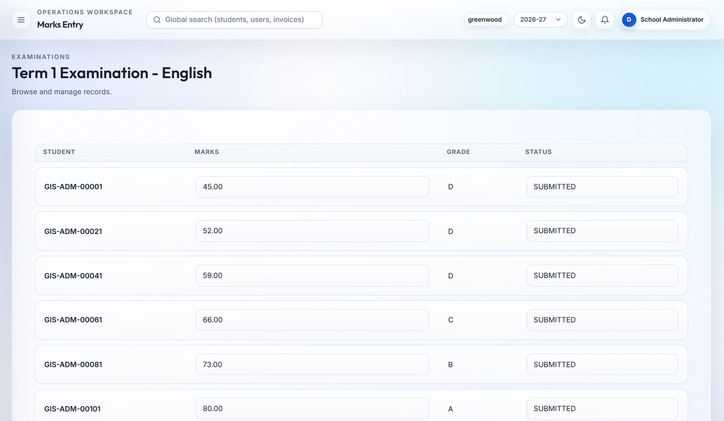
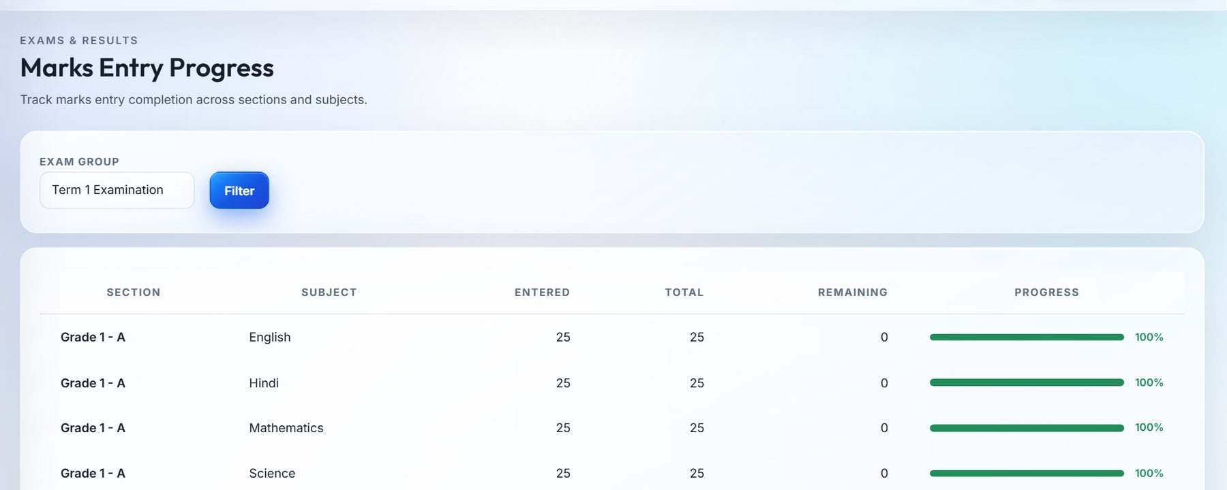
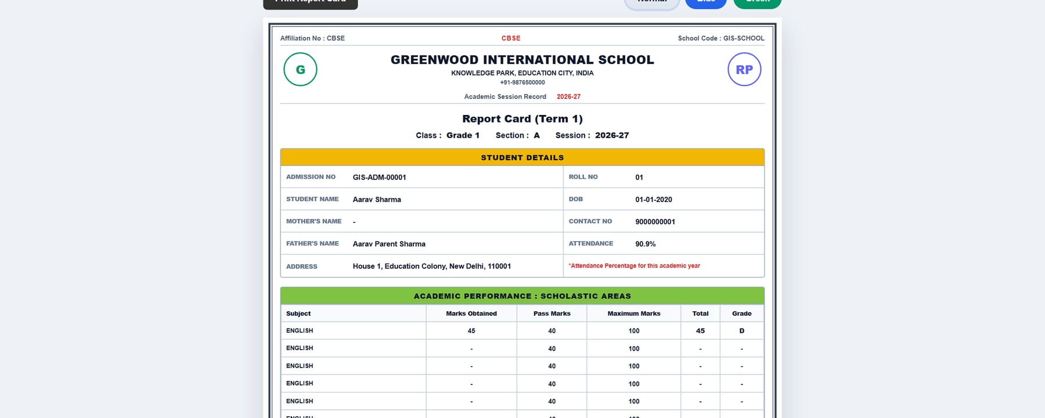
Results day in hours, not weeks
EXAMS & REPORT CARDS
app.agastya · Marks entry
Marks entry progress
2
1
Report card · PDF
3
1
Grid entry, restricted to the teacher's own sections, with automatic grading
2
Completion tracker shows who still has marks to enter
3
Branded report cards with rank, remarks and signatures, published in one click
Notes:
Live screens with demo data: marks entry grid, marks completion tracker and the printable report card. Every exam action is written to the audit log.

Slide 6





What changes when a school group moves to Agastya
WHY AGASTYA
TODAY
WITH AGASTYA
Isolation by design
Data
Spreadsheets, registers and phones
One data model, a dedicated database per school
Each school gets its own database, created and migrated automatically.
Visibility
Reports compiled by hand, days late
Live role cockpits for every leader
Configurable without developers
Dashboard builder, RBAC matrix, feature toggles and branding.
Control
Shared logins, no record of changes
96 permissions, single sessions, full audit trail
A school-owned parent channel
Parents
Personal WhatsApp groups, paper circulars
Portals, student app, school-owned WhatsApp inbox
Two-way WhatsApp inbox through the Meta Cloud API.
Growth
Every new campus repeats the setup
New school provisioned from the console
Audit-grade governance
Before/after audit, login events, lockout and single sessions.
Notes:
The before/after story in five lines, plus the four differentiators. Every claim maps to a capability shown earlier; no quantified ROI is claimed.

