Slide 1
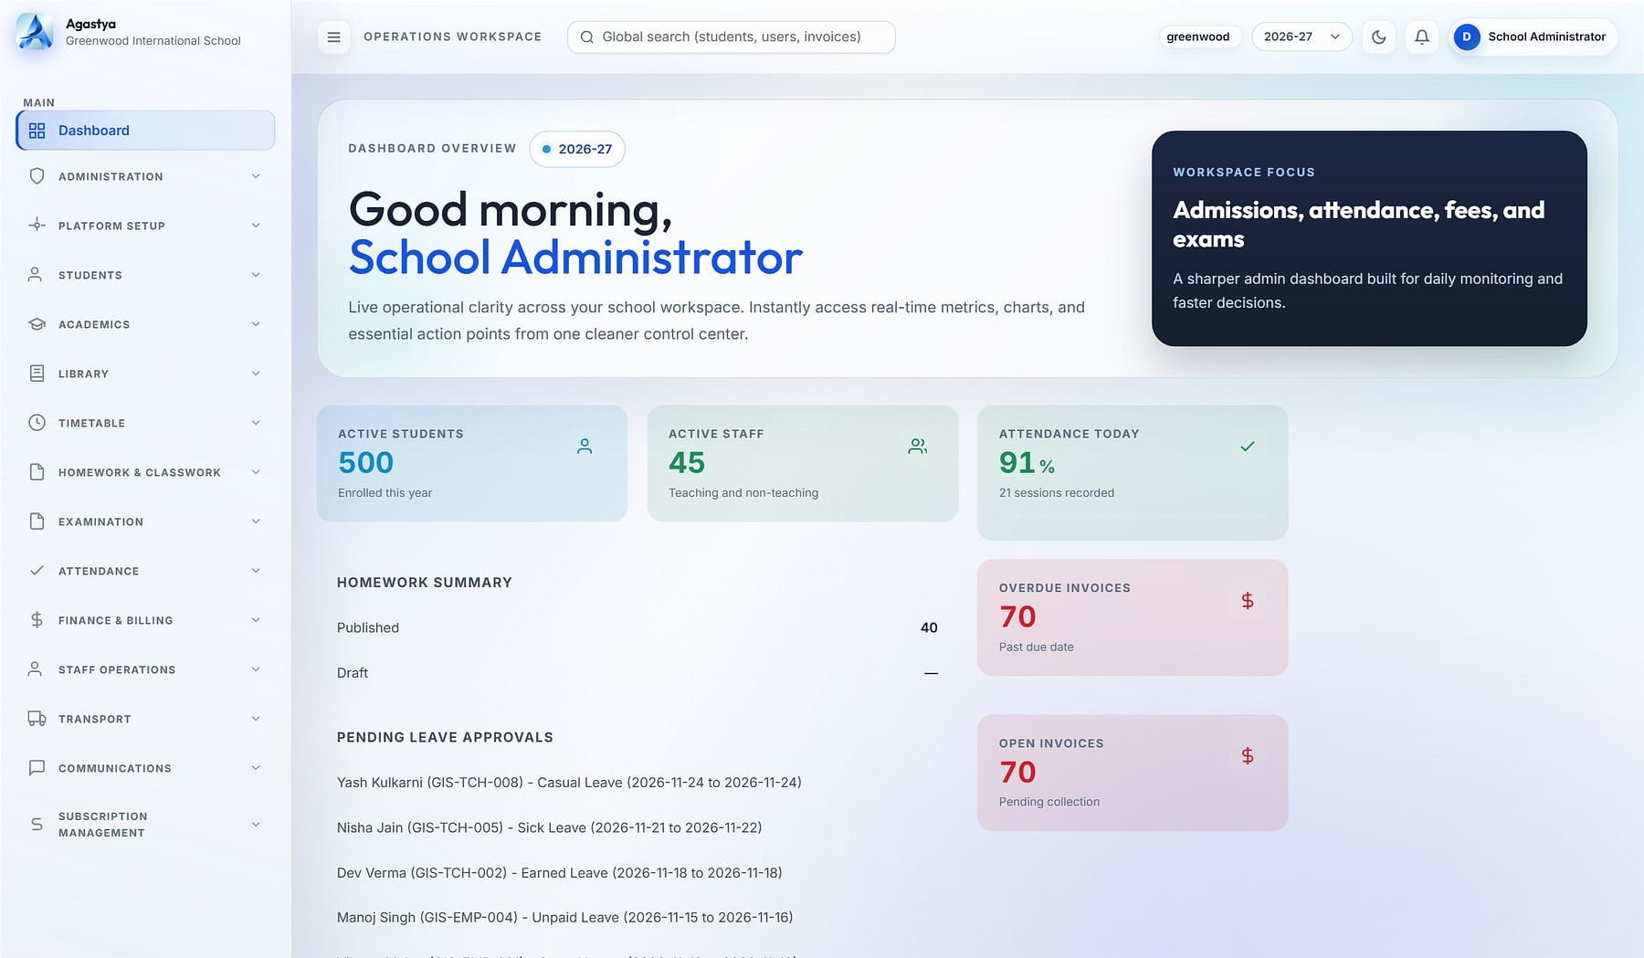
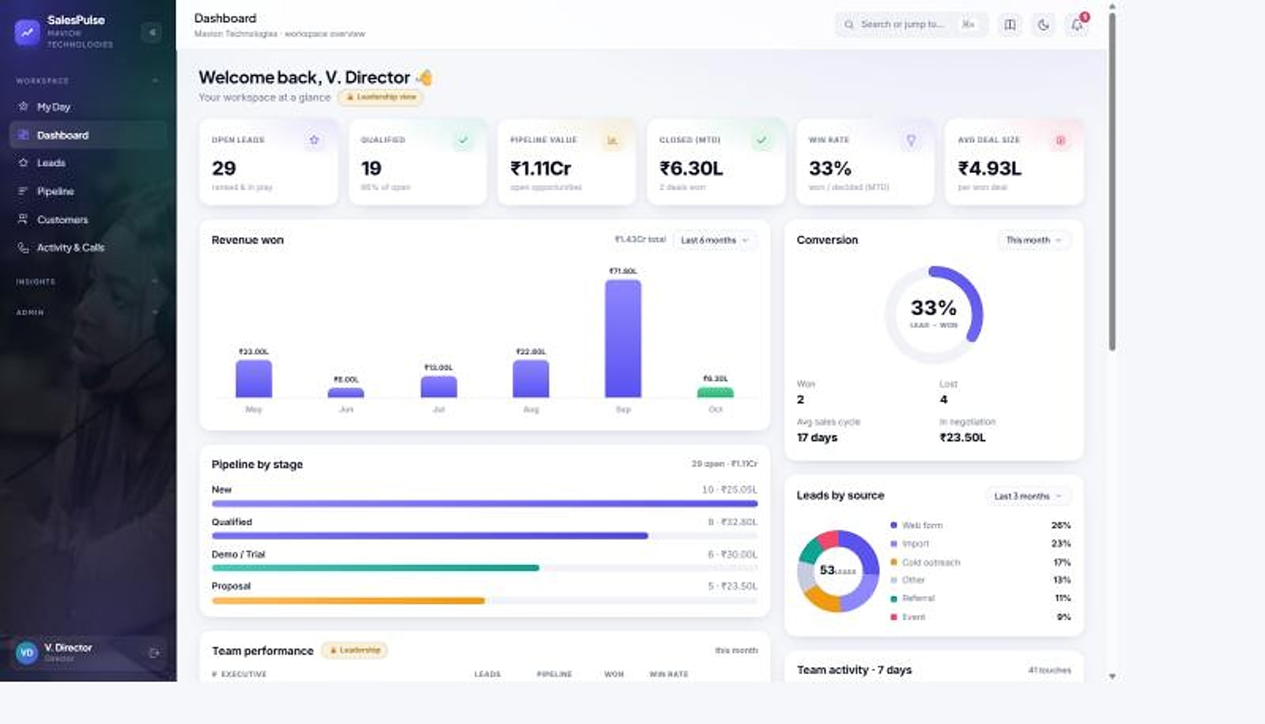
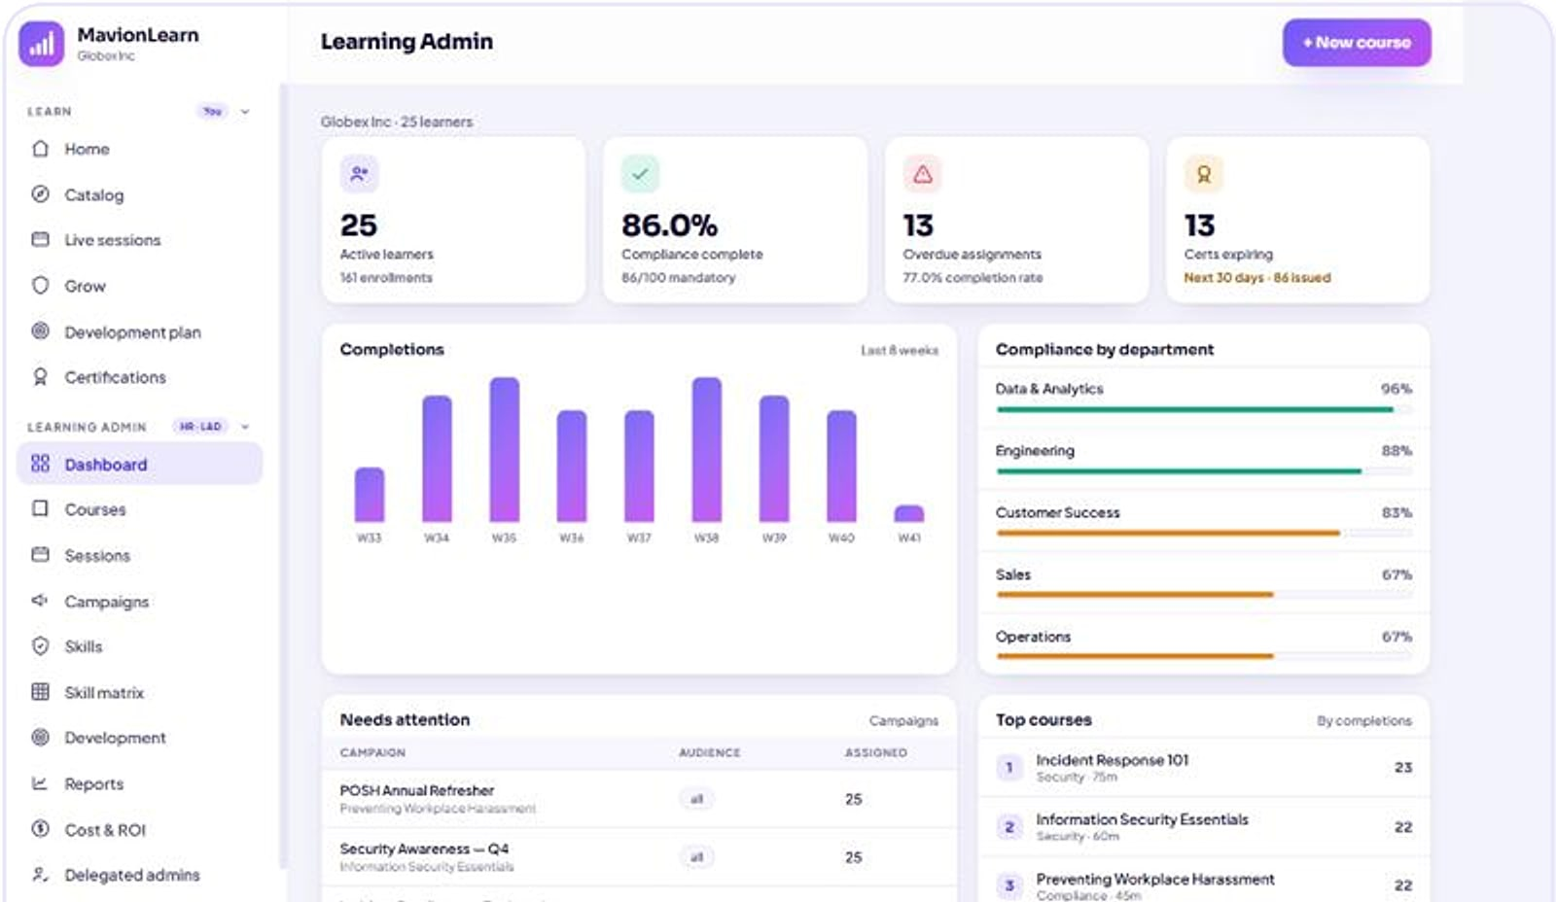


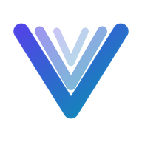

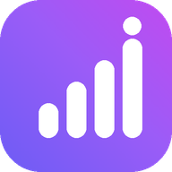

Six platforms. One standard of engineering.
Agastya · Cloud School ERP
CORPORATE PRODUCT CATALOGUE · 2026
SalesPulse CRM
Enterprise business applications for education, people, talent and revenue teams.
Agastya
PragyanNxt
Vortex HRMS
ProtonNxt
MavionLearn
SalesPulse CRM
Notes:
Corporate cover. Product screens shown are real product captures with demo data. Tagline 'Momentum with Vision' and descriptor 'Enterprise Business Applications' are from maviontech.com.

Slide 2
Six platforms in this catalogue, at a glance
CATALOGUE BRIEF
Agastya
Page 15 →
PragyanNxt
Page 20 →
Cloud School ERP · Education
Assessment & Certification · Education
Multi-tenant cloud ERP that runs admissions, academics, fees, transport and parent communication for every school in a group.
Author, deliver, proctor, score and certify assessments, with an integrity score and a verifiable credential for every result.
Vortex HRMS
Page 23 →
ProtonNxt
Page 27 →
Unified People Platform · People & Talent
Enterprise ATS · People & Talent
People platform for HR, Face-AI attendance, leave, policy-driven payroll and employee self-service, on one record.
AI-assisted applicant tracking for recruitment firms and talent teams, from requisition and sourcing to offer and joining.
MavionLearn
Page 31 →
SalesPulse CRM
Page 35 →
Enterprise LMS · Skills & Compliance · People & Talent
India-first Sales CRM · Revenue
Enterprise LMS that scores skills against role targets, runs compliance on its own and reports in your brand.
India-first sales CRM with privacy-masked calling, a live pipeline, GST billing and reports that build themselves.
Notes:
Catalogue brief: the six flagship products with their marks and one-line descriptions drawn from the approved decks. Page references point to each product's showcase opener.

Slide 3
An Indian product company for enterprise applications
ABOUT MAVIONTECH
COMPANY
MavionTech Private Limited
OUR JOURNEY
2023
Training foundation
HEADQUARTERS
Wakad, Pune, Maharashtra, India
Began as a training initiative under Sukrit EnVision Academy.
WHAT WE BUILD
Enterprise business applications
2024
Shift to product development
The team moved from training to building software products.
BRAND PROMISE
Momentum with Vision
2025
Independent product company
Launched as MavionTech, an independent product company.
PORTFOLIO
Six flagship platforms in this catalogue, plus further products on maviontech.com
Today
Six enterprise platforms
Education, people, talent and revenue products, each shown in this catalogue with real screens.
Notes:
All facts from maviontech.com (footer, About and Company pages, inspected 10 Nov 2026). Milestones are the company's own published timeline. No employee, customer or revenue figures are stated because none are evidenced.

Slide 4



We build the systems that run an organisation's daily operations
COMPANY INTRODUCTION
“
What we build
Complete operating platforms for schools, HR and payroll, recruitment, learning, assessment and sales: not point tools.
MavionTech builds enterprise business applications where every customer's data lives in its own database, and every operation is role-governed, audited and configurable without code.
How we build
Workflow-first and multi-tenant. Production-grade UX, predictable performance and maintainable integrations, as our promise states.
Who we build for
Each part of this statement is demonstrated by at least five of our six products.
Staffing and HR, IT companies, EdTech, consulting firms, finance and service providers, and MSMEs.
Notes:
The corporate line is from the Portfolio Positioning Strategy (section 5) and is evidenced across the six product decks. Verticals are from the maviontech.com home page. The promise wording is from the Company page.

Slide 5



Where we are going, and how we get there
VISION AND MISSION
VISION
MISSION
PROMISE
Create intelligent digital ecosystems that help teams move faster, make better decisions, and transform the way organizations operate.
Automate and simplify operational workflows with secure, extensible enterprise software that empowers teams to focus on what matters most.
Production-grade UX, predictable performance, and maintainable integrations — built for real teams solving real problems.
Source: maviontech.com, Company page. Quoted as published.
Notes:
Vision, mission and promise are quoted verbatim from the maviontech.com Company page (verified 10 Nov 2026). The older company PDF uses different wording; the website version is the current official statement.

Slide 6






Six engineering principles, proven across the portfolio
TECHNOLOGY FOCUS
Database per customer
Role-governed and audited
Configurable without code
Every product isolates each customer in its own database, not a shared table with a filter.
Role-based access and audit trails across sensitive actions, in every product.
Dashboards, fields, workflows, toggles and branding are set by administrators.
India-first commercial fit
Mobile where work happens
AI where it helps
INR, GST, statutory payroll, CTC structures and local payment rails.
Student, recruiter, sales and employee apps for people away from a desk.
Question generation, résumé parsing, visual proctoring and face recognition.
Dots show which products demonstrate each principle, in order: Agastya · PragyanNxt · Vortex HRMS · ProtonNxt · MavionLearn · SalesPulse CRM.
Notes:
Evidence: Portfolio Positioning Strategy section 5 and the six approved product decks. Mobile: Agastya student app, Vortex VortexGo and SnapLens, ProtonNxt recruiter app, SalesPulse Android app. AI: PragyanNxt generation, summaries and visual proctoring; ProtonNxt OpenAI/Gemini parsing; Vortex InsightFace attendance.

Slide 7
The operational problems customers bring to us
BUSINESS PROBLEMS WE ADDRESS
THE PROBLEM
WHERE IT SHOWS UP
ANSWERED BY
Operations run on registers, spreadsheets and chat groups
Nothing reconciles and every report is assembled by hand.
Agastya
Vortex HRMS
Customer and candidate data walks out with staff
Raw numbers and CVs sit in personal phones and inboxes.
SalesPulse CRM
ProtonNxt
Training that cannot prove capability
Completions are counted; skills and compliance are guessed.
MavionLearn
Assessments and certificates that can be disputed
Unsupervised exams and forgeable PDFs undermine trust.
PragyanNxt
Manual reconciliation between operations and finance
Attendance to payroll, fees to invoices, every cycle.
Vortex HRMS
Agastya
Leaders waiting days for the numbers
Visibility arrives after the decision was needed.
Agastya
SalesPulse CRM
MavionLearn
Notes:
Problems are taken from the problem slides of the six approved product decks. No market statistics are used; the company PDF figures (for example $1.8T, 73%) are uncited and excluded under the claims policy.

Slide 8
The product ecosystem
02
IN THIS SECTION
Portfolio overview
Ecosystem map
Product categories
Six platforms across three buyer domains, sharing one engineering foundation.
Technology capabilities
Industries and segments
Notes:
Section 2 opens the portfolio view before the product showcases.

Slide 9
Six platforms, each a complete system for one part of the business
PORTFOLIO OVERVIEW
Agastya
PragyanNxt
Vortex HRMS
Cloud School ERP
Assessment & Certification
Unified People Platform
One operating system for every school in your group
Results you can defend. Credentials anyone can verify.
Hire to retire. Attendance to payroll. On one record.
Best for
K-12 school groups and single schools
Best for
Hiring teams and academic institutions
Best for
HR, payroll and field workforces
ProtonNxt
MavionLearn
SalesPulse CRM
Enterprise ATS
Enterprise LMS · Skills & Compliance
India-first Sales CRM
From requisition to hire, in one structured pipeline
Skills that compound: training that becomes provable capability
Your reps sell. Your customers' numbers stay yours.
Best for
Recruitment firms and talent teams
Best for
L&D, HR and compliance leaders
Best for
Indian sales organisations
Notes:
Promises are the approved cover lines of each product deck. Order follows the buyer domains: Education (Agastya, PragyanNxt), People & Talent (Vortex HRMS, ProtonNxt, MavionLearn), Revenue (SalesPulse CRM).

Slide 10


Three buyer domains on one shared foundation
ECOSYSTEM MAP
Education
People & Talent
Revenue
Agastya
PragyanNxt
Vortex HRMS
ProtonNxt
MavionLearn
SalesPulse CRM
Cloud School ERP
Assessment & Certification
Unified People Platform
Enterprise ATS
Enterprise LMS · Skills & Compliance
India-first Sales CRM
Natural pairings (positioning, not built integrations): PragyanNxt + ProtonNxt for screening in hiring · PragyanNxt + MavionLearn for verifiable certification · MavionLearn as the upgrade from Vortex Learning
SHARED MAVIONTECH FOUNDATION
Database per customer
Role-based access & audit
No-code configuration
INR, GST & Razorpay
Platform consoles
Mobile & APIs
Notes:
Domains and pairings from the Portfolio Positioning Strategy, sections 6 and 10. The pairings are cross-sell positioning only; no product-to-product integration is claimed.

Slide 11
How the portfolio is organised
PRODUCT CATEGORIES
PRODUCT
DOMAIN
CATEGORY
PRIMARY BUYER
DELIVERY
PRICING
Agastya
Education
School ERP (K-12)
School group heads, principals
Multi-tenant SaaS
Subscription plans in platform console
PragyanNxt
Education
Assessment, proctoring & certification
Hiring heads, exam controllers
SaaS · private cloud · on-prem
Platform tiers by assessment volume
Vortex HRMS
People & Talent
HRMS, attendance & payroll
CHRO, payroll and finance
Multi-tenant cloud + apps
Per employee per month, by module
ProtonNxt
People & Talent
Applicant tracking (ATS)
Staffing firm owners, TA heads
Multi-tenant SaaS
Subscription plans in platform console
MavionLearn
People & Talent
Enterprise LMS, skills & compliance
CHRO, L&D and compliance
SaaS · private cloud · on-prem
Per user per month, annual billing
SalesPulse CRM
Revenue
Sales CRM
Sales directors, business owners
Multi-tenant SaaS + Android
Per seat, plus calling by usage
ALSO IN THE MAVIONTECH PORTFOLIO
Signet · Visitor Management · MavionMeet · Serene · Project Management Planning · Trackline · Inward Logistics · Vanguard · C2H Resource Management. Briefings on request.
Notes:
Commercial models as stated in each approved deck; prices themselves are only published for Vortex (list) and PragyanNxt (allowances). The 'also in the portfolio' names are listed on maviontech.com and in the company profile; their detail has not been verified for this catalogue, so names only.

Slide 12
Shared capabilities, implemented for each buyer
TECHNOLOGY CAPABILITIES
Agastya
PragyanNxt
Vortex HRMS
ProtonNxt
MavionLearn
SalesPulse CRM
Customer isolation
Database per school
Database per organisation
Database per customer
Database per tenant
Database per tenant
Database per company
Access & audit
96 permission codes; before/after audit
RBAC; activity logging
Role-based access; audit logging
RBAC; append-only audit
Delegated admins; audit
Row-level access; access log
Configuration
Dashboard builder; feature toggles
Plans and entitlements
No-code workflows; module toggles
Custom schema; scoring weights
SSO policy; campaigns
Report builder; quotas
India-first fit
INR, UPI, TC / Bonafide
INR pricing option
PF, ESI, PT, TDS
CTC structure (PF, gratuity)
INR pricing
GST invoices; Razorpay
Mobile
Student app (Expo)
—
VortexGo, SnapLens
Recruiter app
Responsive web
Native Android app
Branded output
Report cards; invoices
Report PDFs; certificates
Payslips; 42 letter types
Multi-sheet XLSX
Excel and PDF in your brand
Multi-sheet Excel
AI
—
Generation; summaries; visual proctoring
Face-AI attendance
OpenAI / Gemini parsing
—
—
Notes:
Matrix from the Portfolio Positioning Strategy section 5, aligned with the approved decks. Columns follow the catalogue order: Agastya, PragyanNxt, Vortex HRMS, ProtonNxt, MavionLearn, SalesPulse CRM. A dash means not offered or not evidenced.

Slide 13



Where our products fit
INDUSTRIES AND CUSTOMER SEGMENTS
INDUSTRIES WE SERVE
SEGMENT AND PRODUCT
Staffing & HR
IT companies
Agastya
K-12 school groups, chains and single schools
PragyanNxt
Corporate hiring and L&D teams; colleges and certification bodies
EdTech & education
Consulting firms
Vortex HRMS
Organisations with HR, payroll and field or shift workforces
Finance & service providers
MSMEs
ProtonNxt
Recruitment and staffing firms; enterprise talent teams
MavionLearn
Enterprises proving skills and compliance at scale
Verticals as published on maviontech.com.
SalesPulse CRM
Indian SMB and mid-market sales organisations
Notes:
Industries from the maviontech.com home page. Segments from each product's approved deck and the Master Product Inventory. No customer names or counts are used.

Slide 14
Product showcases
03
IN THIS SECTION
Agastya
PragyanNxt
Vortex HRMS
Each platform in depth: identity, problem and solution, capabilities, real screens, differentiators and value.
ProtonNxt
MavionLearn
SalesPulse CRM
Notes:
Space is allocated by product breadth: Agastya 5 slides; Vortex HRMS, ProtonNxt, MavionLearn and SalesPulse CRM 4 each; PragyanNxt 3.

Slide 15
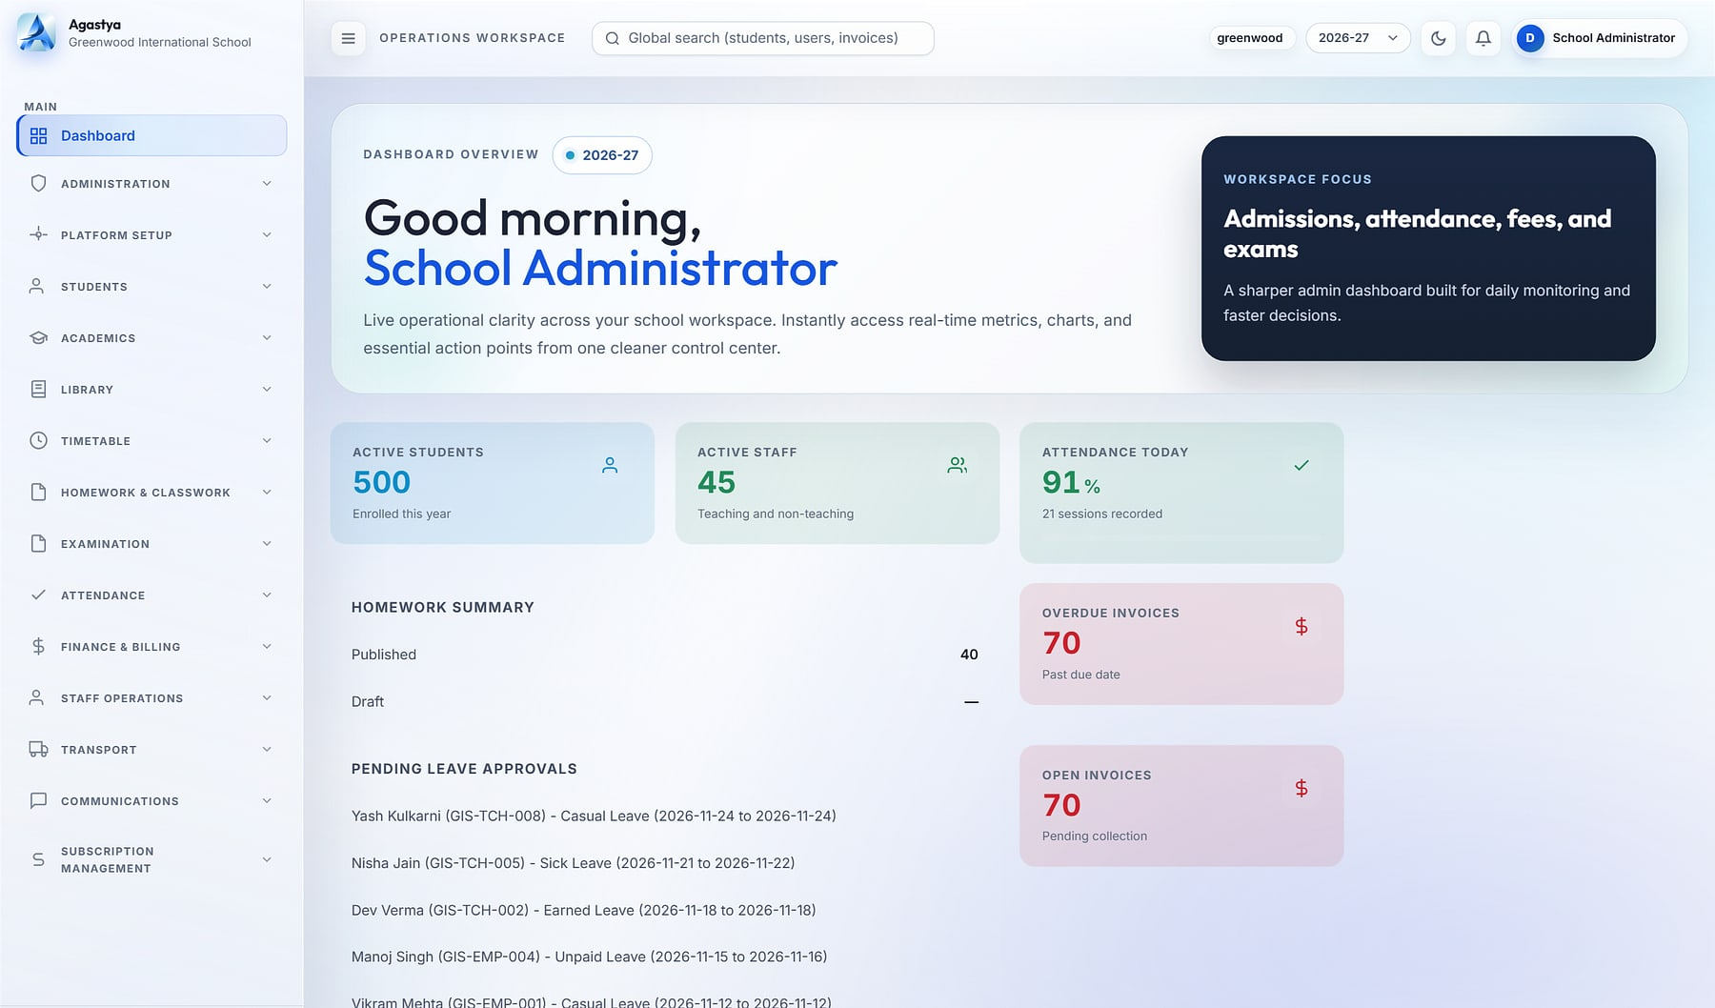
Agastya
PRODUCT SHOWCASE
CLOUD SCHOOL ERP
Agastya · School administrator dashboard
One operating system for every school in your group
THE PROBLEM
OUR ANSWER
School groups run on registers, spreadsheets and WhatsApp. Nothing reconciles, leaders wait days for numbers, and student data sits on personal phones.
Admissions to report cards, fees to fleet: every department, persona and campus on one governed platform, with each school's data in its own database.
19
8
96
integrated modules
role cockpits
permission codes
BUILT FOR
School groups & chains · Single schools · Group heads & principals
School administrator dashboard (demo data).
Notes:
Agastya identity. Figures from the Agastya source review (Nov 2026): 19 Django apps/modules, 8 system roles, 96 permission codes. Screenshot is a real product capture with demo data.

Slide 16






19 modules across six pillars, on one data model
AGASTYA · CAPABILITIES
Agastya
Command & governance
Academics
Operations & finance
3 modules
6 modules
5 modules
Role dashboards & builder
Administration & RBAC
Platform setup & branding
Admissions & student lifecycle
Academics & syllabus
Timetable & substitution
Attendance · Homework
Exams & report cards
Fees & billing
Staff operations & HR
Transport
Inventory & procurement
Service desk & front office
Campus life
Engagement
Platform
2 modules
2 modules
1 module
Library
Hostel, health & discipline
Communications & WhatsApp inbox
Student & parent portals, student app
Multi-tenant SaaS console
Plans, subscriptions & billing
Notes:
Module map as in the approved Agastya deck, slide 5. One data model: attendance feeds report cards, fee plans feed invoices, routes feed manifests.

Slide 17
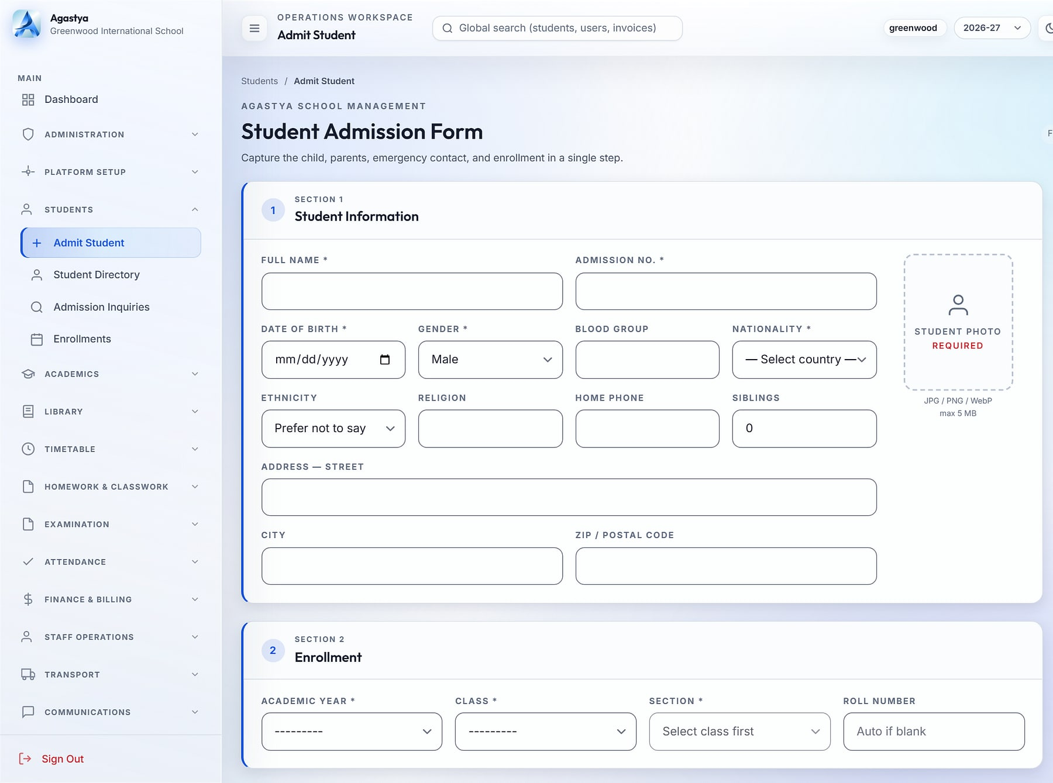
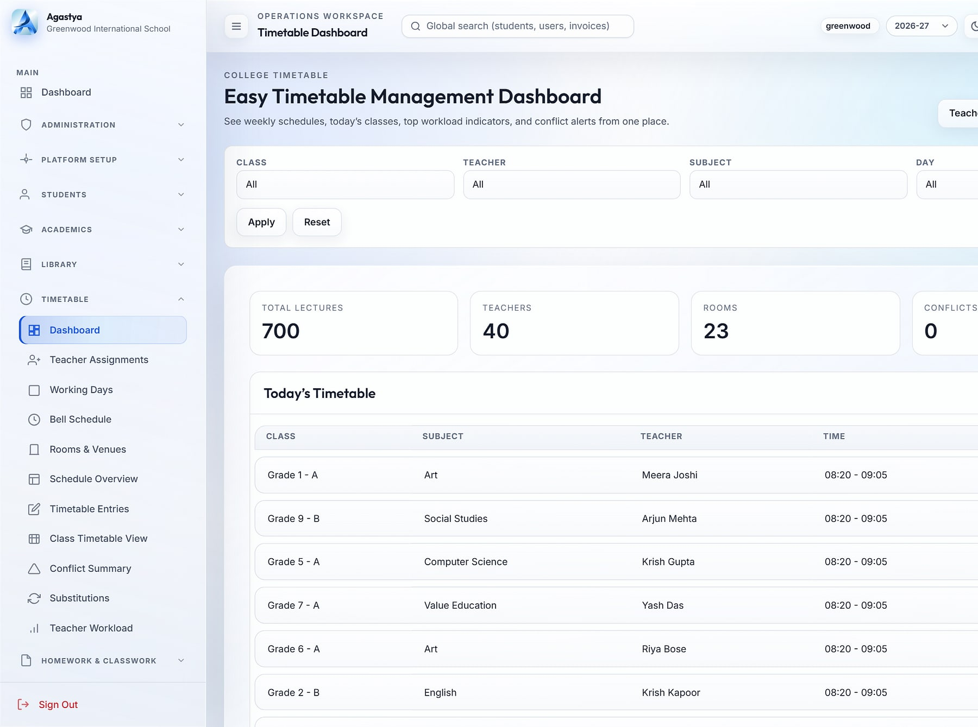
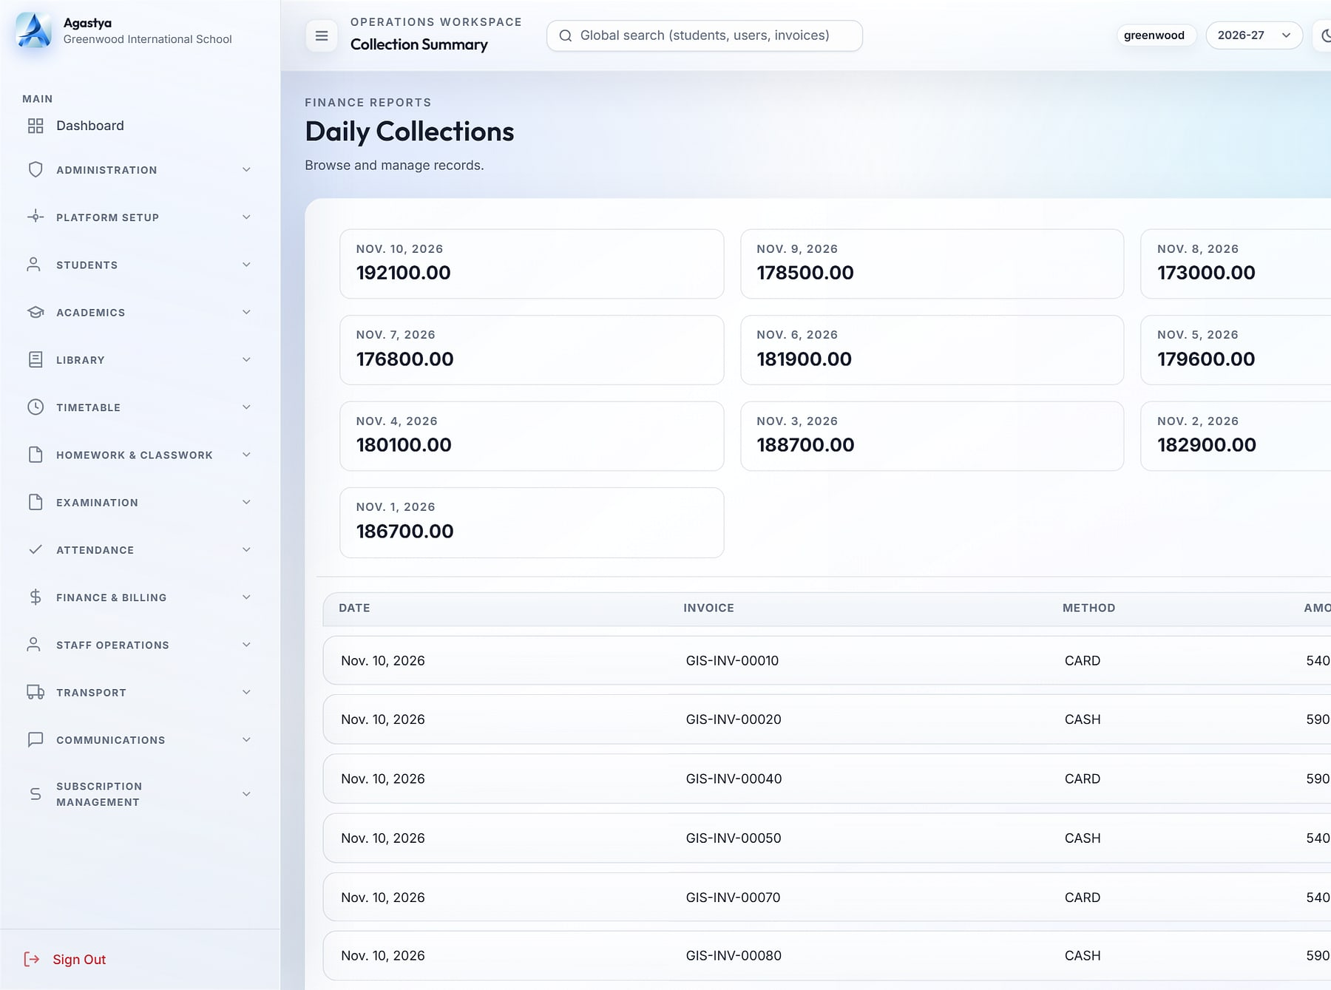
From first inquiry to report card, on one record for life
AGASTYA · WORKFLOWS
Agastya
1 Inquiry
2 Admit & enrol
3 Timetable & attendance
4 Exams & report cards
5 Fees & collections
Admit student
Timetable dashboard
Daily collections
Admission in one screen
Clash-free timetables
Collections in real time
Student, enrolment, guardians and emergency contact in one step (demo data).
700 weekly lectures across 40 teachers with zero conflicts (demo data).
Daily collections with payment-method breakdown (demo data).
Notes:
Real Agastya screens with demo data, as used in the approved deck (slides 11, 12, 19).

Slide 18
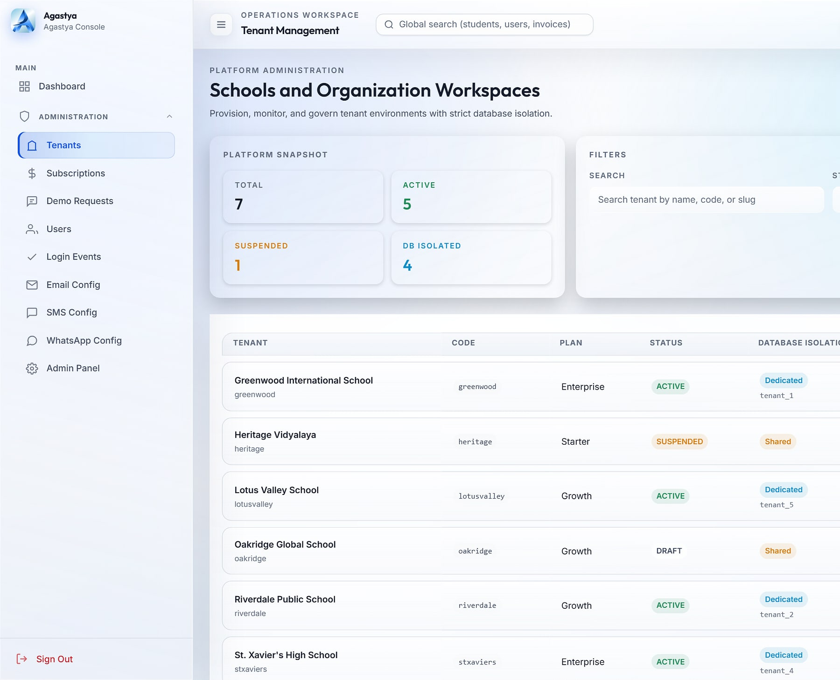
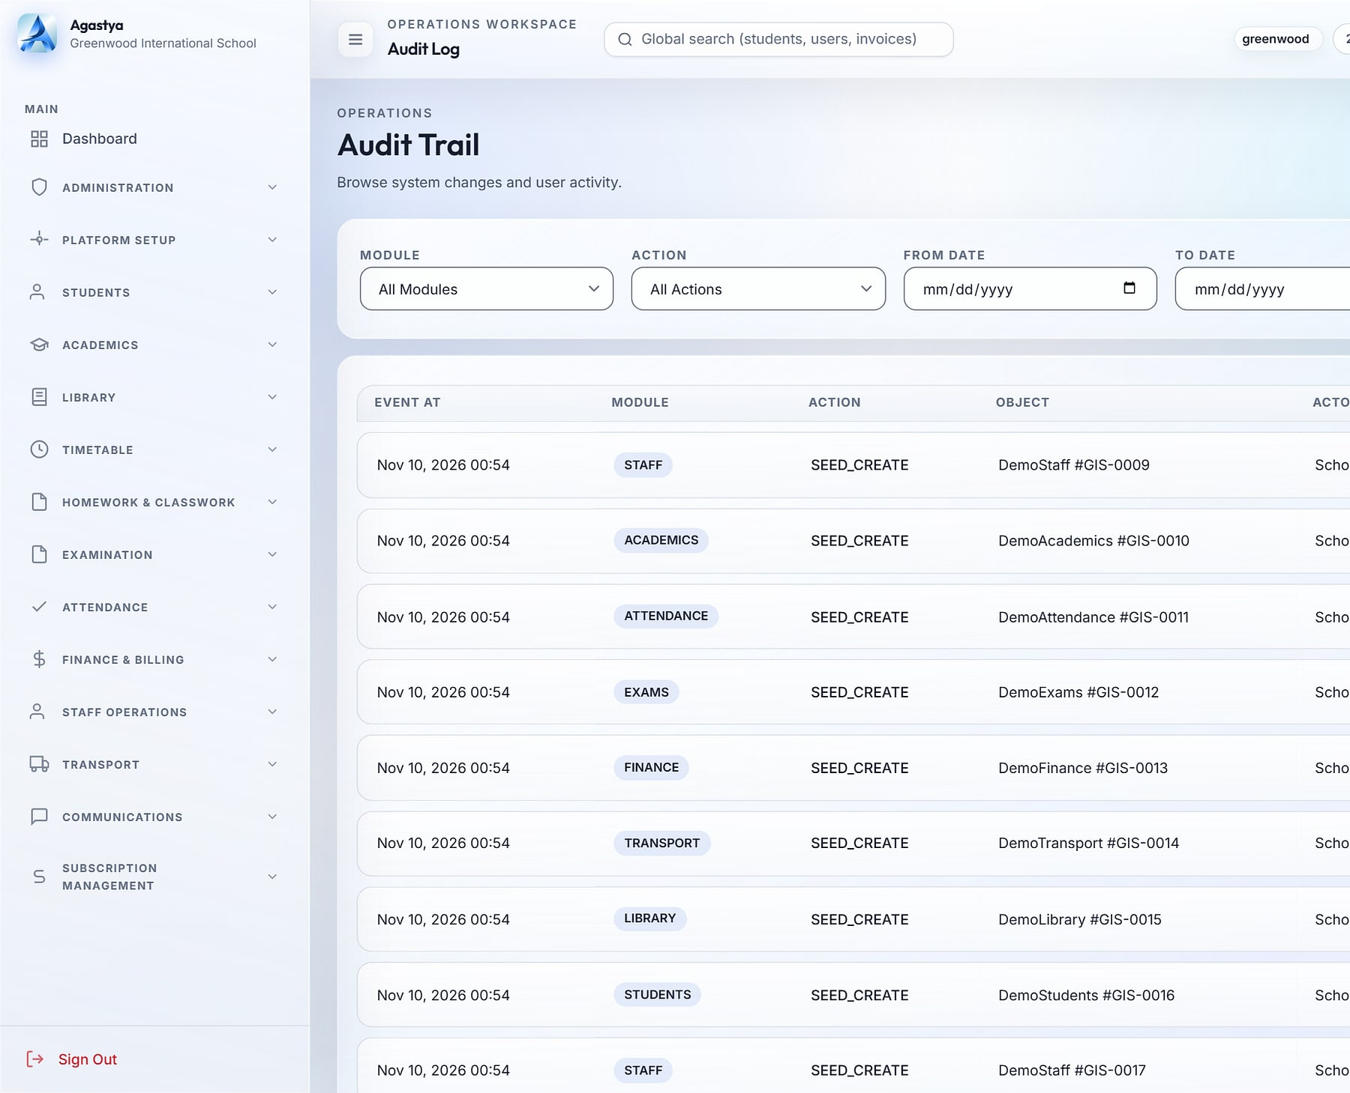
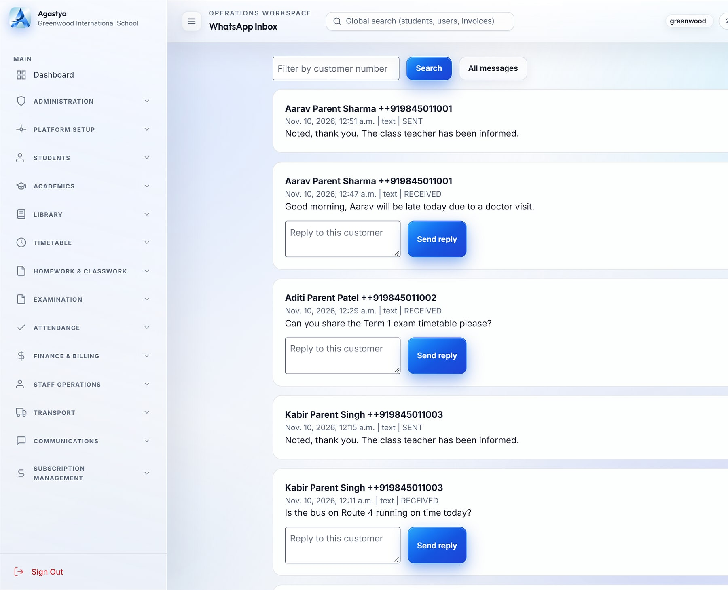
Every campus governed from one console
AGASTYA · GOVERNANCE
Agastya
Tenant management
Audit trail
WhatsApp inbox
Onboard a school in minutes
Every action traceable
A school-owned parent channel
Platform console: schools, plans and a dedicated database each (demo data).
Audit log with before/after values, filters and CSV export (demo data).
Two-way WhatsApp inbox through the Meta Cloud API (demo data).
Lockout after 3 failed logins
One active session per user
4-hour sliding sessions
Signed webhooks
Database per school
Notes:
Controls as evidenced in the Agastya source and approved deck slide 10 and 26.

Slide 19




What changes when a school group moves to Agastya
AGASTYA · WHY IT WINS
Agastya
KEY DIFFERENTIATORS
BUSINESS VALUE
Live numbers for group heads, principals and accountants
Faster collections with branded invoices and dues tracking
Database per school
Configurable without developers
Each school gets its own database, created and migrated automatically.
Dashboard builder, permission matrix and feature toggles per school.
Report cards published in one click
New campuses provisioned from the console
Parents informed without personal phone numbers
School-owned parent channel
Audit-grade governance
BEST FIT
Two-way WhatsApp inbox; no staff personal numbers.
Before/after audit, login events, lockout and single sessions.
School groups and chains running several campuses, and single schools that want group-grade governance.
Multi-tenant SaaS
Razorpay
Meta WhatsApp
Twilio SMS
Student app (Expo)
Notes:
Differentiators from the approved Agastya deck slide 29. Business value is stated qualitatively; no ROI figures are claimed. Planned items (online fee payment, payroll, live bus tracking) are excluded here and shown under Future direction.

Slide 20
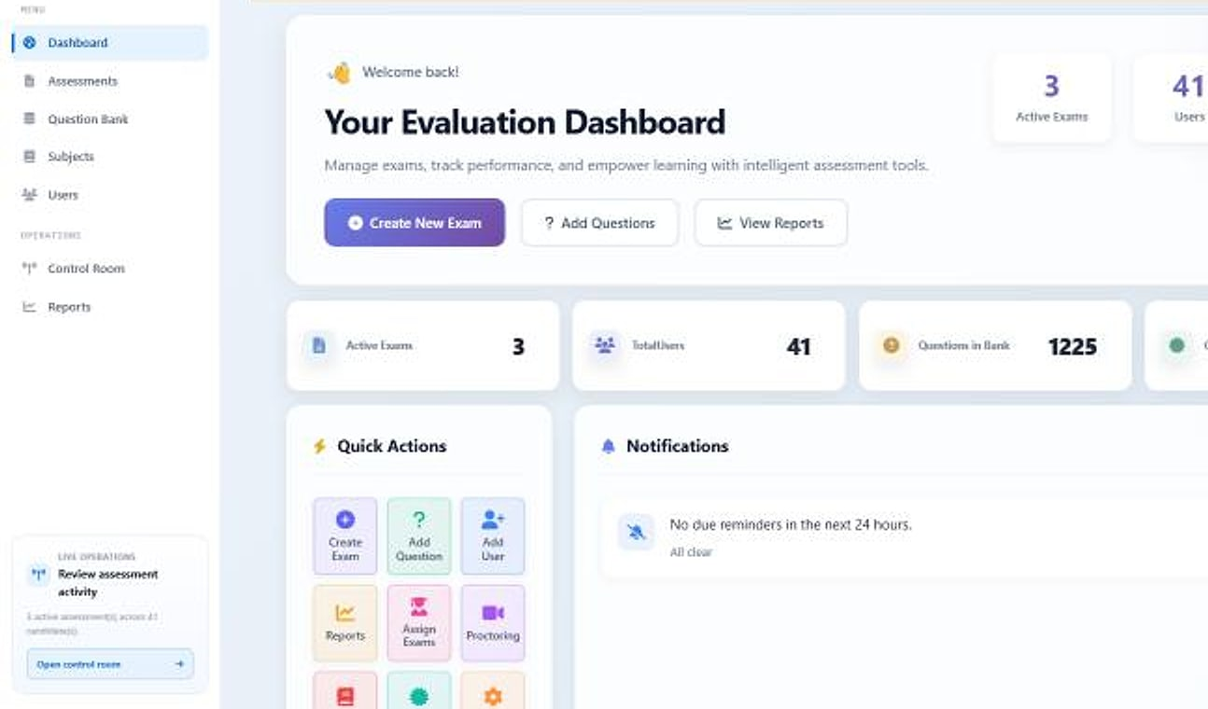
PragyanNxt
PRODUCT SHOWCASE
ASSESSMENT & CERTIFICATION
PragyanNxt · Evaluation dashboard
Results you can defend. Credentials anyone can verify.
THE PROBLEM
OUR ANSWER
Gamed screening tests push the wrong candidates forward, unmonitored exams devalue certificates, and point tools never talk to each other.
One platform for corporates and academic institutions to author, deliver, proctor, score and certify, with an integrity score on every attempt.
8
Ed25519
14-day
integrated modules
signed credentials
free trial
BUILT FOR
Corporate hiring teams · Academic institutions · Certification programmes
Evaluation dashboard: active exams, users and question bank (demo data).
Notes:
PragyanNxt (formerly Evalynx; rename approved by MavionTech). Facts from the approved PragyanNxt deck.

Slide 21







Eight modules, one closed loop of trust
PRAGYANNXT · CAPABILITIES
PragyanNxt
1 Author
2 Deliver
3 Proctor
4 Score
5 Certify
Authoring
Delivery
Proctoring
Integrity
Build
Run
Watch
Score
Question bank & bulk import
AI generation
Bloom's & difficulty
Public, assigned or invite
Randomisation & timers
Retakes
Live monitoring
Screen & webcam recording
AI visual analysis
Behavioural signals
Integrity score
Answer similarity
Results & analytics
Certification
Multi-tenancy & admin
Commerce & AI
Decide
Prove
Govern
Scale
Auto & manual grading
Report PDFs
AI summaries
Signed certificates
Public verification
Open Badges & appeals
Tenant isolation
Roles & RBAC
Activity logging
Subscriptions & entitlements
Metered AI credits
Email invites
Notes:
Module map from the approved PragyanNxt deck slide 7; loop from slide 6.

Slide 22
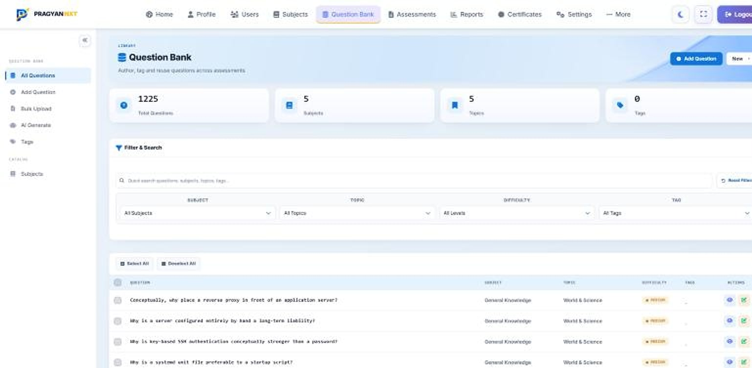




Not just a PDF: a credential the world can verify
PRAGYANNXT · WHY IT WINS
PragyanNxt
Question bank
KEY DIFFERENTIATORS
Cryptographically signed
Ed25519-signed credentials that cannot be forged or altered.
Public verification
Anyone can confirm a certificate is genuine, instantly.
Integrity without a camera
Focus, tab and clipboard telemetry score non-proctored exams too.
Question bank: 1,225 questions across 5 subjects, with filters by subject, topic, difficulty and tag (demo data).
Plugs into your LMS
BUSINESS VALUE
LTI 1.3 writes results back to Canvas, Moodle and more.
Hire on evidence, not gamed scores
Exams that stand up to appeal
Certificates verified in one click
One platform instead of three
Deploy as cloud SaaS, private cloud or on-premise · Basic, Plus and Pro tiers by monthly assessment volume
Notes:
Differentiators from the approved PragyanNxt deck slides 15, 13 and 21. Deployment options as listed on maviontech.com. Tier allowances are on the approved packaging slide; prices are not published.

Slide 23
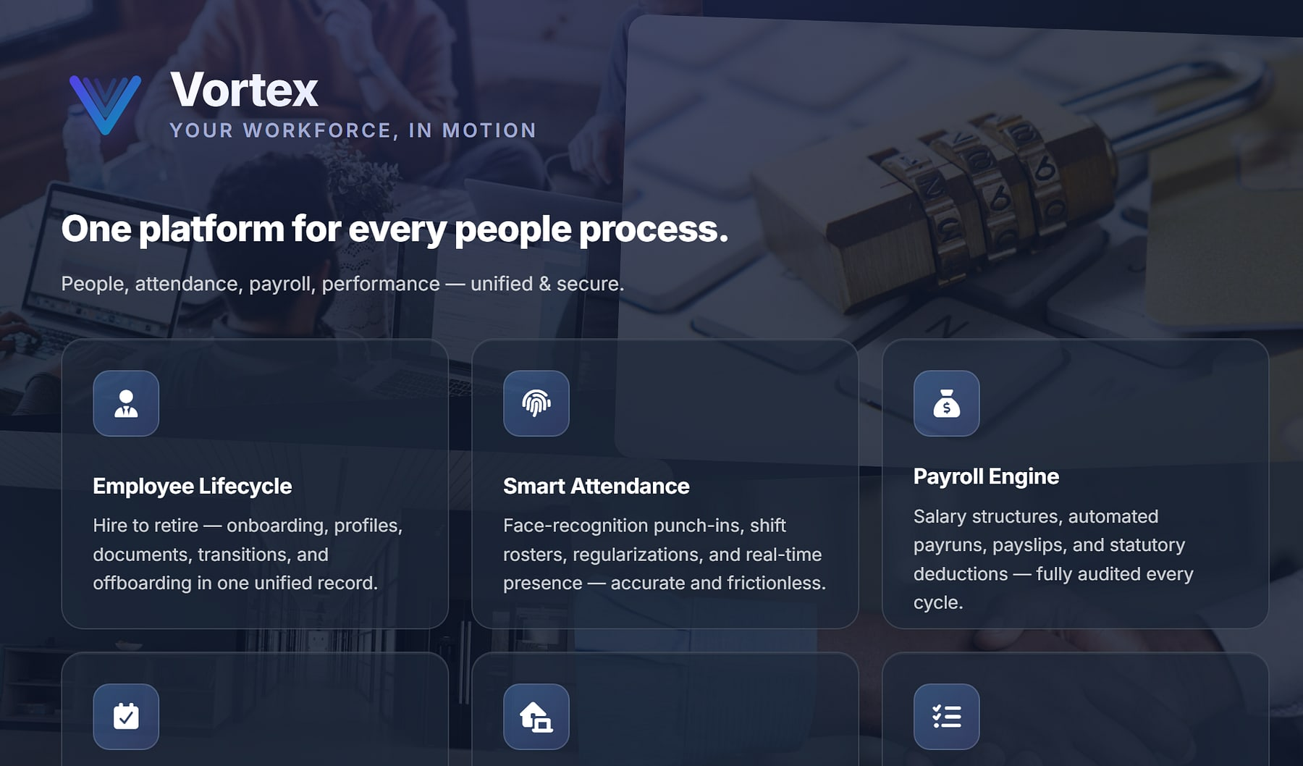
Vortex HRMS
PRODUCT SHOWCASE
UNIFIED PEOPLE PLATFORM
vortexhrms.com
Hire to retire. Attendance to payroll. On one record.
THE PROBLEM
OUR ANSWER
HR, payroll, attendance and helpdesk live in separate tools. Finance reconciles attendance to payroll by hand, and statutory rules change faster than legacy systems.
One people platform: Face-AI attendance, policy-driven payroll, leave, approvals and employee self-service, with a database per customer.
14
₹45
Face-AI
modules
per employee / month base
attendance
BUILT FOR
HR & people teams · Payroll & finance · Field & shift workforces
Vortex HRMS public site, vortexhrms.com.
Notes:
Vortex HRMS (official product name). The source materials include no in-app screenshots; the hero is the public vortexhrms.com page, cropped to remove unverified badges. Base price is the published list price.

Slide 24



Start with core HR, then switch on exactly what you need
VORTEX HRMS · CAPABILITIES
Vortex HRMS
Base bundle
Premium modules
Attendance & mobile add-ons
Every employee gets
Switch on any month
For field and remote teams
People management
Attendance tracking
Leave management
Employee self-service
Company policies
Payroll management
Performance (PMS)
Expenses · Helpdesk · Assets
HR document generation
Learning (LMS)
VortexGo mobile app
Geo-fence attendance & remote punch-in
On-shift location sharing
Punch step-up verification
Underneath everything: the approvals and workflow engine, role-based security, audit logging and a database per customer.
Notes:
Packaging and modules from the approved Vortex deck slide 5.

Slide 25
Attendance and leave flow straight into payroll
VORTEX HRMS · WORKFLOWS
Vortex HRMS
INPUTS
OUTPUTS
Attendance
Punches, shifts, rosters
Inputs locked at cut-off
Period inputs frozen for the run
Payroll engine
Salary structures · statutory deductions · tax computation · adjustments
Payslips
For every employee
Leave & comp-off
Balances and credits
Bank file
Disbursement output
Regularisations
Approved corrections
Statutory
PF · ESI · PT · TDS
Expenses
Approved reimbursements
Period locked
Audit logged
Re-runs are versioned and periods lock after sign-off, so every payroll is reproducible and auditable. Approvals route by role, sequentially or in parallel, with escalation timers.
Notes:
Native diagram from the approved Vortex deck slide 10 and 12. No mock product screens are drawn: Vortex in-app screenshots are an open item.

Slide 26




One record from hire to retire, priced by what you switch on
VORTEX HRMS · WHY IT WINS
Vortex HRMS
KEY DIFFERENTIATORS
BUSINESS VALUE
No manual reconciliation of attendance to payroll
Statutory deductions computed by policy
Face-AI attendance
Policy-first payroll
Face-recognition punch (InsightFace), geo-fencing and device integration.
Versioned re-runs and locked periods make payroll reproducible.
Approvals that never stall, with escalation timers
Employees serve themselves: balances, payslips, policies
BEST FIT
Organisations with HR, payroll and field or shift workforces that want one record from hire to retire.
VortexGo and SnapLens
Pay for what you switch on
Employee and on-site attendance apps, with privacy safeguards for location.
Published per-employee list prices; modules on or off any month.
Multi-tenant cloud
Biometric devices & gates
REST APIs
30-day free trial
Notes:
From the approved Vortex deck slides 7, 8, 11, 19 and 20. List prices: Basic Services ₹45 per active employee per month; modules ₹9 to ₹55; GST extra.

Slide 27
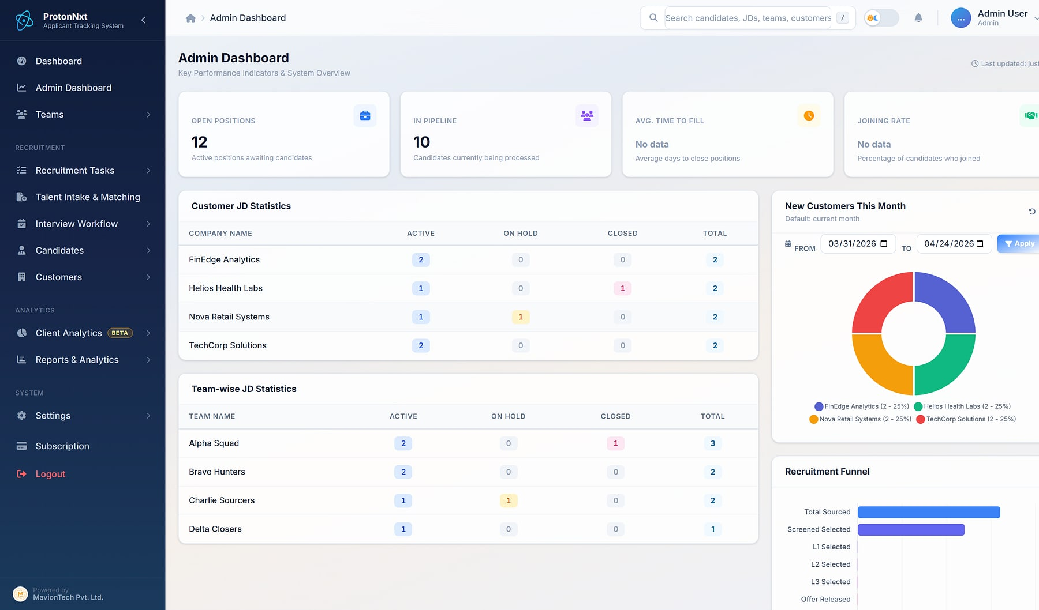
ProtonNxt
PRODUCT SHOWCASE
ENTERPRISE ATS
ProtonNxt · Admin dashboard
From requisition to hire, in one structured pipeline
THE PROBLEM
OUR ANSWER
Recruiters screen résumés by hand, ownership is unclear, feedback lives in inboxes, and vendor CVs arrive with no caps, duplicates or audit.
A multi-tenant, AI-assisted ATS for recruitment firms and talent teams: sourcing, parsing, interviews, offers, vendors and client insight on one system.
15
2
L1–L3
modules in every tenant
AI parsing paths
structured interviews
BUILT FOR
Recruitment & staffing firms · Enterprise talent teams · Vendor agencies
Admin dashboard: KPIs, customer JD statistics and recruitment funnel (demo data).
Notes:
ProtonNxt facts from the approved deck: 15 modules, OpenAI and Gemini parsing paths, L1/L2/L3 interview levels. Personal data in source slides 8 and 36 is not used.

Slide 28





Fifteen modules, every one included in every tenant
PROTONNXT · CAPABILITIES
ProtonNxt
Hiring pipeline
Operations
External access
Analytics
Governance
6 modules
4 modules
2 modules
2 modules
1 module
Job requisitions
Candidate sourcing
Talent intake & matching
Applicant tracking
Interview workflow
Offer management
JD assignment
Team collaboration
Calendar & video
Mobile recruiter app
Careers URL & candidate portal
Vendor management
Reports & analytics
Client engagement analytics (beta)
Settings, admin & custom schema
No add-ons: every module ships to every tenant from day one. Client engagement analytics is in beta.
Notes:
Module map from the approved ProtonNxt deck slide 6.

Slide 29
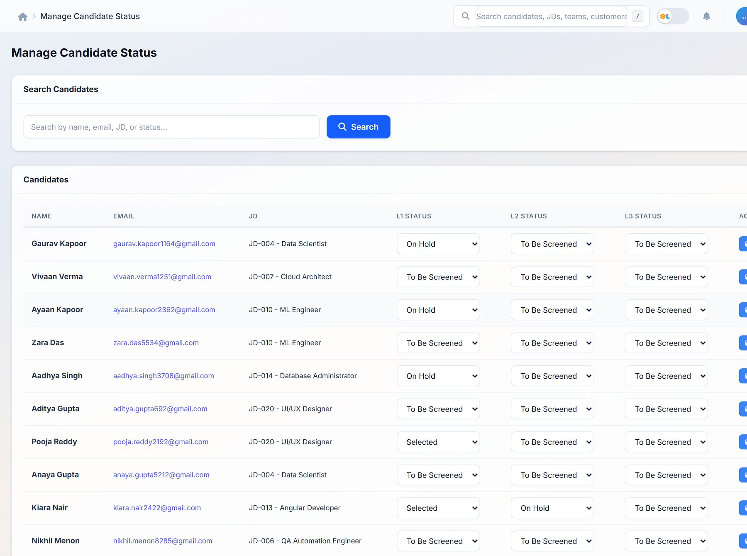
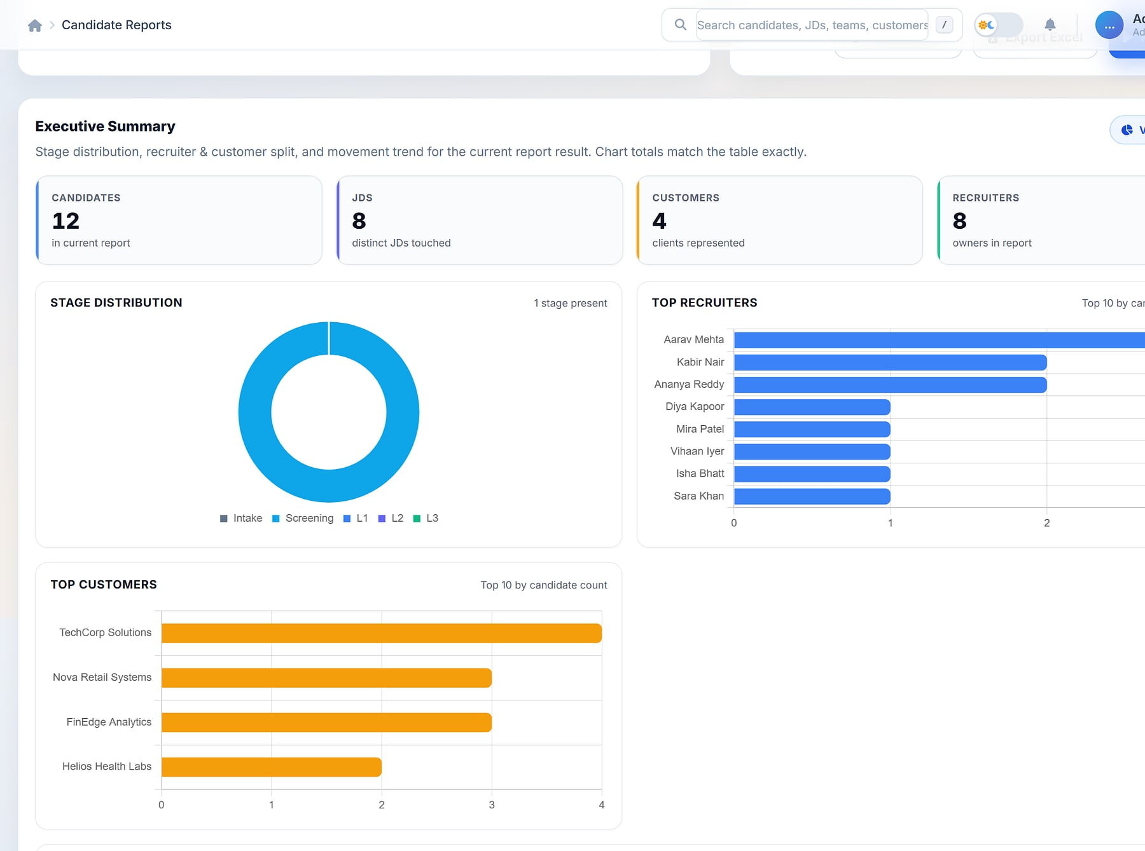
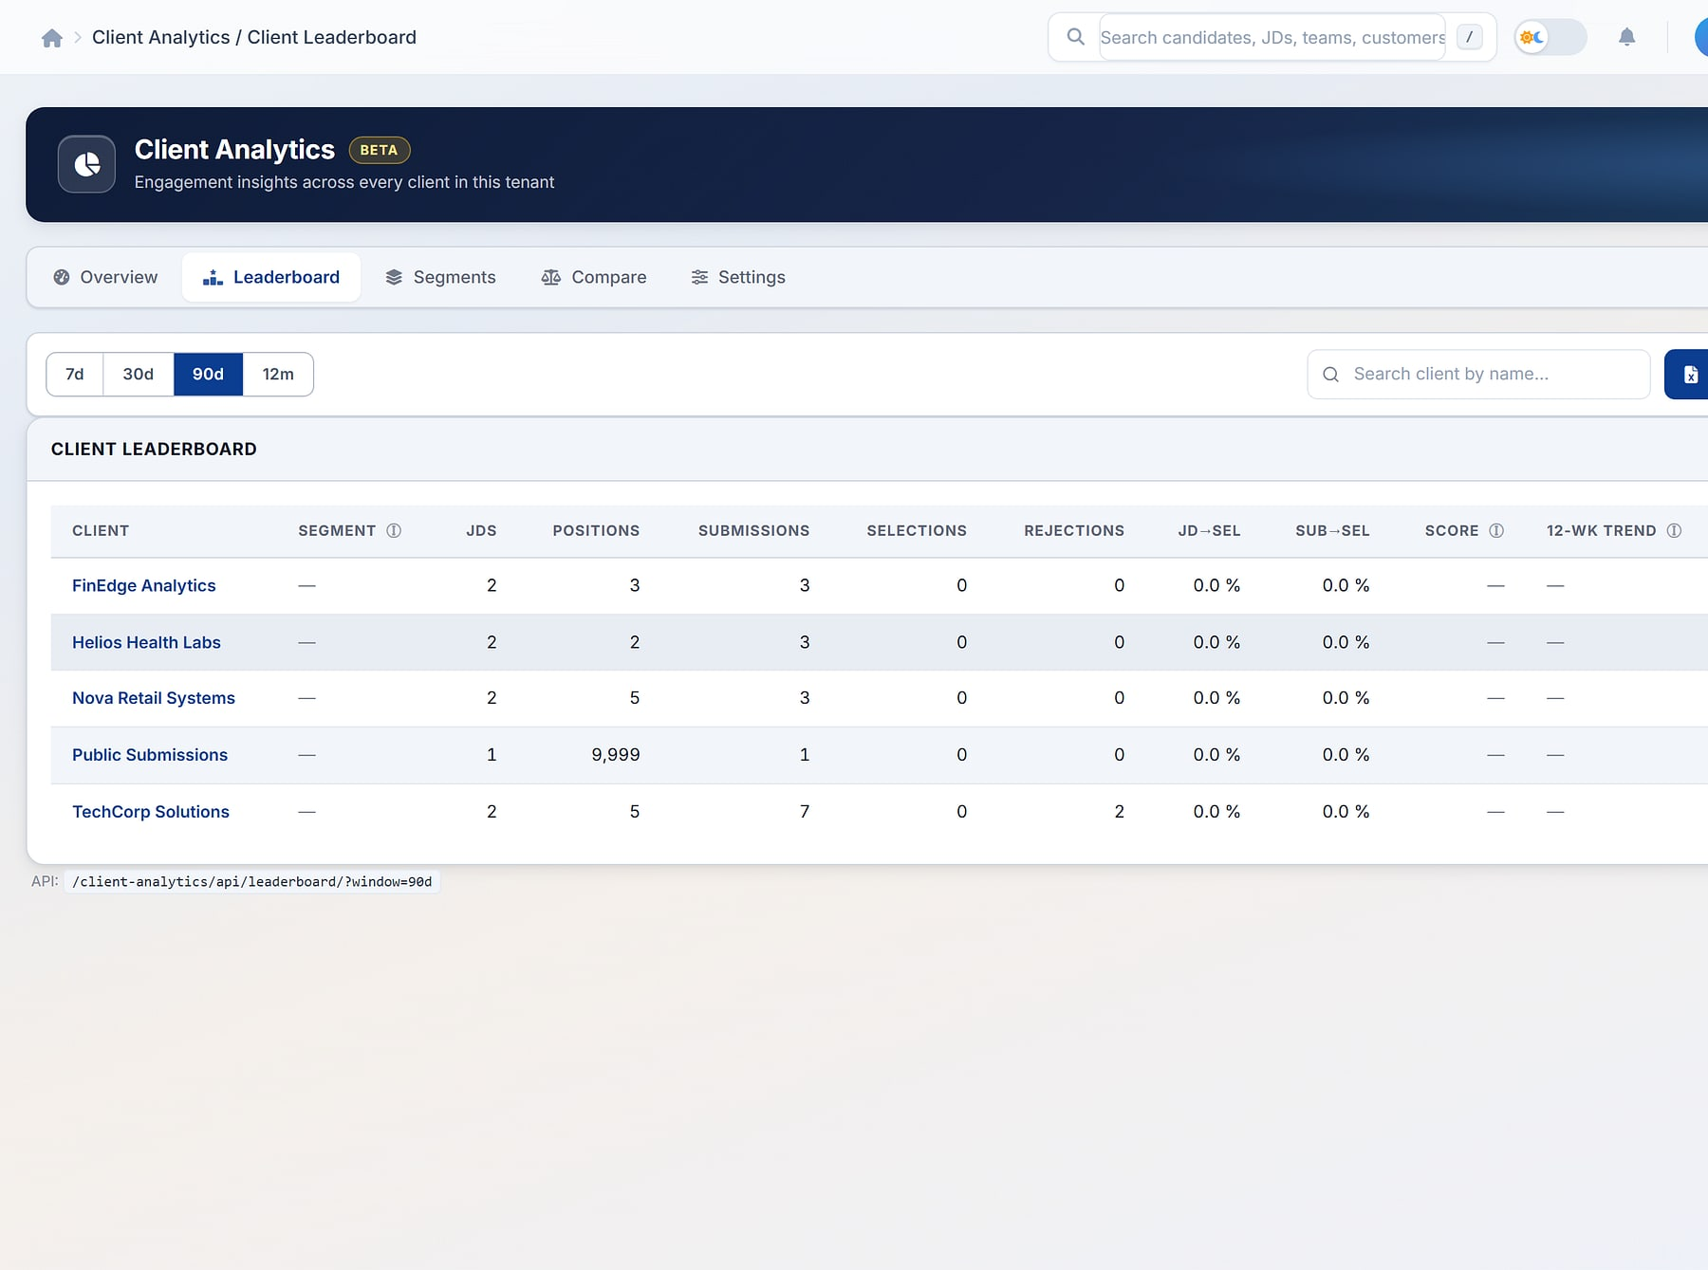
The pipeline always tells the truth
PROTONNXT · WORKFLOWS
ProtonNxt
1 Requisition
2 Source & AI parse
3 Track
4 Interview L1–L3
5 Offer & join
Manage candidate status
Candidate reports
Client analytics
Every stage visible
Answers that match the table
Clients to grow (beta)
Candidate status across L1, L2 and L3 per JD (demo data).
Executive summary over candidate reports (demo data).
Client engagement leaderboard and segments (demo data).
Notes:
Real ProtonNxt screens with demo data (approved deck slides 10, 17, 19). Sidebar cropped.

Slide 30




Structure, speed and evidence across every hire
PROTONNXT · WHY IT WINS
ProtonNxt
KEY DIFFERENTIATORS
BUSINESS VALUE
Structured intake and interviews shorten the path to hire
Clear ownership of every requisition and candidate
AI without lock-in
Agencies inside the process
OpenAI and Gemini parsing paths, with manual override.
Per-vendor caps, duplicate protection and separate vendor logins.
Vendor submissions that are measurable and deduplicated
Reports leaders trust, with saved templates and XLSX
BEST FIT
Recruitment firms serving many clients, and in-house talent teams that work with agency partners.
Client engagement analytics
One candidate portal
Scores and segments show which clients to grow (beta).
A single candidate login across every employer on ProtonNxt.
Multi-tenant SaaS
OpenAI · Gemini
MavionMeet video
Razorpay
ICS calendars
Notes:
From the approved ProtonNxt deck slides 14, 15, 19, 25 and 26. No time-to-hire percentages are claimed.

Slide 31

MavionLearn
PRODUCT SHOWCASE
ENTERPRISE LMS · SKILLS & COMPLIANCE
MavionLearn · Learning admin
Skills that compound: training that becomes provable capability
THE PROBLEM
OUR ANSWER
Finishing a course doesn't prove a skill, mandatory training is chased by hand, and leadership can't see what training spend returns.
A multi-tenant enterprise LMS that scores every employee against role targets, runs compliance on its own and reports in your brand, with identity built in.
12
SSO
30-day
integrated modules
OIDC · SAML · SCIM
all-features trial
BUILT FOR
L&D and HR · Compliance leads · IT & identity teams
Learning admin: enrolments, compliance and completions by department (demo data).
Notes:
MavionLearn sales positioning only; investor-deck content (market sizes, funding) is excluded.

Slide 32




Twelve modules across five capabilities
MAVIONLEARN · CAPABILITIES
MavionLearn
1 Set role targets
2 Score the gaps
3 Recommend courses
4 Complete & certify
5 Capability rises
Learn
Measure
Comply
Report
Govern
4 modules
1 module
1 module
2 modules
4 modules
Catalog & courses
On-demand learning
Live learning (ILT / VILT)
Learner experience
Skills & skill matrix
Development plans
Compliance campaigns
Certifications & renewals
Enterprise reporting
Cost & ROI
People & delegated admin
Identity & security
Standards & integrations
Platform console
Notes:
Module map from the approved MavionLearn deck slide 5; loop from slides 9 and 10.

Slide 33
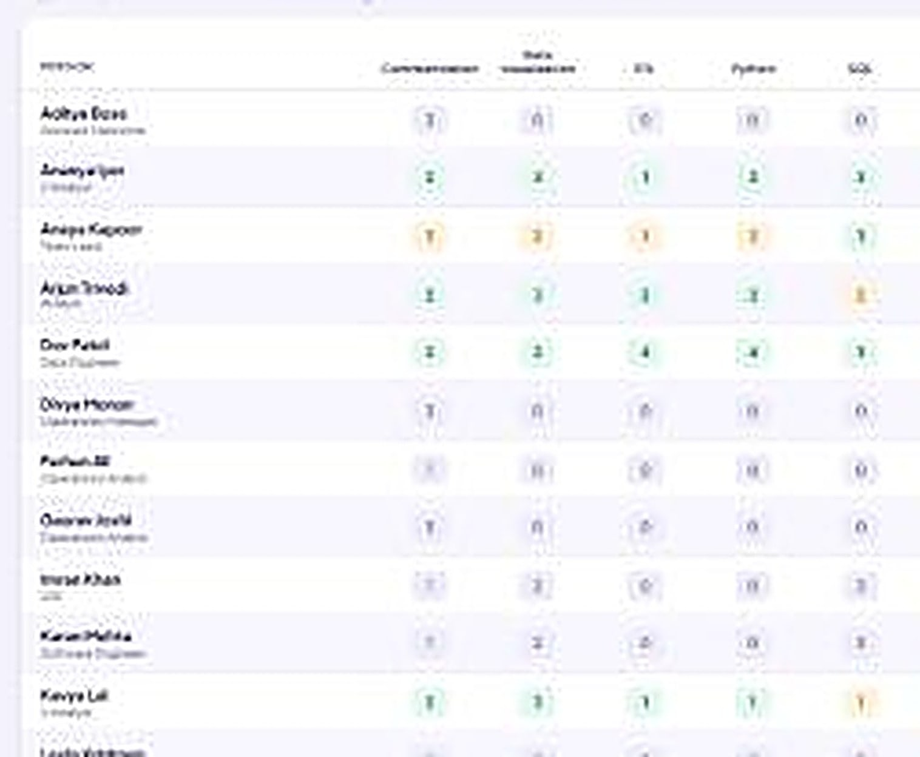
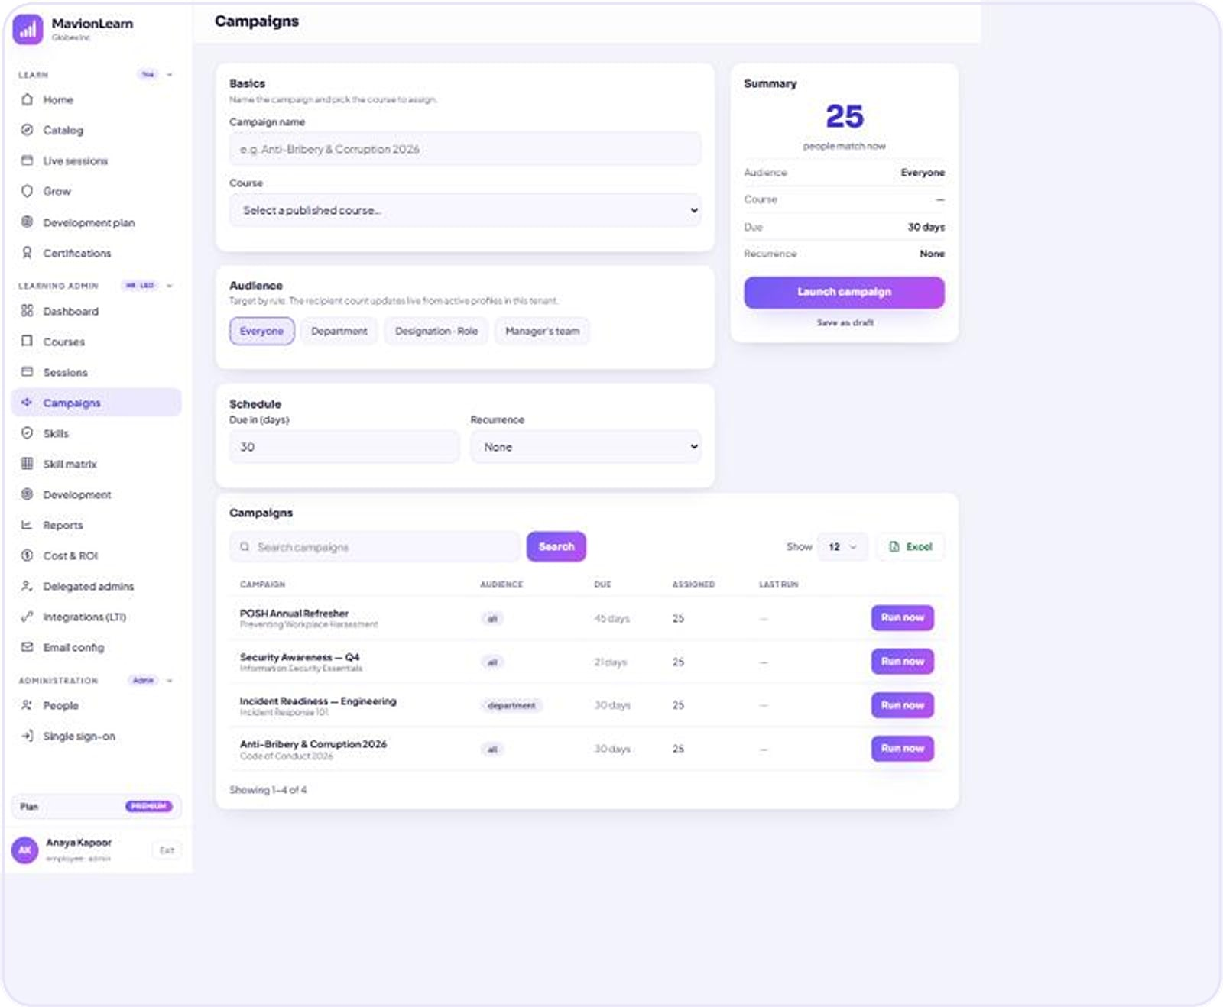
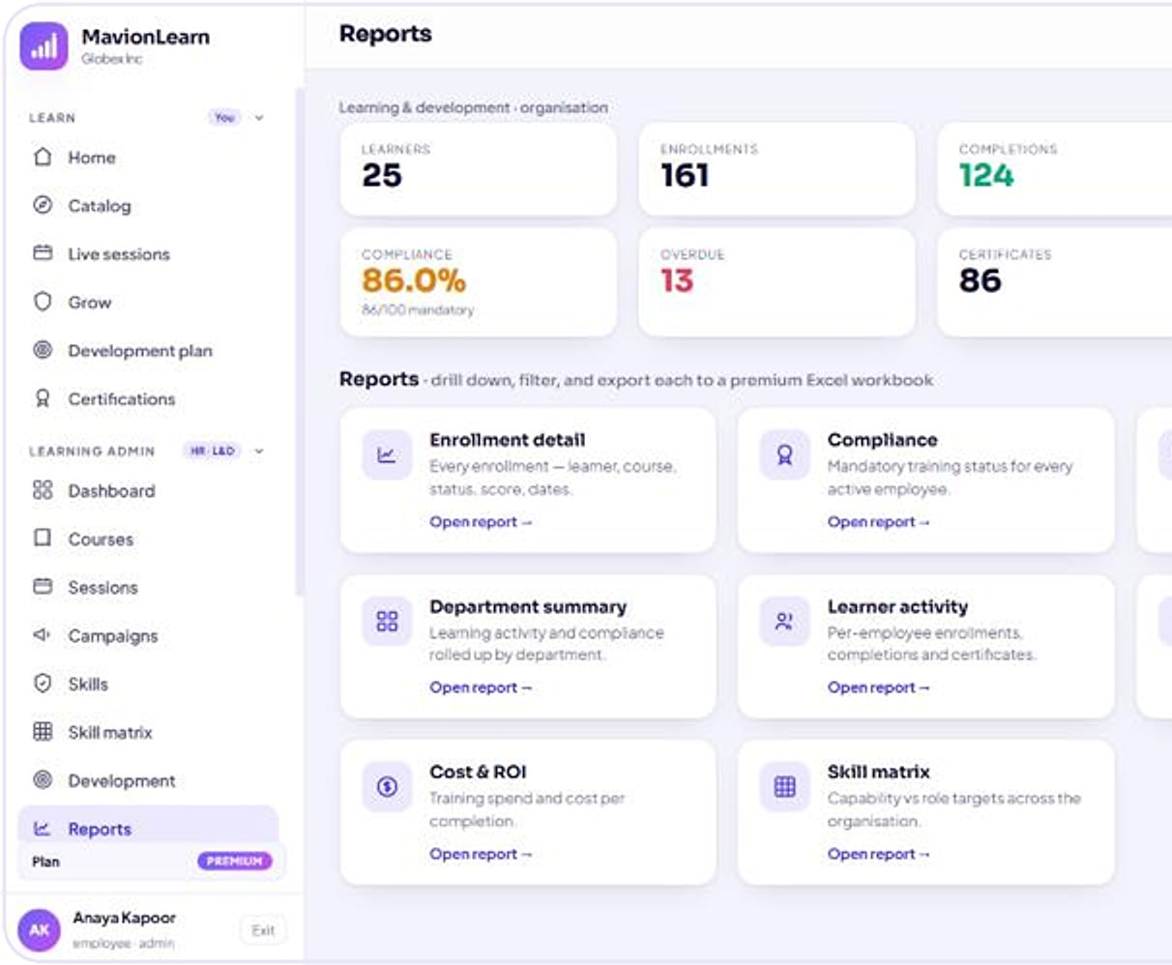
See capability, run compliance, report in your brand
MAVIONLEARN · WORKFLOWS
MavionLearn
Skill matrix
Campaigns
Reports
A living skill matrix
Compliance that runs itself
Board-ready reporting
Employees scored against role targets (demo data).
Campaign builder: audience, course, schedule and status (demo data).
Reports workspace: eight built-in report types (demo data).
Assign
Remind
Certify
Renew
Export in your brand
Notes:
Real MavionLearn screens with demo data (approved deck slides 9, 11, 13).

Slide 34



Others track completions; MavionLearn proves capability
MAVIONLEARN · WHY IT WINS
MavionLearn
KEY DIFFERENTIATORS
BUSINESS VALUE
Prove capability to leadership and auditors
Audit-ready evidence exported in one click
Capability, not completions
Compliance on autopilot
A living skill matrix scored against role targets.
Assign, remind, certify and renew automatically.
Board-ready Excel and PDF reports in your brand
Training spend and cost per completion visible
BEST FIT
Enterprises that must prove skills and compliance across large, distributed organisations.
Identity included
Isolated by design
OIDC, SAML 2.0 and SCIM in the product, not a paid add-on.
A dedicated database per customer, white-labelled.
SaaS · private cloud · on-prem
SCORM
LTI 1.3
OIDC · SAML · SCIM
Cloudflare R2 / S3
Notes:
From the approved MavionLearn deck slides 6, 17, 18, 19 and 21. Pricing tiers are being confirmed and are not shown.

Slide 35
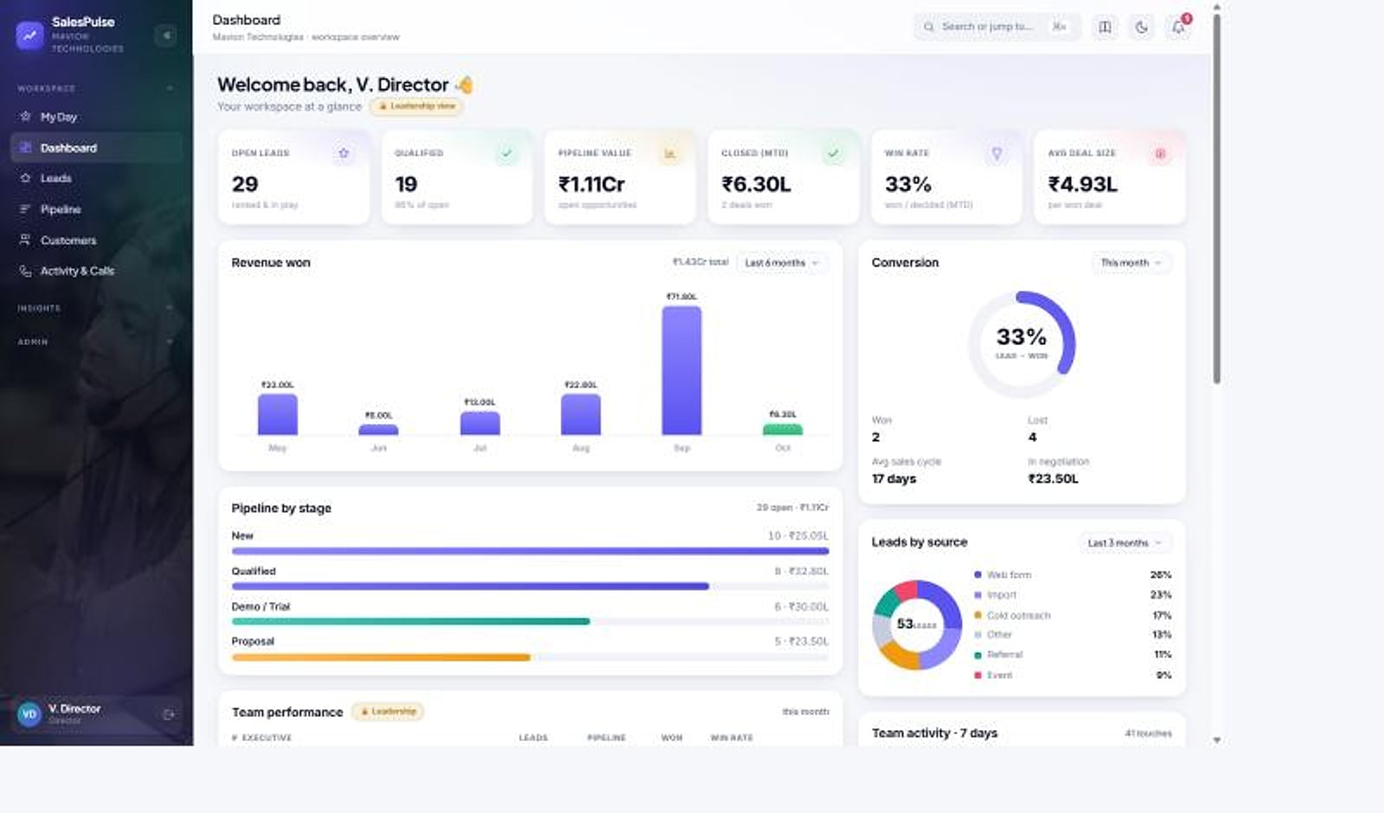
SalesPulse CRM
PRODUCT SHOWCASE
INDIA-FIRST SALES CRM
SalesPulse · Director dashboard
Your reps sell. Your customers' numbers stay yours.
THE PROBLEM
OUR ANSWER
Reps hold raw phone numbers, numbers are re-typed into spreadsheets, leaders lack live visibility, and global CRMs fit Indian billing poorly.
A multi-tenant sales CRM with privacy-masked calling, a live weighted pipeline and reports that build themselves, made for how Indian sales teams work.
14
2-way
GST
integrated modules
masked calling
invoicing built in
BUILT FOR
Indian sales teams · SMB & mid-market · Field and inside sales
Director dashboard: pipeline, closed value, conversion and lead sources (demo data).
Notes:
SalesPulse CRM: catalogue inclusion is still to be confirmed by MavionTech (open item); included here as an approved finalised product.

Slide 36




Fourteen modules in one sales command center
SALESPULSE CRM · CAPABILITIES
SalesPulse CRM
Sell
Engage
Lead
Protect & run
4 modules
3 modules
3 modules
4 modules
My Day
Leads
Pipeline
Customers & 360
Privacy-masked calling
Email & WhatsApp
Activity log & call journal
Command center
Report builder
Weekly reports
Data protection controls
Subscriptions & GST billing
Native Android app
Platform & multi-tenancy
Each company's data lives in its own database, and masking rules are enforced on the server for web, mobile and exports alike.
Notes:
Module map from the approved SalesPulse deck slide 6. 'Command Center' is the product's module name.

Slide 37
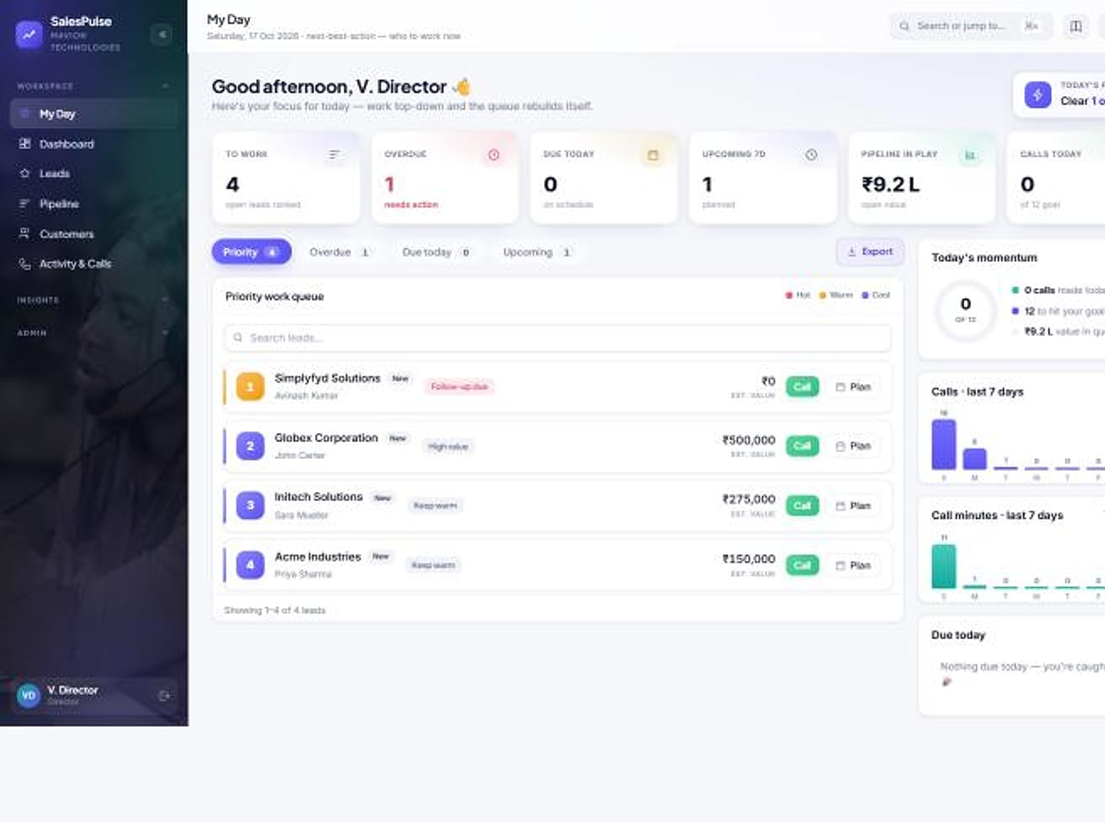
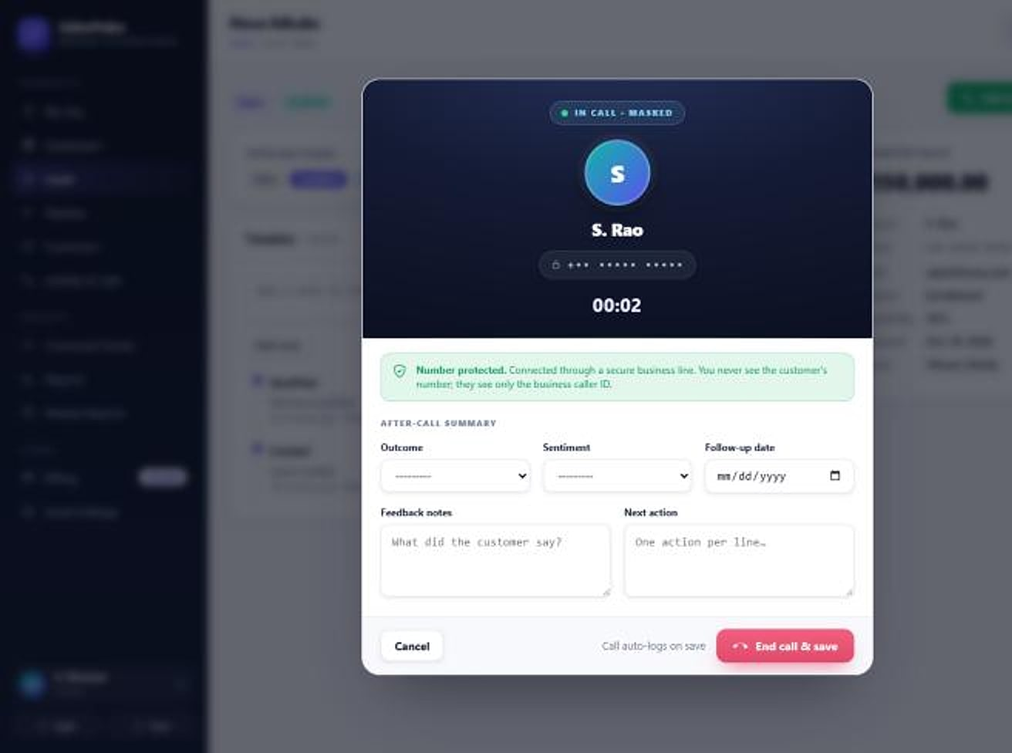
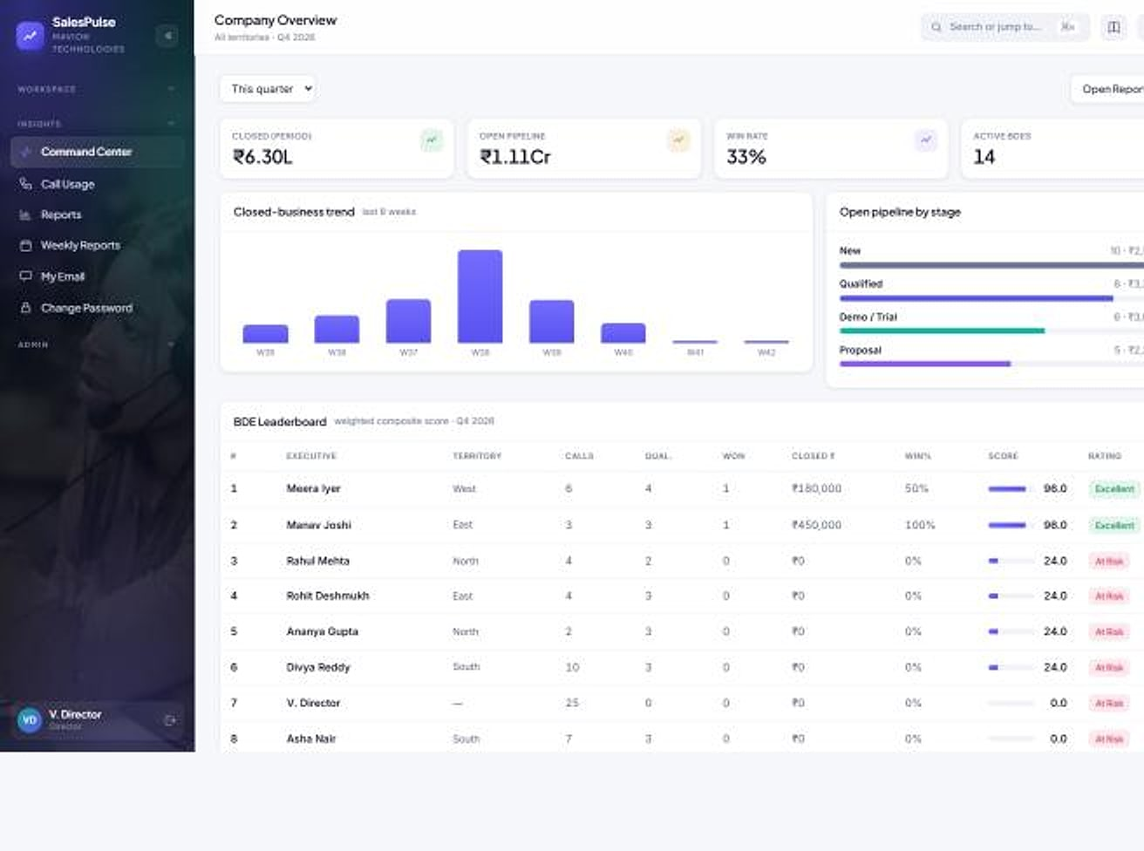
Your reps make the call. They never see the number.
SALESPULSE CRM · WORKFLOWS
SalesPulse CRM
1 My Day queue
2 Masked call
3 Outcome logged
4 Follow-up
5 Weekly report
My Day
Dialer
Command center
Start the day knowing who to call
The number stays masked
Leaders see it live
My Day: KPI strip and prioritised work queue (demo data).
In call: one-click connect; the real number is resolved server-side (demo data).
Command center: org KPIs, trend and leaderboard (demo data).
Notes:
Real SalesPulse screens with demo data (approved deck slides 7, 13, 16).

Slide 38




Privacy built in, visibility built up
SALESPULSE CRM · WHY IT WINS
SalesPulse CRM
KEY DIFFERENTIATORS
BUSINESS VALUE
Customer contacts stay with the company when reps leave
Leaders see pipeline and people in real time
Privacy-masked by default
No bulk export for reps
Phone and email masked on web, mobile and exports.
Lead-list and report downloads are leadership-only.
No re-typing of numbers into spreadsheets
Calling billed on actual usage, or bring your own telephony
BEST FIT
Indian sales teams whose customer relationships are their most valuable asset.
Reports that build themselves
India-first billing
Activity feeds the journal, command center and weekly reports.
INR, GST invoices and Razorpay built in.
Multi-tenant SaaS
Native Android app
Razorpay
WhatsApp Business
30-day free trial
Notes:
From the approved SalesPulse deck slides 18, 20, 22 and 23. Calling is ₹0.50 per leg-minute with a 30-second pulse; seat prices are confirmed in proposals.

Slide 39
Technology and delivery
04
IN THIS SECTION
Architecture and stack
Integrations
Security and governance
How our platforms are built, secured, deployed, implemented and supported.
Deployment, scale and customisation
Implementation and support
Notes:
Section 4 covers only verified technology facts from the product sources and maviontech.com.

Slide 40
One reference architecture, shared by every product
ARCHITECTURE AND STACK
EXPERIENCE
Web apps for every role · mobile apps · portals for parents, candidates and vendors · devices and gates
VERIFIED TECHNOLOGY BY PRODUCT
Agastya
Django 5.1 on Python · MySQL · Daphne ASGI and Channels · Redis · Expo / React Native
REQUEST PIPELINE
Authentication and session policy · tenant resolution · role and permission checks · audit logging · rate limits
PragyanNxt
Ed25519 signing · LTI 1.3 · AI visual proctoring · durable background jobs
Vortex HRMS
APPLICATION
Product modules · no-code configuration · workflow and approvals · real-time updates · background jobs
Django + Python · MySQL · InsightFace · Tailwind UI · REST APIs
ProtonNxt
Isolated MySQL per tenant · WebSockets · OpenAI / Gemini · HMAC-signed links
DATA
A control database for tenants, plans and billing, and one dedicated database per customer
MavionLearn
Isolated MySQL per tenant · Cloudflare R2 / S3 signed media · versioned API
The pattern is common to all six products; implementation details differ by product.
SalesPulse CRM
Own database per company · server-side masking · native Android
Notes:
Reference architecture generalised from the architecture slides of all six approved decks. Stack items only where the product source names them; no framework is attributed where the source does not state it.

Slide 41






Connects to the services your teams already use
INTEGRATION CAPABILITIES
Payments & billing
Agastya · ProtonNxt · SalesPulse
Messaging
Agastya · SalesPulse · ProtonNxt · PragyanNxt
Razorpay
Meta WhatsApp Cloud API · WhatsApp Business · Twilio SMS & Verify · SMTP email
Identity
MavionLearn
Learning standards
MavionLearn · PragyanNxt
OIDC · SAML 2.0 · SCIM 2.0 with JIT provisioning
SCORM · LTI 1.3 (Canvas, Moodle) · Open Badges
AI services
ProtonNxt · Vortex HRMS
Calendar & video
ProtonNxt · MavionLearn
OpenAI · Google Gemini · InsightFace
ICS invites · MavionMeet video interviews
Devices
Vortex HRMS
Data & exports
All products
Biometric terminals · access gates
REST and versioned APIs · webhooks · Excel (XLSX) · PDF
Notes:
Integrations named in the approved product decks only. These are technical integrations, not commercial partnerships.

Slide 42





Controls you can see in the product, not promises on a page
SECURITY AND GOVERNANCE
Isolation
Access control
Audit
A dedicated database per customer in all six products; no shared business tables.
Role-based access everywhere; 96 permission codes in Agastya; row-level access in SalesPulse.
Before/after audit trails, login events and append-only logs across sensitive workflows.
Sessions
Data protection
Signed artefacts
Lockout after failed logins, single active sessions, sliding HttpOnly sessions, IP policies.
Server-side masking of phones and emails; no bulk export for non-leaders; traceability watermarks.
Ed25519-signed credentials, HMAC-signed share links, signed media URLs and webhooks.
Certifications, uptime commitments and support hours are confirmed in each proposal and are not claimed in this catalogue.
Notes:
Every control is visible in a product screen or stated in a product source. ISO 27001, SOC 2, GDPR, 99.9% uptime and 24x7 support appear on the website and company PDF but are unevidenced and conflicting, so they are deliberately excluded.

Slide 43




Run it where you need it, grow it without re-platforming
DEPLOYMENT, SCALABILITY AND CUSTOMISATION
Deployment
Scalability
Customisation
Cloud SaaS, multi-tenant, for every product
New customers provisioned from platform consoles in minutes
Dashboard builders, custom fields and candidate schemas
Private cloud and on-premise for enterprise customers (MavionLearn, PragyanNxt)
A database per customer, so tenants scale independently
No-code workflows, approvals and escalations
Managed hosting, with backup and disaster recovery
Real-time layers and background jobs for heavy work
Feature toggles and module switches per customer
Web plus native mobile apps where field work needs them
Rate limits and quotas protect shared capacity
White-label branding on apps, exports and certificates
Notes:
Deployment options from maviontech.com (Platform page and Contact FAQ) and the approved decks. Scalability is described structurally; no capacity or performance figures are claimed.

Slide 44

A predictable path from first demo to go-live, and beyond
IMPLEMENTATION AND SUPPORT
ENGAGEMENT PATH
1 Demo
2 Pilot
3 Proposal
See the product on scenarios that match yours.
Prove value on your own data with one team or campus.
Scope, plan and commercials confirmed in writing.
IMPLEMENTATION METHOD
Discover
Configure
Validate
Go live
Requirements, process mapping, design and kickoff
Setup, configuration, integrations and data migration
User acceptance, performance testing and security review
Training, launch support, documentation and handover
Support and maintenance
One channel for sales and support: communications@maviontech.com · +91 91580 08002. Managed hosting with backup and disaster recovery, continuous product updates, and support hours and service levels agreed in each contract.
Indicative method from the MavionTech company profile; timelines are confirmed during scoping.
Notes:
Four phases from the MavionTech company profile (page 36). The '4–8 weeks' figure is a company target and is shown only as indicative in the notes, not as a commitment. Support contact from maviontech.com; managed hosting and backup/DR from the Platform page.

Slide 45
Business and investment
05
IN THIS SECTION
Portfolio strategy
Achievements and ambitions
Product-market opportunities
Our portfolio strategy and the opportunities ahead, with achievements and ambitions kept clearly apart.
Commercial models
Partnerships, growth and direction
Notes:
Section 5 is written for partners and investors as well as customers. It makes no claims about revenue, customers, market size or valuation.

Slide 46


Vertical depth on a shared foundation
PORTFOLIO STRATEGY
Vertical depth
Shared foundation
Each product is a complete system for one buyer, not a module of a generic suite: schools, HR, recruitment, learning, assessment and sales.
Isolation, access control, audit, configuration and billing patterns are reused across products, so each new product starts further ahead.
India-first fit
Multi-product accounts
Statutory payroll, GST, INR pricing and local payment and messaging rails are built in rather than added later.
Natural pairings let one customer grow across products: assessment in hiring, certification in learning, learning beyond HR.
Endorsed-brand model: every product keeps its own name and accent, and every product carries the same MavionTech standard.
Notes:
Strategy from the Portfolio Positioning Strategy, sections 4 to 7.

Slide 47


What exists today, and what we are working towards
ACHIEVEMENTS AND AMBITIONS
ACHIEVED · EVIDENCED
AMBITION · NOT YET ACHIEVED
Launched as an independent product company in 2025
Roadmap features: online fee payment, payroll and live bus tracking in Agastya; engagement surveys, benefits and BI in Vortex
Six enterprise platforms with working product screens, shown in this catalogue
Evidence for uptime, support-hour and certification statements
Multi-tenant consoles that provision customers with a dedicated database
Channel, implementation and technology partnerships
Mobile apps in four products: Agastya, Vortex, ProtonNxt, SalesPulse
Deeper connections between products, beyond today's pairings
Agastya codebase: 19 apps, 128 data models, 257 automated tests (Nov 2026 review)
A complete published catalogue covering the wider MavionTech portfolio
Published Vortex list prices and live trials for four products
No revenue, customer counts, market size or valuation are stated: none is evidenced for external use.
Notes:
Achievements: maviontech.com milestones; the six approved decks; Agastya source review November 2026; Vortex published list prices; trials for MavionLearn (30 days), PragyanNxt (14), SalesPulse (30) and Vortex (30). Ambitions: labelled roadmap slides in the Agastya and Vortex decks, and the open items in PROJECT_STATUS.

Slide 48
Where each product meets a clear buying trigger
PRODUCT-MARKET OPPORTUNITIES
PRODUCT
SEGMENT
BUYING TRIGGER
OUR ANSWER
Agastya
School groups digitising operations
Registers, spreadsheets and chat groups across campuses
Replace fragmented tools with one governed system
PragyanNxt
Organisations that must defend results
Remote hiring tests and certificates that are questioned
Integrity scoring and verifiable credentials
Vortex HRMS
Employers paying people correctly
Attendance-to-payroll reconciliation and statutory change
One record from attendance to payslip
ProtonNxt
Firms that recruit for many clients
Hiring spread over inboxes, sheets and agencies
A structured, AI-assisted pipeline with client insight
MavionLearn
Enterprises that must prove skills
Audits and leadership asking for evidence of capability
Skill matrix and self-running compliance
SalesPulse CRM
Sales teams protecting customer data
Reps leaving with contacts; numbers re-typed by hand
Masked calling and reports that build themselves
Notes:
Opportunities are expressed as buyer triggers taken from each product's problem slides. Market sizes are deliberately not used: the only figures available (for example in the MavionLearn investor deck) are investor-only and need full citation.

Slide 49
Recurring subscription revenue, priced the way each buyer buys
COMMERCIAL MODELS
Per employee, per month, by module
Established
Per user, per month, annual billing
Established model
Published list prices: ₹45 base; modules from ₹9 to ₹55; GST extra.
INR pricing with volume discounts; tier matrix being confirmed.
Platform tiers by assessment volume
Established model
Per seat, plus calling by usage
Established model
Basic 500, Plus 5,000, Pro 25,000 assessments a month; AI credits and proctoring capacity added as needed.
Plans by seats and lead quota; calling ₹0.50 per leg-minute, or bring your own telephony.
Subscription plans per school
Model in product
Subscription plans per tenant
Model in product
Plans, renewals and billing managed in the platform console; prices on proposal.
Subscription lifecycle and Razorpay billing inside the product; prices on proposal.
Services alongside subscriptions: implementation, data migration and managed hosting.
Prices shown are those already published in approved materials; all others are confirmed in each proposal.
Notes:
Revenue models as established in the approved decks. No revenue figures are stated. Services listed are offered on maviontech.com (managed hosting) and in the company implementation method.

Slide 50



Where we invite partners to grow with us
PARTNERSHIPS, GROWTH AND FUTURE DIRECTION
PARTNERSHIP MODELS WE ARE OPEN TO
FUTURE PRODUCT DIRECTION
Channel partners
From labelled product roadmaps: planned, not yet available
Resell and refer MavionTech products in your region or vertical.
Agastya
Online fee payment, payroll, multi-channel broadcast, scheduled reports, live bus tracking, teacher and parent apps
Implementation partners
Deliver configuration, migration and training for customers.
Vortex HRMS
Engagement surveys, benefits administration, advanced BI, native manager app; later predictive analytics and an app marketplace
Technology partners
Integrate your service with our platforms through APIs and webhooks.
MavionLearn
No partnerships are announced in this catalogue. Integrations listed earlier are technical, not commercial.
Mobile learning experience, building on today's versioned API
Notes:
Partnership models are invitations, not existing agreements. Roadmap items from the labelled roadmap slides of the Agastya and Vortex decks (PragyanNxt, ProtonNxt and SalesPulse publish no roadmap, so none is shown); the MavionLearn mobile app is listed as planned in the Portfolio Strategy (API for mobile, app planned).

Slide 51





Six reasons to build on MavionTech
WHY MAVIONTECH
01
02
03
Real products, shown as they are
Your data in its own database
Governed by design
Every screen in this catalogue is a real product capture with demo data.
Isolation by design in all six products, not a filter on shared tables.
Role-based access, audit trails and session controls you can inspect.
04
05
06
Configurable without code
Built for how India does business
One partner, six platforms
Administrators shape dashboards, fields, workflows and branding.
GST, statutory payroll, INR pricing and local messaging rails.
One engineering standard and one point of contact across the portfolio.
Notes:
Each reason is backed by earlier slides: screens (section 3), isolation and governance (section 4), configuration (technology capabilities), India-first fit (categories and commercial models).

Slide 52

Momentum for your operations. Vision for what comes next.
LET'S BUILD MOMENTUM TOGETHER
MavionTech Pvt. Ltd.
Enterprise Business Applications
SALES & SUPPORT
communications@maviontech.com
PHONE
+91 91580 08002
Choose a platform, see it on your own data, and start with a pilot. Partners and investors: request a portfolio briefing.
CAREERS
hr@maviontech.com
WEB
www.maviontech.com · www.vortexhrms.com
Book a demo
Request a briefing
OFFICE
Office 505, Zen Business Center, Bhumkar Chowk, Wakad, Pune, Maharashtra 411057 (visits by appointment)
Notes:
All contact details from maviontech.com (Contact page and footer). Social media links are not shown because none were verified on the official website during the audit.

