Slide 1
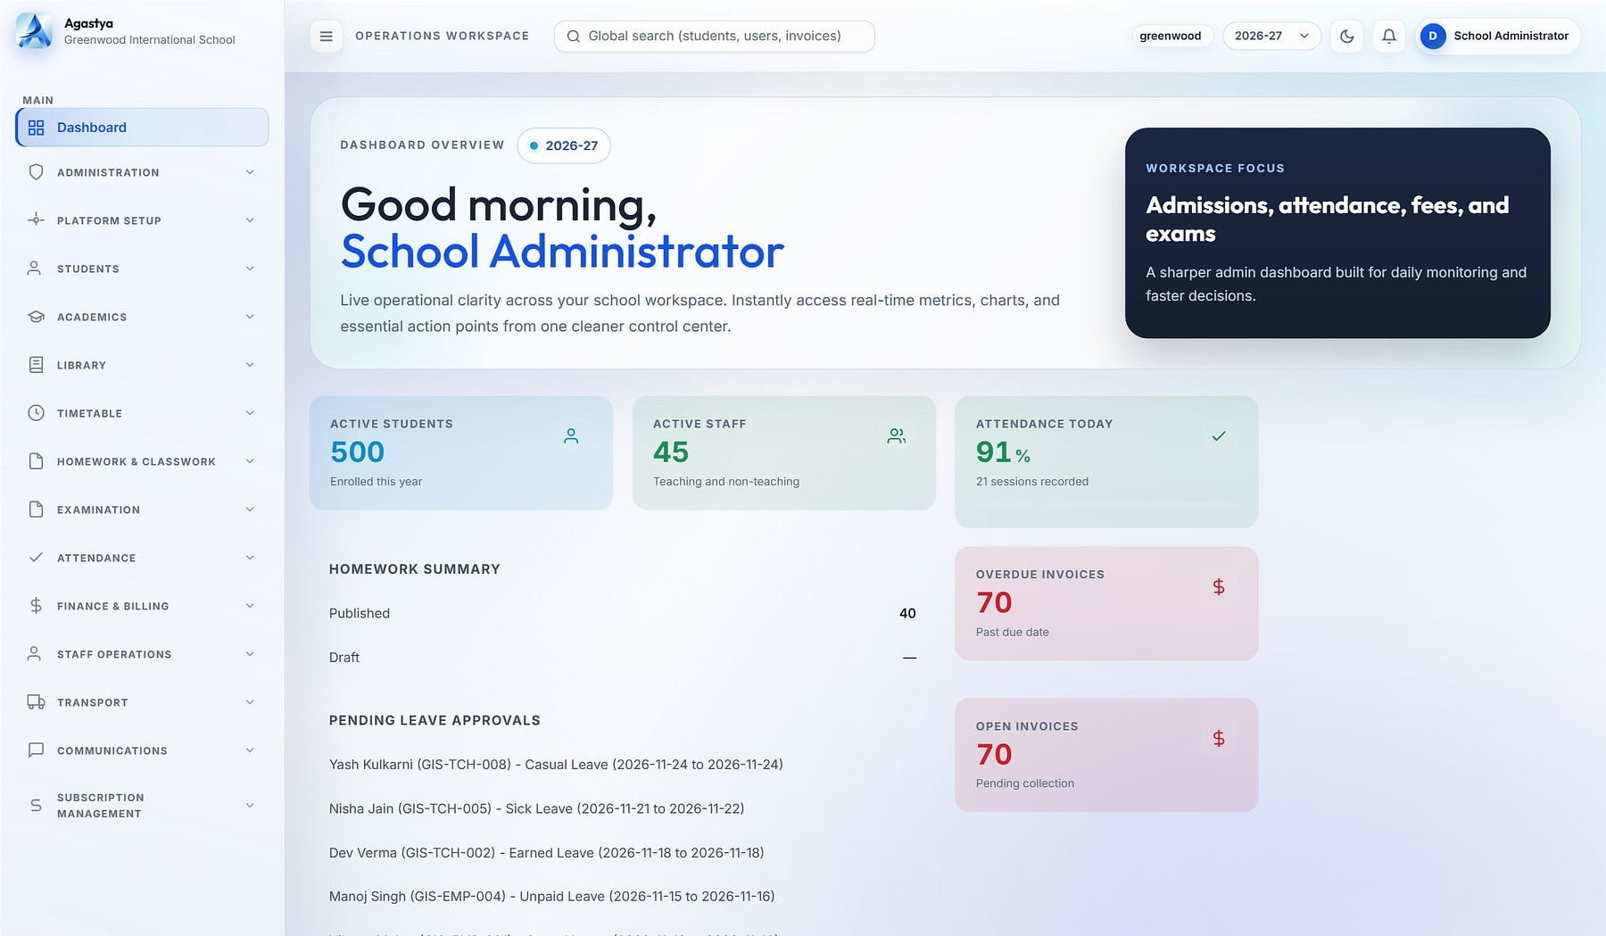
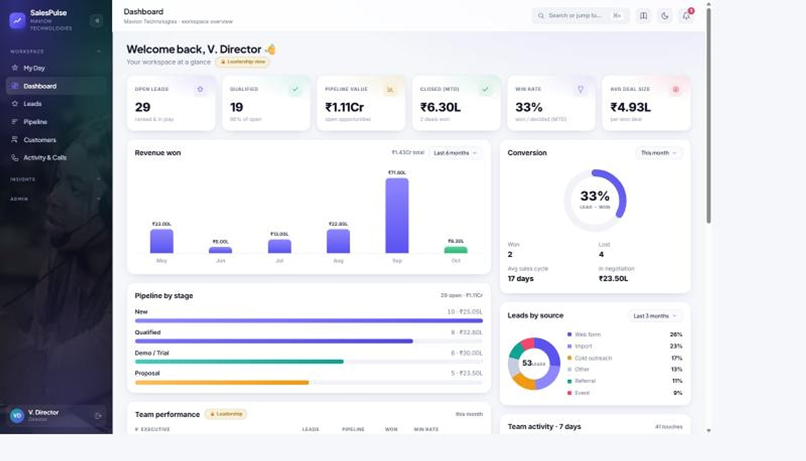
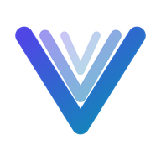


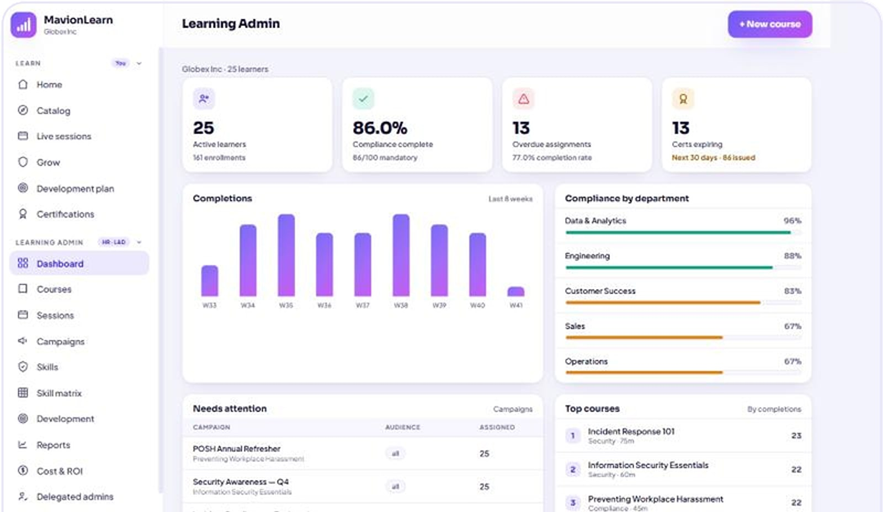





Eight platforms. One standard of engineering.
Agastya · Cloud School ERP
CORPORATE PRODUCT CATALOGUE · 2026
SalesPulse CRM
Enterprise business applications for education, people, talent, revenue, commerce and AI-assisted work.
Vortex HRMS
ProtonNxt
PragyanNxt
Agastya
MavionLearn
SalesPulse CRM
HeeLIKS
Vyaas AI
Notes:
Corporate cover. Product screens shown are real product captures with demo data. Tagline 'Momentum with Vision' and descriptor 'Enterprise Business Applications' are from maviontech.com.

Slide 2
Eight platforms at a glance, led by four flagship products
CATALOGUE BRIEF
Vortex HRMS
Page 15 →
ProtonNxt
Page 19 →
FLAGSHIP · READY
FLAGSHIP · READY
Unified People Platform · People & Talent
Enterprise ATS · People & Talent
People platform for HR, Face-AI attendance, leave, policy-driven payroll and employee self-service, on one record.
AI-assisted applicant tracking for recruitment firms and talent teams, from requisition and sourcing to offer and joining.
PragyanNxt
Page 23 →
Agastya
Page 26 →
FLAGSHIP · READY
FLAGSHIP · READY
Assessment & Certification · Education
Cloud School ERP · Education
Author, deliver, proctor, score and certify assessments, with an integrity score and a verifiable credential for every result.
Multi-tenant cloud ERP that runs admissions, academics, fees, transport and parent communication for every school in a group.
MavionLearn
Page 31 →
SalesPulse CRM
Page 35 →
READY · AVAILABLE
READY · AVAILABLE
Enterprise LMS · Skills & Compliance · People & Talent
India-first Sales CRM · Revenue
Enterprise LMS that scores skills against role targets, runs compliance on its own and reports in your brand.
India-first sales CRM with privacy-masked calling, a live pipeline, GST billing and reports that build themselves.
HeeLIKS
Page 39 →
Vyaas AI
Page 44 →
READY · AVAILABLE
PREMIUM · FUTURE
Inventory, POS & Distribution · Commerce & Operations
Enterprise AI Assistant · AI & Productivity
Inventory, point of sale and B2B order-to-cash on one stock ledger, GST-ready, with a database for each customer.
Enterprise AI assistant: cited answers over your own knowledge, finished documents and a coding agent that opens pull requests.
Notes:
Catalogue brief (vNext): the eight products, including HeeLIKS and Vyaas AI added in the portfolio expansion. Status badges per MavionTech instruction (10 Nov 2026): Vortex HRMS, ProtonNxt, PragyanNxt and Agastya are the flagship products ready today; MavionLearn, SalesPulse CRM and HeeLIKS are ready, tested and available; Vyaas AI is a premium product envisioned for the future. with their marks and one-line descriptions drawn from the approved decks. Page references point to each product's showcase opener.

Slide 3
An Indian product company for enterprise applications
ABOUT MAVIONTECH
COMPANY
MavionTech Private Limited
OUR JOURNEY
2023
Training foundation
HEADQUARTERS
Wakad, Pune, Maharashtra, India
Began as a training initiative under Sukrit EnVision Academy.
WHAT WE BUILD
Enterprise business applications
2024
Shift to product development
The team moved from training to building software products.
BRAND PROMISE
Momentum with Vision
2025
Independent product company
Launched as MavionTech, an independent product company.
PORTFOLIO
Seven products ready today, four of them flagship; Vyaas AI to come
Today
Eight enterprise platforms
Education, people, talent, revenue, commerce and AI products, each shown here with real screens.
Notes:
All facts from maviontech.com (footer, About and Company pages, inspected 10 Nov 2026). Milestones are the company's own published timeline. No employee, customer or revenue figures are stated because none are evidenced.

Slide 4



We build the systems that run an organisation's daily operations
COMPANY INTRODUCTION
“
What we build
Complete platforms for schools, HR and payroll, recruitment, learning, assessment, sales, retail and distribution, and AI at work.
MavionTech builds enterprise business applications where every customer's data lives in its own database, and every operation is role-governed, audited and configurable without code.
How we build
Workflow-first and multi-tenant. Production-grade UX, predictable performance and maintainable integrations, as our promise states.
Who we build for
Each part of this statement is demonstrated by at least seven of our eight products; Vyaas AI scopes data per organisation.
Staffing and HR, IT companies, EdTech, consulting firms, finance and service providers, and MSMEs.
Notes:
The corporate line is from the Portfolio Positioning Strategy (section 5) and is evidenced across the eight product decks (the database-per-customer part holds for seven; Vyaas AI is organisation-scoped). Verticals are from the maviontech.com home page. The promise wording is from the Company page.

Slide 5



Where we are going, and how we get there
VISION AND MISSION
VISION
MISSION
PROMISE
Create intelligent digital ecosystems that help teams move faster, make better decisions, and transform the way organizations operate.
Automate and simplify operational workflows with secure, extensible enterprise software that empowers teams to focus on what matters most.
Production-grade UX, predictable performance, and maintainable integrations — built for real teams solving real problems.
Source: maviontech.com, Company page. Quoted as published.
Notes:
Vision, mission and promise are quoted verbatim from the maviontech.com Company page (verified 10 Nov 2026). The older company PDF uses different wording; the website version is the current official statement.

Slide 6






Six engineering principles, proven across the portfolio
TECHNOLOGY FOCUS
Database per customer
Role-governed and audited
Configurable without code
Seven products give each customer its own database; Vyaas AI scopes data per organisation.
Role-based access and audit trails across sensitive actions, in every product.
Dashboards, fields, workflows, policies and branding are set by administrators.
India-first commercial fit
Mobile where work happens
AI where it helps
INR, GST, GSTR-1, statutory payroll, CTC structures and local payment rails.
Student, recruiter, sales and employee apps for people away from a desk.
Question generation, résumé parsing, proctoring, face recognition, cited AI answers and a coding agent.
Dots show which products demonstrate each principle, in order: Vortex HRMS · ProtonNxt · PragyanNxt · Agastya · MavionLearn · SalesPulse CRM · HeeLIKS · Vyaas AI.
Notes:
Evidence: Portfolio Positioning Strategy section 5 and the eight approved product decks. HeeLIKS and Vyaas AI are web only (no native app). Vyaas AI: cited answers (BM25 retrieval) and a sandboxed coding agent. HeeLIKS has no AI and none is claimed. Mobile: Agastya student app, Vortex VortexGo and SnapLens, ProtonNxt recruiter app, SalesPulse Android app. AI: PragyanNxt generation, summaries and visual proctoring; ProtonNxt OpenAI/Gemini parsing; Vortex InsightFace attendance.

Slide 7
The operational problems customers bring to us
BUSINESS PROBLEMS WE ADDRESS
THE PROBLEM
WHERE IT SHOWS UP
ANSWERED BY
Operations run on registers, spreadsheets and chat groups
Nothing reconciles and every report is assembled by hand.
Vortex HRMS
Agastya
Customer and candidate data walks out with staff
Raw numbers and CVs sit in personal phones and inboxes.
ProtonNxt
SalesPulse CRM
Training that cannot prove capability
Completions are counted; skills and compliance are guessed.
MavionLearn
Assessments and certificates that can be disputed
Unsupervised exams and forgeable PDFs undermine trust.
PragyanNxt
Manual reconciliation between operations and finance
Attendance to payroll, fees to invoices, every cycle.
Vortex HRMS
Agastya
Leaders waiting days for the numbers
Visibility arrives after the decision was needed.
Agastya
MavionLearn
SalesPulse CRM
Stock, sales and GST books that never agree
Spreadsheet stock, a separate till, monthly GST rebuilds.
HeeLIKS
AI pilots that cannot be trusted, governed or shipped
Uncited answers, data in consumer tools, no audit or budget.
Vyaas AI
Notes:
Problems are taken from the problem slides of the eight approved product decks. No market statistics are used; the company PDF figures (for example $1.8T, 73%) are uncited and excluded under the claims policy.

Slide 8
The product ecosystem
02
IN THIS SECTION
Portfolio overview
Ecosystem map
Product categories
Eight platforms across five buyer domains, sharing one engineering foundation.
Technology capabilities
Industries and segments
Notes:
Section 2 opens the portfolio view before the product showcases.

Slide 9
Eight platforms: seven ready today, four of them flagship
PORTFOLIO OVERVIEW
Vortex HRMS
ProtonNxt
PragyanNxt
Agastya
Unified People Platform
Enterprise ATS
Assessment & Certification
Cloud School ERP
FLAGSHIP · READY
FLAGSHIP · READY
FLAGSHIP · READY
FLAGSHIP · READY
Hire to retire. Attendance to payroll. On one record.
From requisition to hire, in one structured pipeline
Results you can defend. Credentials anyone can verify.
One operating system for every school in your group
BEST FOR
BEST FOR
BEST FOR
BEST FOR
HR, payroll and field workforces
Recruitment firms and talent teams
Hiring teams and academic institutions
K-12 school groups and single schools
MavionLearn
SalesPulse CRM
HeeLIKS
Vyaas AI
Enterprise LMS · Skills & Compliance
India-first Sales CRM
Inventory, POS & Distribution
Enterprise AI Assistant
READY · AVAILABLE
READY · AVAILABLE
READY · AVAILABLE
PREMIUM · FUTURE
Skills that compound: training that becomes provable capability
Your reps sell. Your customers' numbers stay yours.
Run your entire store on one platform.
Answers you can cite. Code you can ship.
BEST FOR
BEST FOR
BEST FOR
BEST FOR
L&D, HR and compliance leaders
Indian sales organisations
Outlets and distributors that sell from stock
Engineering and knowledge teams
Notes:
Promises are the approved cover lines of each product deck. Order follows MavionTech's product order (flagships first): People & Talent (Vortex HRMS, ProtonNxt, MavionLearn), Education (PragyanNxt, Agastya), Revenue (SalesPulse CRM), Commerce & Operations (HeeLIKS), AI & Productivity (Vyaas AI). HeeLIKS and Vyaas AI promises are the cover lines of their approved decks.

Slide 10



Five buyer domains on one shared foundation
ECOSYSTEM MAP
People & Talent
Education
Vortex HRMS
ProtonNxt
MavionLearn
PragyanNxt
Agastya
Unified People Platform
Enterprise ATS
Enterprise LMS · Skills & Compliance
Assessment & Certification
Cloud School ERP
Revenue
Commerce & Operations
AI & Productivity
SalesPulse CRM
HeeLIKS
Vyaas AI
India-first Sales CRM
Inventory, POS & Distribution
Enterprise AI Assistant
Natural pairings (positioning, not built integrations): PragyanNxt + ProtonNxt for screening in hiring · PragyanNxt + MavionLearn for verifiable certification · MavionLearn as the upgrade from Vortex Learning
SHARED MAVIONTECH FOUNDATION
Tenant isolation
Role-based access & audit
No-code configuration
INR, GST & Razorpay
Platform consoles
APIs & integrations
Notes:
Domains and pairings from the Portfolio Positioning Strategy, sections 6 and 10, extended with two new domains for HeeLIKS (Commerce & Operations) and Vyaas AI (AI & Productivity). The pairings are cross-sell positioning only; no product-to-product integration is claimed, and none is proposed for the two new products. 'Tenant isolation' covers a database per customer (seven products) and organisation scoping (Vyaas AI). 'Mobile & APIs' became 'APIs & integrations' because HeeLIKS and Vyaas AI are web only.

Slide 11
How the portfolio is organised
PRODUCT CATEGORIES
PRODUCT
DOMAIN
CATEGORY
PRIMARY BUYER
DELIVERY
PRICING
Vortex HRMS
People & Talent
HRMS, attendance & payroll
CHRO, payroll and finance
Multi-tenant cloud + apps
Per employee per month, by module
ProtonNxt
People & Talent
Applicant tracking (ATS)
Staffing firm owners, TA heads
Multi-tenant SaaS
Subscription plans in platform console
PragyanNxt
Education
Assessment, proctoring & certification
Hiring heads, exam controllers
SaaS · private cloud · on-prem
Platform tiers by assessment volume
Agastya
Education
School ERP (K-12)
School group heads, principals
Multi-tenant SaaS
Subscription plans in platform console
MavionLearn
People & Talent
Enterprise LMS, skills & compliance
CHRO, L&D and compliance
SaaS · private cloud · on-prem
Per user per month, annual billing
SalesPulse CRM
Revenue
Sales CRM
Sales directors, business owners
Multi-tenant SaaS + Android
Per seat, plus calling by usage
HeeLIKS
Commerce & Ops
Inventory, POS & B2B order-to-cash
Outlet owners, distributor MDs
Multi-tenant SaaS · on-prem licence
Plans per workspace; perpetual licence
Vyaas AI
AI & Productivity
Enterprise AI assistant & coding agent
CTO, Head of Engineering, IT
SaaS · self-hosted on your server
Per user or seat; INR or USD
ALSO IN THE MAVIONTECH PORTFOLIO
Signet · Visitor Management · MavionMeet · Serene · Project Management Planning · Trackline · Inward Logistics · Vanguard · C2H Resource Management. Briefings on request.
Notes:
Commercial models as stated in each approved deck; prices themselves are only published for Vortex (list) and PragyanNxt (allowances). The 'also in the portfolio' names are listed on maviontech.com and in the company profile; their detail has not been verified for this catalogue, so names only. HeeLIKS prices are published in its approved deck (plans per workspace and a perpetual on-premise licence); Vyaas AI publishes per-user and per-seat plans in INR and USD. Open item: confirm whether 'Inward Logistics' or 'Trackline' overlap with HeeLIKS.

Slide 12
Shared capabilities, implemented for each buyer
TECHNOLOGY CAPABILITIES
Vortex HRMS
ProtonNxt
PragyanNxt
Agastya
MavionLearn
SalesPulse CRM
HeeLIKS
Vyaas AI
Customer isolation
Database per customer
Database per tenant
Database per organisation
Database per school
Database per tenant
Database per company
Database per tenant, fail-closed
Organisation-scoped data
Access & audit
Role-based access; audit logging
RBAC; append-only audit
RBAC; activity logging
96 permission codes; before/after audit
Delegated admins; audit
Row-level access; access log
Enforced 2FA; field-level audit
Owner, Admin, Member; org audit log
Configuration
No-code workflows; module toggles
Custom schema; scoring weights
Plans and entitlements
Dashboard builder; feature toggles
SSO policy; campaigns
Report builder; quotas
Outlet types; role discount caps
Org policies; custom assistants
India-first fit
PF, ESI, PT, TDS
CTC structure (PF, gratuity)
INR pricing option
INR, UPI, TC / Bonafide
INR pricing
GST invoices; Razorpay
GST, GSTR-1, HSN; Tally import
INR or USD; GST at checkout
Mobile
VortexGo, SnapLens
Recruiter app
—
Student app (Expo)
Responsive web
Native Android app
Responsive web
Responsive web
Branded output
Payslips; 42 letter types
Multi-sheet XLSX
Report PDFs; certificates
Report cards; invoices
Excel and PDF in your brand
Multi-sheet Excel
Branded Excel; A4 and thermal
Word, PowerPoint, Excel from chat
AI
Face-AI attendance
OpenAI / Gemini parsing
Generation; summaries; visual proctoring
—
—
—
—
Claude + OpenAI; cited RAG; coding agent
Notes:
Matrix from the Portfolio Positioning Strategy section 5, aligned with the approved decks. Columns follow MavionTech's product order: Vortex HRMS, ProtonNxt, PragyanNxt, Agastya, MavionLearn, SalesPulse CRM, HeeLIKS, Vyaas AI. HeeLIKS and Vyaas AI cells come from their approved decks (code-verified). A dash means not offered or not evidenced.

Slide 13


Where our products fit
INDUSTRIES AND CUSTOMER SEGMENTS
INDUSTRIES WE SERVE
SEGMENT AND PRODUCT
Staffing & HR
IT companies
Vortex HRMS
Organisations with HR, payroll and field or shift workforces
ProtonNxt
Recruitment and staffing firms; enterprise talent teams
EdTech & education
Consulting firms
PragyanNxt
Corporate hiring and L&D teams; colleges and certification bodies
Agastya
K-12 school groups, chains and single schools
Finance & service providers
MSMEs
MavionLearn
Enterprises proving skills and compliance at scale
SalesPulse CRM
Indian SMB and mid-market sales organisations
HeeLIKS
Pharmacies, retail, grocery and bookstores; distributors
Verticals as published on maviontech.com.
Vyaas AI
Engineering and knowledge teams adopting governed AI
Notes:
Industries from the maviontech.com home page. Segments from each product's approved deck and the Master Product Inventory. No customer names or counts are used.

Slide 14
Product showcases
03
IN THIS SECTION
Vortex HRMS
ProtonNxt
PragyanNxt
Each platform in depth: identity, problem and solution, capabilities, real screens, differentiators and value.
Agastya
MavionLearn
SalesPulse CRM
HeeLIKS
Vyaas AI
Notes:
Space is allocated by product breadth: Agastya and HeeLIKS 5 slides each; Vortex HRMS, ProtonNxt, MavionLearn, SalesPulse CRM and Vyaas AI 4 each; PragyanNxt 3. HeeLIKS and Vyaas AI were added in the portfolio expansion (vNext).

Slide 15
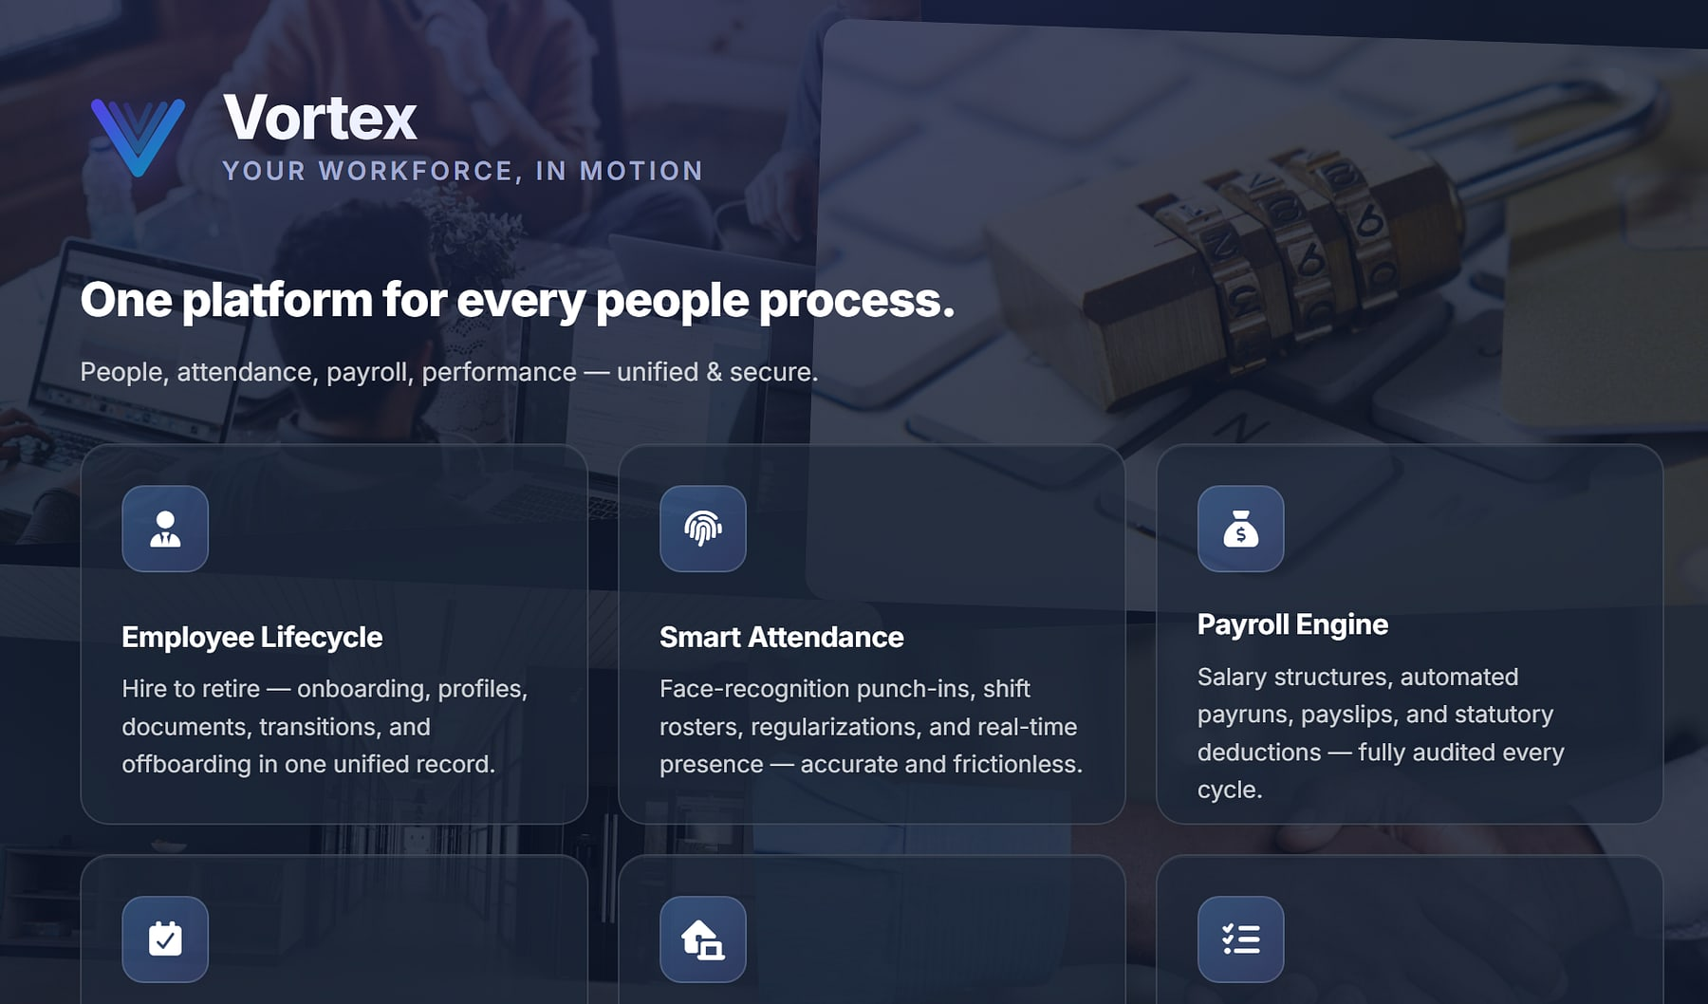
Vortex HRMS
PRODUCT SHOWCASE
UNIFIED PEOPLE PLATFORM
vortexhrms.com
FLAGSHIP · READY
Hire to retire. Attendance to payroll. On one record.
THE PROBLEM
OUR ANSWER
HR, payroll, attendance and helpdesk live in separate tools. Finance reconciles attendance to payroll by hand, and statutory rules change faster than legacy systems.
One people platform: Face-AI attendance, policy-driven payroll, leave, approvals and employee self-service, with a database per customer.
14
₹45
Face-AI
modules
per employee / month base
attendance
BUILT FOR
HR & people teams · Payroll & finance · Field & shift workforces
Vortex HRMS public site, vortexhrms.com.
Notes:
Vortex HRMS (official product name). The source materials include no in-app screenshots; the hero is the public vortexhrms.com page, cropped to remove unverified badges. Base price is the published list price.

Slide 16



Start with core HR, then switch on exactly what you need
VORTEX HRMS · CAPABILITIES
Vortex HRMS
Base bundle
Premium modules
Attendance & mobile add-ons
Every employee gets
Switch on any month
For field and remote teams
People management
Attendance tracking
Leave management
Employee self-service
Company policies
Payroll management
Performance (PMS)
Expenses · Helpdesk · Assets
HR document generation
Learning (LMS)
VortexGo mobile app
Geo-fence attendance & remote punch-in
On-shift location sharing
Punch step-up verification
Underneath everything: the approvals and workflow engine, role-based security, audit logging and a database per customer.
Notes:
Packaging and modules from the approved Vortex deck slide 5.

Slide 17
Attendance and leave flow straight into payroll
VORTEX HRMS · WORKFLOWS
Vortex HRMS
INPUTS
OUTPUTS
Attendance
Punches, shifts, rosters
Inputs locked at cut-off
Period inputs frozen for the run
Payroll engine
Salary structures · statutory deductions · tax computation · adjustments
Payslips
For every employee
Leave & comp-off
Balances and credits
Bank file
Disbursement output
Regularisations
Approved corrections
Statutory
PF · ESI · PT · TDS
Expenses
Approved reimbursements
Period locked
Audit logged
Re-runs are versioned and periods lock after sign-off, so every payroll is reproducible and auditable. Approvals route by role, sequentially or in parallel, with escalation timers.
Notes:
Native diagram from the approved Vortex deck slide 10 and 12. No mock product screens are drawn: Vortex in-app screenshots are an open item.

Slide 18




One record from hire to retire, priced by what you switch on
VORTEX HRMS · WHY IT WINS
Vortex HRMS
KEY DIFFERENTIATORS
BUSINESS VALUE
No manual reconciliation of attendance to payroll
Statutory deductions computed by policy
Face-AI attendance
Policy-first payroll
Face-recognition punch (InsightFace), geo-fencing and device integration.
Versioned re-runs and locked periods make payroll reproducible.
Approvals that never stall, with escalation timers
Employees serve themselves: balances, payslips, policies
BEST FIT
Organisations with HR, payroll and field or shift workforces that want one record from hire to retire.
VortexGo and SnapLens
Pay for what you switch on
Employee and on-site attendance apps, with privacy safeguards for location.
Published per-employee list prices; modules on or off any month.
Multi-tenant cloud
Biometric devices & gates
REST APIs
30-day free trial
Notes:
From the approved Vortex deck slides 7, 8, 11, 19 and 20. List prices: Basic Services ₹45 per active employee per month; modules ₹9 to ₹55; GST extra.

Slide 19
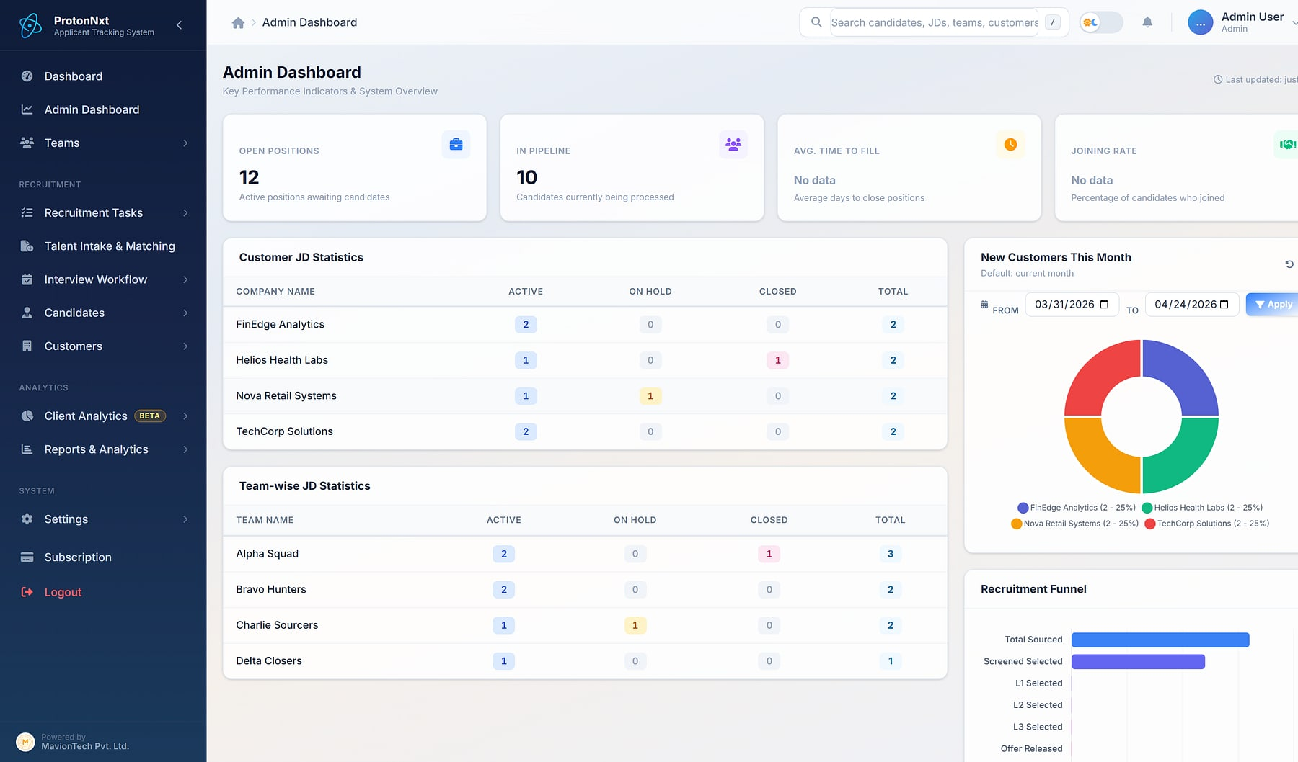
ProtonNxt
PRODUCT SHOWCASE
ENTERPRISE ATS
ProtonNxt · Admin dashboard
FLAGSHIP · READY
From requisition to hire, in one structured pipeline
THE PROBLEM
OUR ANSWER
Recruiters screen résumés by hand, ownership is unclear, feedback lives in inboxes, and vendor CVs arrive with no caps, duplicates or audit.
A multi-tenant, AI-assisted ATS for recruitment firms and talent teams: sourcing, parsing, interviews, offers, vendors and client insight on one system.
15
2
L1–L3
modules in every tenant
AI parsing paths
structured interviews
BUILT FOR
Recruitment & staffing firms · Enterprise talent teams · Vendor agencies
Admin dashboard: KPIs, customer JD statistics and recruitment funnel (demo data).
Notes:
ProtonNxt facts from the approved deck: 15 modules, OpenAI and Gemini parsing paths, L1/L2/L3 interview levels. Personal data in source slides 8 and 36 is not used.

Slide 20





Fifteen modules, every one included in every tenant
PROTONNXT · CAPABILITIES
ProtonNxt
Hiring pipeline
Operations
External access
Analytics
Governance
6 modules
4 modules
2 modules
2 modules
1 module
Job requisitions
Candidate sourcing
Talent intake & matching
Applicant tracking
Interview workflow
Offer management
JD assignment
Team collaboration
Calendar & video
Mobile recruiter app
Careers URL & candidate portal
Vendor management
Reports & analytics
Client engagement analytics (beta)
Settings, admin & custom schema
No add-ons: every module ships to every tenant from day one. Client engagement analytics is in beta.
Notes:
Module map from the approved ProtonNxt deck slide 6.

Slide 21
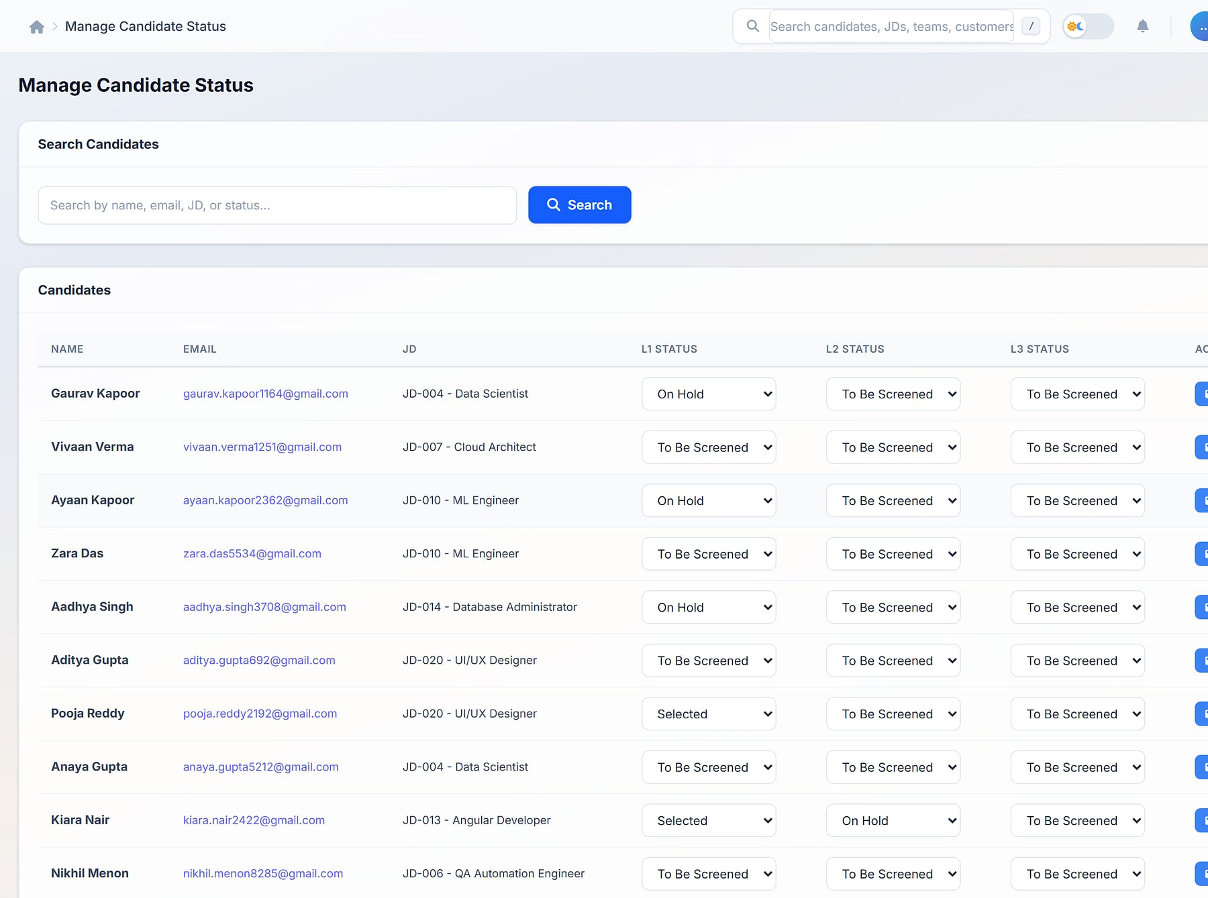
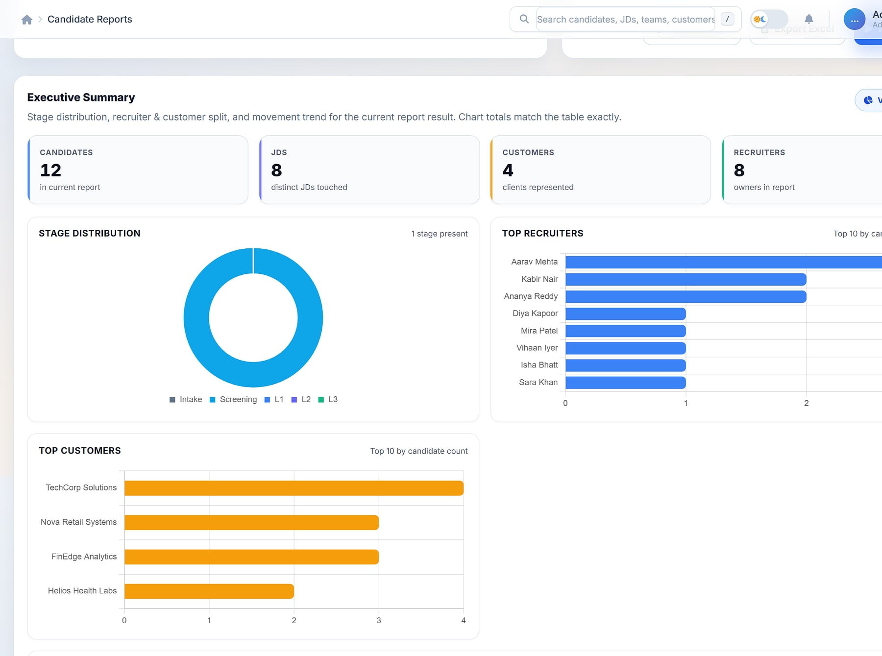
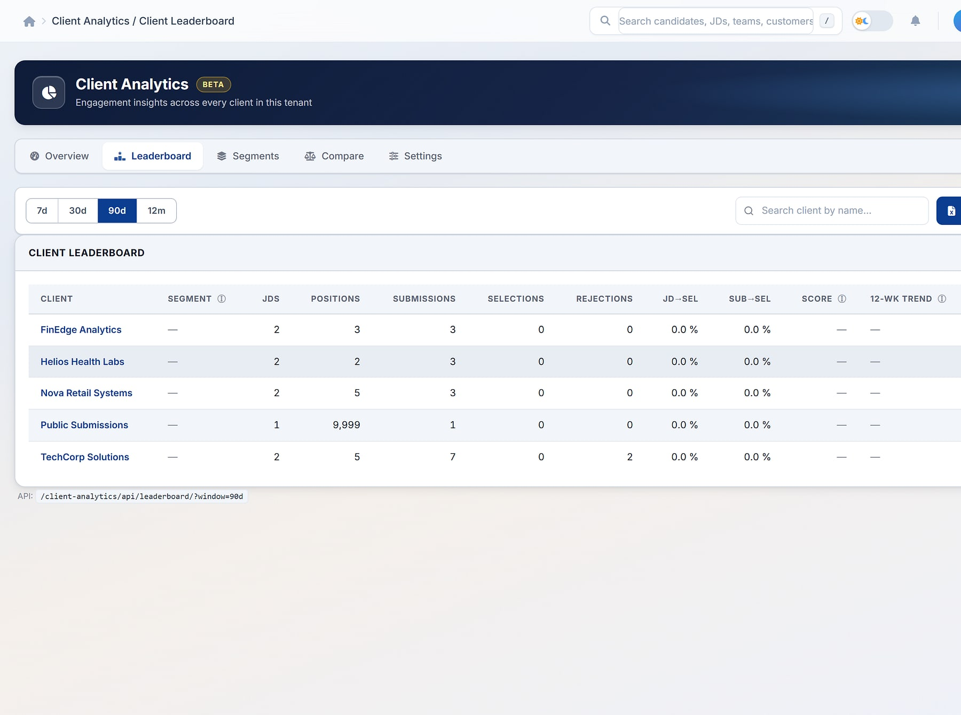
The pipeline always tells the truth
PROTONNXT · WORKFLOWS
ProtonNxt
1 Requisition
2 Source & AI parse
3 Track
4 Interview L1–L3
5 Offer & join
Manage candidate status
Candidate reports
Client analytics
Every stage visible
Answers that match the table
Clients to grow (beta)
Candidate status across L1, L2 and L3 per JD (demo data).
Executive summary over candidate reports (demo data).
Client engagement leaderboard and segments (demo data).
Notes:
Real ProtonNxt screens with demo data (approved deck slides 10, 17, 19). Sidebar cropped.

Slide 22




Structure, speed and evidence across every hire
PROTONNXT · WHY IT WINS
ProtonNxt
KEY DIFFERENTIATORS
BUSINESS VALUE
Structured intake and interviews shorten the path to hire
Clear ownership of every requisition and candidate
AI without lock-in
Agencies inside the process
OpenAI and Gemini parsing paths, with manual override.
Per-vendor caps, duplicate protection and separate vendor logins.
Vendor submissions that are measurable and deduplicated
Reports leaders trust, with saved templates and XLSX
BEST FIT
Recruitment firms serving many clients, and in-house talent teams that work with agency partners.
Client engagement analytics
One candidate portal
Scores and segments show which clients to grow (beta).
A single candidate login across every employer on ProtonNxt.
Multi-tenant SaaS
OpenAI · Gemini
MavionMeet video
Razorpay
ICS calendars
Notes:
From the approved ProtonNxt deck slides 14, 15, 19, 25 and 26. No time-to-hire percentages are claimed.

Slide 23
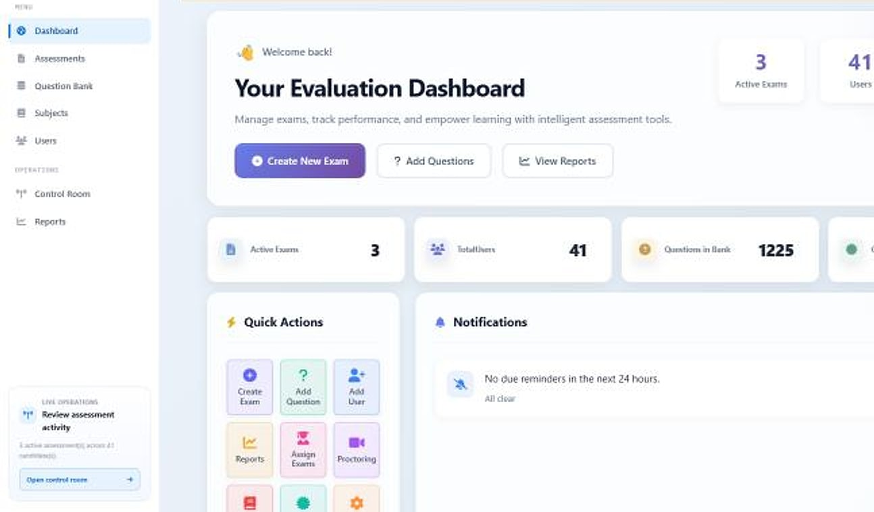
PragyanNxt
PRODUCT SHOWCASE
ASSESSMENT & CERTIFICATION
PragyanNxt · Evaluation dashboard
FLAGSHIP · READY
Results you can defend. Credentials anyone can verify.
THE PROBLEM
OUR ANSWER
Gamed screening tests push the wrong candidates forward, unmonitored exams devalue certificates, and point tools never talk to each other.
One platform for corporates and academic institutions to author, deliver, proctor, score and certify, with an integrity score on every attempt.
8
Ed25519
14-day
integrated modules
signed credentials
free trial
BUILT FOR
Corporate hiring teams · Academic institutions · Certification programmes
Evaluation dashboard: active exams, users and question bank (demo data).
Notes:
PragyanNxt (formerly Evalynx; rename approved by MavionTech). Facts from the approved PragyanNxt deck.

Slide 24







Eight modules, one closed loop of trust
PRAGYANNXT · CAPABILITIES
PragyanNxt
1 Author
2 Deliver
3 Proctor
4 Score
5 Certify
Authoring
Delivery
Proctoring
Integrity
Build
Run
Watch
Score
Question bank & bulk import
AI generation
Bloom's & difficulty
Public, assigned or invite
Randomisation & timers
Retakes
Live monitoring
Screen & webcam recording
AI visual analysis
Behavioural signals
Integrity score
Answer similarity
Results & analytics
Certification
Multi-tenancy & admin
Commerce & AI
Decide
Prove
Govern
Scale
Auto & manual grading
Report PDFs
AI summaries
Signed certificates
Public verification
Open Badges & appeals
Tenant isolation
Roles & RBAC
Activity logging
Subscriptions & entitlements
Metered AI credits
Email invites
Notes:
Module map from the approved PragyanNxt deck slide 7; loop from slide 6.

Slide 25
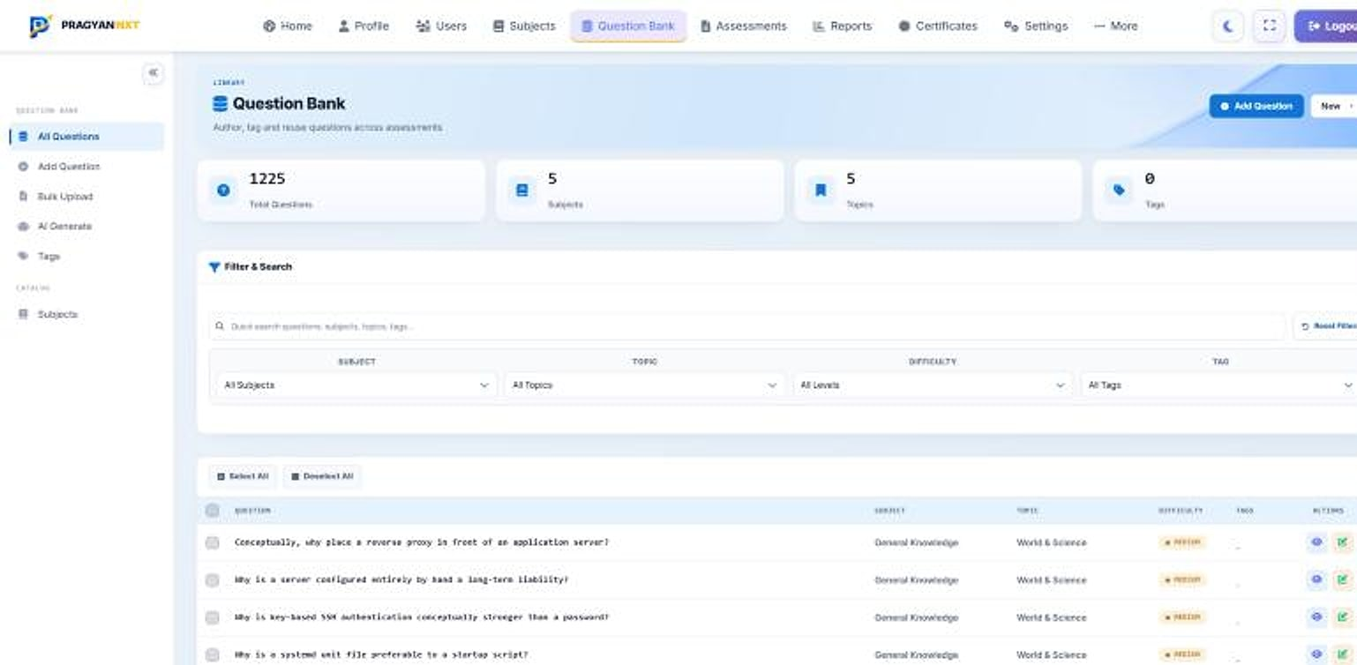




Not just a PDF: a credential the world can verify
PRAGYANNXT · WHY IT WINS
PragyanNxt
Question bank
KEY DIFFERENTIATORS
Cryptographically signed
Ed25519-signed credentials that cannot be forged or altered.
Public verification
Anyone can confirm a certificate is genuine, instantly.
Integrity without a camera
Focus, tab and clipboard telemetry score non-proctored exams too.
Question bank: 1,225 questions across 5 subjects, with filters by subject, topic, difficulty and tag (demo data).
Plugs into your LMS
BUSINESS VALUE
LTI 1.3 writes results back to Canvas, Moodle and more.
Hire on evidence, not gamed scores
Exams that stand up to appeal
Certificates verified in one click
One platform instead of three
Deploy as cloud SaaS, private cloud or on-premise · Basic, Plus and Pro tiers by monthly assessment volume
Notes:
Differentiators from the approved PragyanNxt deck slides 15, 13 and 21. Deployment options as listed on maviontech.com. Tier allowances are on the approved packaging slide; prices are not published.

Slide 26
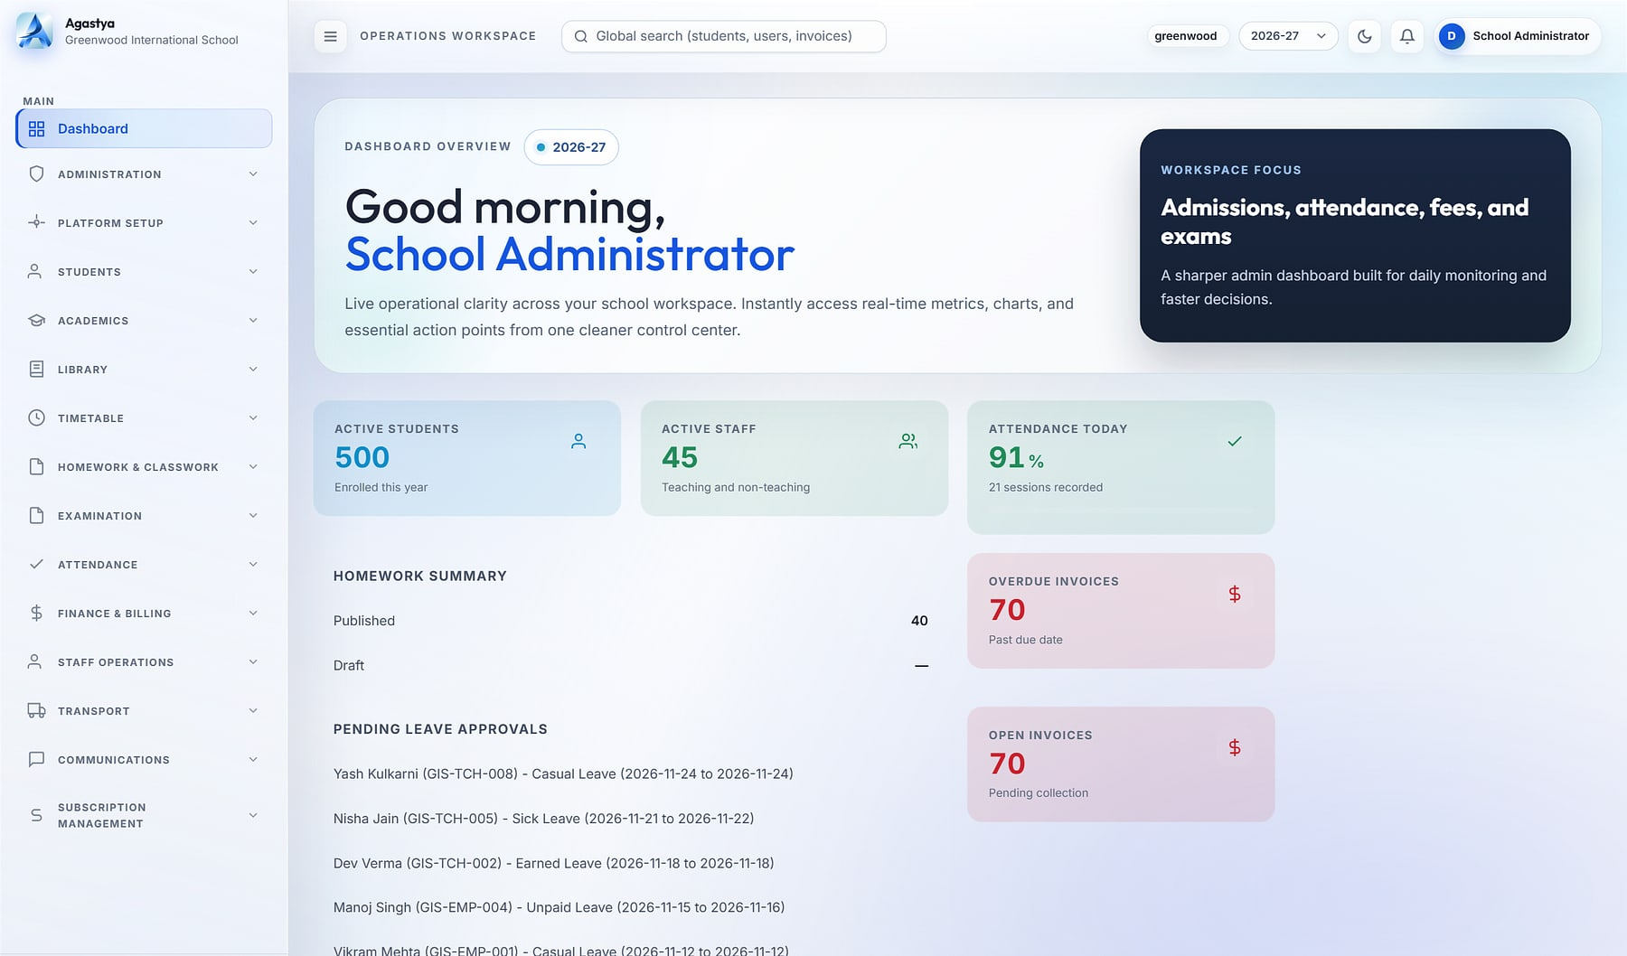
Agastya
PRODUCT SHOWCASE
CLOUD SCHOOL ERP
Agastya · School administrator dashboard
FLAGSHIP · READY
One operating system for every school in your group
THE PROBLEM
OUR ANSWER
School groups run on registers, spreadsheets and WhatsApp. Nothing reconciles, leaders wait days for numbers, and student data sits on personal phones.
Admissions to report cards, fees to fleet: every department, persona and campus on one governed platform, with each school's data in its own database.
19
8
96
integrated modules
role cockpits
permission codes
BUILT FOR
School groups & chains · Single schools · Group heads & principals
School administrator dashboard (demo data).
Notes:
Agastya identity. Figures from the Agastya source review (Nov 2026): 19 Django apps/modules, 8 system roles, 96 permission codes. Screenshot is a real product capture with demo data.

Slide 27






19 modules across six pillars, on one data model
AGASTYA · CAPABILITIES
Agastya
Command & governance
Academics
Operations & finance
3 modules
6 modules
5 modules
Role dashboards & builder
Administration & RBAC
Platform setup & branding
Admissions & student lifecycle
Academics & syllabus
Timetable & substitution
Attendance · Homework
Exams & report cards
Fees & billing
Staff operations & HR
Transport
Inventory & procurement
Service desk & front office
Campus life
Engagement
Platform
2 modules
2 modules
1 module
Library
Hostel, health & discipline
Communications & WhatsApp inbox
Student & parent portals, student app
Multi-tenant SaaS console
Plans, subscriptions & billing
Notes:
Module map as in the approved Agastya deck, slide 5. One data model: attendance feeds report cards, fee plans feed invoices, routes feed manifests.

Slide 28
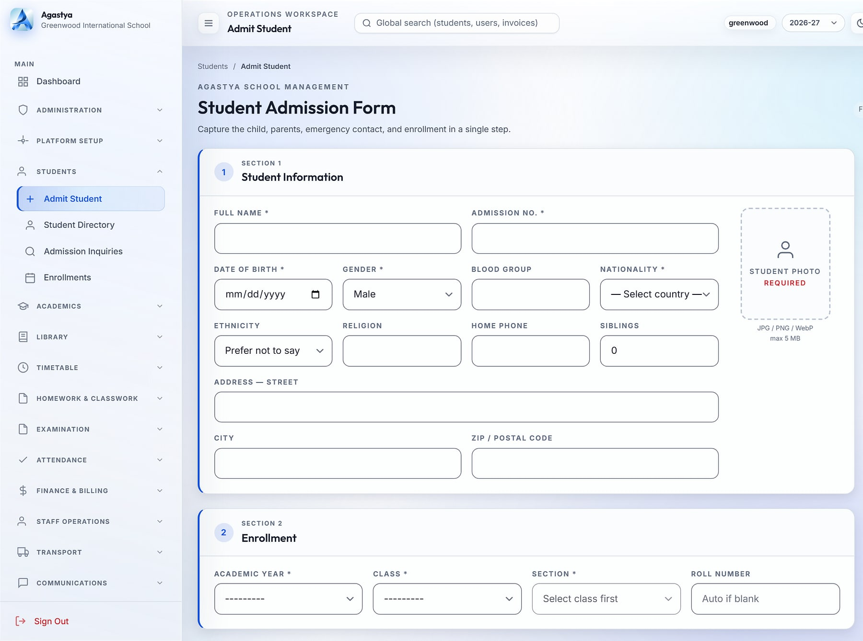
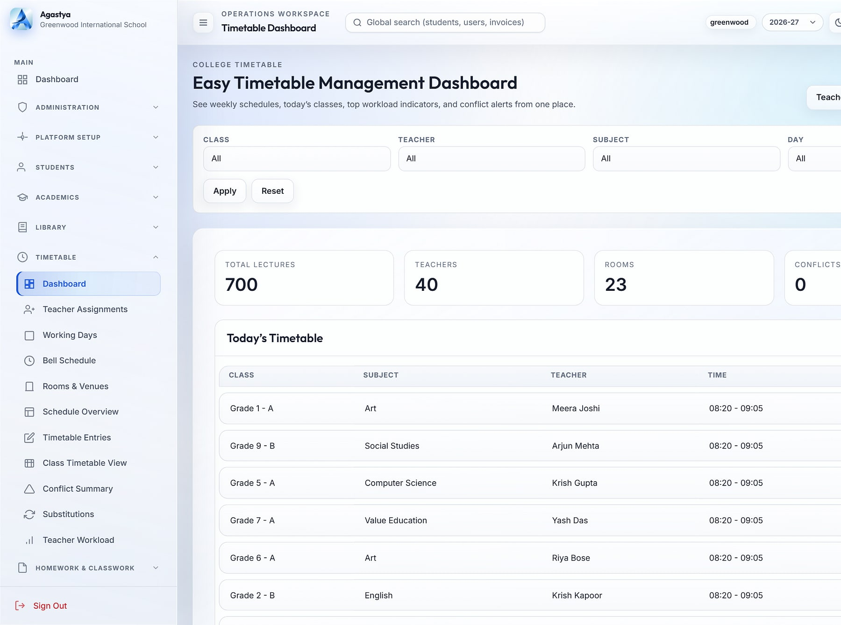
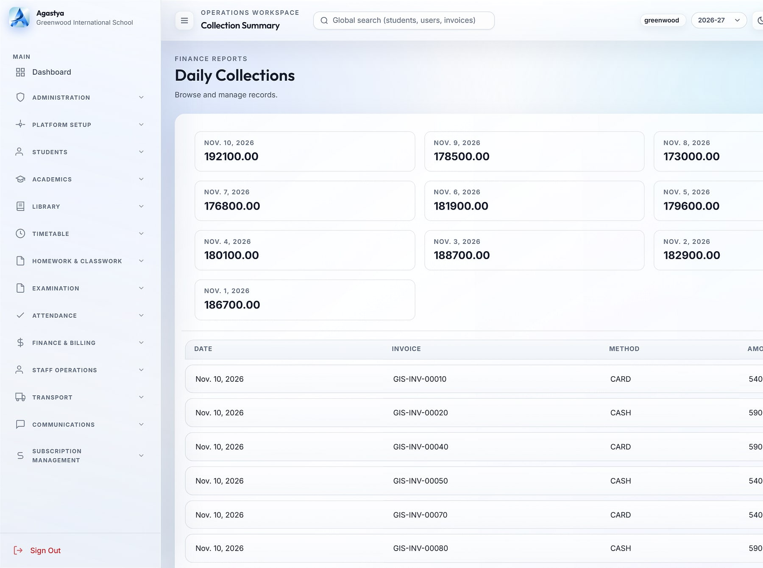
From first inquiry to report card, on one record for life
AGASTYA · WORKFLOWS
Agastya
1 Inquiry
2 Admit & enrol
3 Timetable & attendance
4 Exams & report cards
5 Fees & collections
Admit student
Timetable dashboard
Daily collections
Admission in one screen
Clash-free timetables
Collections in real time
Student, enrolment, guardians and emergency contact in one step (demo data).
700 weekly lectures across 40 teachers with zero conflicts (demo data).
Daily collections with payment-method breakdown (demo data).
Notes:
Real Agastya screens with demo data, as used in the approved deck (slides 11, 12, 19).

Slide 29
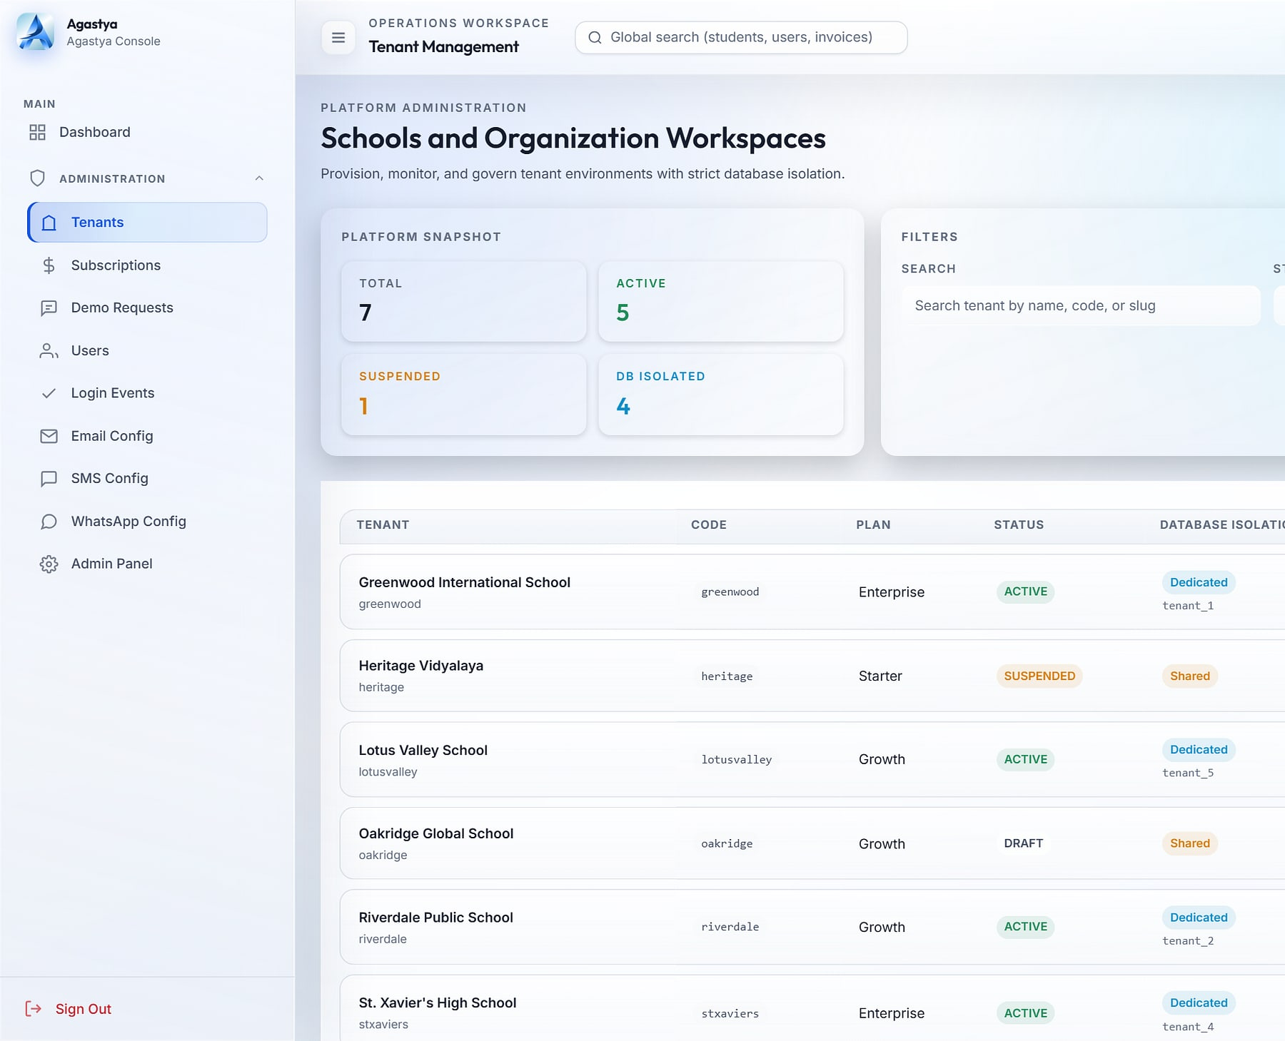
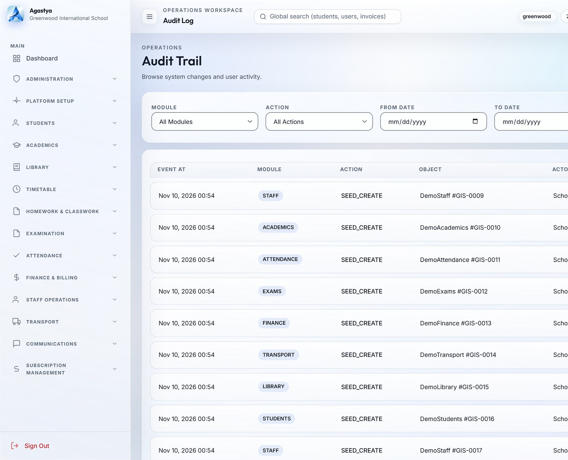
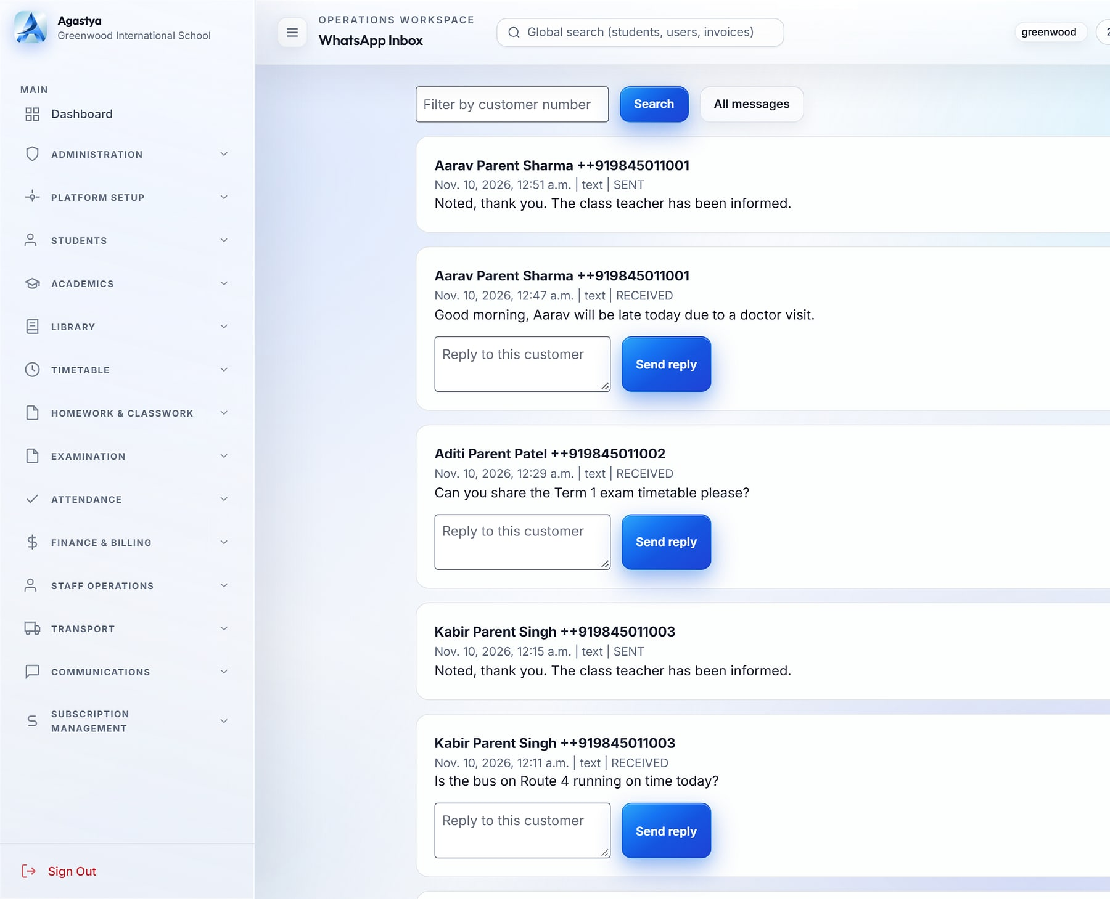
Every campus governed from one console
AGASTYA · GOVERNANCE
Agastya
Tenant management
Audit trail
WhatsApp inbox
Onboard a school in minutes
Every action traceable
A school-owned parent channel
Platform console: schools, plans and a dedicated database each (demo data).
Audit log with before/after values, filters and CSV export (demo data).
Two-way WhatsApp inbox through the Meta Cloud API (demo data).
Lockout after 3 failed logins
One active session per user
4-hour sliding sessions
Signed webhooks
Database per school
Notes:
Controls as evidenced in the Agastya source and approved deck slide 10 and 26.

Slide 30




What changes when a school group moves to Agastya
AGASTYA · WHY IT WINS
Agastya
KEY DIFFERENTIATORS
BUSINESS VALUE
Live numbers for group heads, principals and accountants
Faster collections with branded invoices and dues tracking
Database per school
Configurable without developers
Each school gets its own database, created and migrated automatically.
Dashboard builder, permission matrix and feature toggles per school.
Report cards published in one click
New campuses provisioned from the console
Parents informed without personal phone numbers
School-owned parent channel
Audit-grade governance
BEST FIT
Two-way WhatsApp inbox; no staff personal numbers.
Before/after audit, login events, lockout and single sessions.
School groups and chains running several campuses, and single schools that want group-grade governance.
Multi-tenant SaaS
Razorpay
Meta WhatsApp
Twilio SMS
Student app (Expo)
Notes:
Differentiators from the approved Agastya deck slide 29. Business value is stated qualitatively; no ROI figures are claimed. Planned items (online fee payment, payroll, live bus tracking) are excluded here and shown under Future direction.

Slide 31

MavionLearn
PRODUCT SHOWCASE
ENTERPRISE LMS · SKILLS & COMPLIANCE
MavionLearn · Learning admin
READY · AVAILABLE
Skills that compound: training that becomes provable capability
THE PROBLEM
OUR ANSWER
Finishing a course doesn't prove a skill, mandatory training is chased by hand, and leadership can't see what training spend returns.
A multi-tenant enterprise LMS that scores every employee against role targets, runs compliance on its own and reports in your brand, with identity built in.
12
SSO
30-day
integrated modules
OIDC · SAML · SCIM
all-features trial
BUILT FOR
L&D and HR · Compliance leads · IT & identity teams
Learning admin: enrolments, compliance and completions by department (demo data).
Notes:
MavionLearn sales positioning only; investor-deck content (market sizes, funding) is excluded.

Slide 32




Twelve modules across five capabilities
MAVIONLEARN · CAPABILITIES
MavionLearn
1 Set role targets
2 Score the gaps
3 Recommend courses
4 Complete & certify
5 Capability rises
Learn
Measure
Comply
Report
Govern
4 modules
1 module
1 module
2 modules
4 modules
Catalog & courses
On-demand learning
Live learning (ILT / VILT)
Learner experience
Skills & skill matrix
Development plans
Compliance campaigns
Certifications & renewals
Enterprise reporting
Cost & ROI
People & delegated admin
Identity & security
Standards & integrations
Platform console
Notes:
Module map from the approved MavionLearn deck slide 5; loop from slides 9 and 10.

Slide 33
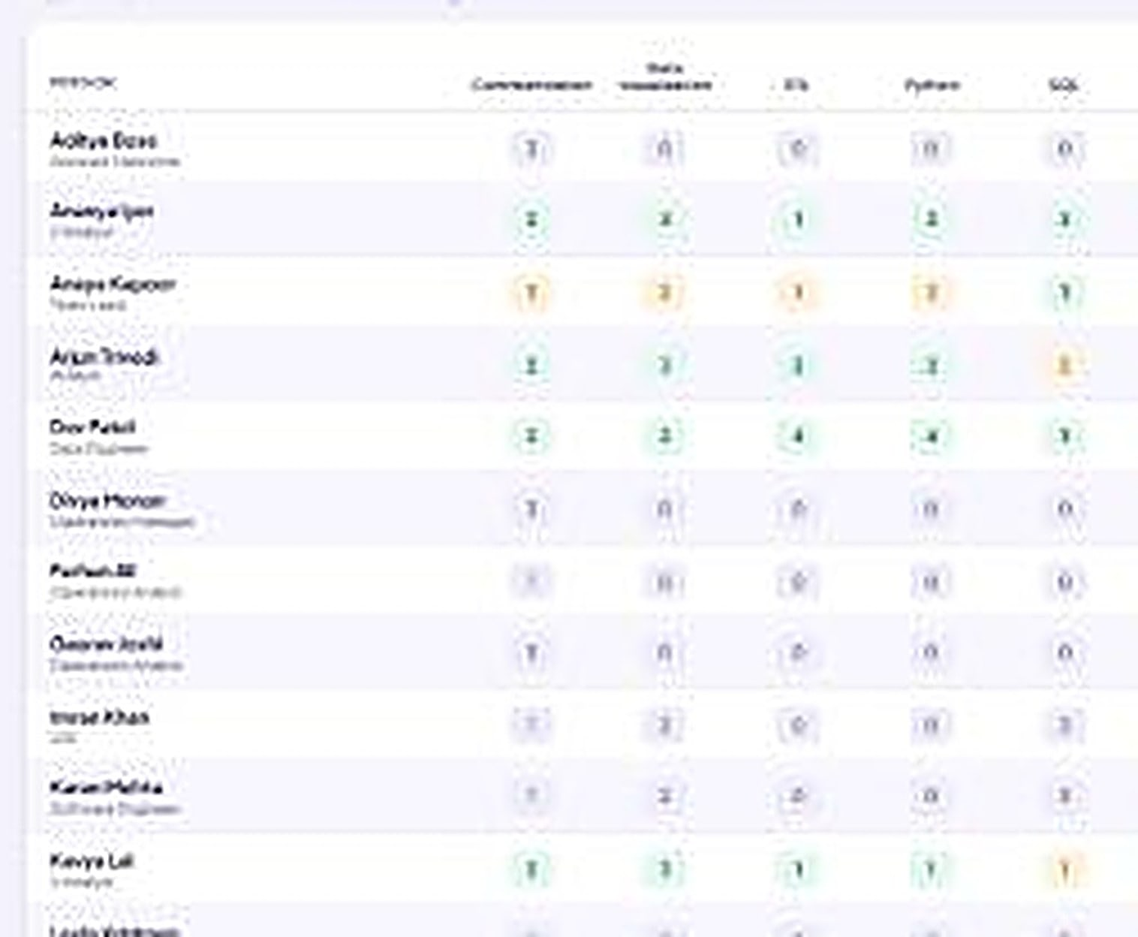
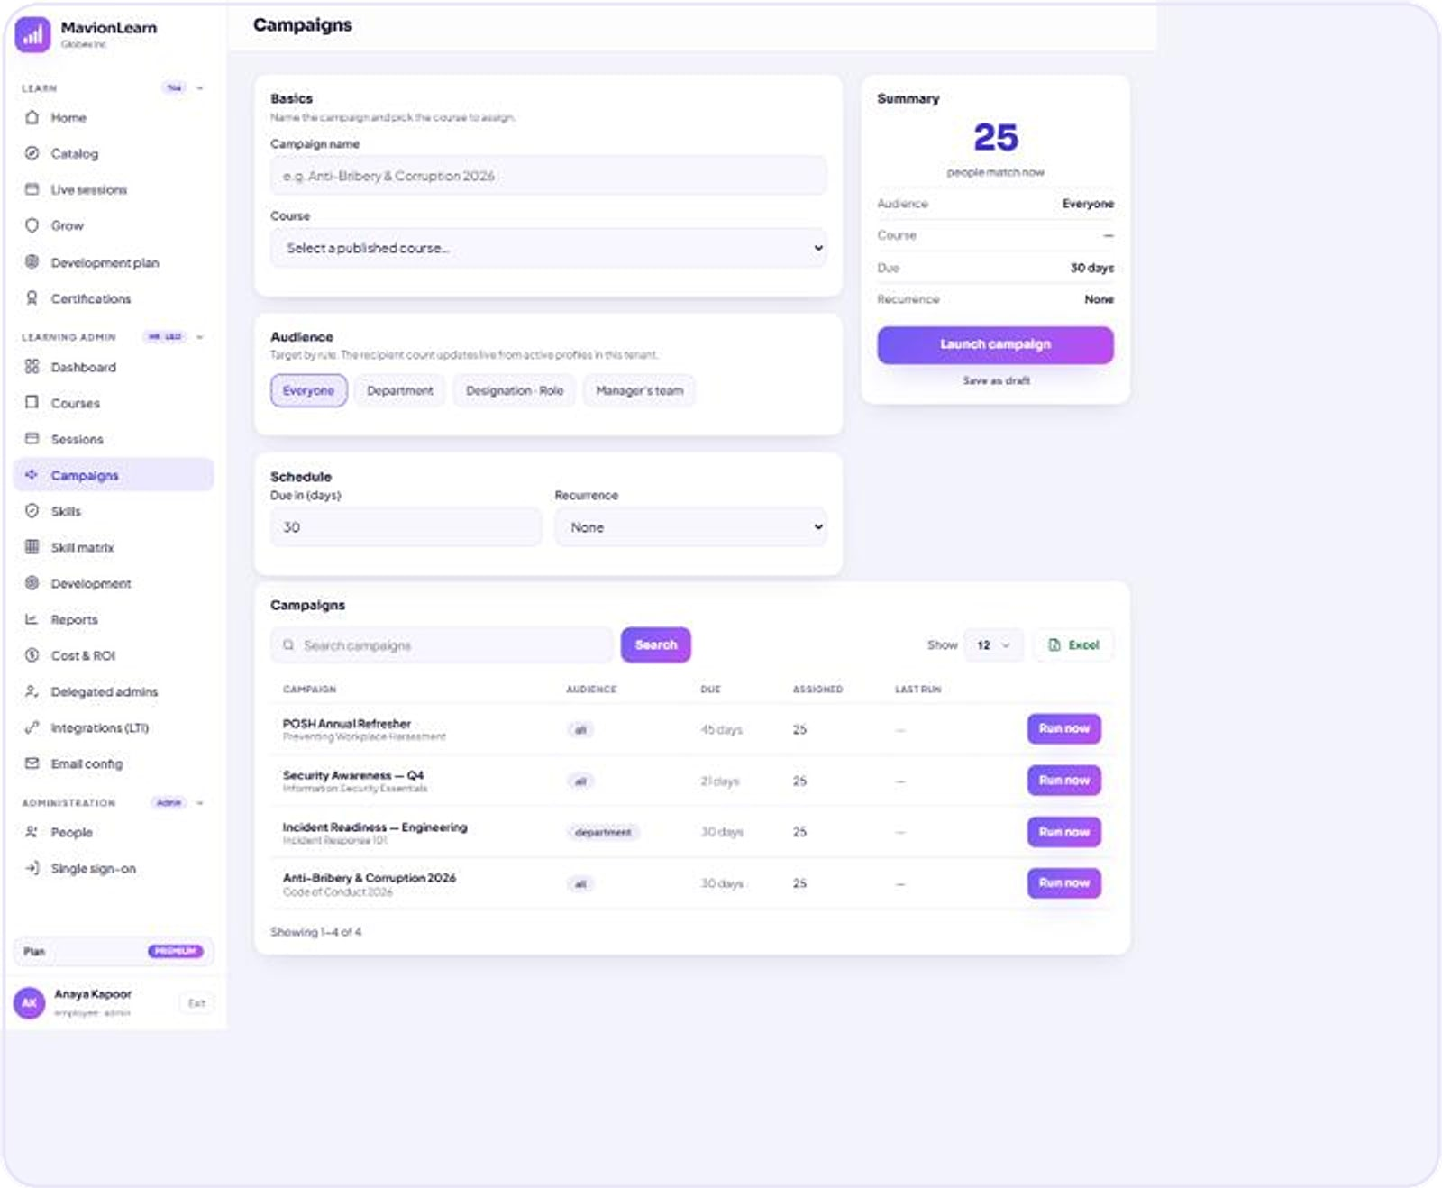
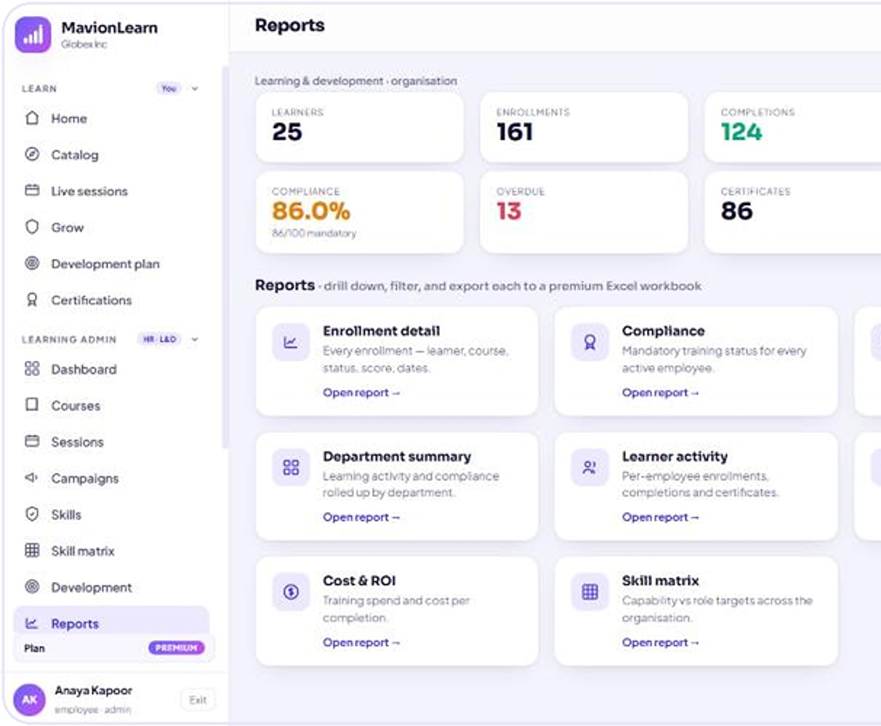
See capability, run compliance, report in your brand
MAVIONLEARN · WORKFLOWS
MavionLearn
Skill matrix
Campaigns
Reports
A living skill matrix
Compliance that runs itself
Board-ready reporting
Employees scored against role targets (demo data).
Campaign builder: audience, course, schedule and status (demo data).
Reports workspace: eight built-in report types (demo data).
Assign
Remind
Certify
Renew
Export in your brand
Notes:
Real MavionLearn screens with demo data (approved deck slides 9, 11, 13).

Slide 34



Others track completions; MavionLearn proves capability
MAVIONLEARN · WHY IT WINS
MavionLearn
KEY DIFFERENTIATORS
BUSINESS VALUE
Prove capability to leadership and auditors
Audit-ready evidence exported in one click
Capability, not completions
Compliance on autopilot
A living skill matrix scored against role targets.
Assign, remind, certify and renew automatically.
Board-ready Excel and PDF reports in your brand
Training spend and cost per completion visible
BEST FIT
Enterprises that must prove skills and compliance across large, distributed organisations.
Identity included
Isolated by design
OIDC, SAML 2.0 and SCIM in the product, not a paid add-on.
A dedicated database per customer, white-labelled.
SaaS · private cloud · on-prem
SCORM
LTI 1.3
OIDC · SAML · SCIM
Cloudflare R2 / S3
Notes:
From the approved MavionLearn deck slides 6, 17, 18, 19 and 21. Pricing tiers are being confirmed and are not shown.

Slide 35
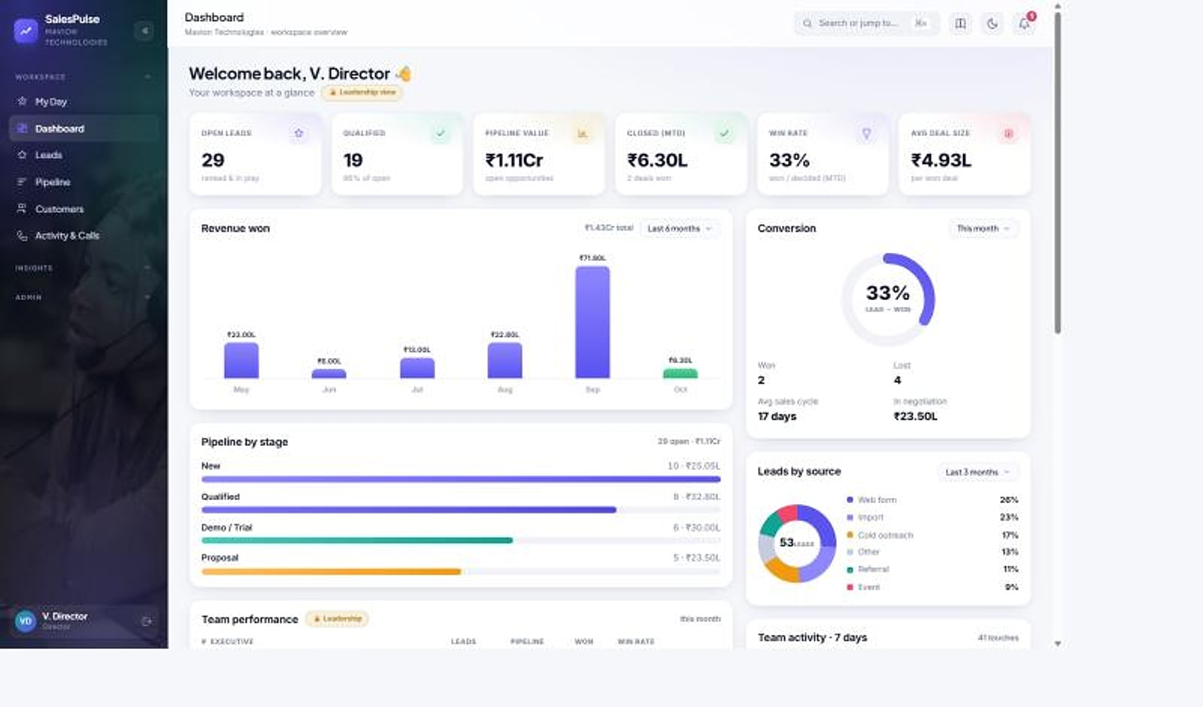
SalesPulse CRM
PRODUCT SHOWCASE
INDIA-FIRST SALES CRM
SalesPulse · Director dashboard
READY · AVAILABLE
Your reps sell. Your customers' numbers stay yours.
THE PROBLEM
OUR ANSWER
Reps hold raw phone numbers, numbers are re-typed into spreadsheets, leaders lack live visibility, and global CRMs fit Indian billing poorly.
A multi-tenant sales CRM with privacy-masked calling, a live weighted pipeline and reports that build themselves, made for how Indian sales teams work.
14
2-way
GST
integrated modules
masked calling
invoicing built in
BUILT FOR
Indian sales teams · SMB & mid-market · Field and inside sales
Director dashboard: pipeline, closed value, conversion and lead sources (demo data).
Notes:
SalesPulse CRM: catalogue inclusion is still to be confirmed by MavionTech (open item); included here as an approved finalised product.

Slide 36




Fourteen modules in one sales command center
SALESPULSE CRM · CAPABILITIES
SalesPulse CRM
Sell
Engage
Lead
Protect & run
4 modules
3 modules
3 modules
4 modules
My Day
Leads
Pipeline
Customers & 360
Privacy-masked calling
Email & WhatsApp
Activity log & call journal
Command center
Report builder
Weekly reports
Data protection controls
Subscriptions & GST billing
Native Android app
Platform & multi-tenancy
Each company's data lives in its own database, and masking rules are enforced on the server for web, mobile and exports alike.
Notes:
Module map from the approved SalesPulse deck slide 6. 'Command Center' is the product's module name.

Slide 37
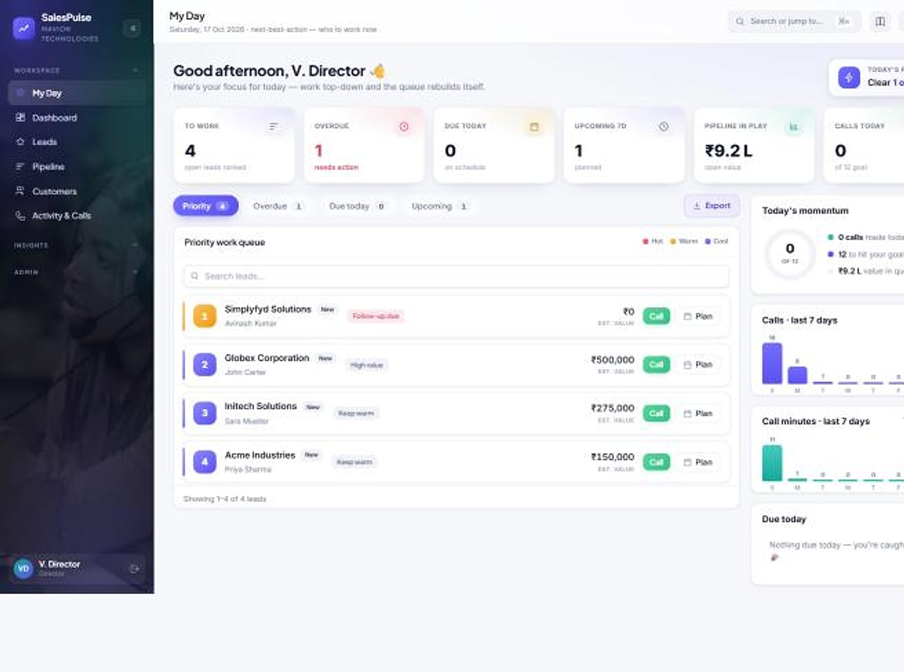
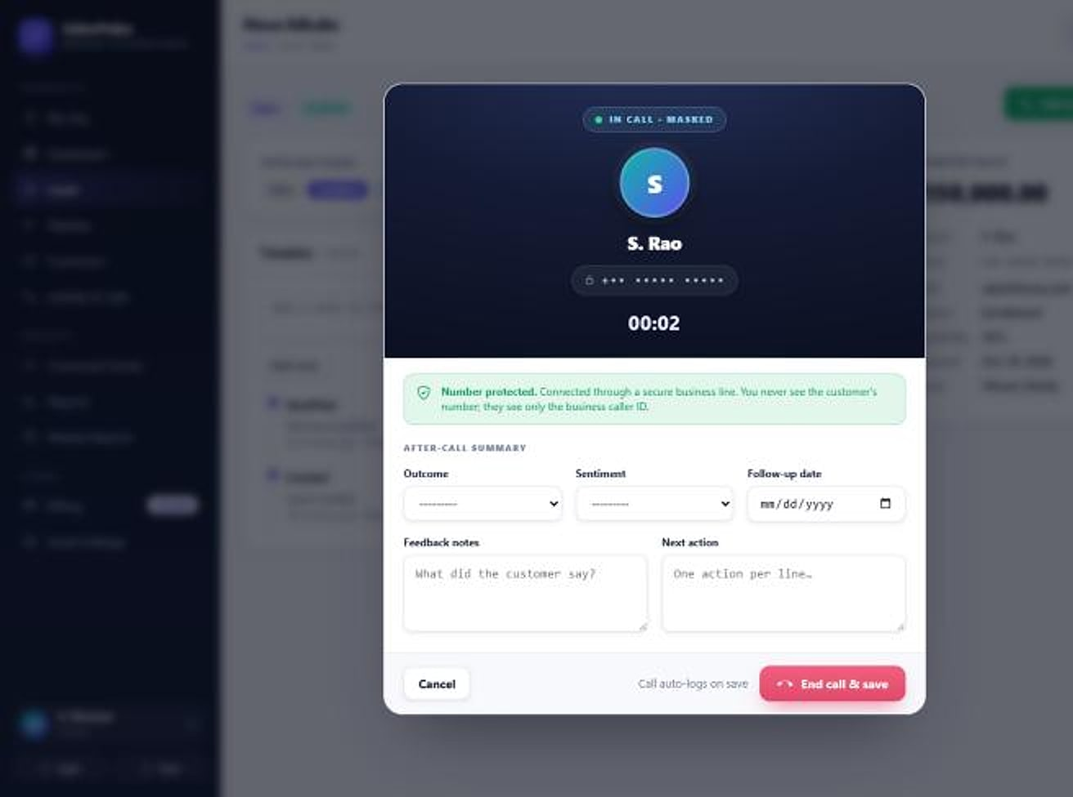
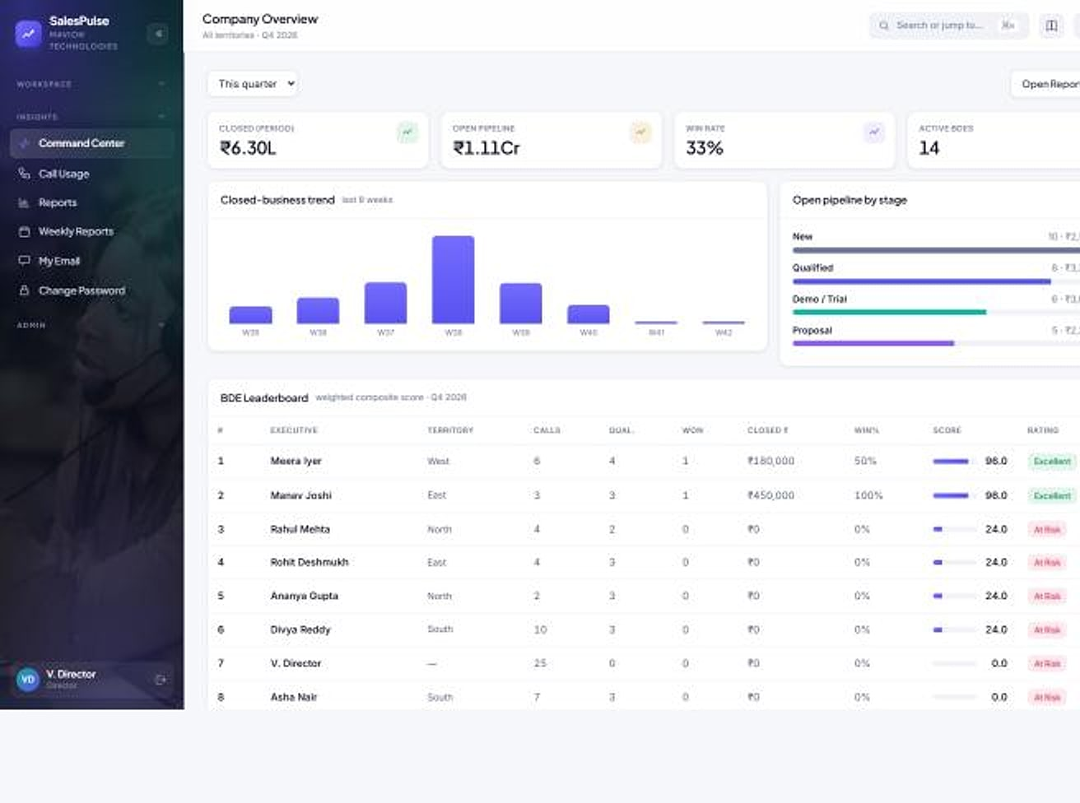
Your reps make the call. They never see the number.
SALESPULSE CRM · WORKFLOWS
SalesPulse CRM
1 My Day queue
2 Masked call
3 Outcome logged
4 Follow-up
5 Weekly report
My Day
Dialer
Command center
Start the day knowing who to call
The number stays masked
Leaders see it live
My Day: KPI strip and prioritised work queue (demo data).
In call: one-click connect; the real number is resolved server-side (demo data).
Command center: org KPIs, trend and leaderboard (demo data).
Notes:
Real SalesPulse screens with demo data (approved deck slides 7, 13, 16).

Slide 38




Privacy built in, visibility built up
SALESPULSE CRM · WHY IT WINS
SalesPulse CRM
KEY DIFFERENTIATORS
BUSINESS VALUE
Customer contacts stay with the company when reps leave
Leaders see pipeline and people in real time
Privacy-masked by default
No bulk export for reps
Phone and email masked on web, mobile and exports.
Lead-list and report downloads are leadership-only.
No re-typing of numbers into spreadsheets
Calling billed on actual usage, or bring your own telephony
BEST FIT
Indian sales teams whose customer relationships are their most valuable asset.
Reports that build themselves
India-first billing
Activity feeds the journal, command center and weekly reports.
INR, GST invoices and Razorpay built in.
Multi-tenant SaaS
Native Android app
Razorpay
WhatsApp Business
30-day free trial
Notes:
From the approved SalesPulse deck slides 18, 20, 22 and 23. Calling is ₹0.50 per leg-minute with a 30-second pulse; seat prices are confirmed in proposals.

Slide 39
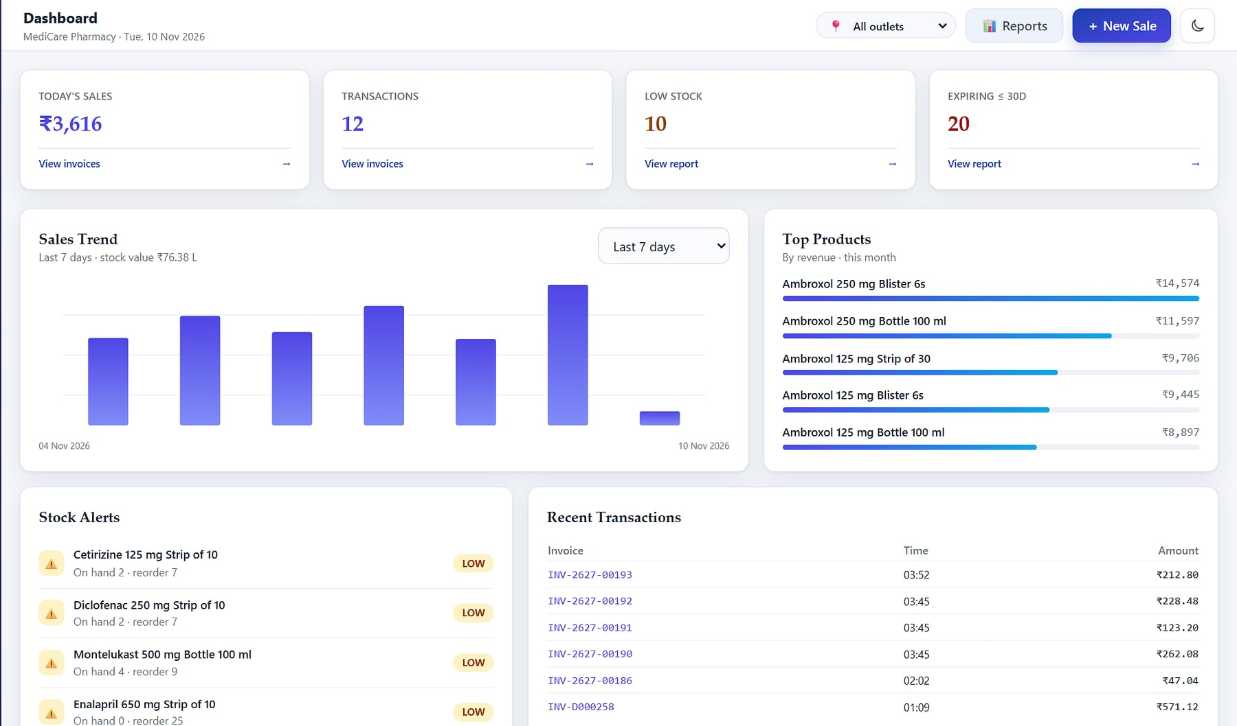
HeeLIKS
PRODUCT SHOWCASE
INVENTORY, POS & DISTRIBUTION
HeeLIKS · Owner dashboard
READY · AVAILABLE
Run your entire store on one platform.
THE PROBLEM
OUR ANSWER
Stock lives in a spreadsheet and billing on a separate till, expiry is found too late, GST is rebuilt every month and distributors track orders on paper.
Inventory, point of sale, purchasing, B2B order-to-cash and GST reporting on one append-only stock ledger, with each customer in its own database.
20
21
348
integrated modules
exportable reports
automated tests
BUILT FOR
Pharmacies & retail · Grocery & bookstores · Distributors
Owner dashboard: sales, stock alerts, expiry and top products (demo data).
Notes:
HeeLIKS identity, from the approved HeeLIKS deck (10 Nov 2026). Figures counted from the product code (commit 3b66227): 21 reports, 348 tests; 20 modules per the coverage map. Screens are a seeded demo workspace (MediCare Pharmacy).

Slide 40





Twenty modules in five pillars, on one stock ledger
HEELIKS · CAPABILITIES
HeeLIKS
Sell
Stock & Buy
Distribute
Insight
Govern & Scale
4 modules
4 modules
4 modules
4 modules
4 modules
Point of sale
Registers & Z-report
Sales invoices
Returns & credit notes
Catalog & masters
Inventory ledger & batches
Procurement & GRN
Partners
Sales orders
Challans & proof of delivery
Receipts & customer ledger
AR aging & collections
Owner dashboard
21 reports
GST & GSTR-1
Stock and expiry alerts
Onboarding & import
Security, roles & audit
Subscription & billing
Platform console & API
Every purchase, sale, return, transfer and count posts to one append-only ledger, row-locked so two counters can never sell the last unit.
Notes:
Module map from the approved HeeLIKS deck, slide 6, grouped to twenty modules as in HeeLIKS_coverage.csv.

Slide 41
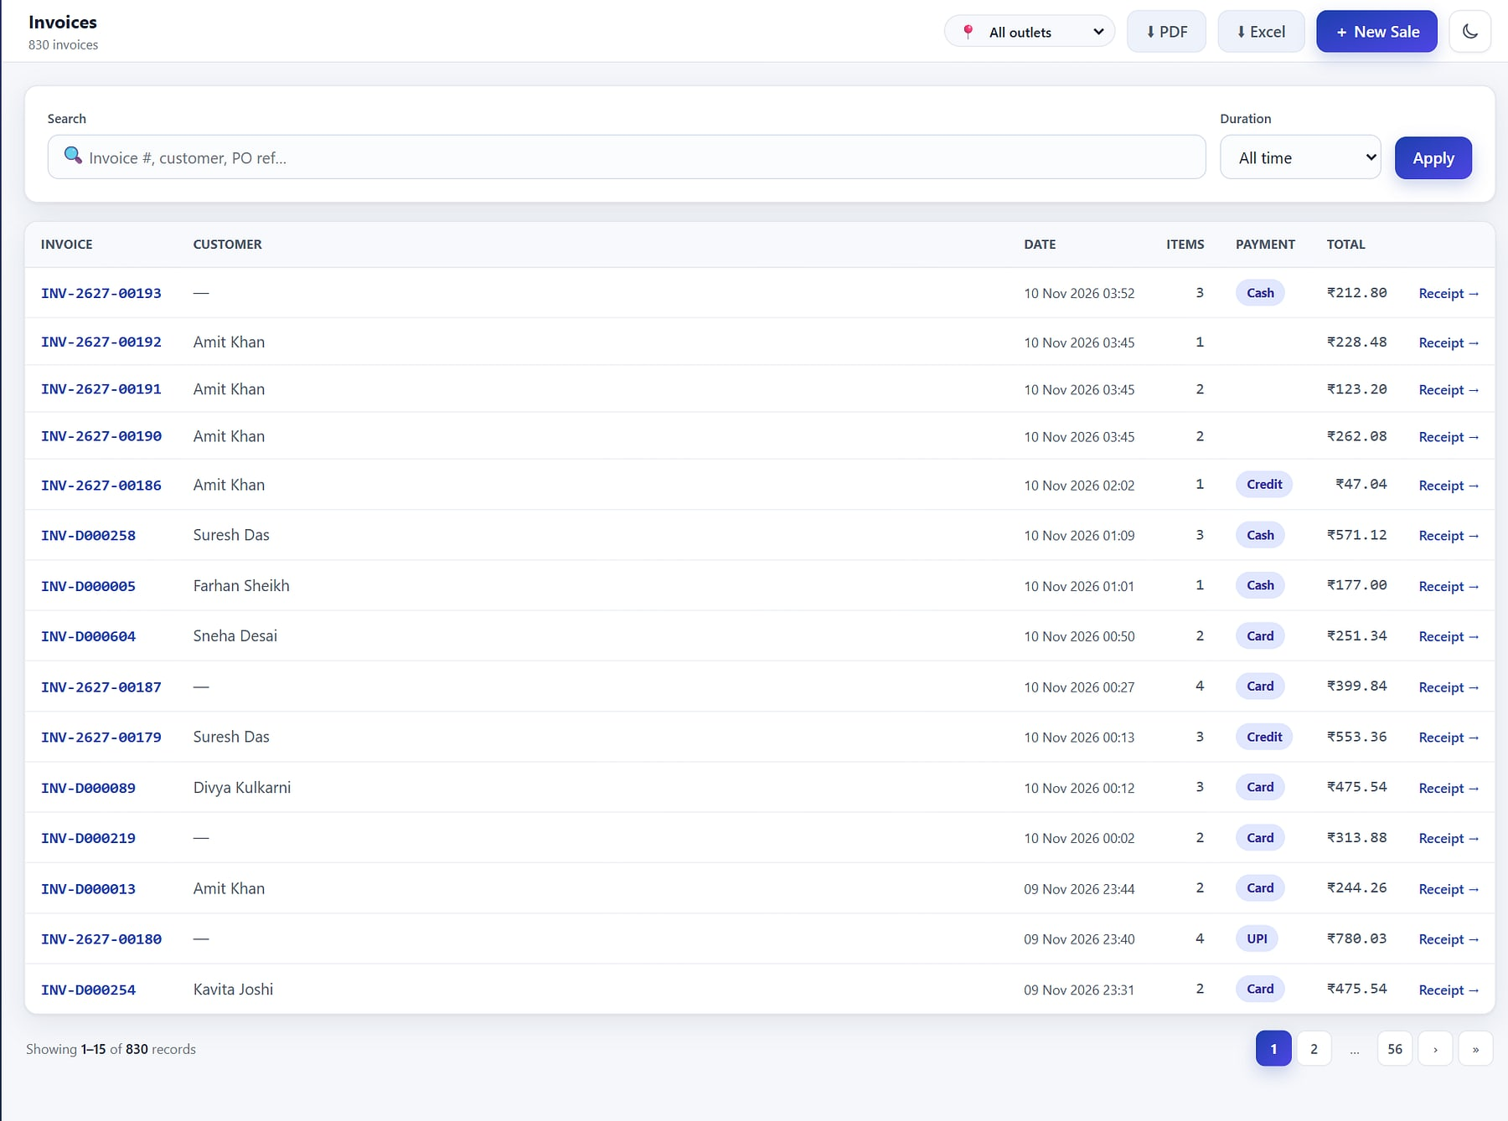
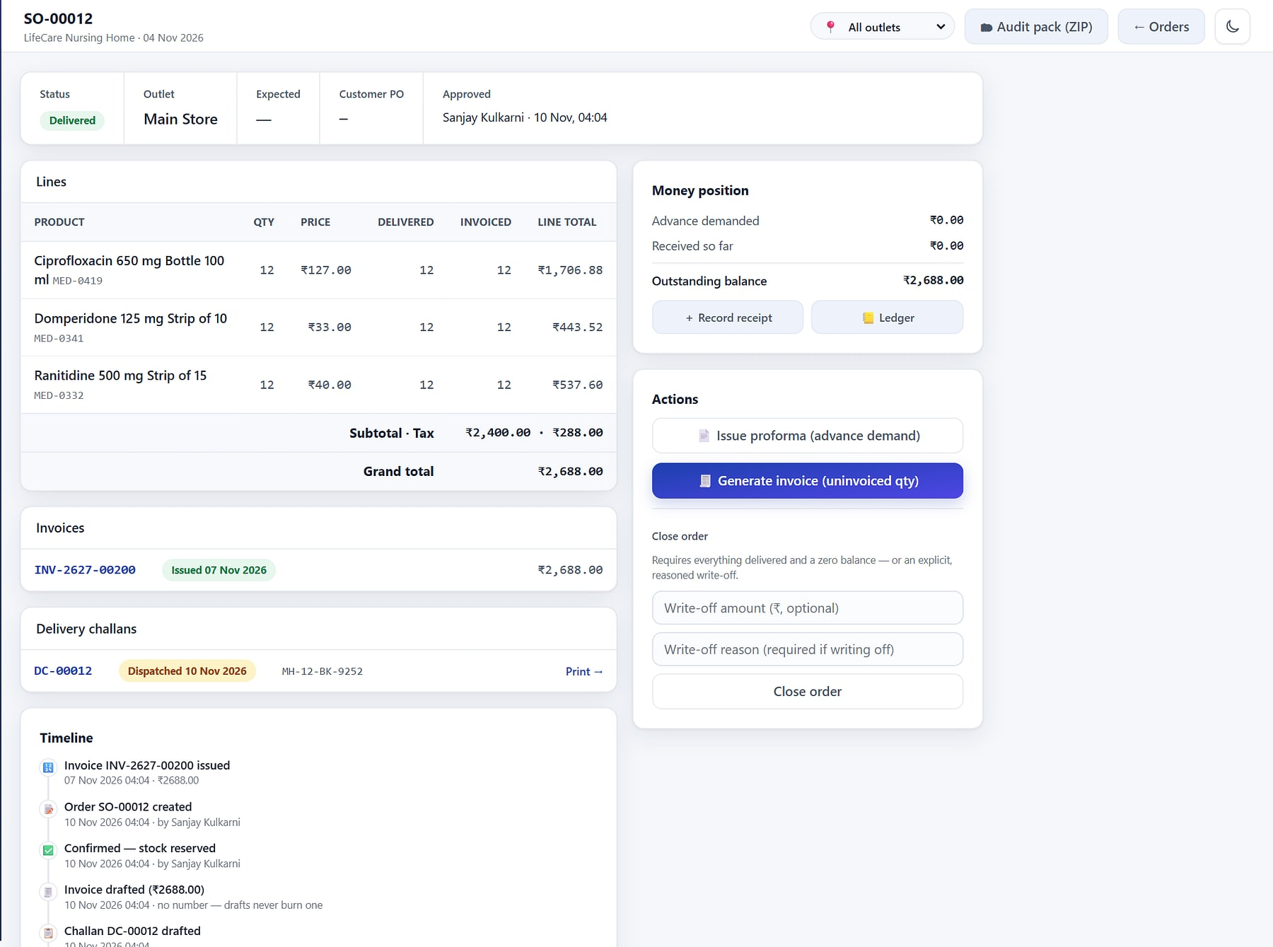
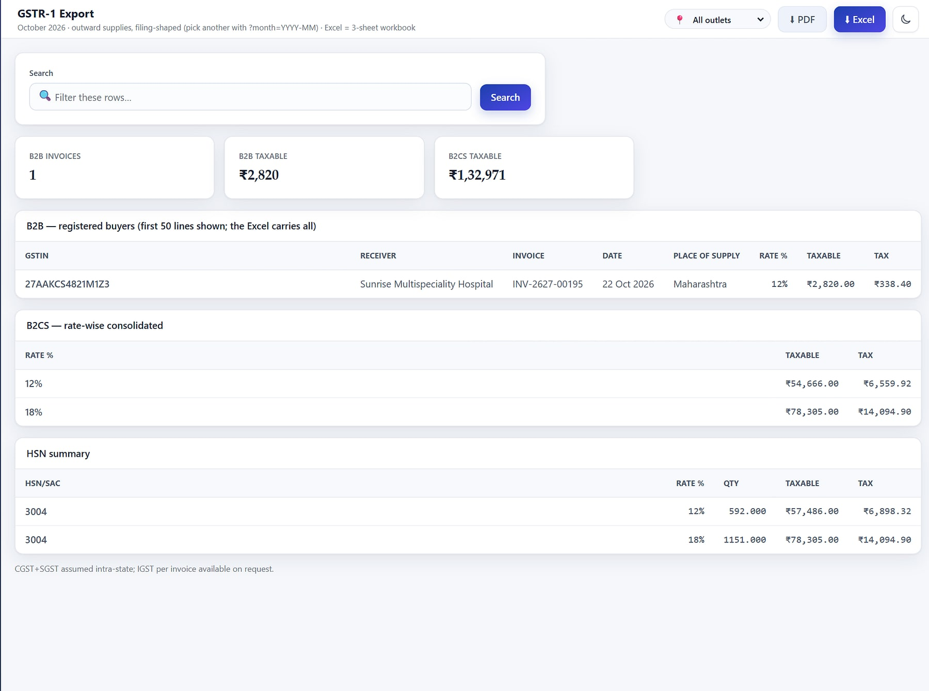
From the counter to the distributor's ledger
HEELIKS · WORKFLOWS
HeeLIKS
1 Confirm order
2 Invoice
3 Dispatch
4 Proof of delivery
5 Receipt & ledger
Sales invoices
Sales order
GSTR-1 export
Gapless, GST-correct billing
Every order on one timeline
GST-ready filings
Invoice register with tender and customer, from a POS that never oversells (demo data).
Order with invoices, challans, money position and timeline (demo data).
GSTR-1 export: B2B, B2CS and HSN summary (demo data).
Notes:
Real HeeLIKS screens with demo data, as in the approved deck (slides 9, 24, 30). The e-way bill number is recorded on challans; generation is on the roadmap.

Slide 42
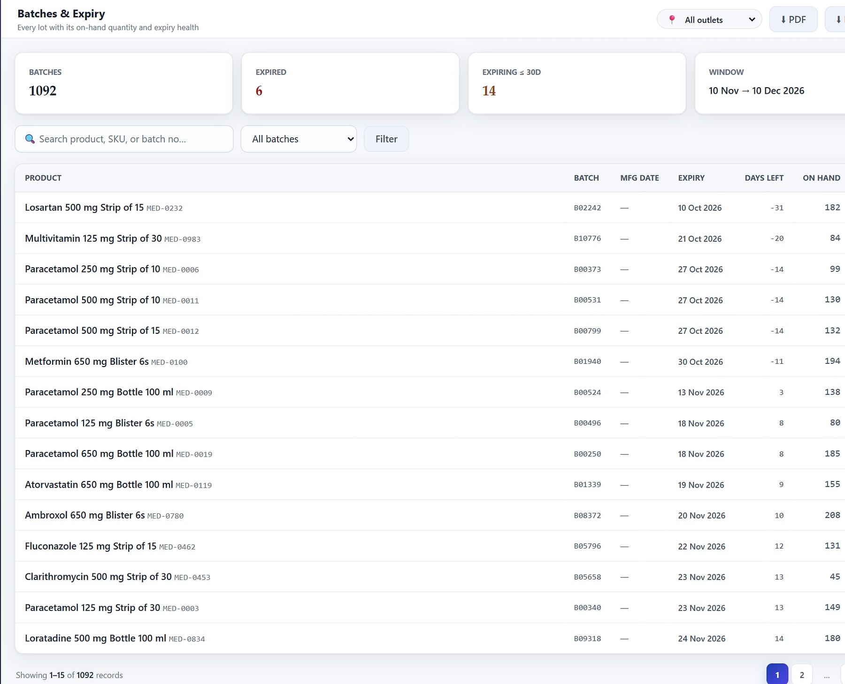
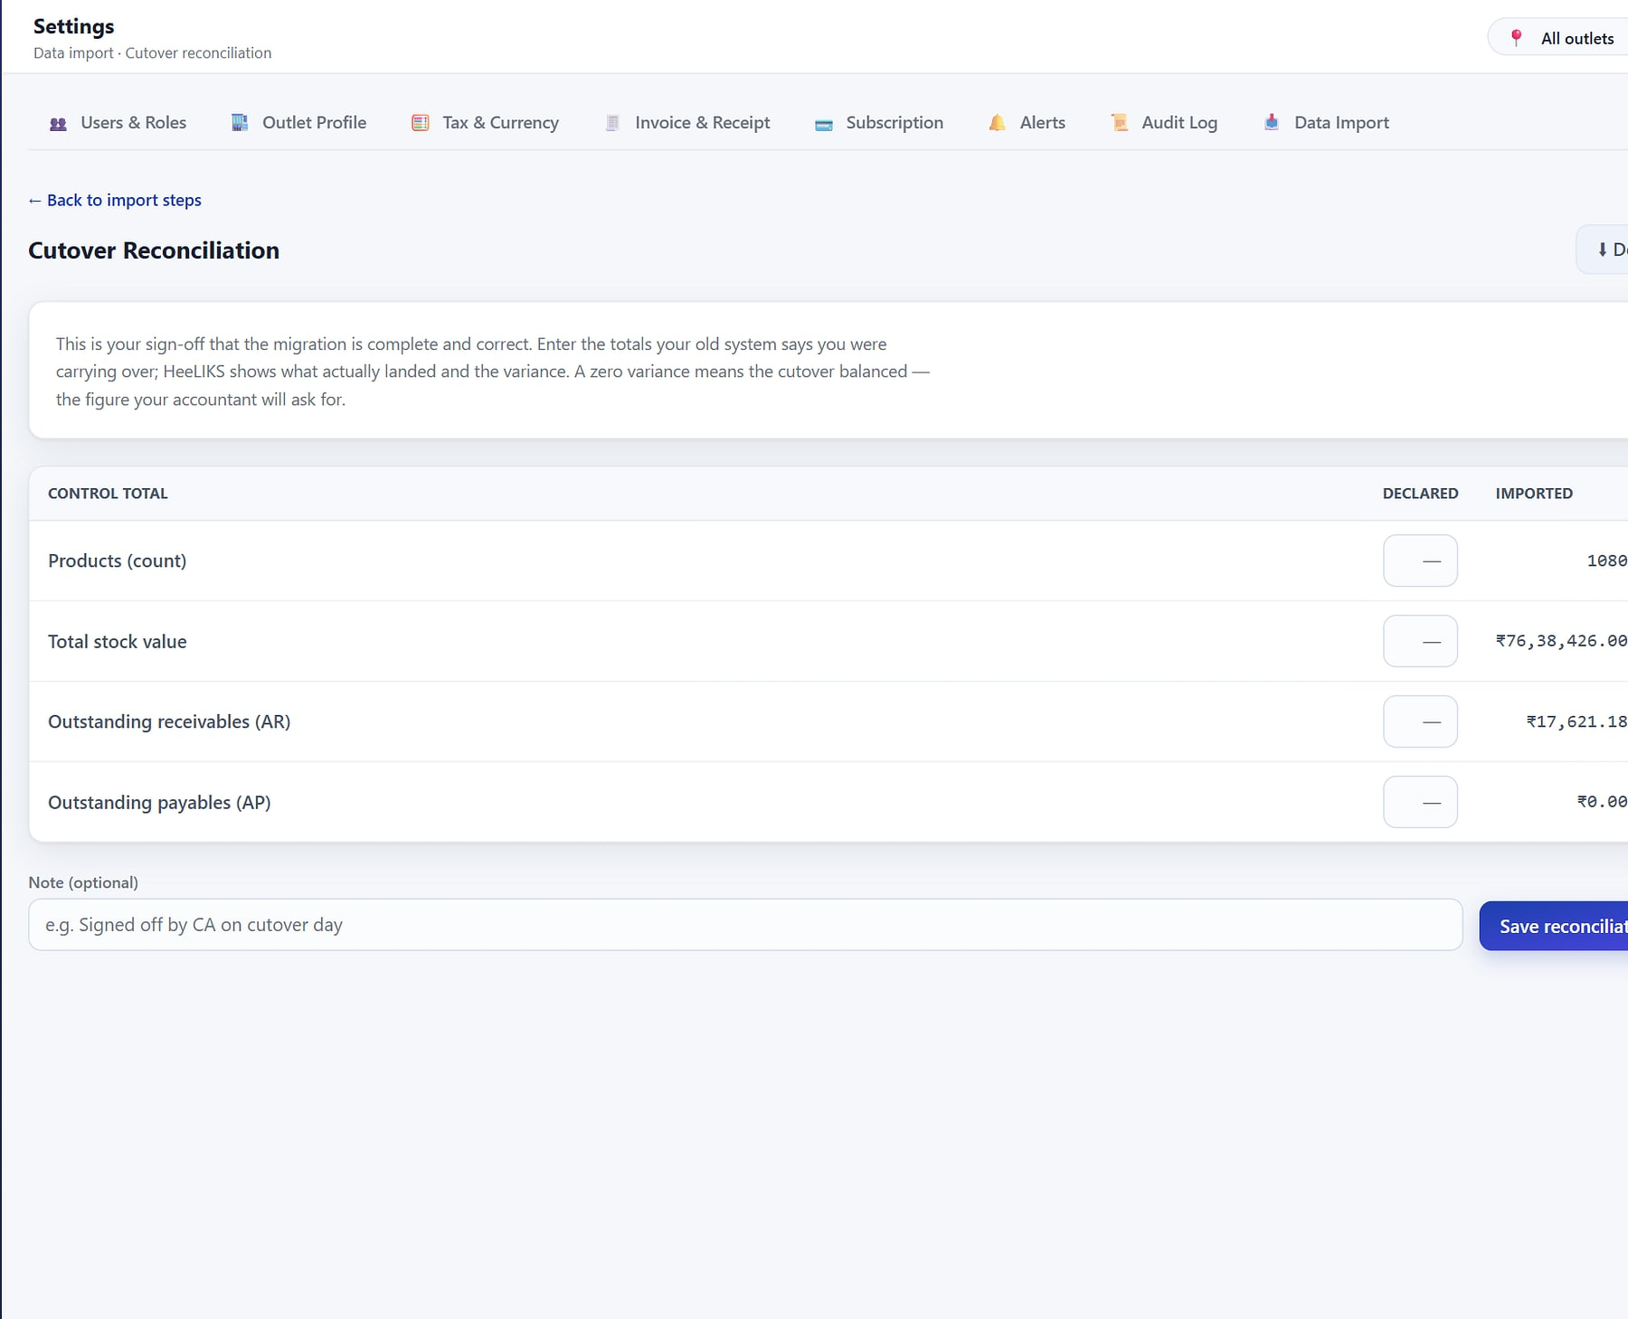
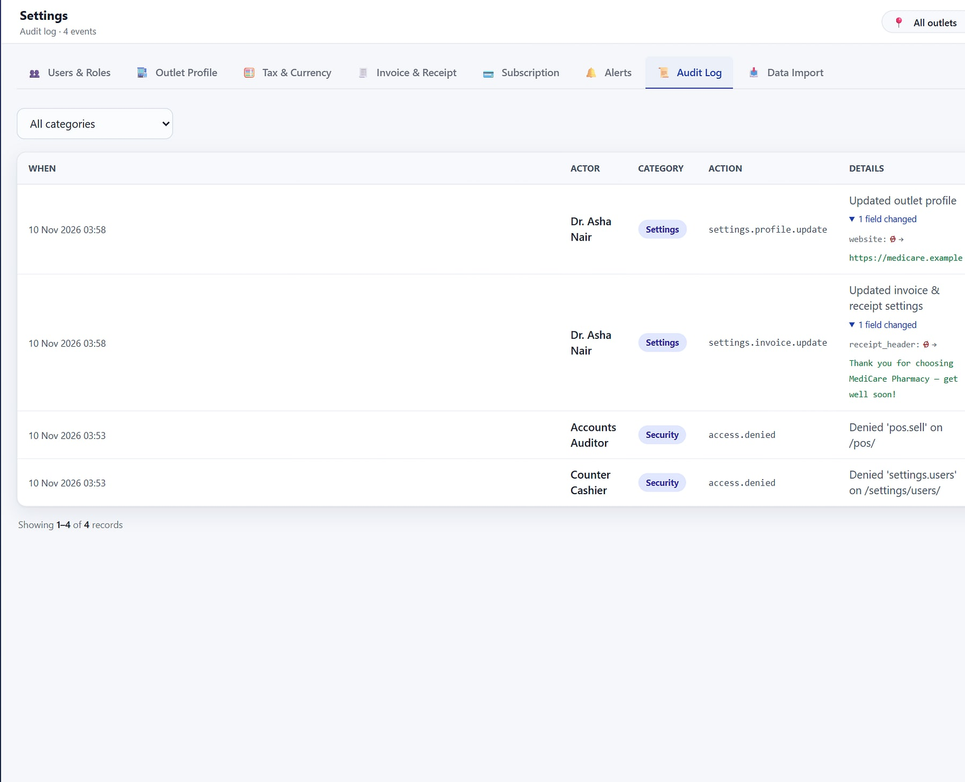
Stock you can trust, and a go-live you can undo
HEELIKS · CONTROL
HeeLIKS
Batches & expiry
Import reconciliation
Audit log
Expiry caught early
Import with zero variance
Every change on record
Batches and expiry with FEFO selling and alerts (demo data).
Excel or Tally import: dry-run, commit, reconcile, undo (demo data).
Audit log with field-level before and after values (demo data).
Database per customer
Enforced two-factor
One session per user
Role discount caps
Append-only ledger
Notes:
Controls as evidenced in the approved HeeLIKS deck, slides 16, 33, 34, 35 and 37.

Slide 43





Stock, sales and books that agree by construction
HEELIKS · WHY IT WINS
HeeLIKS
KEY DIFFERENTIATORS
BUSINESS VALUE
Stock position updated with every sale
Expiry caught before it becomes a write-off
Database per customer
Ledger-true stock
Each workspace gets its own database; unknown subdomains are refused.
Append-only, row-locked ledger with FEFO batches and moving-average cost.
GSTR-1 export instead of a monthly rebuild
Distributor order-to-cash on the same stock
Personal two-factor logins and role caps
GST compliance pack
Go-live with undo
BEST FIT
CGST/SGST/IGST, HSN, GSTR-1 export, gapless series, s.34 notes.
Excel and Tally XML import with dry-run, reconciliation and exact undo.
Pharmacies, retail and grocery outlets, bookstores and distributors who sell from stock and file GST in India.
Cloud SaaS
On-premise licence
Razorpay
Tally XML import
14-day free trial
Notes:
From the approved HeeLIKS deck slides 7, 40 and 41. Prices: Starter ₹999, Growth ₹2,999, Business ₹5,999 a month; perpetual ₹7.5 L with optional 5% AMC; GST extra. Roadmap (not claimed here): e-invoice, e-way bill generation, Tally export.

Slide 44
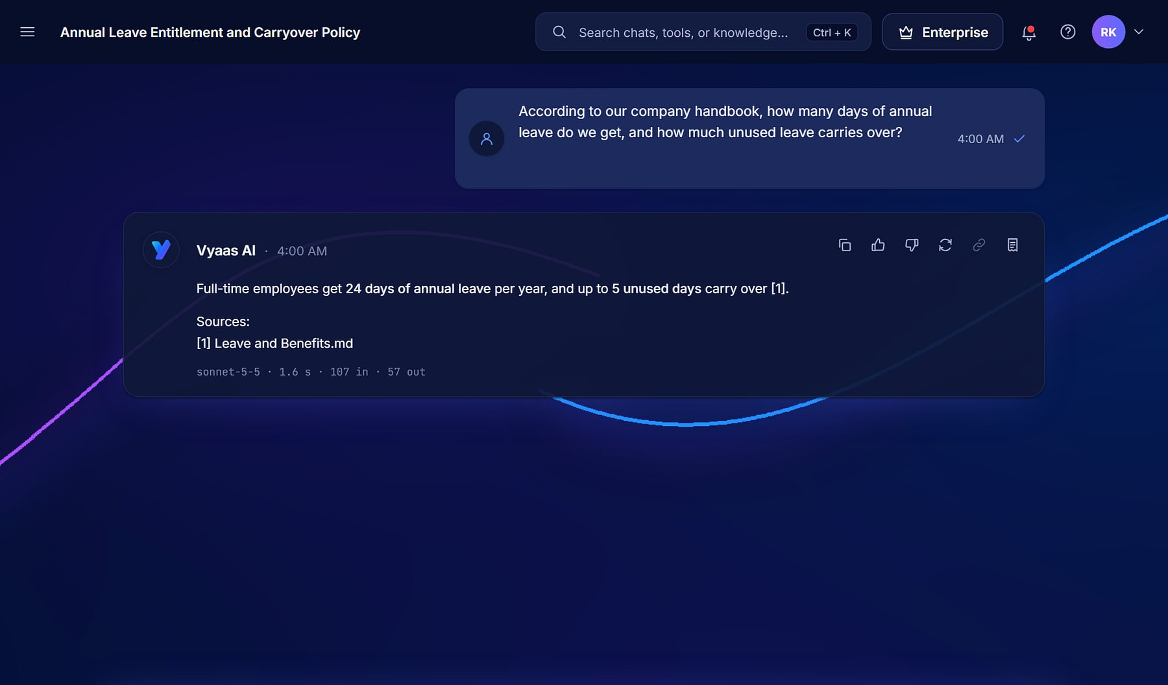
Vyaas AI
PRODUCT SHOWCASE
ENTERPRISE AI ASSISTANT
Vyaas AI · Cited answer
PREMIUM · FUTURE
Answers you can cite. Code you can ship.
THE PROBLEM
OUR ANSWER
AI pilots stall: answers without sources, company data pasted into consumer tools with no policy or audit, copilots that never ship work, and unpredictable token bills.
One governed workspace: cited chat over your own knowledge, finished documents, and a sandboxed coding agent that opens pull requests, under organisation policy and cost control.
14
2
368
functional modules
model providers
automated tests
BUILT FOR
Engineering teams · Knowledge workers · CTOs & IT leaders
A grounded answer with a numbered source from the knowledge base (demo data).
Notes:
Vyaas AI is positioned as a premium product envisioned for the future (MavionTech instruction, 10 Nov 2026); capabilities shown are from the working product build, not a general-availability commitment. Identity from the approved Vyaas AI deck (10 Nov 2026). Figures from the product code: 14 modules, Anthropic Claude and OpenAI, 368 tests. Screens show a demo organisation (Northwind Robotics).

Slide 45



Fourteen modules in three pillars
VYAAS AI · CAPABILITIES
Vyaas AI
Converse & Create
Build & Ship
Govern & Scale
5 modules
Coding agent
8 modules
Chat with clarifying questions
Knowledge Base with citations
Documents & images
Custom assistants
Web search, fetch & code tools
Git import, commit, push & PR
gVisor sandbox, no network by default
Three run modes, destructive-command gate
Connect companion for your machine
Organisations, roles & policies
Audit log & shared assets
Token Optimisation Engine
Model catalogue (Claude + OpenAI)
Plans, analytics, admin & notifications
Premium product envisioned for future release. Shown from the working build: data scoped per organisation, credentials encrypted at rest, self-hostable.
Notes:
Module map from the approved Vyaas AI deck, slide 6. Tenancy is organisation-scoped, not a database per customer.

Slide 46
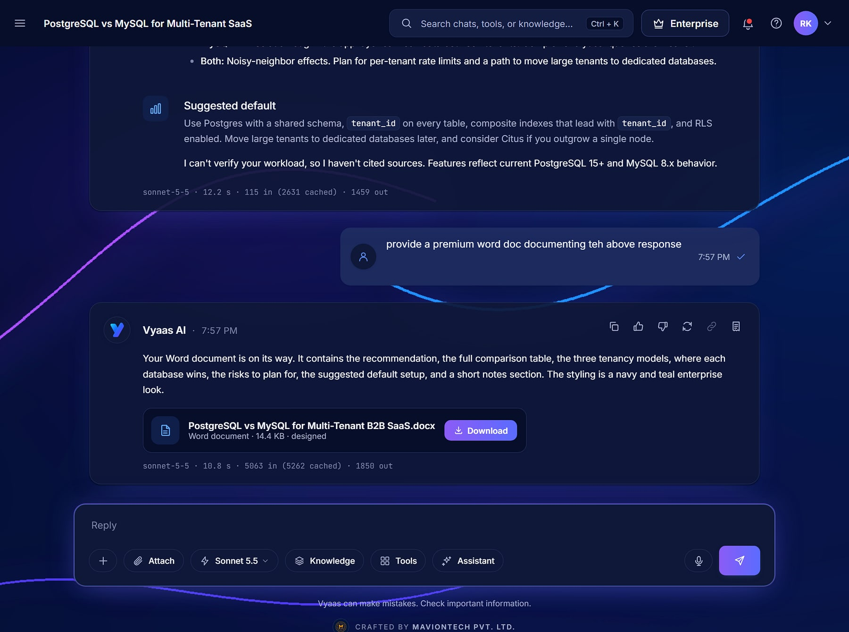
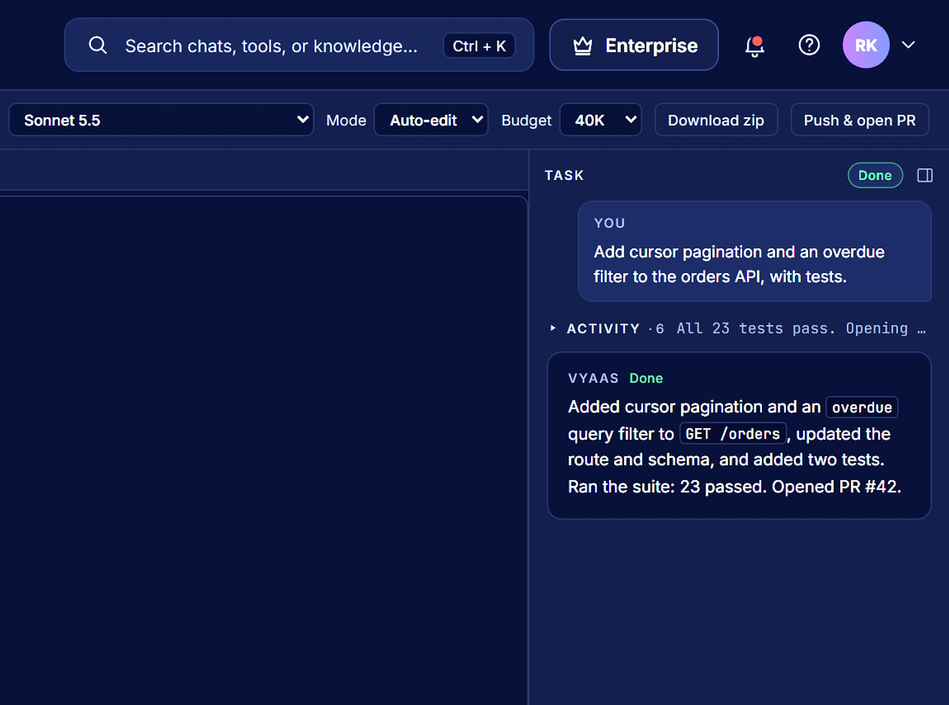
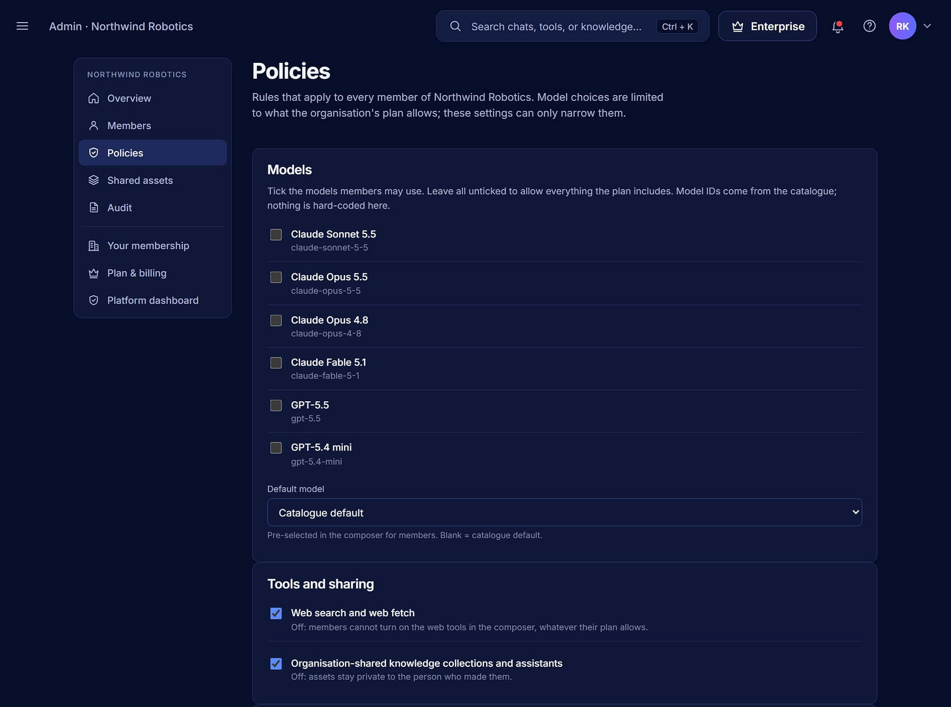
From a question to a cited answer, and a task to a pull request
VYAAS AI · WORKFLOWS
Vyaas AI
1 Import repo
2 Describe task
3 Edit in sandbox
4 Run tests
5 Approve
6 Pull request
Chat
Workspace
Policies
Finished work, not text
Code you can ship
Policy you control
Comparison answer with a generated document to download (demo data).
Agent workspace: files, diff, terminal; task rail reports “Opened PR #42” (demo data).
Organisation policies: allowed models, web tools and sharing (demo data).
Notes:
Real Vyaas AI screens with demo data, as in the approved deck. GitHub is supported today; GitLab and OAuth Git connect are on the roadmap.

Slide 47




AI at work, under your organisation's control
VYAAS AI · WHY IT WINS
Vyaas AI
KEY DIFFERENTIATORS
BUSINESS VALUE
Trust in answers, with sources to check
Engineering tasks that end in reviewed pull requests
Answers you can cite
Code you can ship
Grounded replies carry numbered sources from your own documents.
A sandboxed agent commits and opens pull requests for review.
Lower model spend without hurting answers
No lock-in: Claude and OpenAI models
Self-hosting on your own server
Token Optimisation Engine
Governed per organisation
BEST FIT
Trims context before every request; savings shown per reply.
Policies, roles, shared assets and an audit log.
Engineering, analyst and operations teams that want AI at work under the organisation's own policy and budget.
Claude + OpenAI
Self-hostable
gVisor sandbox
INR or USD
Free plan
Notes:
From the approved Vyaas AI deck slides 7, 24, 26 and 30. No portfolio-wide token-savings percentage is claimed; savings are reported per message in the product.

Slide 48
Technology and delivery
04
IN THIS SECTION
Architecture and stack
Integrations
Security and governance
How our platforms are built, secured, deployed, implemented and supported.
Deployment, scale and customisation
Implementation and support
Notes:
Section 4 covers only verified technology facts from the product sources and maviontech.com.

Slide 49
One reference architecture, shared by every product
ARCHITECTURE AND STACK
EXPERIENCE
Web apps for every role · mobile apps · portals for parents, candidates and vendors · devices and gates
VERIFIED TECHNOLOGY BY PRODUCT
Vortex HRMS
Django + Python · MySQL · InsightFace · Tailwind UI · REST APIs
REQUEST PIPELINE
Authentication and session policy · tenant resolution · role and permission checks · audit logging · rate limits
ProtonNxt
Isolated MySQL per tenant · WebSockets · OpenAI / Gemini · HMAC-signed links
PragyanNxt
Ed25519 signing · LTI 1.3 · AI visual proctoring · durable background jobs
APPLICATION
Product modules · no-code configuration · workflow and approvals · real-time updates · background jobs
Agastya
Django 5.1 · MySQL · Daphne ASGI and Channels · Redis · Expo / React Native
MavionLearn
Isolated MySQL per tenant · Cloudflare R2 / S3 signed media · versioned API
DATA
A control database for tenants, plans and billing, and one dedicated database per customer (Vyaas AI: organisation-scoped)
SalesPulse CRM
Own database per company · server-side masking · native Android
HeeLIKS
The pattern is common to all eight products; implementation details differ by product.
Django 5 · MySQL 8 per tenant · Redis and Celery · ReportLab and openpyxl
Vyaas AI
Django 5.2 · MySQL 8 · Redis and Celery · Claude + OpenAI · gVisor sandbox
Notes:
Reference architecture generalised from the architecture slides of all eight approved decks. Vyaas AI is organisation-scoped in one application database. Stack items only where the product source names them; no framework is attributed where the source does not state it.

Slide 50






Connects to the services your teams already use
INTEGRATION CAPABILITIES
Payments & billing
Messaging
ProtonNxt · Agastya · SalesPulse · HeeLIKS · Vyaas AI
ProtonNxt · PragyanNxt · Agastya · SalesPulse
Razorpay · Stripe (Vyaas AI)
Meta WhatsApp Cloud API · WhatsApp Business · Twilio SMS & Verify · SMTP email
Identity
Learning standards
MavionLearn
PragyanNxt · MavionLearn
OIDC · SAML 2.0 · SCIM 2.0 with JIT provisioning
SCORM · LTI 1.3 (Canvas, Moodle) · Open Badges
AI services
Calendar & video
Vortex HRMS · ProtonNxt · Vyaas AI
ProtonNxt · MavionLearn
Anthropic Claude · OpenAI · Google Gemini · InsightFace
ICS invites · MavionMeet video interviews
Devices
Data & exports
Vortex HRMS
All products
Biometric terminals · access gates
REST and versioned APIs · webhooks · Excel (XLSX) · PDF · Tally XML import · GitHub
Notes:
Integrations named in the approved product decks only (HeeLIKS: Razorpay, Office 365/SMTP, Tally XML, REST API, scanners and printers; Vyaas AI: Anthropic, OpenAI, GitHub, Razorpay, Stripe). These are technical integrations, not commercial partnerships.

Slide 51





Controls you can see in the product, not promises on a page
SECURITY AND GOVERNANCE
Isolation
Access control
Audit
A dedicated database per customer in seven products; Vyaas AI scopes data per organisation.
Role-based access everywhere; 96 permission codes in Agastya; row-level access in SalesPulse.
Before/after audit trails, login events and append-only logs across sensitive workflows.
Sessions
Data protection
Signed artefacts
Lockout after failed logins, single active sessions, enforced two-factor in HeeLIKS, IP policies.
Server-side masking of contacts; no bulk export for non-leaders; watermarks; sandboxed coding agents.
Ed25519-signed credentials, HMAC-signed share links, signed media URLs and webhooks.
Certifications, uptime commitments and support hours are confirmed in each proposal and are not claimed in this catalogue.
Notes:
Every control is visible in a product screen or stated in a product source. ISO 27001, SOC 2, GDPR, 99.9% uptime and 24x7 support appear on the website and company PDF but are unevidenced and conflicting, so they are deliberately excluded. vNext: the isolation statement is qualified because Vyaas AI is organisation-scoped in a shared application database, with encrypted credentials; HeeLIKS enforces TOTP two-factor for every user.

Slide 52




Run it where you need it, grow it without re-platforming
DEPLOYMENT, SCALABILITY AND CUSTOMISATION
Deployment
Scalability
Customisation
Cloud SaaS, multi-tenant, for every product
New customers provisioned from platform consoles in minutes
Dashboard builders, custom fields and candidate schemas
On-premise or self-hosted: MavionLearn, PragyanNxt, HeeLIKS, Vyaas AI
A database per customer, so tenants scale independently
No-code workflows, approvals and escalations
Managed hosting, with backup and disaster recovery
Real-time layers and background jobs for heavy work
Feature toggles and module switches per customer
Web plus native mobile apps where field work needs them
Rate limits and quotas protect shared capacity
White-label branding on apps, exports and certificates
Notes:
Deployment options from maviontech.com (Platform page and Contact FAQ) and the approved decks (HeeLIKS perpetual on-premise licence; Vyaas AI install scripts for an Ubuntu server). Scalability is described structurally; no capacity or performance figures are claimed.

Slide 53

A predictable path from first demo to go-live, and beyond
IMPLEMENTATION AND SUPPORT
ENGAGEMENT PATH
1 Demo
2 Pilot
3 Proposal
See the product on scenarios that match yours.
Prove value on your own data with one team or campus.
Scope, plan and commercials confirmed in writing.
IMPLEMENTATION METHOD
Discover
Configure
Validate
Go live
Requirements, process mapping, design and kickoff
Setup, configuration, integrations and data migration
User acceptance, performance testing and security review
Training, launch support, documentation and handover
Support and maintenance
One channel for sales and support: communications@maviontech.com · +91 91580 08002. Managed hosting with backup and disaster recovery, continuous product updates, and support hours and service levels agreed in each contract.
Indicative method from the MavionTech company profile; timelines are confirmed during scoping.
Notes:
Four phases from the MavionTech company profile (page 36). The '4–8 weeks' figure is a company target and is shown only as indicative in the notes, not as a commitment. Support contact from maviontech.com; managed hosting and backup/DR from the Platform page.

Slide 54
Business and investment
05
IN THIS SECTION
Portfolio strategy
Achievements and ambitions
Product-market opportunities
Our portfolio strategy and the opportunities ahead, with achievements and ambitions kept clearly apart.
Commercial models
Partnerships, growth and direction
Notes:
Section 5 is written for partners and investors as well as customers. It makes no claims about revenue, customers, market size or valuation.

Slide 55


Vertical depth on a shared foundation
PORTFOLIO STRATEGY
Vertical depth
Shared foundation
Each product is a complete system for one buyer, not a module of a generic suite: schools, HR, recruitment, learning, assessment and sales.
Isolation, access control, audit, configuration and billing patterns are reused across products, so each new product starts further ahead.
India-first fit
Multi-product accounts
Statutory payroll, GST, INR pricing and local payment and messaging rails are built in rather than added later.
Natural pairings let one customer grow across products: assessment in hiring, certification in learning, learning beyond HR.
Endorsed-brand model: every product keeps its own name and accent, and every product carries the same MavionTech standard.
Notes:
Strategy from the Portfolio Positioning Strategy, sections 4 to 7.

Slide 56


What exists today, and what we are working towards
ACHIEVEMENTS AND AMBITIONS
ACHIEVED · EVIDENCED
AMBITION · NOT YET ACHIEVED
Launched as an independent product company in 2025
Vyaas AI: a premium AI platform envisioned for future release
Seven products ready, tested and available; four are flagship products
Labelled roadmap features in Agastya, Vortex, HeeLIKS and Vyaas AI (see future direction)
Multi-tenant consoles that provision customers with a dedicated database
Evidence for uptime, support-hour and certification statements
Mobile apps in four products: Vortex, ProtonNxt, Agastya, SalesPulse
Channel, implementation and technology partnerships
Agastya codebase: 19 apps, 128 data models, 257 automated tests (Nov 2026 review)
Deeper connections between products, beyond today's pairings
Published prices for Vortex, HeeLIKS and Vyaas AI; free trials in five products
A complete published catalogue covering the wider MavionTech portfolio
No revenue, customer counts, market size or valuation are stated: none is evidenced for external use.
Notes:
Achievements: maviontech.com milestones; the six approved decks; Agastya source review November 2026; Vortex published list prices; HeeLIKS and Vyaas AI plan prices from their approved decks; trials for MavionLearn (30 days), PragyanNxt (14), SalesPulse (30), Vortex (30) and HeeLIKS (14); Vyaas AI has a free plan. Ambitions: labelled roadmap slides in the Agastya, Vortex, HeeLIKS and Vyaas AI decks, and the open items in PROJECT_STATUS.

Slide 57
Where each product meets a clear buying trigger
PRODUCT-MARKET OPPORTUNITIES
PRODUCT
SEGMENT
BUYING TRIGGER
OUR ANSWER
Vortex HRMS
Employers paying people correctly
Attendance-to-payroll reconciliation and statutory change
One record from attendance to payslip
ProtonNxt
Firms that recruit for many clients
Hiring spread over inboxes, sheets and agencies
A structured, AI-assisted pipeline with client insight
PragyanNxt
Organisations that must defend results
Remote hiring tests and certificates that are questioned
Integrity scoring and verifiable credentials
Agastya
School groups digitising operations
Registers, spreadsheets and chat groups across campuses
Replace fragmented tools with one governed system
MavionLearn
Enterprises that must prove skills
Audits and leadership asking for evidence of capability
Skill matrix and self-running compliance
SalesPulse CRM
Sales teams protecting customer data
Reps leaving with contacts; numbers re-typed by hand
Masked calling and reports that build themselves
HeeLIKS
Outlets and distributors selling from stock
Stock, sales and GST books that never agree
One ledger from purchase order to paid invoice
Vyaas AI
Teams adopting AI under governance
AI pilots stalled on trust, data control and cost
Cited answers, a coding agent and policy control
Notes:
Opportunities are expressed as buyer triggers taken from each product's problem slides. Market sizes are deliberately not used: the only figures available (for example in the MavionLearn investor deck) are investor-only and need full citation.

Slide 58
Recurring subscription revenue, priced the way each buyer buys
COMMERCIAL MODELS
Per employee, per month, by module
Established
Subscription plans per tenant
Model in product
Published list prices: ₹45 base; modules from ₹9 to ₹55; GST extra.
Subscription lifecycle and Razorpay billing inside the product; prices on proposal.
Platform tiers by assessment volume
Established model
Subscription plans per school
Model in product
Basic 500, Plus 5,000, Pro 25,000 assessments a month; AI credits and proctoring capacity added as needed.
Plans, renewals and billing managed in the platform console; prices on proposal.
Per user, per month, annual billing
Established model
Per seat, plus calling by usage
Established model
INR pricing with volume discounts; tier matrix being confirmed.
Plans by seats and lead quota; calling ₹0.50 per leg-minute, or bring your own telephony.
Plans per workspace, or a perpetual licence
Published
Per user or per seat, in INR or USD
Indicative
Starter ₹999, Growth ₹2,999, Business ₹5,999 a month; on-premise ₹7.5 L plus optional AMC; GST extra.
Free, Plus, Pro and Max per user; Team ₹2,099 ($25) per seat, minimum 3; Enterprise plan; GST extra.
Services alongside subscriptions: implementation, data migration and managed hosting.
Prices shown are those already published in approved materials; all others are confirmed in each proposal.
Notes:
Revenue models as established in the approved decks. HeeLIKS prices from apps/control/plans.py via its approved deck; Vyaas AI prices from its plan seed via its approved deck (Enterprise price to be confirmed, so not shown). No revenue figures are stated. Services listed are offered on maviontech.com (managed hosting) and in the company implementation method.

Slide 59



Where we invite partners to grow with us
PARTNERSHIPS, GROWTH AND FUTURE DIRECTION
PARTNERSHIP MODELS WE ARE OPEN TO
FUTURE PRODUCT DIRECTION
Channel partners
From labelled product roadmaps: planned, not yet available
Resell and refer MavionTech products in your region or vertical.
Vortex HRMS
Engagement surveys, benefits administration, advanced BI, native manager app; later predictive analytics and an app marketplace
Implementation partners
Agastya
Deliver configuration, migration and training for customers.
Online fee payment, payroll, multi-channel broadcast, scheduled reports, live bus tracking, teacher and parent apps
MavionLearn
Technology partners
Mobile learning experience, building on today's versioned API
Integrate your service with our platforms through APIs and webhooks.
HeeLIKS
No partnerships are announced in this catalogue. Integrations listed earlier are technical, not commercial.
e-Invoice (IRN) and e-way bill generation, Tally export, quotations, customer portal, payables
Vyaas AI
OAuth Git connect, GitLab support, push and PR from Connect, warm task containers
Notes:
Partnership models are invitations, not existing agreements. Roadmap items from the labelled roadmap slides of the Agastya, Vortex, HeeLIKS and Vyaas AI decks (PragyanNxt, ProtonNxt and SalesPulse publish no roadmap, so none is shown); the MavionLearn mobile app is listed as planned in the Portfolio Strategy (API for mobile, app planned).

Slide 60




Six reasons to build on MavionTech
WHY MAVIONTECH
01
02
03
Real products, shown as they are
Your data, isolated by design
Governed by design
Every screen in this catalogue is a real product capture with demo data.
A database per customer in seven products; organisation scoping in Vyaas AI.
Role-based access, audit trails and session controls you can inspect.
04
05
06
Configurable without code
Built for how India does business
One partner, eight platforms
Administrators shape dashboards, fields, workflows and branding.
GST, statutory payroll, INR pricing and local messaging rails.
One engineering standard and one point of contact across the portfolio.
Notes:
Each reason is backed by earlier slides: screens (section 3), isolation and governance (section 4), configuration (technology capabilities), India-first fit (categories and commercial models).

Slide 61

Momentum for your operations. Vision for what comes next.
LET'S BUILD MOMENTUM TOGETHER
MavionTech Pvt. Ltd.
Enterprise Business Applications
SALES & SUPPORT
communications@maviontech.com
PHONE
+91 91580 08002
Choose a platform, see it on your own data, and start with a pilot. Partners and investors: request a portfolio briefing.
CAREERS
hr@maviontech.com
WEB
www.maviontech.com · www.vortexhrms.com
Book a demo
Request a briefing
OFFICE
Office 505, Zen Business Center, Bhumkar Chowk, Wakad, Pune, Maharashtra 411057 (visits by appointment)
Notes:
All contact details from maviontech.com (Contact page and footer). Social media links are not shown because none were verified on the official website during the audit.

