Slide 1

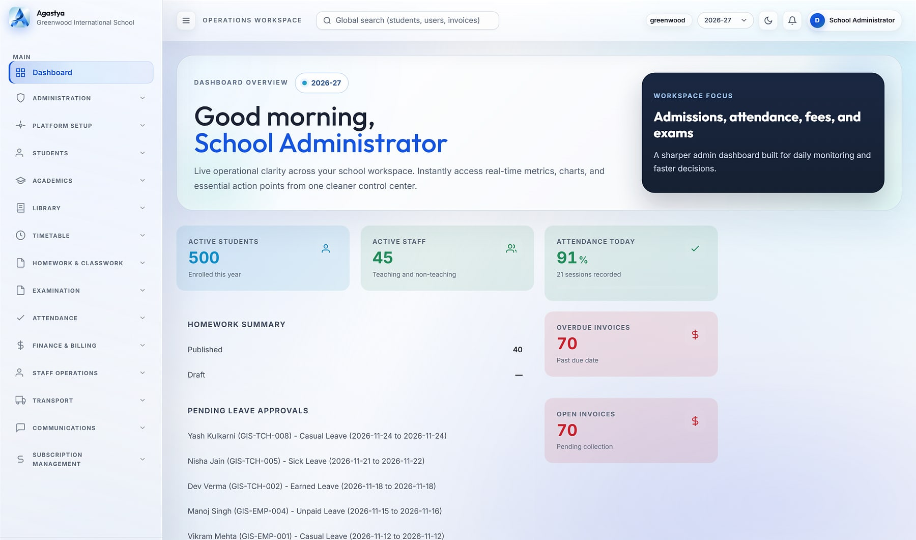
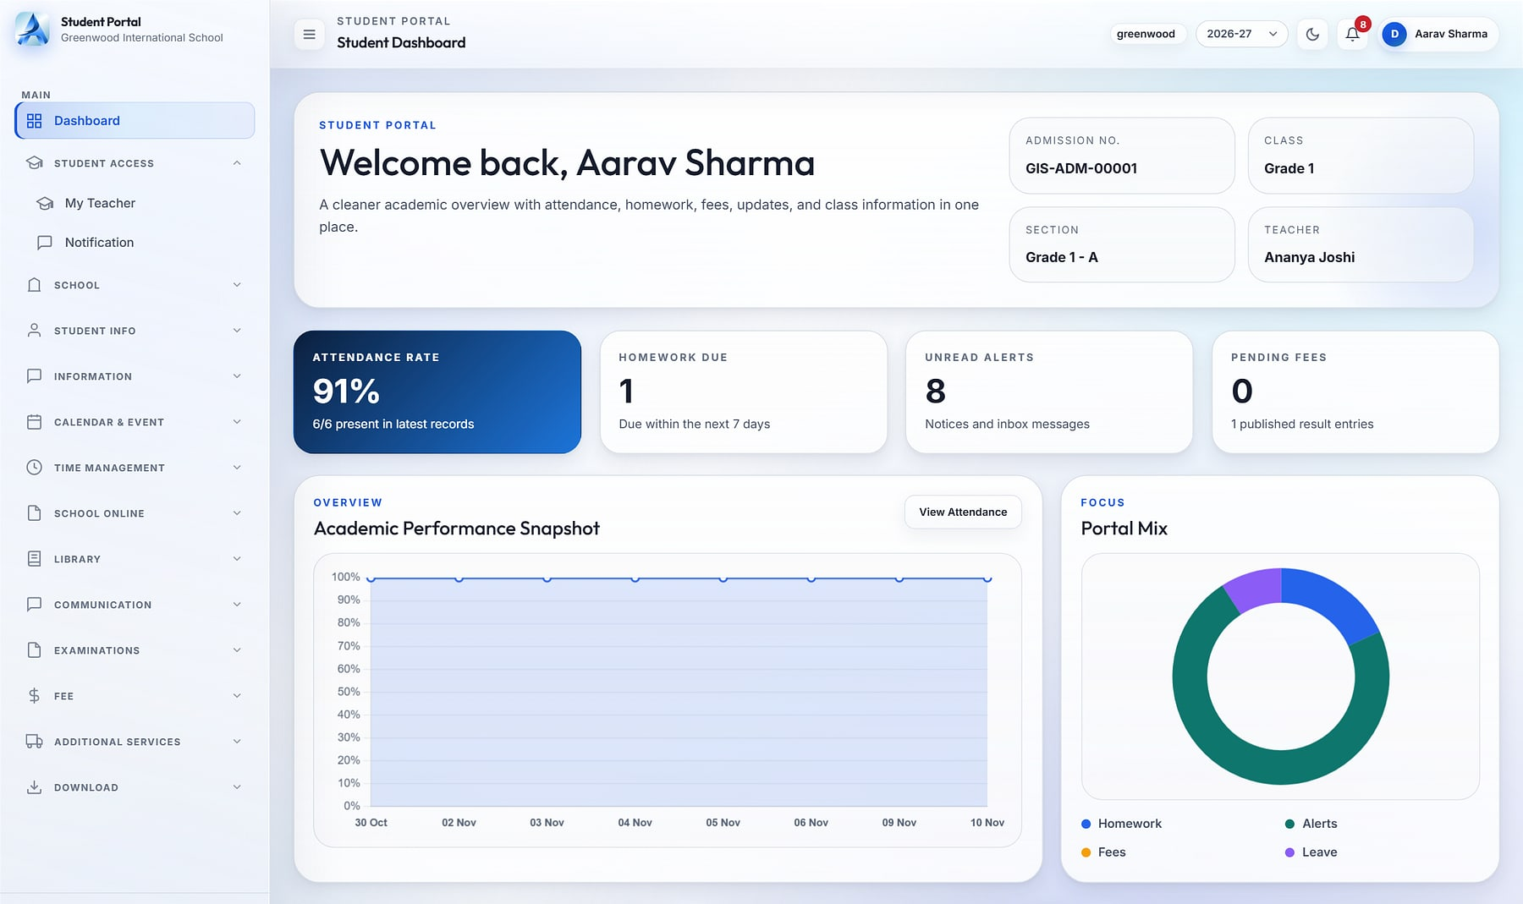
Agastya
Agastya · School administrator dashboard
ENTERPRISE SALES OVERVIEW
CLOUD SCHOOL ERP
One operating system for every school in your group
From admission to report card, fee to fleet: every department, persona and campus on one governed platform, with each school's data in its own database.
19 integrated modules
8 role cockpits
Database per school
Notes:
Opening. Agastya is MavionTech's multi-tenant cloud school ERP for K-12 schools and school groups. Every screen in this deck is a live screenshot from the running product with a demo school (Greenwood International School: 500 students, 45 staff).

Slide 2




School groups still run on registers, spreadsheets and WhatsApp
THE CHALLENGE
Fragmented tools
Leadership flies blind
Admissions in one tool, fees in another, attendance on paper. Nothing reconciles, and every report is a manual export.
Principals and group heads wait days for numbers that should be live: attendance, collections, marks and leave.
Data risk across campuses
Parents out of the loop
Student records sit in shared spreadsheets and personal phones, with no access control and no audit trail.
Updates are scattered across personal WhatsApp groups, paper circulars and calls to the front office.
Notes:
The status quo in most school groups: disconnected tools, delayed visibility for leadership, uncontrolled student data, and parent communication over personal channels. Agastya addresses all four on one platform.

Slide 3

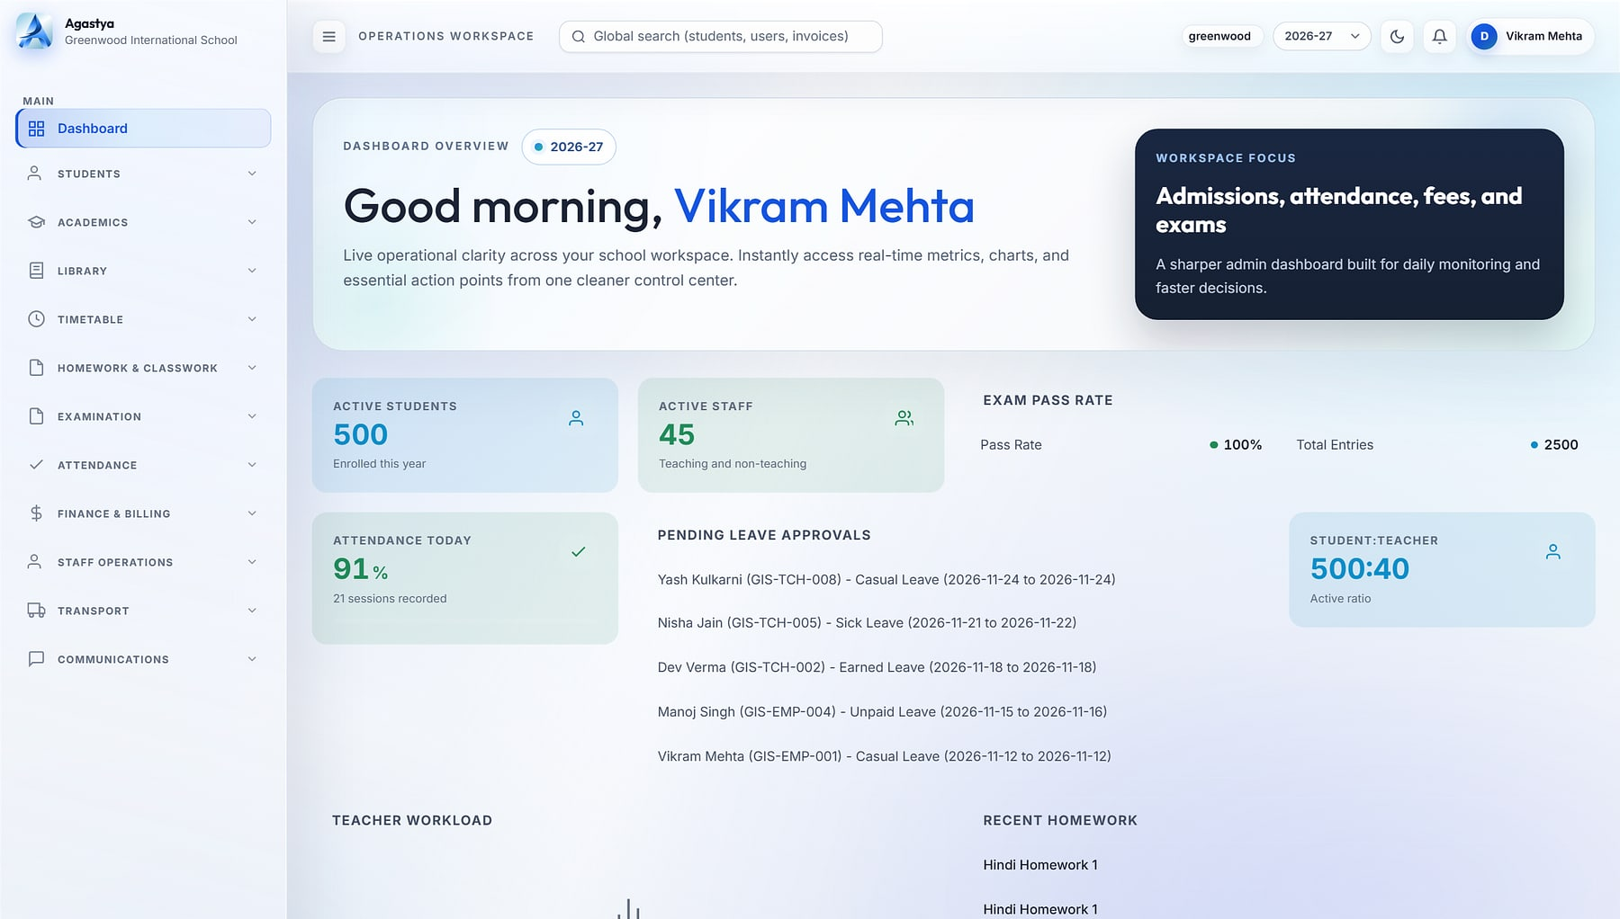

Meet Agastya: one platform for every school operation
THE PLATFORM
Run every operation
Agastya · Principal dashboard
Admissions, academics, attendance, exams, fees, HR, transport, library, hostel, inventory and front office on one data model.
See every school
Live, role-specific cockpits for group heads, principals, teachers, accountants, parents and students.
Govern every record
A dedicated database per school, 96 permission codes and a before/after audit trail.
Principal cockpit: school-wide KPIs, exam pass rate, pending leave approvals and teacher workload (demo data).
Notes:
Agastya in one sentence: run every operation, see every school, govern every record. The principal's cockpit shown here is computed live from the operational data.

Slide 4
Enterprise depth you can verify in the codebase
AT A GLANCE
19
128
456
96
integrated application modules
data models
web routes and screens
granular permission codes
36
8 + custom
257
~115K
pluggable dashboard widgets
system roles plus unlimited custom roles
automated tests, incl. E2E and accessibility
lines of product code
Source: review of the Agastya source tree, November 2026 (19 Django apps; 242 unit/integration tests + 15 Playwright end-to-end journeys with axe-core accessibility checks).
Notes:
These numbers come from the code, not a brochure. 19 application modules map to the 19 product modules on the next slide.

Slide 5





19 modules across six pillars, on one data model
PRODUCT MAP
Command & governance
Academics
Operations & finance
3 modules
6 modules
5 modules
Role dashboards & builder
Administration & RBAC
Platform setup & branding
Admissions & student lifecycle
Academics & syllabus
Timetable & substitution
Attendance
Homework & classwork
Exams & report cards
Fees & billing
Staff operations & HR
Transport
Inventory & procurement
Service desk & front office
Campus life
Engagement
Platform
2 modules
2 modules
1 module
Library
Hostel, health & discipline
Communications & WhatsApp inbox
Student & parent portals, student app
Multi-tenant SaaS console, plans & billing
One data model. Attendance feeds report cards, fee plans feed invoices, routes feed manifests, and every role sees the same live record.
Notes:
The product map. Every module shares one student, staff and academic-year model. Online fee payment, payroll and live bus GPS are roadmap items and are not counted here.

Slide 6






Each role gets exactly the screens it needs
BUILT FOR EVERY PERSONA
Group / platform admin
School admin
Principal
Teacher
Provision schools, plans and subscriptions from one console.
Configure roles, modules, branding, numbering and master data.
School-wide KPIs, approvals, pass rates and results.
Timetable, attendance, marks and homework for own sections.
Accountant
Operations staff
Parent
Student
Invoicing, collections, dues, receipts and the ledger.
Front office, library, hostel, transport and store.
Children, homework feed, results and school notices.
Web portal and mobile app for the whole school day.
Eight system roles ship out of the box; schools can add unlimited custom roles with scoped assignments.
Notes:
Eight system roles ship out of the box, and schools can define unlimited custom roles with scoped assignments.

Slide 7
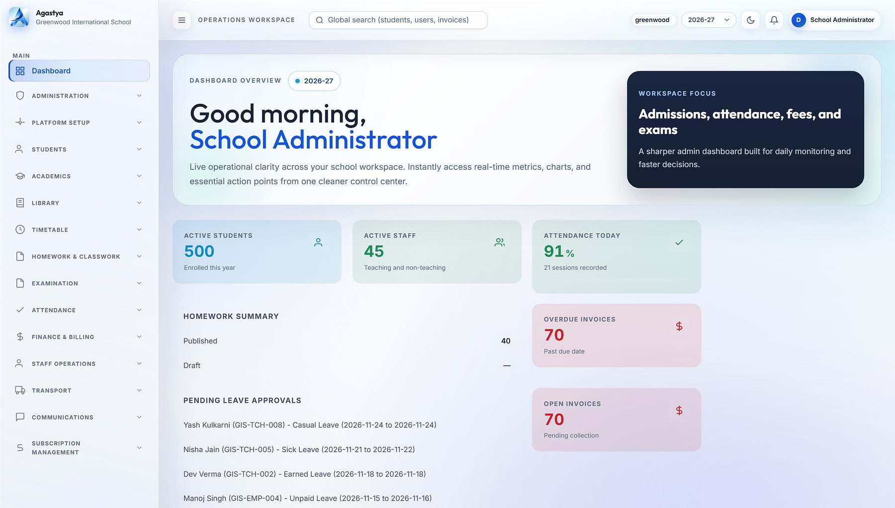



A live command centre for every school
COMMAND CENTRE
Agastya · Dashboard
Live KPIs
Active students, attendance today, overdue invoices and student-teacher ratio.
Action queues
Pending leave approvals, open invoices and homework status in one view.
Scope and search
Switch campus and academic year; search students, users and invoices globally.
Always current
Widgets load asynchronously and refresh without reloading the page.
School administrator dashboard: 500 students, 45 staff, 91% attendance today, 70 overdue invoices (demo data).
Notes:
The school administrator's landing page. Every number is computed live from operational data: no exports, no spreadsheets.

Slide 8
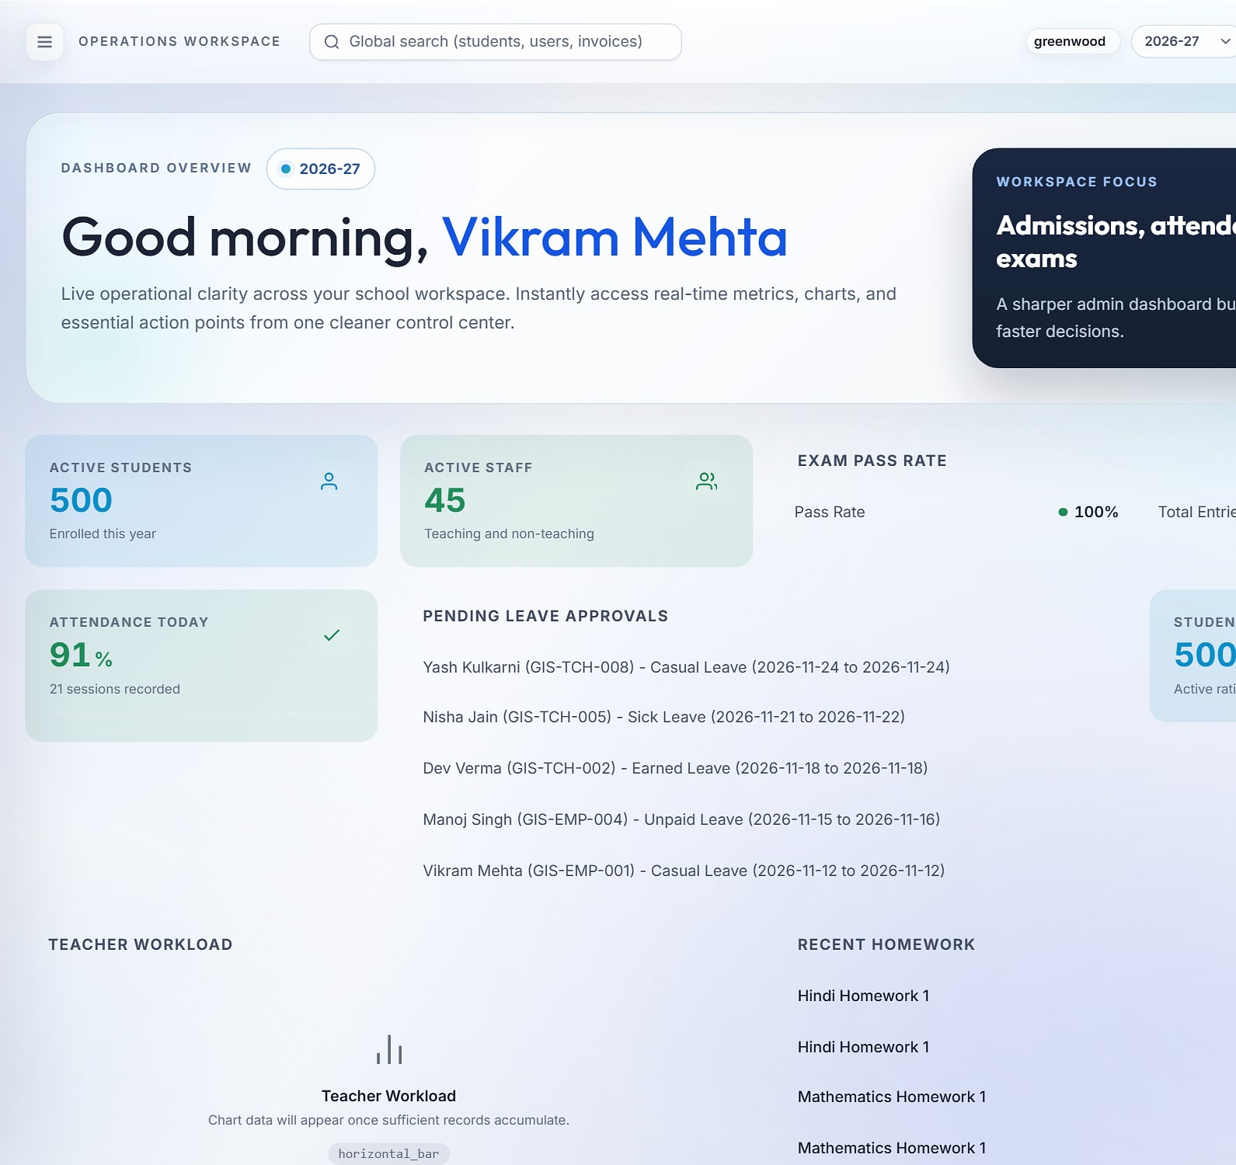
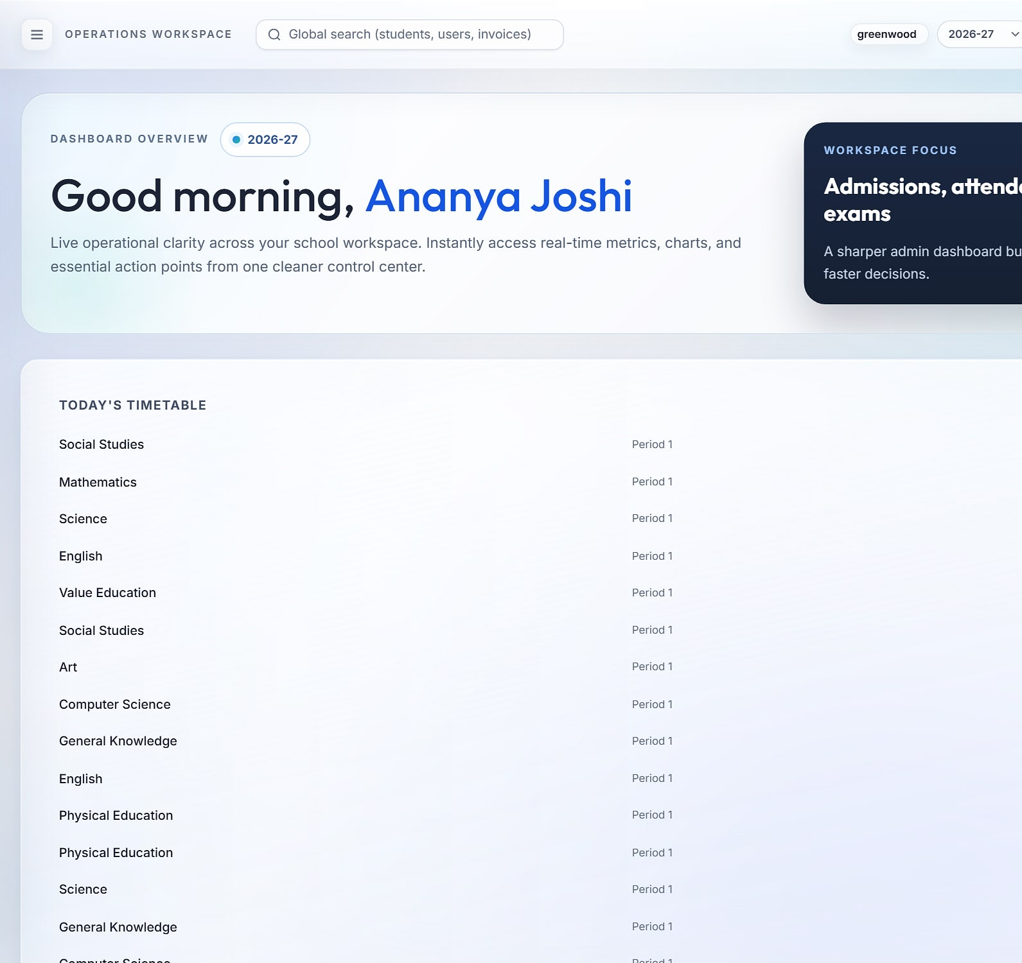

One login, a different cockpit for every role
ROLE-BASED EXPERIENCE
Principal
Teacher
Student
School-wide KPIs, exam pass rate, leave approvals and teacher workload.
Today's timetable across classes and rooms, with the day's teaching load.
Today's periods and the student's own day at a glance.
Notes:
The same /dashboard address renders a different set of widgets for each role, configured per school with the dashboard builder.

Slide 9
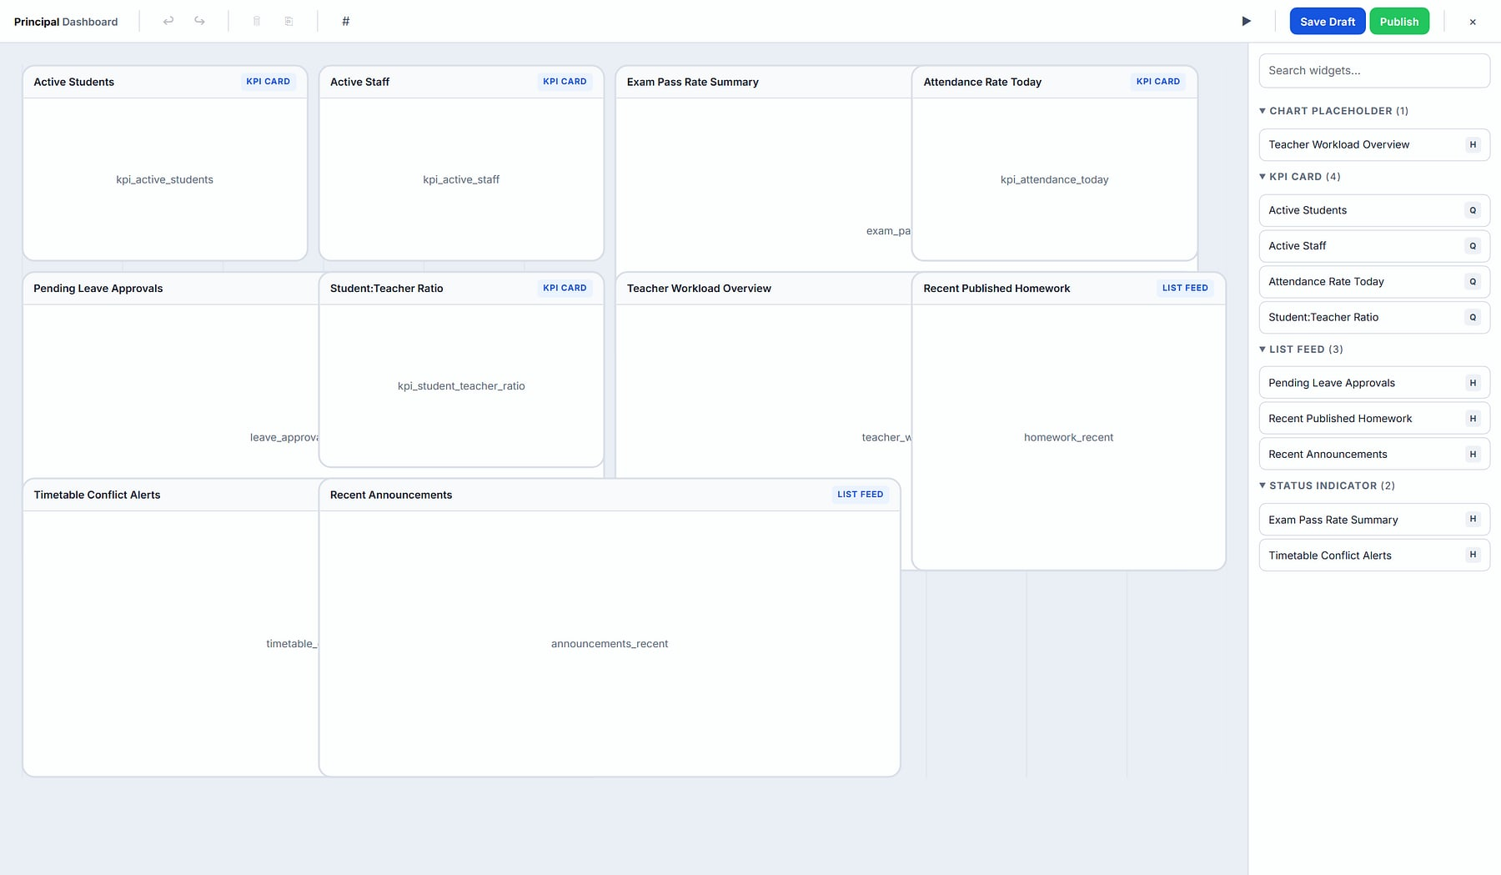
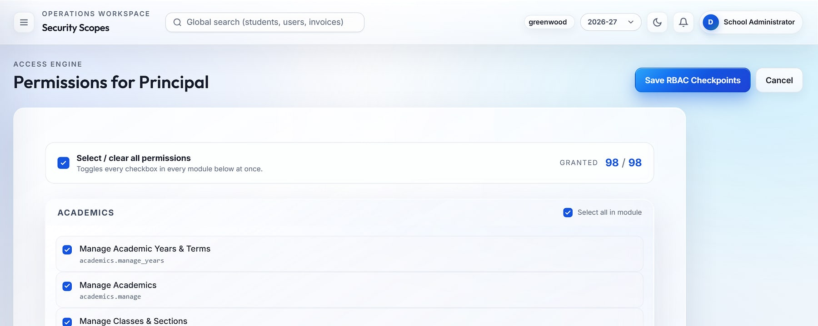
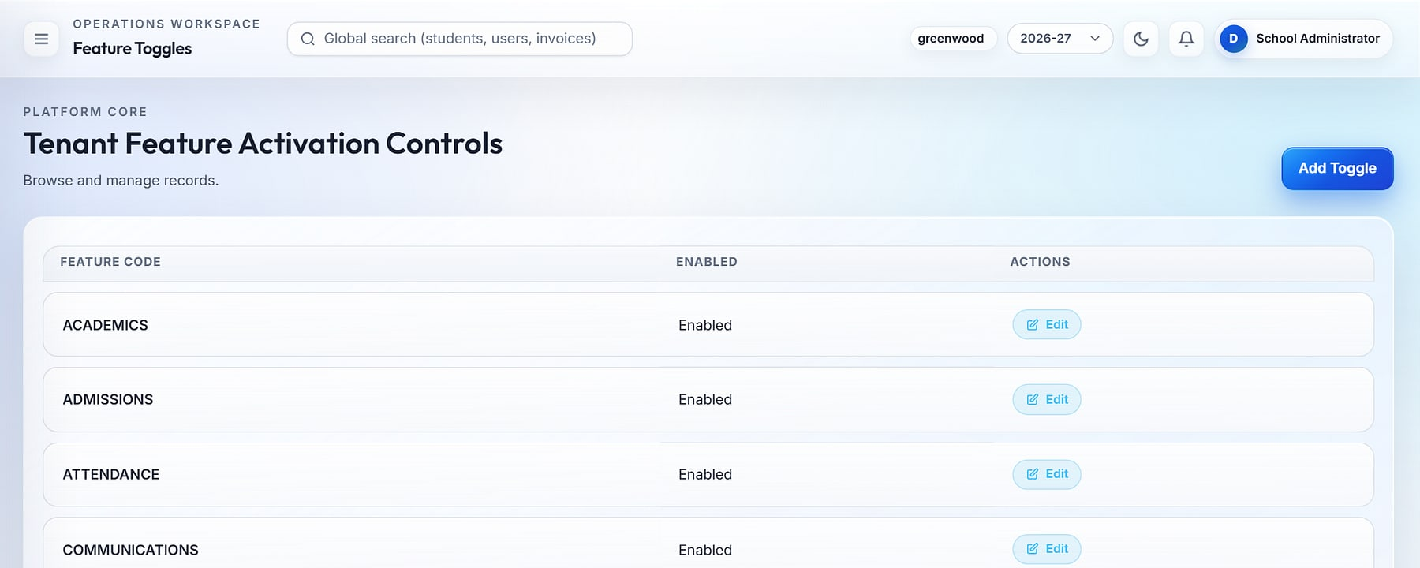
Leaders reconfigure the platform without developers
CONFIGURABLE BY DESIGN
Dashboard builder
Permissions for Principal
1
2
Feature toggles
3
1
Dashboard builder: 36 widgets; draft, publish, revert
2
Permission matrix: 96 codes across 15 module groups
3
Feature toggles switch modules on per school
Notes:
Configuration first: dashboards, roles, permissions, feature toggles, custom fields, numbering sequences and branding are all managed in the user interface.

Slide 10
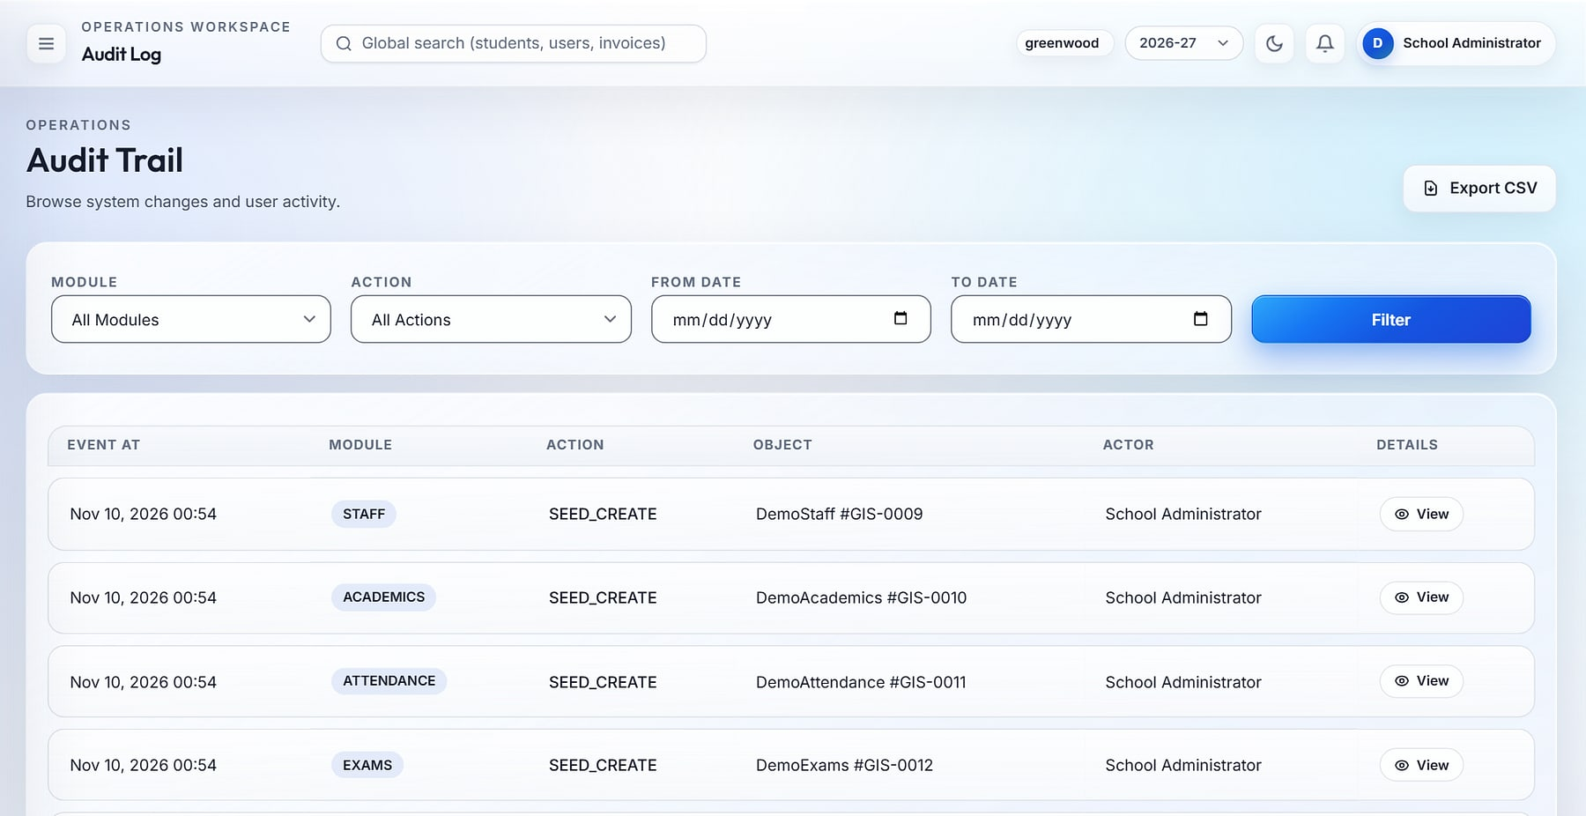
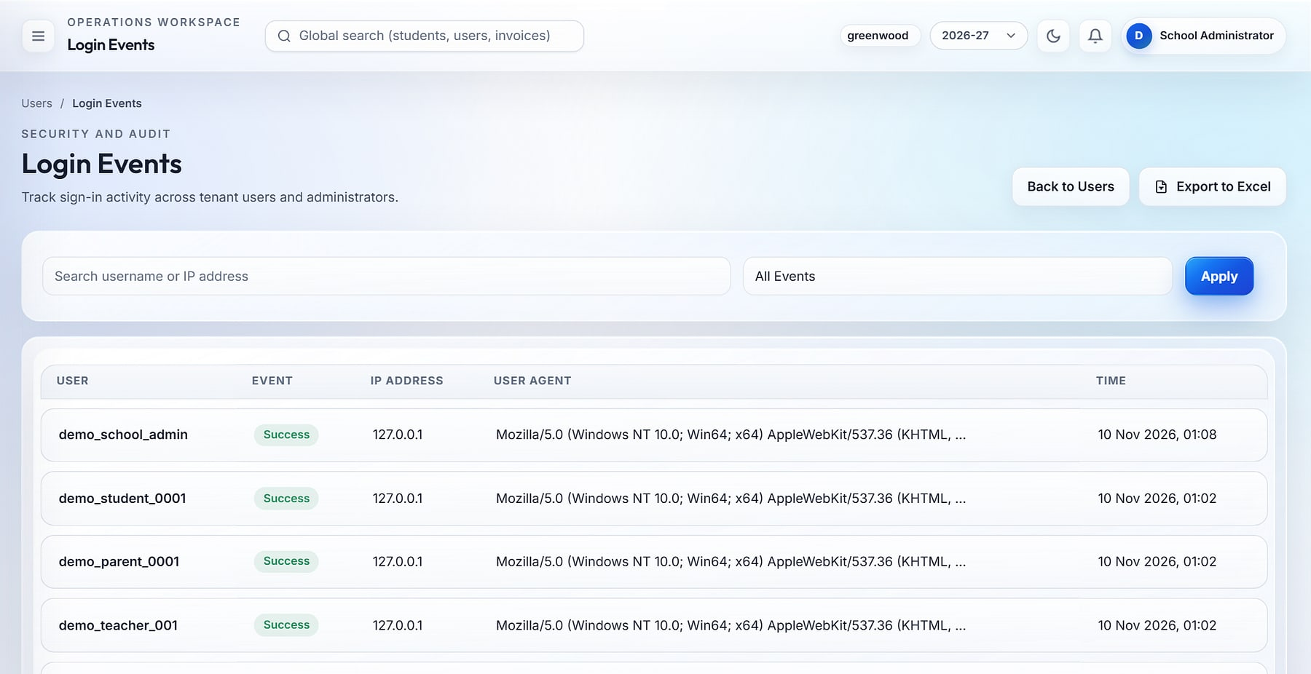

Every action traceable, every account protected
GOVERNANCE & SECURITY
Audit trail
Login events
Audit log: filter by module, action and date; CSV export.
Login events: success and failure with IP address and device.
Before/after audit values
Lockout after 3 failed logins
One active session per user
4-hour sliding HttpOnly sessions
96 permission codes, scoped roles
Signed webhooks, expiring links
Notes:
Security is part of the core, not an add-on. Finance and exam events record before/after JSON in the audit log. Note: these captures come from the demo environment.

Slide 11
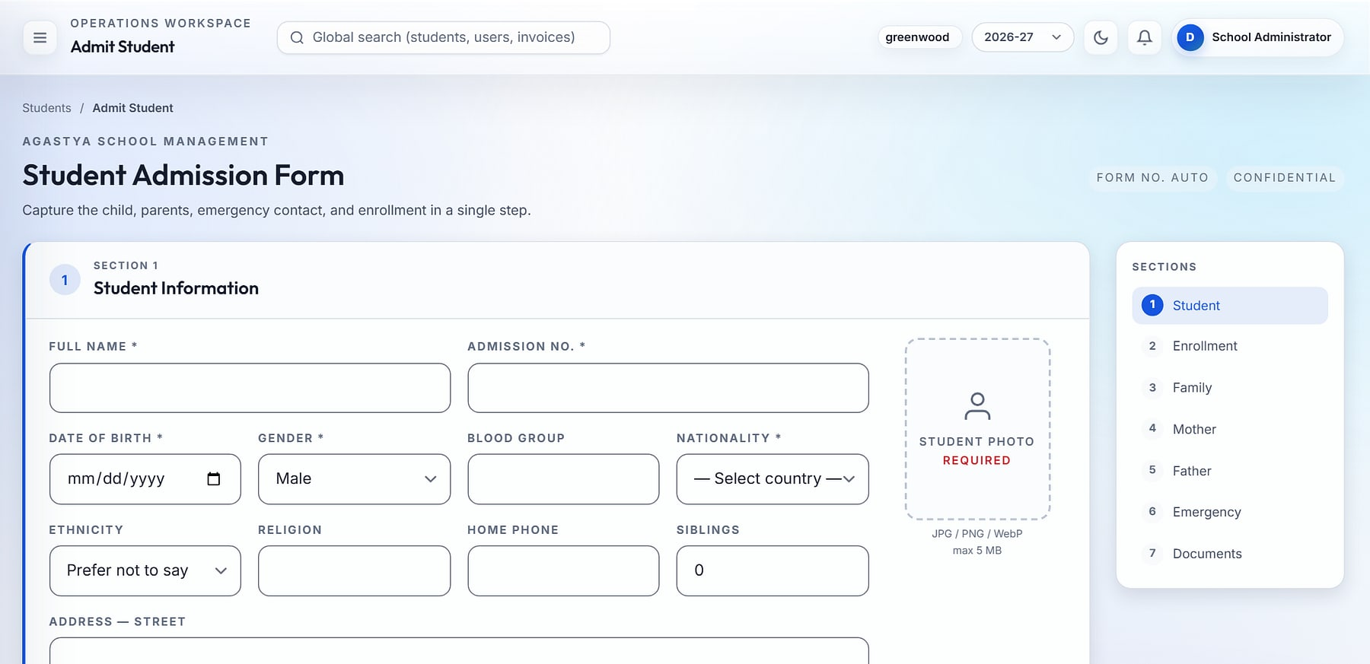
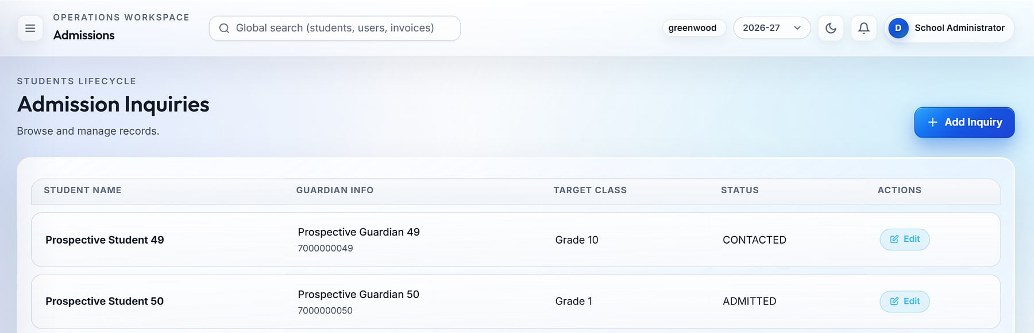
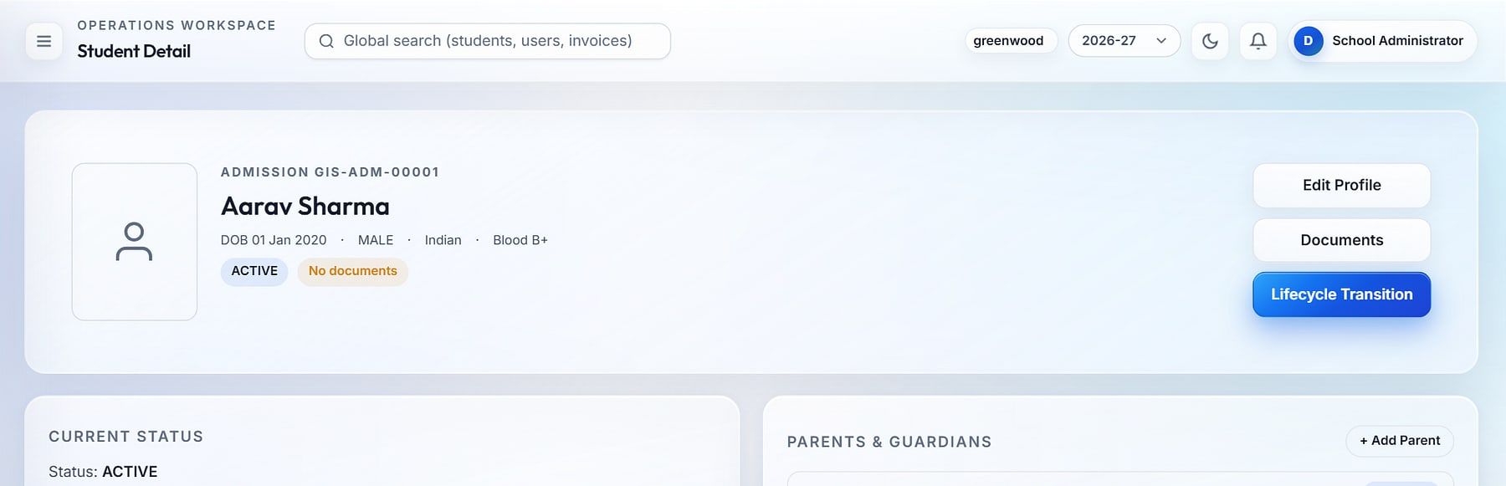
Admit a student in one screen, keep one record for life
STUDENT LIFECYCLE
Admit student
1 Inquiry
2 Admit & enrol
3 Guardian documents
4 Student 360
5 Promote · transfer · exit
Single-screen admission captures student, enrolment, guardians and emergency contact in one step. Guardians upload documents through a link sent by SMS, email or WhatsApp, valid for 7 days, with no login needed.
Notes:
From inquiry to alumni. The inquiry pipeline tracks status (new, contacted, admitted). Admission is one atomic step. Guardian upload links are valid 7 days; Indian 10-digit numbers are formatted to +91 automatically. Student 360 holds enrolment history and lifecycle transitions.

Slide 12
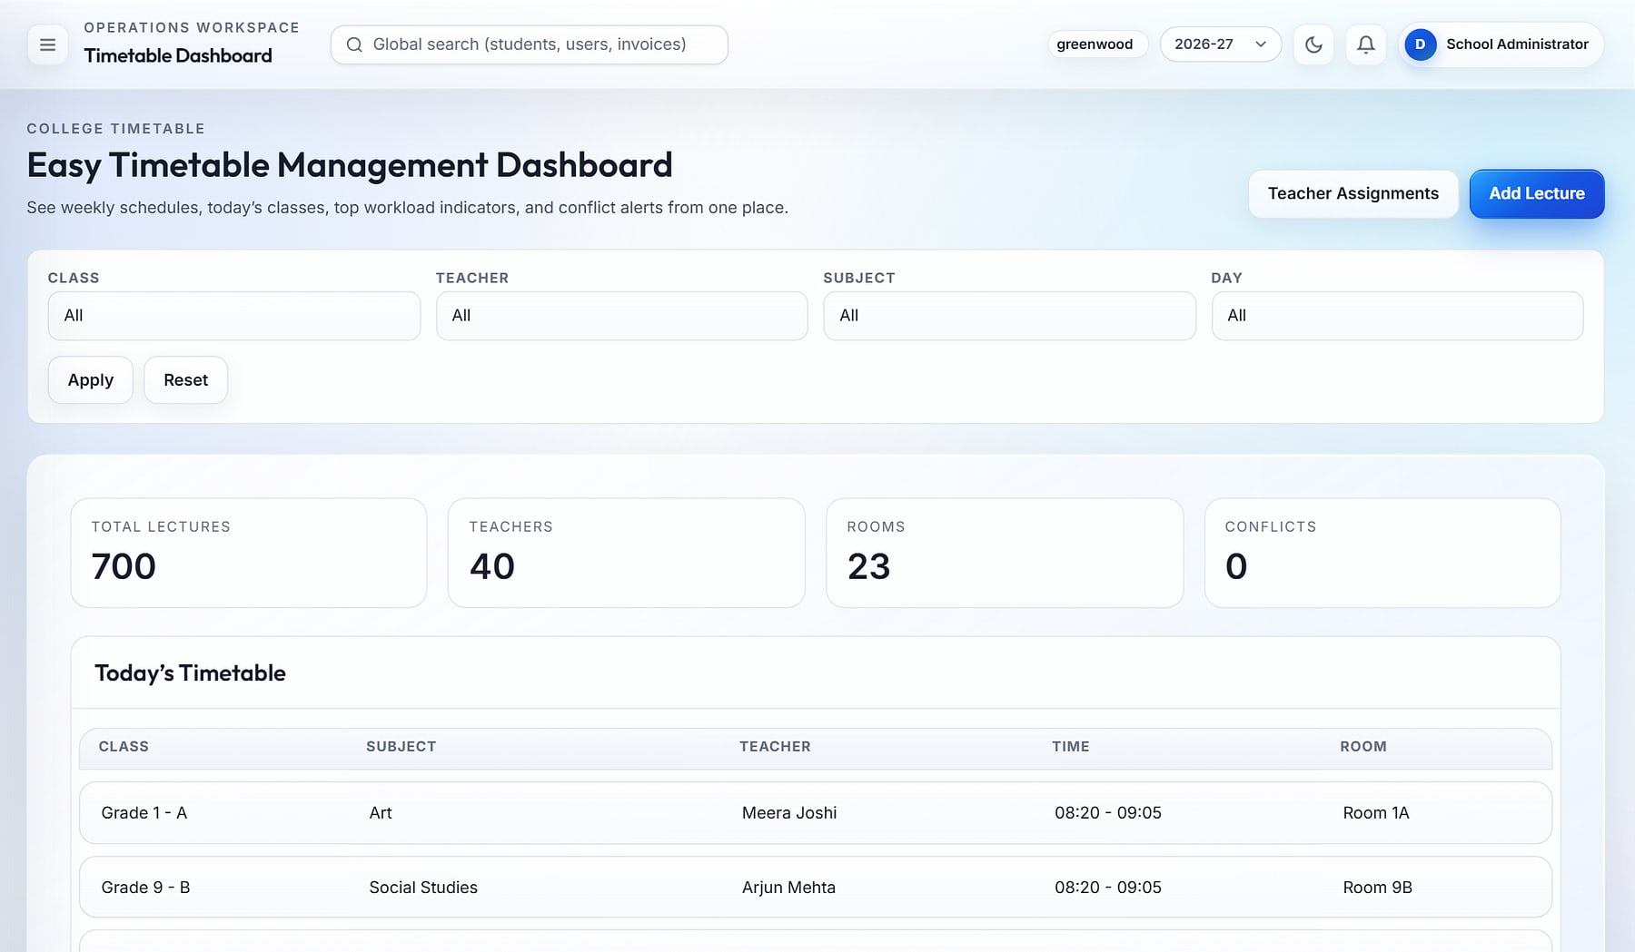
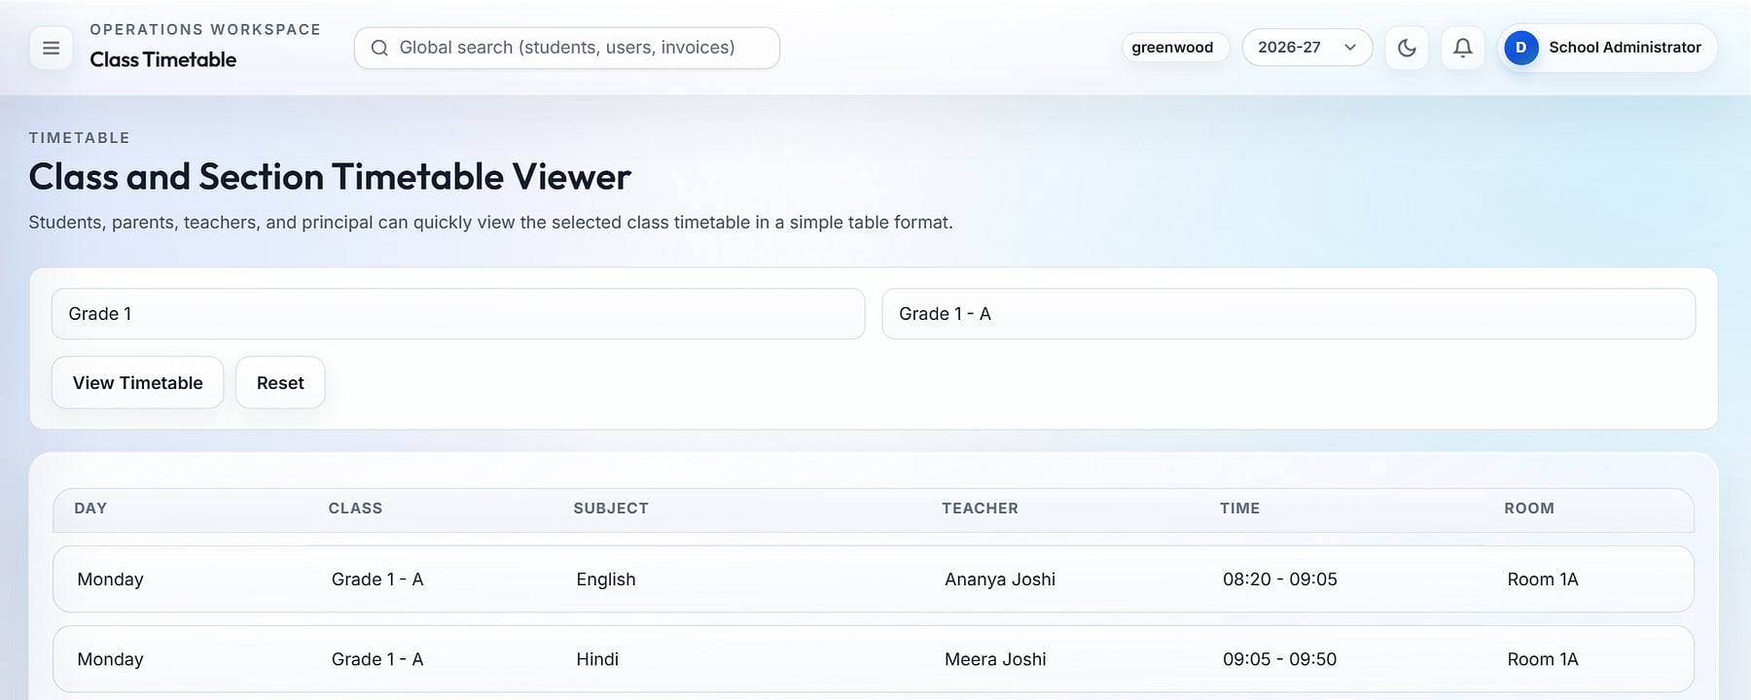
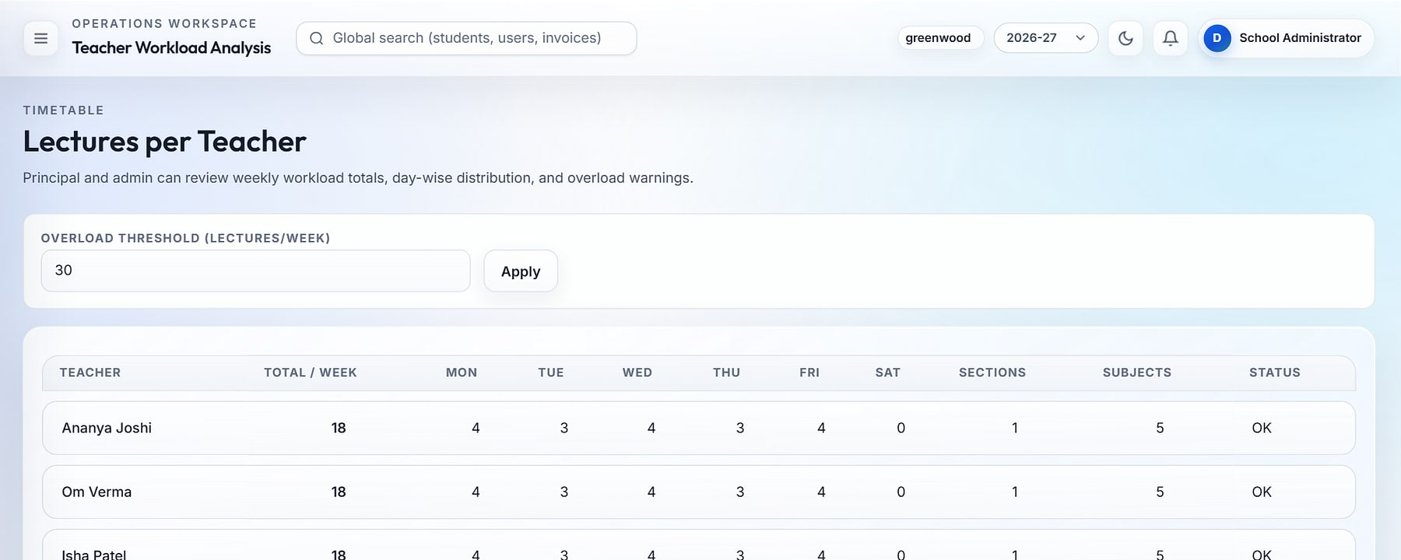
Clash-free timetables, and every absence covered by 9 AM
TIMETABLE & SUBSTITUTION
Timetable dashboard
Class timetable
1
2
Teacher workload
3
1
Timetable dashboard: 700 weekly lectures, 40 teachers, 23 rooms, zero conflicts (demo data)
2
Class and section timetable viewer
3
Teacher workload with overload thresholds; substitutions suggest free teachers
Notes:
Timetable entries are validated for teacher and room conflicts. Foundations include working days, bell schedule, rooms and venues, and teacher assignments. On any date the substitution screen lists absent teachers and suggests available ones; section plans can be copied across classes.

Slide 13
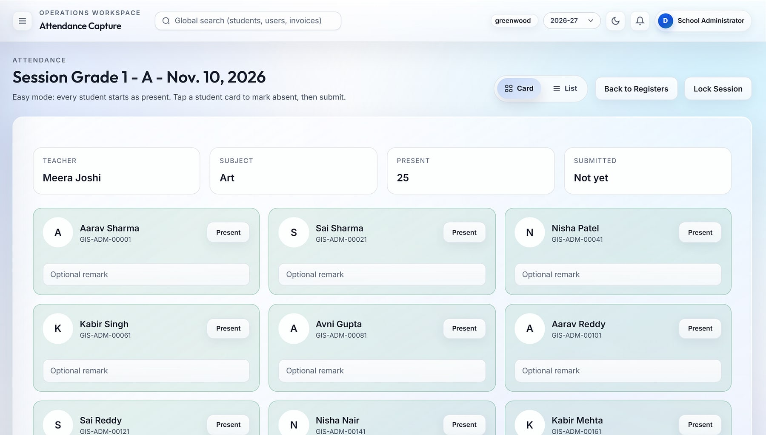


Attendance in seconds per class, records that stand up to audit
ATTENDANCE
Quick capture
Attendance · Quick capture
Card or list mode: everyone starts present; tap to mark absent or late.
Synced to the timetable
Sessions follow the timetable; teachers see only their sections.
Lock and correct
Sessions lock; corrections go through an audited workflow.
Leave and reports
Student leave approvals, daily registers, section summaries and Excel export.
Quick capture for Grade 1-A: tap exceptions, then submit and lock the session.
Notes:
Attendance capture takes seconds per class. The attendance dashboard (90.8% today, 7-day trend, status mix, locked sessions and leave queue) gives the admin the school-wide view.

Slide 14
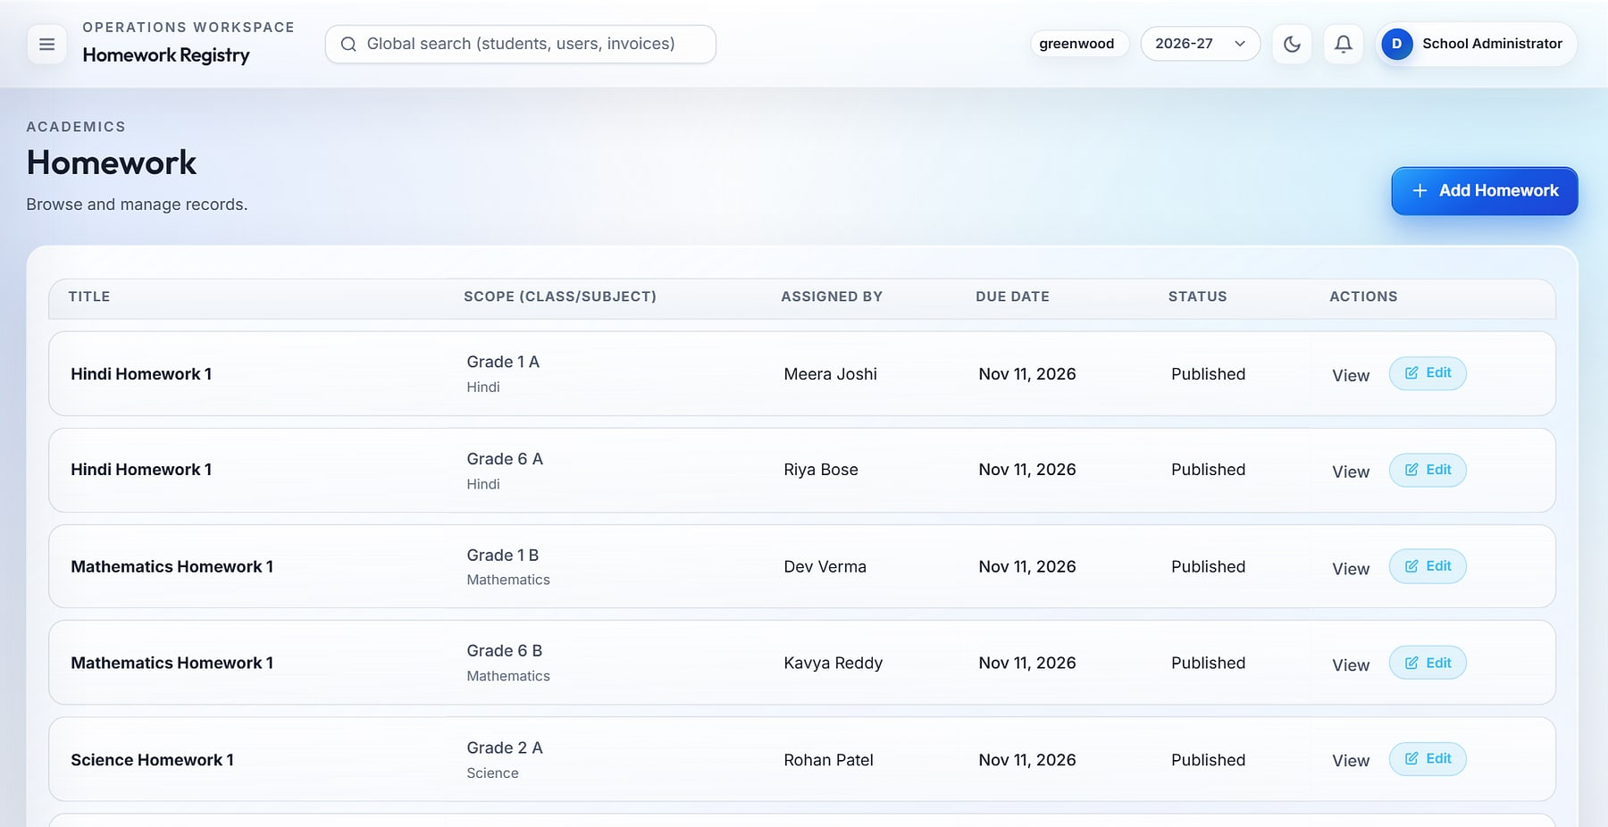
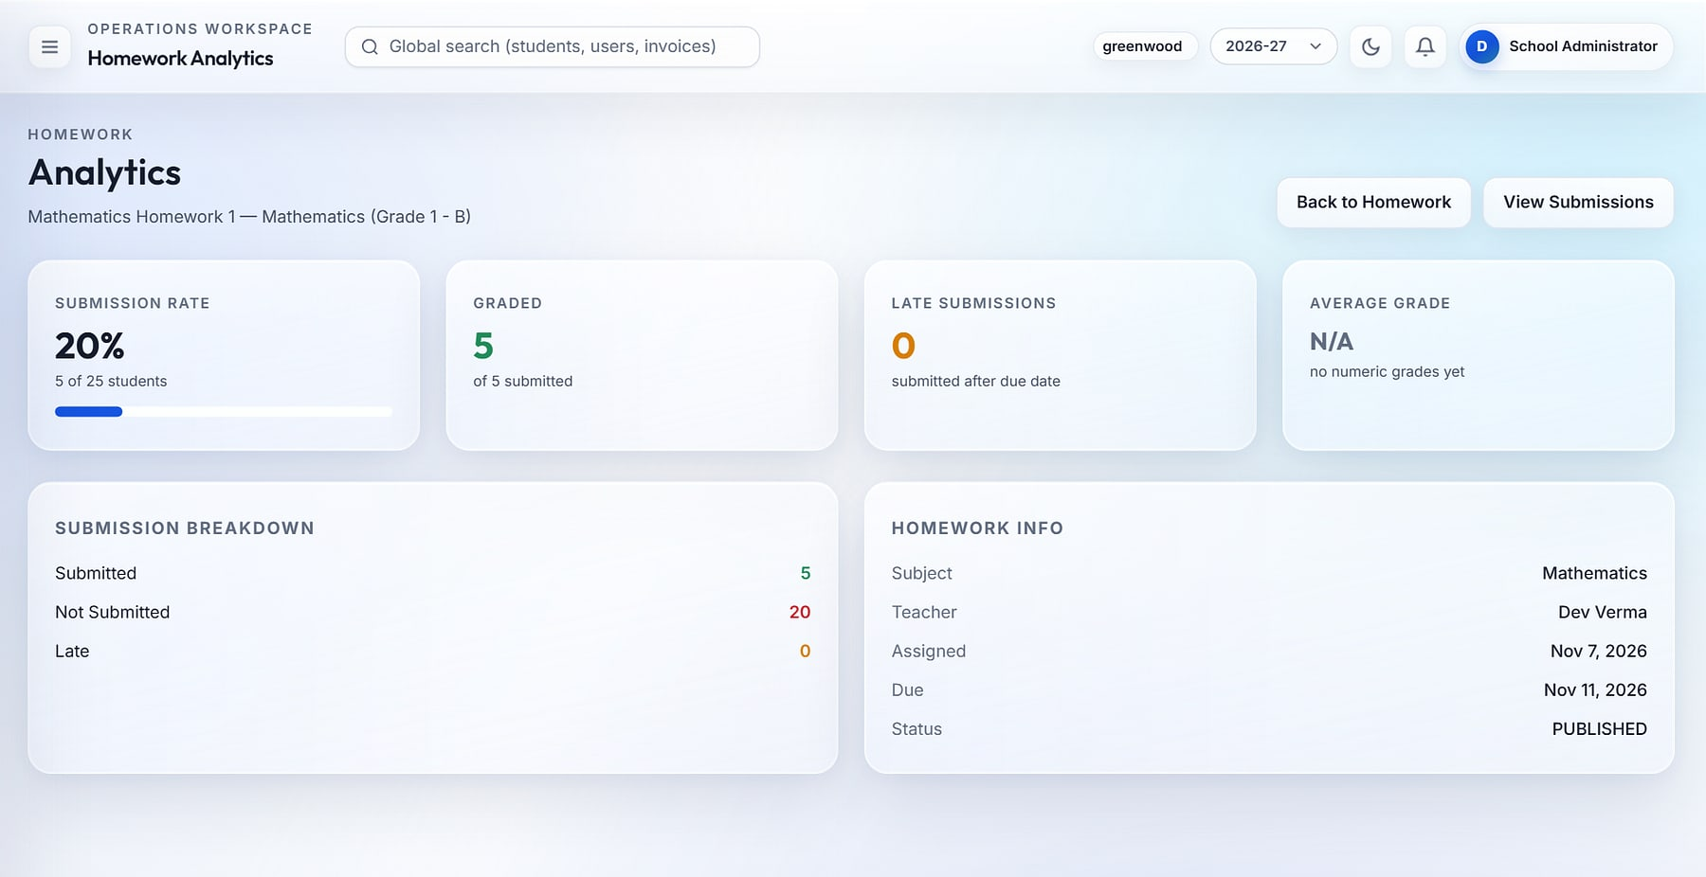

Learning continues at home, with data teachers can act on
HOMEWORK & CLASSWORK
Homework registry by class, subject and teacher.
Per-assignment analytics: submission rate, graded and late work.
Targeted audiences
Read receipts
Bulk grading
Parent feed
Whole section or selected students.
See who opened each assignment.
Grade a whole class in one grid.
Parents follow every assignment.
Notes:
Teachers publish homework and classwork with attachments; students submit and resubmit; parents get their own homework feed.

Slide 15
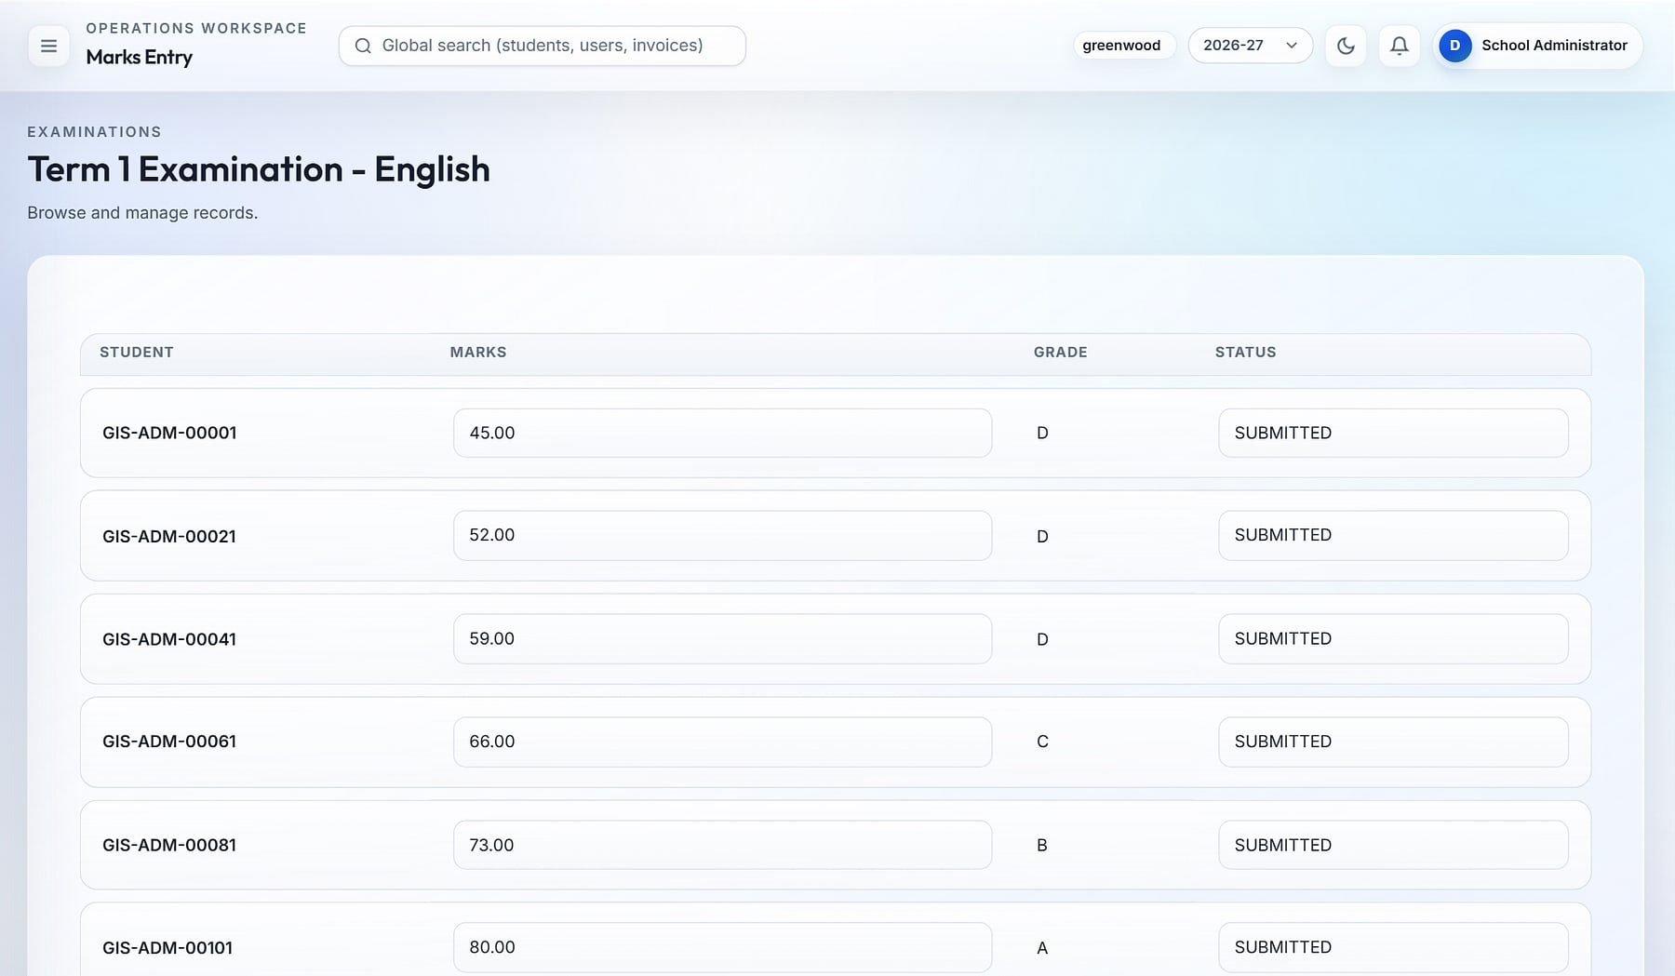
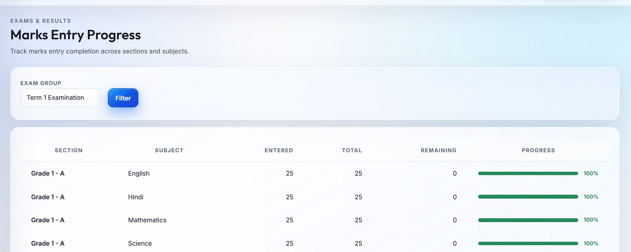
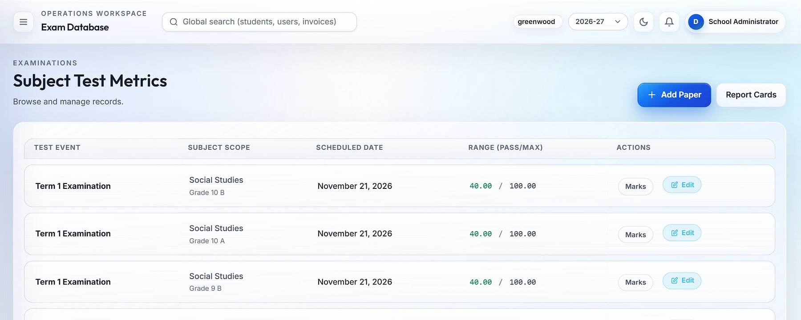
Results day in hours, not weeks
EXAMS & ASSESSMENT
Marks entry
Marks entry progress
1
2
Subject test metrics
3
1
Grid marks entry, restricted to the teacher's own sections, with automatic grading
2
Completion tracker shows who still has marks to enter
3
Exam events, subject papers, grading scales and admit cards are configurable
Notes:
Grade schemes, exam groups, subject papers (maximum and pass marks), admit cards and signature settings are configurable. Every exam action is written to the audit log.

Slide 16
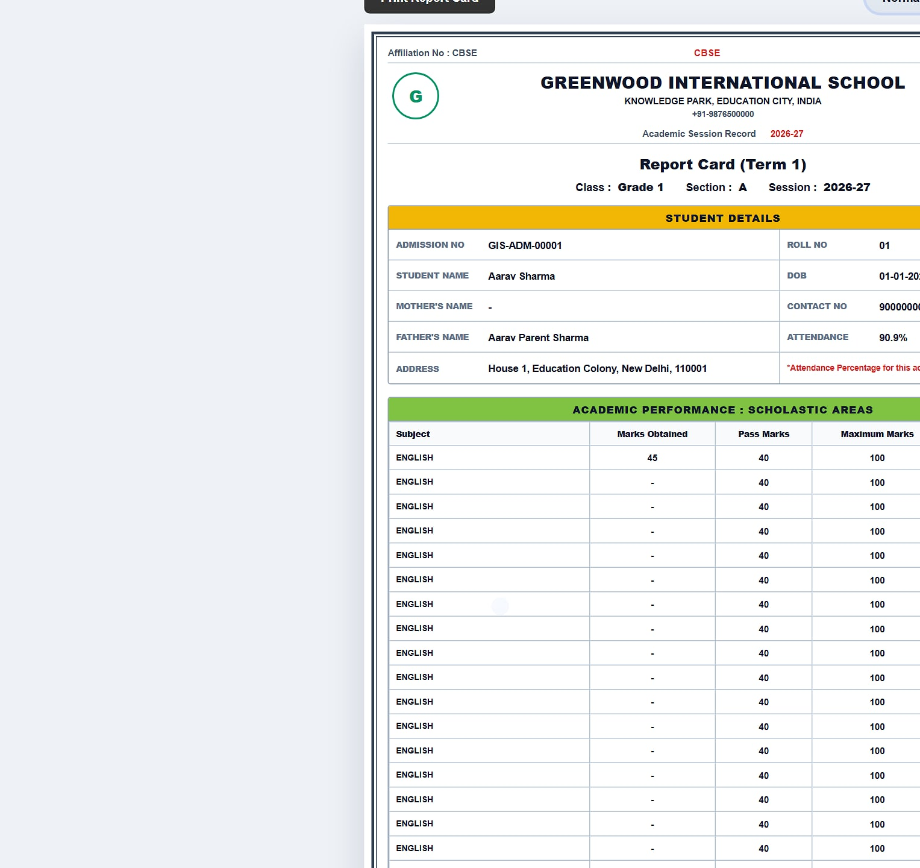
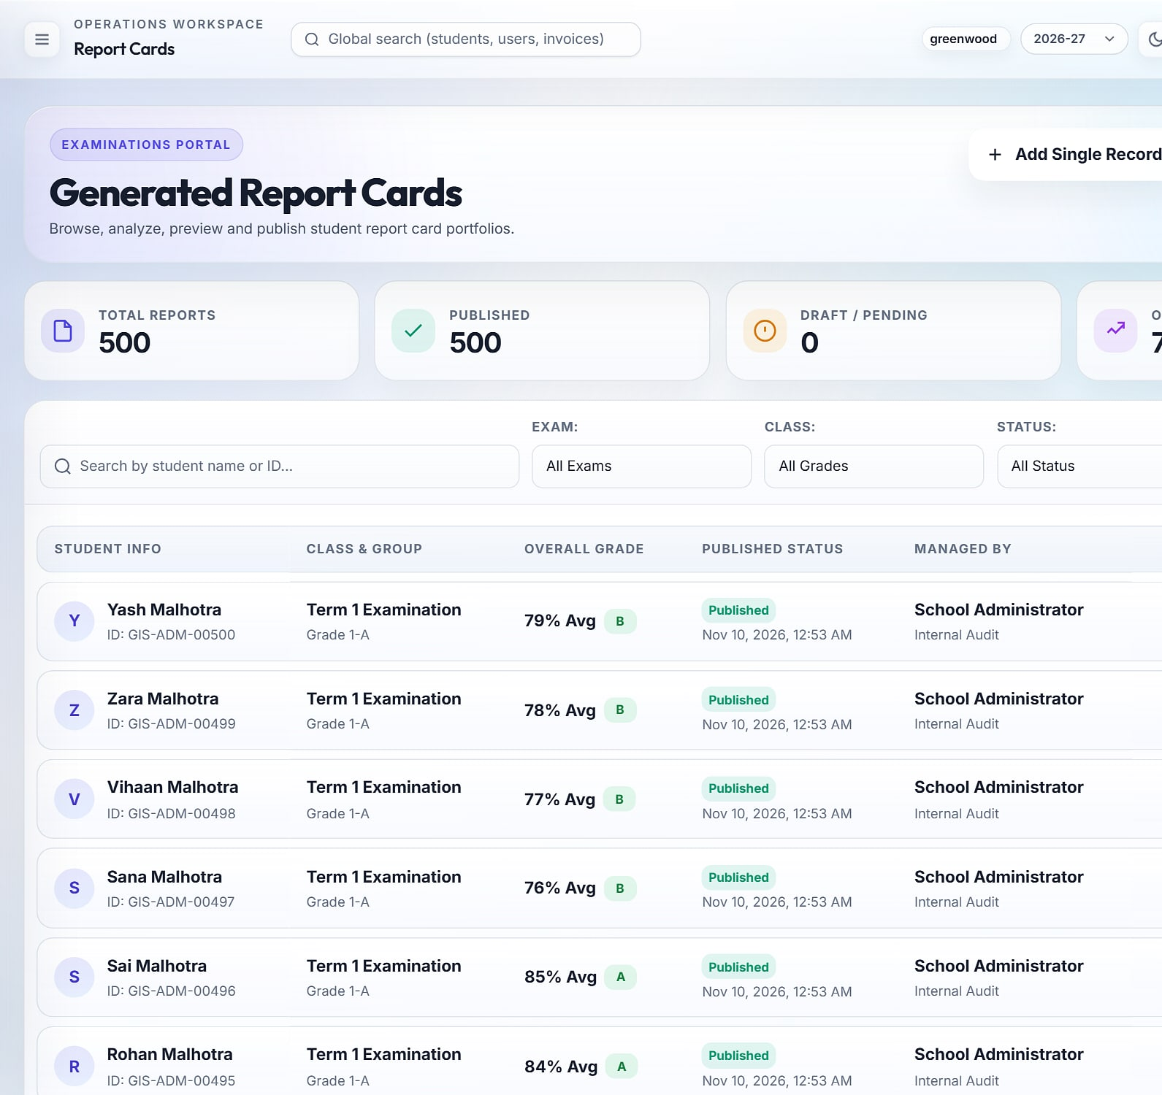
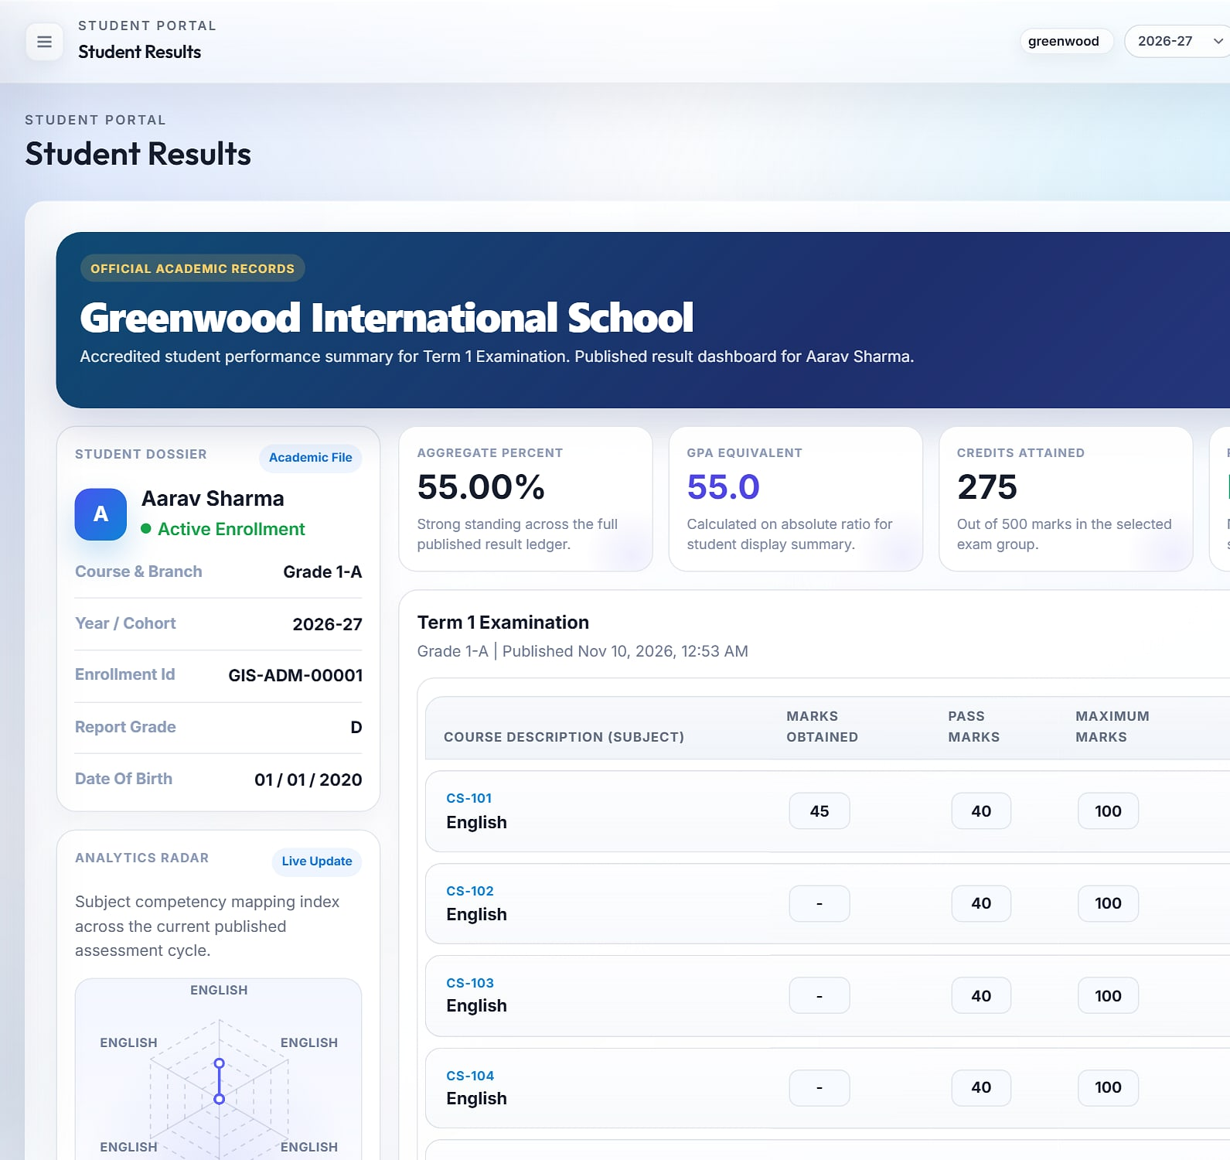
Branded report cards, published in one click
REPORT CARDS & ANALYSIS
Printable report card
Publish control
Families see results
School identity, student details, marks, attendance %, remarks and official signatures.
Generate in batch, then publish individually or all at once.
Students and parents view results with a performance radar and PDF download.
Notes:
500 report cards generated and published for the demo term. Subject-wise analysis (average, highest, lowest, pass %) and top-performer lists support the exam review.

Slide 17
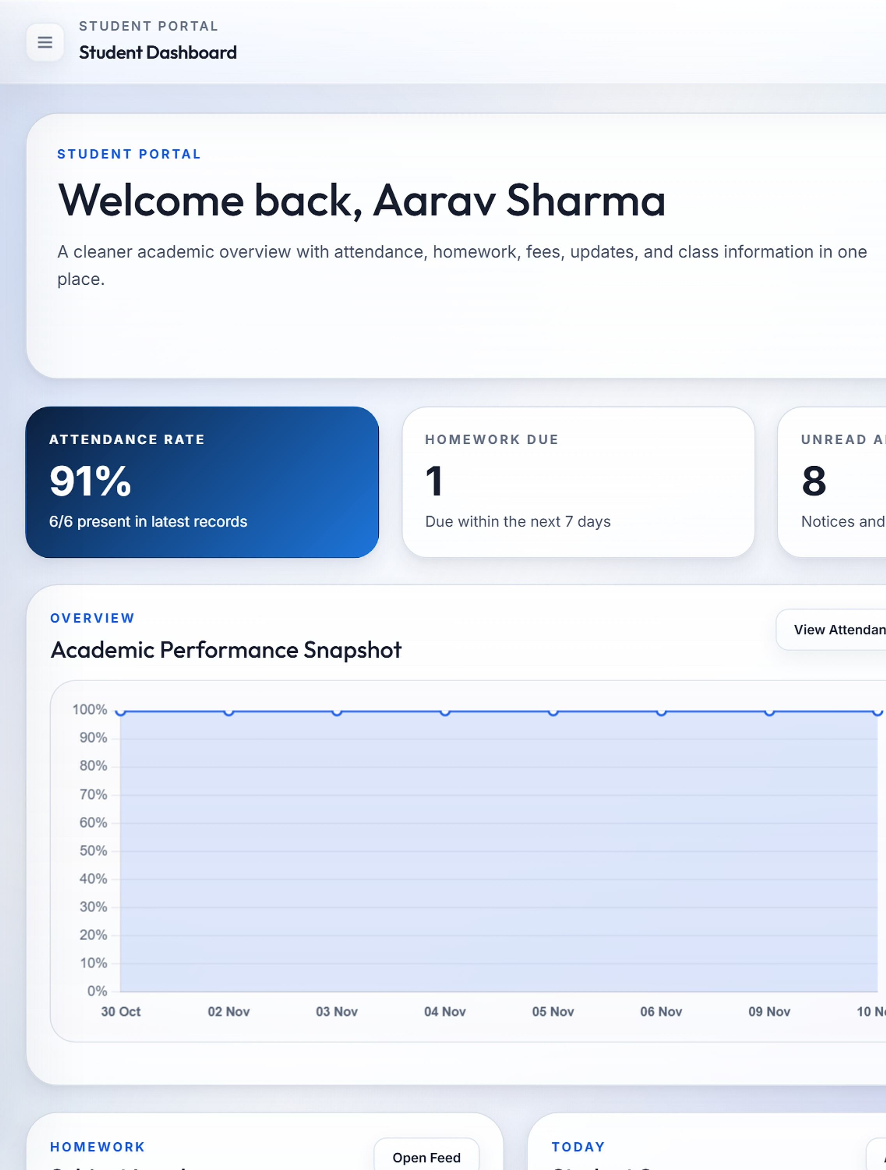
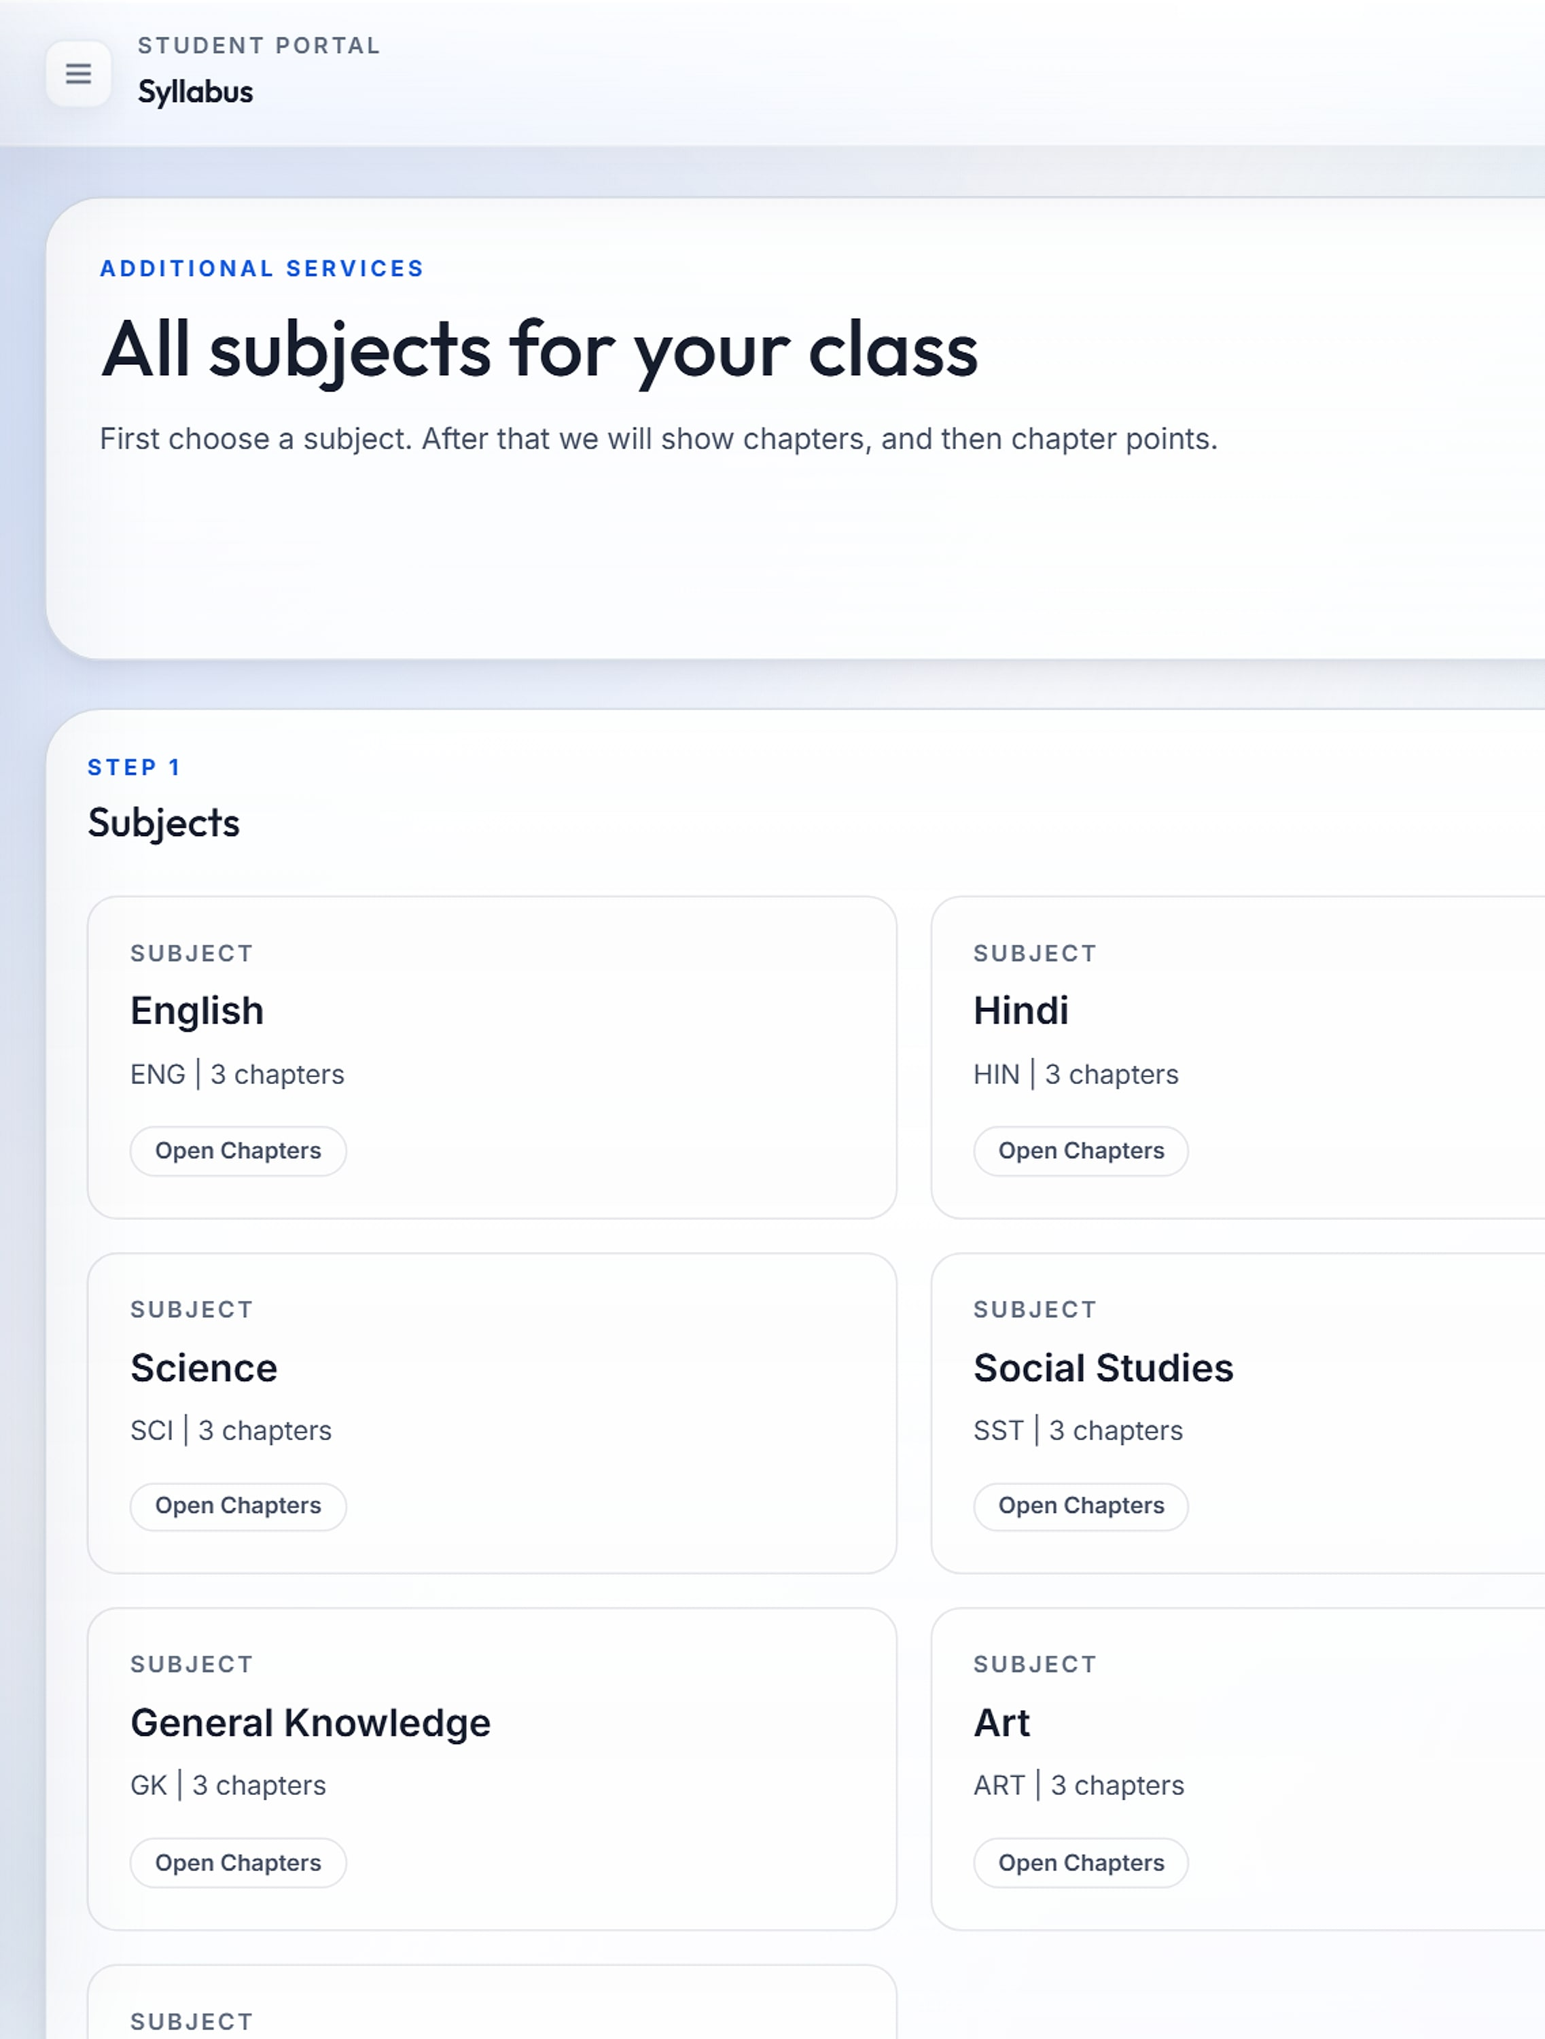
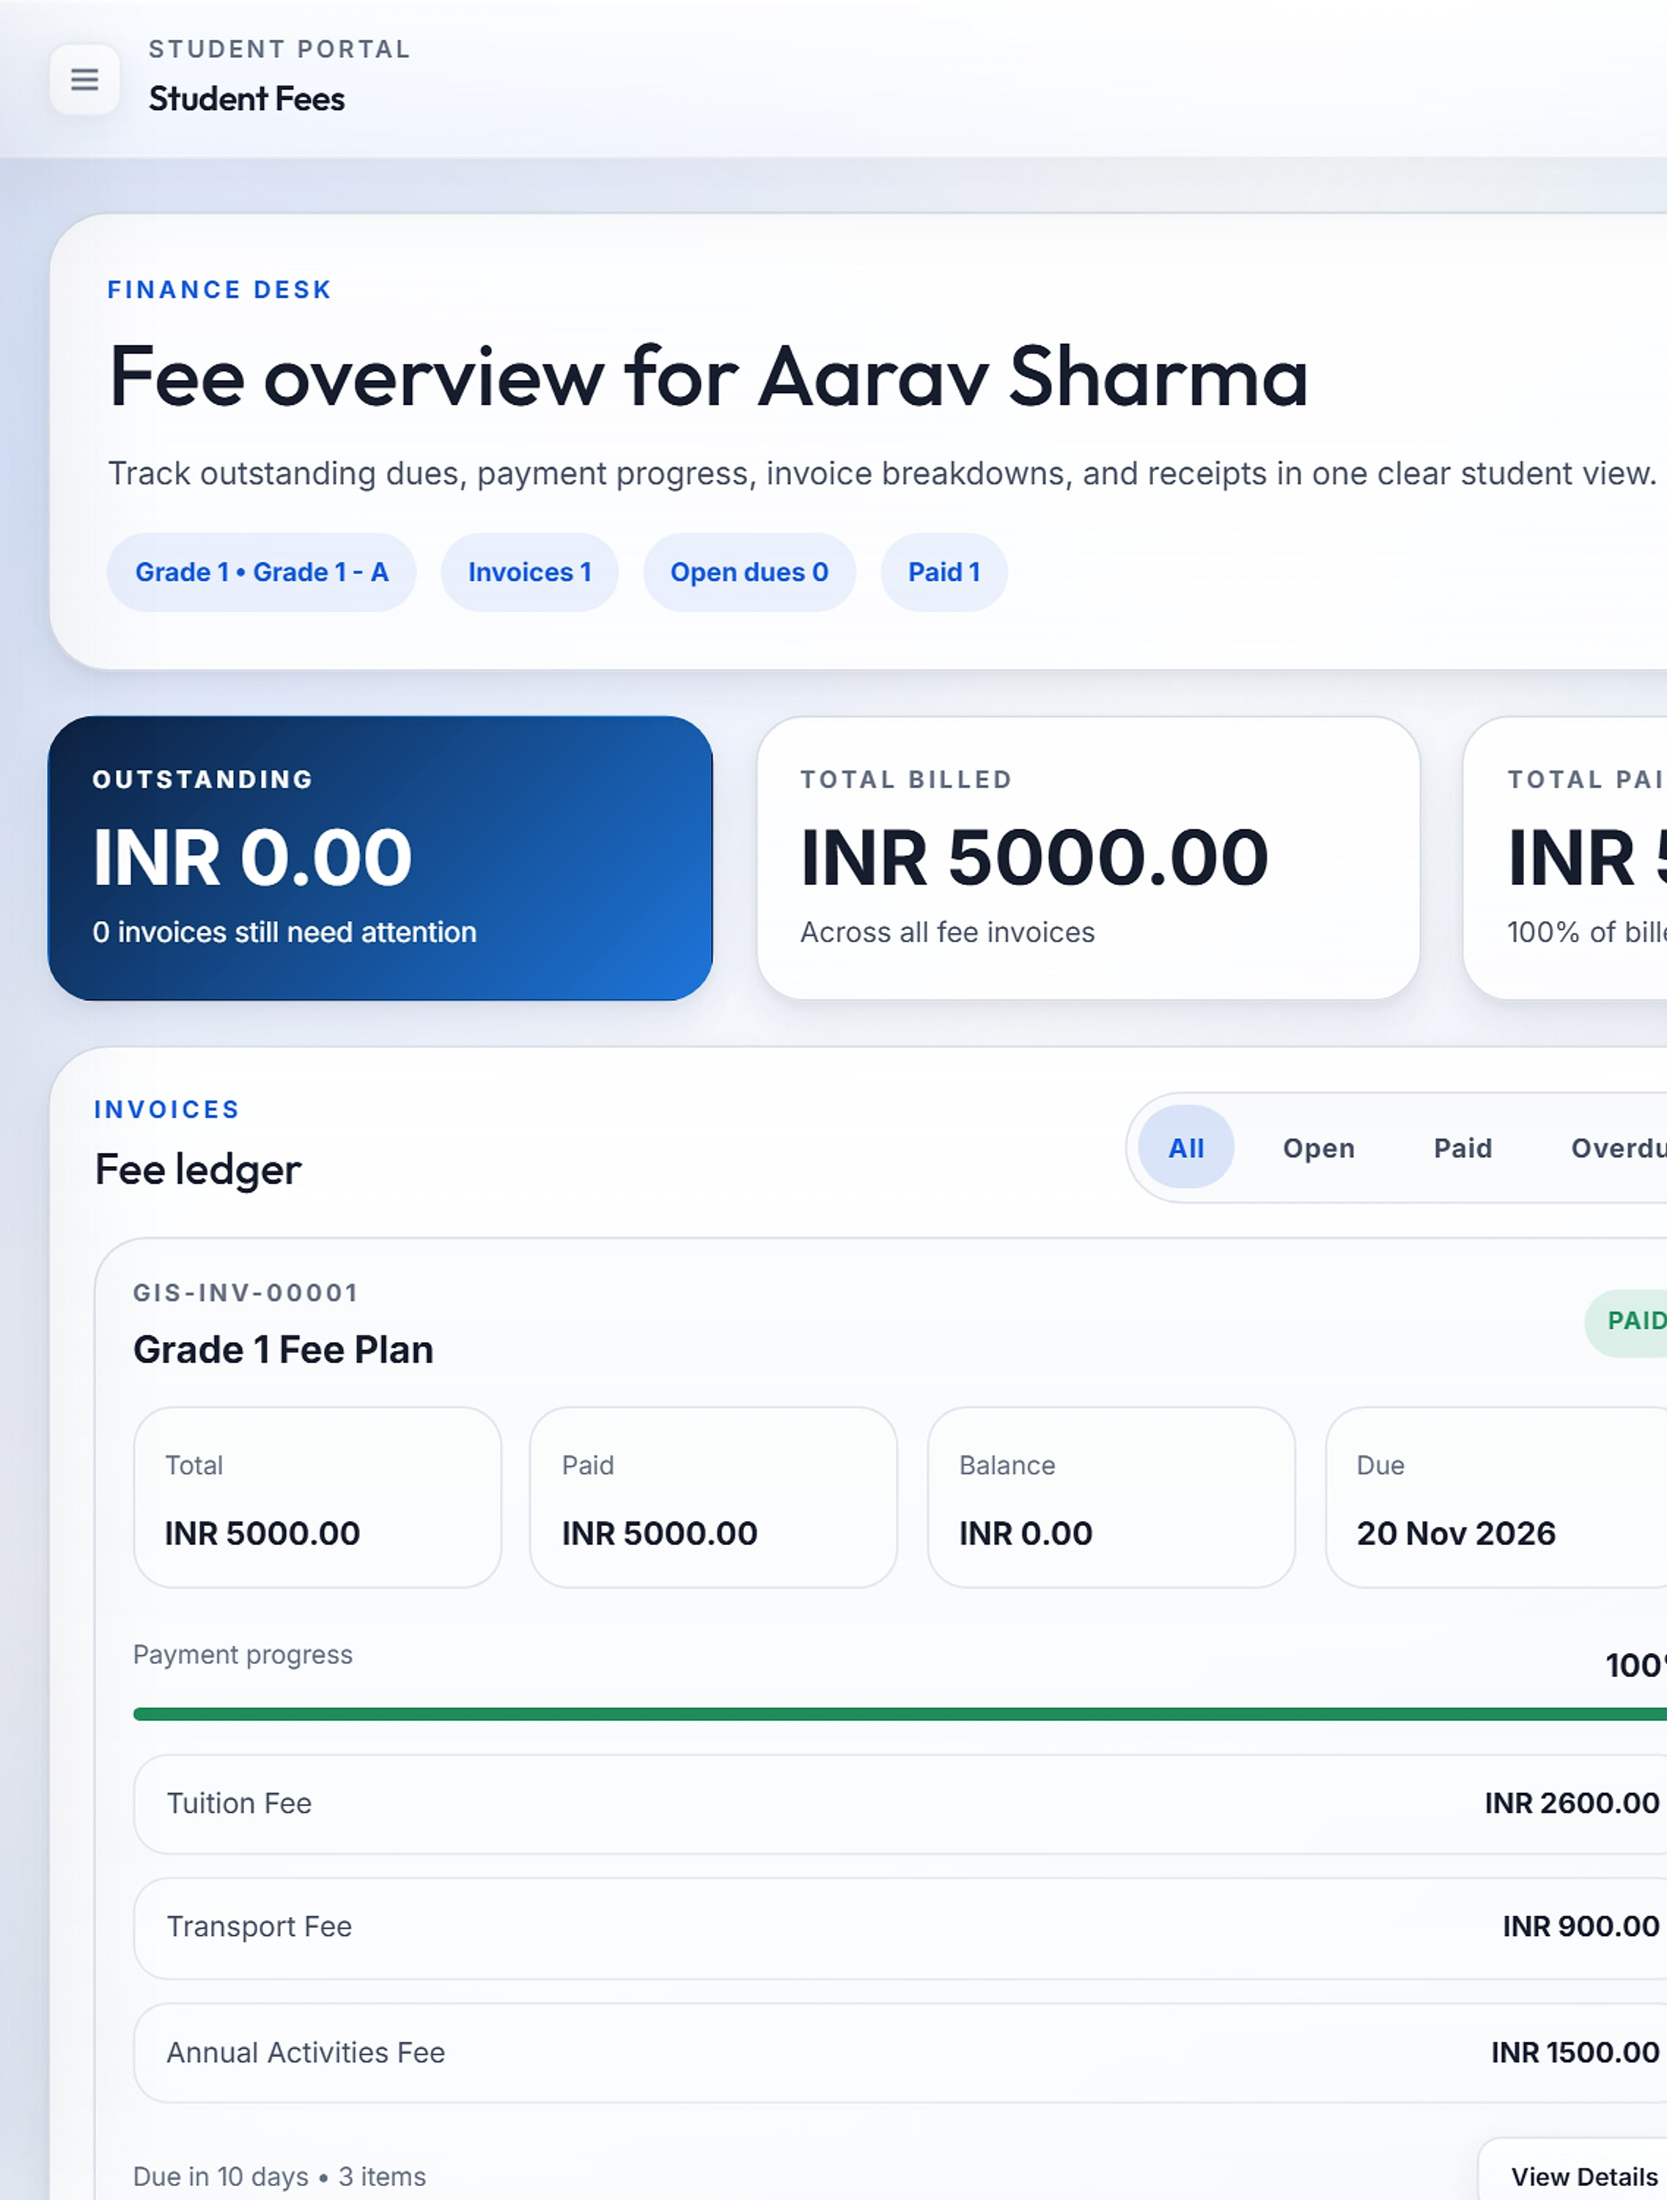
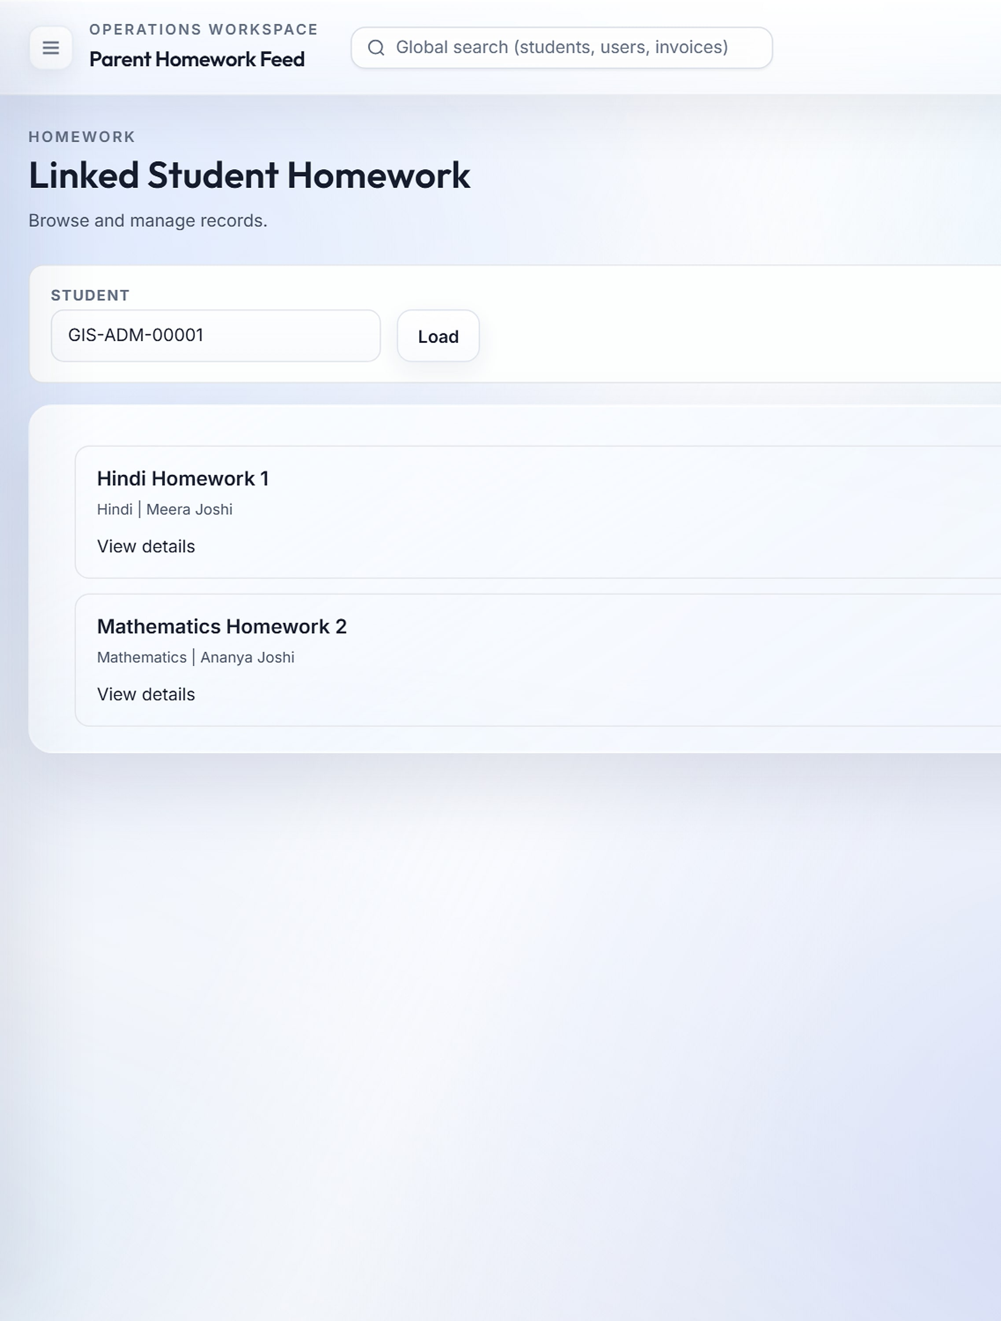
The school in every family's pocket
STUDENT & PARENT PORTALS
Student portal
Syllabus
Fee ledger
Parent feed
Attendance rate, homework due, alerts and a performance snapshot.
Every subject's chapters and coverage points.
Balances, invoices and payment history.
Each child's homework and status, in one place.
Notes:
Students get a web portal and an Expo mobile app (iOS and Android) on the same APIs and session rules: digital ID, transport, library, admit cards and leave tracking. Parents see their children, homework feed, results and notices. No mobile screenshots are available yet.

Slide 18
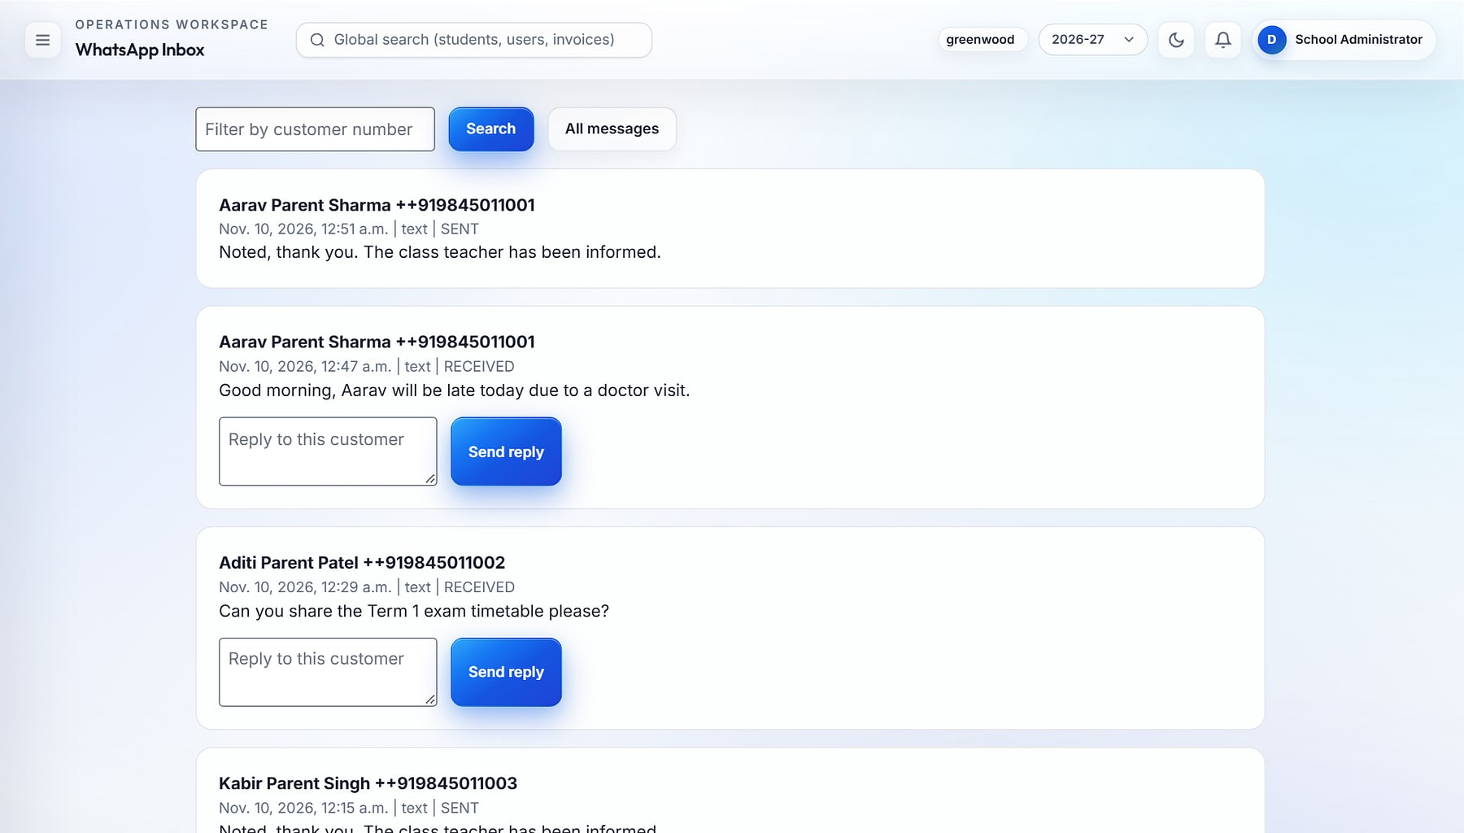




One school-owned channel to every parent
COMMUNICATIONS
Communications · WhatsApp inbox
Two-way WhatsApp inbox
Inbound parent messages via the Meta Cloud API; staff reply from the web.
Targeted broadcasts
School-wide, or by role, class or section.
Real-time notifications
Live unread counts pushed over WebSockets.
SMS, OTP and email
Twilio SMS and Verify, SMTP email; configured per school with test-send.
WhatsApp Business inbox: parent messages with in-line replies (demo data).
Notes:
Communications are configurable per school or at platform level, with a test-send screen for each channel. A 'Trigger Engine' menu item exists; its behaviour is to be confirmed before it is presented.

Slide 19
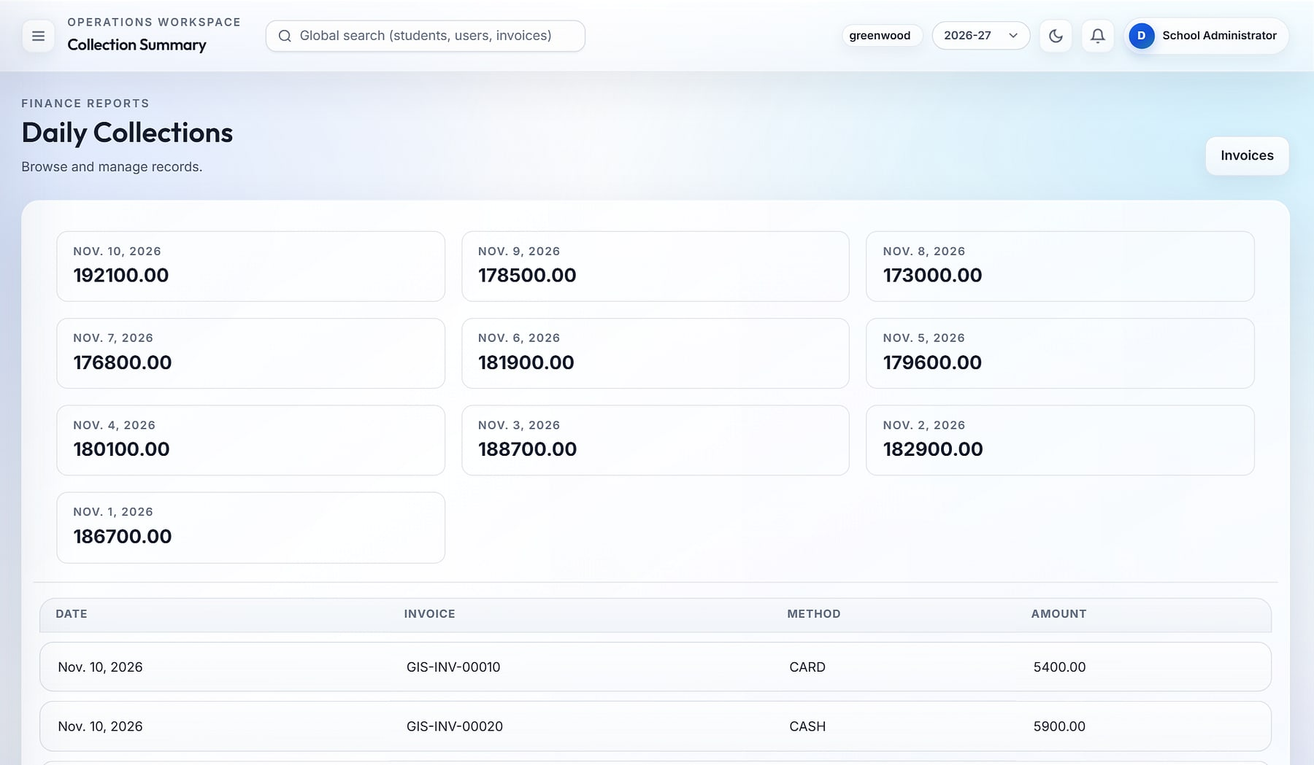
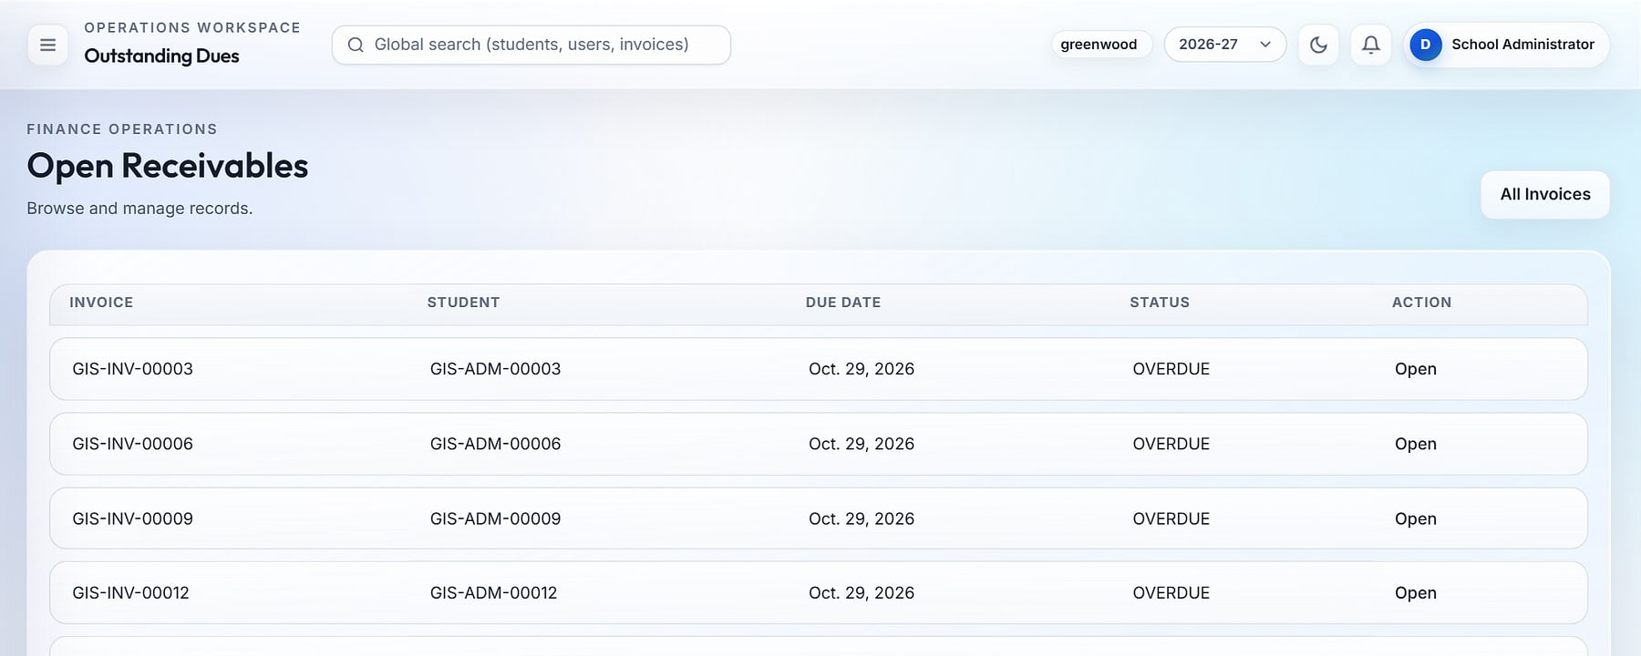
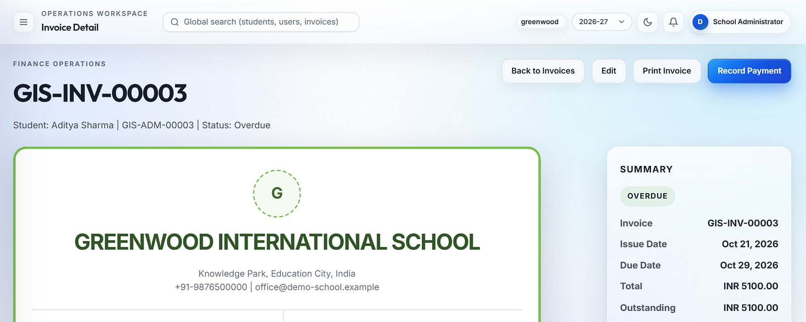
Faster collections and real-time visibility of every rupee
FEES & BILLING
Daily collections
Open receivables
1
2
Invoice GIS-INV-00003
3
1
Daily collection summary with payment-method breakdown
2
Outstanding dues and overdue invoices
3
Branded invoice with balance and payment history
Notes:
Fee heads, plans and concessions apply automatically at invoicing; bulk invoicing runs per fee plan for a student or a whole section. Receipts cover cash, card, UPI, wallet and net banking. Invoice numbers come from race-safe sequence rules; every financial event is audited with before/after values. Online fee payment by parents is on the roadmap.

Slide 20
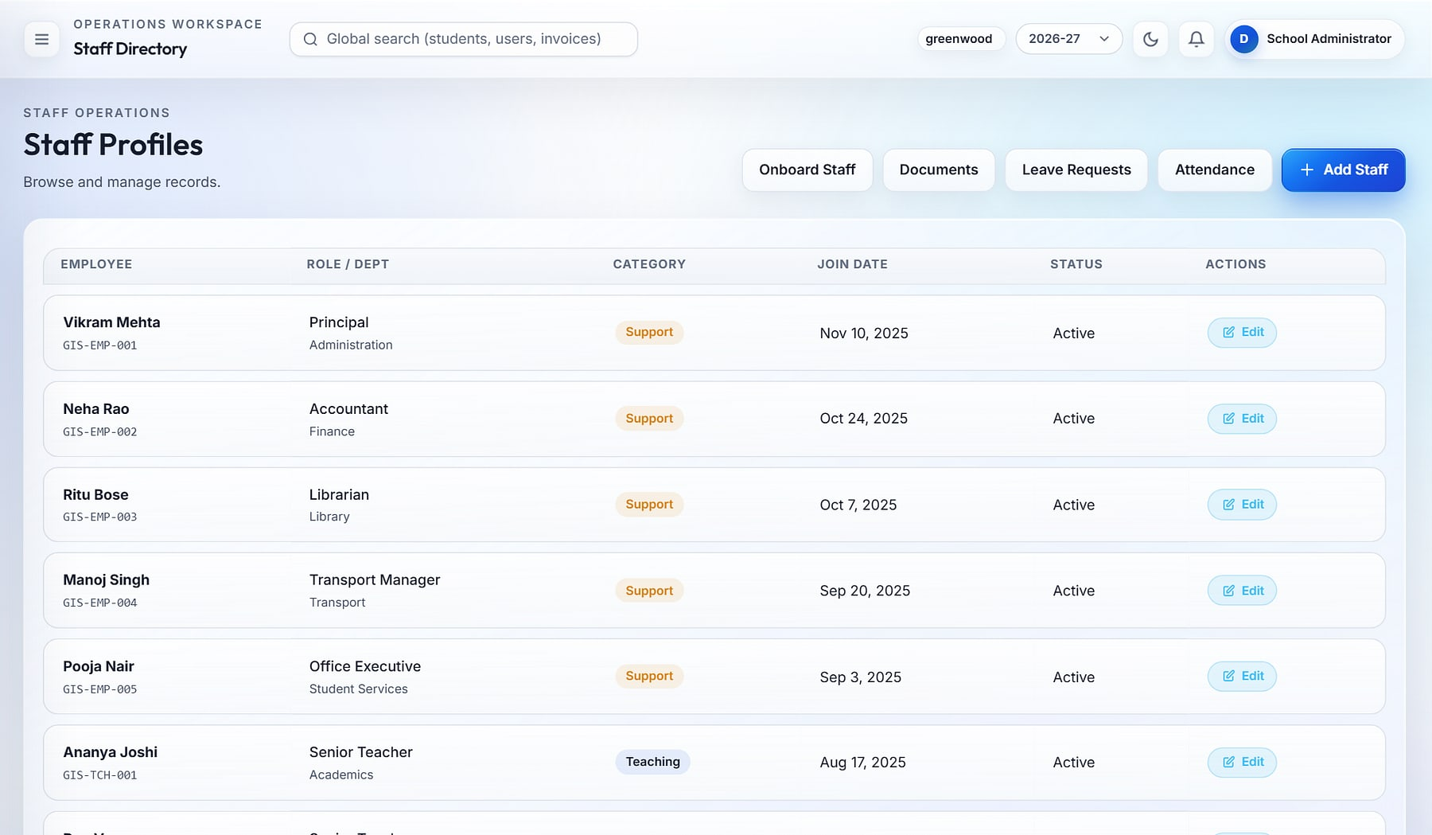
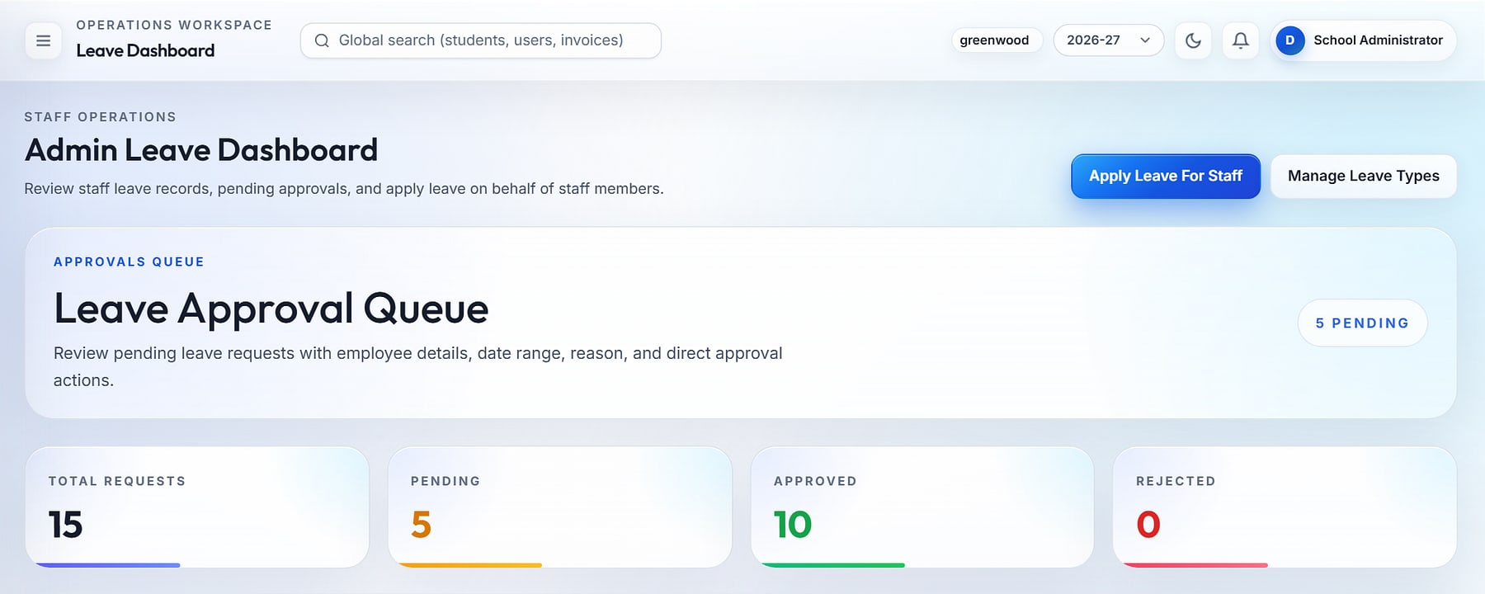
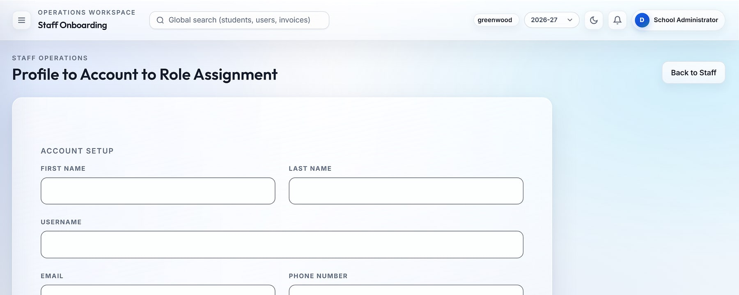
Attendance and leave discipline without paper registers
STAFF OPERATIONS & HR
Staff directory
Leave approval queue
1
2
Staff onboarding
3
1
Staff directory with departments, designations and categories
2
Leave approval queue with pending, approved and rejected counts
3
Guided onboarding: profile, user account and role in one flow
Notes:
Staff self punch-in and punch-out feed a monthly attendance ledger with day-level approval on the attendance calendar, with Excel export. Staff documents, leave types and designations are managed in Staff Operations. Payroll is a roadmap item.

Slide 21

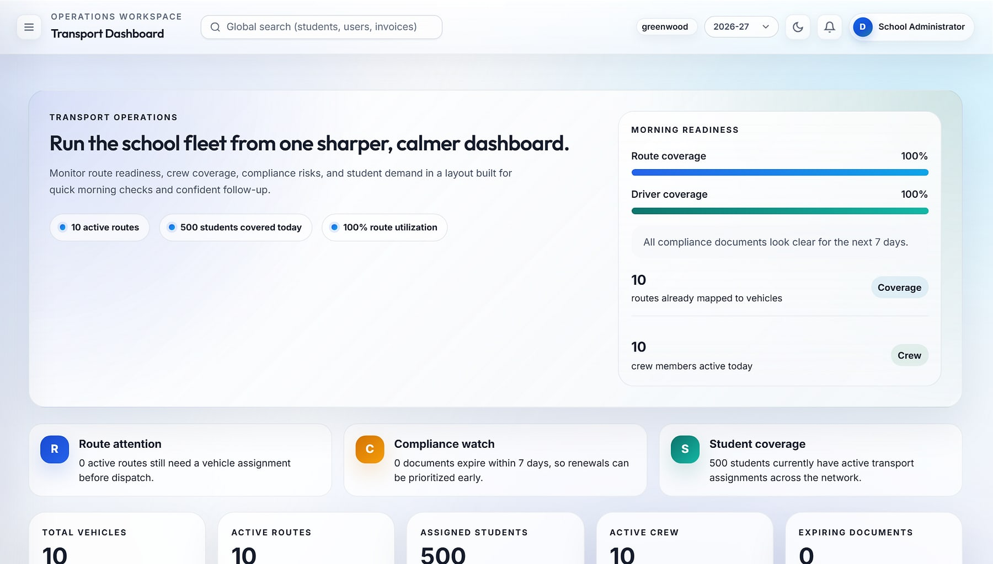

A safer, compliant fleet and fewer 'where is my bus' calls
TRANSPORT
Fleet and compliance
Transport · Dashboard
Vehicles and documents with 7-day expiry alerts.
Routes, stops, crew
Route-vehicle and driver/attendant assignments.
Daily manifests
Stop-by-stop rider list for any route and date.
Automatic alerts
Parents notified when a route or stop changes.
Transport dashboard: 10 vehicles, 10 routes, 500 students assigned, crew coverage and compliance watch (demo data).
Notes:
Live GPS bus tracking is a roadmap item, not available today.

Slide 22
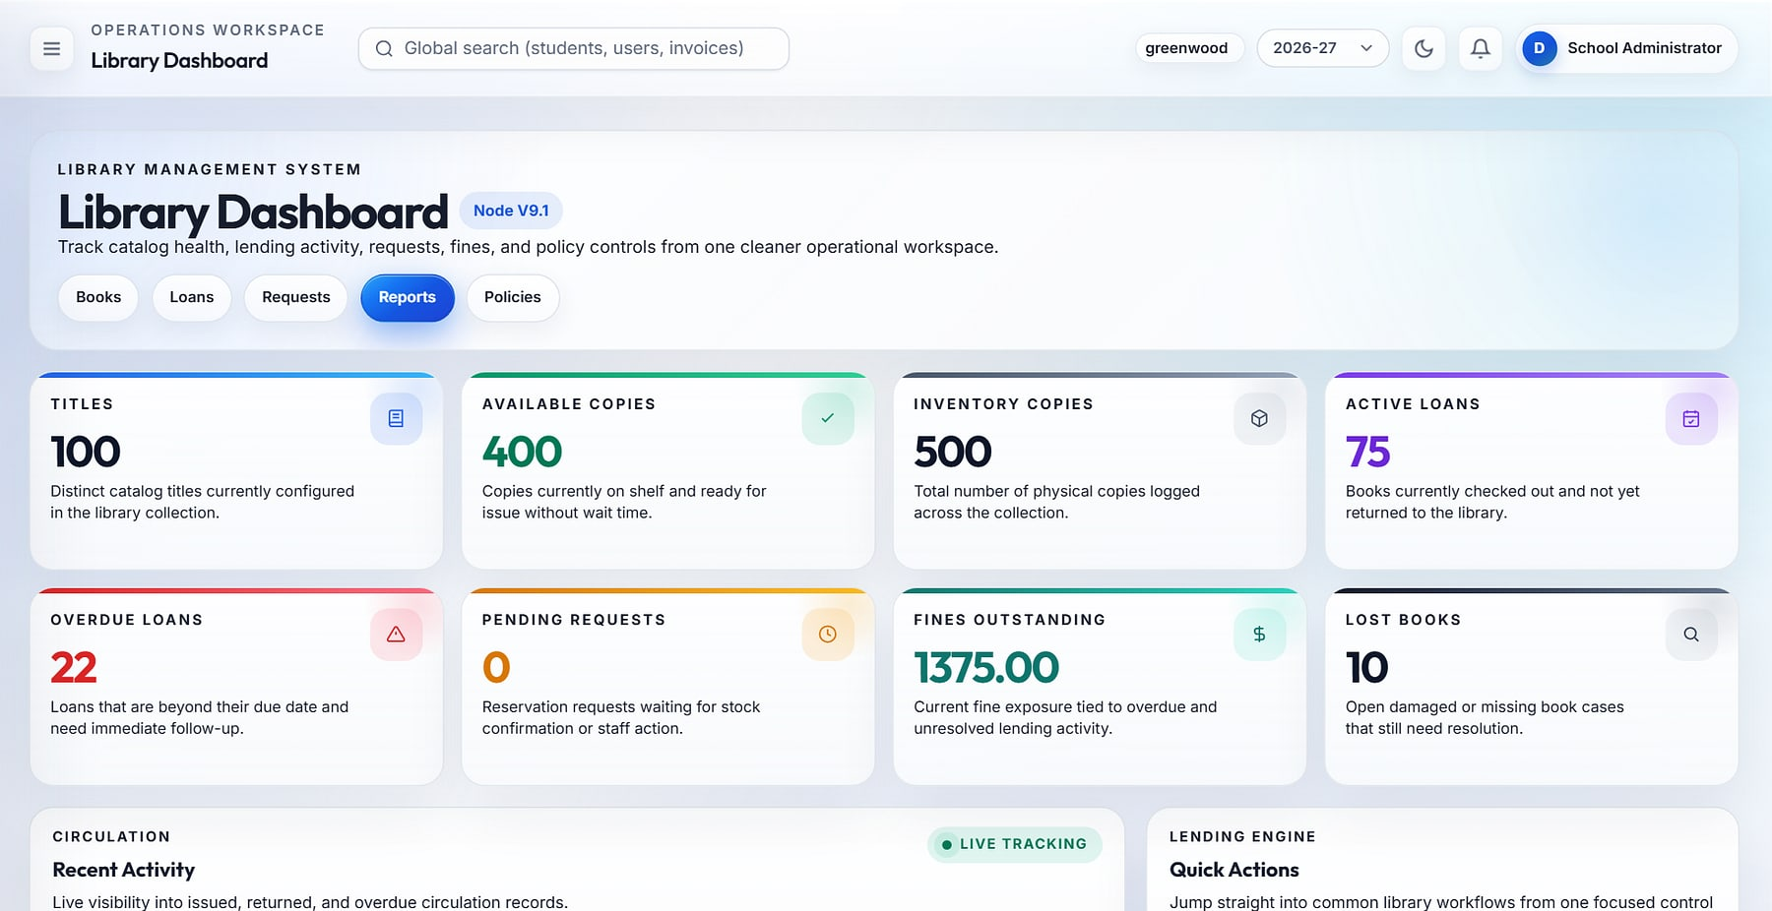
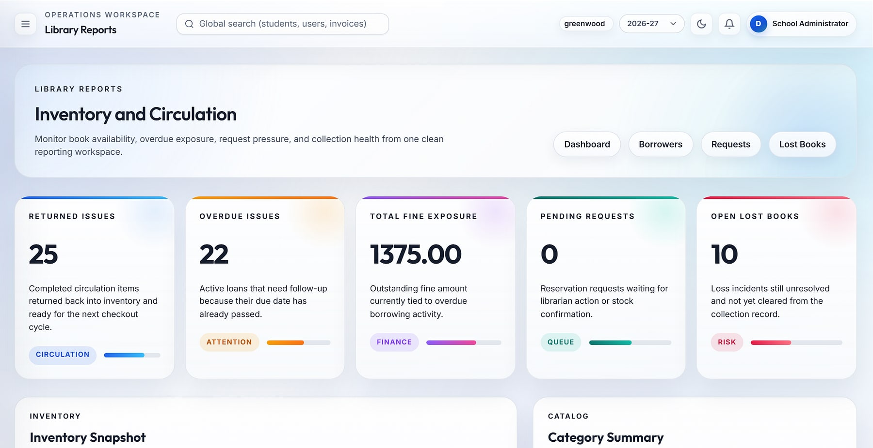



A traceable library with fines enforced automatically
LIBRARY
Library dashboard: titles, copies, active loans, overdue items and fines.
Library reports: circulation, fine exposure, requests and lost books.
Catalogue
Issue and return
Automatic fines
Reservations
Categories, authors and copies.
Loan rules set per school.
Calculated daily on overdue loans.
Student self-borrow requests.
Notes:
Library settings define loan period and fine per day; overdue fines are calculated automatically.

Slide 23
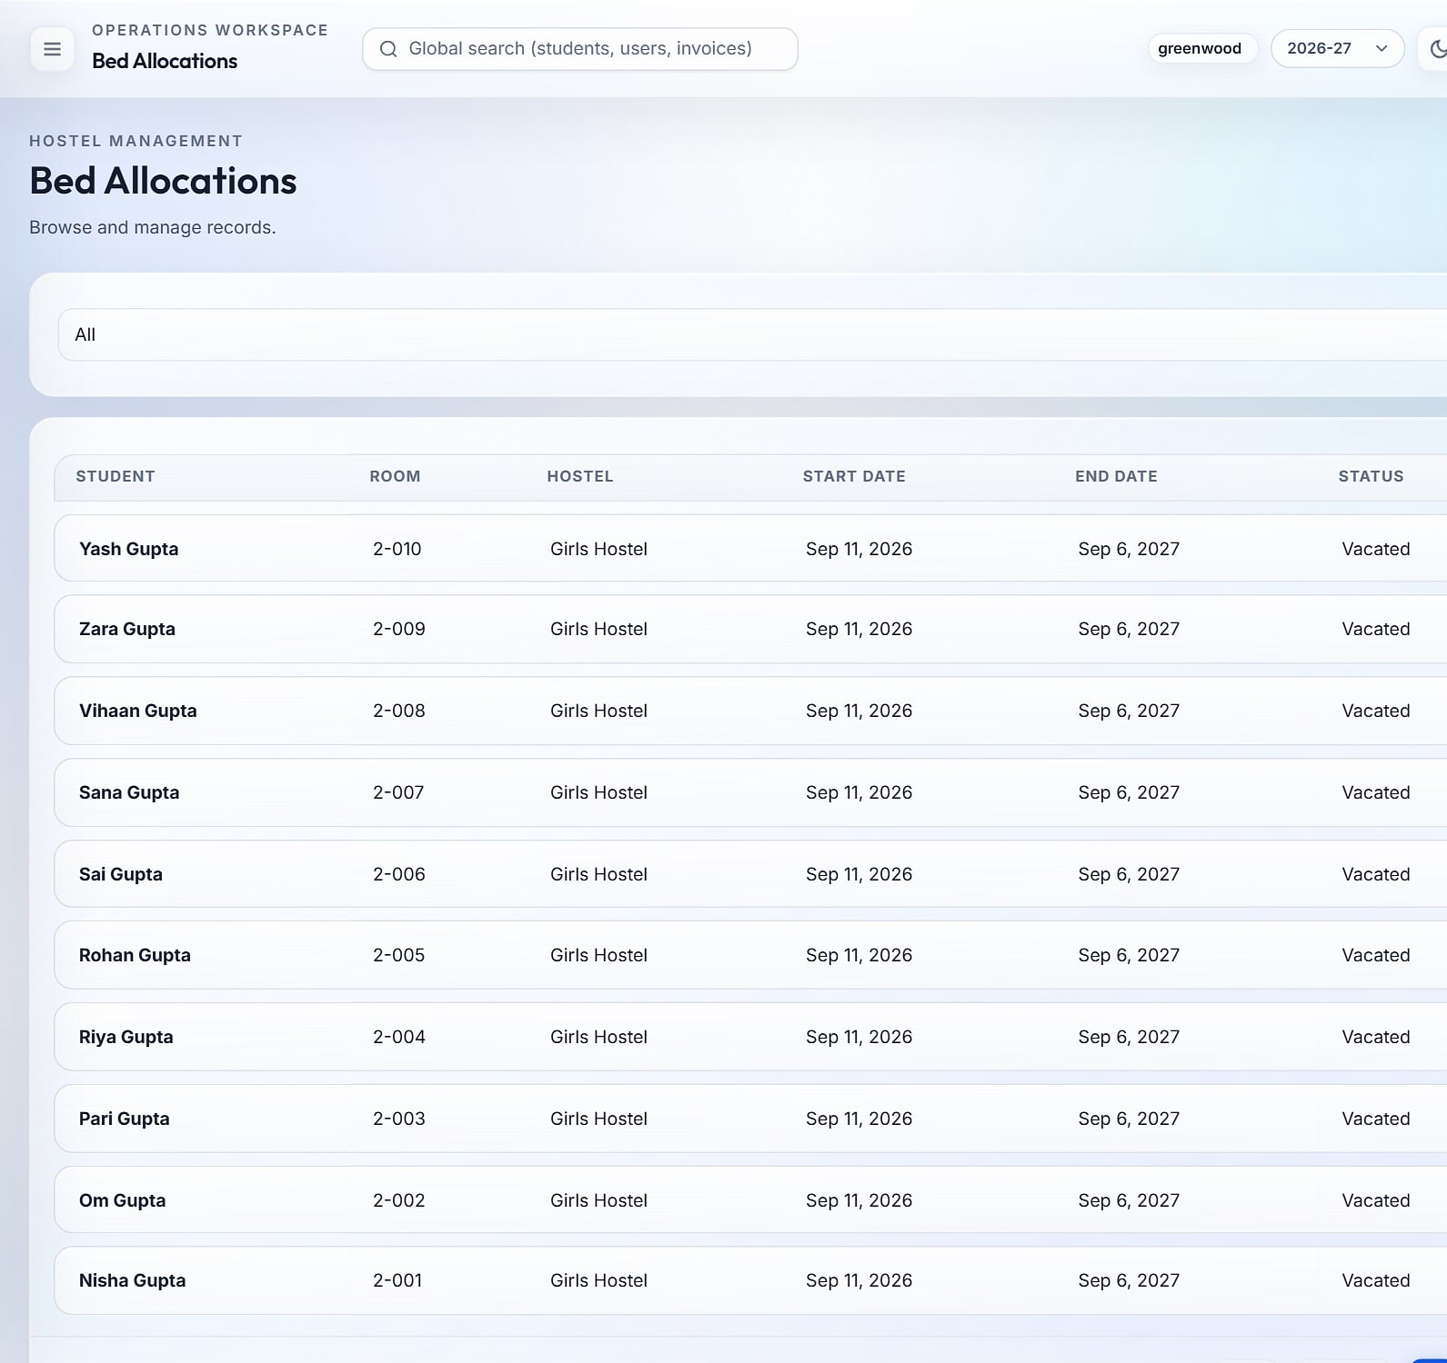
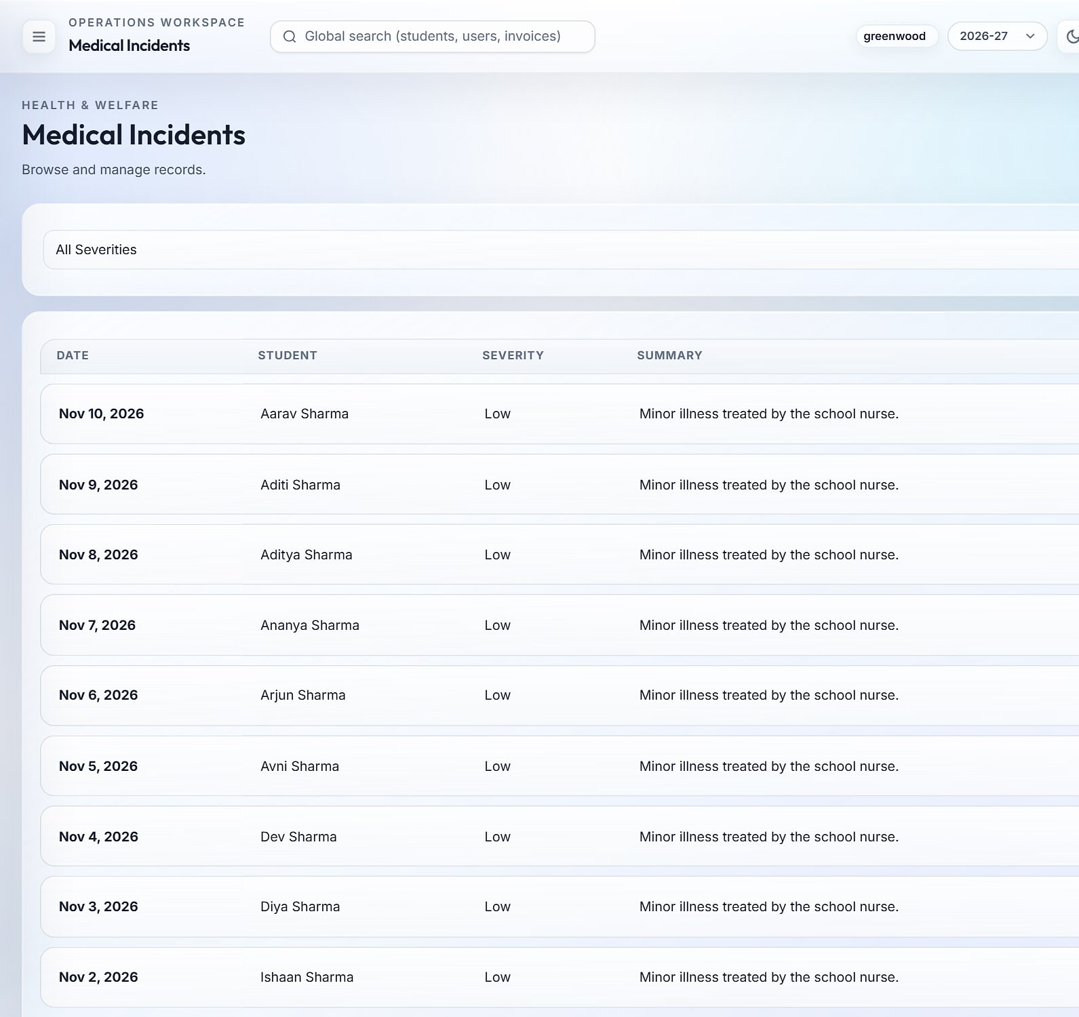
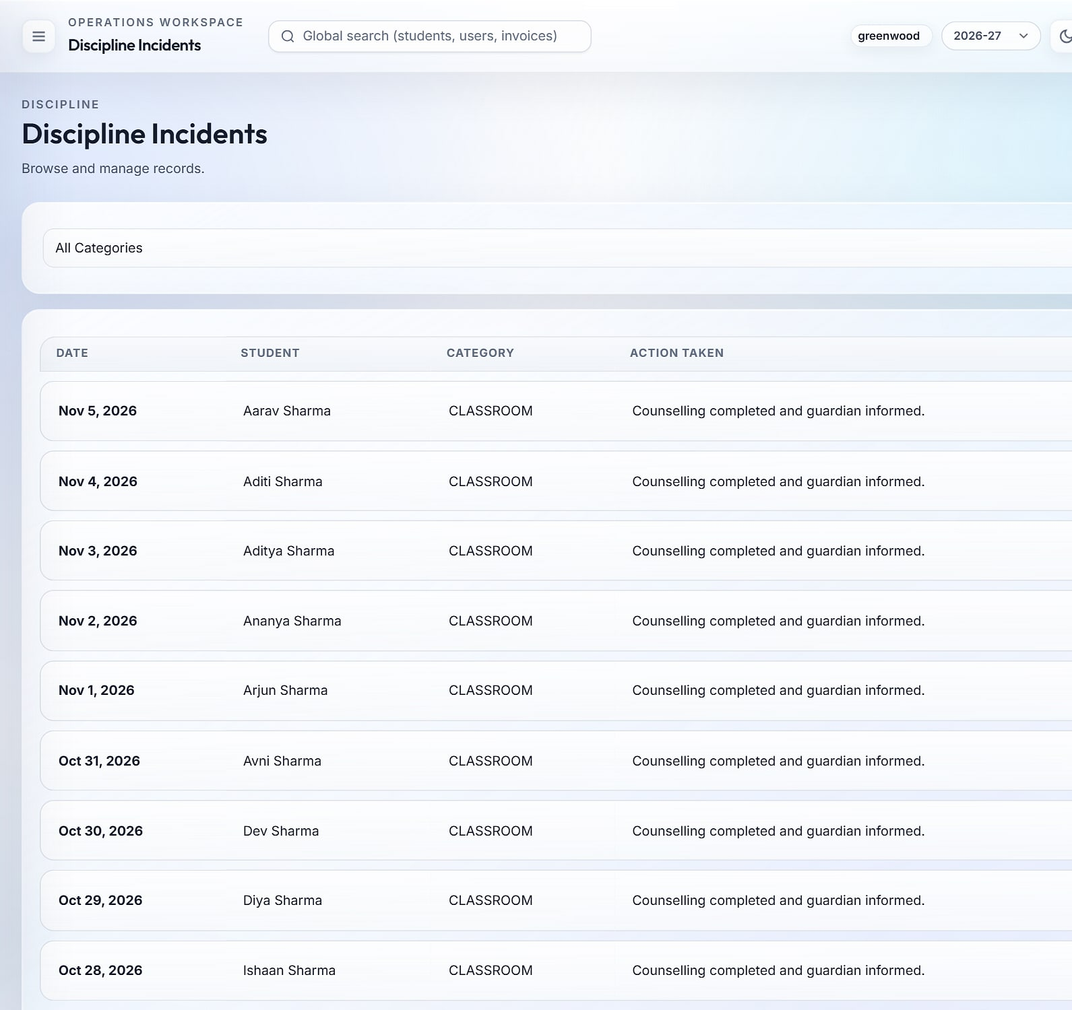
Duty-of-care records for boarding and day schools
HOSTEL, HEALTH & DISCIPLINE
Hostel
Health register
Discipline register
Hostels, rooms and bed allocations with start and end dates.
Medical incidents with severity and treatment notes.
Incidents, category and action taken, with guardian follow-up.
Notes:
Residential schools get hostel, health and discipline records on the same student record.

Slide 24
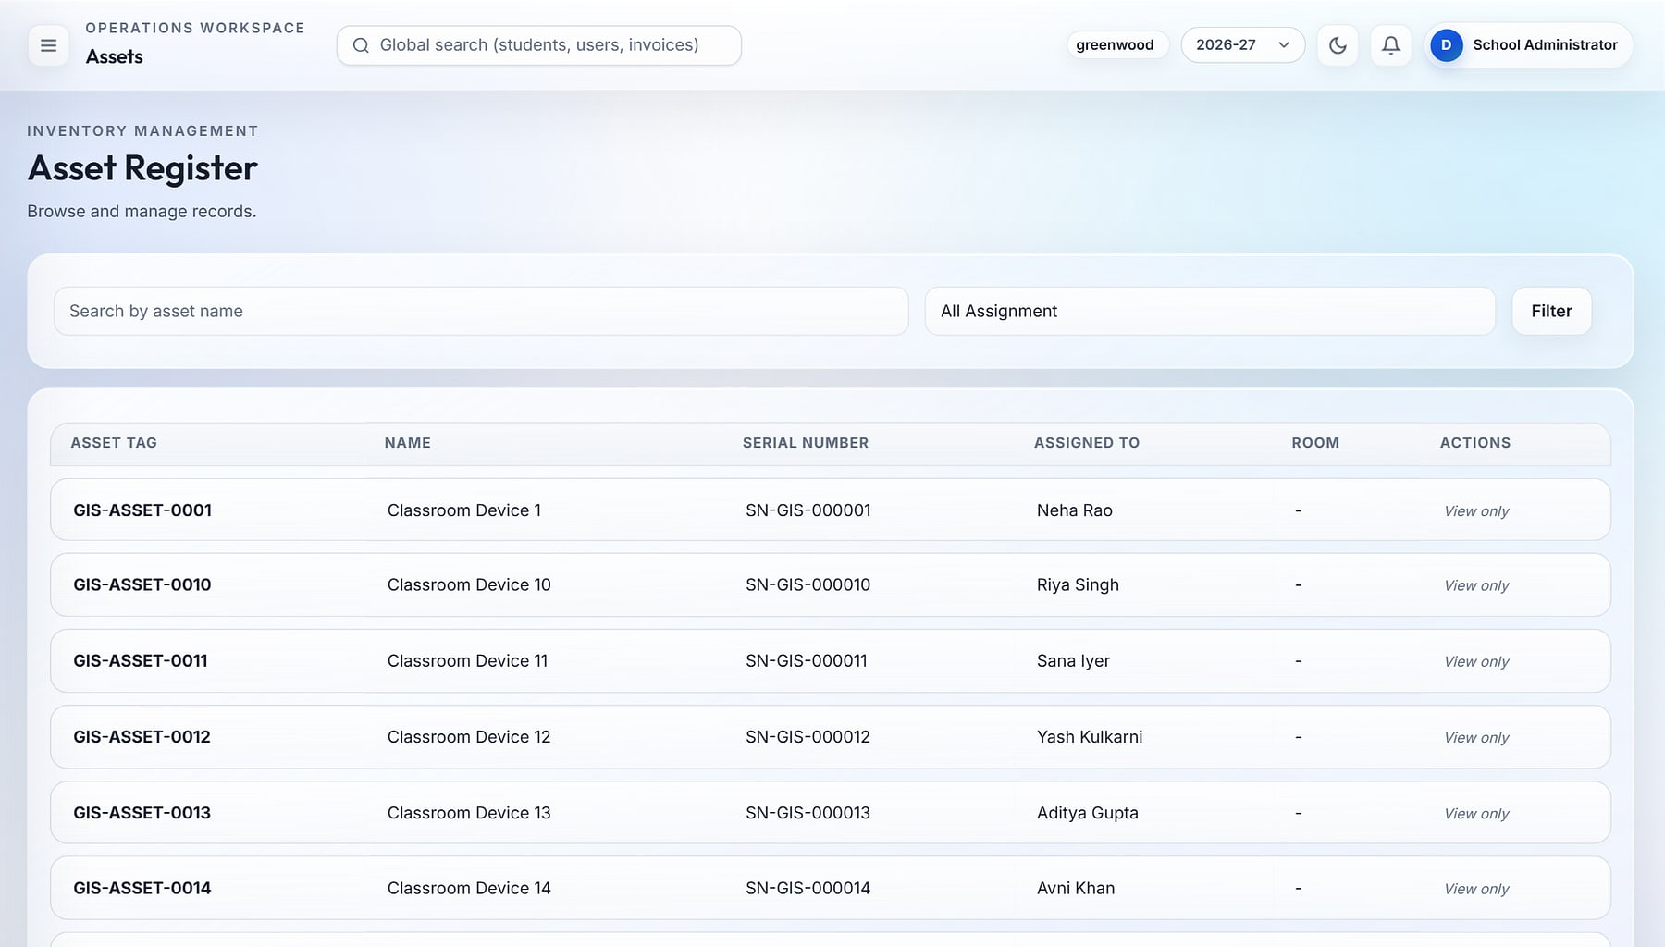




Controlled spend and an asset trail across campuses
INVENTORY & PROCUREMENT
Inventory · Asset register
Items and stock
Inventory items, locations and a stock ledger.
Purchase flow
Purchase requests become purchase orders.
Vendors
Vendor master with contacts and order history.
Asset register
Tagged assets with serial numbers and assignees.
Fixed asset register with tags, serial numbers and assignment (demo data).
Notes:
Store and procurement staff track stock, vendors, purchase orders and fixed assets.

Slide 25
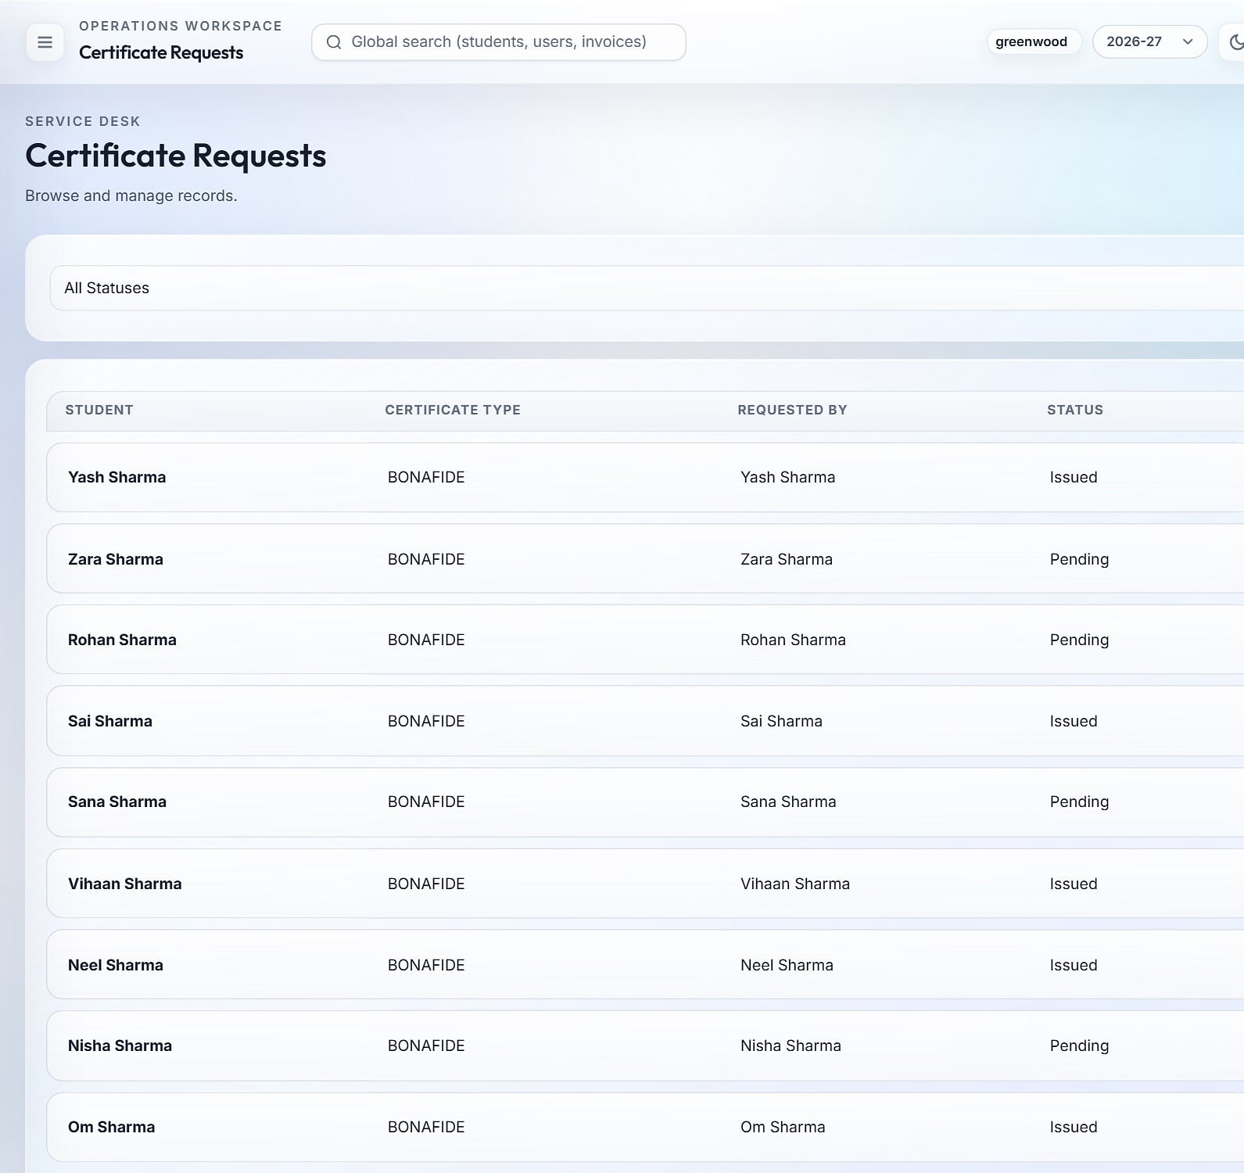
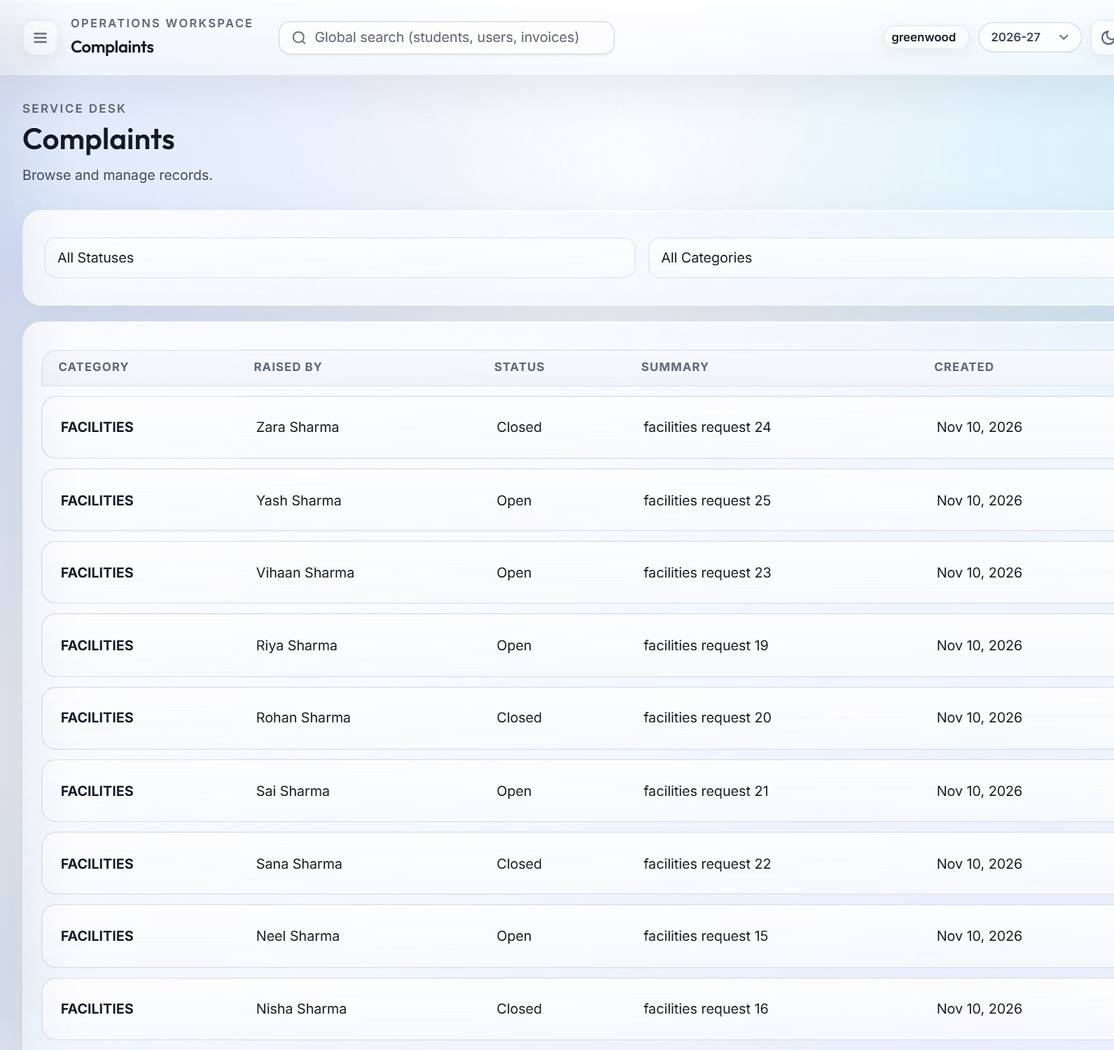
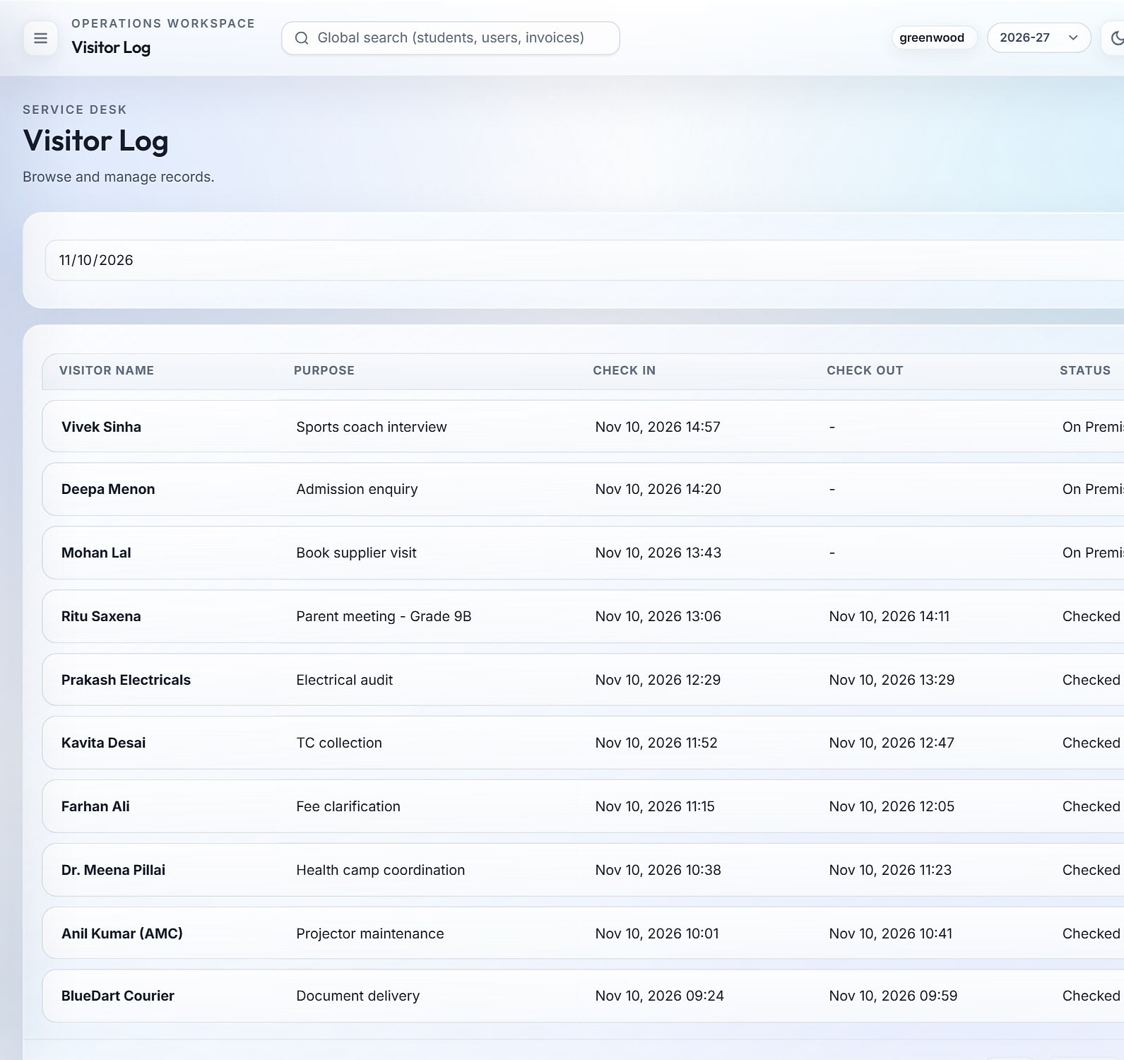
A professional front office: certificates, grievances, visitors
SERVICE DESK & FRONT OFFICE
Certificates
Complaints & requests
Visitor log
Bonafide, transfer and other certificates, requested and issued with numbers.
Grievances and service requests tracked to closure.
Every visitor checked in and out, with purpose.
Notes:
The front office runs from one desk: certificates with issued numbers, complaints and service requests with detail pages, and a visitor log.

Slide 26
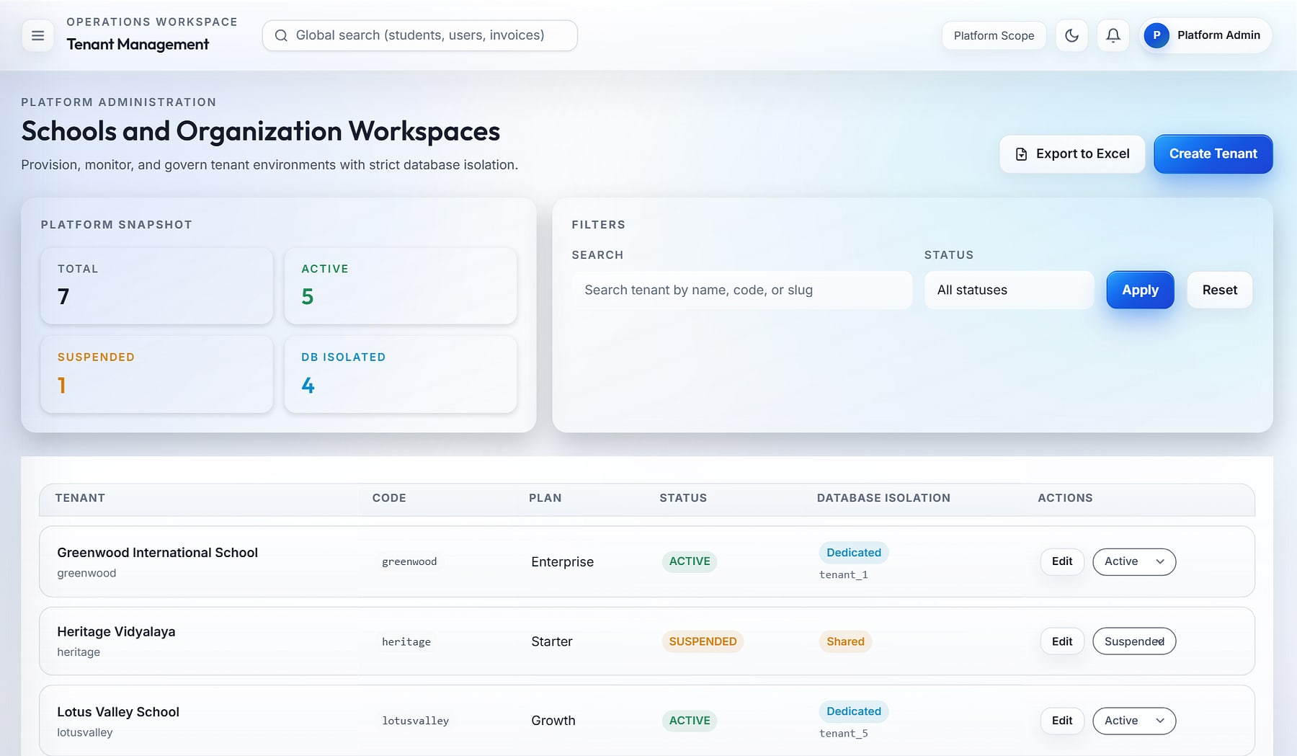
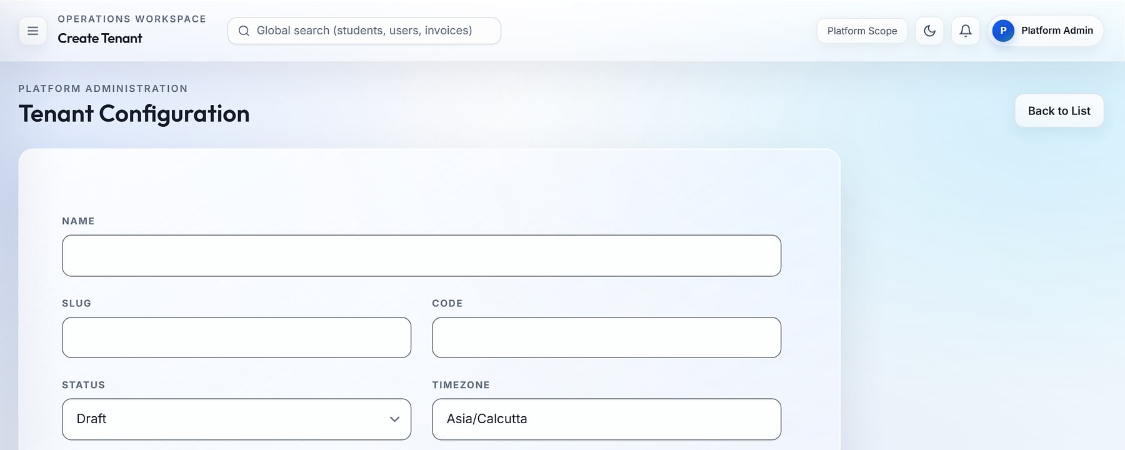
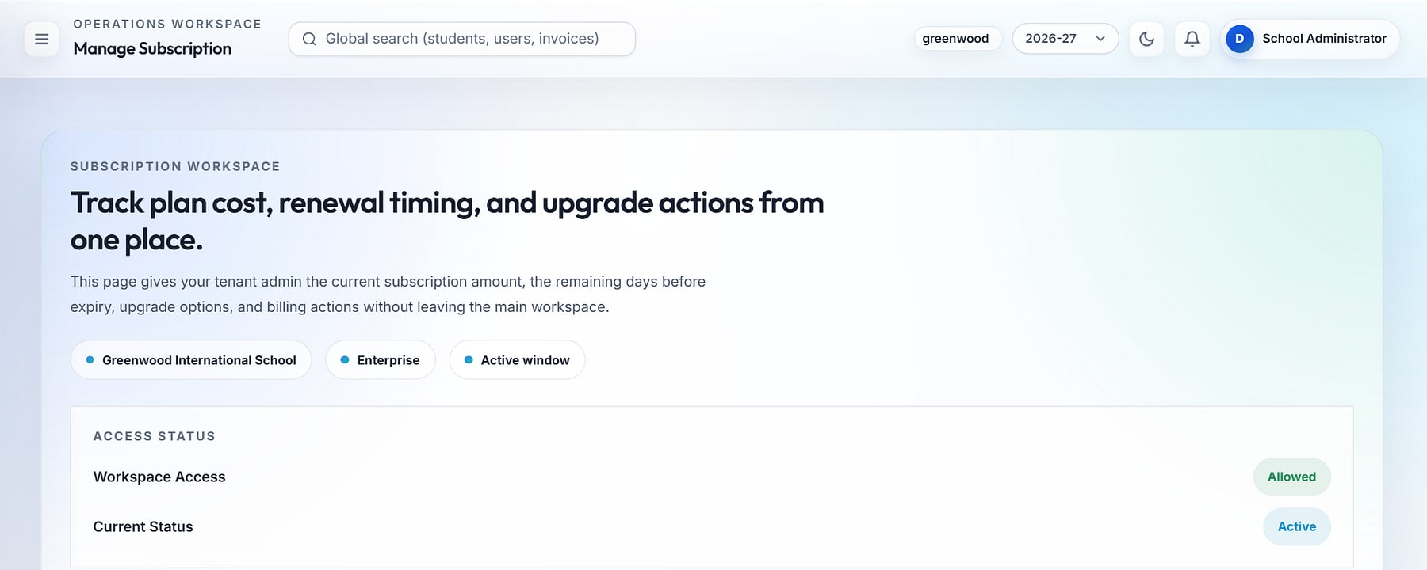
Onboard a new school in minutes, with isolated data from day one
MULTI-TENANT SAAS
Tenant management
Create tenant
1
2
Manage subscription
3
1
Platform console: schools, plans, status and dedicated databases
2
Create a school: code, timezone, currency, locale and plan
3
School-side plan, renewal and billing view
Notes:
Provisioning a school creates its database, migrates it, syncs roles and permissions, and creates a bootstrap admin and default campus. Plans carry student and staff caps; subscriptions are billed through Razorpay payment links and webhooks, and access follows subscription status.

Slide 27
Database-per-school isolation, enforced on every request
ARCHITECTURE
CLIENTS
DAPHNE ASGI · REQUEST PIPELINE
DATA
INTEGRATIONS
Web app
Staff, parents, students
Control database
Tenants · plans · billing
Razorpay
Subscription billing
1
Tenant database context
Meta WhatsApp
Inbox & templates
Student mobile app
Expo · iOS / Android
2
Authentication + single session
tenant_greenwood
Isolated MySQL database
Tenant & subscription gate
Twilio
SMS & OTP
3
Webhooks
Razorpay · WhatsApp
tenant_riverdale
Isolated MySQL database
4
RBAC permission check
SMTP email
Resets, welcomes
Tenant database router
One database per school
Created, migrated and seeded on provisioning
5
ReportLab · Excel
PDF & XLSX exports
Two layers of isolation. Middleware selects each school's dedicated database on every request, and every business model also carries a tenant key.
Notes:
Isolation works in two layers: a dedicated database per school, selected per request by middleware and a database router, plus tenant foreign keys on every business model.

Slide 28






A modern, maintainable stack your IT team will recognise
TECHNOLOGY
Backend
Data
Real-time
Django 5.1 on Python: 19 modular apps, 128 data models, 86 migrations.
MySQL (utf8mb4): one database per school, plus a control database.
Daphne ASGI and Django Channels, with a Redis-ready channel layer.
Design system
Mobile
Quality
Tailwind CSS with design tokens; light and dark themes.
Expo SDK, React Native and expo-router for iOS, Android and web.
242 unit and integration tests, 15 Playwright end-to-end journeys with axe-core.
Open, mainstream technology with no proprietary runtime.
Notes:
Open, mainstream technology. The original deck notes state it can run on any cloud or on-premise MySQL; confirm the on-premise commercial offer before promising it.

Slide 29




What changes when a school group moves to Agastya
WHY AGASTYA
TODAY
WITH AGASTYA
Isolation by design
Data
Spreadsheets, registers and phones
One data model, a dedicated database per school
Each school gets its own database, created and migrated automatically.
Visibility
Reports compiled by hand, days late
Live role cockpits for every leader
Configurable without developers
Dashboard builder, RBAC matrix, feature toggles and branding.
Control
Shared logins, no record of changes
96 permissions, single sessions, full audit trail
A school-owned parent channel
Parents
Personal WhatsApp groups, paper circulars
Portals, student app, school-owned WhatsApp inbox
Two-way WhatsApp inbox through the Meta Cloud API.
Growth
Every new campus repeats the setup
New school provisioned from the console
Audit-grade governance
Before/after audit, login events, lockout and single sessions.
Notes:
The before/after story in five lines, plus the four differentiators. Every 'With Agastya' cell maps to a capability shown earlier; no quantified ROI is claimed.

Slide 30




An indicative rollout: first campus live in about six weeks
GETTING STARTED
WEEK 1
WEEKS 2–3
WEEKS 4–6
WEEK 7+
Provision
Migrate
Pilot go-live
Scale out
Create the school workspace, branding, roles, academic year and fee heads.
Import students, guardians, staff, classes, subjects and fee plans; build the timetable.
Attendance, homework, fees and announcements live at the pilot campus; staff trained.
Exams and report cards, transport and library; next campuses provisioned from the console.
Timelines are indicative and depend on data readiness and the modules in scope; they are confirmed with delivery during scoping.
Notes:
A phased adoption: schools start with core modules and expand. Confirm timelines with delivery before committing.

Slide 31






What's next on the Agastya roadmap
ROADMAP
Specified in the product plans, not yet built. Shown so buyers can plan; not available today.
PLANNED
PLANNED
PLANNED
Online fee payment
Payroll
Multi-channel broadcast
Parents pay fees through a gateway, with refunds and late-fee rules.
Salary structures and payroll processing on top of staff records.
Send announcements over SMS, WhatsApp and email at once.
PLANNED
PLANNED
PLANNED
Saved and scheduled reports
Live bus tracking
Teacher and parent apps
Self-service report builder with scheduled delivery.
GPS tracking and boarding logs for every trip.
Dedicated mobile experiences with push notifications.
Notes:
Roadmap items are specified in the product specifications but not yet built. Position them as upcoming, not available today.

Slide 32

Run every school in your group on one platform
LET'S GET STARTED
MavionTech Pvt. Ltd.
Agastya · Cloud School ERP
communications@maviontech.com
+91 91580 08002
www.maviontech.com
505 Zen Business Center, Bhumkar Chowk, Wakad, Pune, Maharashtra 411057
See Agastya with your own data in a guided walkthrough, then run a pilot at one campus.
Book a demo
Plan a pilot
Notes:
The close. One ask: a walkthrough with the prospect's data, then a single-campus pilot. Contact details are the official MavionTech details from maviontech.com.

