Slide 1

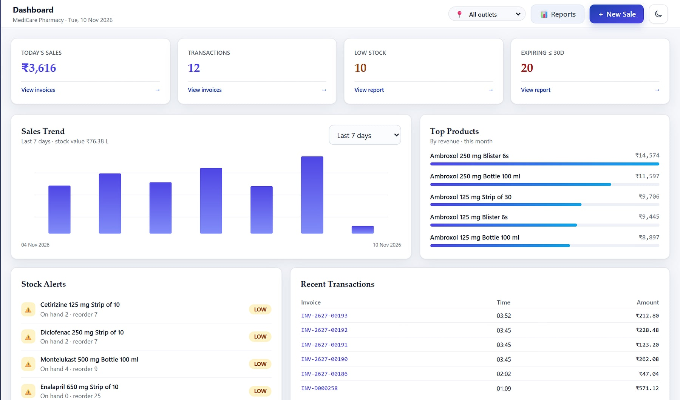
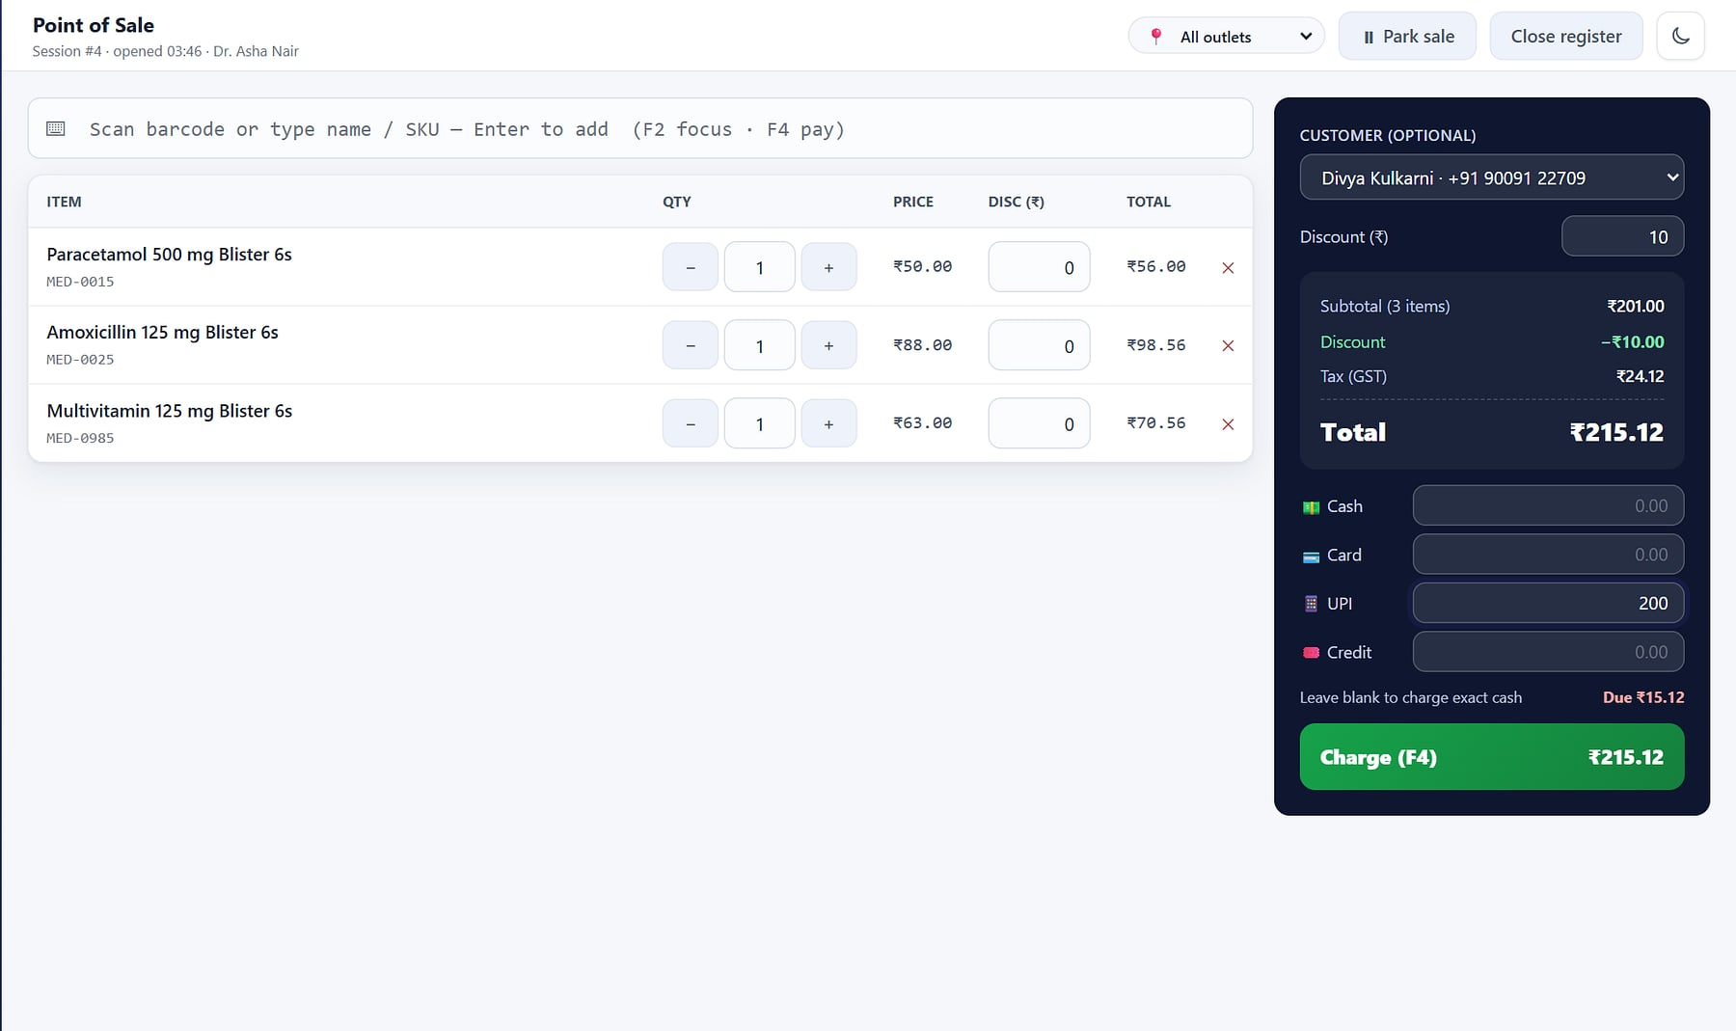
HeeLIKS
HeeLIKS · Owner dashboard
ENTERPRISE SALES OVERVIEW
INVENTORY, POS & DISTRIBUTION
Run your entire store on one platform.
Inventory, point of sale, purchasing, B2B order-to-cash and GST reporting on one stock ledger, with each customer in its own isolated database.
Ledger-true stock
GST-ready
Database per customer
Notes:
Opening. HeeLIKS (Holistic Enterprise Engine for Logistics & Inventory Keeping System) is a MavionTech product. The promise is the product's own website hero line, minus the word 'intelligent' (there is no AI in the product). All screens show seeded demo workspaces (MediCare Pharmacy and four other industry demos), not customers.

Slide 2






Stock, till and books that never agree
THE PROBLEM
Stock lives in a spreadsheet
Expiry found too late
GST is a monthly scramble
Billing runs on a separate till, so on-hand is a guess and stock-outs are found by customers.
Batches and expiry dates sit on cartons, not in the system; write-offs surface at audit time.
Accountants rebuild tax summaries, credit notes and GSTR-1 from bill books by hand.
No control, no trail
Distribution on paper
Tools that don't talk
Shared logins, unlimited discounts and no record of who changed a price or a quantity.
Orders, challans and receipts tracked in registers; nobody knows who owes what.
Separate POS, inventory and accounting tools: every number entered twice.
Notes:
Typical pains of stock-driven outlets and distributors, from the product specification (docs/SRS.md section 2.2) and the source deck. No market statistics are used.

Slide 3
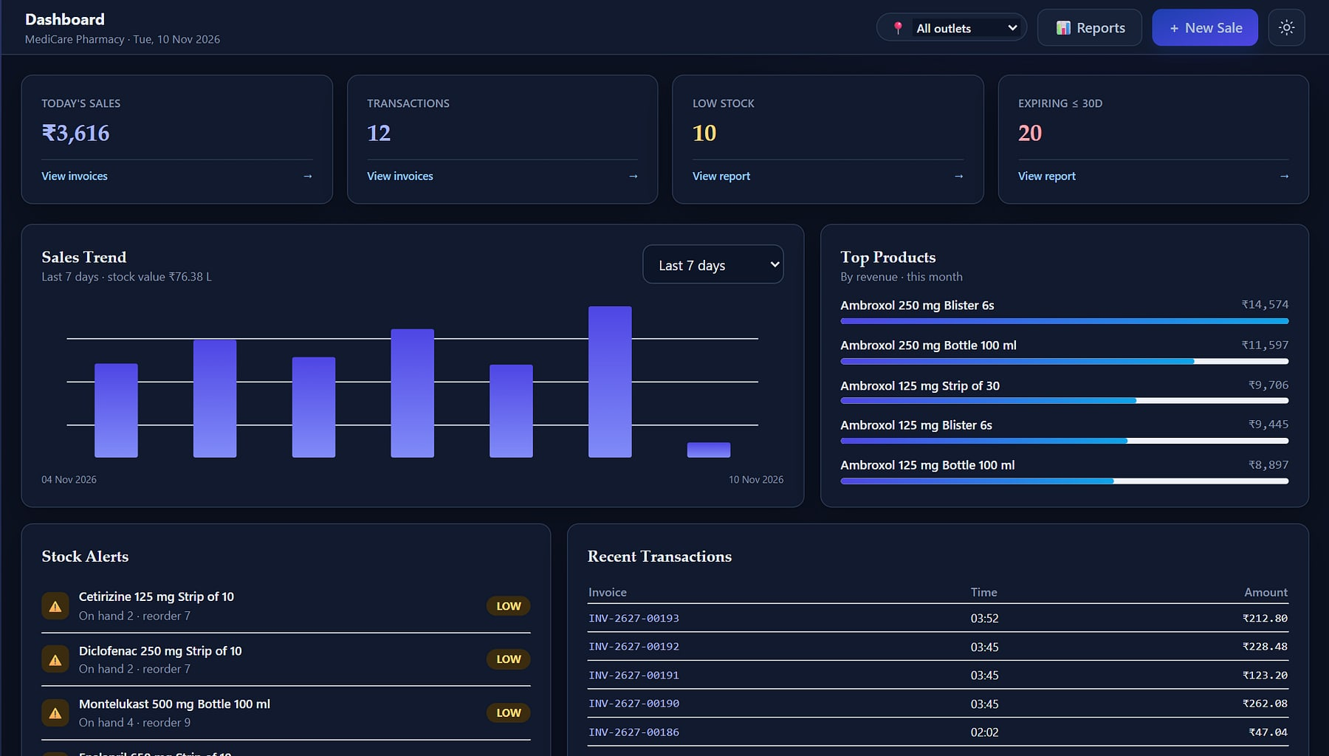



One platform from purchase order to paid invoice
MEET HEELIKS
medicare.heeliks.com
Sell
A keyboard-first, GST-correct POS that cannot oversell.
Stock & buy
Catalog, batches, purchasing and counts on one ledger.
Distribute
Orders, challans, delivery proof, receipts and ledgers.
Comply & govern
21 reports, GSTR-1, two-factor sign-in, roles and audit.
Owner dashboard in dark mode: sales, stock alerts, expiry and top products (demo data).
Notes:
Every purchase, receipt, sale, return, transfer and count posts to one append-only stock ledger, so stock, sales and books agree by construction (apps/inventory/stock.py).

Slide 4
A complete platform, counted from the code
AT A GLANCE
16
70
169
21
domain modules
data models
routes and screens
exportable reports
5 · 10
348
5
1
roles · permission codes
automated tests
verticals configured at signup
database per customer
Source: code review of the HeeLIKS repository (commit 3b66227, 10 Nov 2026): app configs, models, URL resolver, rbac seeding and test functions.
Notes:
All figures were counted from the code, not taken from marketing copy. The website's '~81 tests' and '99.8% uptime engineered' lines are not used.

Slide 5



Built for every role in the business
WHO IT SERVES
Owner / Admin
Manager
Cashier
The economic buyer. Full access: dashboard, reports, users, subscription and billing.
Catalog, stock and purchasing with approval, returns and reports. Discount cap 20%.
POS and returns only, on a focused menu. Discount cap 5%; opens and closes the register.
Store staff
Auditor / CA
HeeLIKS operator
Receives goods, adjusts and counts stock. No pricing or sales access.
Read-only reports, catalog and stock. Every attempt beyond that is denied and logged.
Runs the platform console: provisioning, plans and payments, with tenant metadata only.
Notes:
Roles and discount caps from apps/rbac/seeding.py (DEFAULT_ROLES, ROLE_CONSTRAINTS). Buyers: owner or proprietor of an outlet or chain; MD or finance head of a distributor. Influencers: store manager and accountant/CA.

Slide 6

Five pillars, one stock ledger behind every module
PRODUCT MAP
Sell
Stock & Buy
Distribute
Insight & Comply
Govern & Scale
Point of sale
Registers & Z-report
Sales invoices
Returns & notes
Catalog & masters
Inventory ledger
Batches & expiry
Procurement & GRN
Partners
Sales orders
Challans & POD
Receipts & ledger
AR aging & collections
Owner dashboard
21 reports
GST & GSTR-1
Alerts
Onboarding & import
Security & 2FA
Roles & audit
Subscription
Platform console
REST API
One append-only stock ledger sits behind every module: a sale, a goods receipt, a challan and a stock count all move the same numbers, in the same transaction.
Notes:
Module map from HeeLIKS_coverage.csv (22 module rows, grouped) and the 16 Django apps. The website's 'nine modules' figure is out of date and is not used.

Slide 7



Eight differentiators, each verified in the product
WHY HEELIKS
Database per customer
Ledger-true stock
FEFO and expiry control
GST compliance pack
Each workspace gets its own database; unknown subdomains are refused.
Row-locked, append-only ledger: two registers cannot sell the last unit.
Earliest-expiry batch picked first; expired stock blocked at the counter.
CGST/SGST/IGST split, HSN, GSTR-1 export, gapless series, s.34 notes.
Security by construction
Roles with guard-rails
Full B2B order-to-cash
Go-live with undo
Enforced two-factor, one session per user, lockout and encrypted secrets.
Discount caps per role; every denied attempt is audited.
Order, invoice, challan, POD, receipt and ledger on the same stock.
Excel and Tally XML import with dry-run, reconciliation and exact undo.
Notes:
USPs U1–U10 in product_analysis.md, each with a code reference (TenantResolverMiddleware, stock.py post_movement and fefo_allocate, reporting/returns services, accounts and middleware, rbac decorators, orders services, importer).

Slide 8
Checkout that never oversells
PILLAR 1 · SELL
Point of sale, registers, invoices and returns: every sale posts stock, tax and cash in one transaction.
Notes:
Pillar 1: the counter.

Slide 9
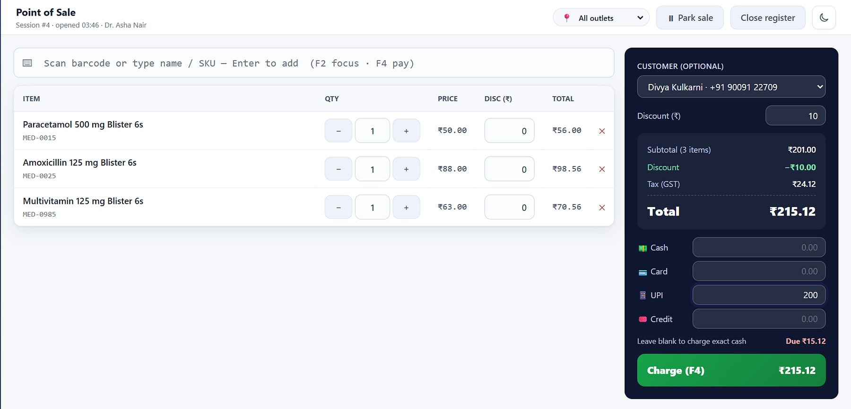




Checkout in seconds, GST-correct every time
POINT OF SALE
medicare.heeliks.com/pos
Scan or type ahead
HID barcode scanners, SKU or name search, with exact matches straight to the cart.
Split tender
Cash, card, UPI and store credit on one bill; change computed live.
Role-capped discounts
Line or bill discount, capped per role; overrides are blocked and logged.
Atomic and gapless
Sale, stock-out, cost snapshot and fiscal-year invoice number in one transaction.
POS: three-line cart with bill discount and a UPI + cash split (demo data).
Notes:
apps/sales/services.py and static/js/pos.js. CGST/SGST/IGST is split by place of supply. Customer name and number on screen are seeded demo data.

Slide 10
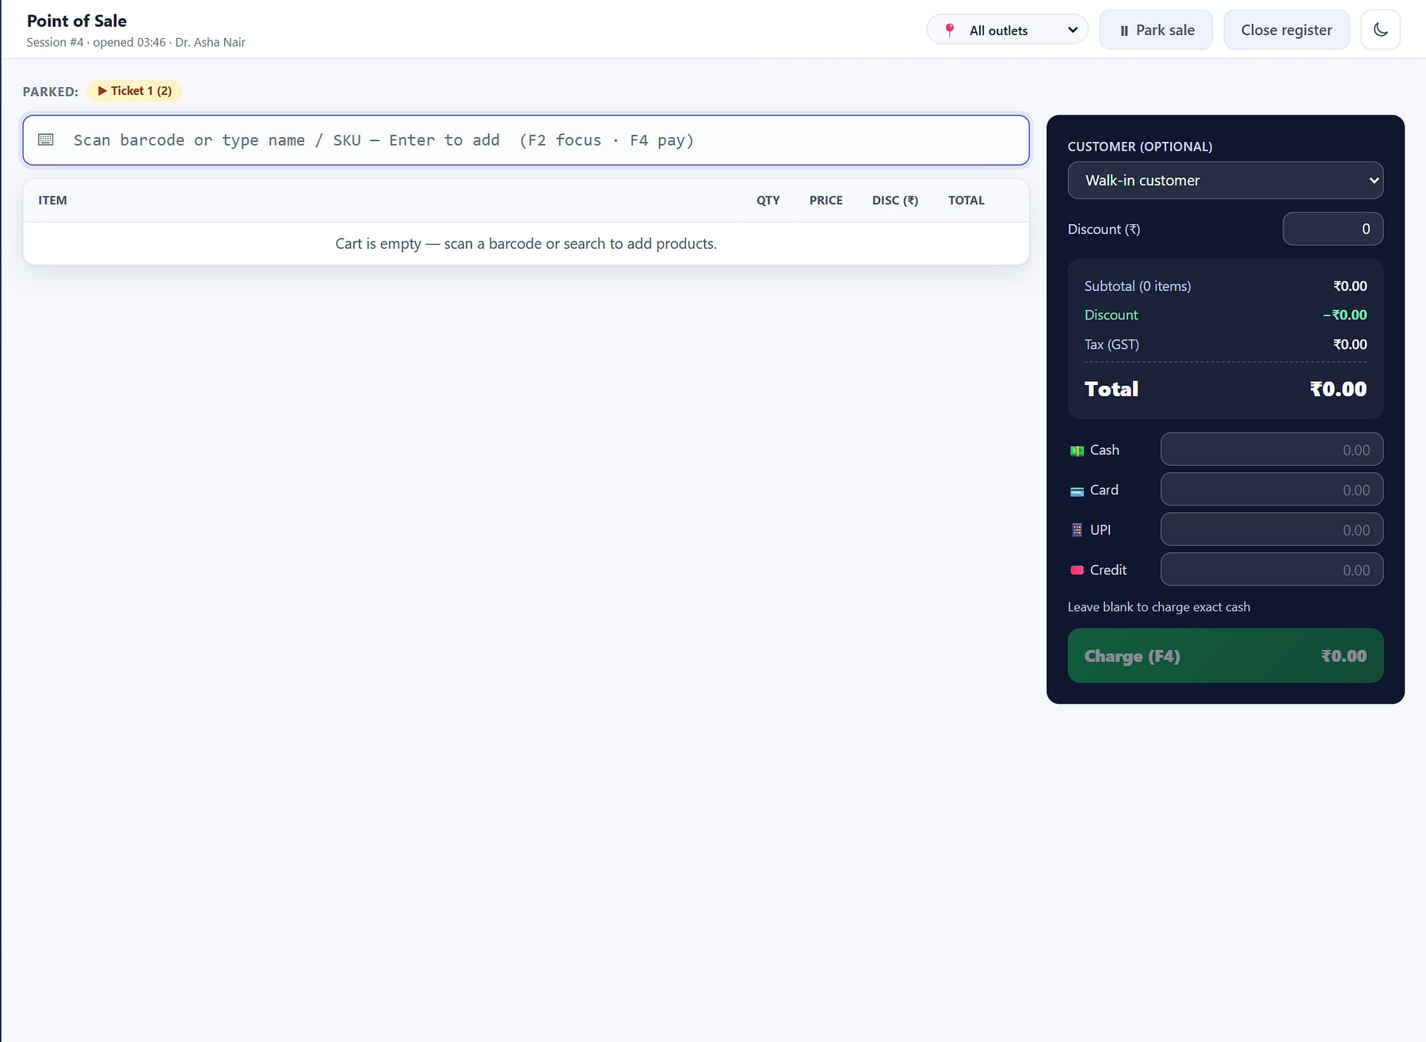
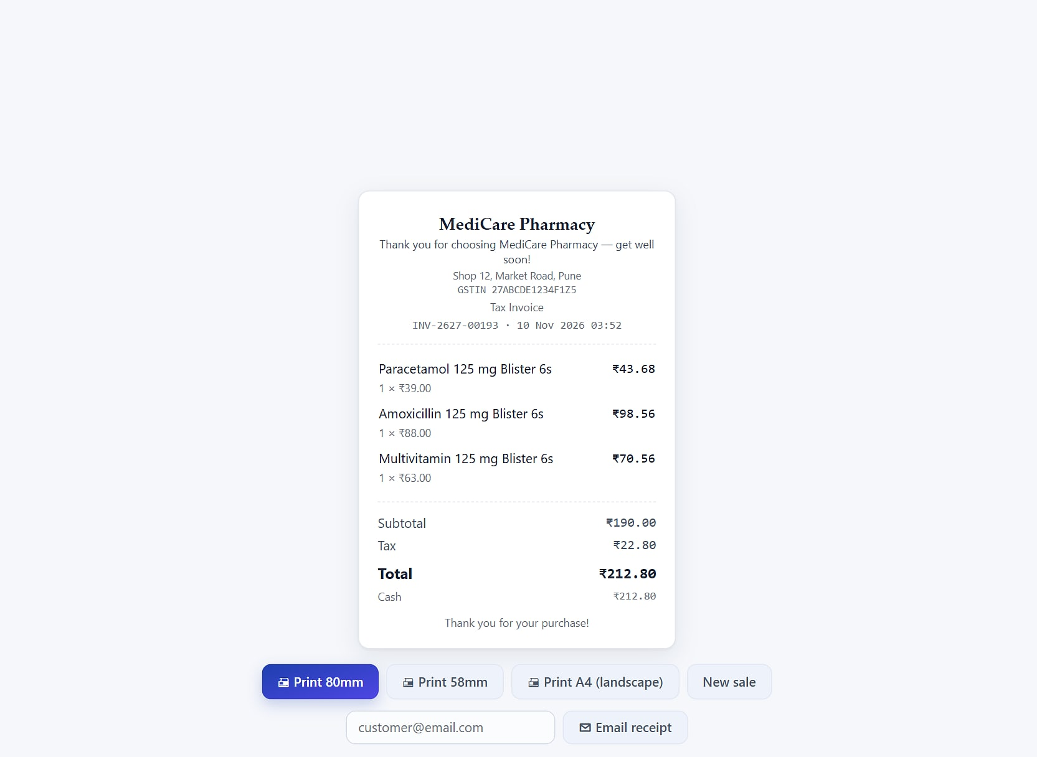
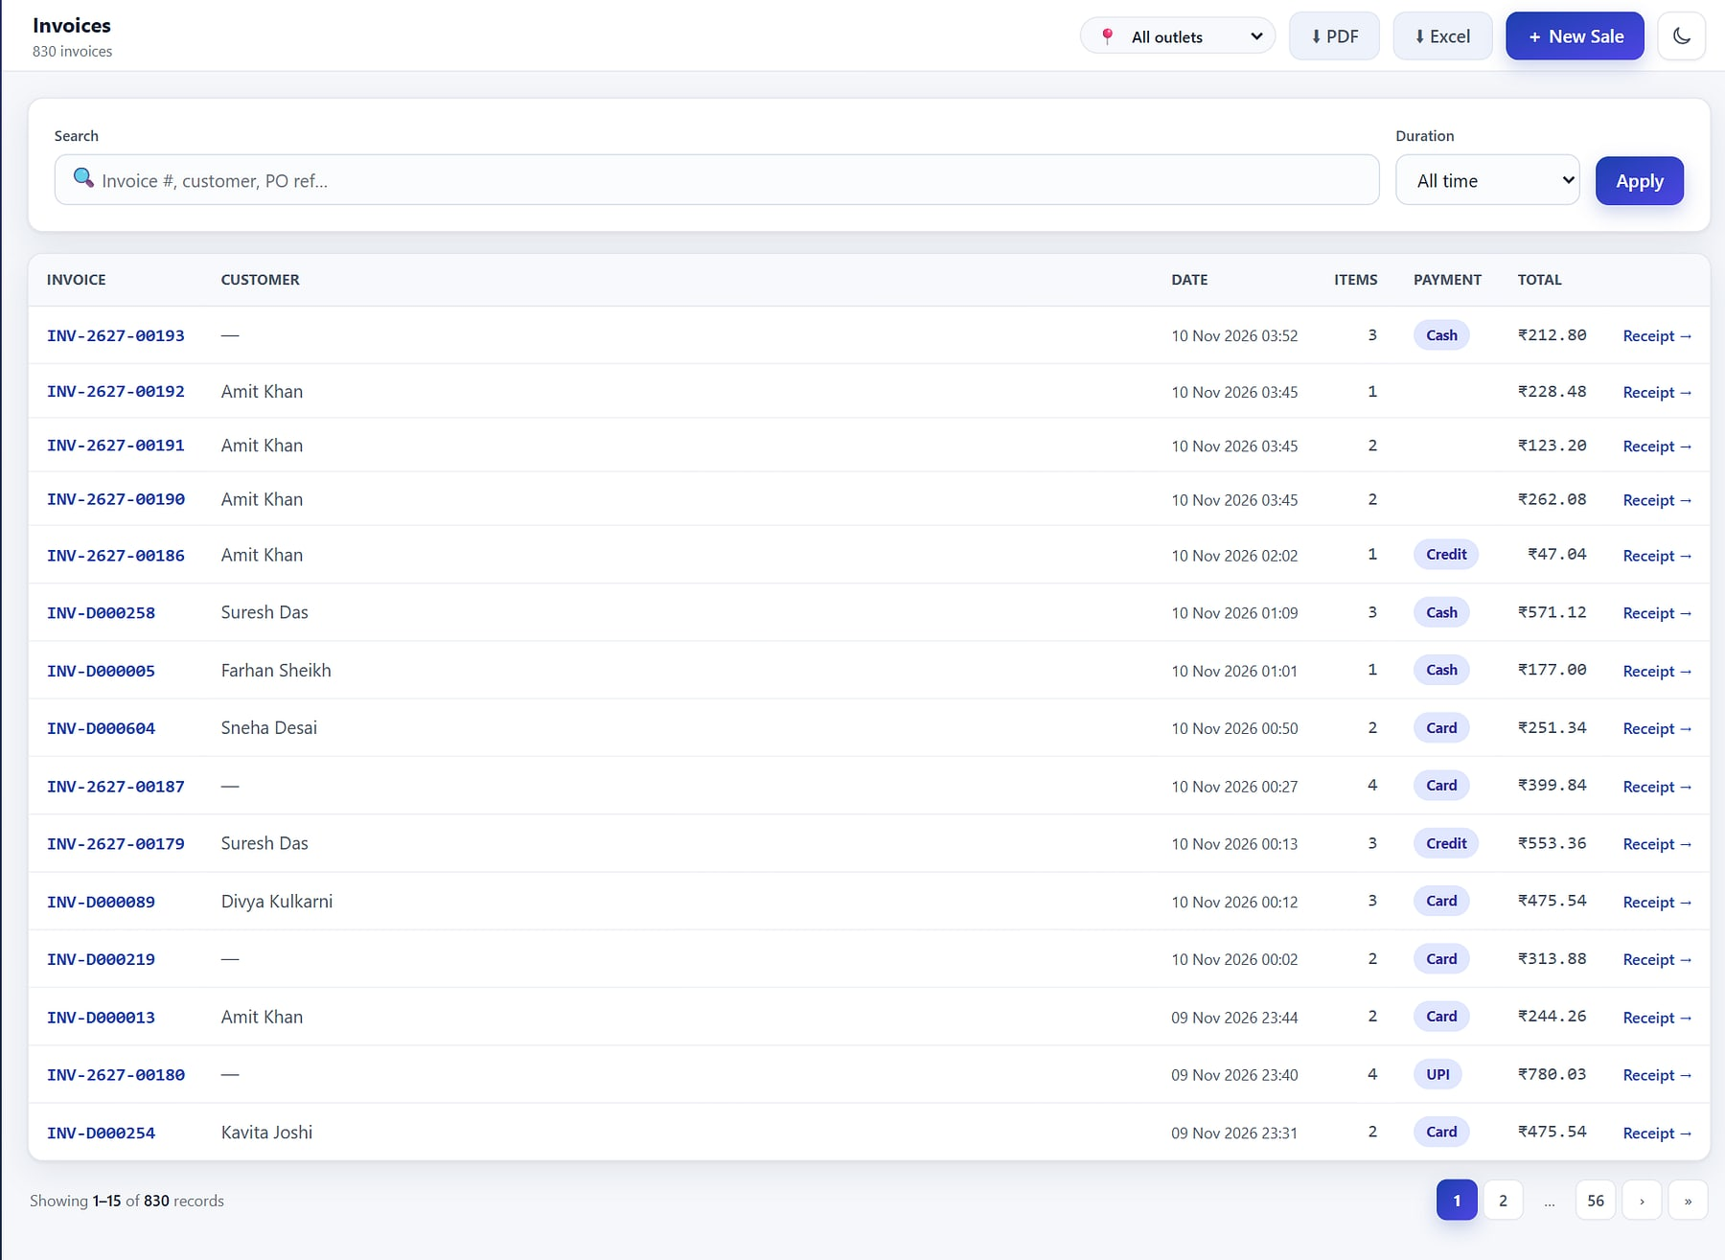
Built for the busiest counter in town
AT THE COUNTER
Park and resume
Print or email
Invoice register
Hold a cart while the customer fetches one more item; resume it with F7. F2 search and F4 charge keep hands on the keyboard.
80 mm or 58 mm thermal, A4 PDF, or email; branded with the outlet profile.
Every bill with tender and customer; search, filter and reprint, with gapless numbering.
Notes:
Counter features from the coverage map: park/unpark, receipts, keyboard shortcuts.

Slide 11
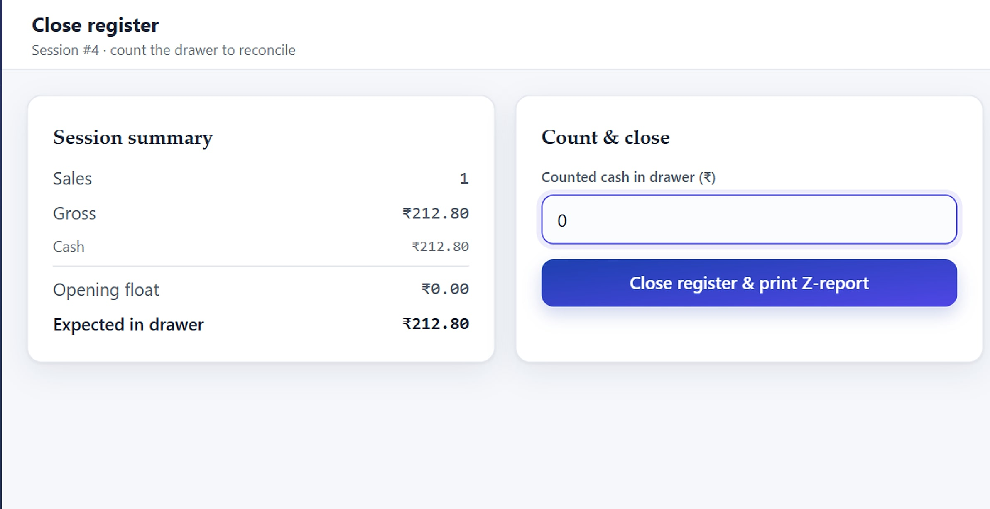
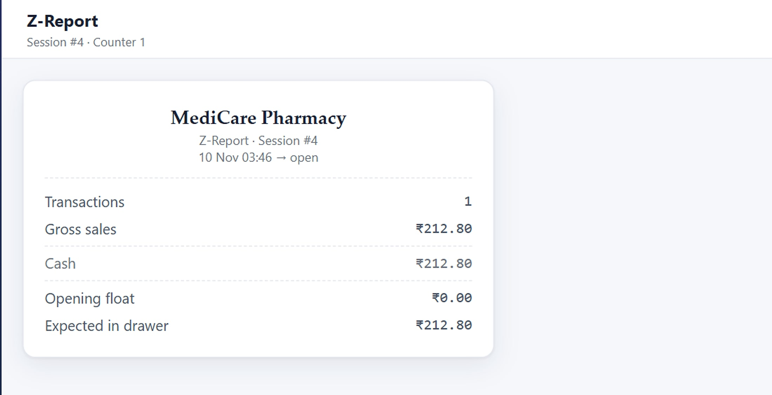



Every rupee in the drawer, accounted for
REGISTERS AND Z-REPORT
Close register: count the drawer; the variance is computed (demo data).
Z-report for a session, printable at day end.
Opening float
Session per cashier
Computed variance
Z-report
Every shift starts counted.
One open session each.
Float + net cash vs counted.
Printable end-of-day summary.
Notes:
Registers module: open with float, close with counted cash, Z-report with variance, session history.

Slide 12
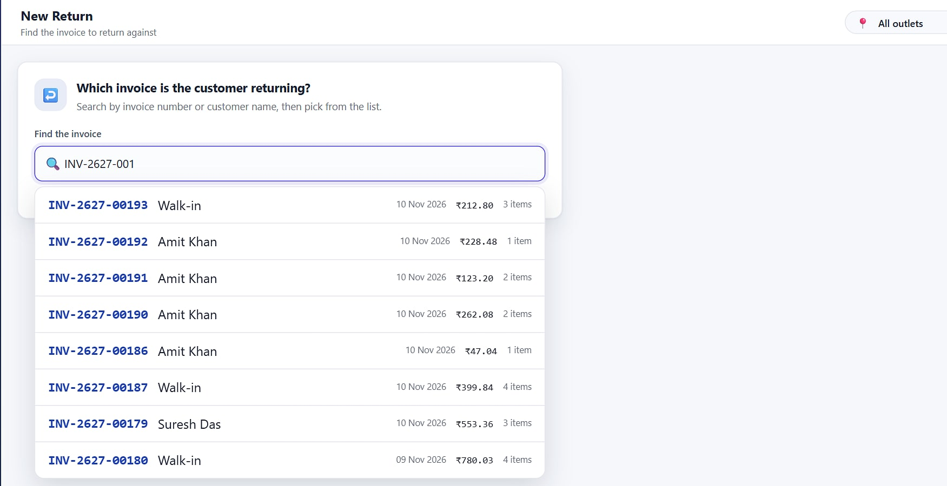
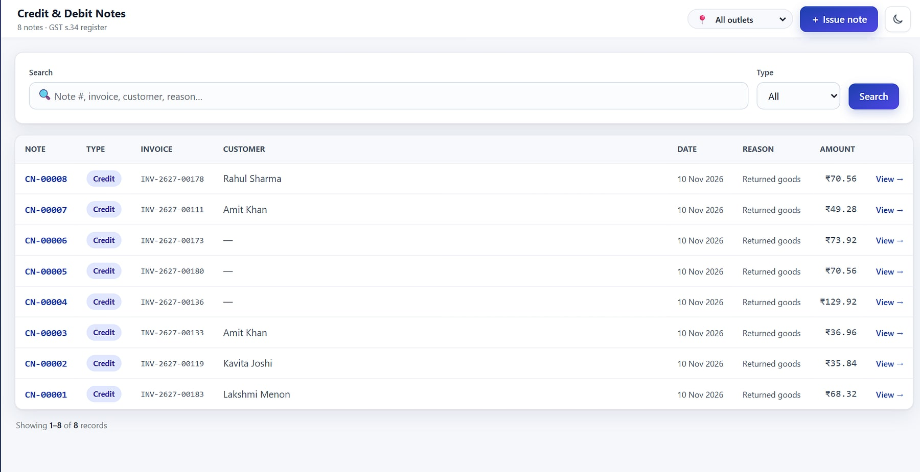



Refunds in a minute, with a compliant credit note
RETURNS AND CREDIT NOTES
Returns start from the real sale: lookup by invoice number or customer.
Credit and debit notes, including standalone notes with s.34 reasons.
Find the sale
Restock or write off
Numbered credit note
Return window
Invoice number or customer.
Per line: shelf or damaged stock.
Tax reversed in proportion.
Configurable; older invoices refused.
Notes:
apps/returns/services.py. Standalone credit/debit notes cover CGST Act section 34 reasons without fake stock movements.

Slide 13
Stock you can trust
PILLAR 2 · STOCK & BUY
Catalog, inventory ledger, batches and expiry, purchasing and partners: one append-only ledger behind every number.
Notes:
Pillar 2: master data, stock and purchasing.

Slide 14

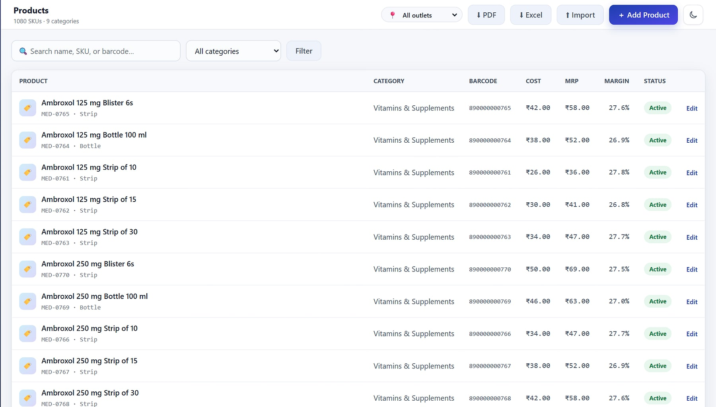


Clean master data at thousand-SKU scale
CATALOG AND MASTERS
Rich product records
medicare.heeliks.com/products
SKU, HSN, MRP, cost, reorder level and batch tracking.
Barcodes and labels
Multiple barcodes per item; Code128 labels ready to print.
Units and tax classes
Strip, box or bottle with conversions; GST slabs mapped per product.
Bulk import
CSV or Excel with a template and validation.
Product list: SKU, barcode, cost, MRP, margin and status (demo data).
Notes:
Catalog module: products, categories, brands, manufacturers, units with conversions, tax classes, barcode labels and import (C01–C10).

Slide 15
On-hand is a ledger, not a guess
INVENTORY LEDGER
EVERY MOVEMENT
ALWAYS DERIVED
Goods receipt
+ batch, expiry, cost
Append-only stock ledger
Signed entries only: never edited or deleted. Row-locked with an availability re-check, so nothing oversells.
On hand · reserved · available
per product, batch and location
Sale / return
- or + at the counter
Stock value
moving-average cost
Transfer
location to location
Reports and alerts
valuation, movement, low stock
Count / adjustment
with a reason code
Because stock levels are a projection of the ledger, every discrepancy has a paper trail: who moved what, when and why.
Notes:
apps/inventory/stock.py: post_movement writes StockLedger and updates the StockLevel projection under SELECT ... FOR UPDATE with an availability re-check; moving-average cost.

Slide 16
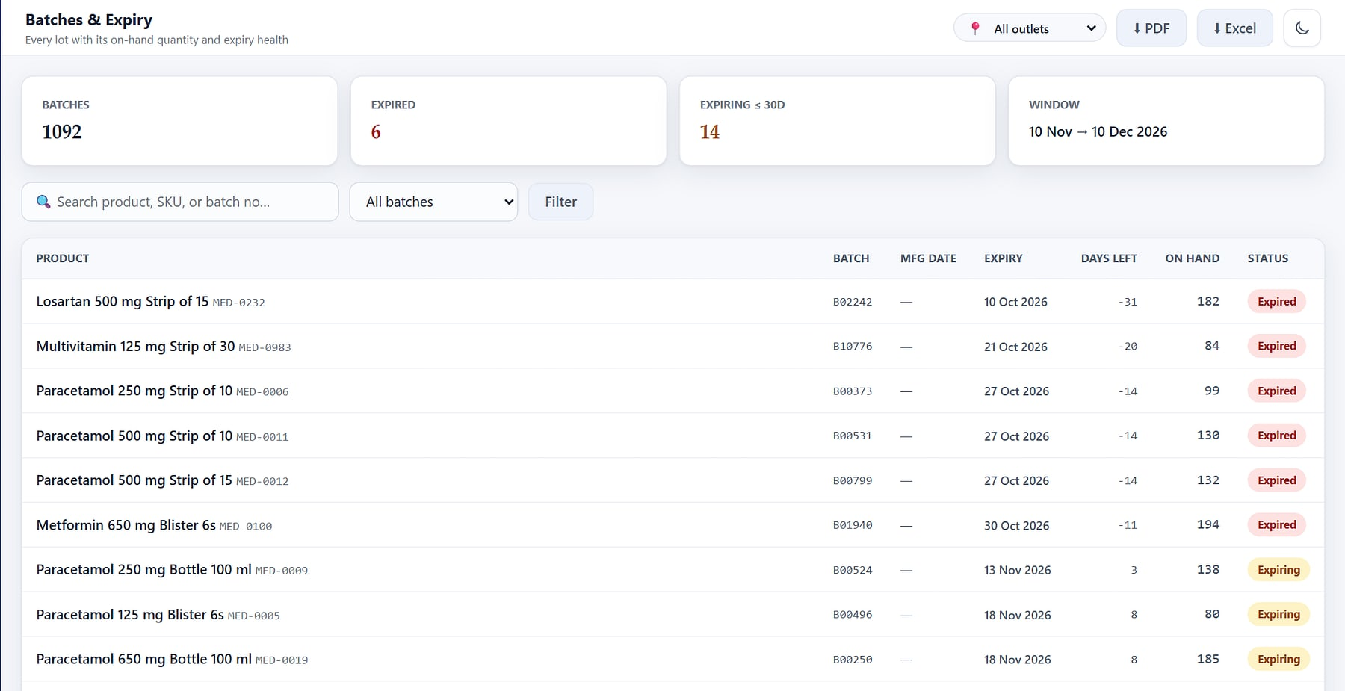
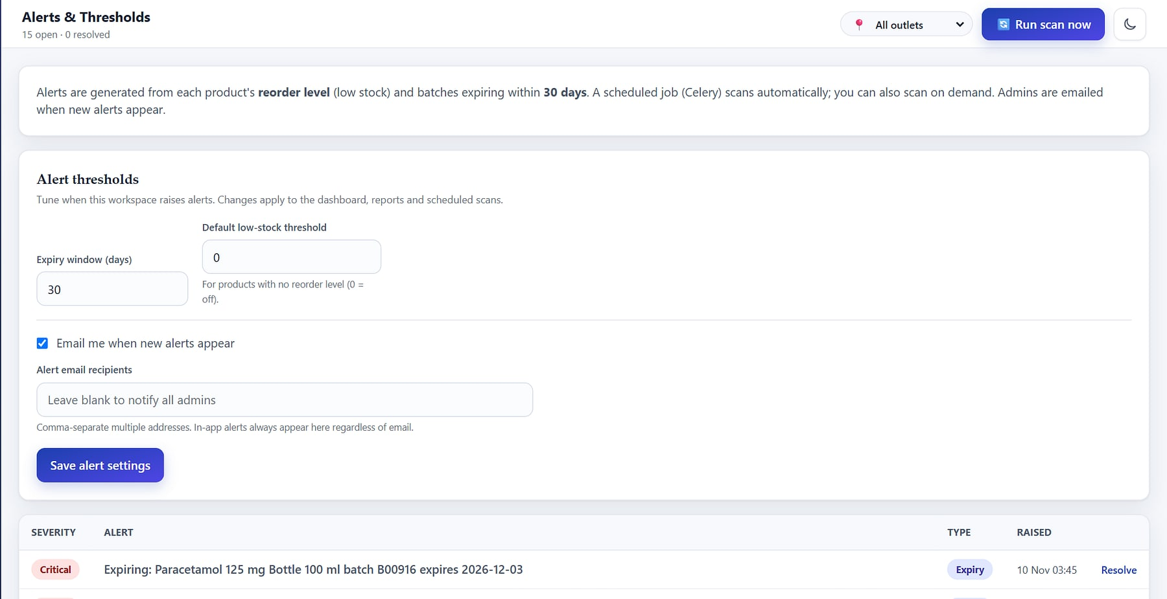



Catch expiry before it becomes a write-off
BATCHES, FEFO AND EXPIRY
Batches and expiry: days left with expired and expiring flags (demo data).
Alerts: low-stock and expiry thresholds with an email channel.
FEFO allocation
Expired blocked
Stock alerts
Email delivery
Earliest expiry sells first.
Cannot be sold at the counter.
Hourly scan, de-duplicated.
Digests to chosen people.
Notes:
fefo_allocate in apps/inventory/stock.py; alerts in apps/notifications with dedupe and auto-resolve; hourly Celery beat scan.

Slide 17
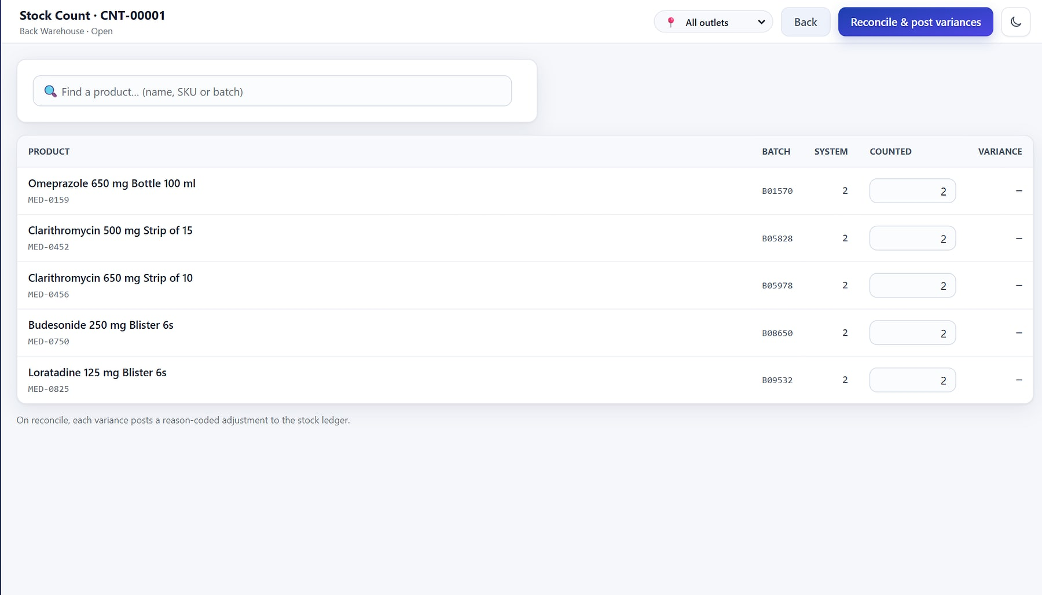
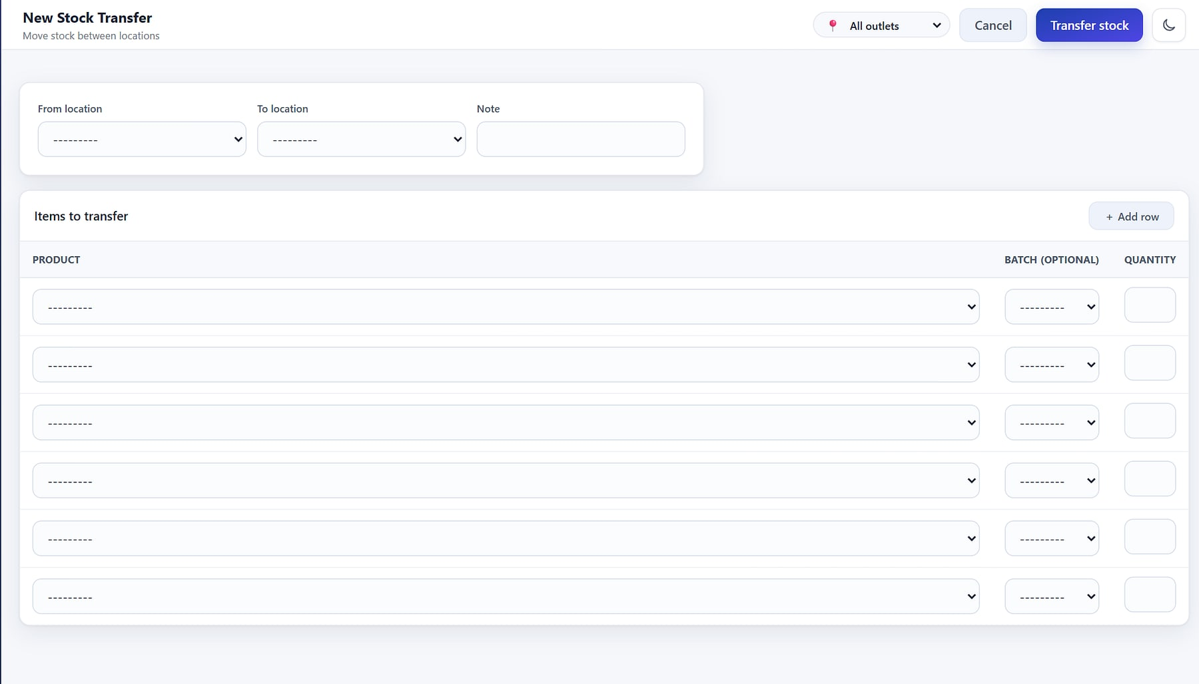
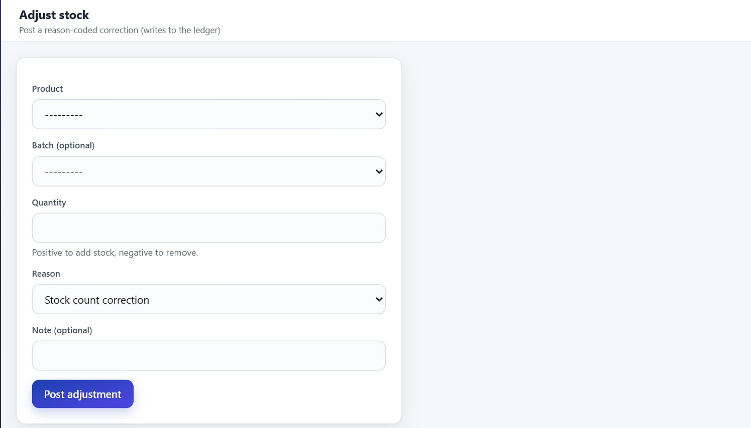
Every stock movement lands on the ledger
COUNTS, TRANSFERS AND ADJUSTMENTS
Physical counts
Inter-location transfers
Reasoned adjustments
System vs counted quantity; only the difference posts, as a variance.
Out of one location and into another, as two ledger entries.
Damage, shrinkage or correction, with a reason code every time.
Stock is held per location: stores and warehouses each keep their own on-hand, users are bound to outlets, and the outlet switcher shows one store or all.
Notes:
Inventory module: counts with variance posting, transfers, adjustments with reason codes, and locations/warehouses (I03–I09). Multi-outlet via the outlet switcher.

Slide 18



Purchase with control, receive with proof
PROCURE TO STOCK
1
2
3
4
5
6
Reorder
Draft PO
Approve
Receive (GRN)
Post to ledger
Supplier return
The reorder report lists items below level; one click turns it into a draft PO.
Lines, unit costs and expected date, raised against a vendor.
A separate permission: the buyer cannot self-approve.
Batch, expiry and cost captured per line against the supplier invoice.
Stock and moving-average cost update; partial receipts tracked.
Return-out posts stock and raises a debit note.
Statuses run draft, approved, partially received, received and cancelled. POs print as branded A4 PDFs for the vendor.
Notes:
apps/procurement: PO workflow with a separate approve permission, GRN with batch/expiry, supplier returns with debit notes, PO PDF, reorder report to PO.

Slide 19
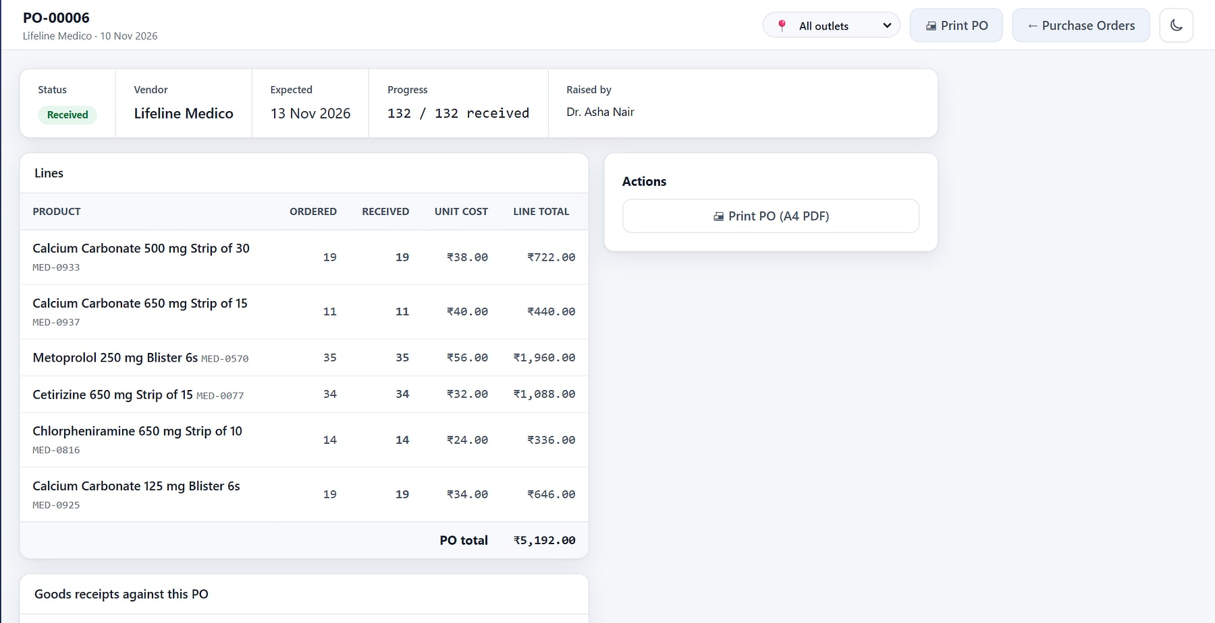
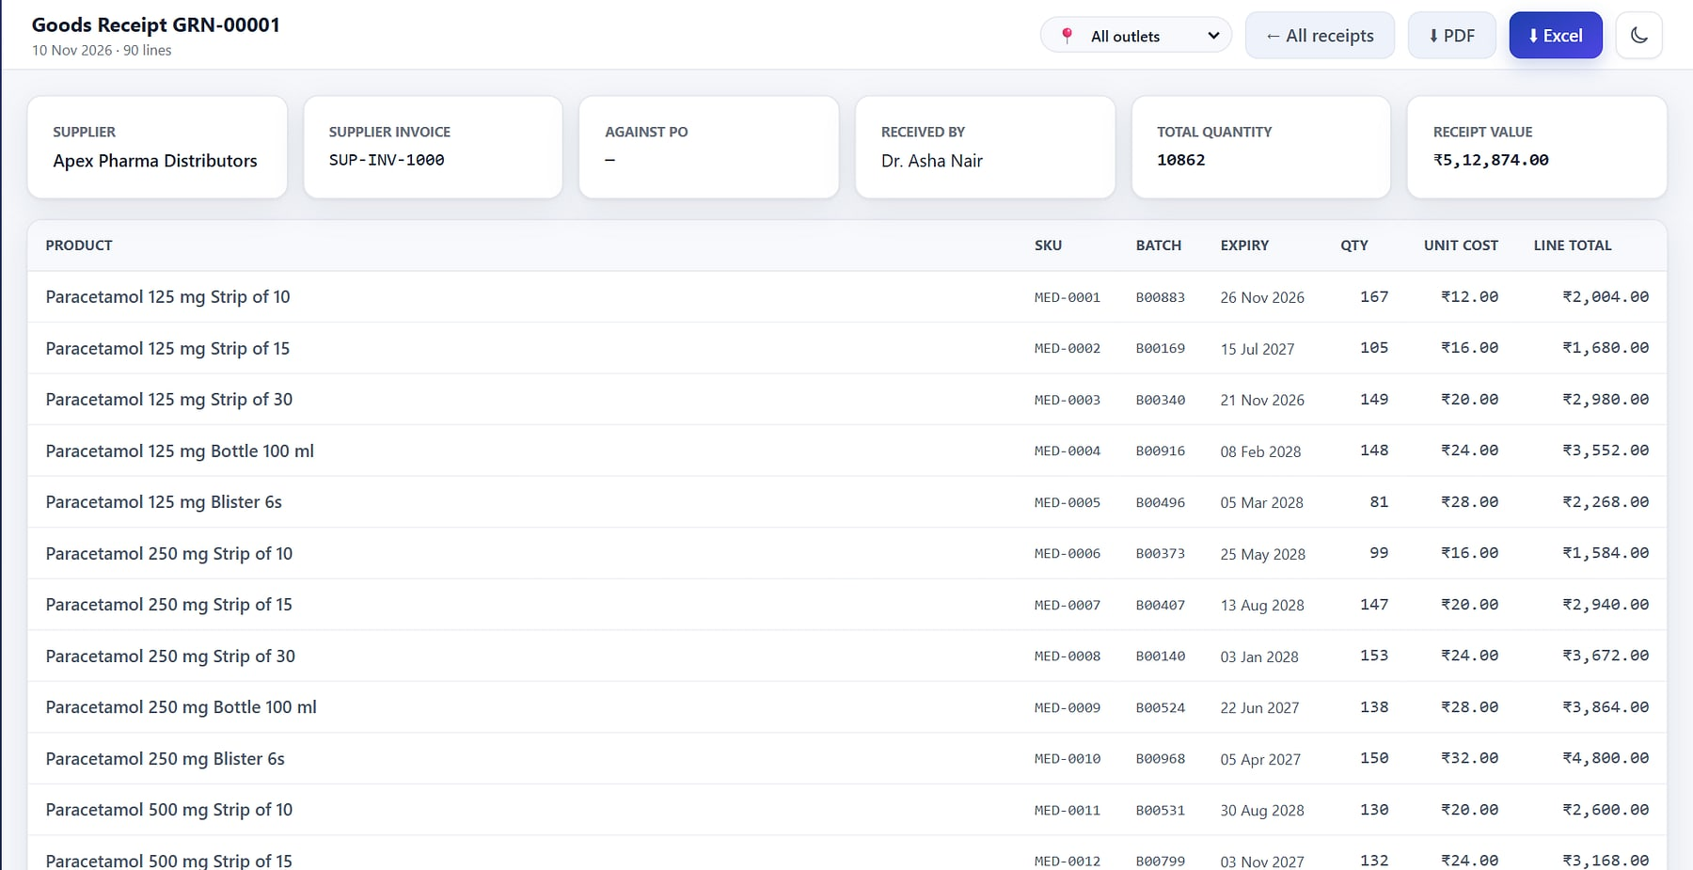



Ordered against received, line by line
PURCHASE ORDERS AND RECEIPTS
Purchase order: ordered vs received, with its goods receipts (demo data).
Goods receipt: supplier invoice, batch, expiry, quantity and cost.
Separation of duties
GRN posts stock
PO as A4 PDF
Invoice matched
Approval is its own permission.
Batch and cost captured per line.
Send a branded order to the vendor.
GRN records the supplier invoice no.
Notes:
U01–U06 screens.

Slide 20
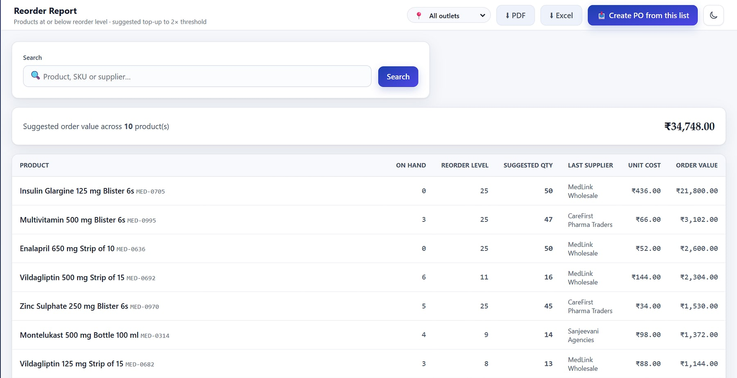
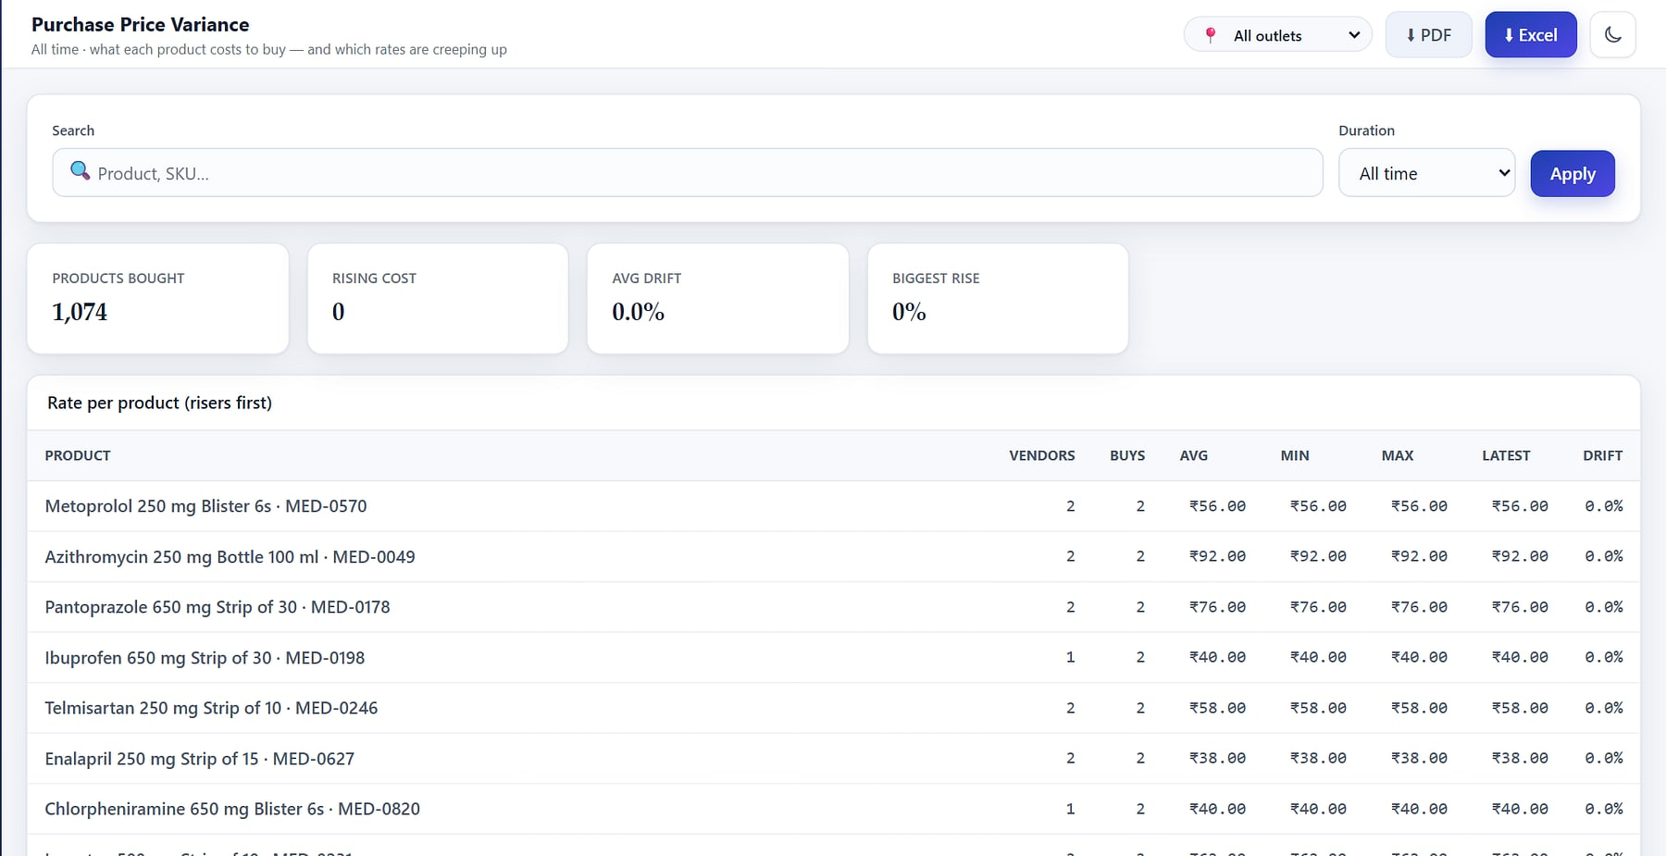

Never run out, never overpay
REORDER AND PRICE CONTROL
Reorder report: items below level, ready to become a purchase order.
Purchase price variance: rate history per product (demo data).
Suggested reorder
One-click PO
Return to vendor
Price variance
Below-level items with quantities.
Turn the list into a draft order.
Stock out with a debit note.
Rate history per product.
Notes:
Reorder report and supplier returns; purchase price variance report (Q17) shows rate creep per product.

Slide 21
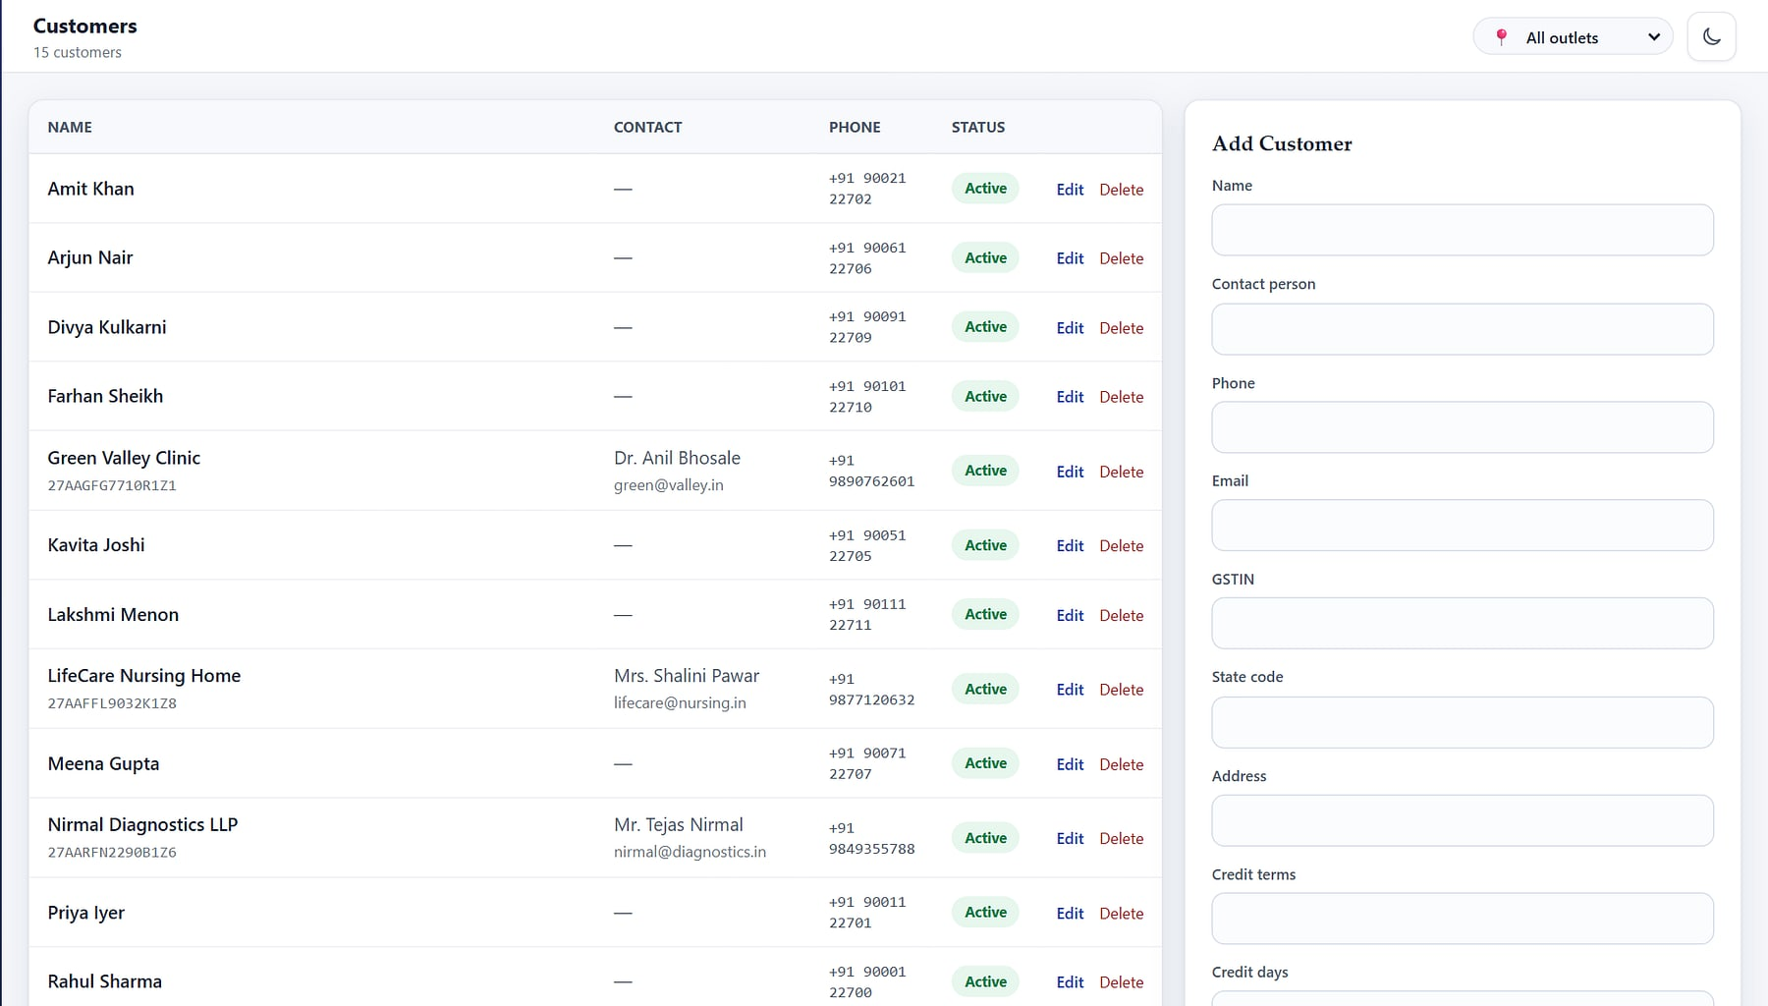



One party master for everyone you buy from and sell to
PARTNERS
medicare.heeliks.com/customers
One party, many roles
Vendor, supplier, manufacturer and customer flags on one record.
GSTIN and state
Drives CGST/SGST vs IGST and place of supply.
Credit terms
Credit days and limit, checked when orders are confirmed.
Opening balances
Bring receivables across at go-live.
Customers with GSTIN, credit terms and limits, including B2B accounts (demo data).
Notes:
apps/partners: single party model.

Slide 22
Order to cash
PILLAR 3 · DISTRIBUTE
Sales orders, invoices, delivery challans, proof of delivery and receipts: distributor-grade order-to-cash on the same stock truth.
Notes:
Pillar 3: the B2B module, included in the Business plan.

Slide 23



From confirmed order to reconciled ledger, on one timeline
ORDER-TO-CASH WORKFLOW
1
2
3
4
5
6
Confirm order
Invoice
Dispatch
Proof of delivery
Receipt
Ledger and aging
Confirmation reserves stock and checks the customer's credit position.
Invoice the order in full or in part; GST computed per line.
One invoice, many challans: transport, LR and e-way bill reference.
Receiver and time recorded on the challan.
Bank, UPI or cheque, allocated to invoices; bounces reverse.
Append-only customer ledger, AR aging and collections.
Available-to-promise is computed from orders and stock, never typed in, so it cannot drift. Every step is stamped on the order's timeline.
Notes:
apps/orders/services.py. Today HeeLIKS records the e-way bill number on the challan; generating e-way bills and e-invoices (IRN) is on the roadmap.

Slide 24
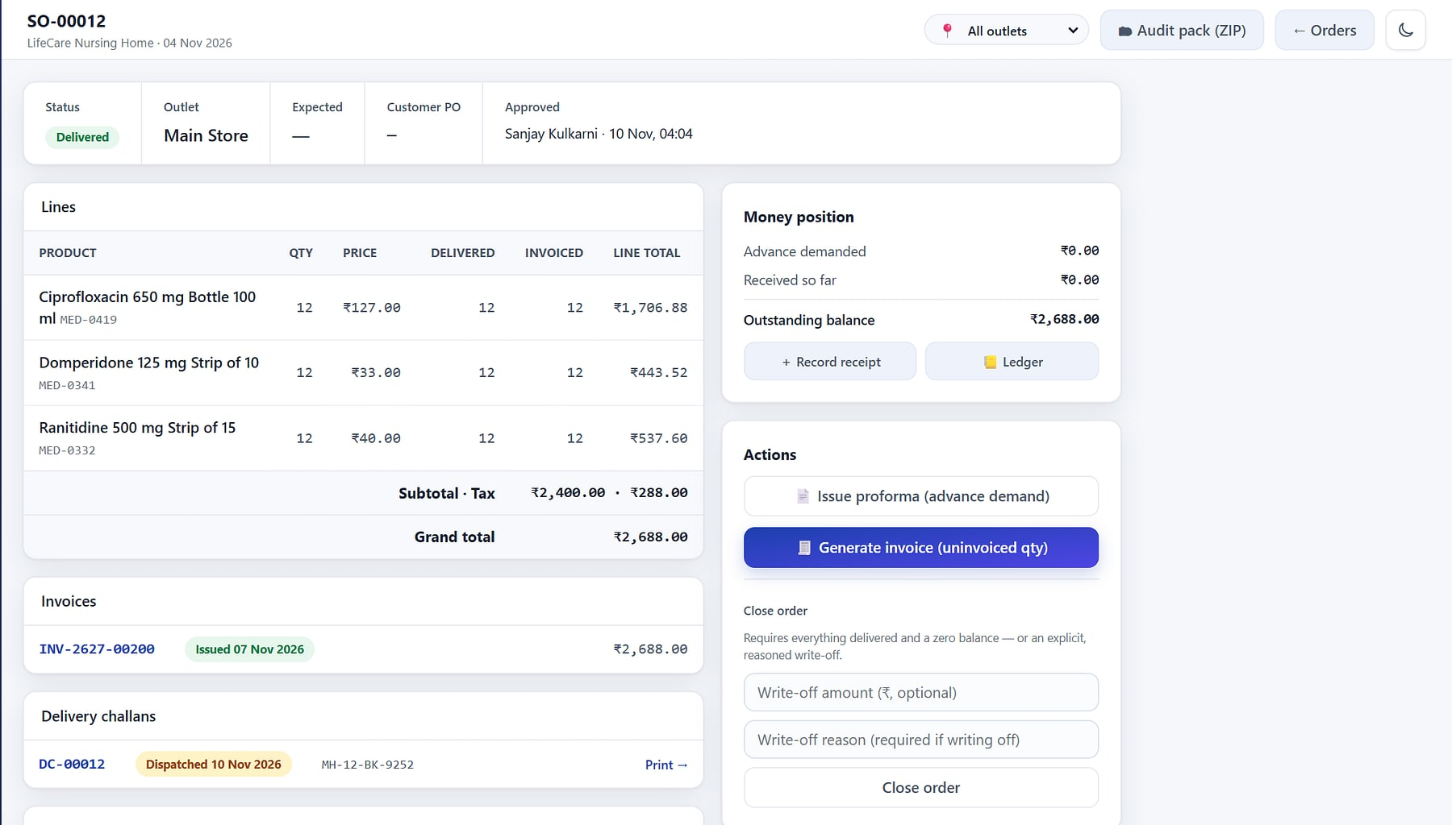

Every order's story on one timeline
SALES ORDERS
Draft to confirmed
medicare.heeliks.com/orders
Confirmation reserves stock; advance terms recorded.
Invoice from order
Part or full, against the order.
Full timeline
Every action, user and time; audit pack export.
Money position
Advance, received and outstanding at a glance.
Order detail: lines, invoices, challans, money position and timeline (demo data).
Notes:
B01–B08 screens. 'LifeCare Nursing Home' and similar names are seeded demo customers.

Slide 25
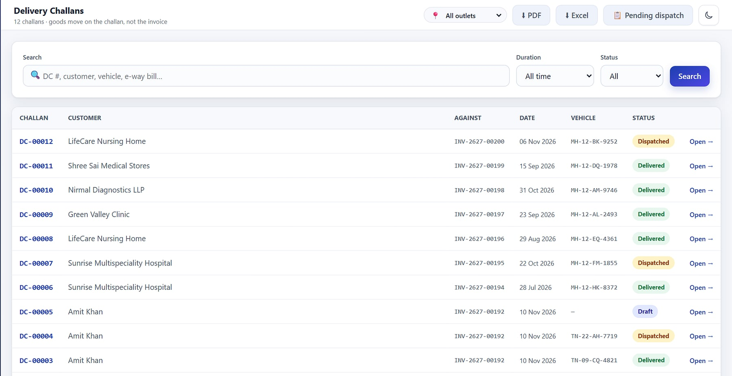
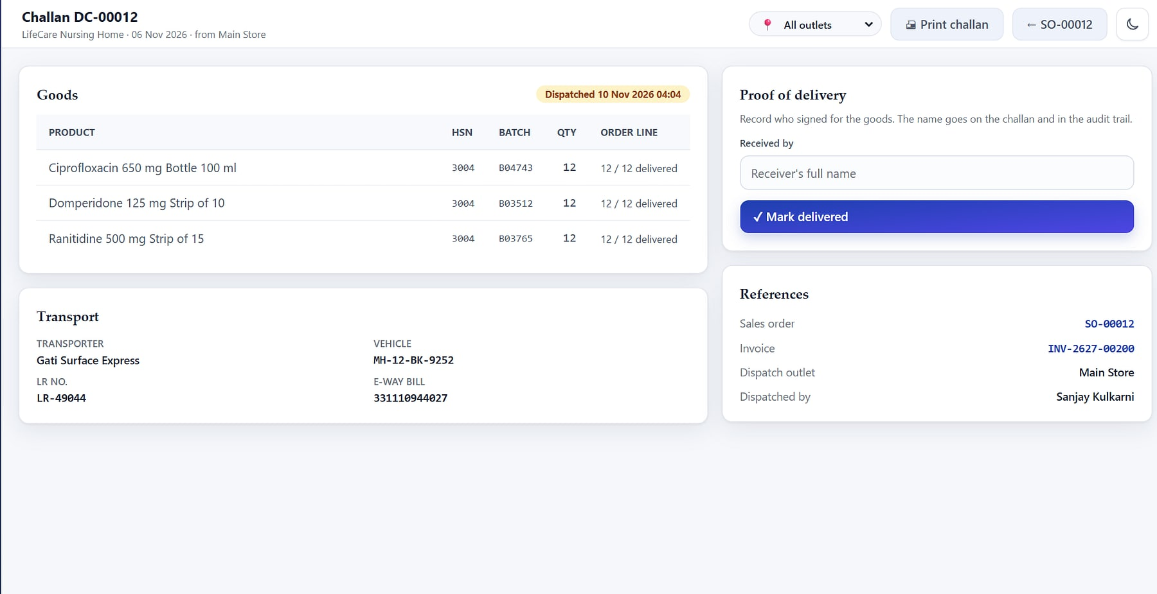

Ship in parts, invoice once, prove delivery
DISPATCH AND DELIVERY
Delivery challans by status across confirmed orders (demo data).
Challan: transport details, e-way bill reference and proof of delivery.
Dispatch moves stock
Many challans
Transport details
Proof of delivery
Reservation consumed on dispatch.
Part-shipments, one invoice.
Vehicle, LR, e-way bill no.
Receiver and time recorded.
Notes:
B10–B12 screens and the challan PDF (E07), which prints without prices.

Slide 26
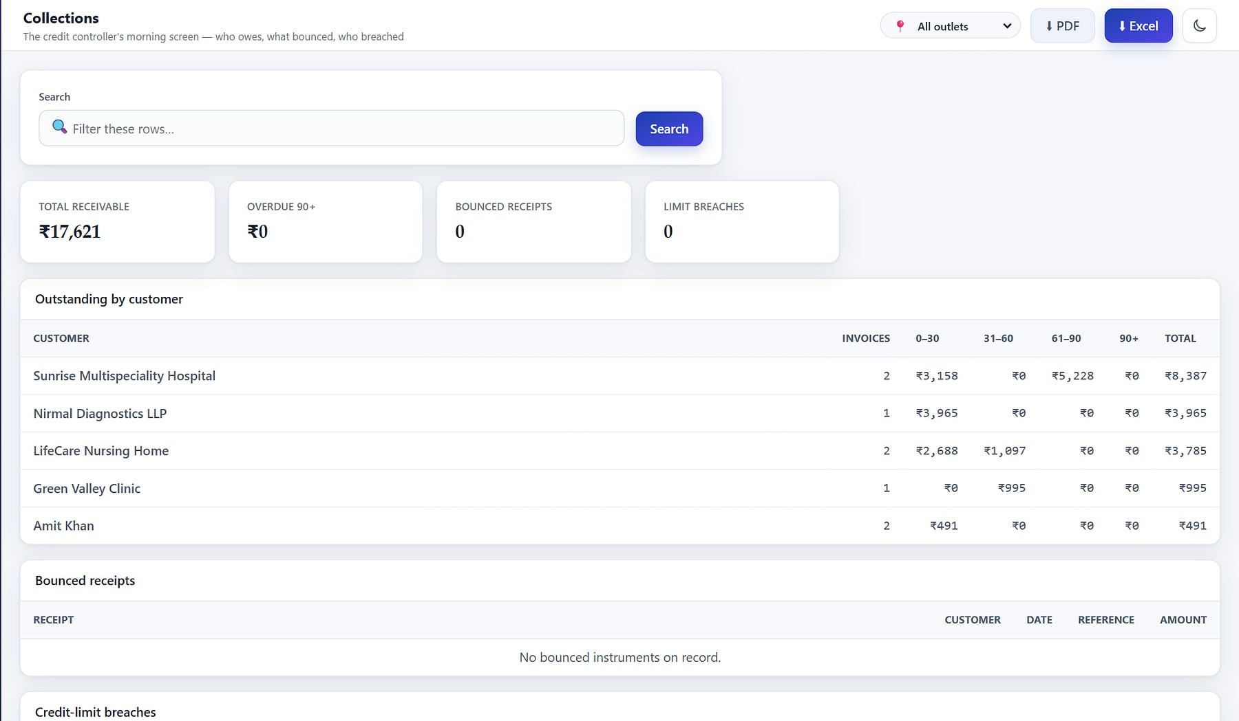
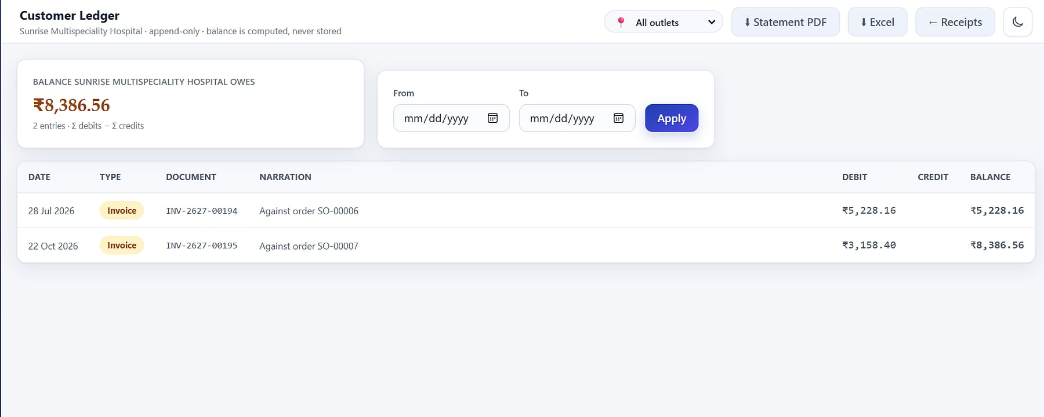
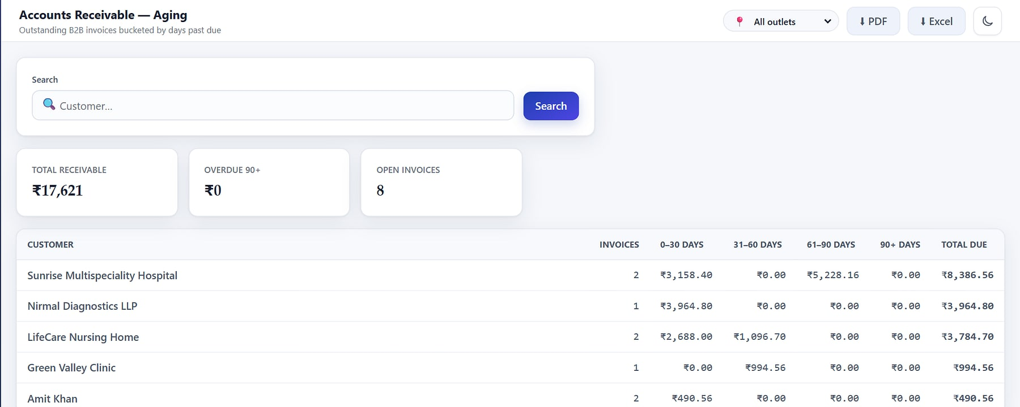
Know who owes what, and since when
RECEIPTS, LEDGER AND COLLECTIONS
1
2
3
1
Collections: receivables, bounced instruments and credit limits (demo data)
2
Customer ledger with a running balance
3
AR aging by bucket, per customer
Notes:
Receipts and allocation, bounced instruments, append-only customer ledger with PDF/Excel statements, AR aging, order book and collections (B13–B19).

Slide 27
Answers in one click
PILLAR 4 · INSIGHT & COMPLY
The owner dashboard, 21 reports, GST packs and branded Excel and PDF exports.
Notes:
Pillar 4: reporting and compliance.

Slide 28
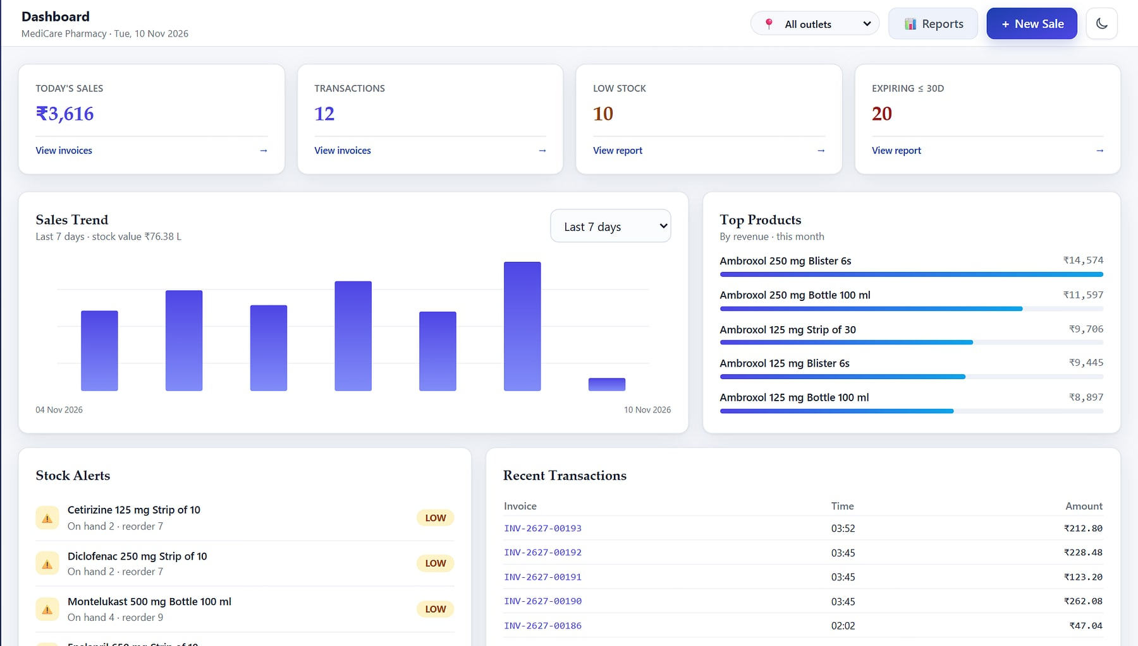



The whole business before the first coffee
OWNER DASHBOARD
medicare.heeliks.com
Live KPIs
Today's sales, bills, low stock and items expiring within 30 days.
Trend and top sellers
7- or 14-day sales trend; top products by revenue.
Actionable alerts
Low-stock and expiring items one click away.
Outlet switcher
All outlets, or one store at a time.
MediCare Pharmacy dashboard (demo data).
Notes:
Dashboard module (D01–D04). Figures on screen are demo data.

Slide 29
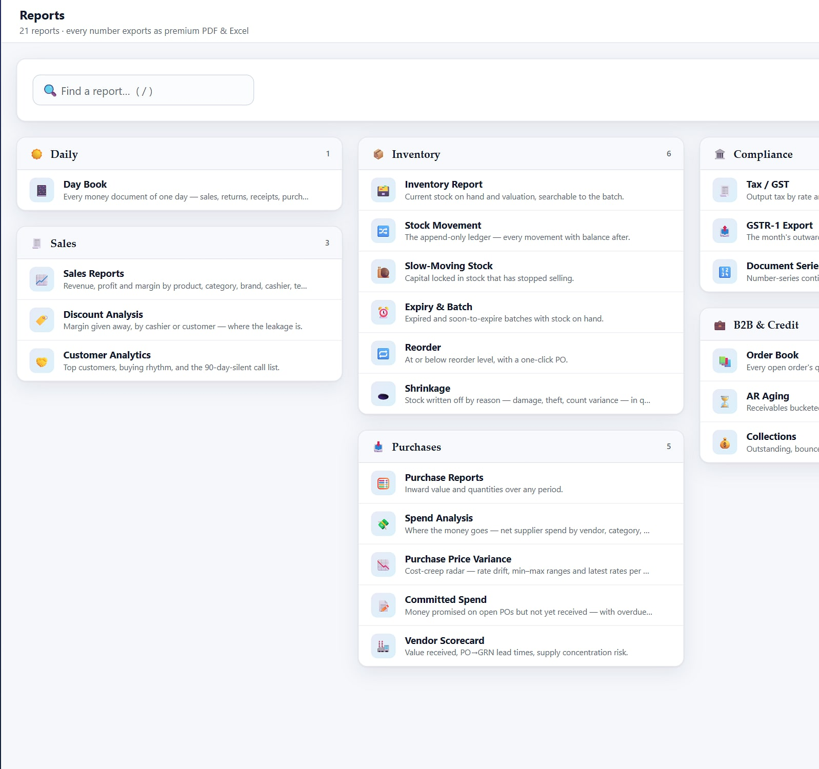
Twenty-one reports, each one click from Excel
REPORTS
Sales & daily · 4
Inventory · 6
Purchasing · 5
Sales, profit & margin
Discounts by cashier
Customer analytics
Day book
Valuation
Stock movement
Expiry & batch
Reorder
Slow-moving stock
Shrinkage
Purchases
Vendor scorecard
Spend
Price variance
Committed spend
Compliance · 3
B2B · 3
Every report
Tax / GST
GSTR-1 export
Document series
Order book
Collections
AR aging
Filter and group by period, outlet, product or tender. Export to branded Excel (frozen headers, totals), PDF or CSV.
Report hub: daily, sales, inventory, purchasing, compliance, B2B.
Notes:
21 reports per apps/reporting/urls.py (22 routes including the hub). Exports from apps/reporting/exports.py; pre-aggregated SalesDailySummary read-model.

Slide 30
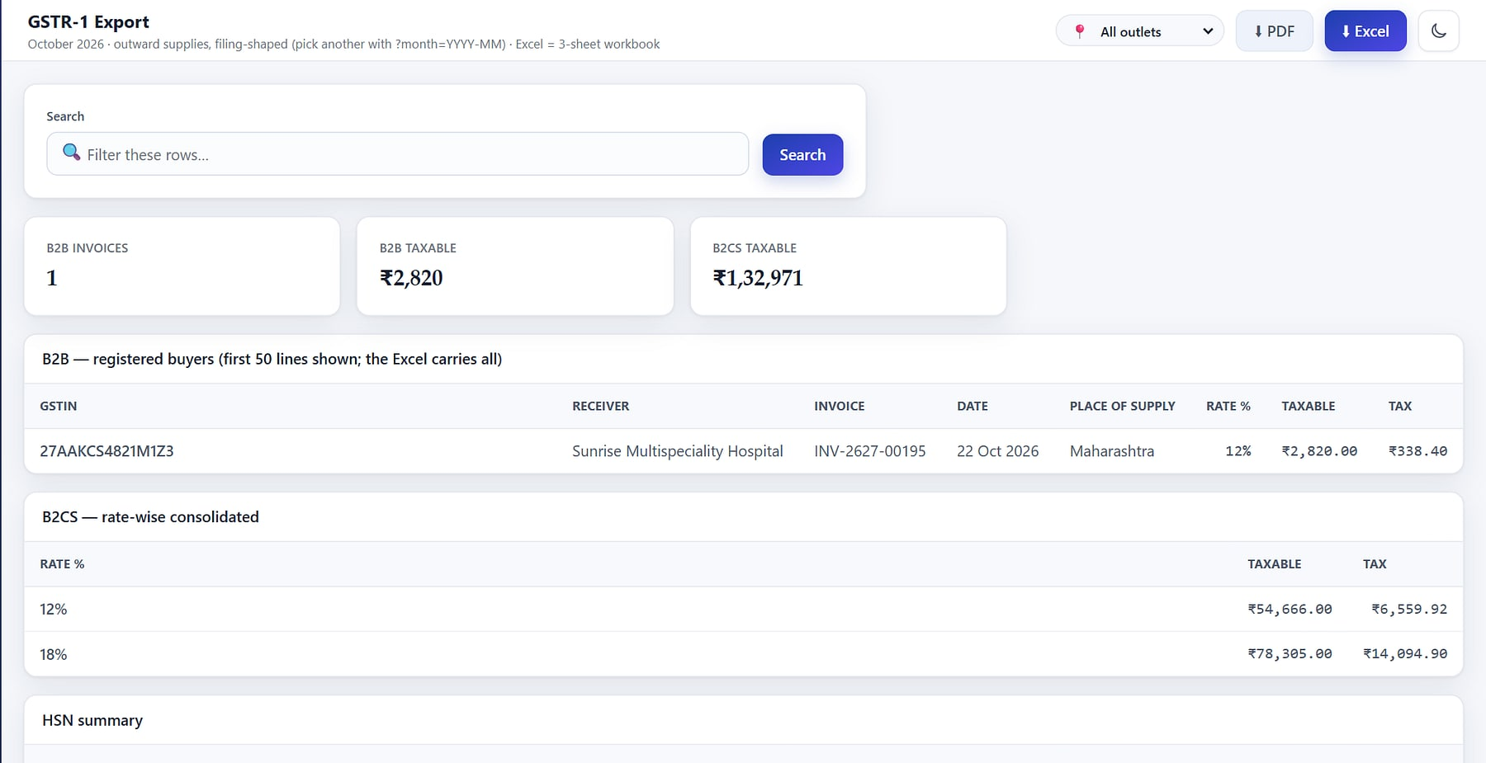
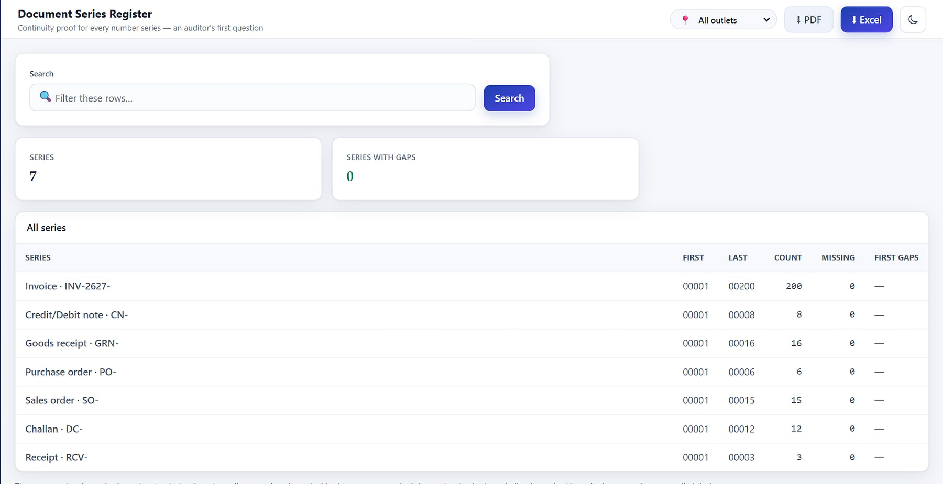
GST-ready from the very first bill
GST COMPLIANCE
GSTR-1 export: B2B, B2CS and HSN summary (demo data).
Document-series register: gap check across invoice and note series.
CGST / SGST / IGST
GSTR-1 ready
s.34 credit / debit notes
Gapless series
Split by place of supply on every line.
B2B, B2CS and HSN sections, Excel export.
Standalone notes without fake stock moves.
Fiscal-year numbering, audited for gaps.
Notes:
Tax/GST report (Q04), GSTR-1 (Q05) and document series (Q13). GSTR-1 is an export for filing; HeeLIKS does not file returns on the GST portal.

Slide 31
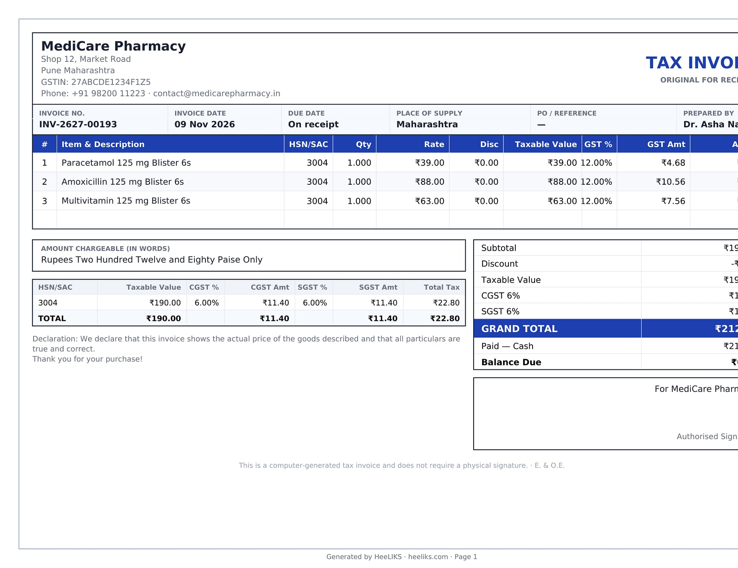
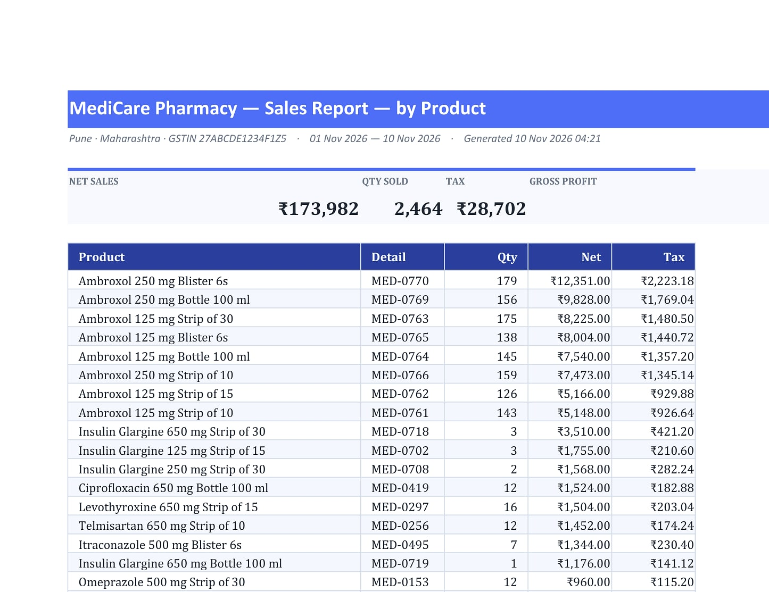
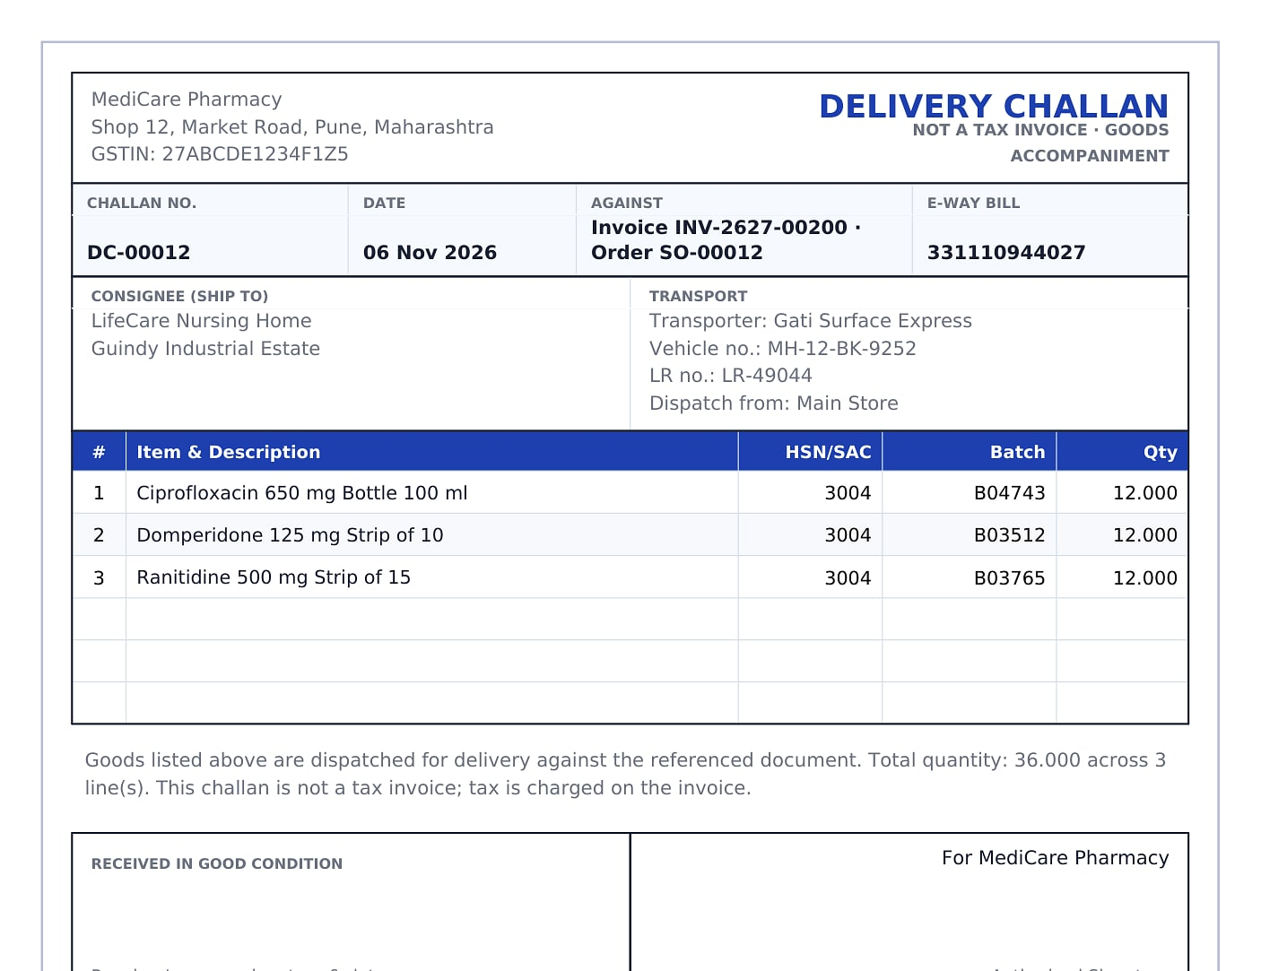
Documents your accountant will actually use
DOCUMENTS AND EXPORTS
Tax invoice, A4 PDF
Branded Excel
Delivery challan
Branded with the outlet profile; thermal layouts too.
Frozen headers and totals, ready for the CA.
Transport details, printed without prices.
Notes:
Real files generated by the product are in HeeLIKS_exports (sales and GSTR-1 Excel; inventory, AR aging, PO, invoice and challan PDFs).

Slide 32
Secure, and live in days
PILLAR 5 · GOVERN & SCALE
Onboarding and import, two-factor security, roles and audit, subscriptions and the platform console.
Notes:
Pillar 5: control and scale.

Slide 33
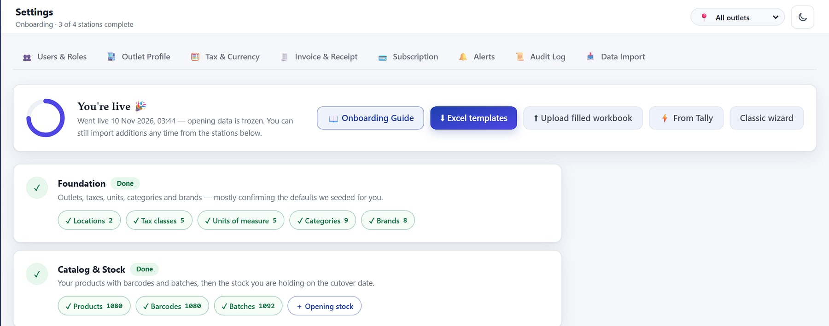
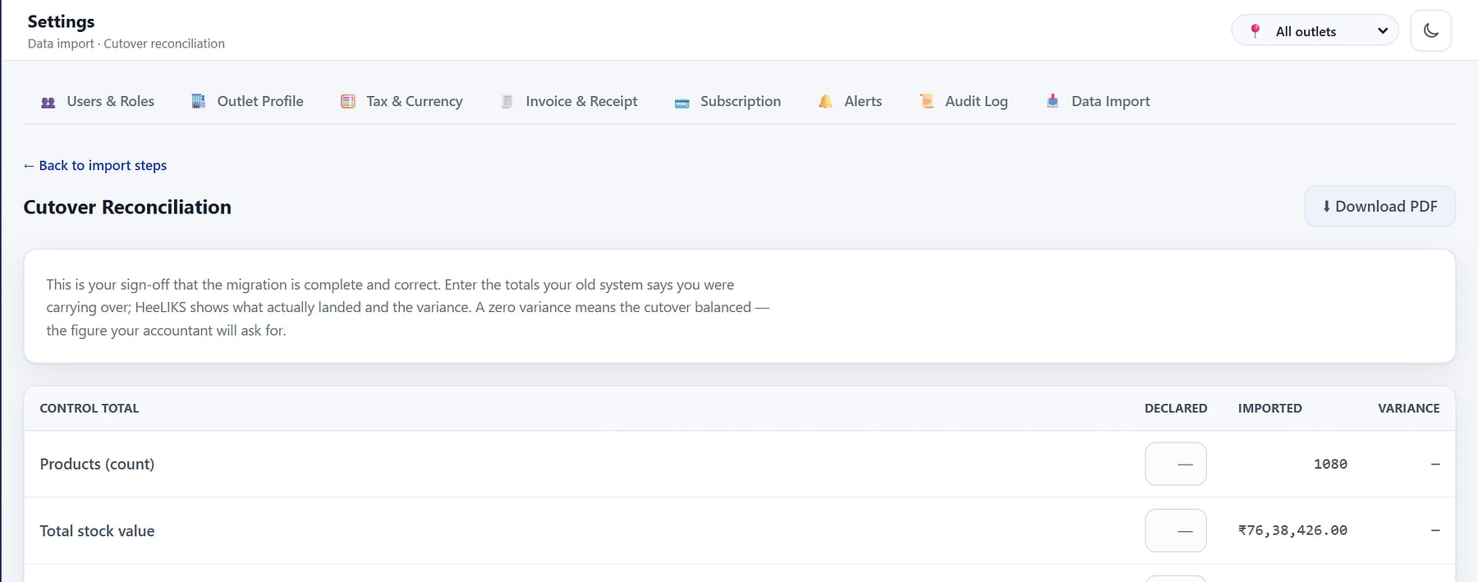
Import safely: stage, dry-run, commit, reconcile, undo
GO-LIVE AND DATA IMPORT
Stage
Dry-run
Commit
Reconcile
Undo
Workbook, Tally Masters XML or per-entity CSV/Excel.
Every row validated with zero writes.
Atomic: all rows or none.
Declared vs imported totals must hit zero variance.
Roll back a committed batch exactly.
Guided go-live checklist (demo data).
Import reconciliation: control totals checked to zero variance.
Notes:
apps/importer (registry.py, tally.py): stage, dry-run with zero writes, atomic commit, exact undo, reconciliation; read-only history archive for old Tally documents (O07, O08).

Slide 34
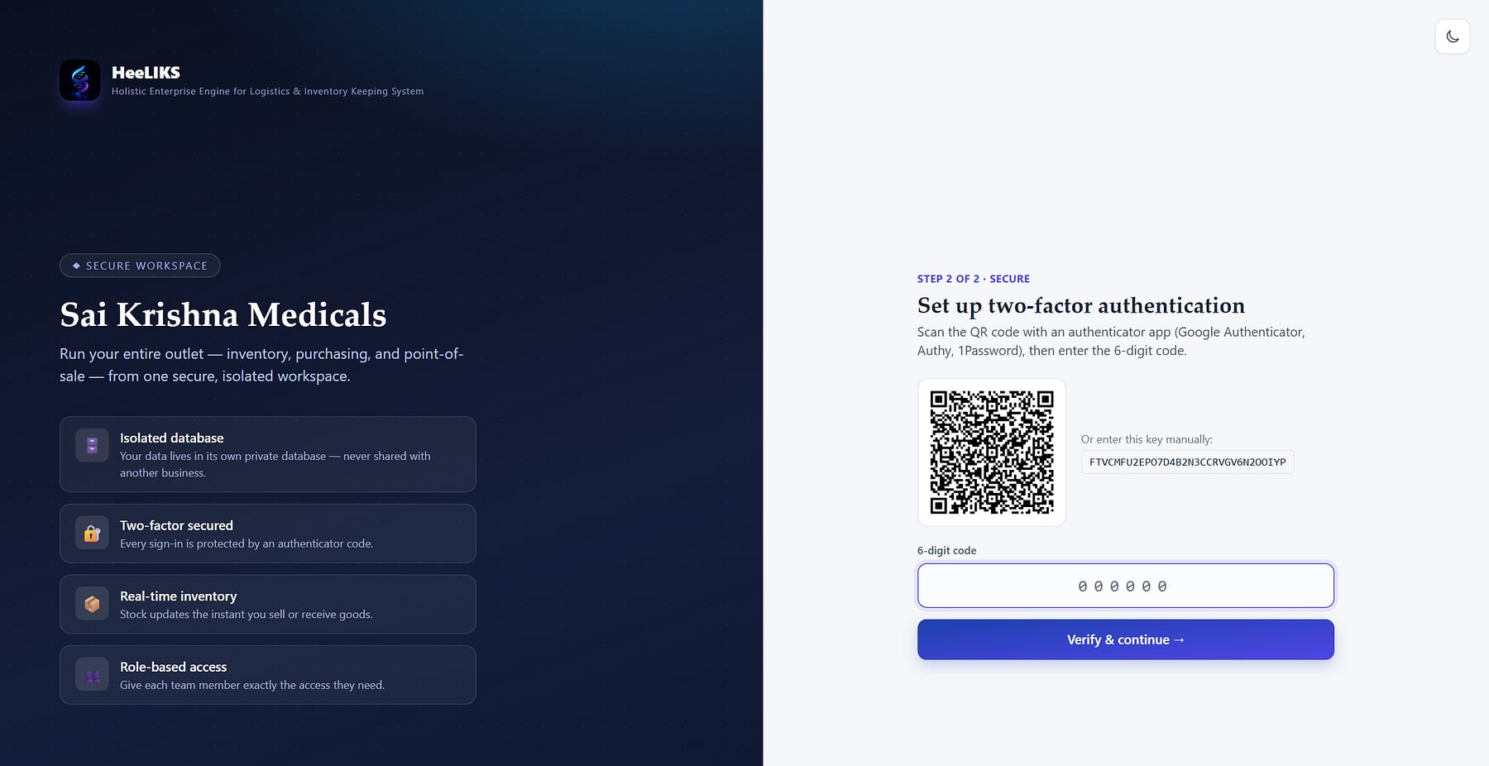
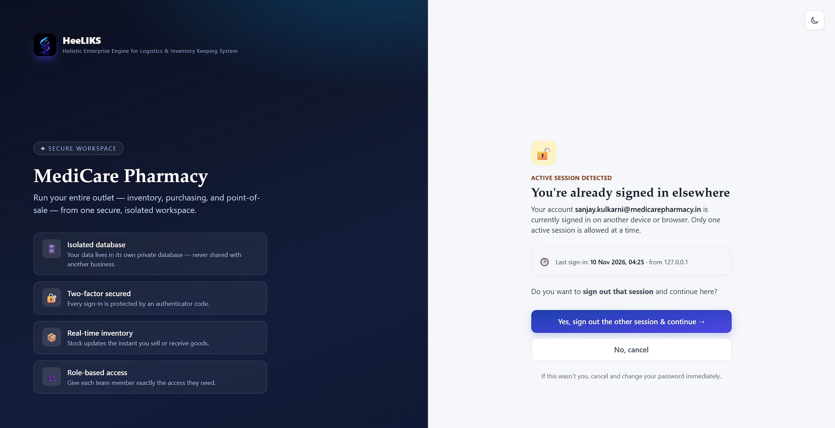


Two-factor for every user, no exceptions
SECURITY AND SIGN-IN
Forced two-factor enrolment by QR code at first sign-in.
One session per user: a new sign-in replaces the old one.
Argon2 + TOTP
Lockout and limits
Idle expiry
Encrypted secrets
Backup codes and email OTP fallback.
5 strikes; rate-limited endpoints.
8-hour sliding inactivity timeout.
TOTP secrets encrypted at rest.
Notes:
apps/accounts/views.py, SingleSessionMiddleware, apps/common/crypto.py (Fernet), apps/common/ratelimit.py. HSTS, secure cookies and SSL redirect in production. No external security certification is claimed.

Slide 35
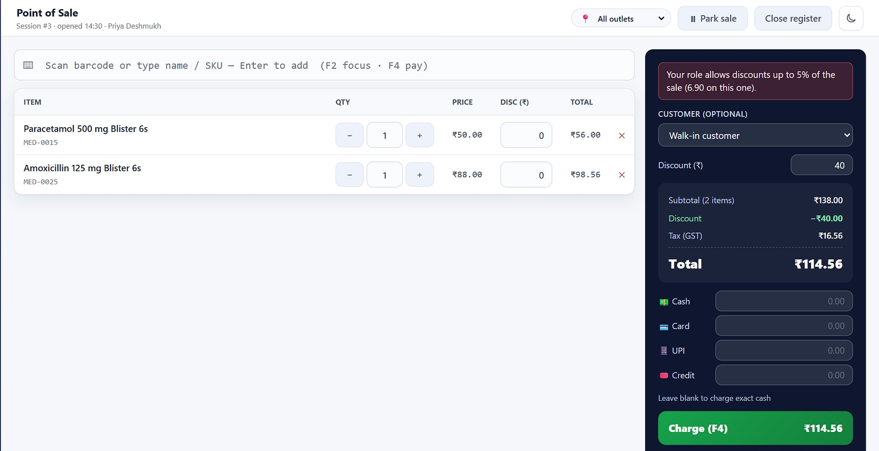
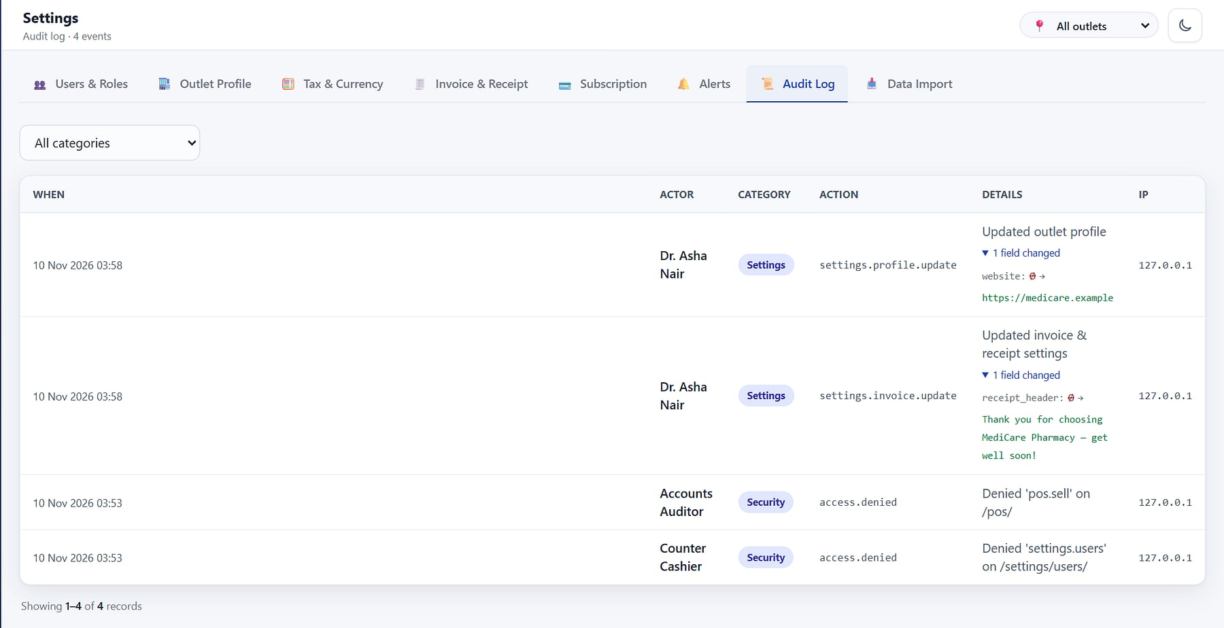
Exactly the right access, and every change on record
ROLES, CAPS AND AUDIT
A cashier's 40% discount blocked by the 5% role cap.
Audit log: field-level before and after values, and denied-access events.
10 permissions, 5 roles
Discount caps
Outlet binding
Append-only audit
Plus custom roles.
Cashier 5%, Manager 20%.
Users restricted to their stores.
Entries cannot be edited or deleted.
Notes:
apps/rbac/seeding.py and decorators.py; record_audit in apps/settings_app/services.py. Role-aware navigation (V01–V08).

Slide 36
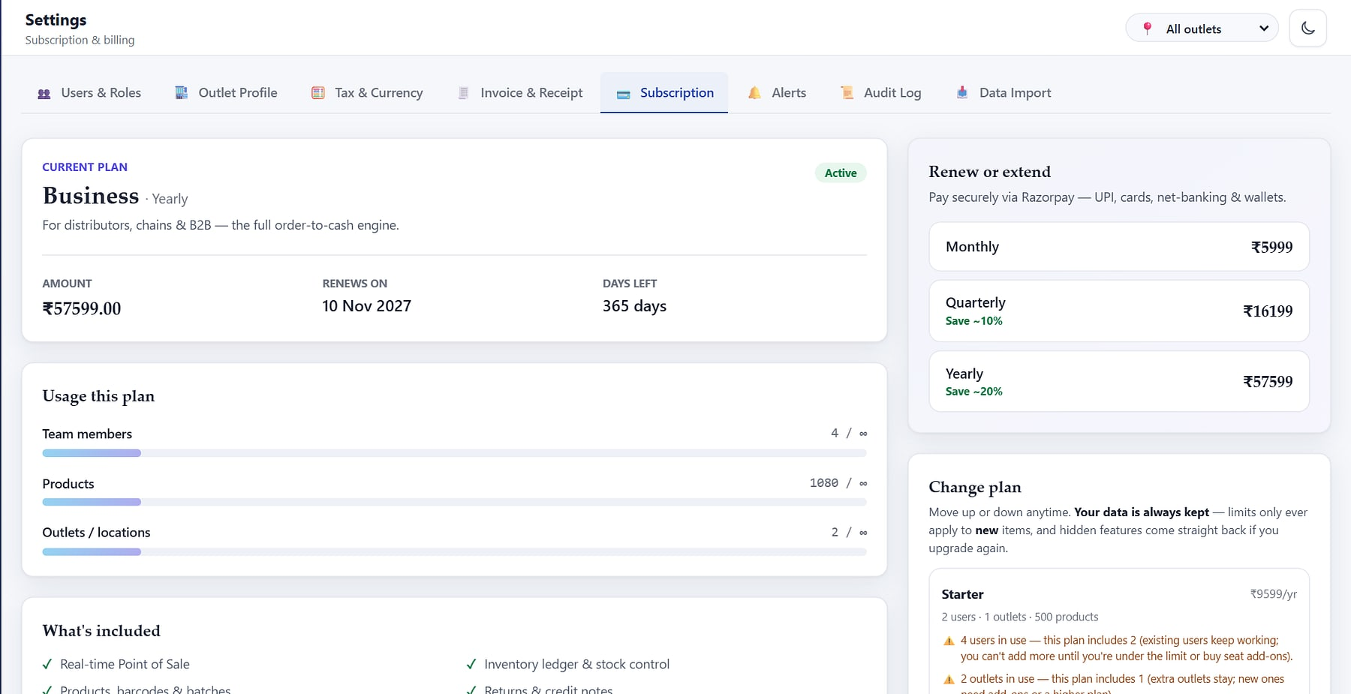
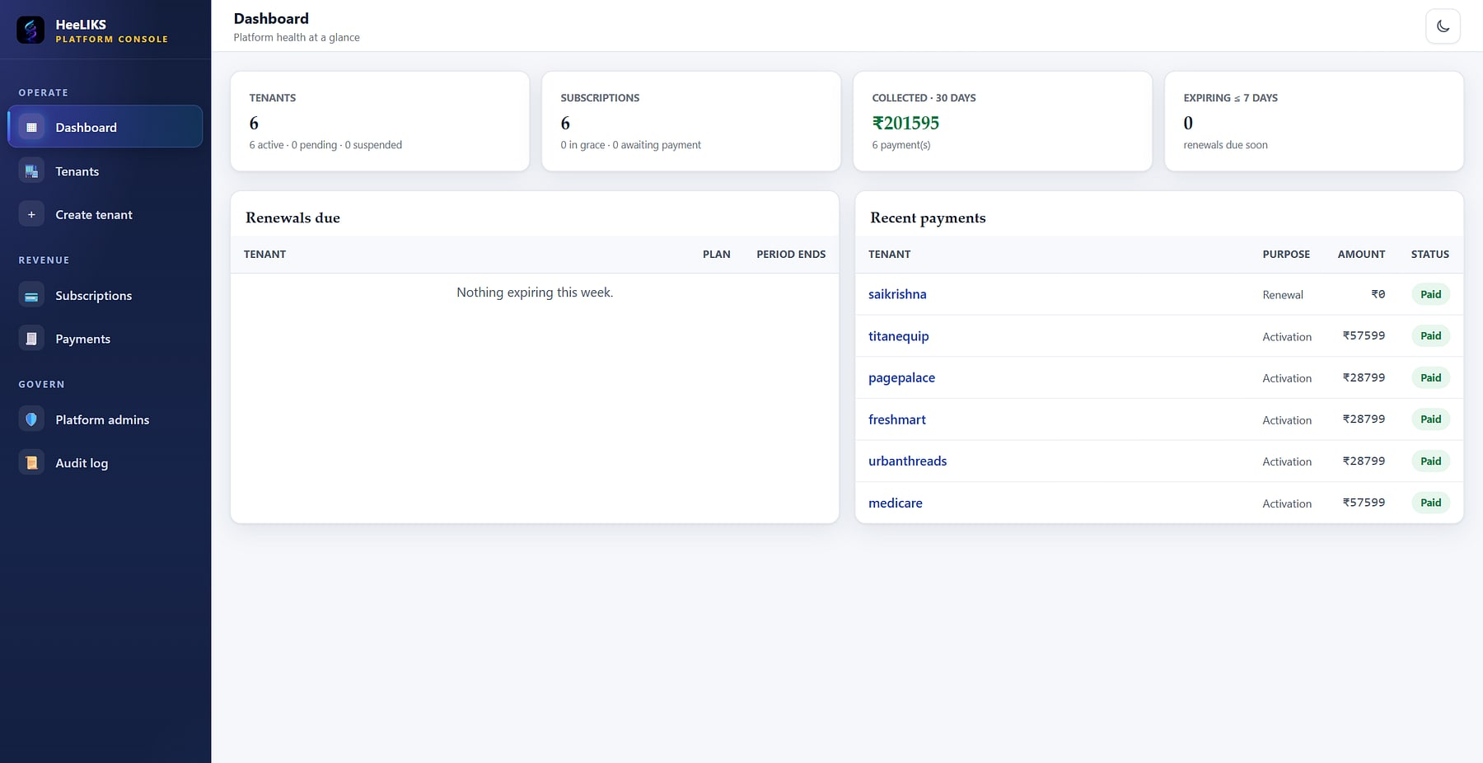
Self-serve for customers, one console for the operator
SUBSCRIPTION AND PLATFORM CONSOLE
Subscription: plan, renewal, usage meters and add-ons (demo data).
Platform console: tenants, subscriptions, collections and renewals.
Razorpay checkout
Usage meters
Trial and grace
Operator console
HMAC-verified payment activates the workspace.
Seats, outlets and products per plan.
14-day trial; 15-day grace, then suspension.
Provision, suspend, extend; metadata only.
Notes:
apps/control (plans.py, billing.py, tasks.py, console/). The console sees tenant metadata and usage counts only, never business data.

Slide 37
Isolation-first and multi-tenant by design
ARCHITECTURE
CLIENTS
DJANGO APPLICATION TIER
DATA
Browsers and counters
POS, back office, console
Nginx
*.heeliks.com wildcard DNS and TLS; gated file serving
1 Tenant resolver
subdomain to tenant database, fail-closed
Control database
tenants, plans, payments, platform audit
2 Session and idle expiry
one active session per user
Scanners and printers
HID barcode, thermal, A4
One database per tenant
3 Auth: Argon2 + TOTP
lockout, rate limits
e.g. stocksage_medicare
4 RBAC on every view and API
10 permission codes
e.g. stocksage_freshmart
Integrations
REST API clients, Tally XML
5 Services and audit log
ledger, POS, orders, imports
Redis + Celery beat
cache, rate limits, scheduled jobs
Each tenant's data lives only in its own database; the control database holds commercial metadata. Provisioning runs create database, migrate, then seed roles and defaults.
Notes:
config/settings/routers.py, apps/common/middleware.py, apps/control/provisioning.py. The 'stocksage_' prefix is the product's legacy codename in database names.

Slide 38

Connects to the tools you already run, on a proven stack
INTEGRATIONS AND TECHNOLOGY
Razorpay
Office 365 / SMTP
Checkout with HMAC-verified webhooks.
Receipts, alerts, password resets, OTP.
TECHNOLOGY STACK
Python 3.12 · Django 5 · DRF
application and API
MySQL 8
one control DB plus one DB per tenant
Redis 7 · Celery 5.4 beat
cache, rate limits, scheduled jobs
Tailwind UI · server-rendered
responsive web, dark mode
ReportLab · openpyxl
PDF documents and Excel exports
Gunicorn · Nginx · Docker
wildcard TLS, systemd, Compose
Tally
Excel and CSV
Masters XML import with opening stock.
Import templates and every export.
REST API
Scanners and printers
Tenant-scoped, RBAC-checked: products, stock, sales.
HID barcode, Code128 labels, thermal and A4.
Web only: HeeLIKS runs in any modern browser on desktop or tablet. There is no native mobile app.
Notes:
Integrations: apps/api, apps/control/billing.py, config/settings/base.py, catalog barcode views, importer/tally.py. Cloudflare Turnstile protects public forms. Stack from requirements and docker-compose.yml; CI runs lint, pytest on MySQL and a migrations check.

Slide 39
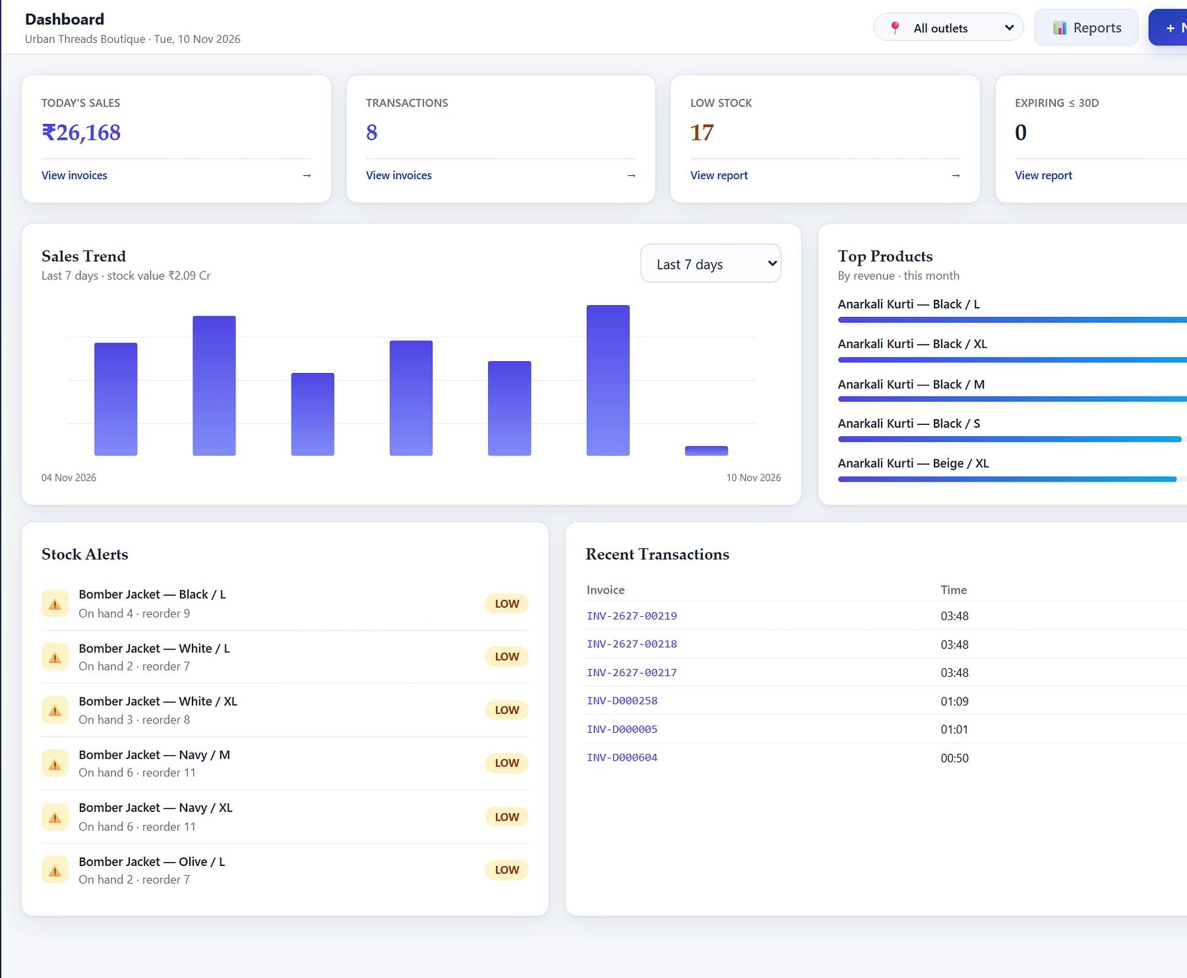
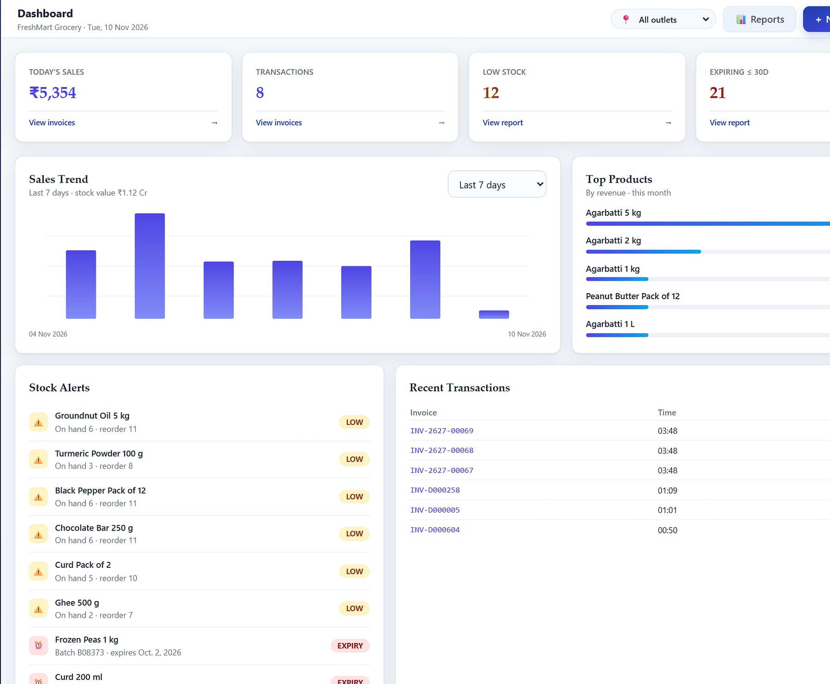
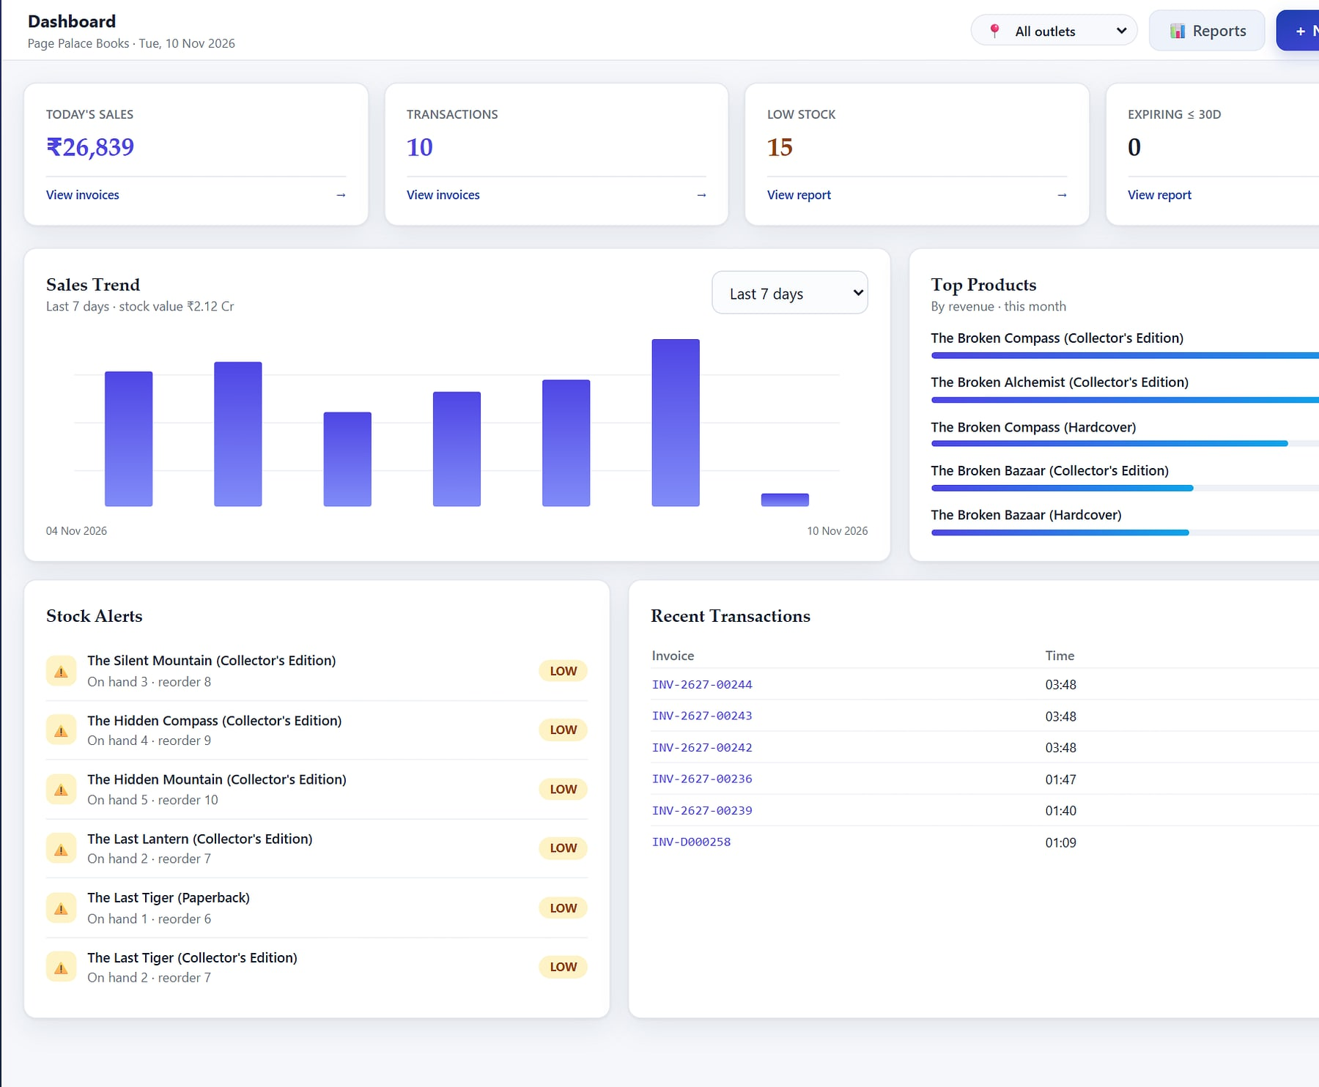
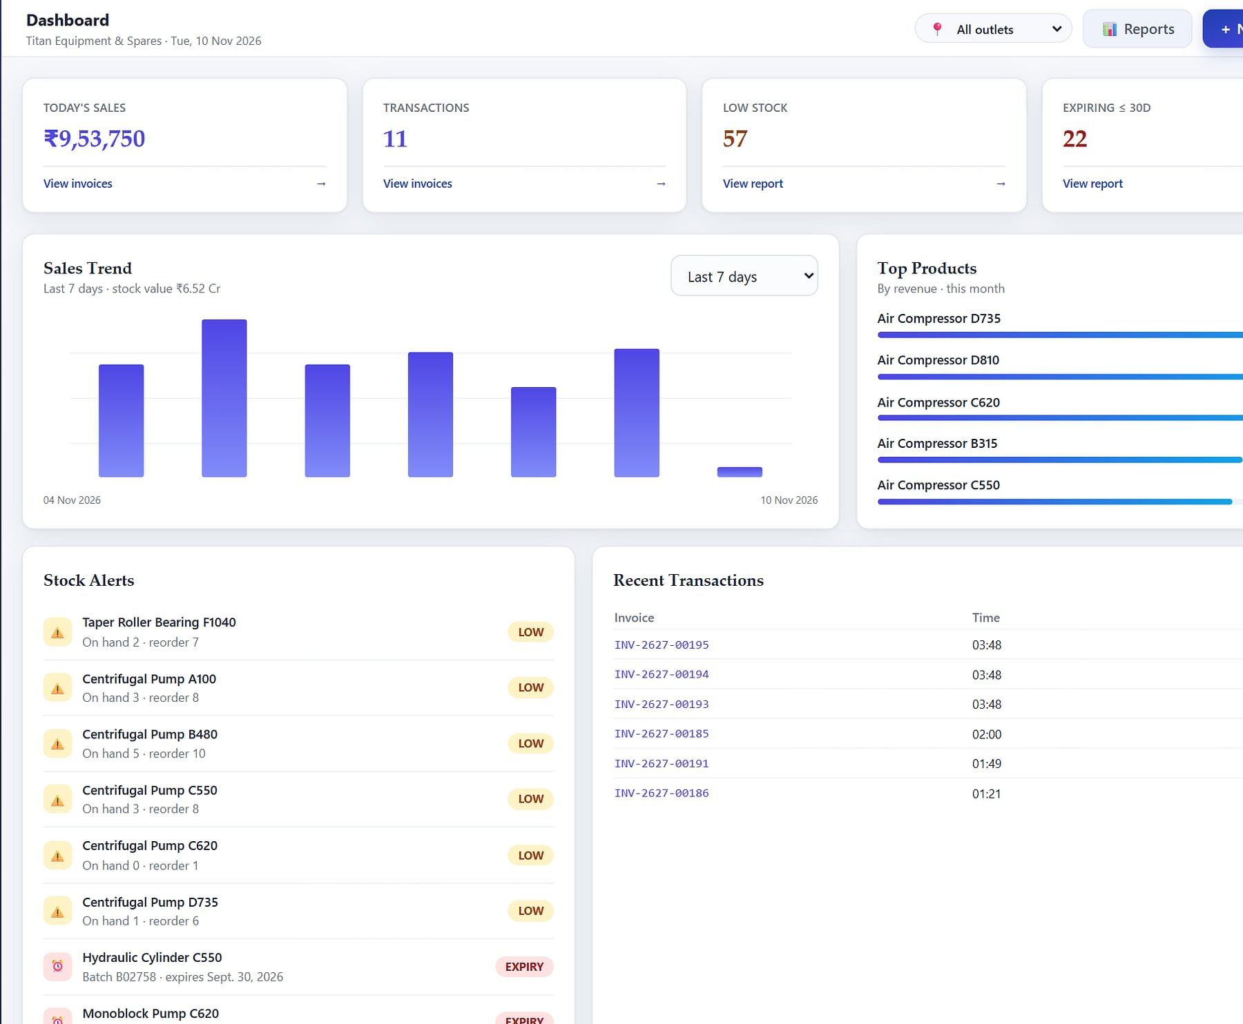
One platform, configured for five verticals at signup
INDUSTRY FIT
Retail and fashion
Grocery and kirana
Bookstores
Industrial spares
Size and colour variants as SKUs on shared masters (Urban Threads, demo).
Perishables, loose and packed units, fast billing (FreshMart, demo).
Large title catalogues by title and edition (Page Palace, demo).
High-value B2B lines, credit limits and AR (demo distributor).
Pharmacy and medical, with batch, expiry and FEFO, is the MediCare demo used throughout this deck. Every vertical runs the same product; the outlet type chosen at signup sets the defaults.
Notes:
Pharmacy and medical (batch, expiry, FEFO) is the MediCare demo used throughout. The outlet type chosen at signup tunes defaults (templates/site/solutions.html, seed_demo_tenant INDUSTRIES). These are configurations of one product, not separate editions. All five are fictional demo workspaces; the industrial one is a demo distributor, not a customer.

Slide 40





Today versus with HeeLIKS
WHY SWITCH
TODAY
WITH HEELIKS
Your own database
Stock
Spreadsheet, updated at day end
Ledger updated with every sale
Isolation by design, not a filter.
Expiry
Found at audit, written off
FEFO selling and 30-day alerts
One stock truth
Every module moves the same ledger.
GST
Rebuilt from bill books
GSTR-1 export in one click
Built for Indian GST
Access
Shared logins, any discount
Personal 2FA logins, role caps
From the first bill to GSTR-1.
B2B
Paper challans and khata
Order to ledger, on one timeline
Live in days
Import with dry-run and undo.
Notes:
Generic 'today' patterns, not a named competitor.

Slide 41
Cloud subscription or a perpetual on-premise licence
PLANS AND DEPLOYMENT
STARTER
GROWTH
BUSINESS
PERPETUAL
₹999
₹2,999
₹5,999
₹7.5 L
/ month
/ month
/ month
one-time
1 user + admin · 1 outlet · 500 products. POS, inventory, returns, dashboard and reports.
5 users + admin · 2 outlets · unlimited products. Adds purchasing, POs and goods receipts.
Unlimited users, outlets and products. Adds B2B order-to-cash for distributors and chains.
The complete product on your own servers; optional AMC at 5% a year from year two.
Prices exclude GST. Quarterly saves about 10% and yearly about 20%. 14-day free trial. Extra users ₹599 and extra outlets ₹699 a month on Starter and Growth.
Notes:
Prices from apps/control/plans.py and templates/site/pricing.html (D:\heeliks, read-only): Starter 999/2,699/9,599; Growth 2,999/8,099/28,799; Business 5,999/16,199/57,599 (monthly/quarterly/yearly). Perpetual 7,50,000 + optional 5% AMC from year two, with 6–12 months support included; self-hosted, the customer provides the server. Confirm the live price list before quoting.

Slide 42


From kick-off to every outlet live in about a month
INDICATIVE ROLLOUT
1
2
3
4
5
Discover · week 0
Provision · week 1
Import · weeks 1–2
Pilot · weeks 2–3
Go live · weeks 3–4
Outlets, roles, plan and data sources agreed.
Workspace with its own database; profile, tax and users.
Workbook or Tally import, dry-run and reconcile.
Train by role; run one outlet live.
Lock go-live; roll out the remaining outlets.
Indicative only. Timing depends on the number of outlets, data quality and training availability, and is confirmed per engagement.
Notes:
Indicative plan from the source deck. Not a commitment.

Slide 43




What's next on the HeeLIKS roadmap
ROADMAP
PLANNED
PLANNED
PLANNED
e-Invoice (IRN)
e-Way bill generation
Tally export
Generate the IRN and signed QR through the GST portal.
Today the number is recorded; next, generate it.
Push vouchers back to Tally for accounting.
PLANNED
PLANNED
PLANNED
Quotations
Customer portal
Payables workflow
Quote to order conversion for B2B sales.
B2B customers view orders, invoices and statements.
Vendor invoices and supplier payments.
Planned items from the product roadmap (docs/Roadmap.md, Phase D). Not in the current release; timelines to be confirmed.
Notes:
Roadmap only: nothing on this slide is shipped. Never present these as available.

Slide 44

Put one outlet on HeeLIKS, with your own data
LET'S GET STARTED
MavionTech Pvt. Ltd.
HeeLIKS · Inventory, POS & Distribution
communications@maviontech.com
+91 91580 08002
www.maviontech.com
505 Zen Business Center, Bhumkar Chowk, Wakad, Pune, Maharashtra 411057
We provision your workspace, import your product list and opening stock, reconcile it with you, and train your team by role.
Book a demo
Plan a pilot
Notes:
One ask: a pilot outlet. Product contacts from the HeeLIKS site templates: sales@heeliks.com, support@heeliks.com (heeliks.com was unavailable on 10 Nov 2026; confirm before adding them to the slide).

