Slide 1

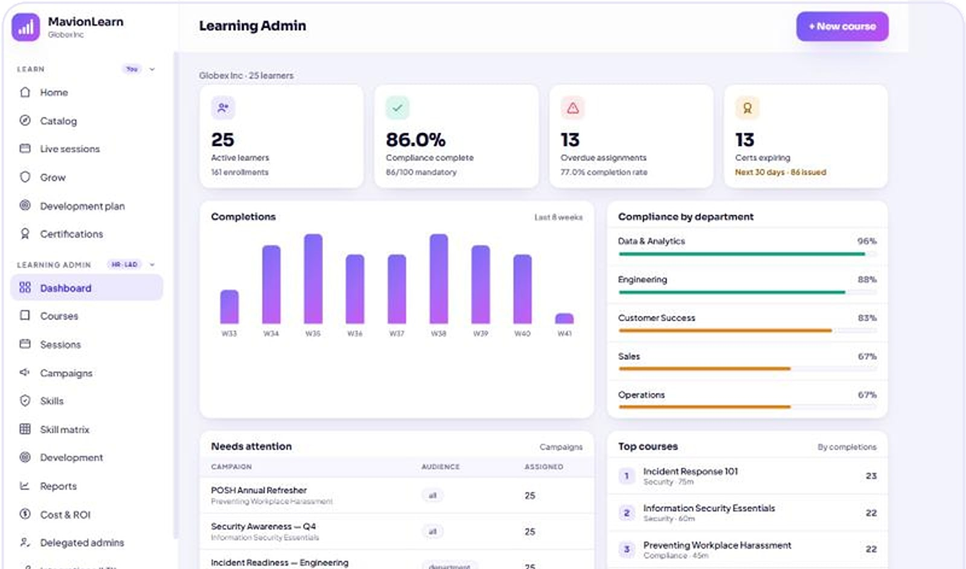
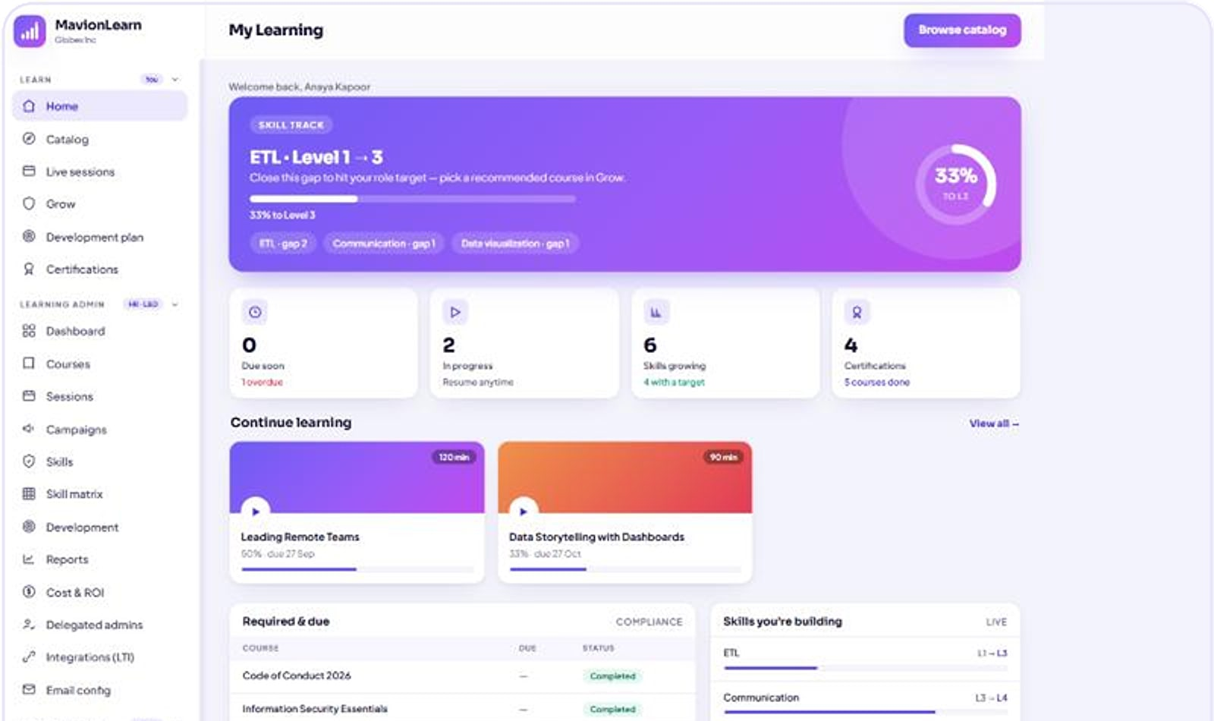
MavionLearn
MavionLearn · Learning admin
ENTERPRISE SALES OVERVIEW
ENTERPRISE LMS · SKILLS & COMPLIANCE
Skills that compound: training that becomes provable capability
A multi-tenant enterprise LMS that scores every employee against role targets, runs compliance on its own, and reports in your brand, with identity built in.
Isolated database per tenant
SSO · SCIM
Excel & PDF reports
Notes:
Opening. MavionLearn is MavionTech's multi-tenant enterprise LMS. Screens are from the product with a demo tenant (Globex Inc). Tagline: Skills that compound.

Slide 2






Training spend is up, but capability is still a guess
THE PROBLEM
Completions ≠ capability
Compliance is a fire drill
Reporting is slow
Finishing a course doesn't prove a skill or show which gaps remain.
Mandatory training is chased and tracked by hand, then rebuilt at audit time.
Generic exports that take days and are never board-ready.
Learning is fragmented
Identity is hard
ROI is invisible
Video, LMS and live sessions sit in disconnected tools.
Provisioning, SSO and deprovisioning are set up again for every vendor.
Leadership can't see what training spend actually returns.
Notes:
Six recurring problems in enterprise learning. MavionLearn addresses each with a specific module, shown on the following slides.

Slide 3
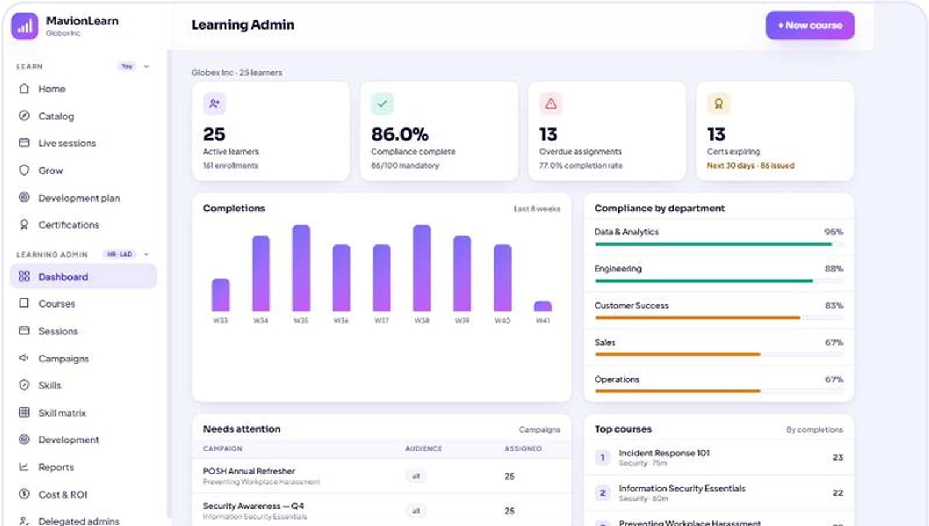
One system that turns training into capability
THE SOLUTION
Measure capability
MavionLearn · Learning admin
A living skill matrix scores every employee against the levels their role needs, and shows the exact gaps.
Automate compliance
Rule-based campaigns assign, remind, track and certify. Audit-ready by default.
Prove ROI
Cost per completion, training hours and spend: the numbers leadership asks for.
Learning admin: enrolments, compliance %, completions by department and items needing attention (demo data).
Notes:
Three pillars structure the rest of the deck: measure, automate, prove.

Slide 4




Built for the people who own learning, compliance and identity
WHO IT SERVES
L&D and HR admins
Delegated admins
Compliance leads
Author courses, run campaigns, issue certificates and report.
Department-scoped administration for large, distributed organisations.
Mandatory training by audience, with audit-ready evidence.
Managers
Learners
IT and identity teams
See their team's progress, skills and gaps.
A personal home with skill tracks, recommendations and certificates.
SSO, SCIM provisioning and an isolated tenant database.
Notes:
The economic buyers are the CHRO, the head of L&D and compliance leaders; IT is a key influencer because identity and isolation come built in.

Slide 5



Twelve modules across five capabilities, in one platform
PRODUCT MAP
Learn
Measure
Comply
Report
Govern
4 modules
1 module
1 module
2 modules
4 modules
Catalog & courses
On-demand learning
Live learning (ILT / VILT)
Learner experience
Skills & skill matrix, development plans
Compliance campaigns & certifications
Enterprise reporting
Cost & ROI
People & delegated admin
Identity & security
Standards & integrations
Platform console
One isolated database per customer. Each tenant's data, brand and controls stay in its own database, white-labelled across the app, exports and certificates.
Notes:
Twelve modules, grouped by what they do for the buyer. Each one is covered on the following slides.

Slide 6


Others track completions; MavionLearn proves capability
WHY MAVIONLEARN
Capability, not completions
Compliance that runs itself
Identity built in
Scored against role targets; each completed course raises real skill levels (slides 9–10).
Assign, remind, certify and renew automatically (slides 11–12).
OIDC, SAML 2.0 and SCIM included, not a paid add-on (slide 17).
One isolated database per tenant
Reports in your brand
Live and on-demand together
Zero shared rows; isolation you can verify in the console (slides 19–20).
Board-ready Excel and PDF with your name on top (slide 13).
ILT/VILT sessions and self-paced learning in one place (slide 8).
Notes:
Each differentiator points to the slide that proves it.

Slide 7
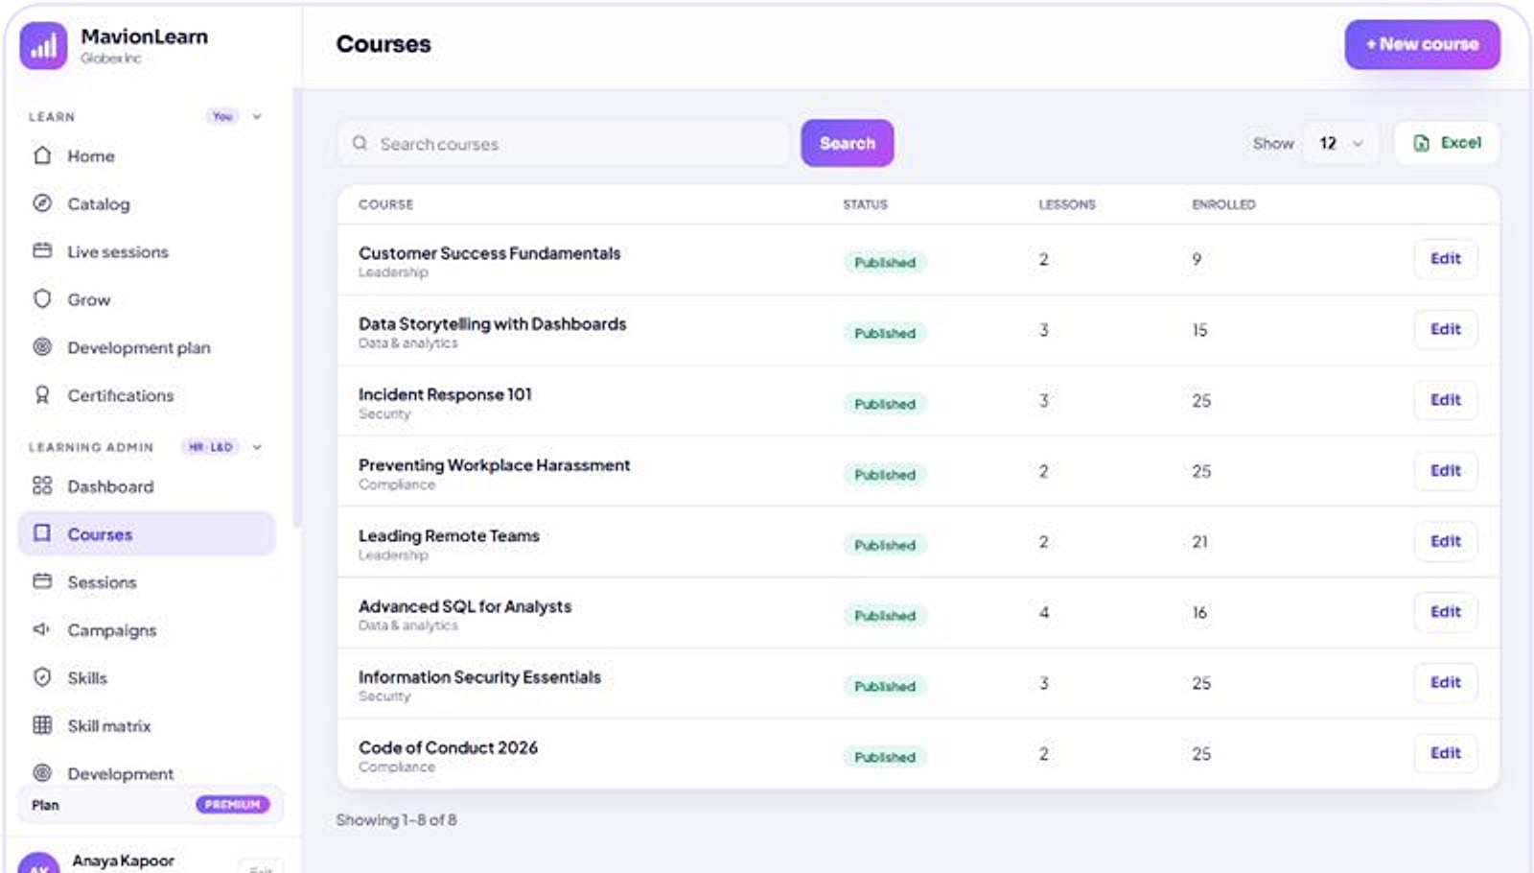


Author once, deliver to every audience
CATALOG & COURSES
Courses
Structured authoring
Courses, modules and lessons, with drafts and publishing.
Lifecycle control
Deactivate and reactivate courses without losing history.
Standard content
SCORM packages, video, readings and graded quizzes.
Targeted delivery
Assign by audience or let learners self-enrol from the catalog.
Course administration: status, lessons and enrolments per course (demo data).
Notes:
Admins author courses as modules and lessons, keep drafts, and deactivate or reactivate content. Learners browse the catalog to self-enrol.

Slide 8
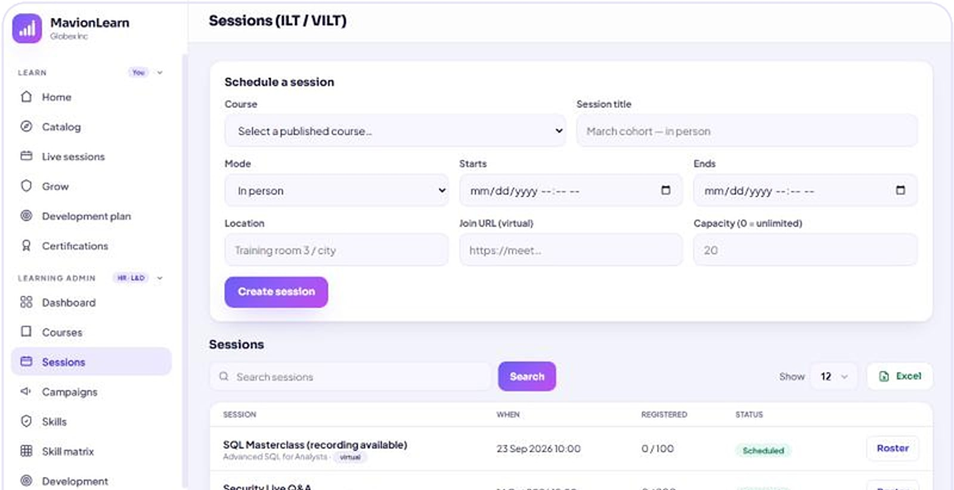
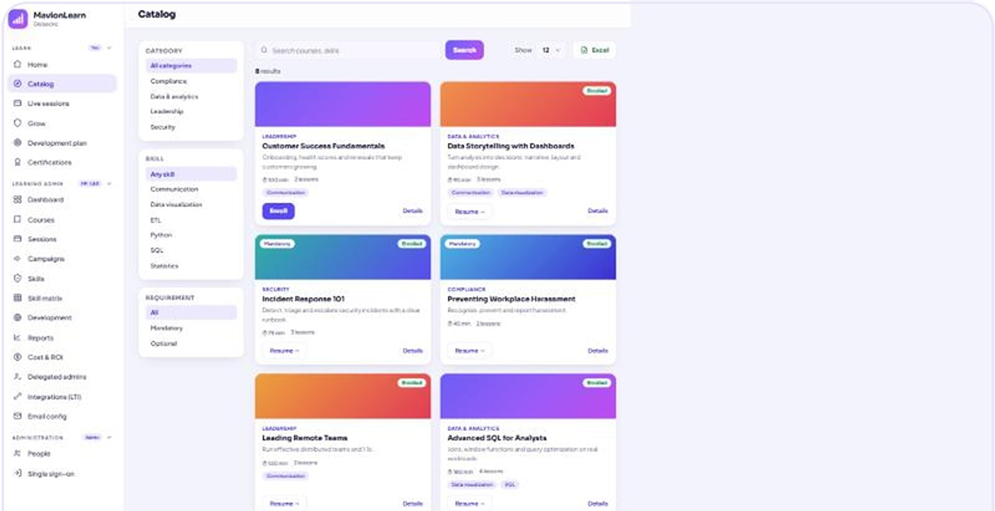



Learn live or on-demand, in one place
LIVE & ON-DEMAND
ILT and VILT sessions: schedule, roster and status (demo data).
Learner catalog: on-demand courses ready to start.
On-demand
Live & virtual
Calendar invites
Never fall behind
Video, readings, SCORM and graded quizzes.
ILT and VILT sessions with rosters.
.ics invites sent to participants.
Recordings published automatically after a session.
Notes:
Instructor-led and virtual sessions are scheduled with rosters and .ics invites; recordings are auto-published so a missed session never becomes a compliance gap. The original deck's video-player and live-classroom images were layout mockups, so they are not shown.

Slide 9
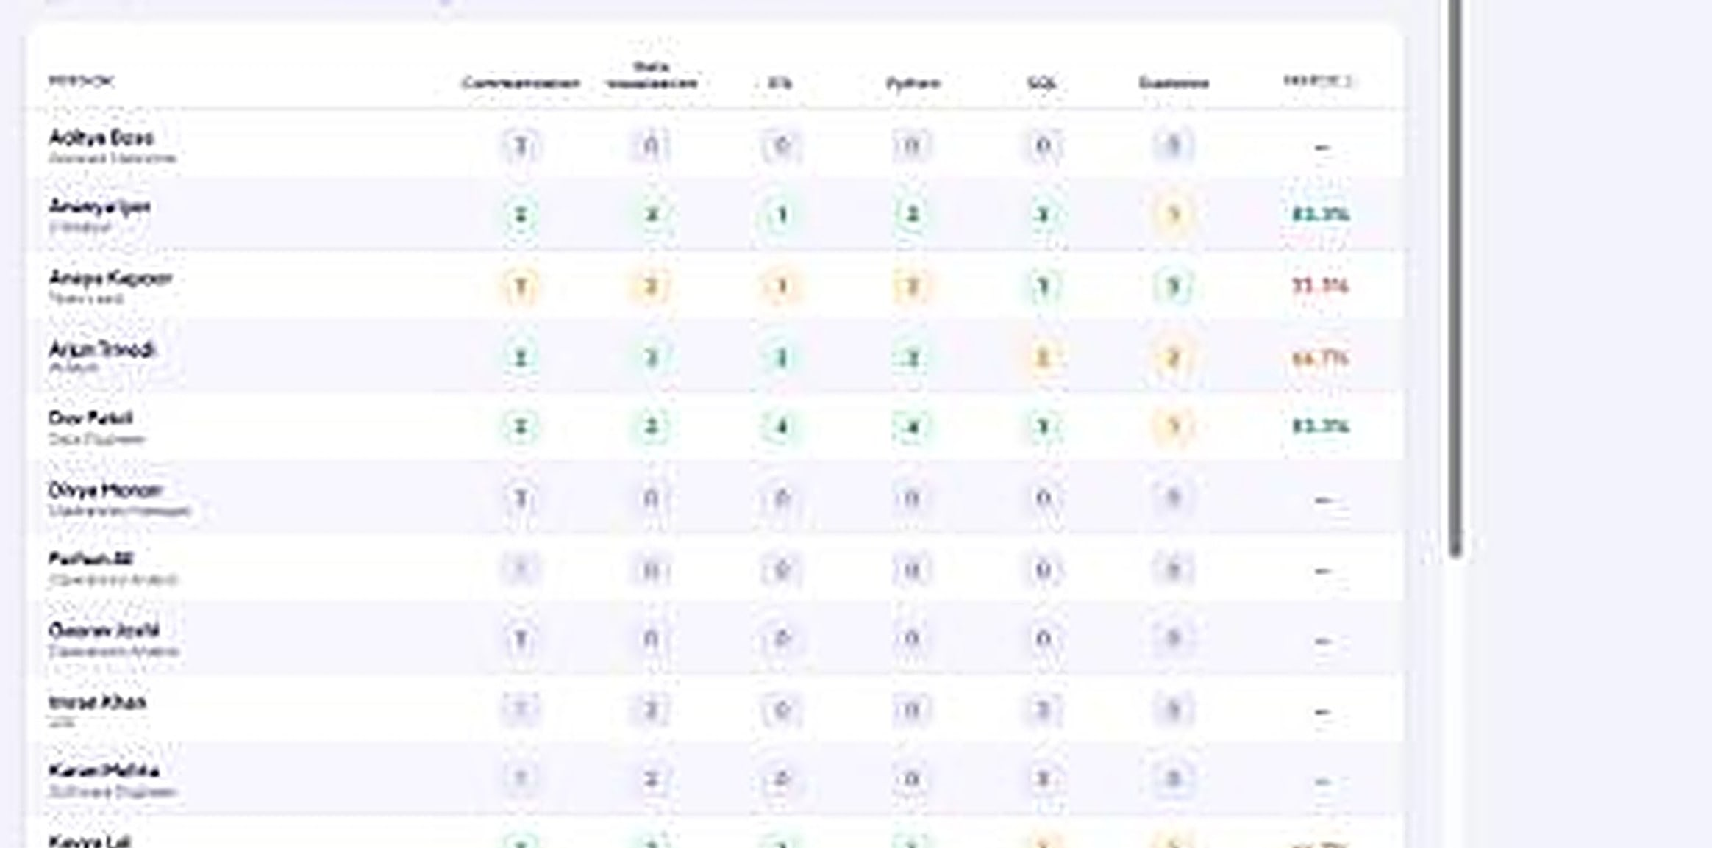


See capability across the whole organisation
SKILL MATRIX · THE DIFFERENTIATOR
Role targets per skill
Skill matrix
Define the level each role needs; everyone is scored against it.
Live match %
Per person, per department and for the whole organisation.
Training that compounds
Completing a course raises the learner's real skill level.
73.6%
organisation capability match in the demo tenant (demo data)
Skill matrix: employees scored against role targets (demo data).
Notes:
The flagship. Competitors measure completions; MavionLearn measures capability against role targets and updates it automatically as courses are completed. 73.6% is a demo-tenant figure.

Slide 10
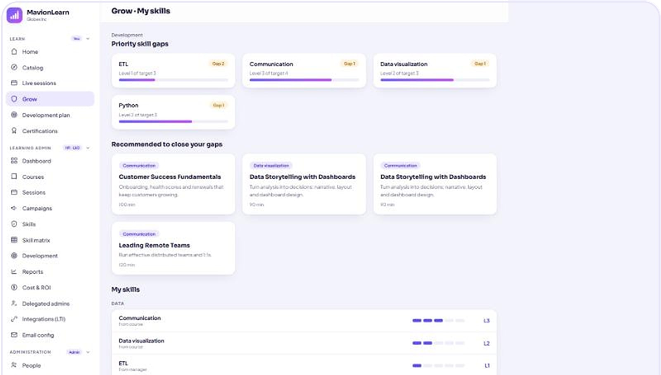



Every gap turns into the next best course
GROW & DEVELOPMENT PLANS
Grow · My skills
Priority skill gaps
Each learner sees the gaps between their level and their role target.
Recommended courses
Courses recommended to close each gap.
Development plans
Plans that track progress towards target levels.
My skills
Current level per skill, rising as courses are completed.
Grow view: priority skill gaps, recommended courses and current skill levels (demo data).
Notes:
The Grow view turns role gaps into the next best course; development plans are available in the Pro tier per the sales deck.

Slide 11
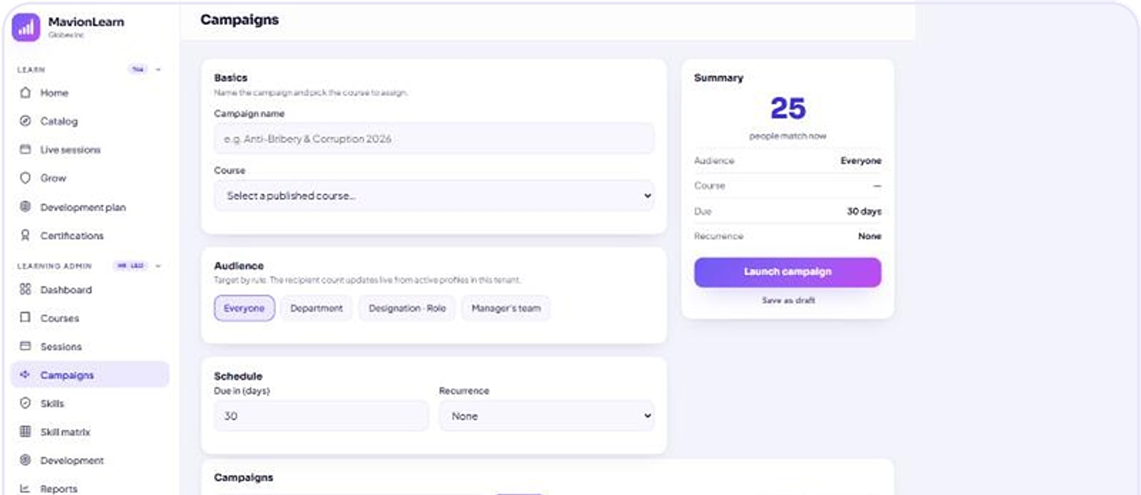

Compliance that runs itself
COMPLIANCE CAMPAIGNS
Campaigns
Rule-based audiences
Target by department, role, team or the whole organisation.
Recurring by design
Campaigns repeat on schedule, with automatic reminders.
Certificates on completion
Issued automatically, with expiry tracking.
Campaign builder: audience, course, schedule and status (demo data).
1 Define rule
2 Assign
3 Remind
4 Complete
5 Certify
6 Renew
Notes:
Campaigns assign mandatory courses by rule, remind automatically, track status per employee and issue certificates with expiry, which then feed renewal.

Slide 12
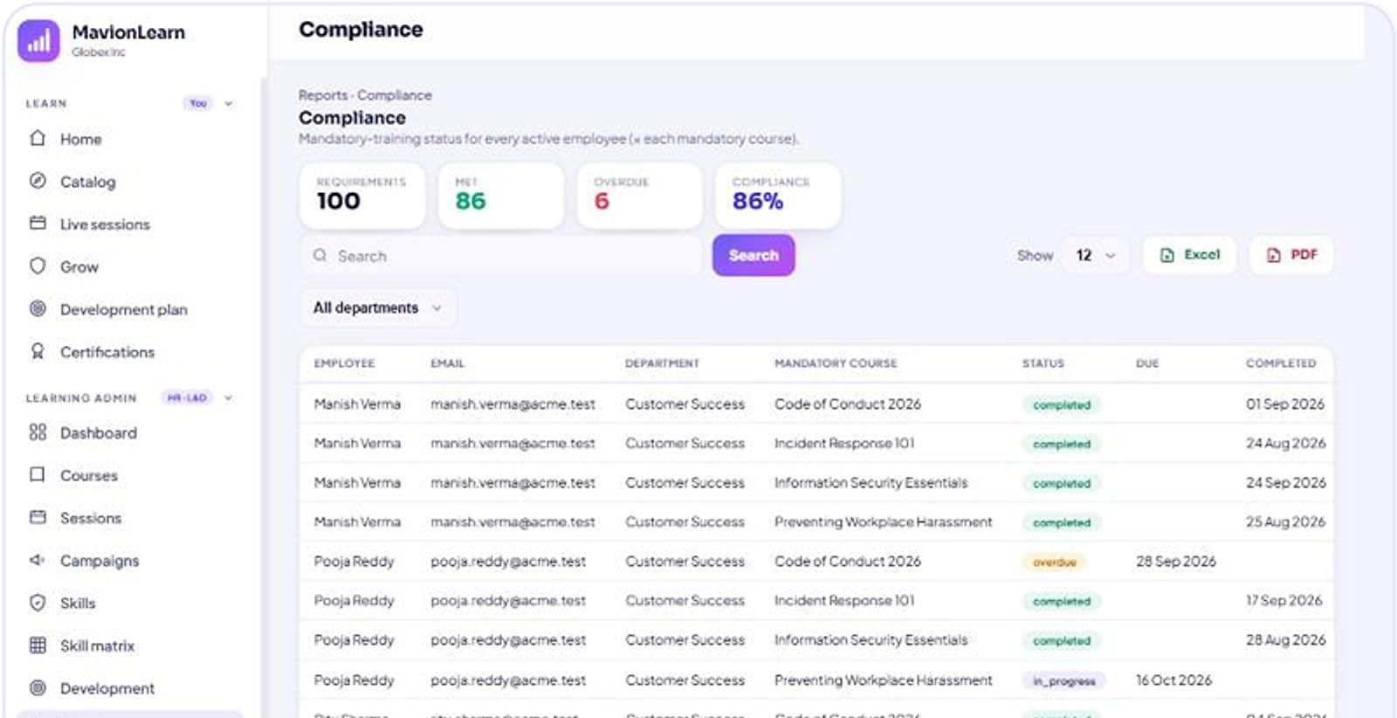
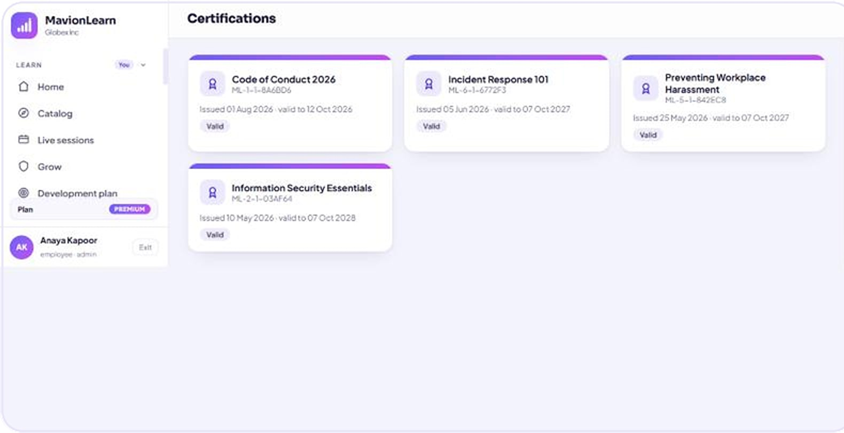


Audit-ready evidence in one click
COMPLIANCE EVIDENCE
Compliance report: per-employee status, by department, exportable (demo data).
Learner certificates with issue and expiry dates.
By department
Overdue flags
Excel and PDF
Expiry & renewal
Compliance status per department and course.
Know who is late before the audit.
Evidence exported in your brand.
Certificates tracked with renewal reminders.
Notes:
Auditors get per-employee evidence in branded Excel and PDF; certificates carry expiry dates and renewal reminders.

Slide 13
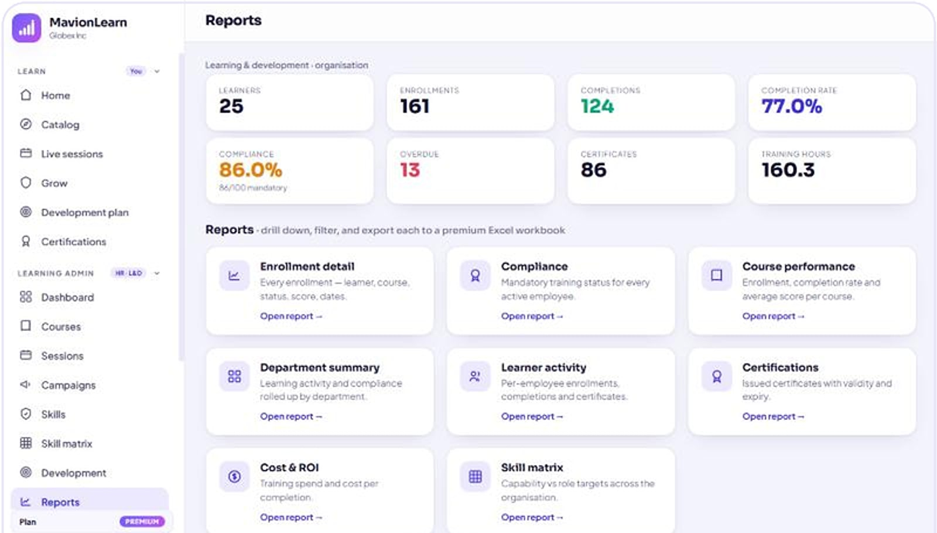


Board-ready reporting in one click
ENTERPRISE REPORTING
8 built-in reports
Reports
Enrolment, compliance, courses, learners, certifications, ROI and more.
Filter and drill down
Date ranges, departments and record-level detail.
Premium exports
Light-themed Excel workbooks and boardroom PDFs.
In your brand
White-labelled with your name on top.
Reports workspace: organisation summary and the eight report types (demo data).
Notes:
Eight enterprise reports with filters and drill-downs, exported as premium Excel or PDF in the customer's brand.

Slide 14
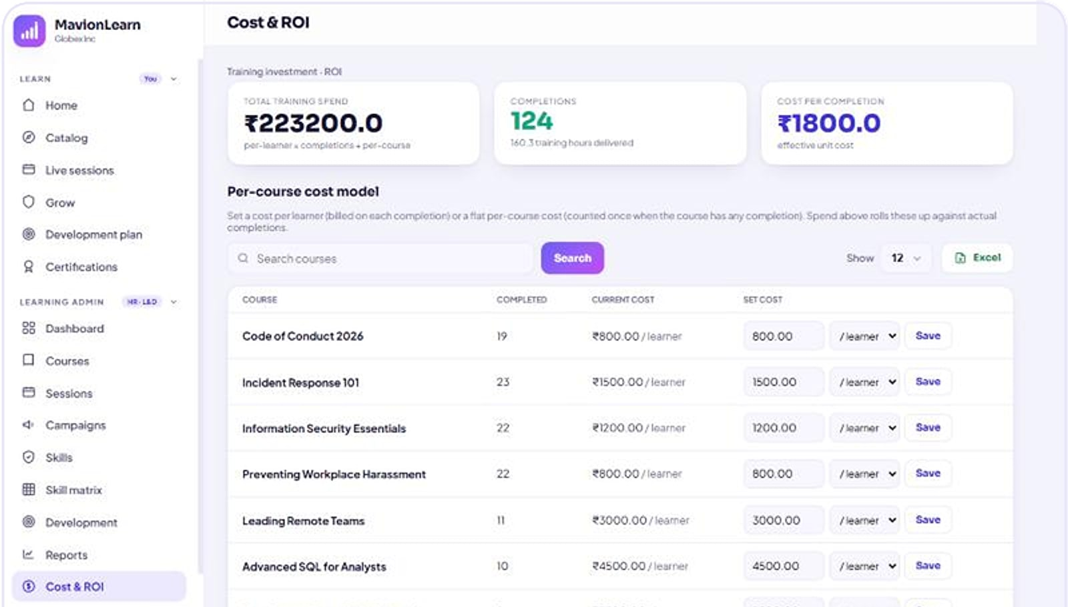
Prove the return on every training rupee
COST & ROI
Cost & ROI
Per-course cost model
Set a cost per learner; spend rolls up against real completions.
One-screen ROI
Total spend, cost per completion and hours delivered.
Finance-ready
Export the numbers leadership asks for.
Cost & ROI: total spend, completions and effective cost per completion of ₹1,800 (demo data).
Notes:
Cost per completion and hours delivered turn training spend into defensible numbers. Figures shown are demo data.

Slide 15

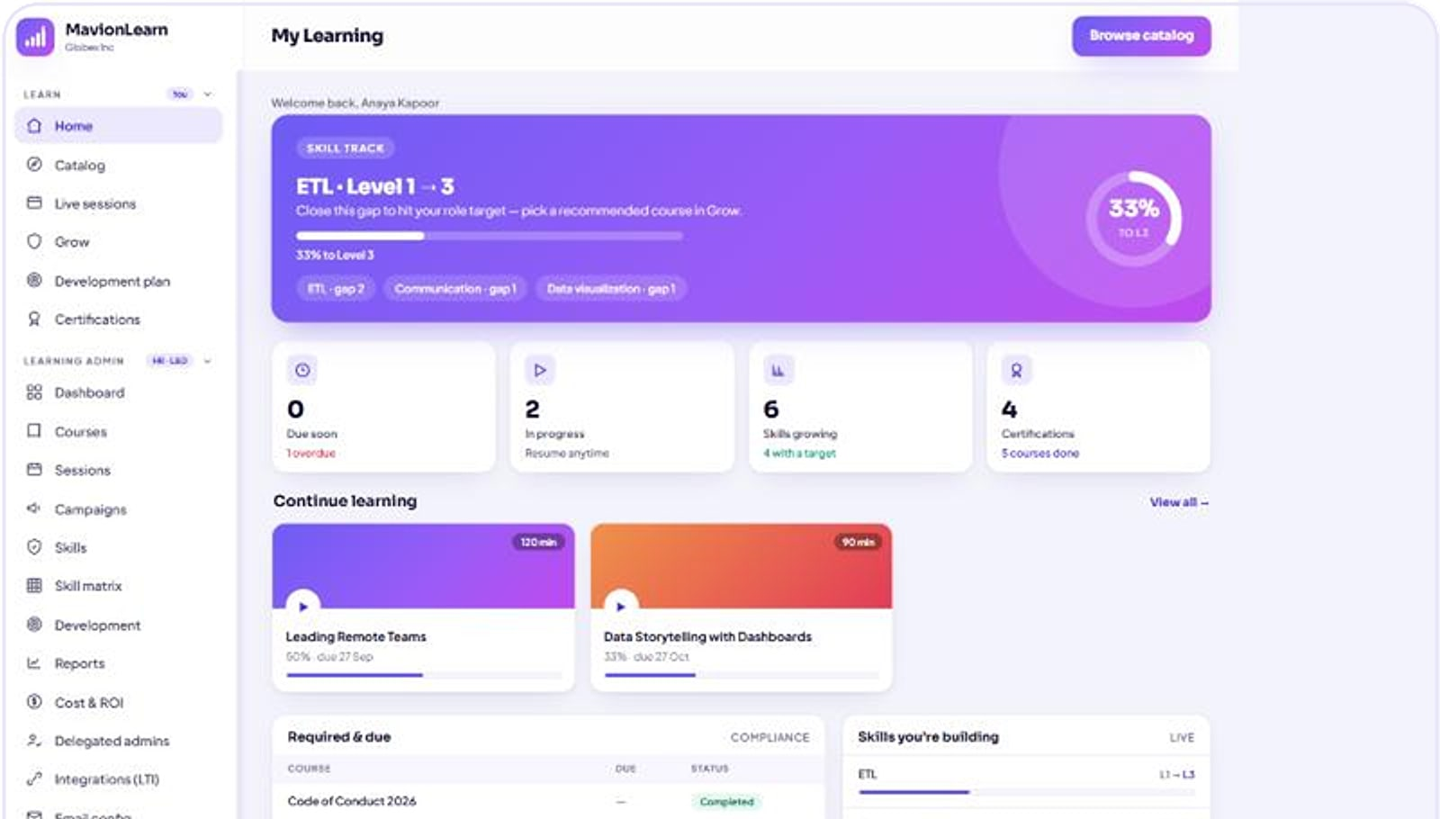
A learner home that drives real progress
LEARNER EXPERIENCE
Personalised home
My Learning
Skill tracks, progress and what to do next.
Continue learning
Pick up exactly where you left off.
Recommendations
Courses suggested from role gaps.
Certificates
Issued automatically, with expiry reminders.
My Learning: active skill track, progress, continue learning and required courses (demo data).
Notes:
The employee side: a personalised, skills-first home that keeps certifications current.

Slide 16

Run large organisations safely
PEOPLE & ADMINISTRATION
Bulk onboarding
Delegated administrators
Audiences that follow the org
Create employees one by one or import them by CSV, with profile photos.
Department-scoped admins manage only their part of the organisation.
Departments, roles and teams drive campaigns, reports and skill targets.
Tenant admin (whole organisation)
Sales · delegated admin
Operations · delegated admin
Engineering · delegated admin
Notes:
Bulk employee onboarding by CSV, and department-scoped delegated administrators for large organisations. The department names in the diagram are illustrative.

Slide 17
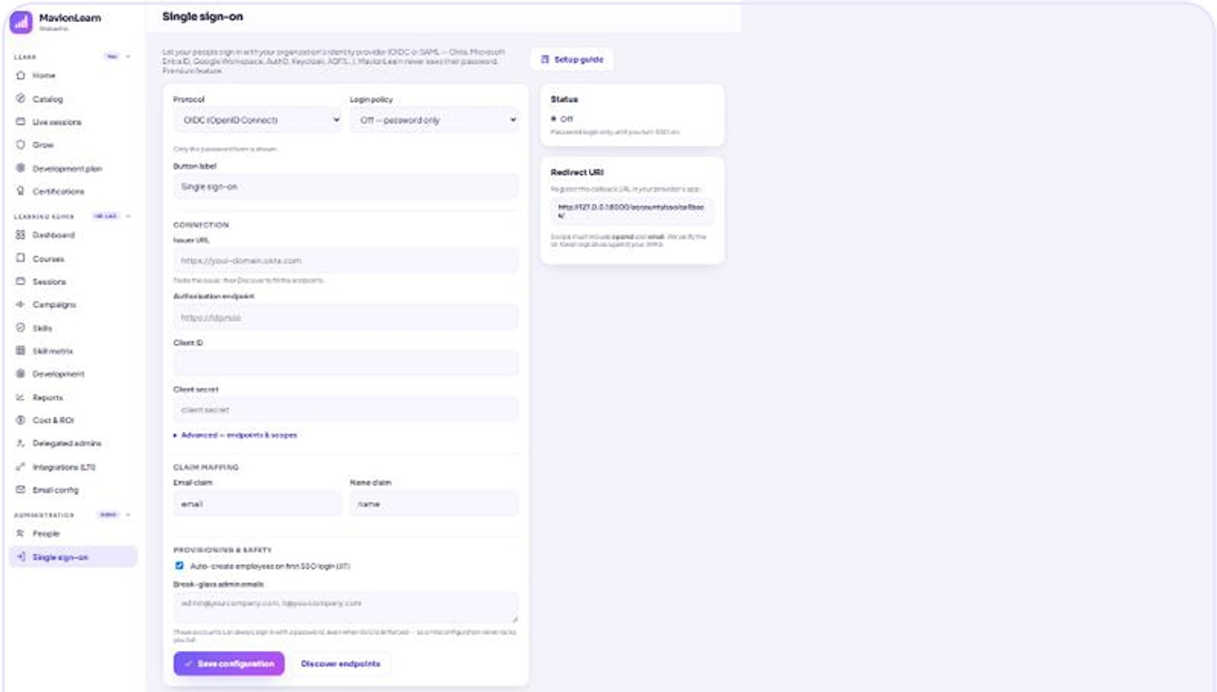
Enterprise identity, built in rather than bolted on
IDENTITY & SECURITY
Settings · Single sign-on
SSO: OIDC and SAML 2.0
Per-tenant policy: off, optional or enforced, with break-glass access.
SCIM 2.0 and JIT
Automated provisioning and deprovisioning; accounts created just in time.
Secure by design
Signed-URL media, audit logging, rate limiting and an auth gate on every page.
Single sign-on settings for a tenant (demo data).
Notes:
SSO, SCIM and JIT are configured per tenant. Break-glass access keeps admins in if the identity provider is unavailable.

Slide 18



Fits the identity and content standards you already use
STANDARDS & INTEGRATIONS
OIDC
SAML 2.0
SCIM 2.0
SCORM
Single sign-on
Single sign-on
User provisioning
Packaged e-learning content
LTI 1.3
API
.ics
Cloudflare R2 / S3
Learning tool interoperability
Versioned API
Calendar invites for sessions
Per-tenant media storage
Excel and PDF exports are generated in the customer's brand. LTI and API access are part of the Premium tier (per the current price list).
Notes:
Standards and integrations stated in MavionTech's product materials. xAPI appears only in the investor deck and is not claimed here pending confirmation.

Slide 19
True multi-tenant isolation: a dedicated database per customer
ARCHITECTURE
USERS & IDENTITY
MAVIONLEARN APPLICATION
PER-TENANT DATA
OPERATIONS
Learners & managers
Web app, server-rendered
tenant: Globex
Isolated MySQL database
Platform console
Tenants & plans
1
Auth gate on every page
Admins & delegated admins
Per-tenant console
2
SSO policy + break-glass
tenant: Northwind
Isolated MySQL database
Live health
Across the fleet
3
Rate limiting
Identity provider
OIDC · SAML 2.0 · SCIM 2.0
One database per customer
Zero shared rows
Metering
Usage per tenant
4
Audit logging
Media storage
Cloudflare R2 / S3 · signed URLs
Self-healing schema
Zero-downtime upgrades
5
Versioned API
Notes:
Each customer gets its own MySQL database, with no shared rows, verifiable from the platform console. Tenant names are demo tenants.

Slide 20
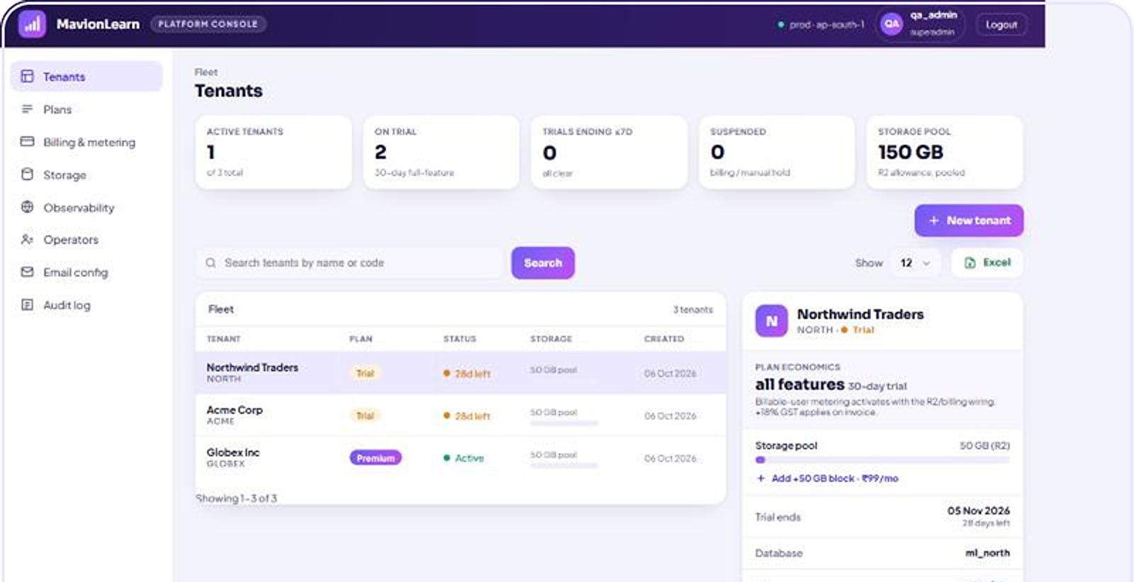
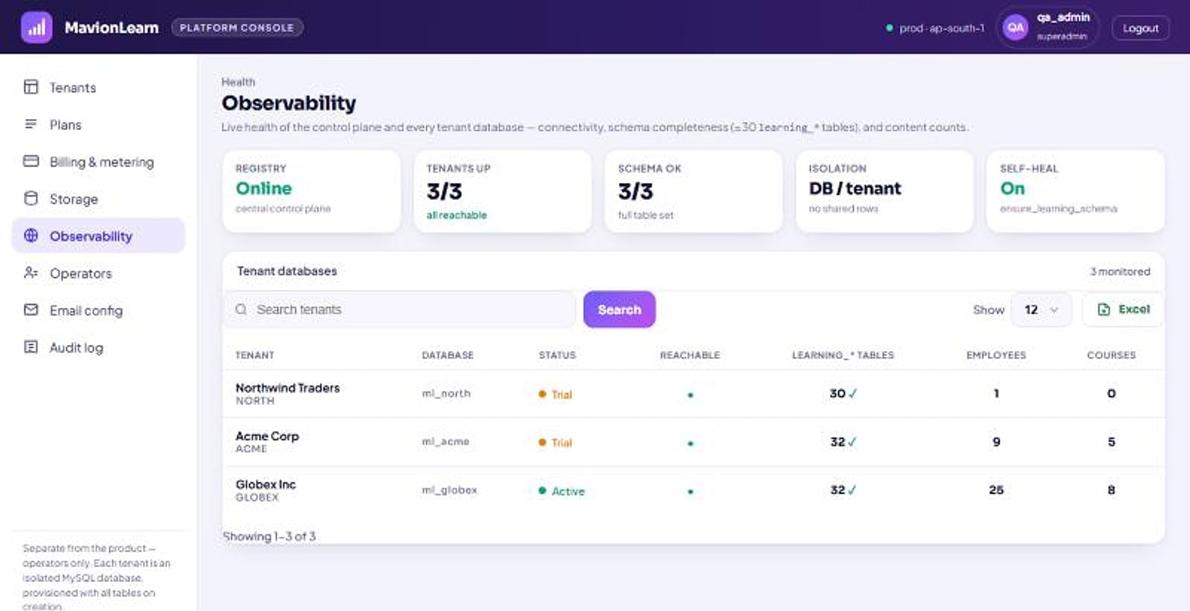
Isolation you can verify, health you can see
OPERATED WITH CONFIDENCE
Platform console: tenants, plans, storage and features (demo data).
Observability: tenant databases, schema status and health.
Verifiable isolation
Self-healing schema
Health & metering
White-labelled
Every tenant's database listed in the console.
Tenants kept current, with no downtime.
Live status and usage across tenants.
Each tenant's brand across app, exports and certificates.
Notes:
MavionTech operators manage tenants, plans and storage from the platform console, with live health and metering.

Slide 21





What changes compared with a generic LMS
WHY MAVIONLEARN
GENERIC LMS
WITH MAVIONLEARN
Capability you can see
Capability
Measures completions
Living skill matrix against role targets
Skill levels rise as courses are completed.
Compliance
Tracked by hand
Self-running: assign, remind, certify
Audit-ready by default
Evidence exported in one click.
Reporting
Generic CSV dumps
Board-ready Excel and PDF in your brand
Identity
Often a paid add-on
OIDC, SAML 2.0 and SCIM included
Identity included
SSO and SCIM in the product.
Isolation
Shared schema
One isolated database per tenant
Isolated by design
Learning
Separate live and video tools
ILT, VILT and on-demand together
A database per customer.
Notes:
The comparison describes common generic-LMS patterns, not any named competitor. Every 'With MavionLearn' cell maps to a capability shown earlier.

Slide 22

Start with a 30-day, all-features trial
GETTING STARTED
STEP 1
STEP 2
STEP 3
STEP 4
Trial
Deploy your way
Onboard fast
Run your first campaign
30 days with every feature, so you can prove value on your own content.
Multi-tenant SaaS; private cloud or on-premise available on request.
Import employees by CSV, connect SSO and SCIM, publish courses.
Assign a compliance course by audience and watch evidence build.
Pricing is per user per month in INR, with annual billing and volume discounts on request. The tier details are being confirmed and will be shared in your proposal.
Notes:
Trial: 30 days, all features (both source decks). Deployment options per the sales deck and maviontech.com. A pricing slide is deliberately omitted until the tier matrix is confirmed (the sales and investor decks differ).

Slide 23

See capability compound from week one
LET'S GET STARTED
MavionTech Pvt. Ltd.
MavionLearn · Enterprise LMS
communications@maviontech.com
+91 91580 08002
www.maviontech.com
505 Zen Business Center, Bhumkar Chowk, Wakad, Pune, Maharashtra 411057
Start a 30-day trial or book a walkthrough with your own courses and org structure.
Book a demo
Start a free trial
Notes:
One ask: a trial or a walkthrough. Official MavionTech contact details.

