Slide 1

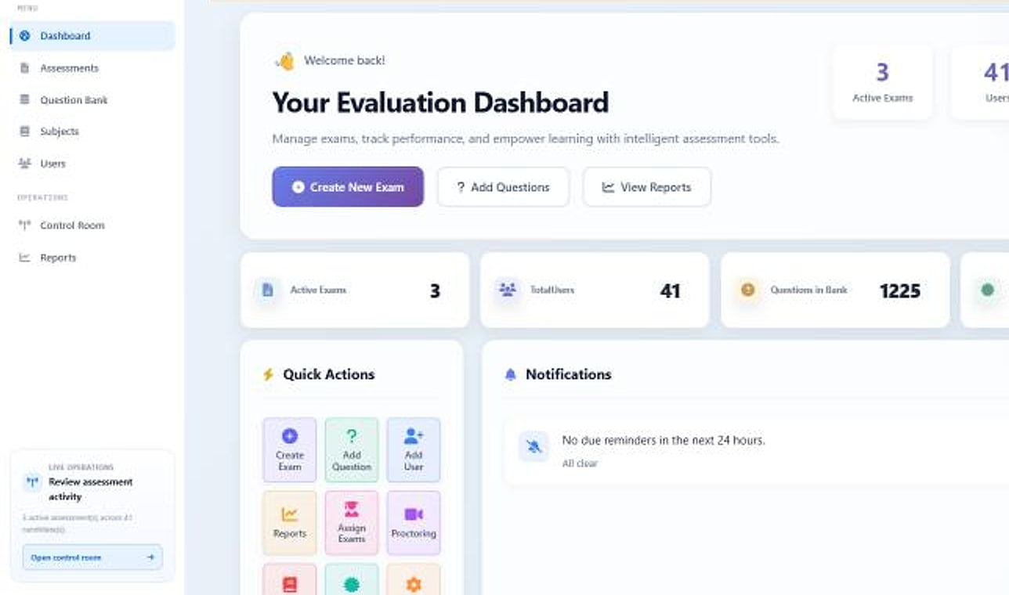
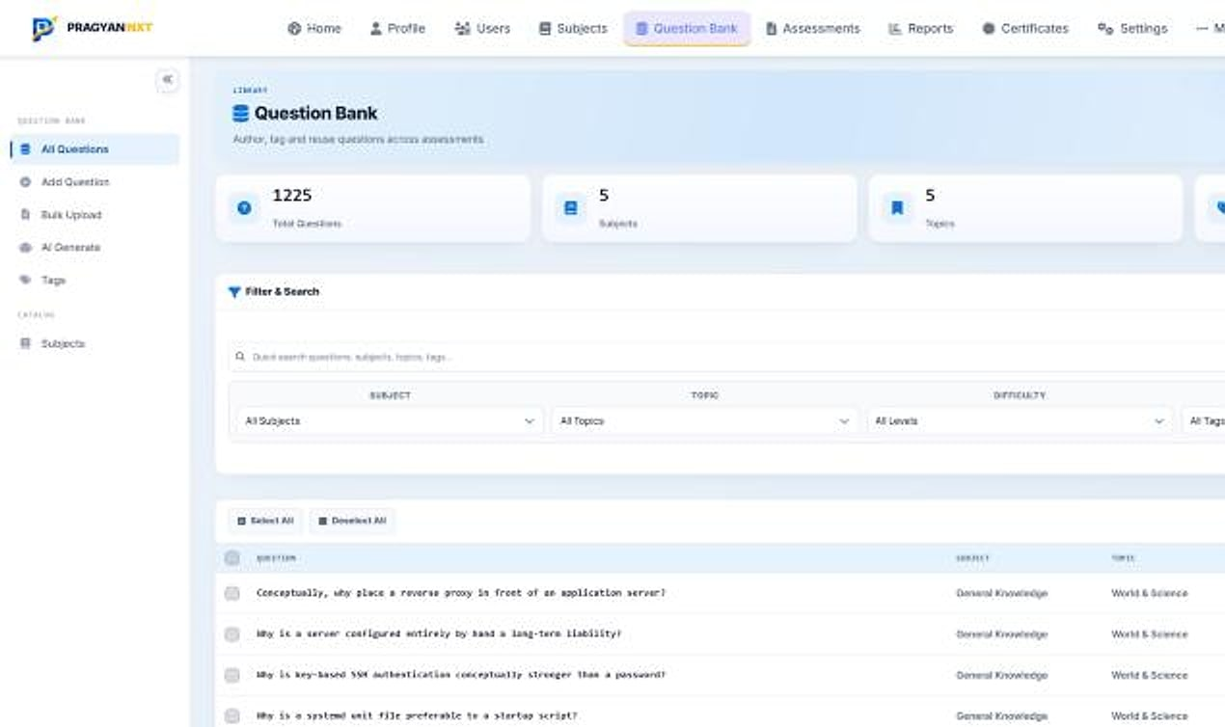
PragyanNxt
PragyanNxt · Evaluation dashboard
ENTERPRISE SALES OVERVIEW
ASSESSMENT · PROCTORING · CERTIFICATION
Results you can defend. Credentials anyone can verify.
One platform for corporates and academic institutions to author, deliver, proctor, score and certify, with an integrity score on every attempt.
Author to certificate
Integrity scoring
Isolated tenants
Notes:
Opening. PragyanNxt (formerly Evalynx) is MavionTech's enterprise assessment and certification platform. Screens are from the running product with a demo organisation: 1,225 questions, 5 subjects, 3 assessments, 41 users.

Slide 2





Online testing scaled, but trust didn't
THE PROBLEM
For hiring teams
For academic institutions
Gamed screening tests push the wrong candidates forward, while strong talent walks away from a process it doesn't trust.
Unmonitored exams devalue the certificate, invite disputes and grade appeals, and put accreditation and reputation at risk.
WHAT AN ASSESSMENT YOU CAN'T DEFEND COSTS
The wrong hire
The disputed result
The leaked exam
Every bad hire that cleared a gamed test costs months of ramp-up and re-hiring.
Contested scores trigger appeals, manual re-grading and reputational damage.
Once a question bank leaks, the assessment has to be rebuilt from scratch.
Notes:
The problem framed for both buyers, then the three failure modes that cost real money and reputation. No statistics are claimed.

Slide 3

Six real problems, each answered by a specific capability
PROBLEMS WE SOLVE
THE CHALLENGE
HOW PRAGYANNXT SOLVES IT
Candidates cheat in unsupervised remote exams
AI proctoring plus an integrity score on every attempt
Scores get disputed and appealed
A defensible evidence trail with a formal appeals process
Certificates are easy to forge
Cryptographically signed credentials anyone can verify
Authoring quality assessments takes days
Bulk import and AI generation from your own content
Point tools don't talk to each other
One platform from authoring to verifiable credential
Mixing organisations' data is a security risk
A separate, isolated database for every organisation
Notes:
The problem-to-solution map. Each answer is a shipped capability shown later in the deck.

Slide 4

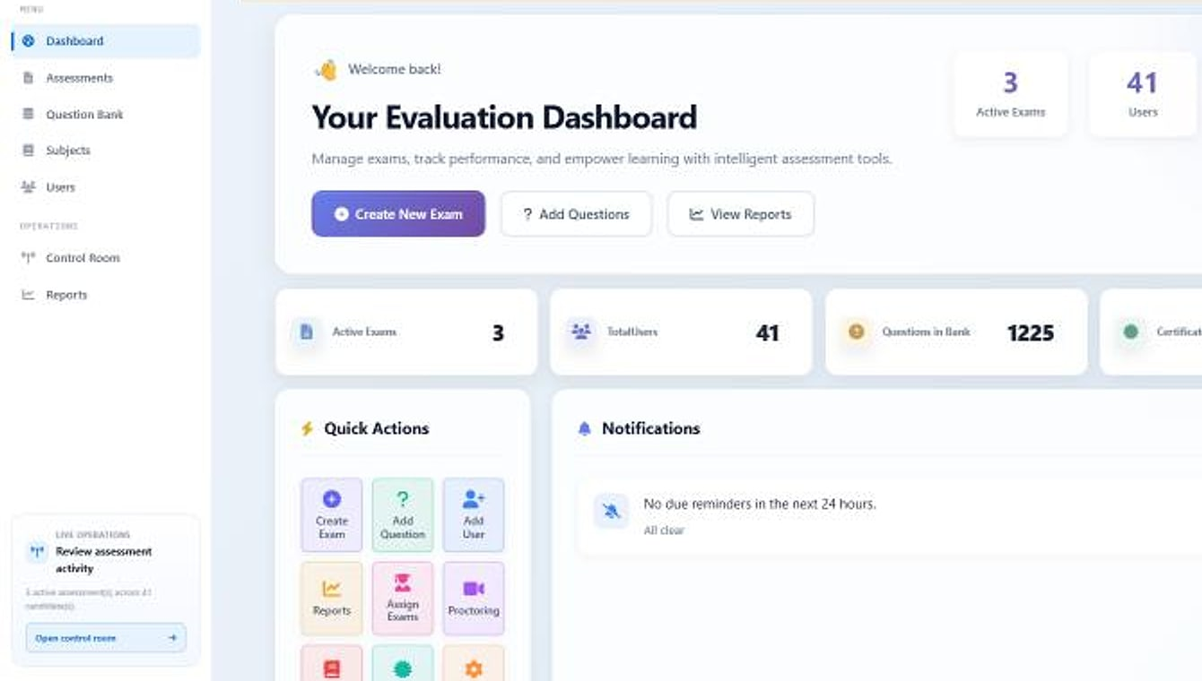


One platform for the entire assessment lifecycle
THE SOLUTION
Unified lifecycle
PragyanNxt · Evaluation dashboard
Authoring, delivery, proctoring, integrity scoring, analytics and certification in one system.
Integrity on every attempt
AI proctoring and behavioural signals produce a defensible score, even without a camera.
Verifiable credentials
Signed certificates that anyone can check, and that carry the evidence behind them.
Evaluation dashboard: active exams, users, a 1,225-question bank and quick actions (demo data).
Notes:
The pivot: one platform for the whole lifecycle, with integrity and verifiable credentials as the two proof points.

Slide 5





Every role in the assessment chain, in one system
WHO USES PRAGYANNXT
Platform manager
Organisation admin
Author
Provisions organisations into isolated databases and sets their plan.
Runs the organisation: users, subjects, exams, reports and certificates.
Builds the question bank by hand, in bulk or with AI.
Proctor
Candidate
Verifier / employer
Monitors live sessions and reviews flagged evidence.
Takes the exam by invitation, assignment or public link.
Confirms that a credential is genuine.
Notes:
Candidates are kept separate from staff in the user directory, so candidates are not priced as staff seats.

Slide 6
Five stages, one closed loop of trust
HOW IT WORKS
01
02
03
04
05
Author
Deliver
Proctor
Score
Certify
Tagged question banks, bulk import and AI generation.
Scheduled, assigned or invite-link exams, randomised per candidate.
Live monitoring, recording and AI visual integrity analysis.
Auto-scoring, manual grading, integrity scores and reports.
Signed, verifiable certificates the world can trust.
Each stage feeds the next, so the certificate at the end carries the integrity evidence from every step before it. Most tools stop at the score.
Notes:
Five stages, one loop. Certify is highlighted because it is the differentiator.

Slide 7






Eight modules, one integrated system
PRODUCT MAP
Authoring
Delivery
Proctoring
Integrity
Question bank
Bulk import
AI generation
Bloom's & difficulty
Public / assigned / invite
Randomisation
Timers & auto-submit
Retakes
Live monitoring
Screen & webcam recording
AI visual analysis
Media library
Integrity engine
Behavioural signals
Non-proctored scoring
Answer similarity
Results & analytics
Certification
Multi-tenancy & admin
Commerce & AI
Auto & manual grading
Report PDFs
Dashboards
AI summaries
Signed certificates
Public verification
Portable badges
LTI
Appeals
Tenant isolation
Control plane
Roles & RBAC
Activity logging
Subscriptions & billing
Entitlements
AI credits
Email invites
Notes:
All eight modules and their key features on one screen. Certification is highlighted to keep the differentiator visible.

Slide 8
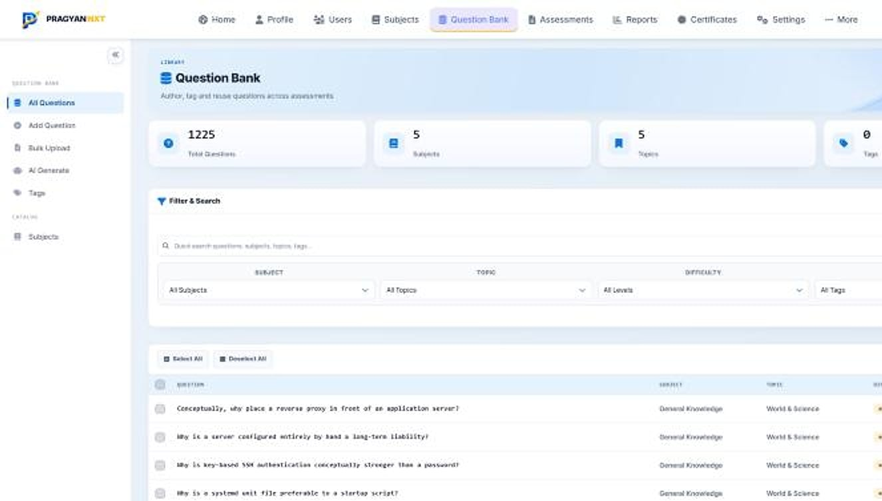




A question bank built for scale
AUTHOR
Question bank
Organised library
Reusable questions by subject and topic, searchable in seconds.
Difficulty and Bloom's
Tag every item for balanced, targeted papers.
Bulk import
Upload from CSV and Excel: thousands of items at once.
AI generation
Draft questions from a prompt, a job description or documents.
Question bank: 1,225 questions across 5 subjects, with filters by subject, topic, difficulty and tag (demo data).
Notes:
Live screen: a real question bank with 1,225 items. The menu shows All Questions, Add Question, Bulk Upload, AI Generate and Tags.

Slide 9
AI that does the heavy lifting, with metered cost
AI-NATIVE
Generate questions
Build whole exams
Summarise results
Draft on-topic questions from a prompt, a job description or your own documents, then review and keep what fits.
Turn a role or a syllabus into a complete, balanced assessment in minutes.
Performance summaries turn raw scores into readable strengths and gaps for each candidate.
HOW GENERATION STAYS UNDER CONTROL
1 Your prompt, JD or document
2 AI drafts questions
3 Author reviews
4 Saved to the bank
Model usage is metered against AI credits, so AI stays an advantage rather than a runaway bill. A human always reviews generated content.
Notes:
AI is assisted, never autonomous: generated items are reviewed before use. 'AI Generate' (question bank) and 'Generate with AI' (assessments) appear in the product menus.

Slide 10

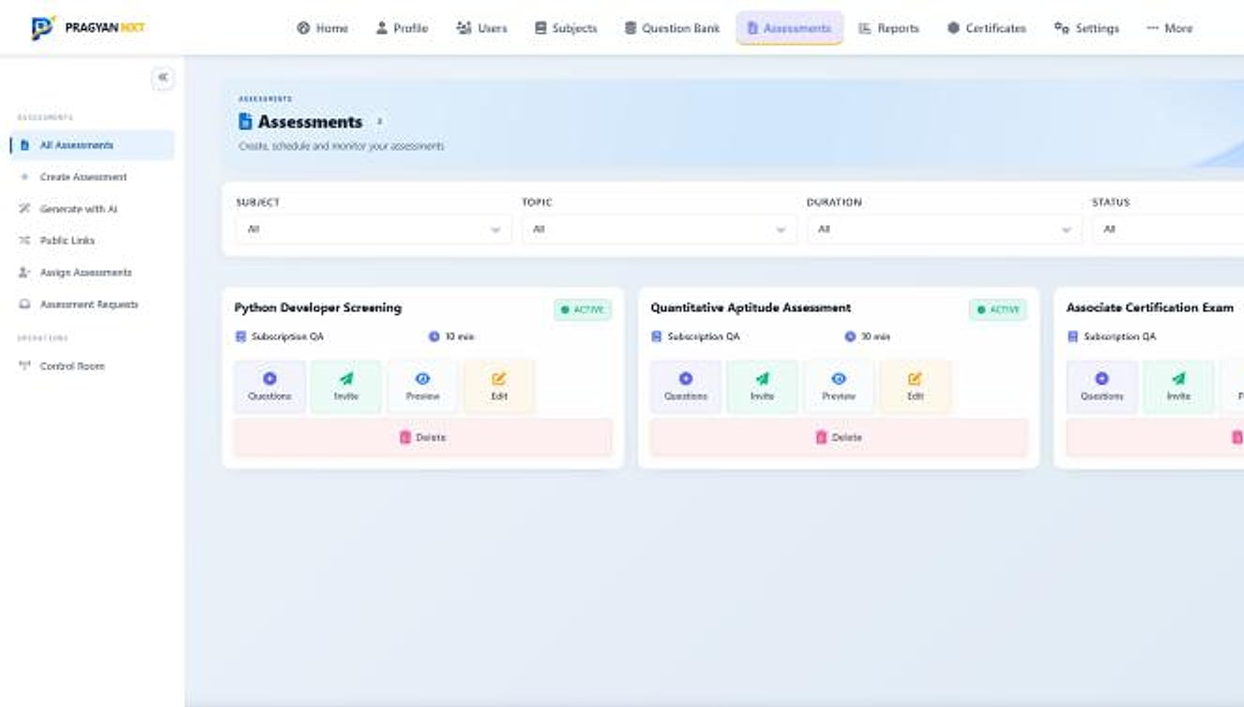



Flexible delivery, locked-down experience
DELIVER
Three delivery modes
Assessments
Public campaigns, assigned candidates or single-use invite links.
A unique paper each
Randomised by section and difficulty for every candidate.
Server-enforced timers
Auto-submit and protection for draft answers.
Reconnect and resume
A dropped connection never loses an answer.
Assessments workspace: active exams with questions, invite, preview and edit actions (demo data).
Notes:
Three delivery modes cover hiring campaigns, named cohorts and external candidates without an account. The menu shows Create Assessment, Generate with AI, Public Links, Assign Assessments and Assessment Requests.

Slide 11
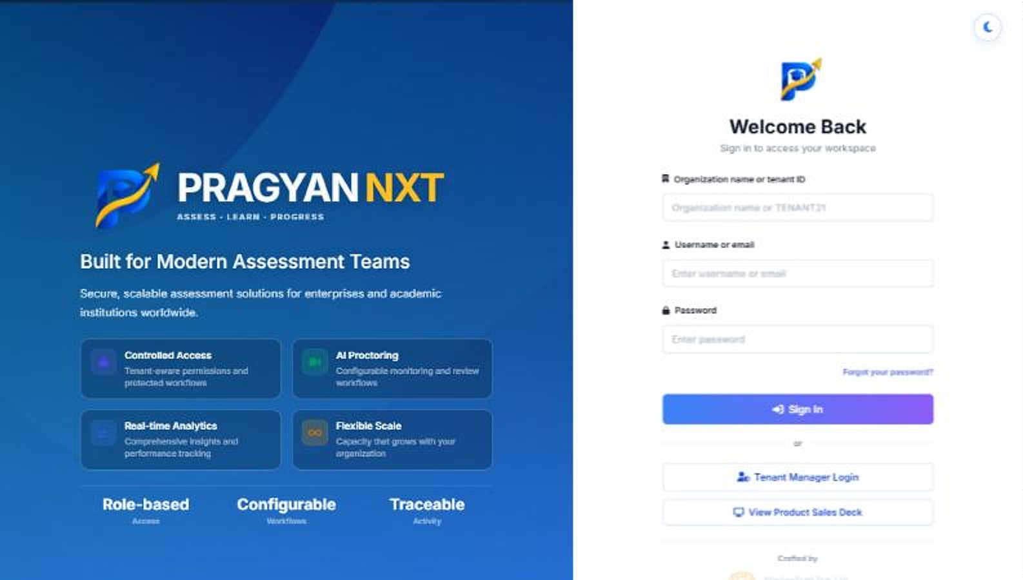

From invitation to verified credential
THE CANDIDATE JOURNEY
1 Invitation
Public link, assignment or a single-use invite, even without an account.
2 Sign in
Into the organisation's own workspace.
3 Take the exam
Randomised, timed, with live or recorded supervision.
Organisation-scoped sign-in (organisation name or tenant ID).
4 Result + integrity
Score and integrity report attached.
5 Certificate
Signed credential the candidate can share and anyone can verify.
Notes:
The candidate's path through the platform. The sign-in screen is the organisation-scoped login.

Slide 12




See every session, catch every anomaly
PROCTOR
Live monitoring
Recording
AI visual analysis
Supervision your way
A real-time control room for every active session.
Screen and webcam recording that survives restarts.
Flags no face, multiple faces, a second person or a phone.
From full live proctoring to lightweight recorded supervision.
AI FLAGS
No face detected
Multiple faces
Second person
Phone in view
Recordings and flags are stored as evidence in the media library and attached to the candidate's integrity report.
Notes:
No populated proctoring screenshot is available yet (the captured dashboard was idle). Capabilities per the product deck: live monitoring, screen and webcam recording, AI visual analysis, and modes from full live to recorded supervision.

Slide 13

Integrity you can put a number on
INTEGRITY ENGINE
WEIGHTED BEHAVIOURAL SIGNALS (POINTS DEDUCTED)
INTEGRITY SCORE
92
/ 100
Every attempt starts at 100. Weighted risk signals subtract points, giving a score and a risk level.
Low
Medium
Works without a camera
Answer similarity
High
Critical
Focus, tab and clipboard telemetry score non-proctored exams too.
Surfaces collusion and AI-written responses across candidates.
Illustrative score
Notes:
The integrity engine turns suspicion into a defensible number. Point weights are the engine's values per the product deck; 92 is an illustrative score.

Slide 14
From raw answers to decisions
SCORE & ANALYSE
COMPLETION FUNNEL FOR EVERY ASSESSMENT (ILLUSTRATIVE)
Auto and manual grading
Assigned
Objective items scored instantly; subjective answers graded by reviewers.
Started
Report PDFs and CSV
Downloadable per assessment and per candidate.
Completed
Integrity attached
Every result carries its integrity report, proctored or not.
Passed
AI summaries
Strengths and gaps in plain language.
Notes:
Auto-scoring and manual grading feed a live analytics layer. The funnel is illustrative; the captured reports screen was empty on a fresh tenant and is not shown.

Slide 15





Not just a PDF: a credential the world can verify
CERTIFY · THE DIFFERENTIATOR
Cryptographically signed
Public verification
Portable credentials
Ed25519-signed credentials that can't be forged or altered.
Anyone can confirm a certificate is genuine, instantly.
Open Badges and verifiable-credential exports that travel anywhere.
Plugs into your LMS
Employer verification
Appeals & due process
LTI 1.3 writes results back to Canvas, Moodle and more.
Hiring teams verify a credential before the interview.
A 14-day appeal window with independent case review.
Notes:
The flagship differentiator: a certification authority, not a certificate generator. Enabled per deployment.

Slide 16
A trail of trust from result to verified credential
HOW VERIFICATION WORKS
Candidate passes
Score and integrity report recorded
Credential signed
Ed25519 signature applied
Candidate shares
Open Badge or verifiable credential
Anyone verifies
Public verification, instantly
ALSO PART OF THE TRAIL
LMS write-back
LTI 1.3 returns results to Canvas, Moodle and other LMSs
Appeals & review
14-day appeal window with independent case review
Because the integrity evidence travels with the credential, employers and institutions verify the result, not just the paper.
Notes:
Verification flow. Certificate and public-verification screens still need to be captured from a populated tenant.

Slide 17
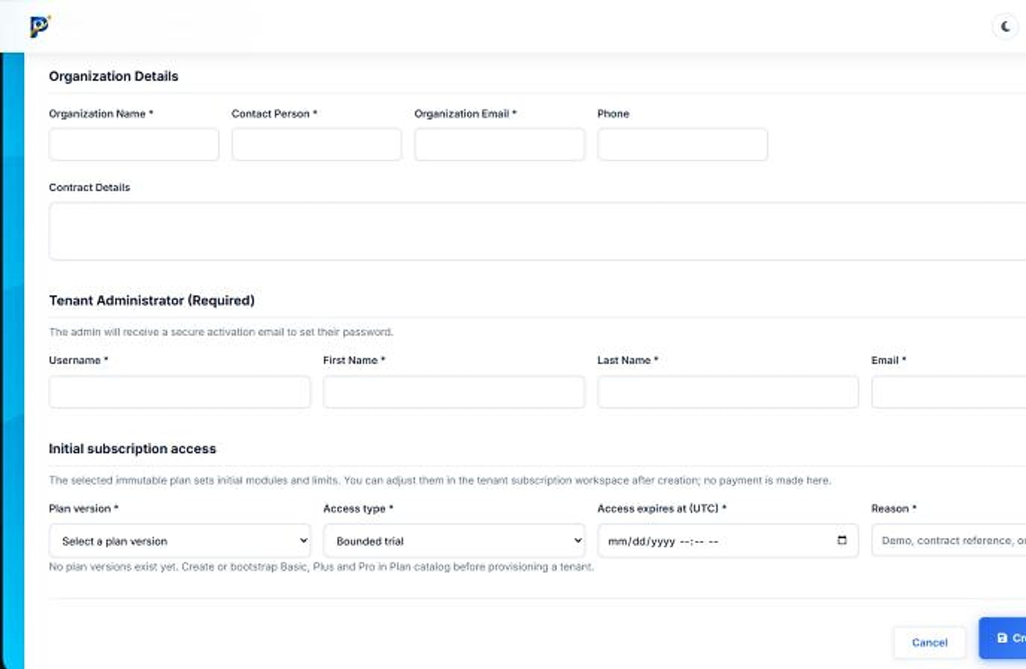
Built like enterprise software
ARCHITECTURE
CONTROL PLANE
PER-ORGANISATION DATA
Tenant Manager · Create organisation
Tenant Manager
Provisions each organisation
Organisation A · own database
Organisation B · own database
Plans & entitlements
Plan version, access type, expiry
One database per organisation
BUILT-IN CONTROLS
Role-based access
Activity logging
Signed, expiring media URLs
Durable background processing
Creating an organisation: details, tenant administrator and initial subscription access.
Reports and recordings survive restarts; one organisation's data never touches another's.
Notes:
Database-per-tenant isolation is a hard boundary, not a shared table with a tenant column. Background processing is durable so submissions, reports and recordings are not lost.

Slide 18
Hire on evidence; run exams you can stand behind
BUILT FOR BOTH BUYERS
For corporates
For academic institutions
Screen faster, at any volume
Remote exams at cohort scale
Run large applicant pools through one fair, automated funnel.
Deliver and proctor whole batches without a physical hall.
Defensible decisions
Academic integrity, documented
Every score carries a proctoring and integrity trail.
An integrity report on every attempt protects the degree.
Verify skills before you interview
Verify and plug into your LMS
Confirm a candidate's credential is genuine in one click.
Signed credentials and LTI write-back to your platform.
Notes:
Two buyers, one platform: hiring teams care about speed and defensibility; institutions about documented integrity and LMS integration.

Slide 19




One platform where others give you three
WHY PRAGYANNXT
Author, proctor and certify together
Integrity built in, not bolted on
No stitching point tools together or leaking data between them. One system, one trail of trust.
A defensible integrity score on every exam, including those with no camera.
Real multi-tenant isolation
AI-native and cost-aware
A separate database per organisation: a hard security boundary, not a shared table.
Generation and summaries that speed up work, with metered spend you control.
Notes:
The four USPs. Competitors typically sell one slice; PragyanNxt covers the whole chain from authoring to verifiable credential.

Slide 20

Pay for the platform, scale with usage
PACKAGING
Basic
Plus
Pro
POPULAR
500
5,000
25,000
assessments / month
assessments / month
assessments / month
For teams getting started with secure online assessment.
For growing programmes that certify and report.
For enterprises and institutions at full scale.
Authoring, delivery and scoring
Reports and certificates
Full proctoring and control room
Integrity scoring included
Recorded proctoring capacity
Priority support and onboarding
Start with a 14-day trial with real assessments, AI credits and a bounded proctoring demo. AI credits and recorded-proctoring capacity are added as needed; pricing is scoped to your volume, with INR and annual options.
Notes:
Allowances only, as in the source deck: pricing is scoped per customer.

Slide 21




Runs where you need it; connects to what you already use
DEPLOYMENT & INTEGRATIONS
DEPLOYMENT OPTIONS
Cloud SaaS
Private cloud
On-premise
Multi-tenant, with a database per organisation.
A dedicated environment for your organisation.
For enterprises that need it on their own infrastructure.
INTEGRATIONS & STANDARDS
LTI 1.3
Open Badges
Verifiable credentials
Email invitations
Canvas, Moodle and other LMSs
Portable credentials
Signed exports
Invite candidates directly
Deployment options as listed on maviontech.com; private cloud and on-premise are offered for enterprise customers.
Notes:
The company materials also list Jitsi, Razorpay, SMTP and webhooks for this product (as Evalynx); confirm before presenting them. No SSO or ATS integration is claimed.

Slide 22

Let's build assessment you can trust
LET'S GET STARTED
MavionTech Pvt. Ltd.
PragyanNxt · Assessment & Certification
communications@maviontech.com
+91 91580 08002
www.maviontech.com
505 Zen Business Center, Bhumkar Chowk, Wakad, Pune, Maharashtra 411057
Start a 14-day trial, or book a walkthrough tailored to your hiring or academic programme.
Book a demo
Start a free trial
Notes:
One ask, two actions. Official MavionTech contact details.

