Slide 1

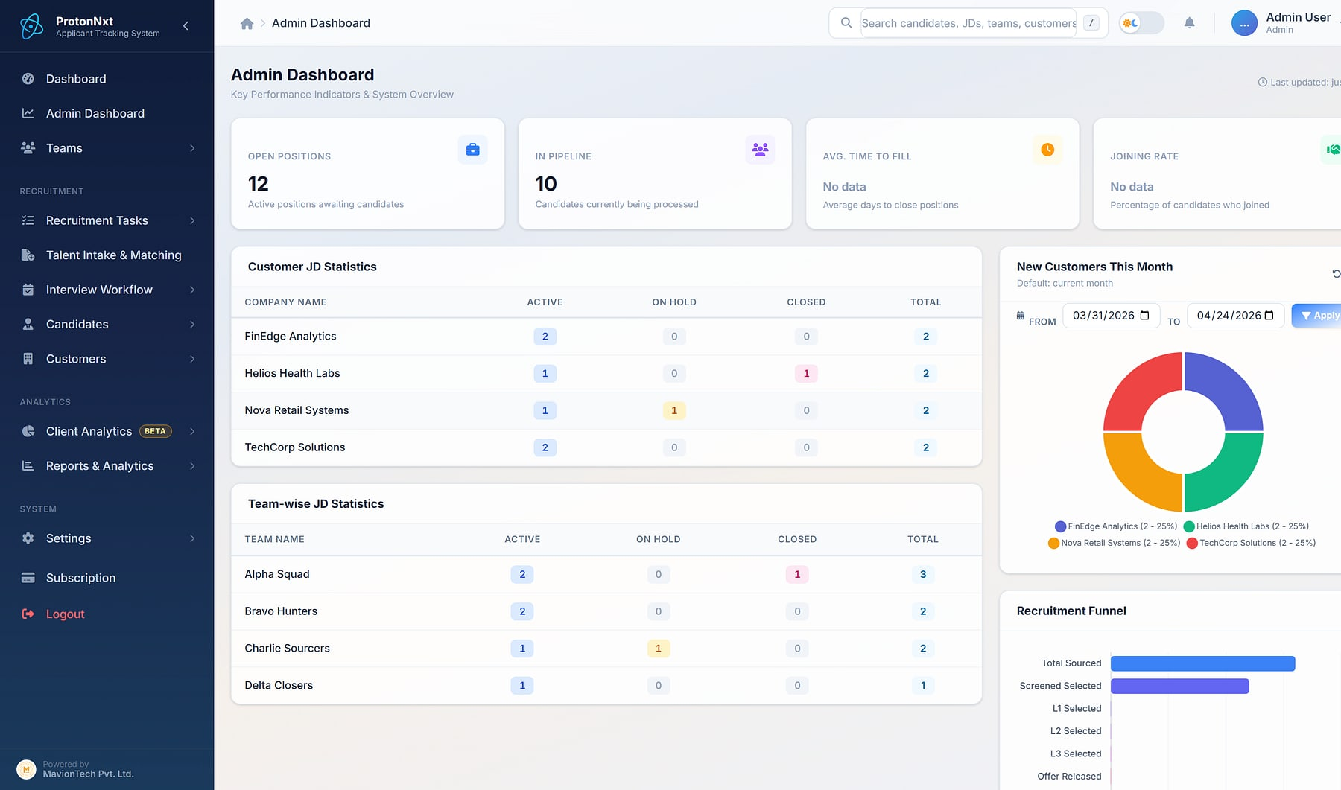
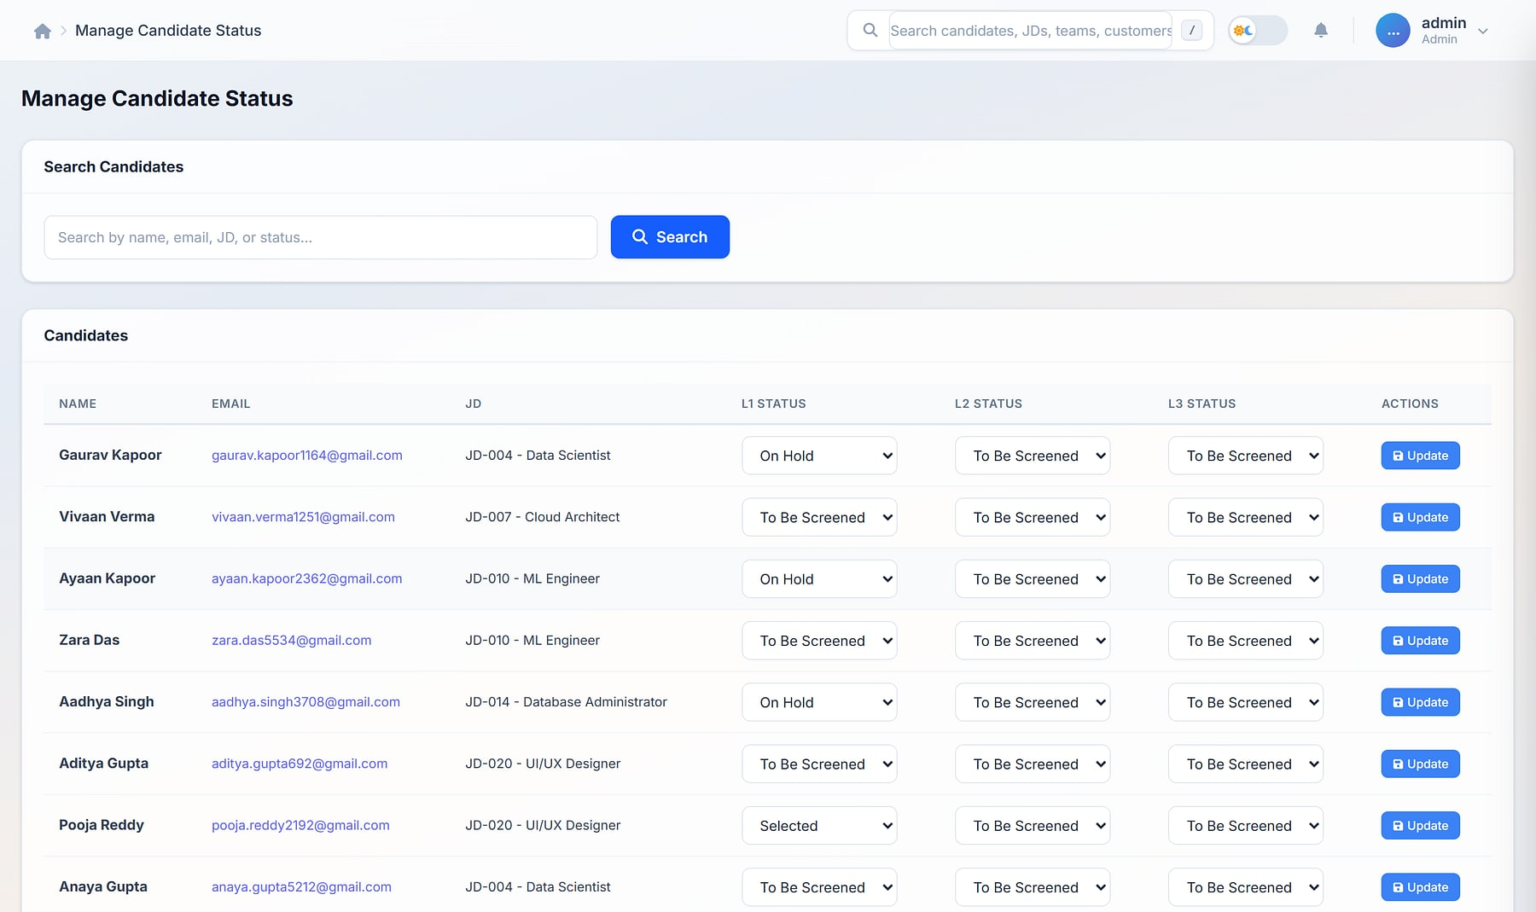
ProtonNxt
ProtonNxt · Admin dashboard
ENTERPRISE SALES OVERVIEW
ENTERPRISE APPLICANT TRACKING
From requisition to hire, in one structured pipeline
A multi-tenant, AI-assisted ATS for recruitment firms and talent teams: sourcing, parsing, interviews, offers, client insight and a candidate portal.
15 modules
AI resume parsing
Isolated tenants
Notes:
Opening. ProtonNxt is MavionTech's multi-tenant applicant tracking system. All screens use a demo tenant (customers such as TechCorp Solutions and Nova Retail Systems are demo data).

Slide 2






Where hiring breaks down
THE CHALLENGE
Manual screening
Unclear ownership
Context lost in email
Recruiters read every resume by hand while volume keeps rising.
Nobody is sure who owns which requisition, so idle JDs go unnoticed.
Interview feedback and offers live in inboxes and attachments.
Improvised metrics
No client insight
Ungoverned agencies
Monday reviews start with someone rebuilding numbers in a spreadsheet.
Recruitment firms can't see which clients are growing and which are slipping.
Vendor CVs arrive as forwarded email with no caps, duplicates or audit.
Notes:
The six recurring problems in recruitment operations. Each maps to a ProtonNxt module later in the deck.

Slide 3





Recruiters, administrators and candidates on one system
ONE PLATFORM, THREE EXPERIENCES
Recruiter workspace
Tenant administration
Candidate & partner surfaces
Requisitions, intake and tracking
Interviews, offers and joining
Reports and client analytics
Users, roles and teams
Custom candidate schema
Subscription, sessions and notifications
Branded careers URL
Invite-based uploads and vendor portal
Candidate portal across employers
Faster time-to-hire
Enterprise multi-tenancy
Decision-ready analytics
AI parsing, single-page intake and structured interview cadence.
Isolated tenant databases, roles and audit-ready operations.
Reports, executive summaries and client engagement scoring.
Notes:
Three surfaces designed together, and the three outcomes every tenant gets.

Slide 4


Built for every role in a recruiting operation
WHO USES PROTONNXT
Super user & admin
Team lead
Recruiter
Configure the tenant: users, roles, schema, subscription.
Owns a team, assigns requisitions and watches workload.
Sources, screens, schedules interviews and moves candidates.
Leadership
Vendor (agency) users
Candidates
Reads reports, executive summaries and client analytics.
Submit candidates to published JDs through their own login.
Apply, upload once and track status across employers.
Notes:
Roles: SuperUser, Admin, Team Lead and User; vendor users (admin, recruiter, finance); and candidates via the public and portal surfaces.

Slide 5
Every step from requisition to joining, end to end
THE HIRING LIFECYCLE
MODULE 01
MODULE 02 · 13
MODULE 03
MODULE 04 · 05
MODULE 07 · 14
MODULE 08
Requisition
Source
Intake & parse
Track
Interview
Offer & join
JD with SPOC, skills, CTC and positions
Careers URL, invite links, vendors
Bulk upload, AI parsing, dedupe
Pipeline, owner and next action
L1 / L2 / L3 with calendar and video
CTC structure and joining lifecycle
RUNNING UNDERNEATH EVERY STEP
Team collaboration (06)
Reports & analytics (10)
Client analytics (11)
Settings & admin (12)
Mobile app (15)
Notes:
The lifecycle with module numbers. Intake and parsing is highlighted because it is where recruiters save the most time.

Slide 6

Fifteen modules, every one included in every tenant
PRODUCT MAP
Hiring pipeline
Operations
External access
Analytics
Governance
6 modules
4 modules
2 modules
2 modules
1 module
01 Job requisitions
02 Candidate sourcing
03 Talent intake & matching
04 Applicant tracking
07 Interview workflow
08 Offer management
05 JD assignment
06 Team collaboration
14 Calendar & video
15 Mobile recruiter app
09 Careers URL & candidate portal
13 Vendor management
10 Reports & analytics
11 Client engagement analytics (beta)
12 Settings, admin & custom schema
No add-ons: every module ships to every tenant from day one. Client engagement analytics is in beta.
Notes:
The full module map. Modules 13–15 (vendor, calendar & video, mobile) were the 'latest additions' in the original deck and are now part of the main flow.

Slide 7
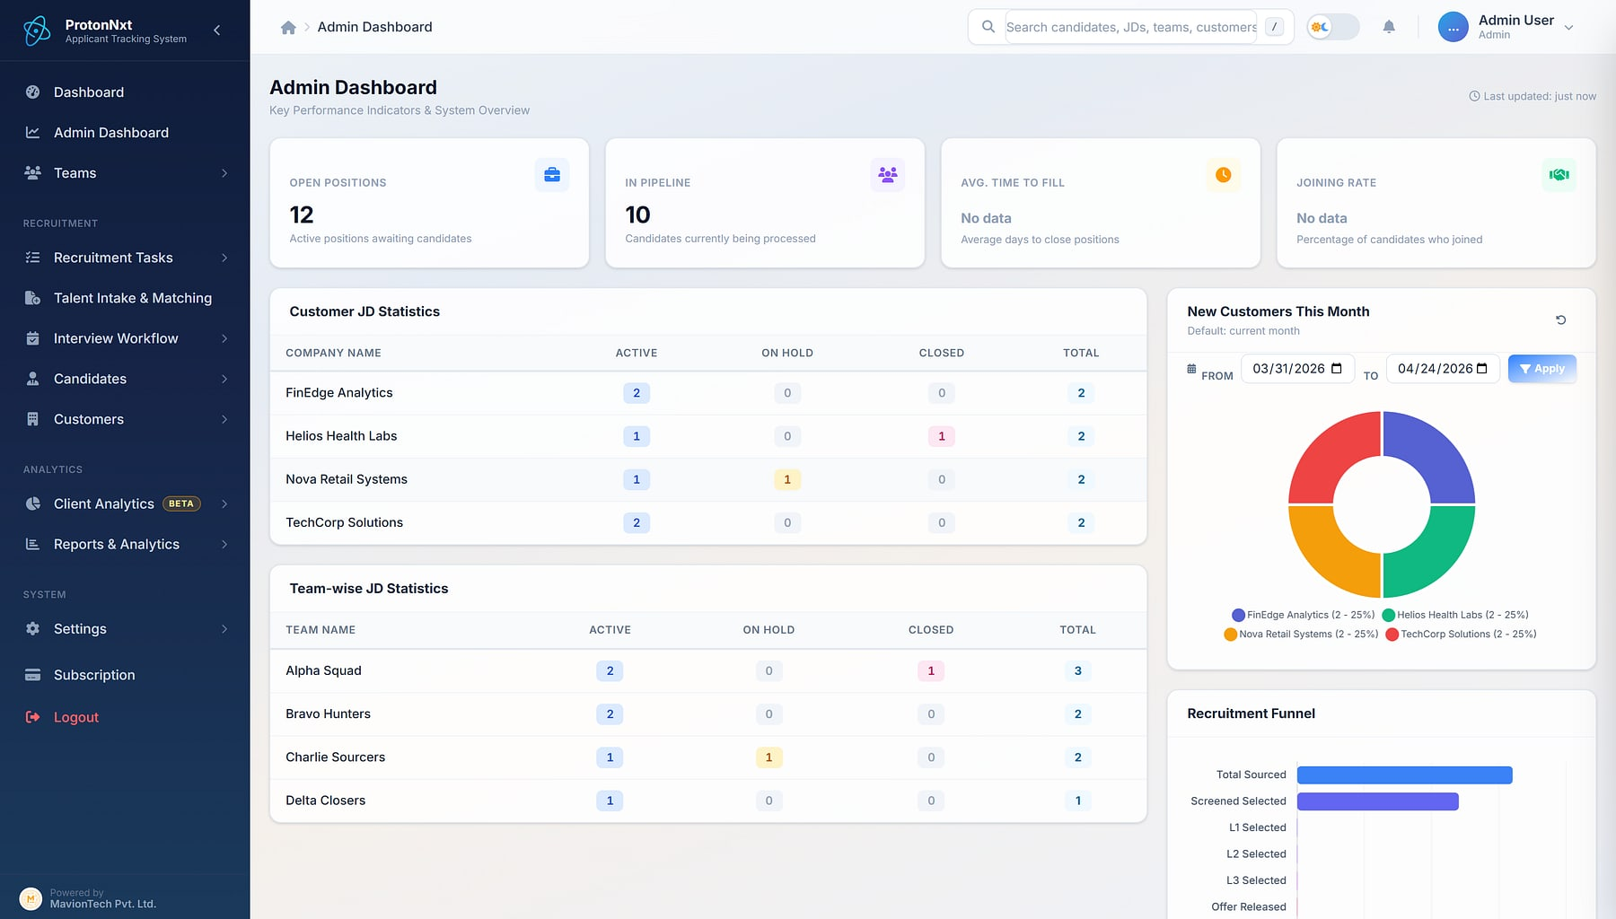



Pipeline health in one glance
ADMIN DASHBOARD
ProtonNxt · Admin dashboard
KPI tiles
Open positions, pipeline, time to fill and joining rate.
Customer JD statistics
Active, on-hold and closed requisitions per client.
Recruitment funnel
Candidates by stage across the tenant.
Idle-JD alerts
Requisitions nobody is working surface automatically.
Admin dashboard: KPI tiles, customer JD statistics, new customers and the recruitment funnel (demo data).
Notes:
Every tenant admin lands here after login. Team-wise contribution and workload views sit further down the same page.

Slide 8

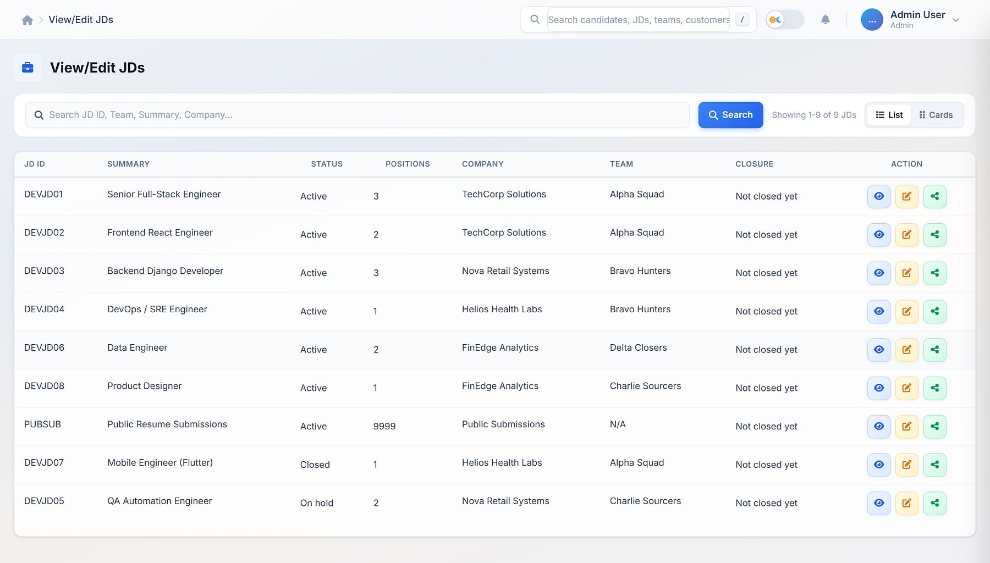


Requisitions that act as contracts, not spreadsheet rows
JOB REQUISITIONS
Skills framing
View / edit JDs
Must-have and good-to-have skills on every JD.
Customer SPOC
SPOC name and email for customer-side updates.
Positions and budget
Positions, budget CTC and experience bands.
Lifecycle
Active, on hold or closed, with team and recruiter assignment.
Job descriptions: status, positions, company and team per requisition (demo data).
Notes:
Requisitions become a contract between recruiter, hiring lead and the platform.

Slide 9
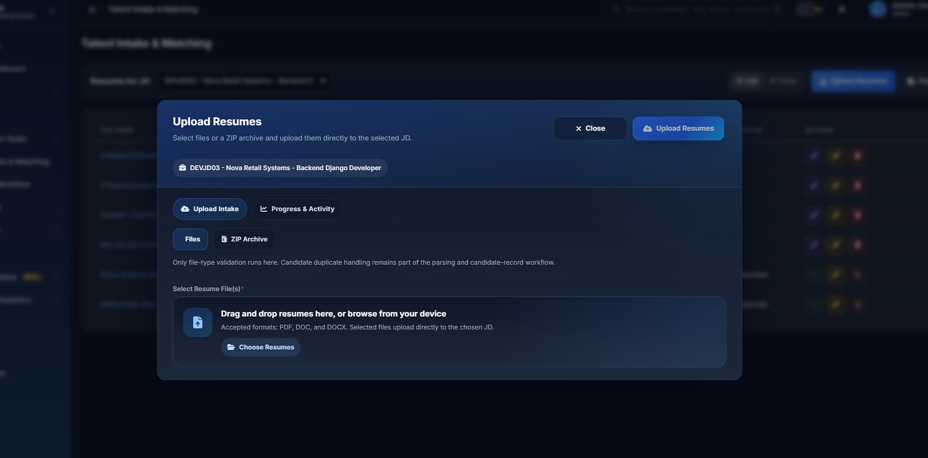



Every channel into one pipeline, parsed by AI
SOURCING & INTAKE
Talent intake & matching
Branded careers URL
A tenant-scoped public submission page per tenant.
Invite-based upload
Signed per-JD links for candidates and partners.
AI parsing, your choice
OpenAI or Gemini parsing, with manual override.
Dedupe where it matters
Duplicates caught when the candidate is saved.
Upload resumes: single files, multiple files or a ZIP archive, scoped to the target JD.
Public submissions are auto-assigned to active JDs by AI; unclaimed profiles route to a generic pool. Existing candidates can be attached to a new JD without re-parsing.
Notes:
Recruiters upload PDF, DOC or DOCX singly, in batches or as a ZIP. Batches are tracked per row. Parsing uses OpenAI or Gemini with manual override.

Slide 10

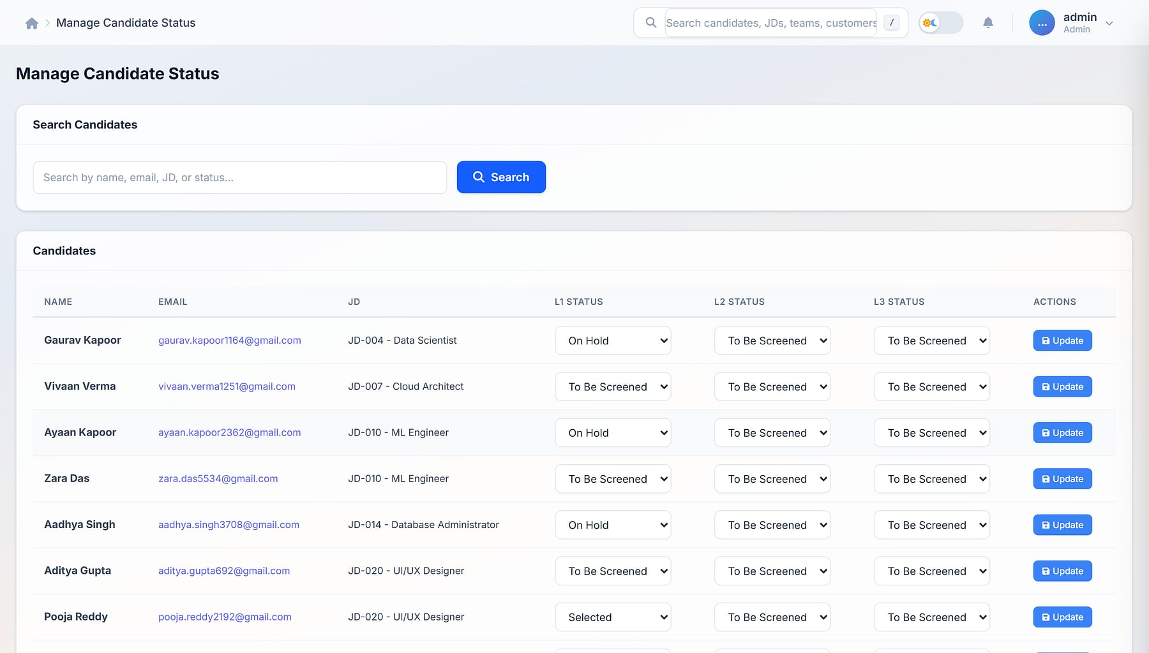
The pipeline always tells the truth
APPLICANT TRACKING
Every stage visible
Manage candidate status
Screening, L1 / L2 / L3 outcomes, offer and joining status.
Clear ownership
Recruiter and HR owner on every candidate.
Activity log
Notes, feedback and status moves, kept on the record.
Reports from the same data
Conversion reports one click away.
Candidate status: L1, L2 and L3 status per candidate and JD (demo data).
Notes:
Pipeline, muster and finalised-candidate views share one record per candidate.

Slide 11
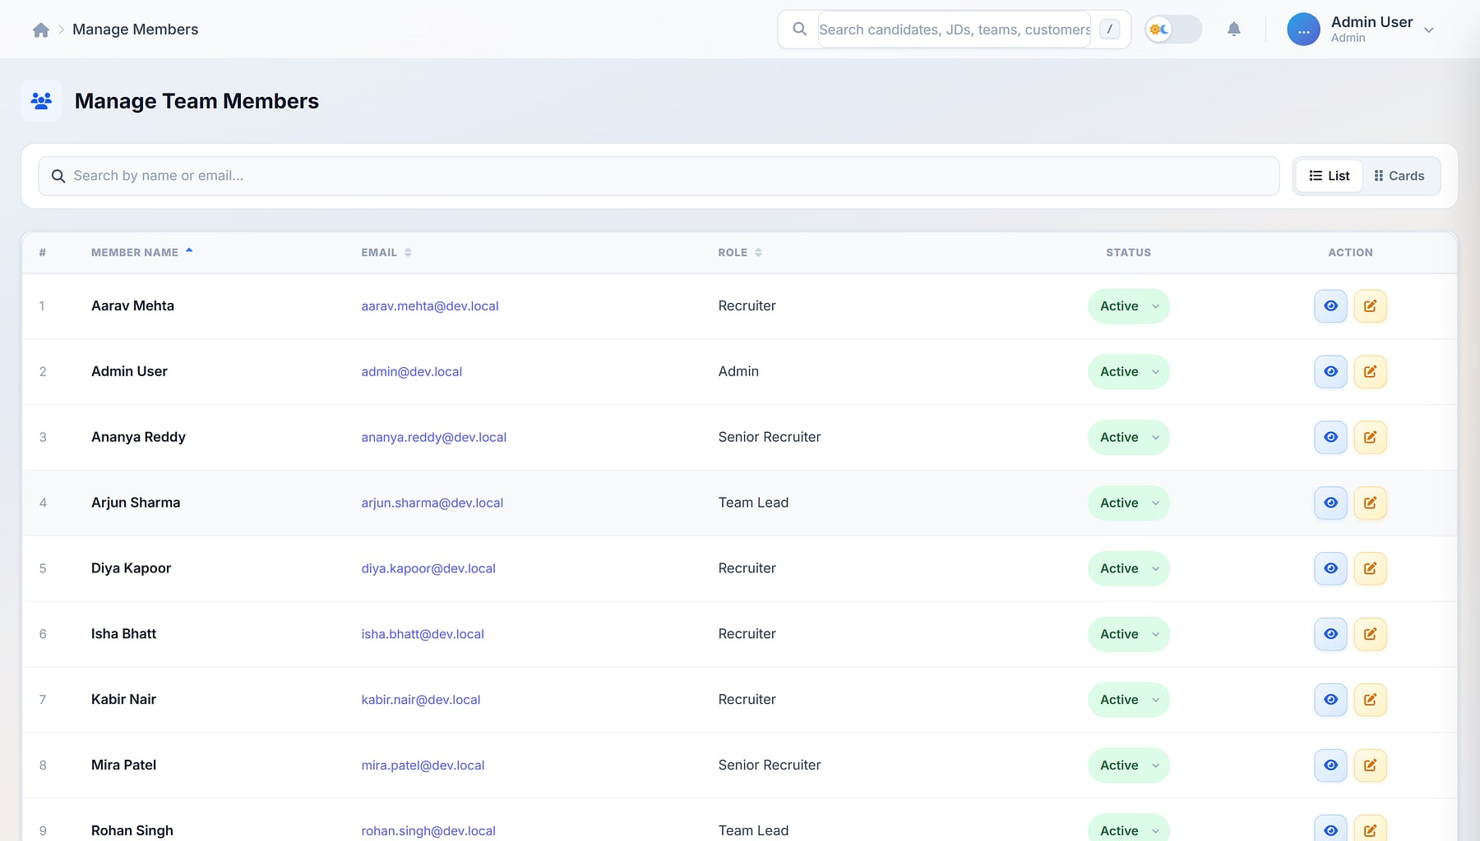
Ownership made explicit, teams working in one context
ASSIGNMENT & COLLABORATION
Manage team members
Teams and roles
Team leads, members and roles: SuperUser, Admin, Team Lead, User.
JD assignment
Assign each requisition to recruiters or teams, with multi-recruiter coverage.
Visible load
Active-JD counts per recruiter and assignment-driven reports.
Real-time notifications
Live updates pushed over WebSockets.
Team members: roles, status and actions (demo data).
Notes:
Structured assignment removes tribal knowledge about who owns what. Each user can be signed in on web and mobile, with sessions governed from settings.

Slide 12




Structured interviews on a real calendar
INTERVIEWS, CALENDAR & VIDEO
1 Schedule L1 / L2 / L3
2 Create meeting
3 Invite & remind
4 Interview
5 Outcome synced
Per-recruiter calendar
One-click video
Invites and ICS files
Outcome sync
Scheduling, rescheduling and progression gates between levels.
MavionMeet meetings with auto-generated guest join links.
Automatic candidate and panel invites, calendar files and reminders.
Started, ended, recorded and minutes flow back to the record.
Every interview records interviewer, type, location, status and structured feedback, visible in the pipeline and reports instantly.
Notes:
Encrypted per-recruiter keys and hourly reconciliation mean no outcome is lost. Screens for the calendar and video module still need to be captured.

Slide 13
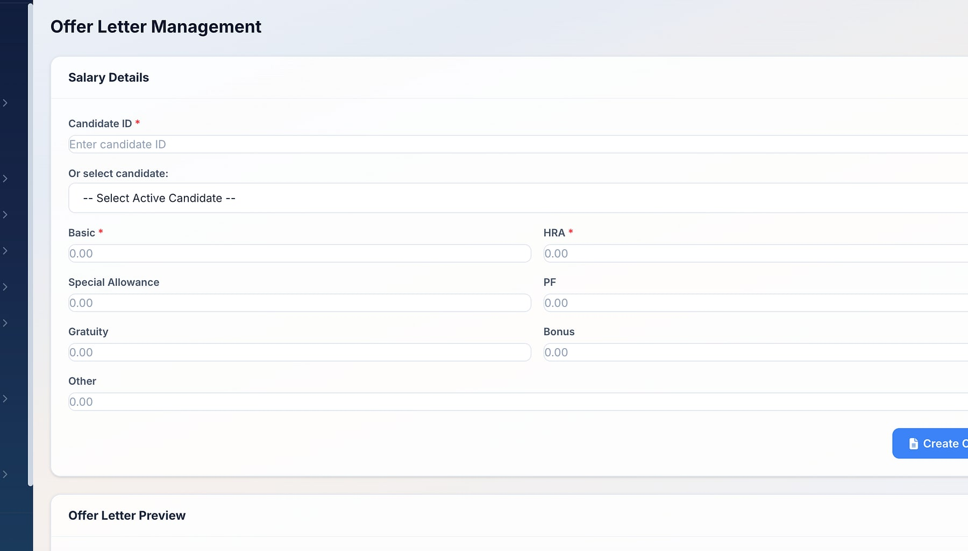
Offers that convert to joiners
OFFER MANAGEMENT
Structured CTC
Offer letter management
Basic, HRA, special allowance, PF, gratuity, bonus and other.
Total CTC calculated
Components aggregate automatically.
Joining date
Captured at offer time.
Offer lifecycle
Accepted, declined, released and joined, visible in reports.
Offer letter management: salary details per candidate.
Notes:
Offers move out of email attachments and into the pipeline as a first-class record.

Slide 14

Bring staffing agencies inside the process
VENDOR MANAGEMENT
1 Invite agency
2 Publish JD with caps
3 Vendor submits
4 Review & accept
5 Contract & payment
Vendor users & roles
Per-vendor caps
Duplicate protection
Isolated by default
Admin, recruiter and finance roles for each agency.
Publish specific requisitions to selected vendors, with limits.
Vendor submissions land in your pipeline, deduplicated.
Separate vendor login with JWT, deny-by-default; nothing leaks across tenants.
Contracts, invoices and payments are tracked with each vendor, so the agency channel becomes measurable.
Notes:
Vendor management was added after the original deck's main section. Its screens still need to be captured; the workflow is from the product documentation.

Slide 15




One candidate login across every employer
CANDIDATE PORTAL
One login, every employer
All applications, one screen
A single portal account works across every tenant using ProtonNxt.
Active and closed applications across every employer.
Status in near real time
Upload once, fan out
When a recruiter moves a candidate to L2, the portal updates within seconds.
A resume uploaded once is delivered to every tenant applied to.
Notes:
Platform-level candidate identity across tenants. The original portal screenshot showed a real person's details and is not used; a demo capture is needed.

Slide 16
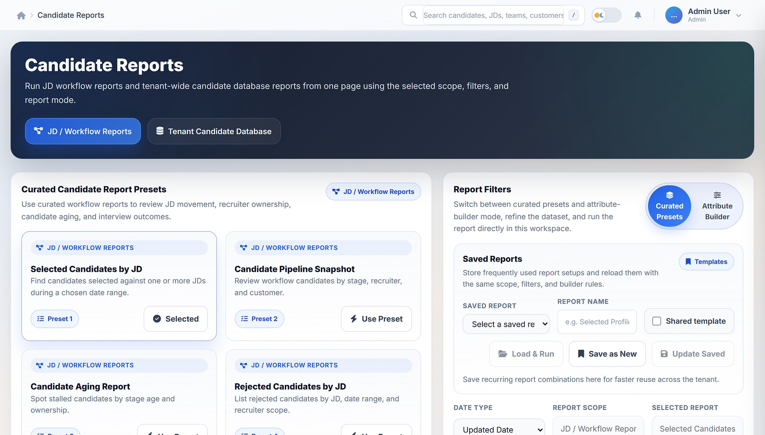



Reporting leadership relies on
REPORTS & ANALYTICS
Candidate reports
Eight curated presets
Selected, pipeline, aging, rejected, interview outcome, inventory, talent pool, freshness.
Two scopes
JD / workflow reports or the tenant-wide candidate database.
Saved templates
Personal or shared with admins.
Enterprise XLSX
Title banner, metadata, summary and applied filters in every export.
Candidate reports: curated presets, report filters and saved reports (demo data).
Notes:
Role-aware filters by customer, JD, team, recruiter, status, experience and location. Team, task-progress, status and conversion reports complete the set.

Slide 17
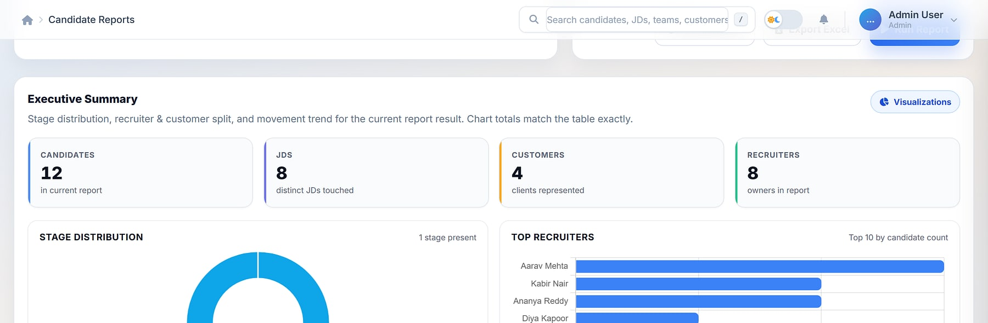
One-screen answers that always match the table
EXECUTIVE SUMMARY
Candidate reports · Executive summary
1
2
3
4
1
Tile strip: candidates, JDs, customers, recruiters
2
Stage distribution donut
3
Top recruiters and top customers (top 10)
4
Totals always equal the table's row count
Notes:
Every report run also produces chart summaries over the same filtered dataset, so the numbers can't drift from the table below. Names shown are demo users and demo customers.

Slide 18

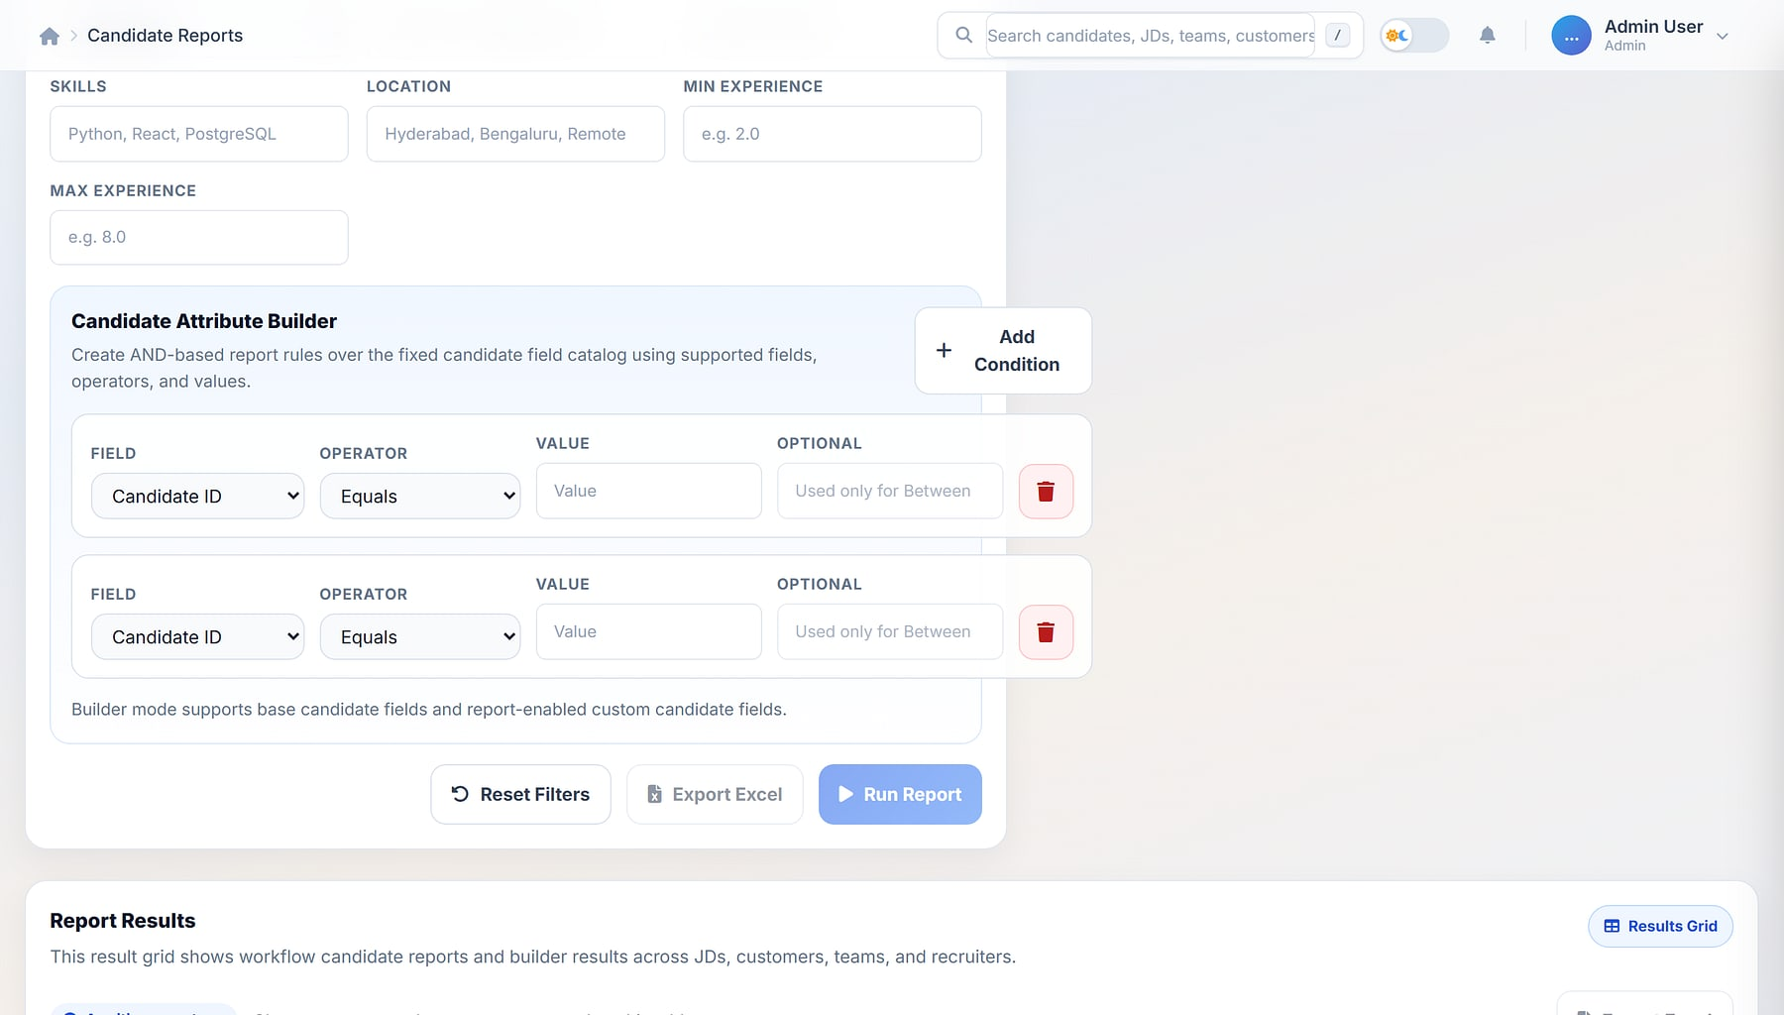
Turn the talent pool into a searchable asset
SEARCH & BUILDER
Skill search
Candidate reports · Builder
Stacked skill queries across parsed resumes and searchable custom fields.
Attribute builder
AND-logic reports on a validated field, operator and value catalog.
Reuse, don't re-parse
Attach an existing candidate to a new JD without a duplicate.
Leadership packs
Excel with a report-context sheet for reviews.
Candidate attribute builder: fields, operators and values with safe, role-aware results.
Notes:
The validated catalog prevents bad queries; custom candidate fields can opt in to reports and search.

Slide 19
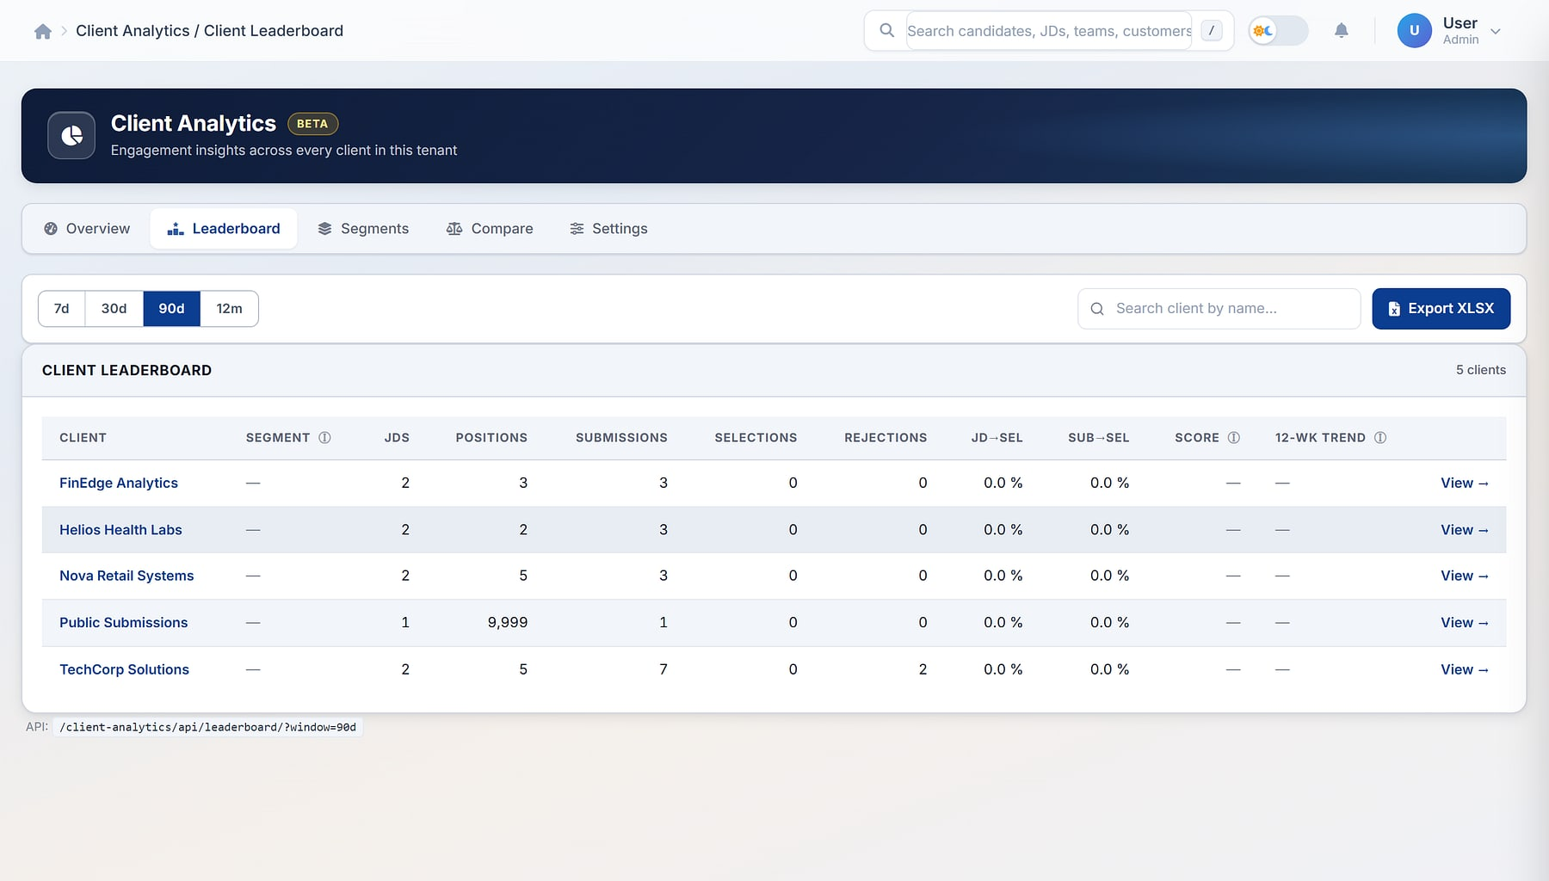

Know which clients to grow and which are slipping
CLIENT ENGAGEMENT ANALYTICS · BETA
Client analytics · Leaderboard
Engagement score
Volume + conversion + velocity + consistency, minus a rejection penalty.
Seven segments
Premium, growth, active, dormant, backbench, risky, high rejection.
Leaderboard & trends
Score bars, 12-week sparklines and top movers.
Explainable
Every segment pill shows the rule that fired.
Client leaderboard: engagement scores and pipeline counts per client (demo data).
Notes:
A tenant-admin module. Scores refresh on a schedule or on demand. Labelled beta in the product.

Slide 20
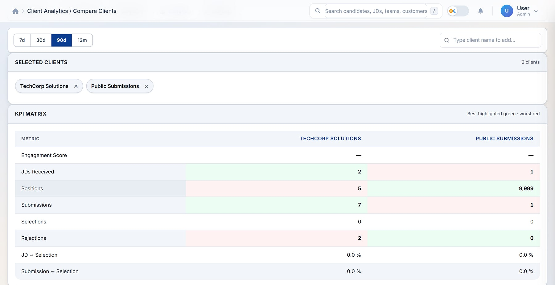
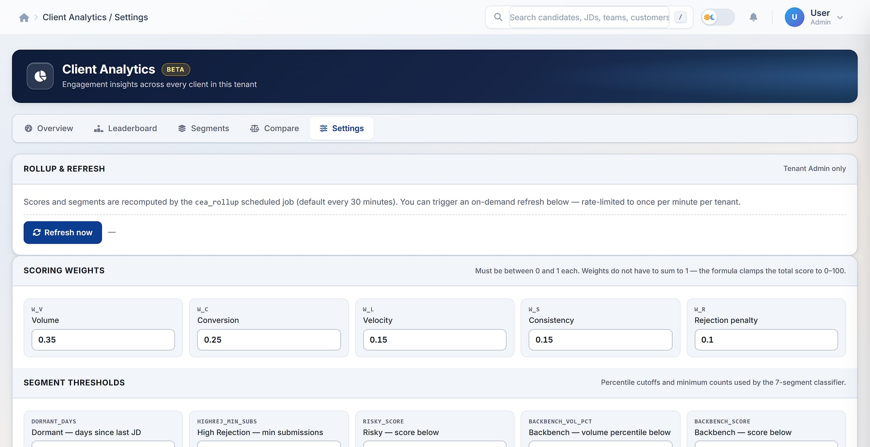


Compare clients and share evidence safely
COMPARE & TUNE
Compare up to 10 clients: KPI matrix and engagement radar (demo data).
Settings: tunable scoring weights and segment thresholds per tenant.
5-axis comparison
Tunable rules
Signed snapshots
Audited & accessible
Volume, conversion, velocity, consistency, low rejection.
Each tenant defines its own 'premium'.
Read-only links, 7-day expiry, no login.
Append-only audit; WCAG 2.1 AA.
Notes:
HMAC-signed share URLs let admins share evidence outside the ATS safely. Exports include summary, leaderboard and about sheets.

Slide 21





Hiring keeps moving between meetings
MOBILE RECRUITER APP
Today dashboard
Pipeline in your pocket
Act on the move
Interviews, approvals, agenda and company KPIs at a glance.
Candidates, JDs, interviews and search with fast pagination.
Advance, hold or reject; call, WhatsApp or share a CV; record results.
Secure by design
Offline-aware
Push notifications
Biometric app lock and secure token authentication.
Light and dark themes; works through patchy connections.
Real-time alerts with one governed login across web and mobile.
Notes:
Mobile app screens still need to be captured; the platform (iOS / Android) is to be confirmed.

Slide 22
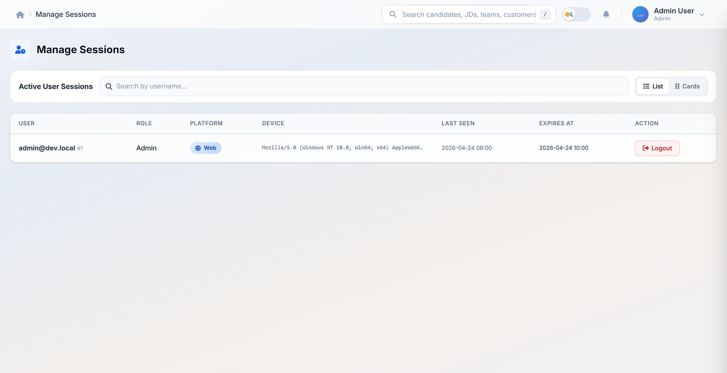
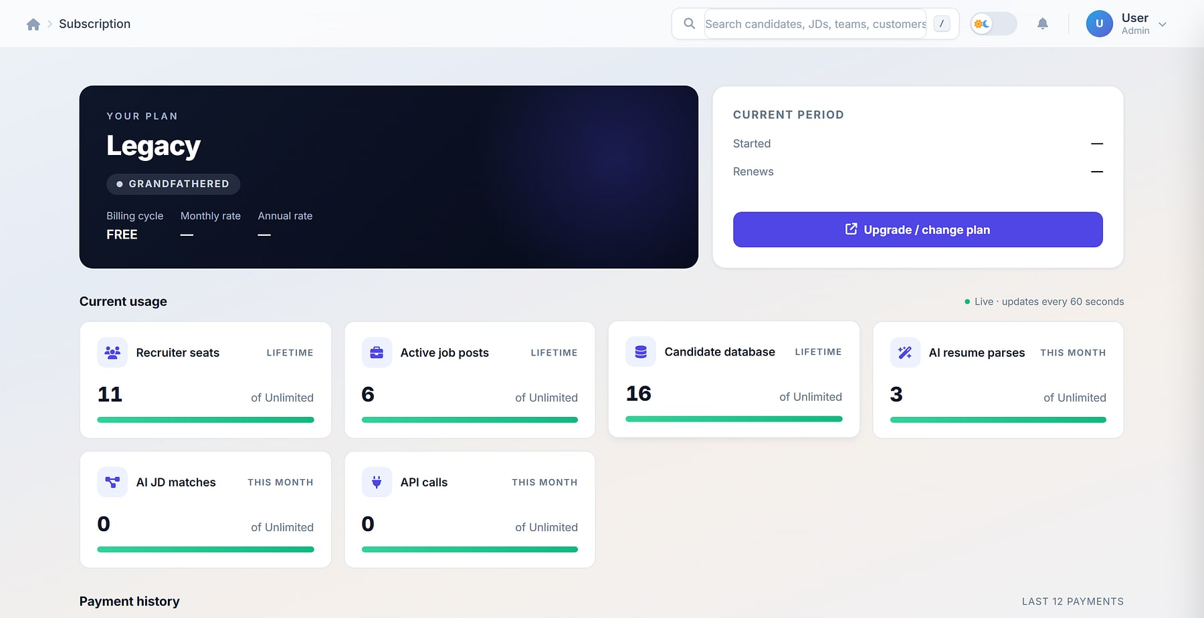
Administrators in control, without engineering tickets
SETTINGS & ADMINISTRATION
Session management: active web and mobile sessions with forced logout.
Subscription & billing: plan, usage against limits and payment history.
Users, roles, permissions
Notifications & email
Razorpay billing
Branding & toggles
Active and inactive status per user.
Email configuration per tenant.
Subscription lifecycle inside the ATS.
Tenant branding and module toggles.
Notes:
Administrators shape, secure and operate the tenant themselves.

Slide 23
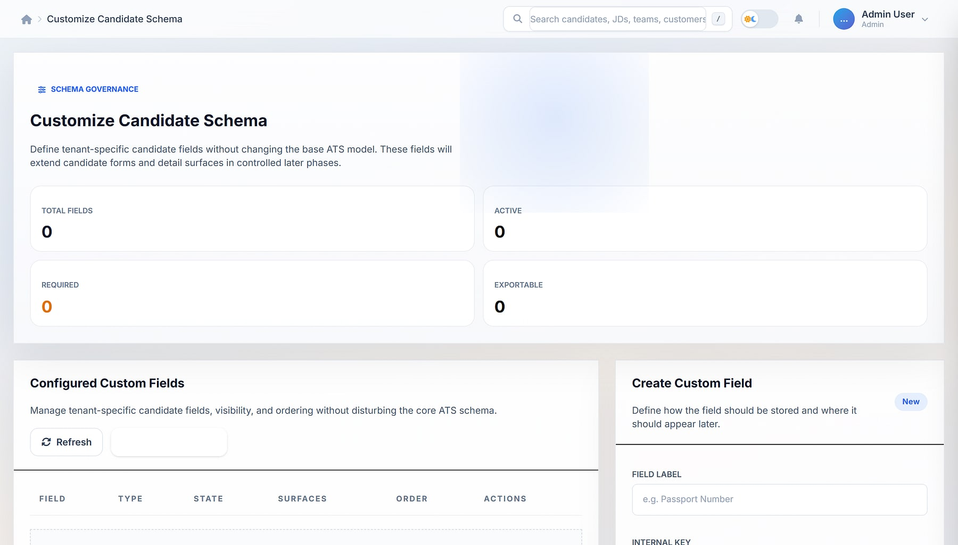


Your hiring model, without code
CUSTOM CANDIDATE SCHEMA
Customize candidate schema
Nine field types
Text, number, date/time, boolean, select, multi-select, email, phone, URL.
Four visibility toggles
Show in detail, exports, search and reports.
Safe changes
Reorder, activate or deactivate without data loss.
Tenant-scoped
Strict isolation; no cross-tenant bleed.
Customize candidate schema: configured fields and the create-field form.
Notes:
Custom fields render across the create, profile and finalised views. One product, many tenant-specific hiring models.

Slide 24
Multi-tenant by design, secure by default
ARCHITECTURE
SURFACES
APPLICATION
DATA
INTEGRATIONS
Recruiter web app
Teams, pipeline, reports
Tenant A · isolated MySQL
OpenAI · Gemini
Resume parsing
1
Role-aware access
Mobile recruiter app
Token auth, biometric lock
2
Real-time layer (WebSockets)
Tenant B · isolated MySQL
MavionMeet
Video interviews
3
AI parsing (OpenAI · Gemini)
Vendor portal
Separate login · JWT
One database per tenant
Razorpay
Subscriptions
4
Append-only audit logs
Careers URL & portal
Public submission, candidate identity
Platform candidate identity
Shared portal login across tenants
Email · ICS
Invites & calendars
5
HMAC-signed share links
No shared tables and no retrofitted multi-tenancy: each tenant runs on its own isolated database.
Notes:
Database-per-tenant isolation, a Channels + Redis real-time layer, JWT for vendors, HMAC-signed URLs, append-only audit and session governance. The candidate identity is platform-level so one candidate login works across tenants.

Slide 25


Connects to how your team already works
INTEGRATIONS
OpenAI
Google Gemini
MavionMeet
Razorpay
Resume parsing
Alternative parsing path
One-click video interviews
Subscription billing
Email
ICS calendars
Excel (XLSX)
WhatsApp & calls
Per-tenant email configuration
Invites for candidates and panels
Enterprise exports everywhere
Contact candidates from mobile
Parsing is pluggable, with no lock-in to a single AI provider, and a manual override is always available.
Notes:
Job boards and LinkedIn are listed on maviontech.com but not in the product deck; confirm before presenting them.

Slide 26







Eight reasons recruitment teams choose ProtonNxt
WHY PROTONNXT
Multi-tenant by design
AI without lock-in
Tenant-defined schema
Reporting done right
Each tenant on an isolated database; no shared tables.
OpenAI and Gemini paths with manual override.
Extend the candidate record without forking the product.
Presets, builder, templates and executive summaries.
Client analytics
Candidate portal
Enterprise exports
Audit-ready operations
Scoring and segmentation show where to invest.
One login across every ProtonNxt tenant.
Styled multi-sheet XLSX, not raw CSV.
Append-only audit, sessions and subscription governance.
Notes:
The eight USPs, each shown earlier in the deck. The original 'beats every ATS you have evaluated' claim is not used.

Slide 27

Let's build your next hire, together
LET'S GET STARTED
MavionTech Pvt. Ltd.
ProtonNxt · Enterprise ATS
communications@maviontech.com
+91 91580 08002
www.maviontech.com
505 Zen Business Center, Bhumkar Chowk, Wakad, Pune, Maharashtra 411057
Book a walkthrough on your own requisitions, then pilot ProtonNxt with one team.
Book a demo
Plan a pilot
Notes:
One ask: a walkthrough, then a single-team pilot. Official MavionTech contact details. Product domains (protonnxt.com) to be confirmed before adding.

