Slide 1

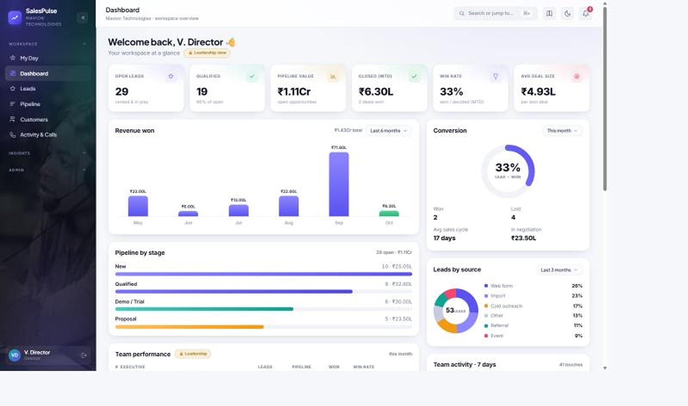
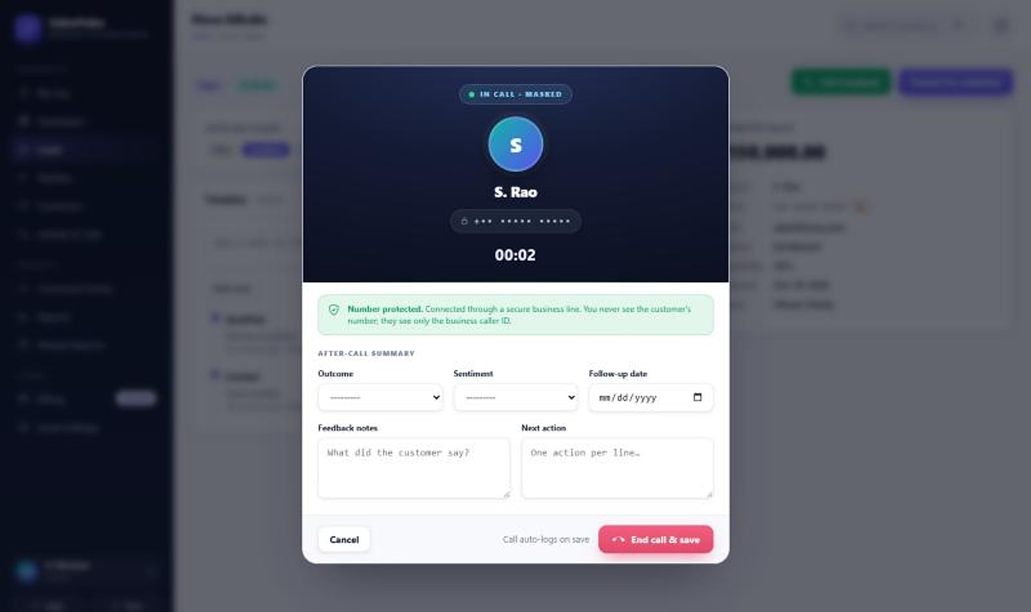
SalesPulse CRM
SalesPulse · Director dashboard
ENTERPRISE SALES OVERVIEW
INDIA-FIRST SALES CRM
Your reps sell. Your customers' numbers stay yours.
A multi-tenant sales CRM with privacy-masked calling, a live pipeline and reports that build themselves, made for how Indian sales teams work.
Masked calling
Self-building reports
GST-ready billing
Notes:
Opening. SalesPulse CRM is a MavionTech product for Indian sales teams: INR, GST and Razorpay. Screens use a demo company (customers such as Orbit Retail and Riverstone Hotels are demo data).

Slide 2






Where CRMs let Indian sales teams down
THE PROBLEM
Customer data leaks
Spreadsheet busywork
No real-time visibility
Reps hold raw phone numbers, and contacts walk out with them.
Weekly numbers are re-typed by hand, and the data ends up inconsistent.
Leaders can't see the pipeline or rep performance when it matters.
Fragmented customer view
Billing and GST chaos
Not built for India
Accounts, calls and history scattered across disconnected tools.
Manual invoicing that global tools weren't built for.
Global CRMs are heavy, costly and a poor fit for Indian teams.
Notes:
The six recurring failures of generic CRMs. The original deck's '5+ hours lost per rep' figure is not used because it is unsourced.

Slide 3

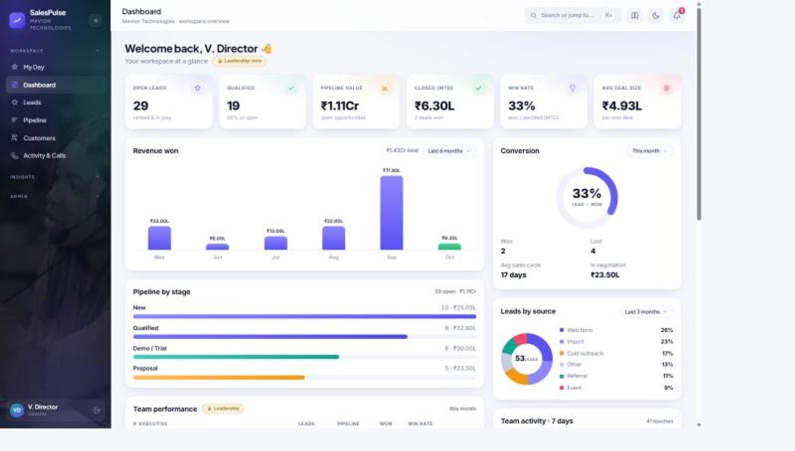



One command center, built the way India sells
THE SOLUTION
Capture
SalesPulse · Dashboard
Leads captured, qualified and deduplicated in moments.
Protect
Masked calling, email and WhatsApp: reps never see raw contact details.
Run
A weighted pipeline and a daily queue that tells every rep who to call.
Report
Command center, report builder and weekly reports that fill themselves.
Director dashboard: open pipeline, closed value, conversion and leads by source (demo data).
Notes:
Capture, protect, run, report: the four jobs SalesPulse does for a sales organisation.

Slide 4




Four roles, each seeing exactly what it should
WHO USES SALESPULSE
BDE (sales rep)
Manager
Director
Admin
Works the daily queue, calls through masked lines, logs outcomes. Sees only their own leads and customers.
Coaches the team with talk-time, outcomes and RAG ratings; reviews weekly reports.
Runs the command center: org KPIs, closed-business trend and the leaderboard.
Manages users, roles, billing and settings; the only role with bulk exports.
Row-level access is enforced on the server, not just hidden on screen: every rep sees only their own leads and customers. Lead-list and report downloads are leadership-only.
Notes:
Role-based access: BDE, Manager, Director, Admin, with company-code login.

Slide 5




From the morning queue to the weekly report, with no re-typing
A REP'S DAY, END TO END
1
2
3
4
5
My Day queue
Masked call
Outcome logged
Follow-up
Weekly report
Highest-value, most-overdue actions first
One click; the number is never shown
Disposition, sentiment, next action
Email or WhatsApp from the lead, masked
Assembles itself from logged activity
Every call, email and WhatsApp message lands on the customer timeline automatically, so the activity journal, command center and weekly reports always reflect real work.
Notes:
The loop that removes manual reporting: the queue drives activity, activity is logged automatically, and reports are generated from it.

Slide 6

Fourteen modules in one sales command center
PRODUCT MAP
Sell
Engage
Lead
Protect & run
4 modules
3 modules
3 modules
4 modules
My Day
Leads
Pipeline
Customers & 360
Privacy-masked calling
Email & WhatsApp
Activity log & call journal
Command center
Report builder
Weekly reports
Data protection controls
Subscriptions & GST billing
Native Android app
Platform & multi-tenancy
Each company's data lives in its own database, and masking rules are enforced on the server for web, mobile and exports alike.
Notes:
Fourteen modules across four jobs. Masked calling is the flagship.

Slide 7
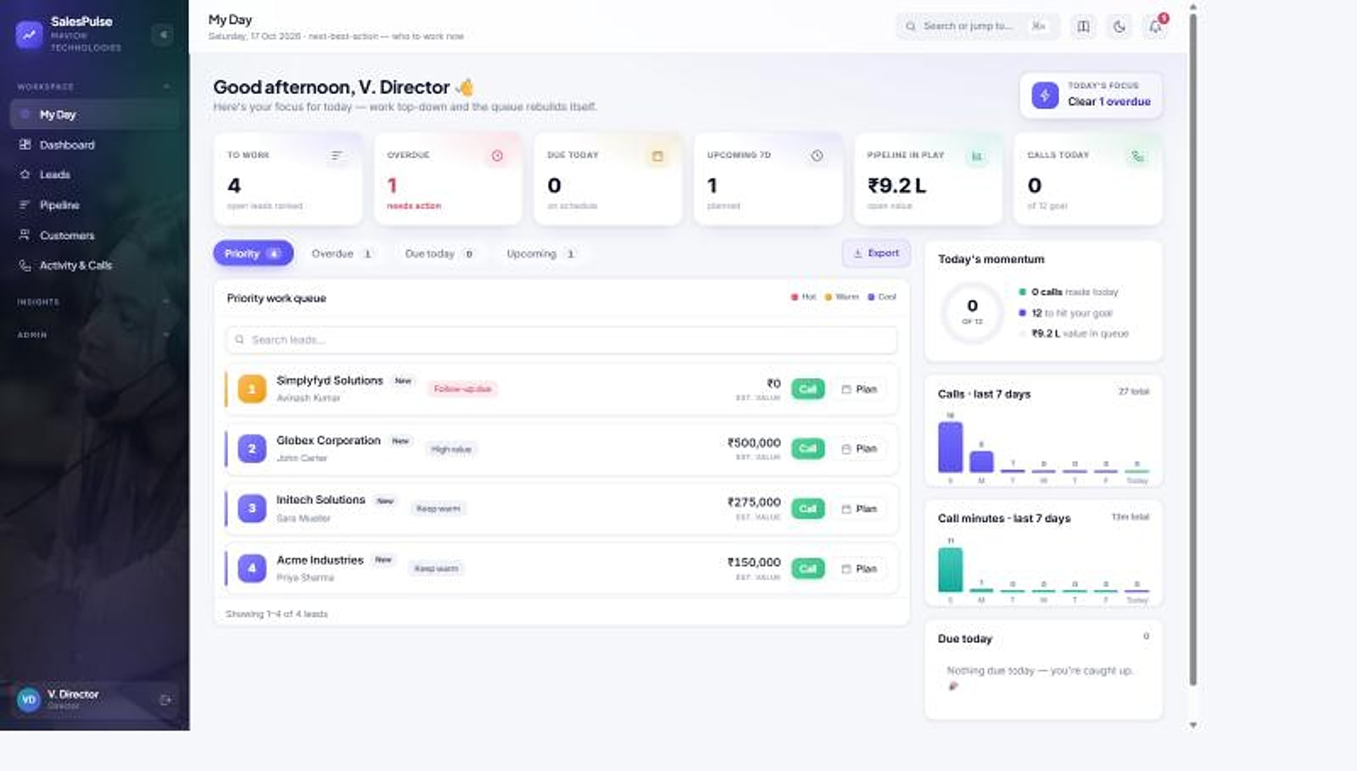



Every rep starts the day knowing exactly who to call
MY DAY
SalesPulse · My Day
Prioritised work queue
Highest-value, most-overdue actions surface first.
Follow-ups due today
Every promised call-back is front and centre.
Today's momentum
Calls, talk-time and pipeline at a glance.
More selling, less admin
Act on the queue instead of digging through lists.
My Day: KPI strip, priority work queue with one-click calling, and today's momentum (demo data).
Notes:
My Day turns the activity log into a daily action plan for each rep.

Slide 8
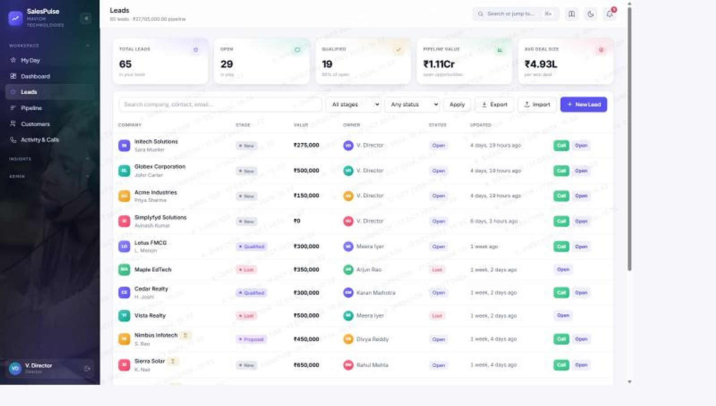


Capture and qualify leads at speed
LEAD MANAGEMENT
Fast capture & qualification
Leads
Owner, stage and status at a glance.
CSV import with dedupe
Bulk-import lists; duplicates caught on the way in.
Pipeline value in view
Total and per-stage value the moment a lead lands.
Call from the list
Masked calling straight from each lead.
Leads: pipeline totals, stage, owner and one-click call per lead (demo data).
Notes:
Clean, deduplicated leads with owners, stages and value, ready to work.

Slide 9
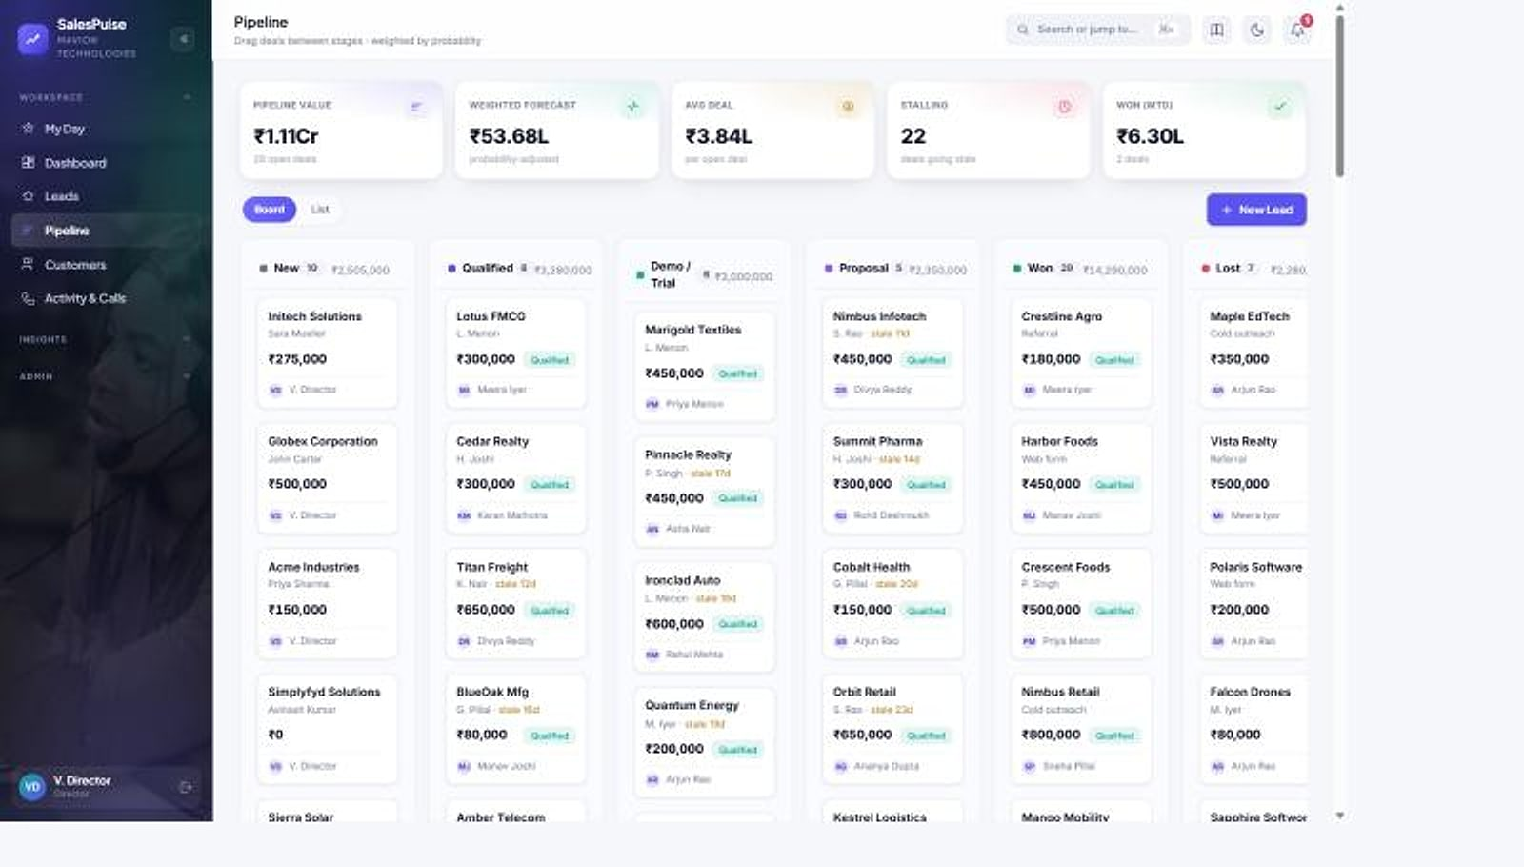
A weighted pipeline you can actually steer
PIPELINE
Pipeline
Drag-and-drop stages
Five weighted stages that reflect real close probability.
Stage aging
Spot deals going cold before they stall.
Weighted forecast
Values roll up into a number leadership can trust.
Pipeline: weighted Kanban across stages with totals per column (demo data).
Notes:
Drag-and-drop Kanban across five weighted stages, with aging on every card.

Slide 10

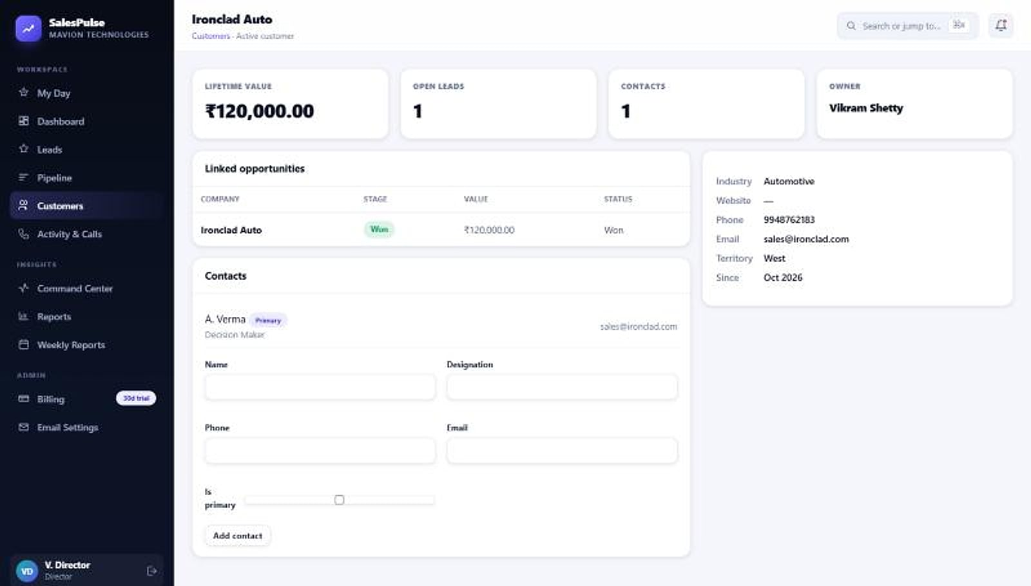


The whole relationship on one screen
CUSTOMER 360
Accounts & contacts
Customers · Ironclad Auto
Every person and opportunity tied to the account.
Interaction timeline
Calls, emails, demos and follow-ups in order.
Lifetime value
What each customer is worth and where to invest time.
Customer 360 (leadership view): lifetime value, linked opportunities and contacts (demo data).
Notes:
This is a Director's view. Reps see the same record with phone and email masked; the real values are used server-side only.

Slide 11
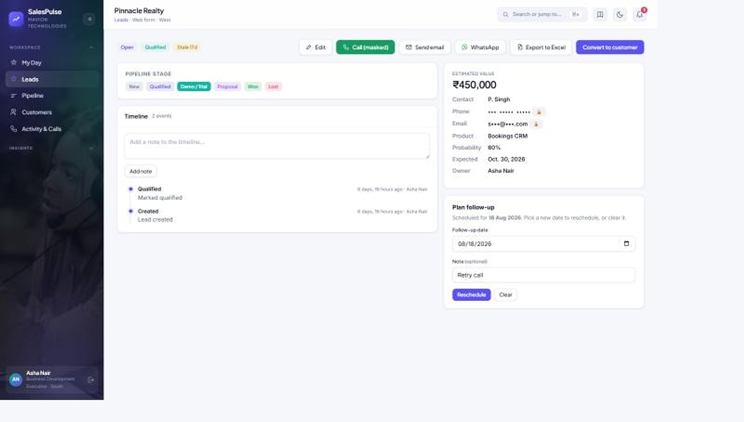


Your reps make the call. They never see the number
FLAGSHIP · PRIVACY-MASKED CALLING
Leads · Nova EdLabs
Numbers never exposed
Masked in the interface and on screen: nothing to copy or screenshot.
Masked both ways
Customers who call your business number reach their own rep, still masked.
No poaching, no leakage
Reps sell without ever owning the customer's contact details.
Lead record: masked phone and one-click 'Call (masked)' (demo data).
Notes:
The differentiator. Customer data leakage through reps is the risk SalesPulse removes structurally.

Slide 12

One business line, both directions, no personal numbers
HOW MASKING WORKS
OUTBOUND: REP CALLS CUSTOMER
Rep clicks Call
From the lead, queue or app
SalesPulse business line
Real number resolved server-side only
Customer
Sees only your business caller ID
INBOUND: CUSTOMER CALLS BACK
Customer calls
Your business number
Routed to the owning rep
Still masked, in both directions
Rep answers
Without seeing the number
Pay-as-you-go calling
Bring your own telephony
Same rule everywhere
₹0.50 per leg-minute, 30-second pulse.
Use SalesPulse calling or your existing provider.
Masked on web, mobile and exports, enforced on the server.
Notes:
Masking applies in both directions. Calling rates are as stated in the source deck; the telephony provider is to be confirmed.

Slide 13
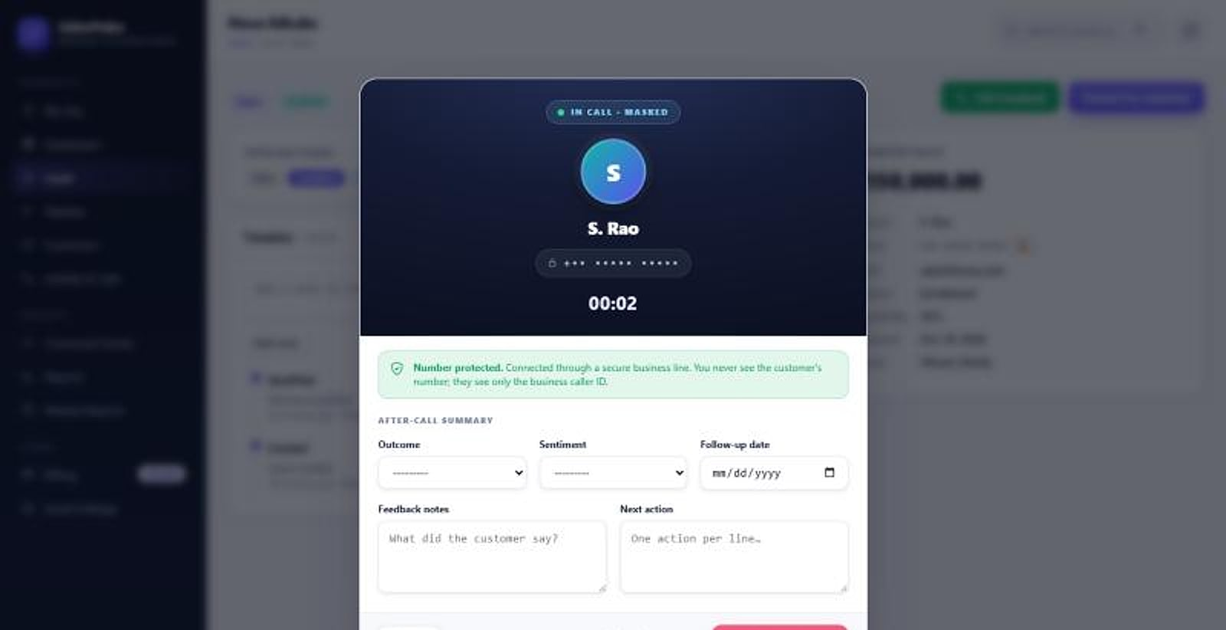


A dialer that protects the customer, and logs every call itself
IN THE CALL AND AFTER IT
In call: the number stays masked the whole time (demo data).
After the call: outcome, sentiment, feedback and next action.
One-click connect
Outcome & sentiment
Next action
Talk-time builds itself
Dial straight from the lead.
Recorded in seconds, in the dialer.
Saved to the timeline instantly.
No separate data entry.
Notes:
Live masked-call dialer and after-call summary, auto-logged to reports and the activity journal.

Slide 14


Every channel from the lead, masked and logged
EMAIL & WHATSAPP
Send as yourself
Cc your team
Designed signatures
Each rep sends from their own verified address, so mail lands in the inbox, with fallback to the company sender.
Cc a teammate in a click, but never a way to expose the masked address.
Full HTML signatures with logos and brand colours, preserved exactly.
WhatsApp Business
Masked, like calling
Logged automatically
Approved templates with product images, PDFs and brochures.
Reps write to a masked address; the real one is resolved server-side.
Every email and WhatsApp lands on the timeline and feeds reports.
Notes:
Email and WhatsApp screens still need to be captured; capabilities are from the product deck.

Slide 15
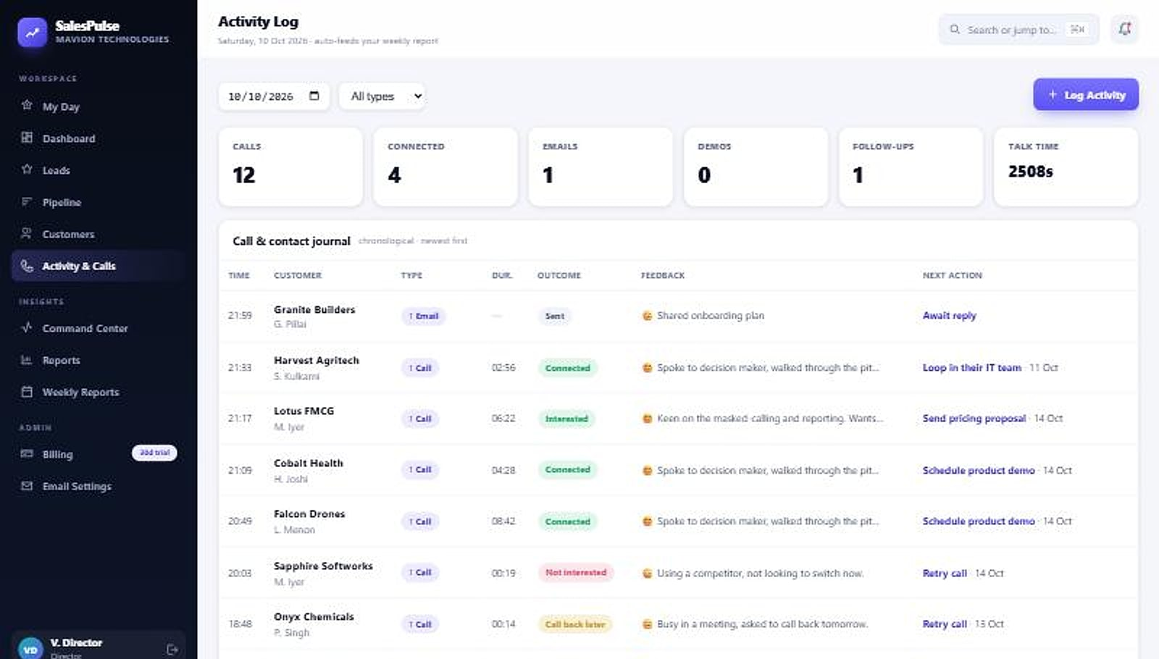
Every interaction, captured without the busywork
ACTIVITY LOG & CALL JOURNAL
One running record
Activity log
Calls, emails, demos and follow-ups.
Outcomes and sentiment
Structured fields, not just a list of events.
Talk-time totals
Effort is measurable, which makes coaching fair.
Activity log: calls, connected, demos, follow-ups and talk-time per day (demo data).
Notes:
The activity journal powers the command center and weekly reports automatically.

Slide 16
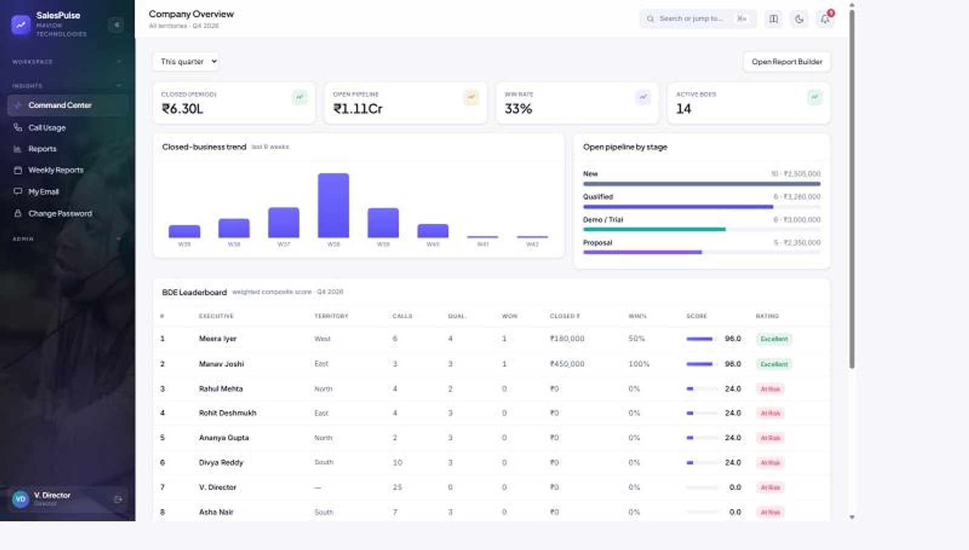

Real-time visibility into pipeline and people
LEADERSHIP COMMAND CENTER
Command center
Org KPIs
Closed business, open pipeline and win rate.
8-week trend
Closed business over time.
Live BDE leaderboard
Composite scoring ranks reps on what matters.
RAG ratings
Red, amber and green make coaching clear and fair.
Company overview: KPIs, closed-business trend, pipeline by stage and BDE leaderboard (demo data).
Notes:
Command center: org KPIs, the 8-week closed trend and a live leaderboard with composite scores and RAG ratings.

Slide 17
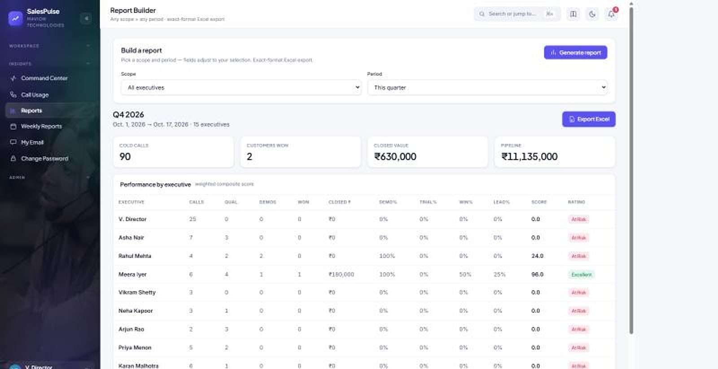
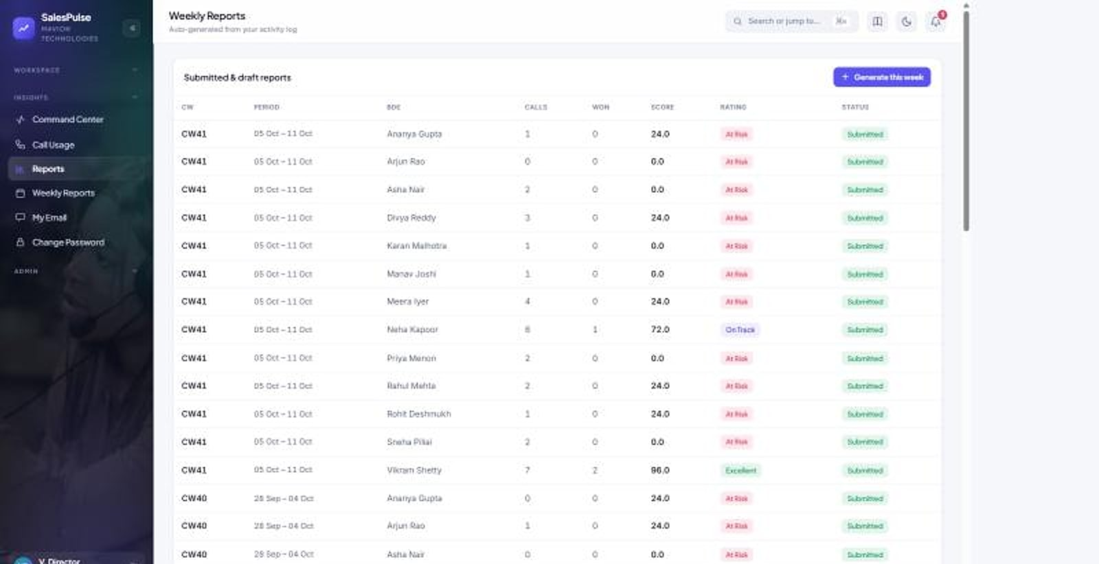
No more re-typing numbers into spreadsheets
REPORTS THAT BUILD THEMSELVES
Report builder: any scope and period, per-executive scores and ratings.
Weekly reports: generated from activity, scored and submitted.
Any scope, any period
Multi-sheet Excel
Scored and rated
Submit to leadership
All execs, chosen execs or a territory.
Summary plus monthly, weekly and daily sheets.
KPIs colour-coded by threshold.
One consistent report up the chain.
Notes:
The report builder exports a print-ready multi-sheet workbook; weekly reports assemble themselves from the activity log.

Slide 18






Your customer data can't walk out the door
DATA PROTECTION & INTEGRITY
Phone and email masked
No bulk export for reps
Row-level access
On web, mobile and exports; real values used server-side only.
Lead-list and report downloads are leadership-only.
Each rep sees only their own leads, enforced on the server.
Access log + anomaly alerts
Traceability watermark
Isolation & rate limits
Every view and export audited; abnormal volume flagged to admins.
Every screen stamped with viewer and time, so any leak is attributable.
Database per company and API rate limits stop bulk extraction.
Notes:
Defence in depth keeps the customer relationship with the business, not the individual rep. Screens for the access log and watermark still need to be captured.

Slide 19

The full command center in your rep's pocket
NATIVE ANDROID APP
My Day on mobile
Masked calling on the go
The same ranked queue, follow-ups and pipeline, rebuilt for the phone.
Protected calls and outcome logging from the field.
Real-time notifications
Same privacy everywhere
Push alerts for follow-ups due and call outcomes.
Phone and email masked exactly as on the web, enforced server-side.
Field reps keep the same ranked queue, pipeline and masked calling between visits, with one governed login across web and mobile.
Notes:
Android app screens still need to be captured. iOS is not claimed.

Slide 20
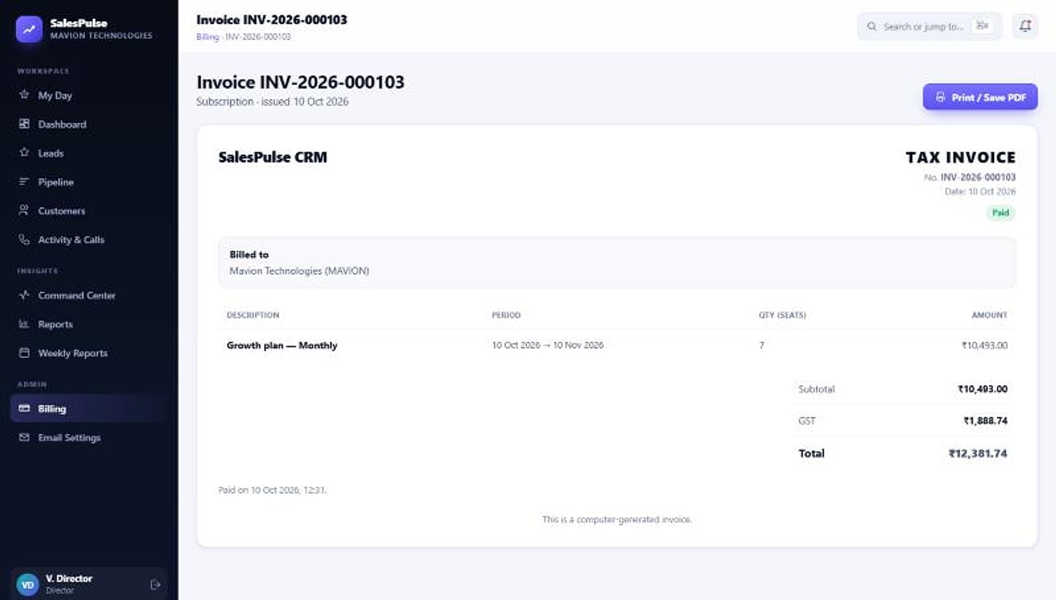
Automated, India-first billing with nothing to reconcile
SUBSCRIPTIONS & BILLING
Billing · Invoice
Razorpay payment links
Customers pay online; subscriptions activate automatically.
Automatic GST invoices
Tax invoices generated for every period.
Trials, renewals and grace
30-day trial, renewals and a 10-day grace period.
Seat and quota limits
Seats and lead quotas enforced automatically.
Tax invoice generated automatically for a subscription period (demo data).
Notes:
Billing is fully automated and multi-tenant. The billing screen with plan cards is not shown because its prices differ from the price list (to be confirmed).

Slide 21
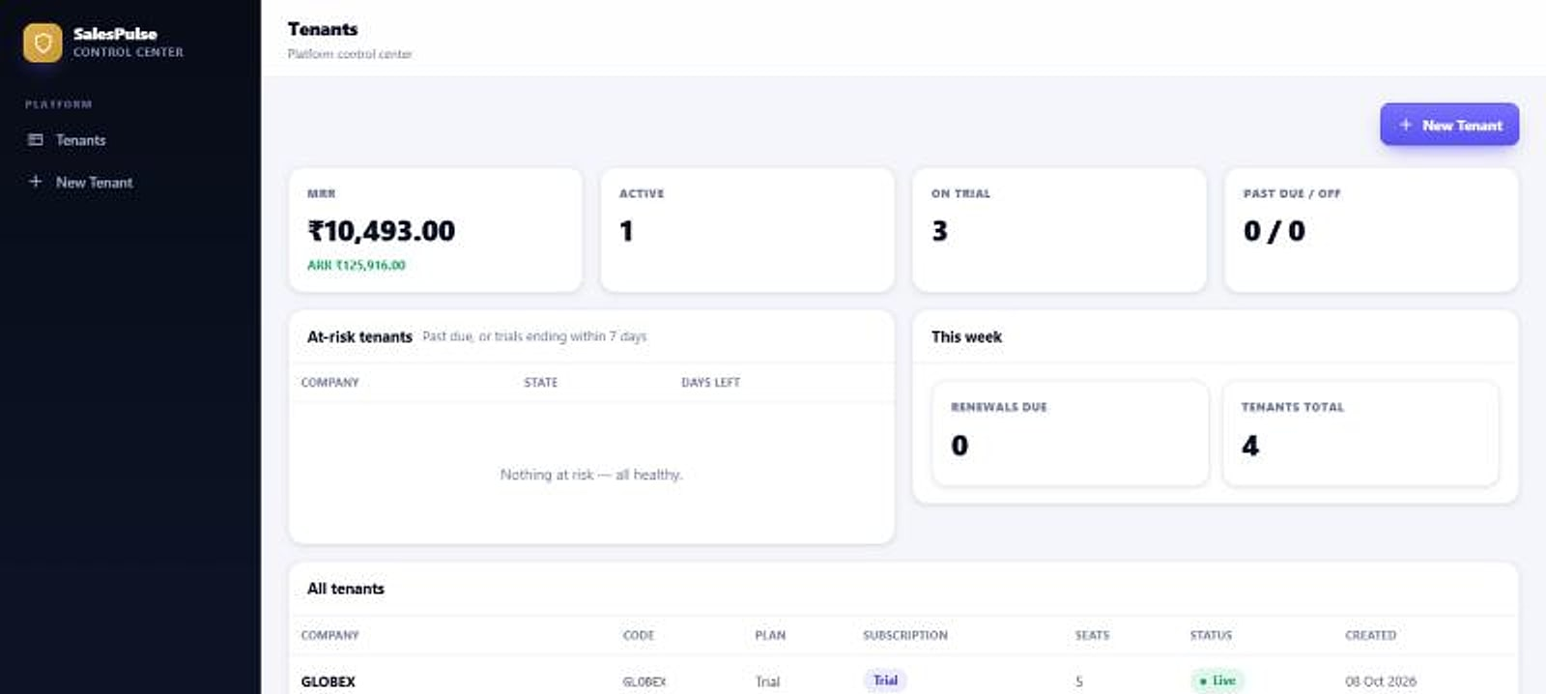
Multi-tenant by design, isolated by default
ARCHITECTURE
SIGN-IN & ROLES
PER-COMPANY DATA
Company-code login
Single host, per-company workspace
Company A · own database
Platform control center
RBAC
BDE · Manager · Director · Admin
Company B · own database
Web + Android
Same masking rules, server-side
One database per company
Platform control center: MRR, ARR and tenants.
Isolation is physical, not a filter: one company's data can never touch another's. API rate limiting and an audited access log sit on top.
Notes:
Database-per-tenant isolation, company-code login, RBAC and a platform control center for provisioning and billing.

Slide 22





What sets SalesPulse apart from generic CRMs
WHY SALESPULSE
GENERIC CRM
WITH SALESPULSE
Privacy built in
Customer data
Reps hold raw numbers
Masked calling, email and WhatsApp
Masking is the default, not an add-on.
Reporting
Re-typed into spreadsheets
Reports and weekly submissions build themselves
India-first
INR, GST, Razorpay and Asia/Kolkata out of the box.
Billing
Manual invoices, no GST
INR, GST invoices and Razorpay built in
Automation that removes work
Visibility
Stale, after the fact
Live command center and leaderboard
Reports feed themselves from real activity.
Isolation
Shared tables
A database per company
Purpose-built for selling
Every screen earns its place in a rep's day.
Notes:
The comparison describes common generic-CRM patterns, not a named competitor.

Slide 23

Software per seat; calling billed on actual usage
HOW PRICING WORKS
Software
Calling
Free trial
Per user per month
Pay as you go
30 days, no card
Plans scale by seats and lead quota, from small teams to large organisations. GST 18% extra.
₹0.50 per leg-minute, outbound and inbound, 30-second pulse, billed on actual usage, or bring your own telephony.
All features, up to 5 seats and 2,000 leads and contacts, to prove value first.
Per-seat prices for each plan are confirmed in your proposal, based on seats and lead volume.
Notes:
The tier price table is held back: the source deck (Basic ₹980 / Starter ₹559 / Growth ₹1,049 / Enterprise ₹2,099) conflicts with the in-app billing screen (Starter ₹799 / Growth ₹1,499 / Enterprise ₹2,999). Confirm the price list before adding tiers.

Slide 24

Live in days, not quarters
GETTING STARTED
STEP 1
STEP 2
STEP 3
STEP 4
Sign up
Import leads
Invite your team
Start selling
We provision your isolated workspace and company code.
Bring your lists by CSV; duplicates removed on the way in.
Add reps, managers and directors with role-based access.
Place masked calls and watch the reports build themselves.
Start with the 30-day free trial: no card required, all features, up to 5 seats and 2,000 leads.
Notes:
Fast onboarding: provision, import, invite, sell.

Slide 25

Give your team the command center they deserve
LET'S GET STARTED
MavionTech Pvt. Ltd.
SalesPulse CRM · India-first Sales CRM
communications@maviontech.com
+91 91580 08002
www.maviontech.com
505 Zen Business Center, Bhumkar Chowk, Wakad, Pune, Maharashtra 411057
Start a free 30-day trial, or talk to us about rolling SalesPulse out across your sales organisation.
Book a demo
Start a free trial
Notes:
One ask. Official MavionTech contact details. The product domain salespulse.maviontech.com is to be confirmed before it is added.

