Slide 1
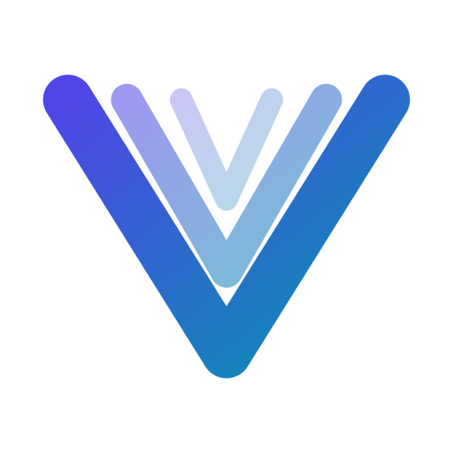
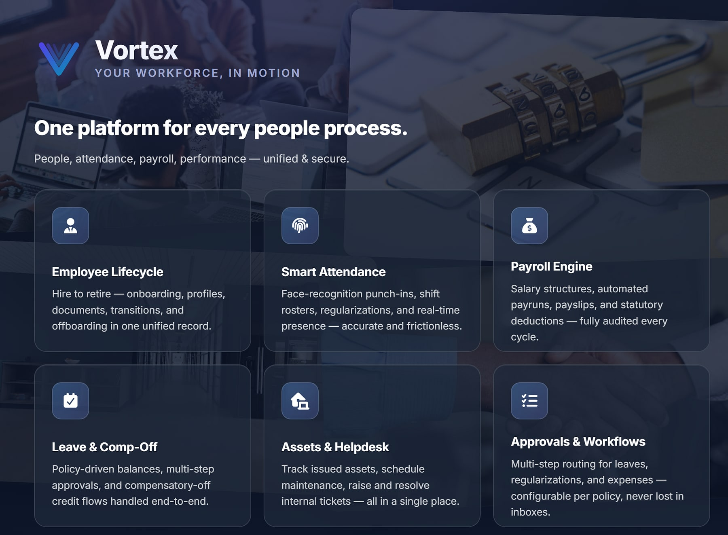
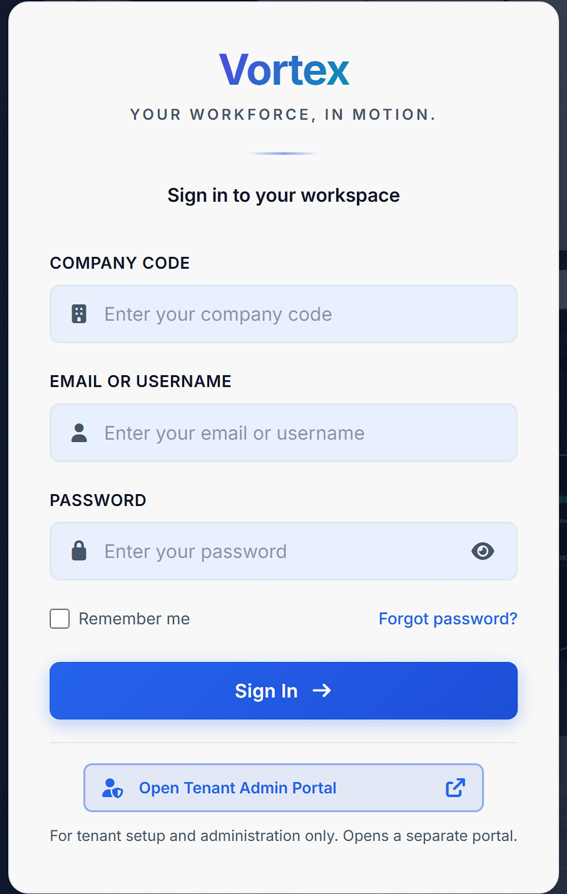
Vortex HRMS
vortexhrms.com
ENTERPRISE SALES OVERVIEW
UNIFIED PEOPLE PLATFORM
Hire to retire. Attendance to payroll. On one record.
Face-AI attendance, policy-driven payroll, leave and comp-off, approvals and employee self-service, in one secure multi-tenant HRMS.
Hire to retire
Face-AI attendance
Policy-first payroll
Notes:
Opening. Vortex HRMS is MavionTech's HR, attendance and payroll platform (www.vortexhrms.com). Images are from the public sign-in page; the uptime, support-hours and compliance badges on that page are cropped out because they are not yet evidenced.

Slide 2






Why workforce platforms break at scale
THE STATUS QUO
Disconnected systems
Manual reconciliation
Compliance debt
HR, payroll, attendance and helpdesk live in separate tools that never quite agree.
Finance reconciles attendance to payroll by hand, every cycle.
Statutory rules change faster than legacy systems adapt.
Poor employee experience
Hidden cost of ownership
No data trust
Several logins and a ticket just to update a phone number.
Licence sprawl, integration effort and double data entry.
Reports don't match across systems, so decisions wait.
Notes:
Six reasons people operations break as organisations grow.

Slide 3



Attendance flows into payroll; approvals flow into balances
ONE PLATFORM, ONE RECORD
People
Unified
One record per employee: every event, document, balance and payslip.
Performance
Attendance
Intelligent
Helpdesk
Leave
Face-AI attendance, policy-first payroll and no-code workflows.
VORTEX
Secure
Assets
Payroll
A database per customer, role-based access and audit trails.
Approvals
Notes:
Vortex unifies the employee journey: documents stay attached to people, not inboxes, and compliance updates ship as policy changes rather than code releases.

Slide 4





Each role works from the same record
BUILT FOR EVERY PEOPLE ROLE
HR team
Payroll & finance
Managers & approvers
Lifecycle, documents, policies and onboarding.
Payruns, statutory deductions, sign-off and bank files.
One-tap approvals for leave, regularisation and expenses.
Employees
Field & shift staff
Admins & IT
Self-service profile, punches, balances and payslips.
Mobile punch-in, geo-fenced check-ins and rosters.
Tenant setup, roles, security policies and assets.
Notes:
Built for organisations of 200 to 20,000 employees per the product deck; the official site positions it for SMBs and mid-size enterprises.

Slide 5
Start with core HR, then switch on exactly what you need
PRODUCT MAP
Base bundle
Premium modules
Attendance & mobile add-ons
Every employee gets
Switch on any month
For field and remote teams
People management
Attendance tracking
Leave management
Employee self-service
Company policies
Payroll management
Performance (PMS)
Expense management
Helpdesk
Asset management
HR document generation
Learning (LMS)
VortexGo mobile app
Remote punch-in
Geo-fence attendance
On-shift location sharing
Punch step-up verification
Remote check-in
Underneath everything: the approvals & workflow engine, role-based security, audit logging and a database per customer.
Notes:
Fourteen modules in three commercial tiers, plus the platform layer. Every module is independently gated per tenant.

Slide 6



Hire to retire, in one record
EMPLOYEE LIFECYCLE
Pre-boarding
Tasks before day one
Onboarding
Checklists and documents
Profile & vault
One record, all documents
Transitions
Role and reporting changes
Separation
Exit clearance
Alumni
Archived record
Secure uploads
Document vault
Full timeline
Clean exits
Onboarding documents uploaded through secure pages, linked to the employee record.
Letters, verification files and records kept per employee.
Reporting changes and life events tracked with history.
Exit clearance and an alumni archive, with assets recovered.
Notes:
New joiners are productive on day one, HR stops chasing paperwork, and every life event has an audit-ready record.

Slide 7




Friction-free attendance, audit-grade accuracy
SMART ATTENDANCE
Face-recognition punch
Shifts and rosters
Geo-fenced check-ins
Punch in and out by face, with sub-second matching (InsightFace).
Shift, roster, weekend and holiday logic.
Location-bounded attendance for field teams.
Regularisation
Live presence
Devices & gates
Self-service correction requests through the workflow engine.
Real-time presence by location, team and role.
Biometric terminal and access-control integration.
Notes:
No buddy punching, no paper rosters, and no surprises when attendance reaches payroll.

Slide 8




Attendance for the field, with privacy built in
FIELD & MOBILE WORKFORCE
VortexGo
SnapLens
On-shift location sharing
The employee app: punch-in, leave, approvals, payslips and helpdesk on the phone.
A dedicated attendance app for capture on site.
Optional, employer-enabled tracking for attendance verification and field work.
PRIVACY SAFEGUARDS FOR LOCATION SHARING
Off by default
Employee consent required
Interval set by employer: 5–60 min
Work-hours-only option
Visible notification while active
Retention 30 / 60 / 90 days
Mock-location detection
Never sold or used for ads
Notes:
Details from the published Vortex HRMS privacy policy (VortexGo background location). SnapLens is named in the privacy policy as the attendance app; confirm its positioning.

Slide 9



Honour every leave policy, automatically
LEAVE & COMP-OFF
Configurable leave types
Multi-step approvals
Half and quarter days
Accrual and carry-forward rules per type.
Mobile-first approval chains.
Fine-grained leave units.
Weekend & holiday credits
Comp-off engine
Live balances
Work on off-days earns comp-off by policy.
Policy-driven comp-off generation with a credit ledger.
Remaining vs allocated, per employee per year.
Notes:
Employees see real balances, managers approve in one click, and HR stops mediating disputes.

Slide 10
Payroll consumes attendance and leave directly
FROM ATTENDANCE TO PAYSLIP
INPUTS
OUTPUTS
Attendance
Punches, shifts, rosters
Inputs locked at cut-off
Period inputs frozen for the run
Payroll engine
Salary structures · statutory deductions · tax computation · adjustments
Payslips
For every employee
Leave & comp-off
Balances and credits
Bank file
Disbursement output
Regularisations
Approved corrections
Statutory
PF · ESI · PT · TDS
Expenses
Approved reimbursements
Period locked
Audit logged
Re-runs are versioned and periods lock after sign-off, so every payroll is reproducible and auditable.
Notes:
The core integration story: attendance, leave and approvals feed payroll directly.

Slide 11



Run payroll on policy, not on spreadsheets
PAYROLL ENGINE
1 Inputs locked
At cut-off
2 Engine computes
Per policy
3 HR reviews
Finance signs off
4 Disbursement
Bank file generated
5 Period locked
Audit logged
Salary structures
Statutory compliance
Tax declarations
Configurable components and payruns.
PF, ESI, PT and TDS deductions.
Declarations and proofs from staff.
Versioned re-runs
Multi-entity payroll
Payslips
Re-run a payroll with full version history.
Run payroll across legal entities.
Generated for every employee, every cycle.
Notes:
Payroll closes on time from locked inputs. Finance trusts the numbers; employees trust their payslip.

Slide 12


Decisions at the speed of policy, not the speed of inboxes
APPROVALS & WORKFLOWS
Sequential approvers
One after another
Request
Leave · regularisation · comp-off · expense
Routing rule
By role, configured without code
Decision + audit trail
Balances and ledgers update automatically
Parallel approvers
At the same time
Out-of-office cover
Escalation timers
Mobile-first approvals
Audit per request
Approvals never stall when someone is away.
Overdue requests escalate automatically.
Approve from the phone in one tap.
Every decision recorded and defensible.
Notes:
One workflow chassis powers leave, regularisation, comp-off, expenses and other approvals.

Slide 13


Self-service that ends routine HR tickets
EMPLOYEE SELF-SERVICE
Personal dashboard
Profile updates
Balances, punches, pending approvals and announcements.
Employees maintain their own details.
Payslips & tax
Company policies
Payslips and tax declarations in one place.
Publish policies everyone can read.
Notes:
Employee self-service and company policies are part of the base bundle.

Slide 14



Appraisal cycles that run themselves
PERFORMANCE MANAGEMENT
Goal plans
Set and track goals
Self-appraisal
Employee input
Reviewer actions
Manager review
Appeals
Fair, recorded process
Reports
Performance reporting
Goals that connect
Structured reviews
Due process
Goal plans per employee and appraisal cycle.
Self-appraisal and reviewer stages with audit trails.
Appeals handled inside the workflow.
Notes:
Performance (PMS) is a premium module: goals, appraisal cycles and reviews.

Slide 15



Operational modules on one workflow chassis
EXPENSES, ASSETS & HELPDESK
Expense management
Asset management
Helpdesk
Claims with receipts
Register with categories & warranties
IT and HR ticket queues per team
Multi-level approvals
Allocation history and maintenance
SLA timers and escalations
Reimbursement through payroll
Return requests at exit
Self-service knowledge base
Assets recovered at exit, faster resolution of day-to-day issues, and reimbursements that flow into payroll.
Notes:
Expense, Asset and Helpdesk are premium modules, each priced per employee per month.

Slide 16

Letters and training, built into the HR record
HR DOCUMENTS & LEARNING
HR document generation
Learning (LMS)
42 branded letters and certificates generated as PDFs from the employee record: offer to relieving.
Courses, compliance training and certifications for the workforce, managed alongside HR records.
Need more? Organisations that need standalone document automation or an enterprise skills and compliance LMS can extend with MavionTech's Signet and MavionLearn.
Notes:
Positioning per the portfolio strategy: Vortex modules cover HR-suite needs; Signet and MavionLearn are the specialist upgrades.

Slide 17



Built to govern a sensitive HR dataset
SECURITY & PRIVACY
A database per customer
Company-code sign-in
Access policies
Strict isolation with separate credentials; no shared schema.
Each organisation signs in to its own workspace; tenant administration in a separate portal.
Session settings, access policies and IP rules.
Role-based access
Audit logging
Published privacy policy
Role-based navigation with configurable permission and approval structures.
Across onboarding, payroll, document review, employee changes and approvals.
Covering data categories, retention, consent and individual rights.
Notes:
Controls listed here come from the Vortex deck and the published privacy policy. Encryption, multi-region, uptime SLA, ISO 27001, SOC 2 and GDPR statements are not shown until evidenced.

Slide 18
Built for scale, secured by design
ARCHITECTURE
EDGE
Web app · VortexGo & SnapLens mobile apps · biometric devices · access gates
AROUND IT
Integration APIs
REST APIs for connected systems
APPLICATION
People · Attendance · Leave · Payroll · Performance · Expenses · Learning · Assets · Helpdesk · Approvals
Identity & directory
Role-based access, company-code sign-in
WORKFLOW & SECURITY
No-code workflow engine · role-based access · session and IP policies · audit logging
Audit & events
Logged across sensitive workflows
DATA
A dedicated MySQL database per customer, with separate credentials
Observability
Operations monitoring
TECHNOLOGY
Django + Python
MySQL, one database per customer
Face-AI (InsightFace)
Tailwind UI
REST APIs
Notes:
Architecture layers per the Vortex product deck, without the unverified 'encrypted at rest' and 'replicated across regions' statements. Technology stack as listed in the deck.

Slide 19


How Vortex compares with the alternatives
WHERE VORTEX WINS
Against legacy suites
Against point HR tools
Modern and mobile-first, with a biometric core. No implementation army required.
Vortex is the platform of record, not another module to integrate.
Against generic SaaS
Against building in-house
Strict multi-tenant isolation, Indian statutory payroll built in, and Face-AI attendance native.
Every module your team would build, plus the ones they would never get to.
Notes:
Positioning versus categories, not named competitors.

Slide 20
One base price, then add exactly what you need
PRICING
PREMIUM MODULES (PER EMPLOYEE / MONTH)
BASIC SERVICES
Payroll management
₹49
Learning (LMS)
₹55
₹45
Performance (PMS)
₹39
Expense management
₹19
per employee / month
HR document generation
₹19
Helpdesk
₹19
People management
Asset management
₹19
Attendance tracking
ATTENDANCE & MOBILE ADD-ONS
Leave management
VortexGo mobile app
₹49
Remote punch-in
₹59
Employee self-service
Geo-fence attendance
₹39
On-shift location sharing
₹39
Company policies
Punch step-up verification
₹19
Remote check-in (with VortexGo)
₹9
List prices per active employee per month, editable per tenant · switch modules on or off any month · 30-day free trial, no credit card · GST extra
Notes:
Prices as listed in the Vortex product deck.

Slide 21
Build your plan, and pay only for what you switch on
EXAMPLE PLANS
Core HR
Growing team
Full platform
EVERYONE STARTS HERE
MOST CHOSEN
THE COMPLETE WORKFORCE OS
₹45
₹132
from ₹313
per employee / month
per employee / month
per employee / month
Basic Services bundle
Basic Services
Basic Services
Payroll management
Payroll · Performance · Learning
Expense management
Expense · HR docs · Helpdesk
Helpdesk
Assets · VortexGo app
Illustrative stacks: totals are sums of list prices. Attendance and security add-ons are priced on top. GST extra.
Notes:
Totals verified against the list prices: 45+49+19+19 = 132; the full platform = 313.

Slide 22
Live today, and what comes next
ROADMAP
LIVE TODAY
NEXT · WITHIN 6 MONTHS
LATER · 12+ MONTHS
Employee profiles & onboarding
Document vault
Face-AI attendance
Shifts, rosters, geo-fencing
Leave & comp-off engine
Multi-step approvals
Payroll & payslips
PF · ESI · PT · TDS
Multi-entity payroll
Performance & appraisals
Expenses & reimbursements
LMS
Assets & maintenance
IT & HR helpdesk
HR document generation
VortexGo mobile app
Multi-tenant isolation · RBAC · audit
Recruitment & applicant tracking
Employee engagement & surveys
Benefits & insurance administration
Advanced BI & custom reports
Native mobile manager app
Predictive workforce analytics
Generative-AI policy authoring
Regional payroll engines
Vortex app marketplace
Notes:
Roadmap per the Vortex product deck; 'Next' and 'Later' items are not available today. Recruitment overlaps with ProtonNxt; position ProtonNxt as the recruitment answer until decided.

Slide 23

See Vortex on your data
LET'S GET STARTED
MavionTech Pvt. Ltd.
Vortex HRMS · www.vortexhrms.com
communications@maviontech.com
+91 91580 08002
www.maviontech.com
505 Zen Business Center, Bhumkar Chowk, Wakad, Pune, Maharashtra 411057
Start with a 45-minute working session: we map your people stack, share a tailored value model, and propose a 30-day pilot.
Book a demo
Plan a pilot
Notes:
Discover, model, pilot. Official MavionTech contact details; the product site is www.vortexhrms.com.

