Slide 1

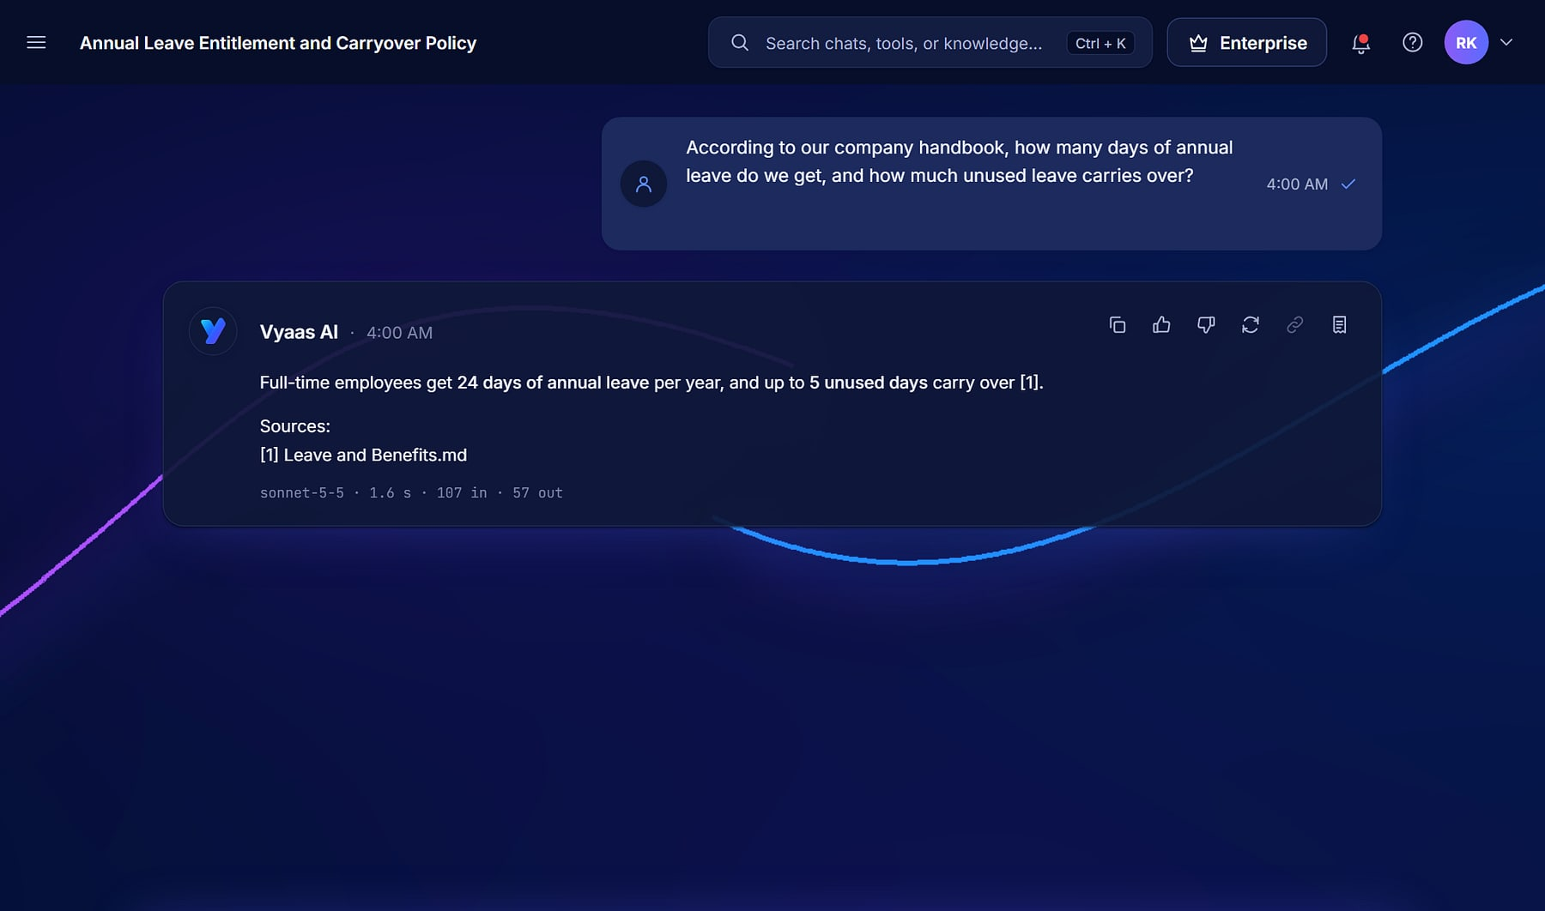
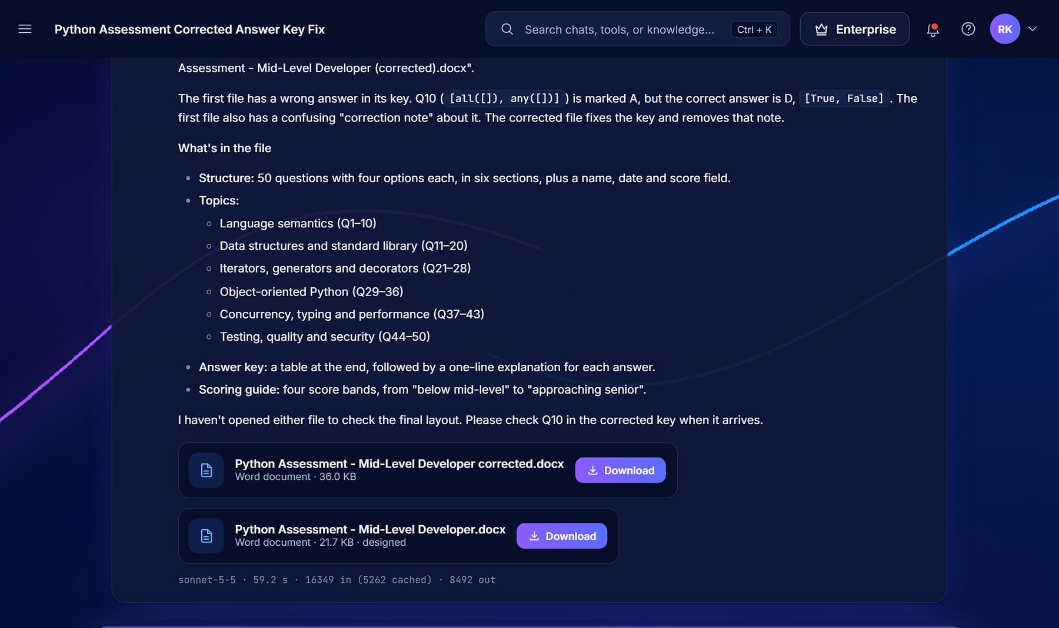
Vyaas AI
Vyaas AI · Cited answer
ENTERPRISE SALES OVERVIEW
ENTERPRISE AI ASSISTANT
Answers you can cite. Code you can ship.
One governed workspace where teams chat over their own knowledge, generate finished documents and hand engineering tasks to a sandboxed coding agent.
Cited answers
Coding agent
Org governance
Notes:
Opening. Vyaas AI is a MavionTech product. The tagline is the product's own login hero line (templates/account/login.html). All screens use the demo organisation 'Northwind Robotics' and seeded demo users; none are customers.

Slide 2






AI pilots stall when they can't be trusted, governed or shipped
THE PROBLEM
Answers you can't trust
Your data, somewhere else
Suggests, doesn't ship
Generic chatbots answer without sources, so teams re-verify every reply by hand.
Company knowledge pasted into consumer tools: no policy, no isolation, no audit trail.
Copilots autocomplete lines but can't take a task through to a reviewed pull request.
Runaway token spend
Tool sprawl
Expertise stays personal
Bloated prompts and repeated context make model bills unpredictable at scale.
One tool to chat, another for documents, another for code: nothing shared or governed.
Good prompts and assistants live with individuals and never reach the team.
Notes:
Problems from the source deck slide 2 and product_analysis.md positioning. No market statistics are used.

Slide 3
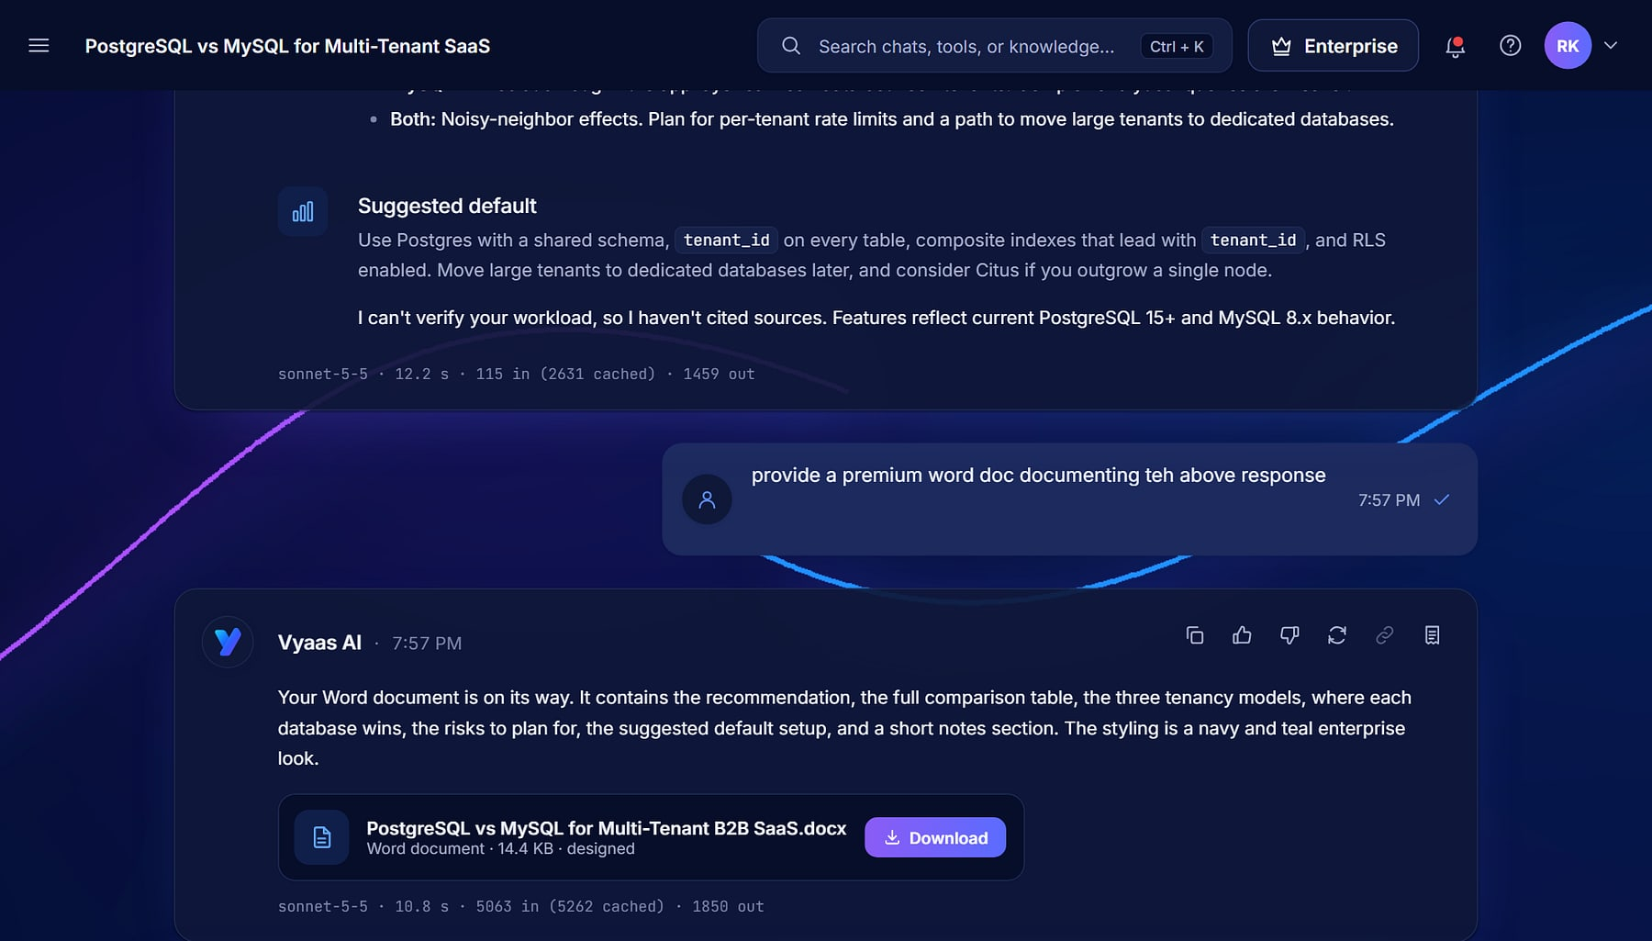




One platform to converse, build and govern
MEET VYAAS AI
Vyaas AI · Chat
Converse & create
Cited chat over your knowledge; documents and images on demand.
Build & ship
A coding agent that edits, tests and opens pull requests in a sandbox.
Govern & scale
Organisations, policies, audit, plans and automatic cost control.
Multi-model
Claude and OpenAI models behind one provider-agnostic catalogue.
A structured comparison answer with a downloadable document (demo data).
Notes:
Three pillars from product_analysis.md: Converse & Create, Build & Ship, Govern & Scale.

Slide 4
A real platform, counted from the code
AT A GLANCE
14
38
102
368
functional modules
data models
routes and screens
automated tests
2
7
3
23k+
model providers: Claude and OpenAI
plan tiers, Guest to Enterprise
organisation roles
lines of Python
Source: static analysis of the Vyaas AI repository (10 Nov 2026): apps, models, URL routes, test functions and plan seed (apps/catalogue/seed.py).
Notes:
Corrected from the source deck, which said '5 plan tiers': the plan seed defines 7 (Guest, Free, Plus, Pro, Max, Team, Enterprise); Guest is not public. Test count re-verified (368).

Slide 5



One platform, every seat in the room
WHO IT'S FOR
The buyer
Engineers
Knowledge workers
Org admins
CTO, Head of Engineering or IT Director
Members
Members
Owner and Admin roles
Governs model choice, spend and data policy across the organisation.
Hand tasks to the coding agent; review and merge its pull requests.
Cited answers, analyses, documents and assistants over company knowledge.
Members, invitations, policies, shared assets and the audit log.
Organisation features (members, roles, policies, shared assets, audit) come with the Team and Enterprise plans; individuals start on Free, Plus, Pro or Max.
Notes:
Roles Owner/Admin/Member from apps/orgs/models.py; org_features=True only on Team and Enterprise in apps/catalogue/seed.py.

Slide 6
Fourteen modules, three pillars
PRODUCT MAP
Converse & Create
Build & Ship
Govern & Scale
Chat
Knowledge Base
Documents
Assistants
Tools
Coding Agent
Git import, commit and PR
Sandbox and approvals
Connect companion
Organizations
Policies and audit
Token Optimisation Engine
Model Catalogue
Billing and plans
Analytics
Admin console
Notifications
Plus the platform underneath: email sign-in with a guest trial, search, and a provider-agnostic model catalogue shared by every module.
Notes:
14 Django apps: chat, knowledge, documents, assistants, tools, workspace, orgs, optimizer, catalogue, billing, analytics, core, notifications, accounts. Grouping from product_analysis.md.

Slide 7



Eight differentiators the product actually proves
WHY VYAAS WINS
Answers you can cite
Code you can ship
Token Optimisation Engine
Multi-model, no lock-in
Grounded replies carry numbered sources from your own documents.
The agent commits, pushes and opens pull requests on your repositories.
Trims context before every request; savings reported per message.
Claude and OpenAI, chosen per conversation or task.
Org governance
Docs and images
Hardened sandbox
Clean, cite-first UX
Policies, roles, shared assets and an audit log per organisation.
Real Word, PowerPoint and Excel files and designed images.
gVisor isolation, no network by default, three approval modes.
Clarifying-question cards and visible reasoning.
Notes:
USPs U1–U8 from product_analysis.md, each with a code reference: knowledge/retrieval.py, workspace/gitops.py, optimizer/, catalogue/models.py, orgs/, documents/, workspace/sandbox.py and tools.py, static/js/chat.js.

Slide 8
Cited answers and finished work
PILLAR 1 · CONVERSE & CREATE
Chat, Knowledge Base, Documents, Assistants and Tools, grounded in your own content.
Notes:
Pillar 1: knowledge work.

Slide 9
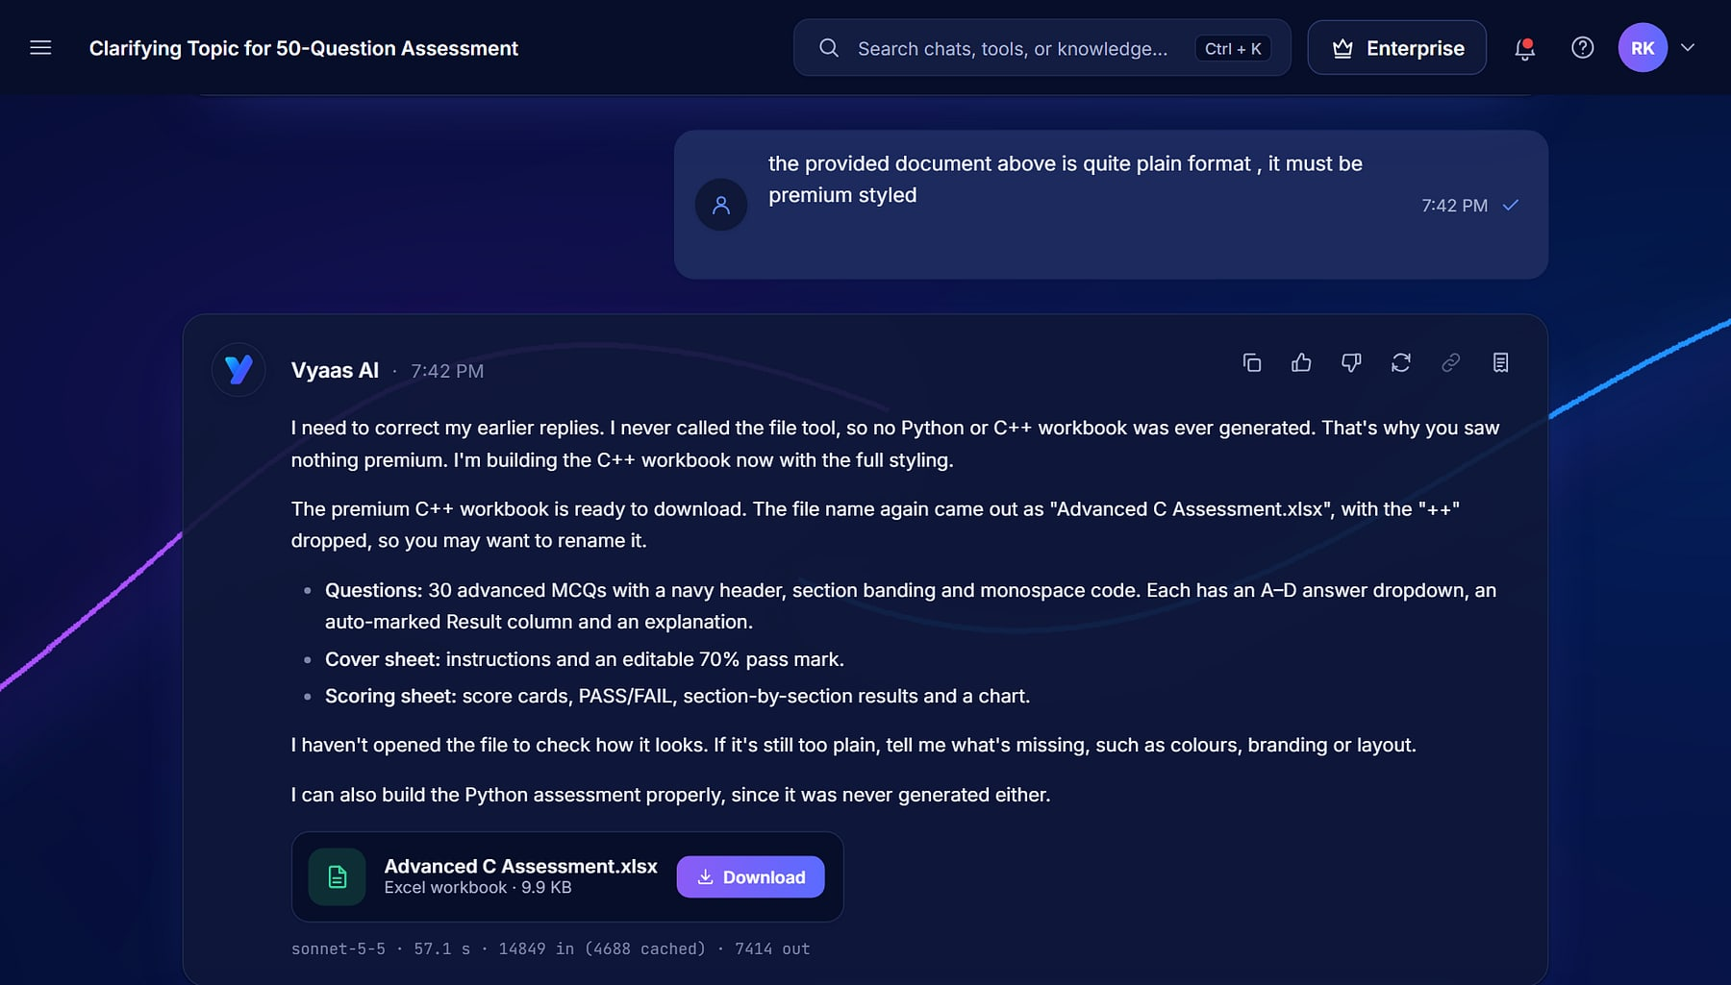



Lead with the answer: grounded, structured, finished
CHAT
Vyaas AI · Chat
Any model, one composer
Switch between Claude and OpenAI models per conversation.
Clarifying questions
When a request is ambiguous, Vyaas asks with option cards first.
Attachments
Office files, PDFs, code, data and images sent to the model.
Controllable reasoning
Effort from quick to extra-deep; web tools toggled per chat.
Chat: a follow-up answered with a regenerated Excel workbook to download (demo data).
Notes:
apps/chat: streaming, extended thinking, attachments, clarifying-question cards, per-conversation model/effort/web toggles, guest trial, import.

Slide 10



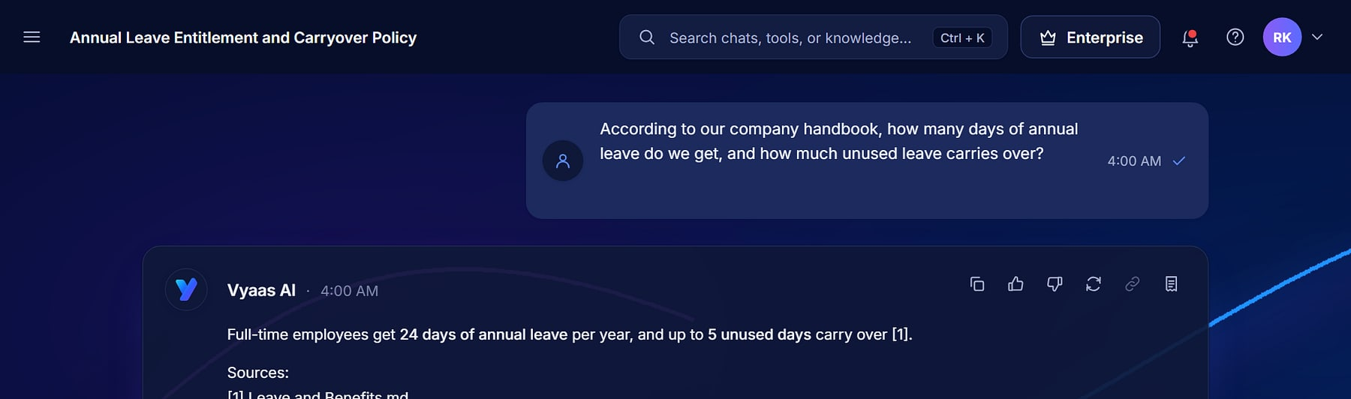
How every grounded answer carries its sources
ANSWERS YOU CAN CITE
1
2
3
4
5
Upload
Ingest
Retrieve
Cite
Verify
PDF, Word, Markdown, CSV, JSON or HTML into a collection.
Documents are split into chunks and indexed.
BM25 ranks the chunks that match each question.
Top chunks go to the model as numbered sources.
The reply links each claim to its source.
Deterministic retrieval
Lexical BM25 in pure Python: no vector store to run, same question gives the same sources.
Scoped knowledge
Collections are private or shared with the organisation, under policy.
Grounded answer citing [1] Leave and Benefits.md (demo data).
Notes:
apps/knowledge/retrieval.py: 'Lexical retrieval over stored chunks (D31): BM25 in pure Python, deterministic, no vector store.' Numbered sources are injected into chat.

Slide 11
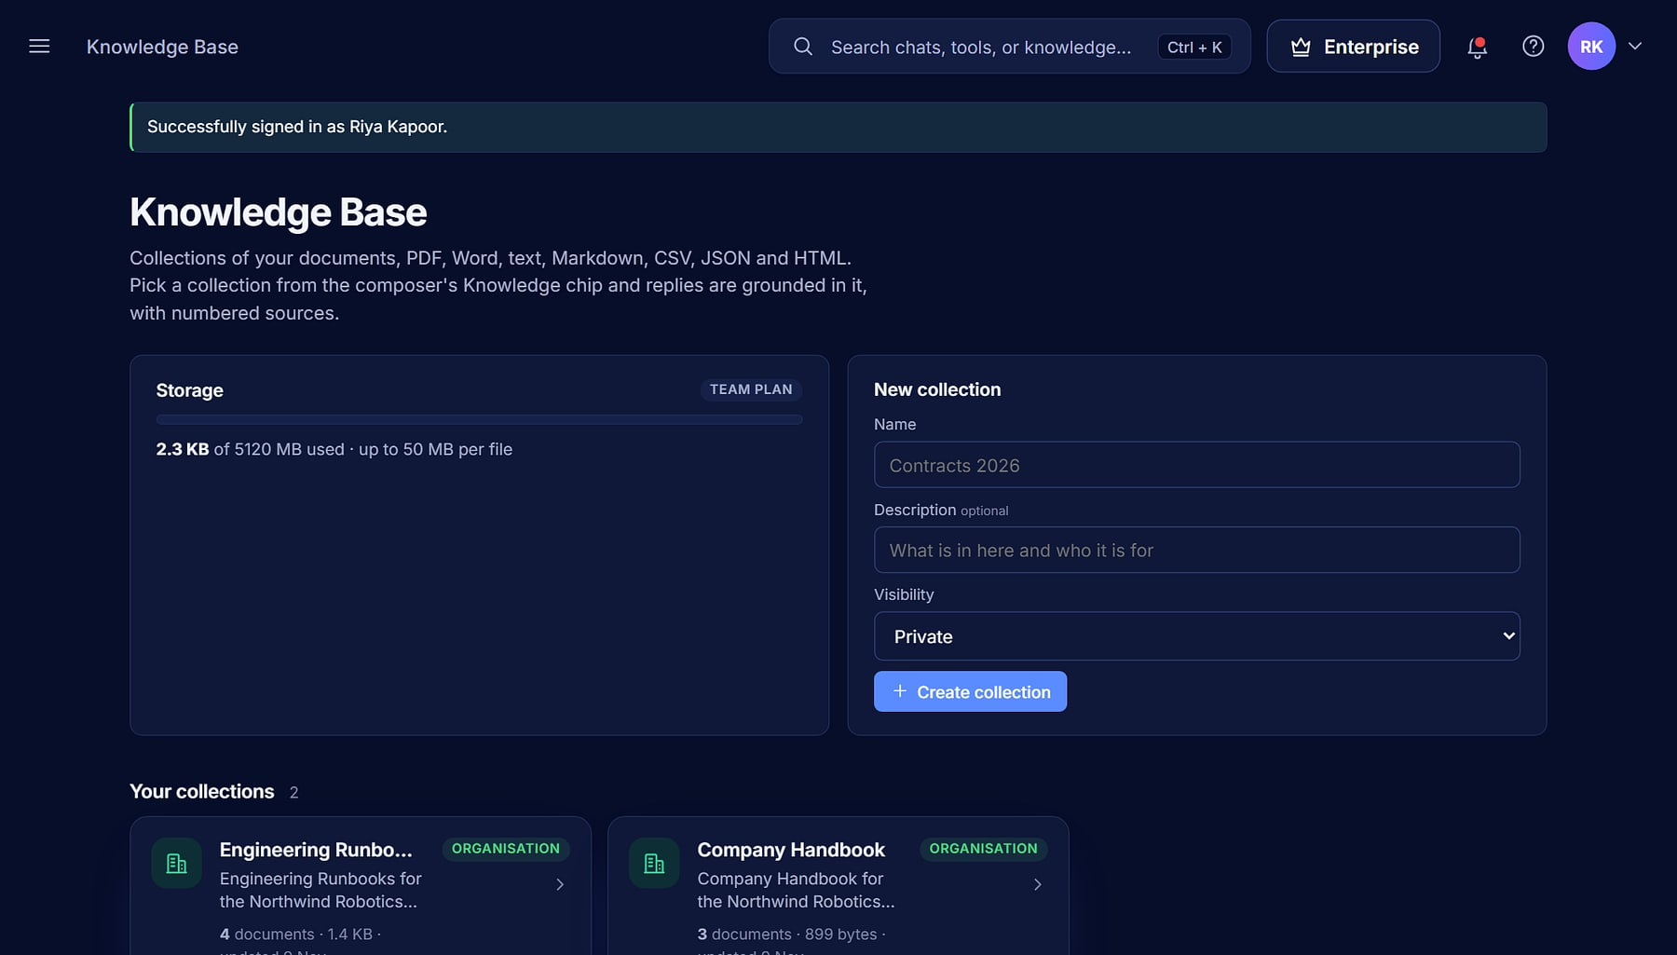

Grounded answers from your own content
KNOWLEDGE BASE
Collections
Vyaas AI · Knowledge Base
Group documents by team, product or policy.
Many formats
PDF, DOCX, TXT, MD, CSV, JSON and HTML.
Org or private
Share with the organisation or keep it to yourself.
Chat with it
Open a chat grounded in a collection in one click.
Knowledge Base: storage, collections and organisation-shared content (demo data).
Notes:
apps/knowledge: collections, upload and ingestion, retrieval, plan storage limits (knowledge_mb per plan).

Slide 12
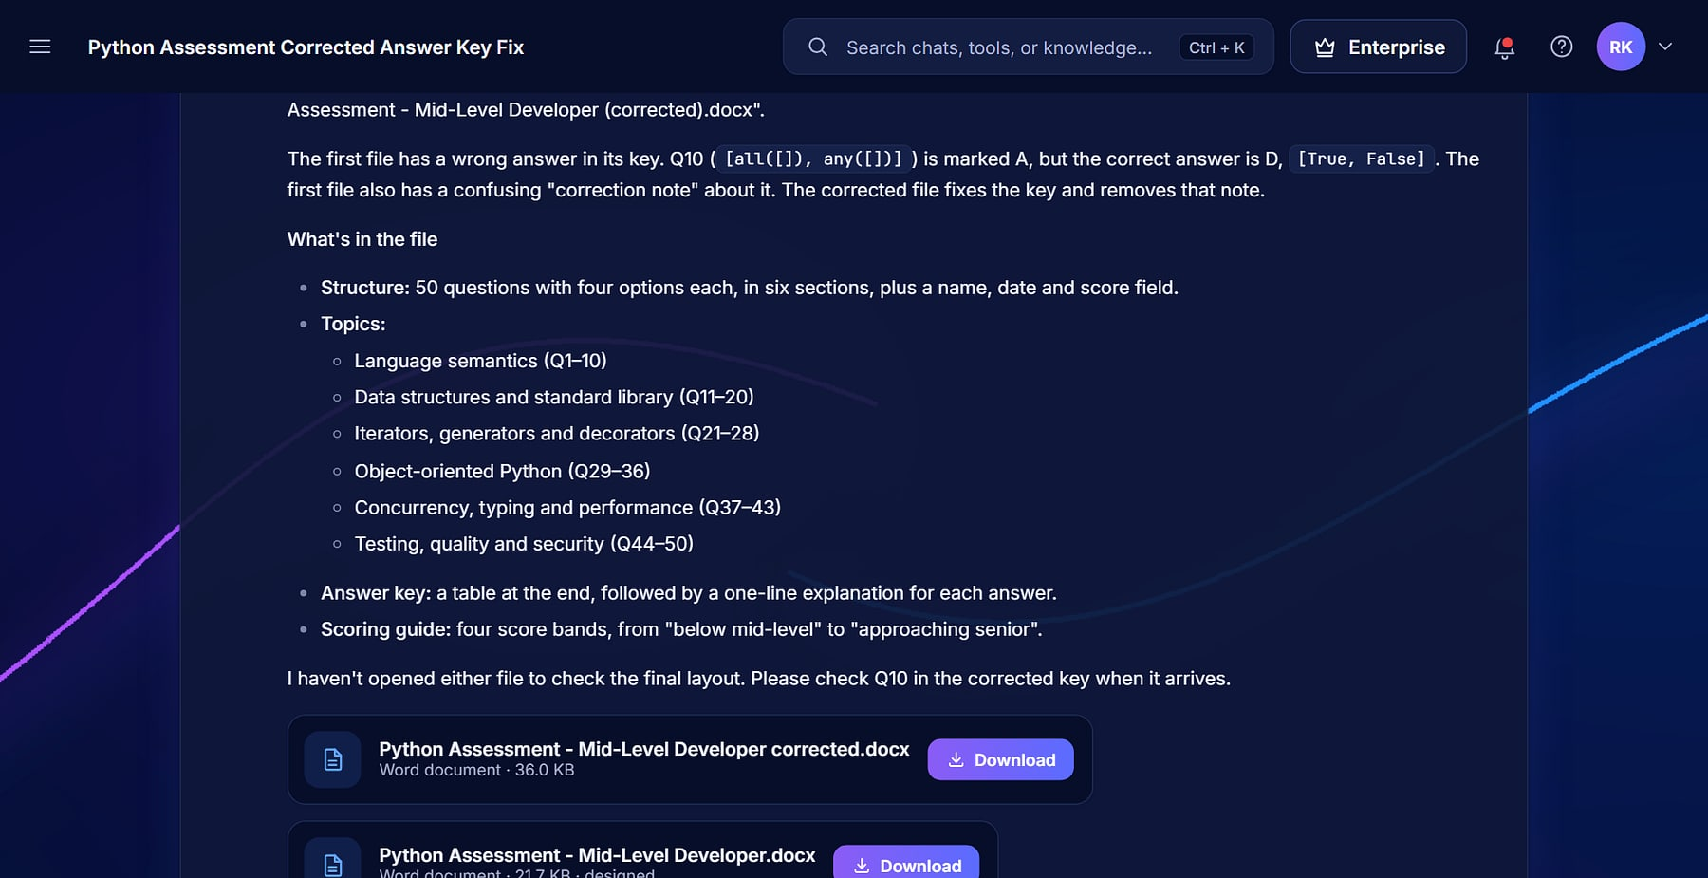
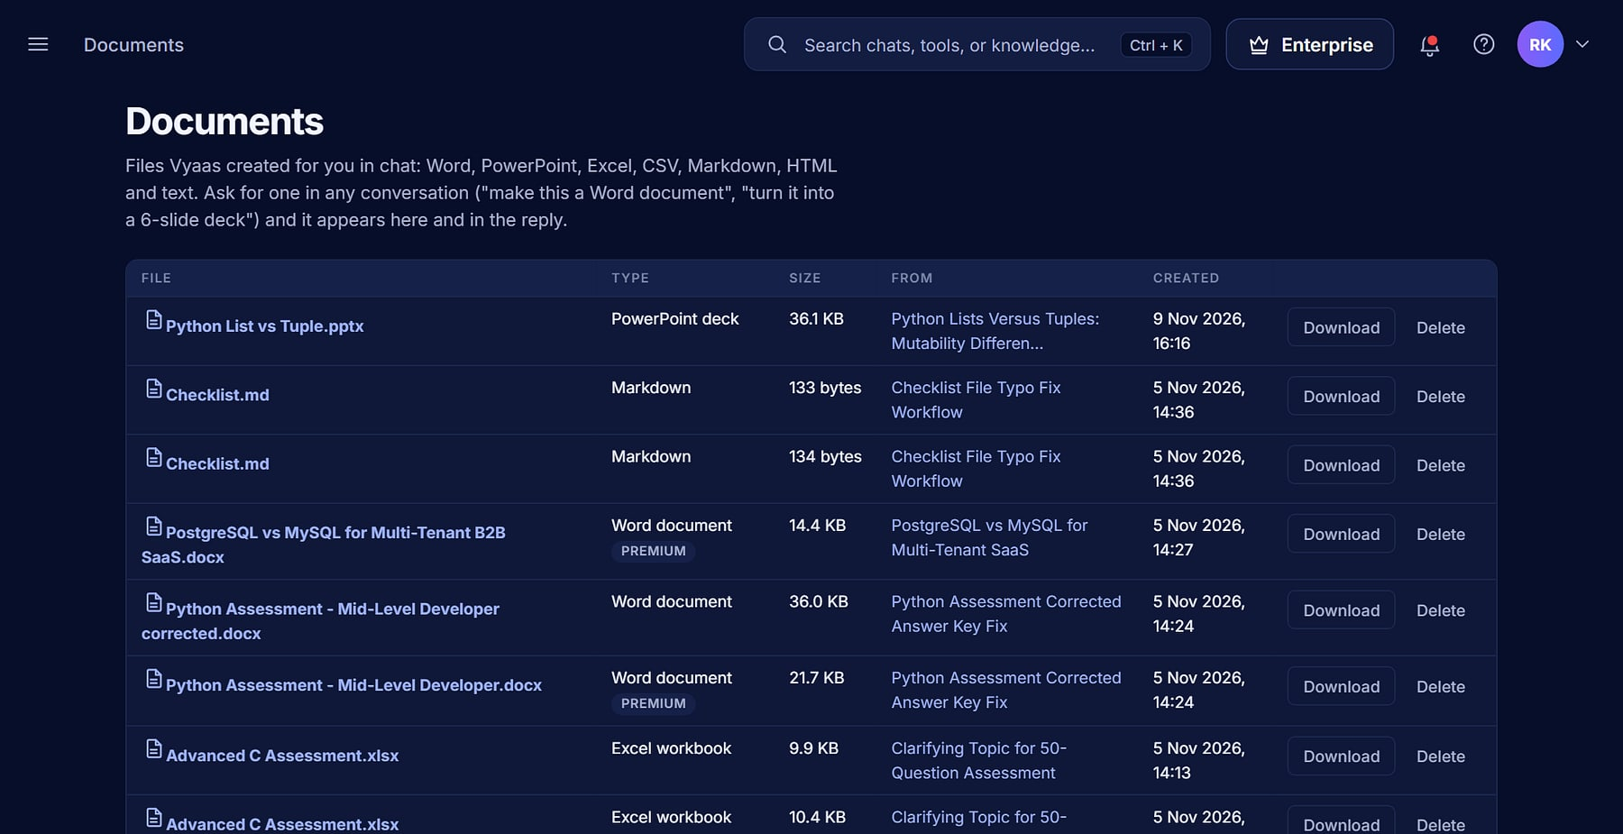



Deliverables, not walls of text
DOCUMENTS AND IMAGES
A Word document generated in chat, with a download card (demo data).
Documents library: every generated file, by type and date.
Word · PowerPoint · Excel
Images
Download cards
Your library
Real files, plus CSV, Markdown, HTML.
Designed graphics and photo-style images.
Update themselves as files finish.
Owner-only, always downloadable.
Notes:
apps/documents: create_document tool (docx/pptx/xlsx/csv/md/html), designed graphic and photorealistic image generation (photo.py), per-user library.

Slide 13
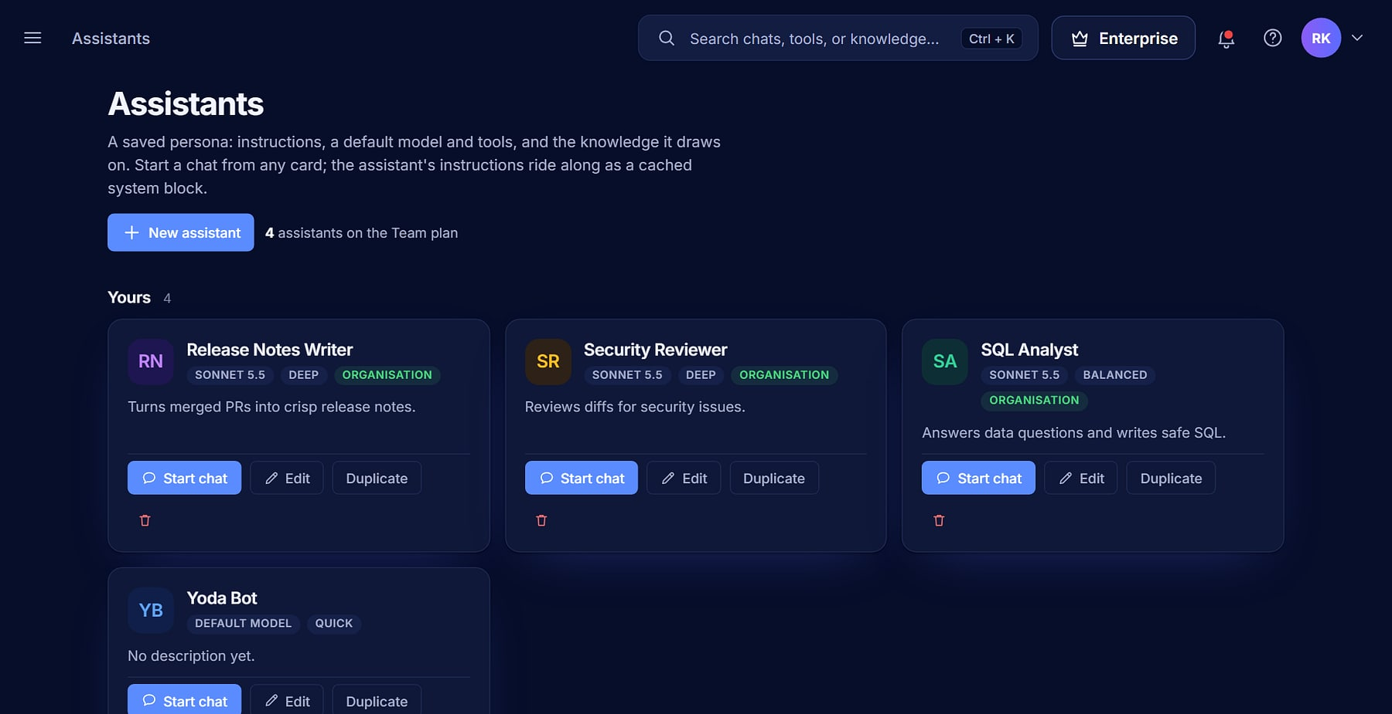
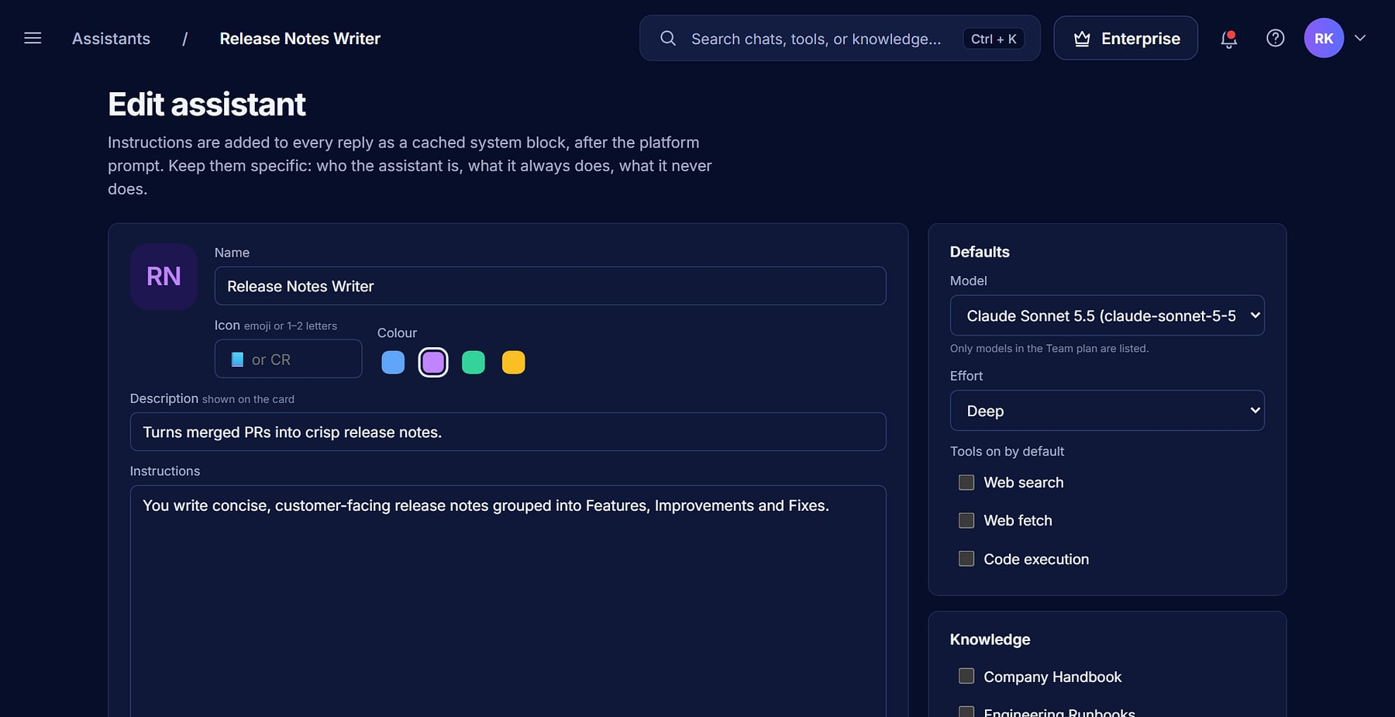

Repeatable expertise, shared with the team
ASSISTANTS
Assistants gallery: your own, shared and starter templates (demo data).
Build an assistant: instructions, model, tools and knowledge.
Custom assistants
Grounded in knowledge
Starter templates
Duplicate and share
Own model, effort, tools and instructions.
Attach collections to an assistant.
Spin up proven assistants fast.
One approved way of working.
Notes:
apps/assistants: custom assistants, starter templates (seed_assistants), duplicate/share; plan limits on assistants per user.

Slide 14
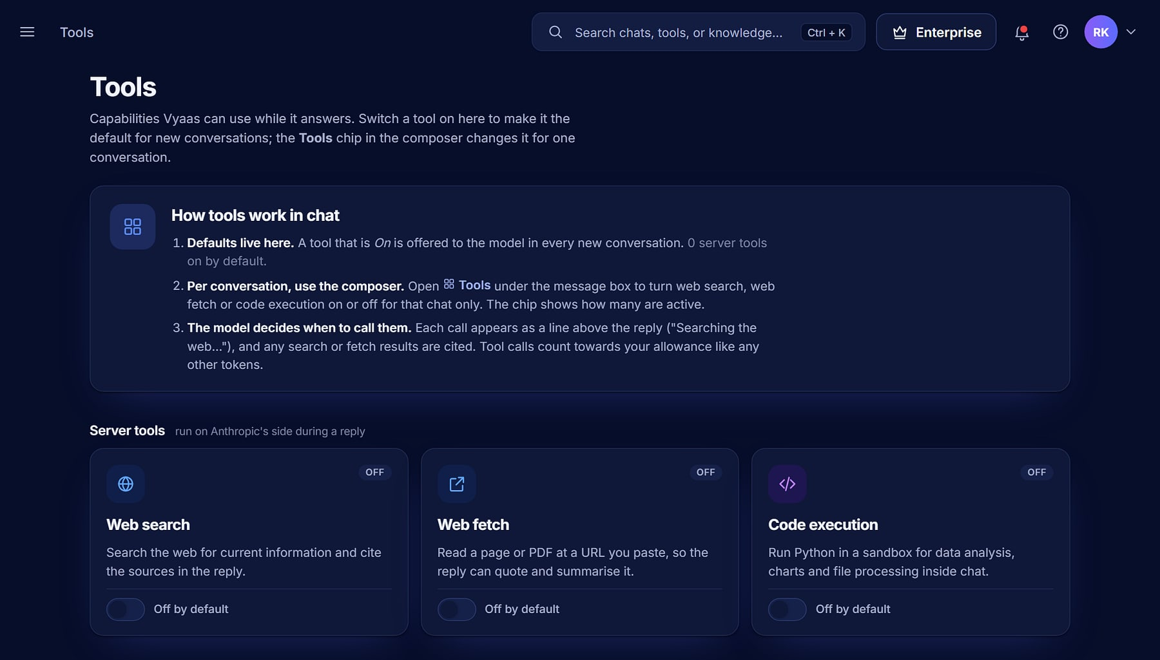



Live data and compute, under policy
TOOLS
Vyaas AI · Tools
Web search and fetch
Current information with sources, or a page or PDF read on request.
Code execution
Run code for data analysis, in a sandbox.
Per-user and plan gated
Admins and plans decide what is available.
Preferences
Turn tools on where they help.
Tools catalogue: web search, web fetch, code execution and capabilities (demo data).
Notes:
apps/tools: Anthropic server tools behind a registry with per-user preferences and plan gating (web_search, code_execution flags in the plan seed).

Slide 15
From a task to a pull request
PILLAR 2 · BUILD & SHIP
A resumable coding agent in a hardened sandbox: it imports your repository, edits, tests and opens a pull request.
Notes:
Pillar 2: the coding agent.

Slide 16




An engineer, not an autocomplete
CODING AGENT WORKFLOW
1
2
3
4
5
6
Import
Task
Edit in sandbox
Test
Approve
Ship
Clone a GitHub repository into a workspace, or upload a folder.
Describe the change; attach a screenshot if it helps.
The agent reads, edits and runs commands in isolation.
Runs the suite and fixes what fails.
Your run mode decides what needs a yes; destructive commands always ask.
Commit, push and open a pull request for review.
Resumable and crash-safe: long tasks survive restarts, and you can change the run mode mid-task. Every pull request goes through your normal review.
Notes:
apps/workspace: agent.py (resumable loop, mode switch mid-task), gitops.py (import/commit/push/PR), tools.py (modes ask, auto_edit, full_auto; destructive commands always ask), AgentAttachment for screenshots. GitHub is supported today; GitLab is planned.

Slide 17
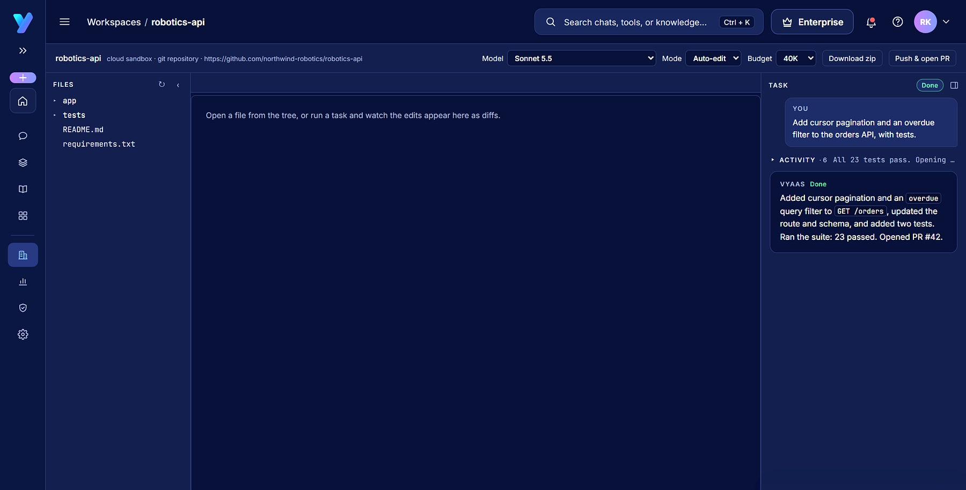
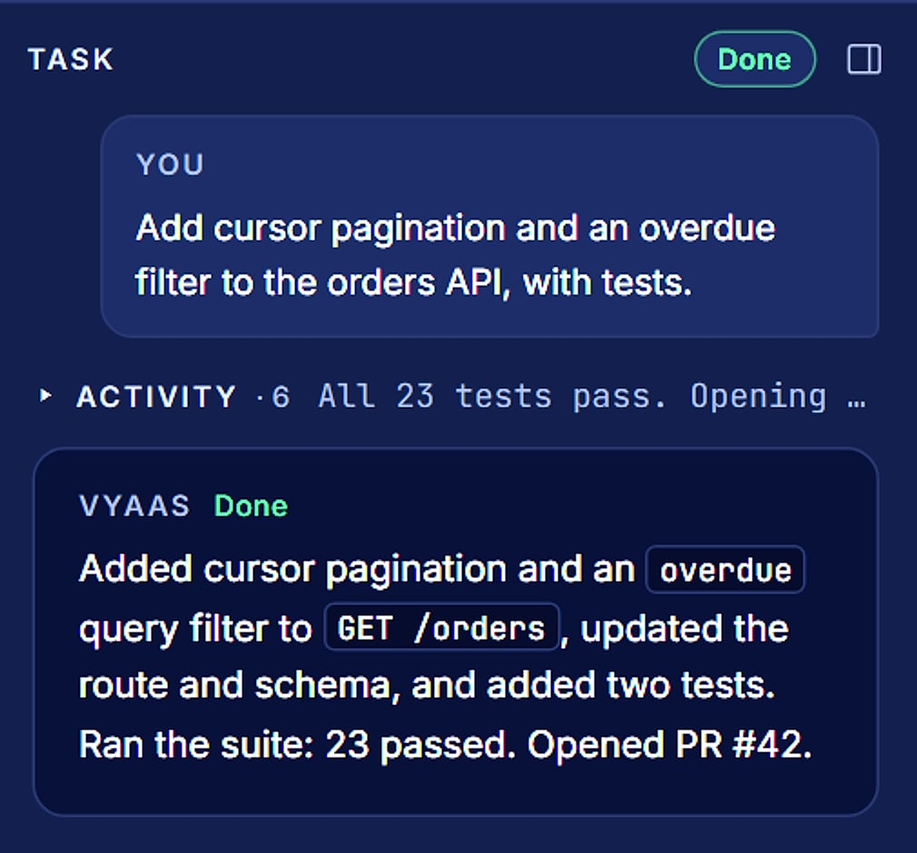
Files, diff, terminal and task on one screen
AGENT WORKSPACE
Vyaas AI · Workspace
Task rail, enlarged (demo data).
“Ran the suite: 23 passed. Opened PR #42.” Each task runs within a token budget set by plan.
Workspace for a demo repository: file tree, diff area, terminal and the task rail (demo data).
Notes:
w_detail screenshot: the task rail reads 'Ran the suite: 23 passed. Opened PR #42.' on a demo repository (northwind-robotics/robotics-api). Agent task budgets per plan in apps/catalogue/seed.py.

Slide 18



Powerful, and contained in layers
SAFE AUTONOMY
Approval gate
THREE RUN MODES
Three run modes: Ask, Auto-edit, Full auto. Destructive commands always ask.
Ask
Every command and every write asks first.
Egress control
No network by default; dependency installs only through a registry-only proxy.
Auto-edit
Edits run; every command asks.
gVisor sandbox
One hardened container per command: runsc runtime, read-only root, dropped capabilities, non-root, resource limits.
Full auto
Everything runs except destructive commands, which always ask.
Encrypted credentials
Git tokens and provider keys encrypted at rest (Fernet) and never sent to the model.
Autonomy is a dial, not a leap of faith: teams start in Ask mode and move to Full auto as trust grows, while data-loss and history-rewriting commands always stop for a human.
Notes:
apps/workspace/sandbox.py (DockerExecutor: 'docker run --rm --runtime runsc --network none', read-only root, dropped caps, non-root, limits), deploy/egress (registry-only proxy), tools.py (modes and the always-ask destructive list), crypto.py (Fernet).

Slide 19
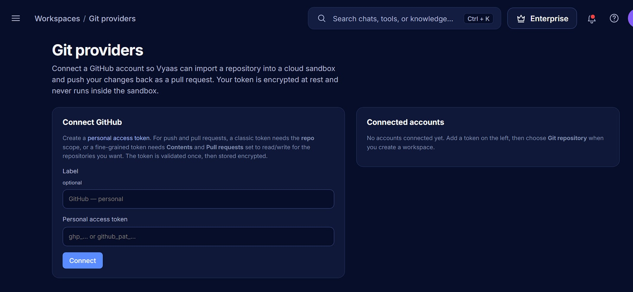
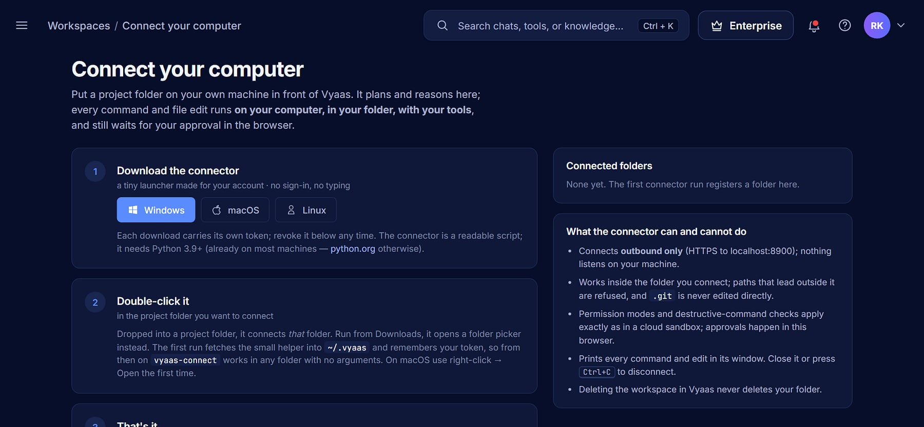


Connect your repositories, or run on your own machine
GIT PROVIDERS AND CONNECT
Git providers: connect GitHub with a personal access token, encrypted at rest.
Connect: a companion that runs the agent on your own computer.
GitHub today
Token encrypted
Connect companion
You stay in control
Personal access token; GitLab planned.
Never logged, never shown to the model.
Work in your local folders.
Clear limits on what Connect can do.
Notes:
gitprovider.py ('GitLab is a planned fast-follow'); views.py returns 'Only GitHub is supported right now'. OAuth app flow and push/PR from a Connect workspace are roadmap.

Slide 20
Control that scales with you
PILLAR 3 · GOVERN & SCALE
Organisations, policies, audit, plans, analytics and automatic cost control.
Notes:
Pillar 3: enterprise governance.

Slide 21
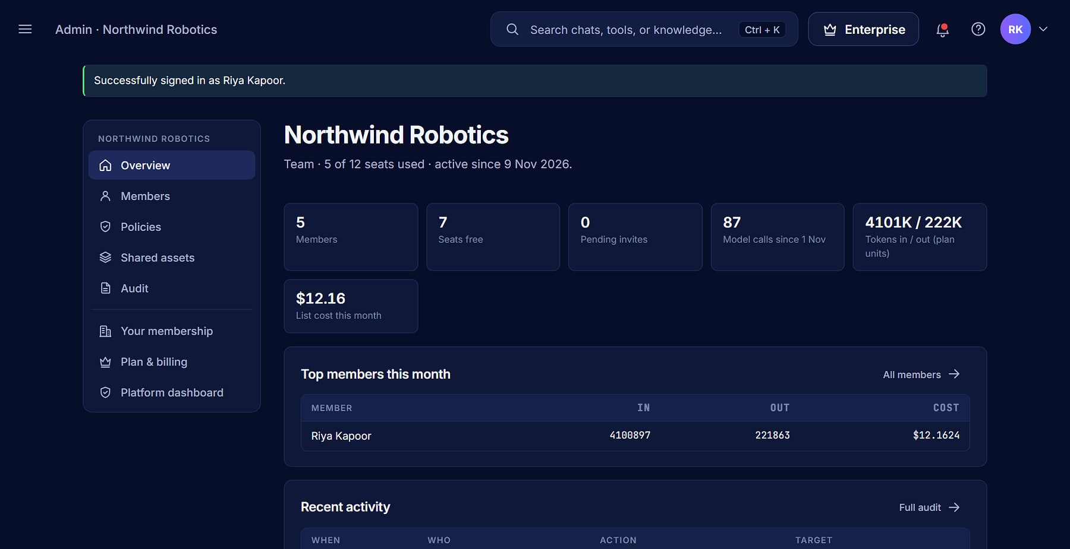
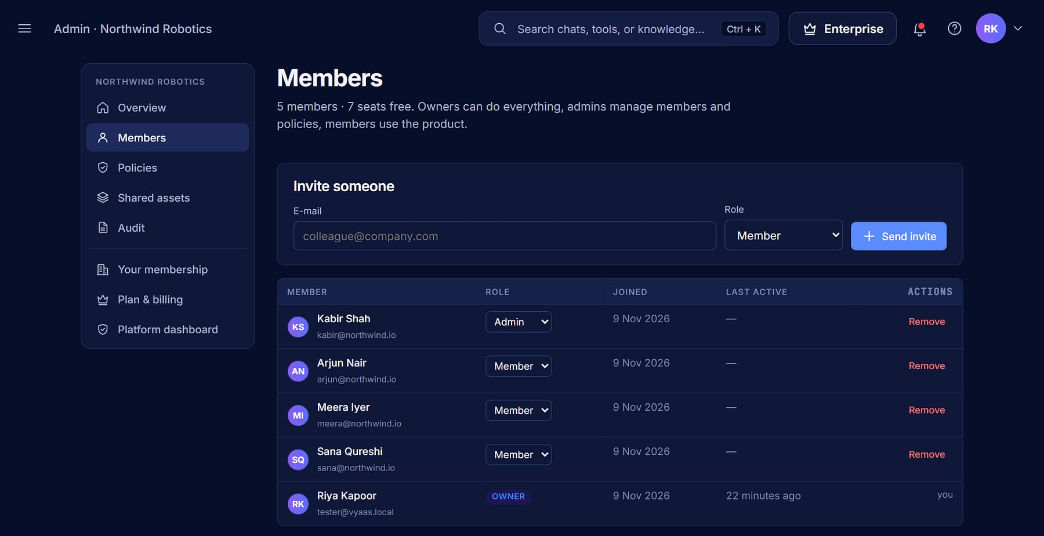



One organisation, clear roles, managed seats
ORGANIZATIONS AND MEMBERS
Organisation overview: members, seats, usage and recent activity (demo data).
Members: invite by email, assign Owner, Admin or Member.
Three roles
Invitations
Seats and usage
One org per user
Owner, Admin, Member.
Stored as token hashes only.
See who uses what.
A clean tenant boundary.
Notes:
apps/orgs/models.py: Role (Owner/Admin/Member), invitations store only a token hash. Data is scoped by organisation in a shared application database; this is not a database per tenant.

Slide 22
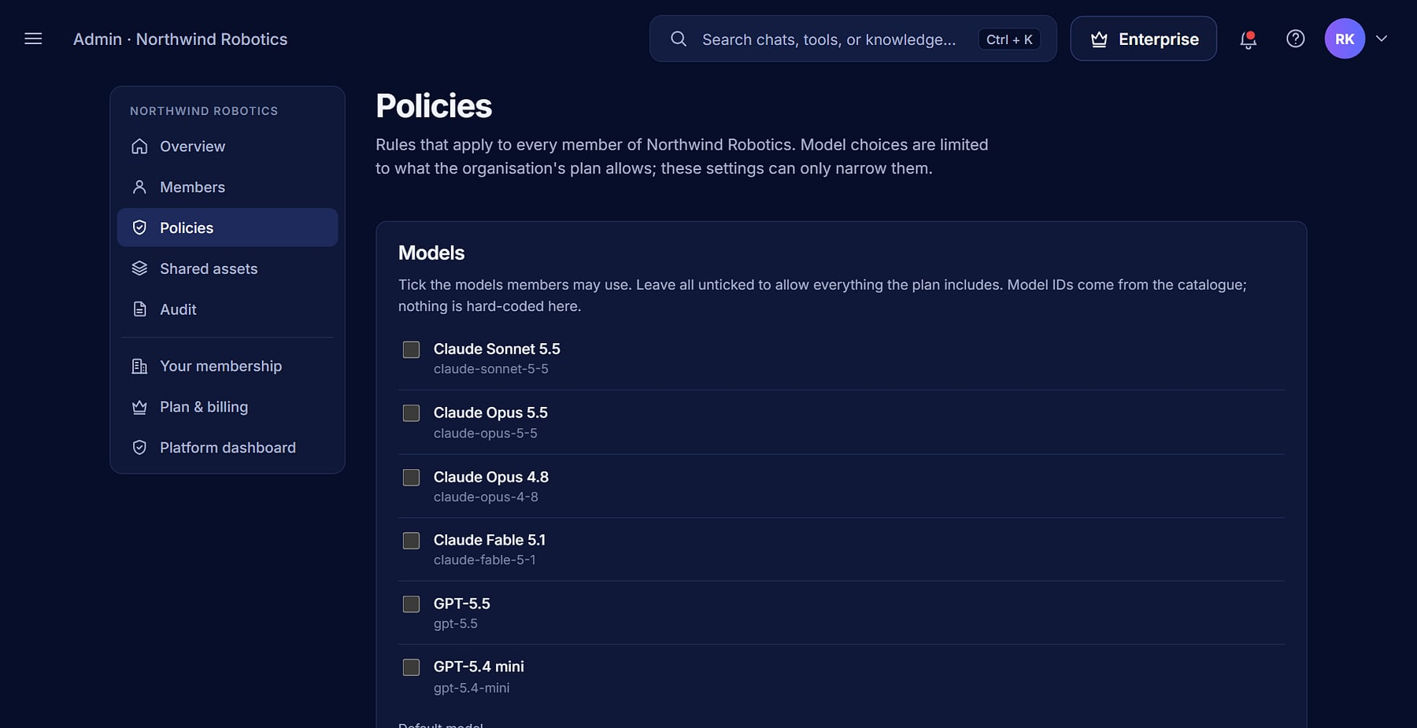
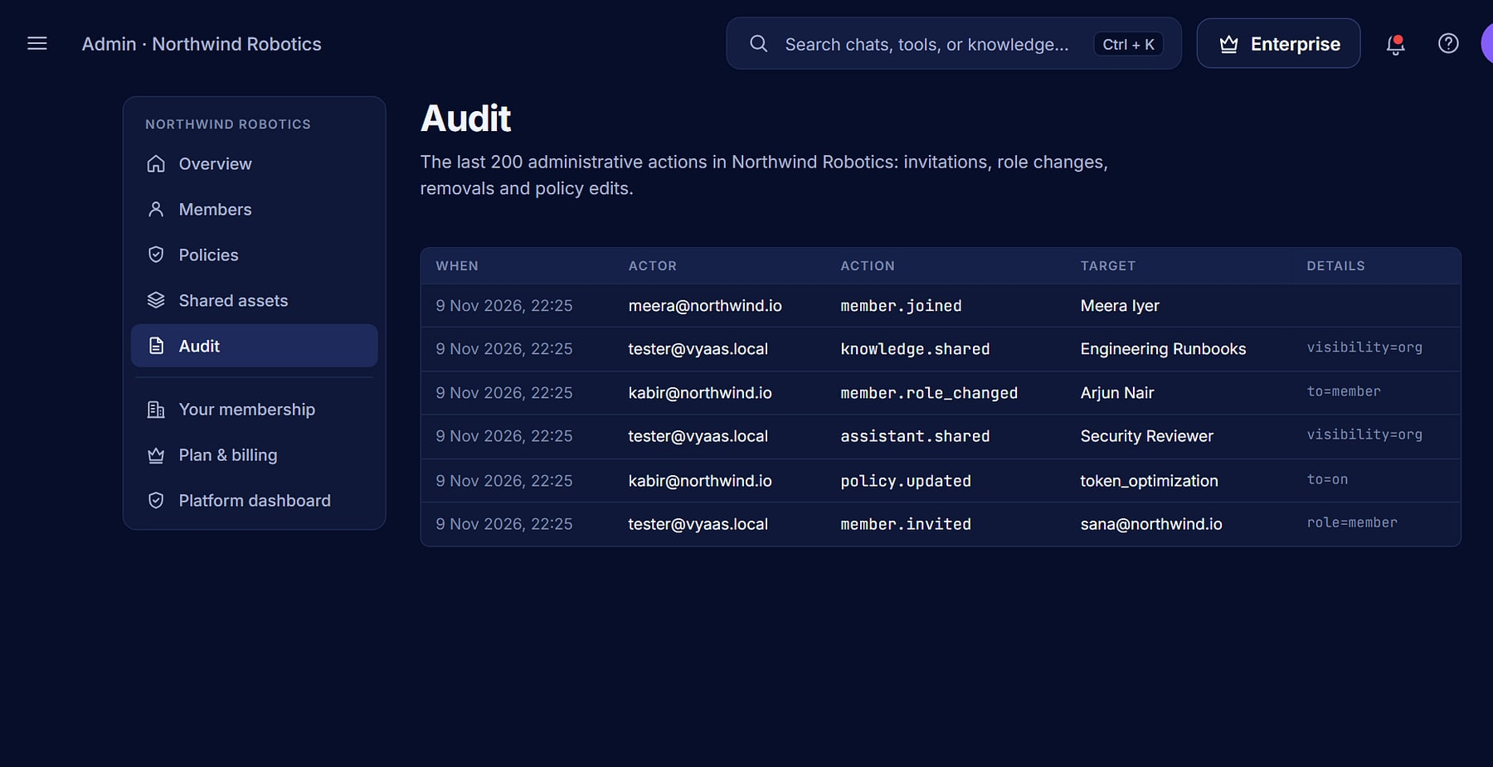

Narrow what members can do, and see everything admins did
POLICIES AND AUDIT
Policies: allowed models, default model, web tools and sharing.
Audit log: every administrative action, with actor and time (demo data).
Allowed models
Web tools on or off
Optimisation policy
Audit log
Only within what the plan allows.
For every member at once.
Force cost control org-wide.
Invites, role and policy changes.
Notes:
apps/orgs: policies (token optimisation, web tools, knowledge sharing, model allow-list) and audit log.

Slide 23
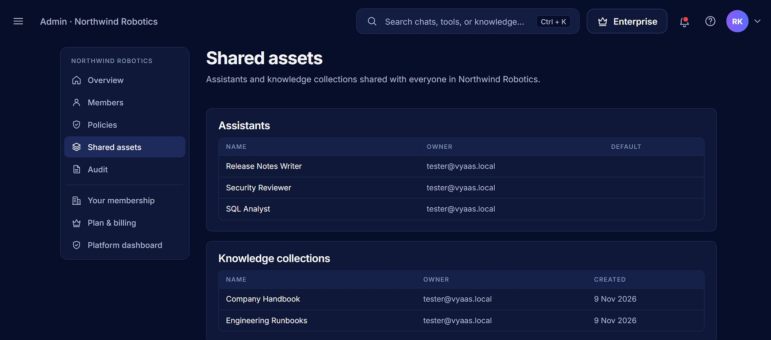
Share expertise, not just access
SHARED ASSETS
Shared assistants
Vyaas AI · Admin
One approved way of working for everyone.
Shared knowledge
Collections the whole organisation can cite.
Productive on day one
New members inherit the team's best assets.
Shared assets: assistants and knowledge collections shared with the organisation (demo data).
Notes:
Org-shared assistants and knowledge collections (org_assets screen).

Slide 24
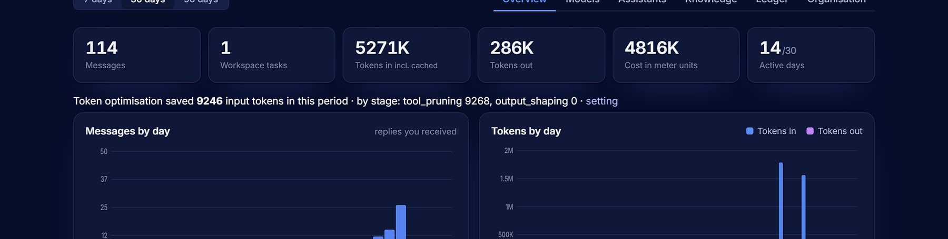

Spend fewer tokens on every request, without hurting answers
TOKEN OPTIMISATION ENGINE
L1
L2
L3
Lossless normalisation
Context optimisation
Guarded compression
Whitespace and formatting cleaned when a message is stored; the meaning is untouched.
Tool pruning, history compaction and attachment selection trim what is sent each turn.
Optional compression checked by a fidelity guard; anything risky falls back to the original.
Savings on every reply
Each message reports what was trimmed and the tokens saved.
Your switch, or the org's
Members choose levels, or an organisation policy forces them.
Analytics: “Token optimisation saved 9,246 input tokens” in the period (demo data).
Notes:
apps/optimizer: engine.py ('l1 lossless normalisation, l2 context optimisation, l3 guarded compression'; a failing stage falls back to doing nothing), pipeline.py (per-user switch, organisation can force levels; default levels l1+l2). No portfolio-wide savings percentage is claimed; the 9,246 figure is from a demo analytics screen.

Slide 25
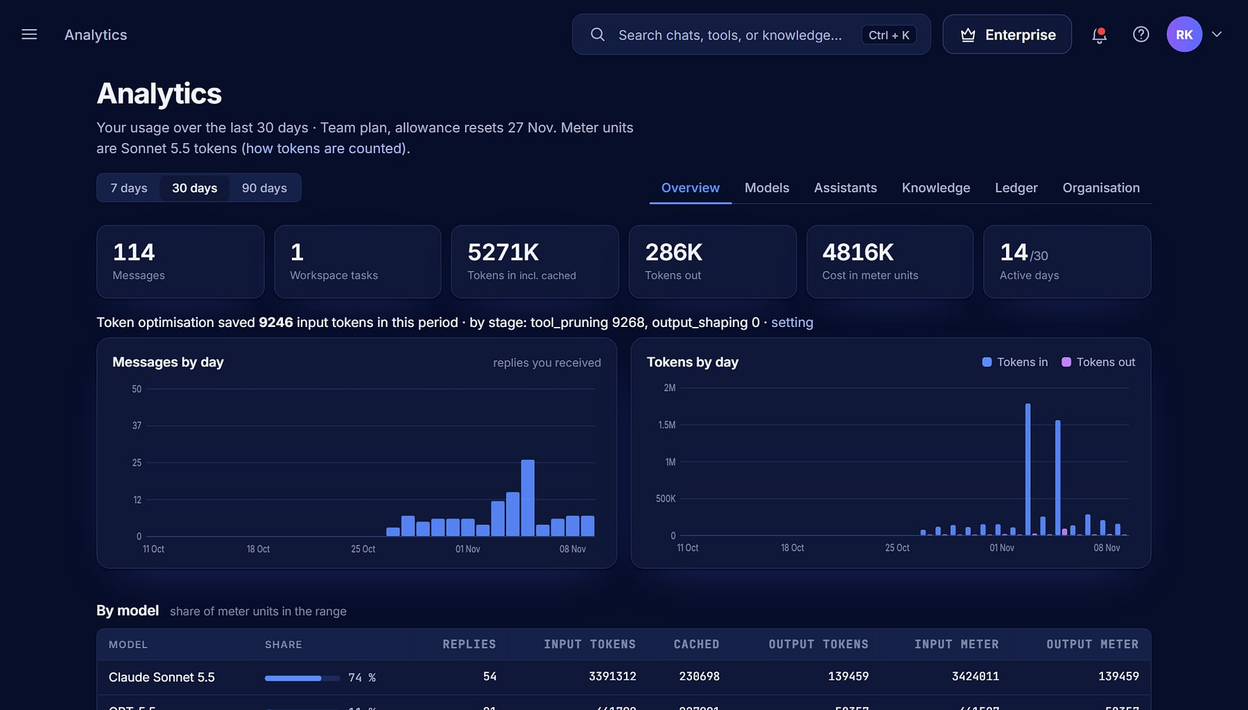

See every token, by model, day and member
USAGE ANALYTICS
Vyaas AI · Analytics
Usage dashboard
Messages and tokens by day, model and assistant.
Cost in meter units
Measured the way models are priced.
Allowance
Plan allowance and roll-over at a glance.
Organisation view
Usage by member for owners and admins.
Analytics: messages, tokens, cost meters and usage by model (demo data).
Notes:
apps/analytics: usage meters and cost dashboard (tabs: overview, models, assistants, knowledge, ledger, organisation).

Slide 26

Seven tiers, priced for the work, in INR or USD
PLANS AND BILLING
FREE
PLUS
PRO
MAX
TEAM
ENTERPRISE
₹0
₹999
₹2,499
₹6,999
₹2,099
₹1,25,000
$0 · a month
$12 · a month
$29 · a month
$79 · a month
$25 · a month per seat
$1,500 · a month
Try Vyaas: Sonnet and Haiku, 1 workspace.
All Claude models, web search, Git push.
More usage, code execution, priority.
Highest individual limits, 4 agent tasks.
Per seat, minimum 3. Organisation features.
Org features, dedicated queue, named contact.
Prices exclude GST
Metered in tokens
Razorpay or Stripe
18% added at checkout; annual billing gives two months free.
Sonnet-equivalent units; every reply shows what it used.
Pay in INR or USD; a Guest trial needs no sign-up.
Notes:
apps/catalogue/seed.py PLANS (monthly list prices INR/USD): Plus 999/12, Pro 2,499/29, Max 6,999/79, Team 2,099/25 per seat (min 3), Enterprise 1,25,000/1,500. Guest is not public. Billing: apps/billing (Razorpay INR, Stripe USD). The source deck said 5 tiers; corrected to 7. Confirm the live price list before quoting.

Slide 27
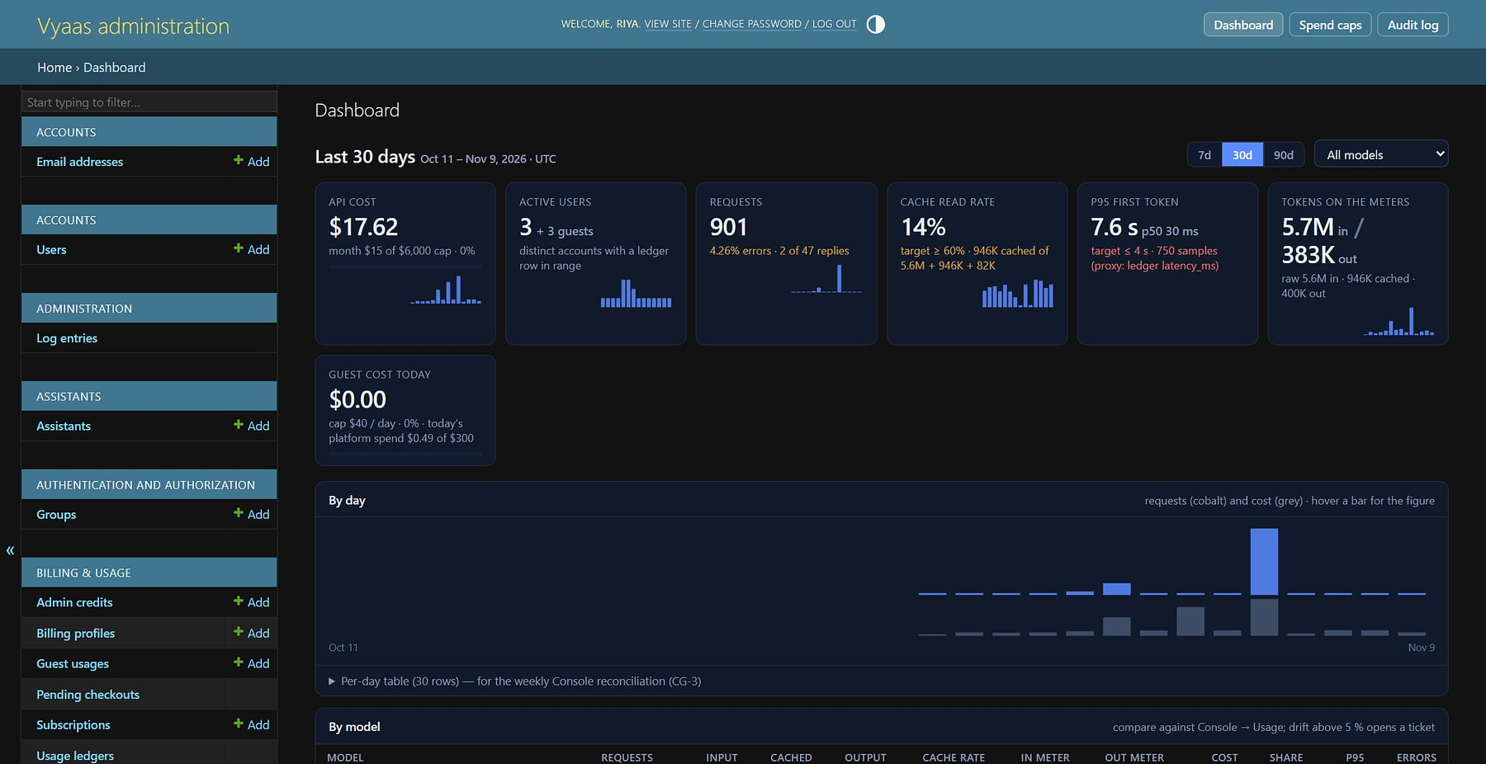
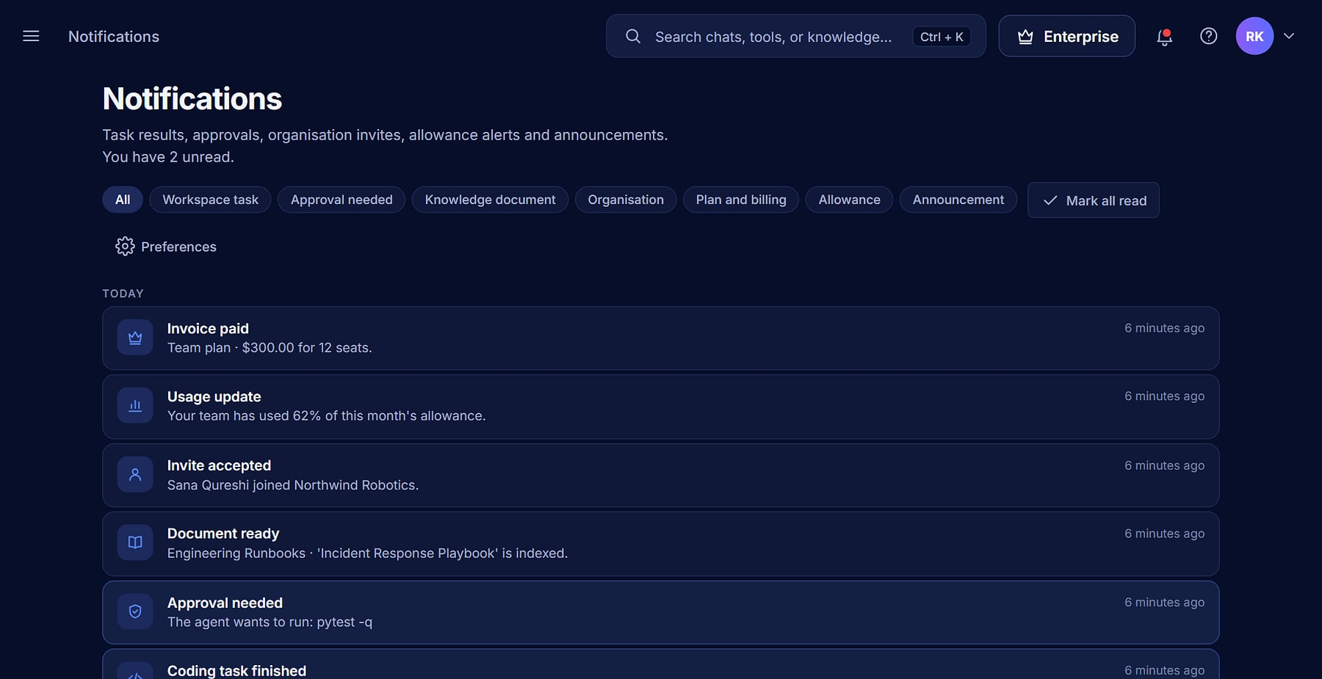


Operate the fleet, and keep everyone in the loop
ADMIN CONSOLE AND NOTIFICATIONS
Platform dashboard: cost, users, requests, cache rate and tokens by model (demo data).
Notifications: tasks done, approvals needed, documents ready, invites.
Per-user reports
Grant credits
Toggle access
Notifications
Drill into any account's usage.
One-off allowances when needed.
Activate or suspend accounts.
Tasks, approvals, invites, billing.
Notes:
apps/core admin console (platform dashboard, per-user report, grant credits, toggle active) and apps/notifications.

Slide 28
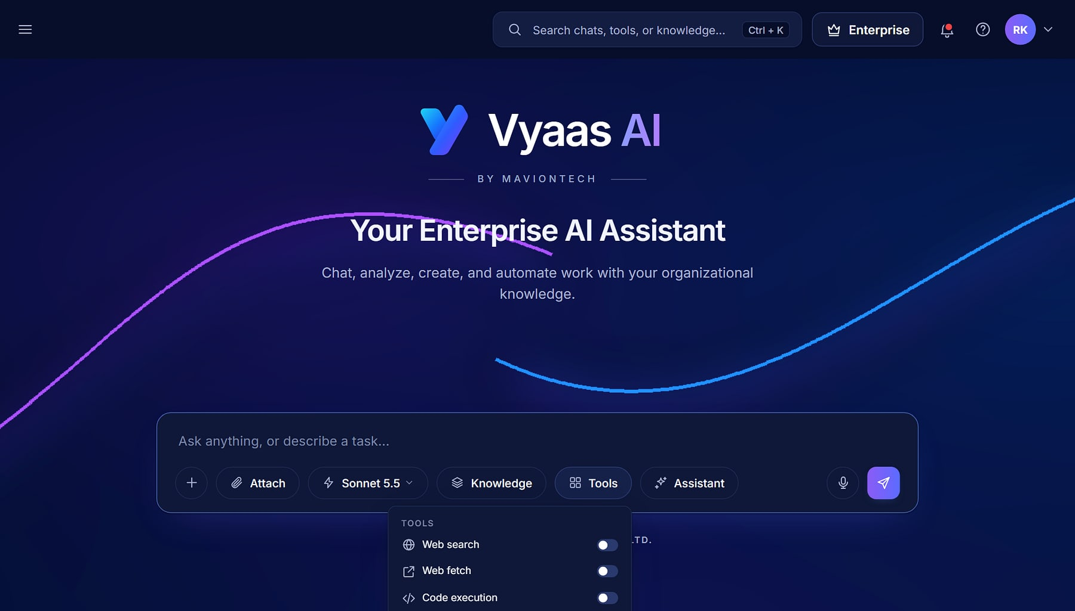

Choose your horsepower: Claude and OpenAI
MULTI-MODEL CATALOGUE
Provider-agnostic
Vyaas AI · Composer
Claude and OpenAI models in one catalogue; new models are added without code changes.
Per-plan gating
Each plan decides which models and how much effort.
Org allow-list
Admins narrow the models members may use.
One meter
Usage measured in Sonnet-equivalent units across providers.
Composer: model, knowledge, tools and assistant chosen per conversation (demo data).
Notes:
apps/catalogue/models.py (provider-agnostic), apps/chat/openai_chat.py. Specific model names are kept off the slide because they change; the current catalogue lists Claude Sonnet, Opus, Haiku and Fable models and OpenAI GPT models.

Slide 29
Built for the enterprise from the ground up
ARCHITECTURE
Experience
Enterprise shell · chat · knowledge · documents · workspaces · admin console
Platform
Django 5.2 + DRF · allauth sign-in · organisations, policies and audit · Token Optimisation Engine
Intelligence
Provider-agnostic catalogue: Anthropic Claude + OpenAI · BM25 retrieval · document and image skills
Execution
Coding agent loop · gVisor sandbox · registry-only egress proxy · Connect companion
Foundation
MySQL 8 · Redis + Celery · gunicorn + whitenoise · encrypted secrets · Ubuntu VPS install scripts
Multi-tenant through organisations: data is scoped per organisation, with per-organisation policy and audit, in one application database.
Notes:
Stack from CLAUDE.md, requirements.txt and deploy/ (install.sh, systemd, nginx, egress, sandbox). Tenancy is organisation-scoped, not a database per tenant; this matters for the portfolio catalogue's isolation statement.

Slide 30





Your data, your models, your controls
SECURITY AND DATA HANDLING
Encrypted secrets
Sandboxed execution
Organisation scoping
Provider keys and Git tokens encrypted at rest; never sent to the model.
gVisor containers, no network by default, approval gates.
Members see their organisation's shared assets, under its policies.
Audit trail
Self-hostable
Model choice
Administrative actions logged with actor and time.
Install on your own Ubuntu VPS with the provided scripts.
Allow only the providers and models your policy approves.
Notes:
Evidence: workspace/crypto.py, workspace/sandbox.py, orgs/, deploy/install.sh. No certification, data-residency or uptime claim is made; those are open items for MavionTech.

Slide 31



Today versus with Vyaas AI
WHY SWITCH
TODAY
WITH VYAAS AI
Trust
Answers
Hallucinations, no sources
Cited answers from your knowledge
Every grounded answer shows its source.
Engineering
Autocomplete snippets
An agent that opens pull requests
Throughput
Tasks go from request to PR.
Governance
Data pasted into consumer tools
Org policies, roles and audit
Control
Models
Locked to one vendor
Claude and OpenAI, your choice
Policies narrow what members can do.
Cost
Unpredictable token bills
Optimisation and per-reply metering
Spend
Fewer tokens per request, measured.
Notes:
Generic 'today' patterns from the source deck, not a named competitor.

Slide 32



Live in weeks, not quarters
DEPLOYMENT AND INDICATIVE ROLLOUT
1
2
3
4
Stand up · week 1
Seed knowledge · week 2
Pilot · week 3
Scale · week 4+
Deploy on your VPS or use the hosted service; connect models; create the organisation.
Load collections, set policies and invite the team.
Engineers use the coding agent; analysts use cited chat.
Share assistants, review analytics, roll out organisation-wide.
Indicative only: timing depends on your environment, knowledge sources and team size, and is confirmed per engagement.
Notes:
Indicative plan from the source deck slide 28. Self-hosting evidenced by deploy/install.sh; not a commitment.

Slide 33



What's next on the Vyaas AI roadmap
ROADMAP
PLANNED
PLANNED
OAuth for Git providers
GitLab support
One-click connect; personal access tokens work today.
Beyond GitHub, with the same workflow.
PLANNED
PLANNED
Push and PR from Connect
Warm task containers
Open pull requests from a workspace on your own machine.
Dependencies that persist across task steps.
Planned items from docs/Vyaas_AI_Coding_Agent_P0_Spec (deferred items). Not in the current release; timelines to be confirmed.
Notes:
Roadmap only: nothing on this slide is shipped.

Slide 34

Put a cite-first, ship-ready AI platform to work
LET'S GET STARTED
MavionTech Pvt. Ltd.
Vyaas AI · Enterprise AI Assistant
communications@maviontech.com
+91 91580 08002
www.maviontech.com
505 Zen Business Center, Bhumkar Chowk, Wakad, Pune, Maharashtra 411057
Start with a pilot team on your data, under your policies, with the models you choose.
Book a demo
Plan a pilot
Notes:
One ask: a pilot. Official MavionTech contact details; no Vyaas-specific domain has been verified.

