Slide 1
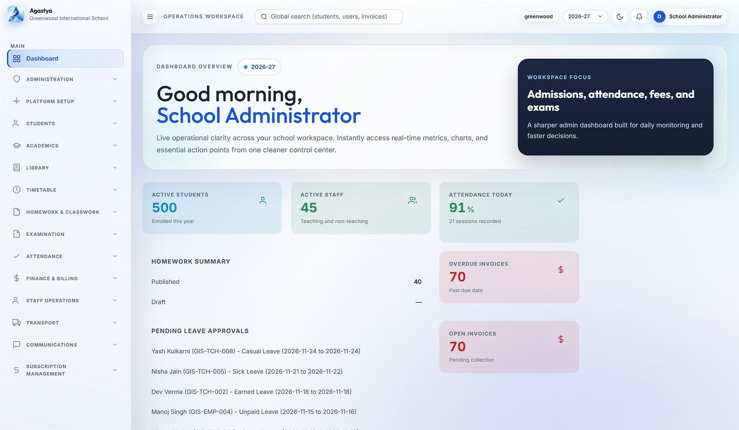
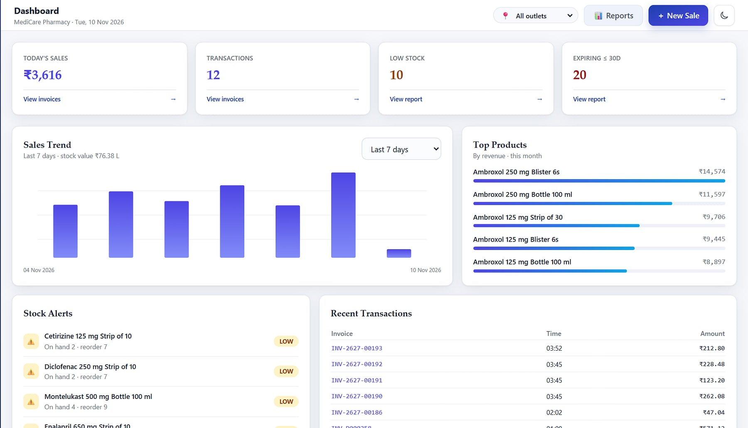



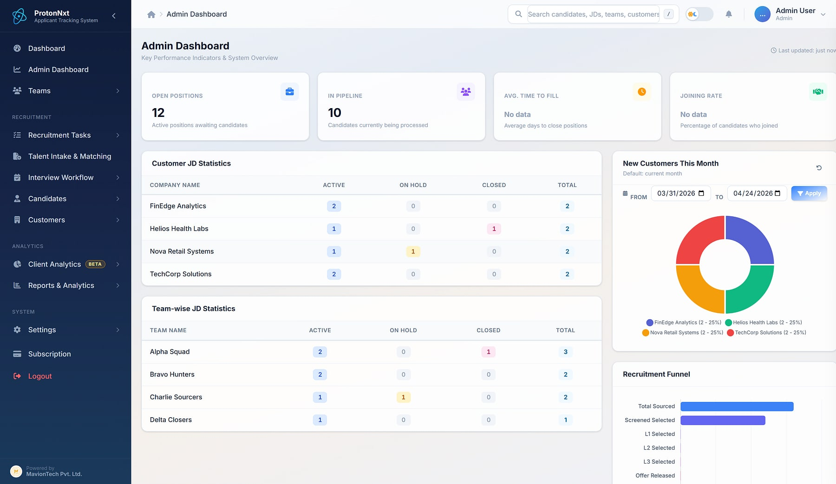

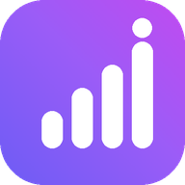



Simpler operations. Stronger momentum.
Agastya · Cloud School ERP
COMPANY INTRODUCTION · 2026
HeeLIKS · Owner dashboard
Enterprise software that runs schools, people, hiring, learning, sales and stock, so your teams can run the business.
Vortex HRMS
ProtonNxt
PragyanNxt
Agastya
MavionLearn
SalesPulse CRM
HeeLIKS
Vyaas AI
Notes:
Company introduction for any audience (customers, partners, investors). Screens are real product captures with demo data. Facts from maviontech.com and the approved Corporate Product Catalogue vNext (10 Nov 2026).

Slide 2
An Indian product company for enterprise applications
WHO WE ARE
COMPANY
MavionTech Private Limited
OUR MISSION
Automate and simplify operational workflows with secure, extensible enterprise software that empowers teams to focus on what matters most.
HEADQUARTERS
Wakad, Pune, Maharashtra, India
WHAT WE BUILD
Enterprise business applications
OUR PORTFOLIO
Eight platforms; seven ready today, four of them flagship products
OUR JOURNEY
WHO WE SERVE
Staffing & HR, IT, EdTech, consulting, finance and service providers, MSMEs
2023
2024
2025
Today
Training foundation
Product development
Independent product company
Eight enterprise platforms
Momentum with Vision
Notes:
Company facts, mission and milestones from maviontech.com (Company page and footer), quoted as published. Verticals from the maviontech.com home page. No employee, customer or revenue figures are stated because none are evidenced.

Slide 3






Why everyday operations feel harder than they should
THE PROBLEMS WE HEAR EVERY DAY
Work lives in spreadsheets
Reconciliation, every single cycle
Leaders wait days for the numbers
Admissions, stock, attendance and leads live in files and chat groups, so nothing reconciles.
Attendance to payroll, fees to invoices, stock to books: re-keyed by hand every month.
Reports are assembled after the fact, when the decision was needed yesterday.
Data walks out with people
Compliance rebuilt by hand
No control, no trail
Customer numbers, CVs and records sit on personal phones and inboxes.
GST returns, statutory payroll and certificates are prepared again every period.
Shared logins and no record of who changed a price, a mark or a payslip.
Notes:
Problems drawn from the problem slides of the eight approved product decks and the catalogue (slide 7). No market statistics are used.

Slide 4




One governed system for each part of the business
HOW MAVIONTECH SIMPLIFIES OPERATIONS
Capture once
Automate the routine
Control who does what
See it live
BEFORE
BEFORE
BEFORE
BEFORE
The same data typed into three tools
Reconciliation and reports built by hand
Shared logins and no audit trail
Numbers arrive days late
WITH MAVIONTECH
WITH MAVIONTECH
WITH MAVIONTECH
WITH MAVIONTECH
One record for every student, employee, candidate, customer or product
Payroll from attendance, invoices from fees, reports that build themselves
Role-based access, two-factor where it matters, every change on record
Live dashboards for every role, exports in your own brand
Built for how India does business: GST, statutory payroll, INR pricing, Razorpay and WhatsApp, with each customer's data kept separate.
Notes:
Four ways every MavionTech product simplifies operations, generalised from the approved decks and the catalogue's shared foundation (slide 10). 'Kept separate' covers a database per customer (seven products) and organisation scoping (Vyaas AI).

Slide 5
Eight platforms, one standard of engineering
OUR PRODUCT CATALOGUE
Vortex HRMS
FLAGSHIP · READY
ProtonNxt
FLAGSHIP · READY
Unified People Platform
Enterprise ATS
People platform: HR, Face-AI attendance, leave, payroll and employee self-service on one record.
AI-assisted applicant tracking for recruitment firms and talent teams, from requisition to joining.
PragyanNxt
FLAGSHIP · READY
Agastya
FLAGSHIP · READY
Assessment & Certification
Cloud School ERP
Author, deliver, proctor, score and certify assessments, with verifiable credentials.
Cloud ERP for school groups: admissions, academics, fees, transport and parent communication.
MavionLearn
READY · AVAILABLE
SalesPulse CRM
READY · AVAILABLE
Enterprise LMS · Skills & Compliance
India-first Sales CRM
Enterprise LMS that scores skills against role targets and runs compliance on its own.
India-first sales CRM with privacy-masked calling and reports that build themselves.
HeeLIKS
READY · AVAILABLE
Vyaas AI
PREMIUM · FUTURE
Inventory, POS & Distribution
Enterprise AI Assistant
Inventory, point of sale and B2B order-to-cash on one stock ledger, GST-ready.
Enterprise AI assistant: cited answers, finished documents and a coding agent, under your policy.
Notes:
Status as set by MavionTech (10 Nov 2026): Flagship and ready: Agastya, PragyanNxt, Vortex HRMS, ProtonNxt. Ready, tested and available: MavionLearn, SalesPulse CRM, HeeLIKS. Premium product envisioned for the future: Vyaas AI. Full detail in the Corporate Product Catalogue vNext.

Slide 6
Each problem, the product that answers it, and how
HOW OUR PRODUCTS TACKLE THEM
THE PROBLEM TODAY
OUR PRODUCT
HOW IT IS SOLVED
Attendance-to-payroll reconciliation every month
Vortex HRMS
Face-AI attendance and policy-driven payroll on one employee record
Hiring spread across inboxes, sheets and agencies
ProtonNxt
One structured pipeline with AI résumé parsing and controlled vendor access
Assessments and certificates that get questioned
PragyanNxt
Proctored assessments with an integrity score, and credentials anyone can verify
School operations spread across registers and chat groups
Agastya
Admissions to report cards, fees and transport on one governed platform per school
Training that cannot prove capability
MavionLearn
A skill matrix against role targets, and compliance campaigns that run themselves
Customer contacts leave with sales reps
SalesPulse CRM
Privacy-masked calling, email and WhatsApp, and reports that build themselves
Stock, sales and GST books that never agree
HeeLIKS
One append-only stock ledger from purchase order to paid invoice, GSTR-1 ready
AI answers nobody can trust or govern
Vyaas AI
Cited answers over your own knowledge, under organisation policy (premium, coming)
Notes:
Problem and solution pairs from the approved product decks and the catalogue's opportunities slide. Vyaas AI is a premium product envisioned for the future.

Slide 7
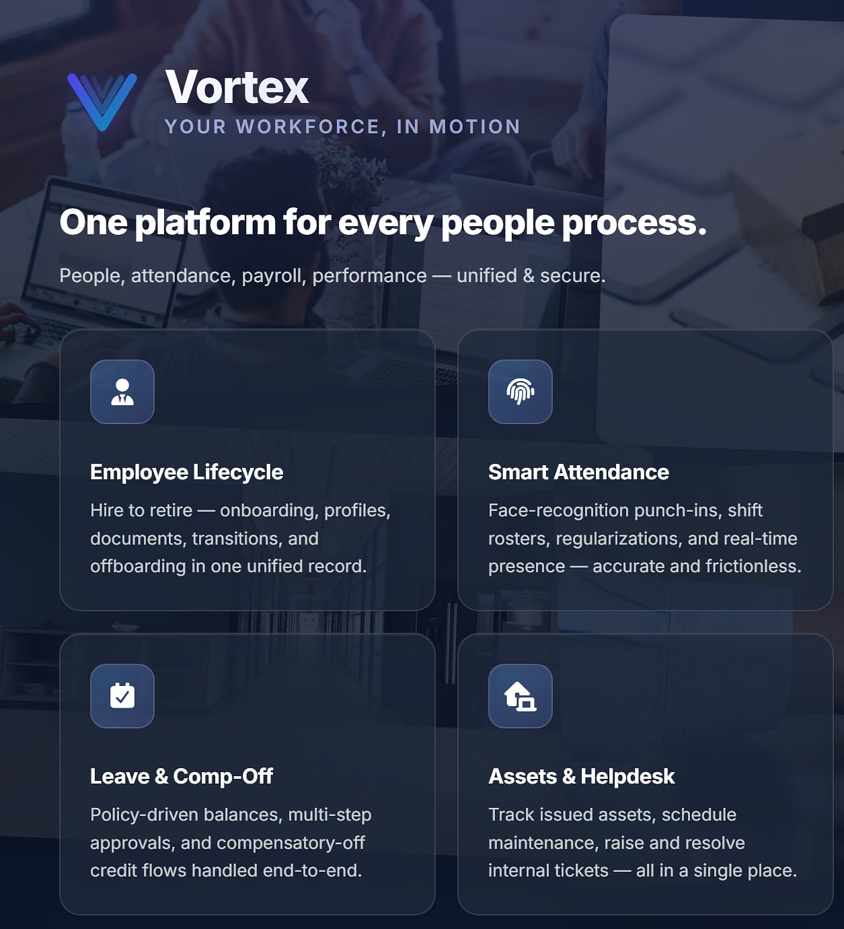
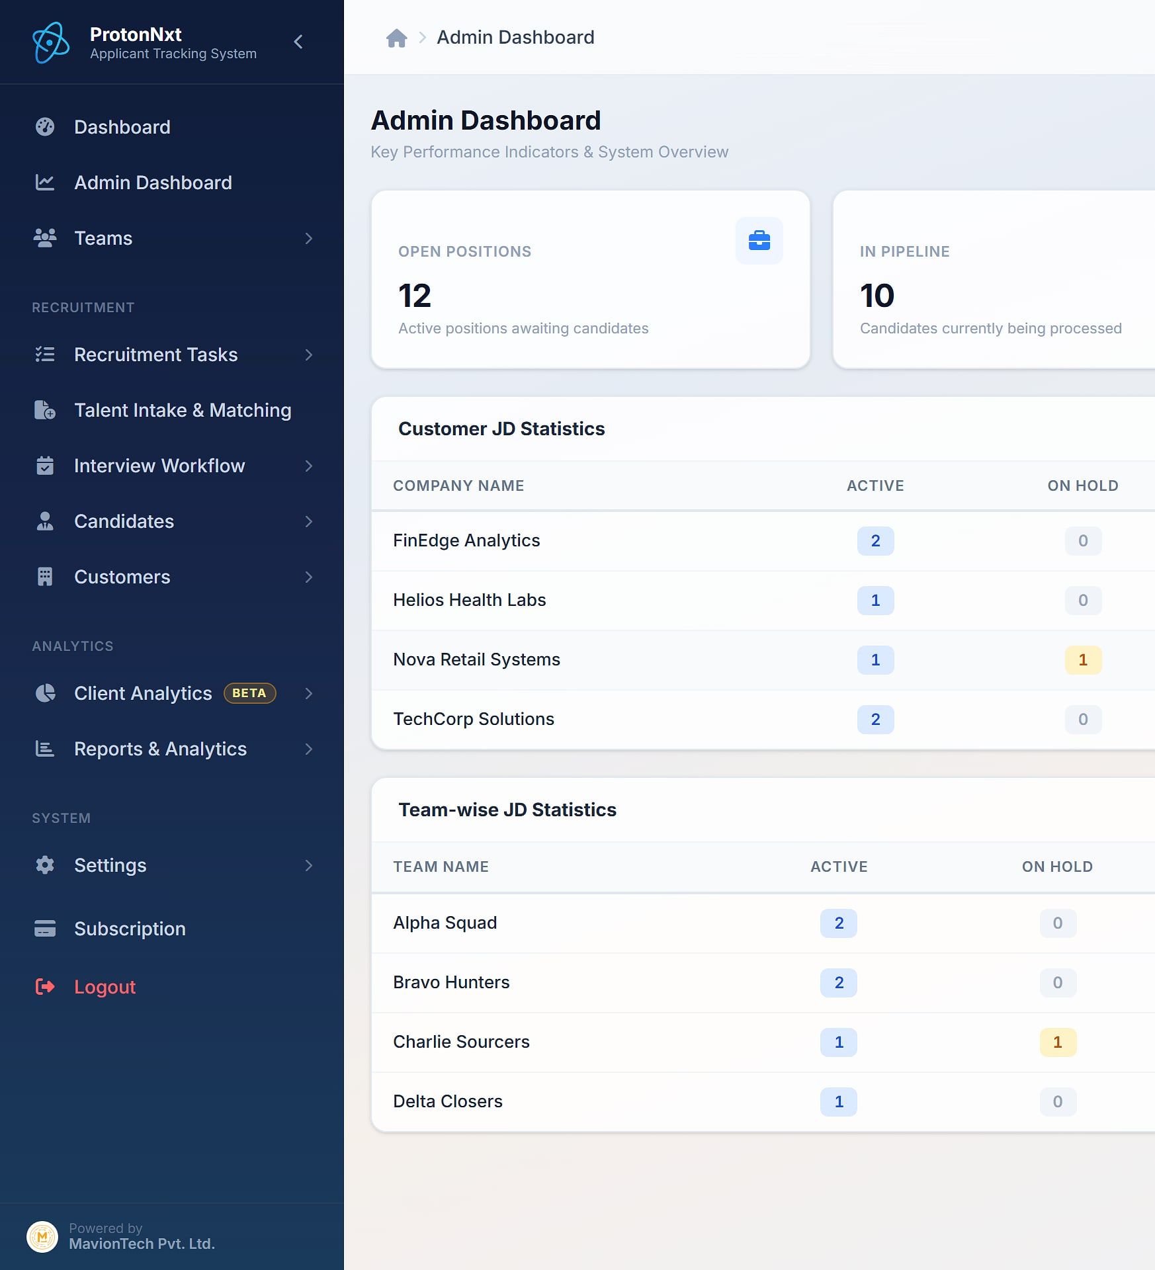
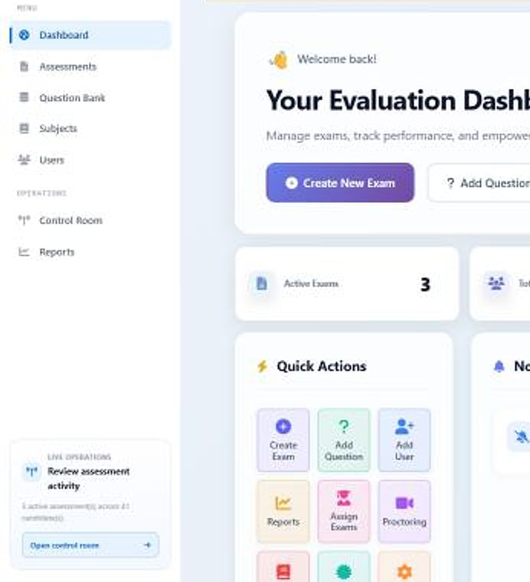
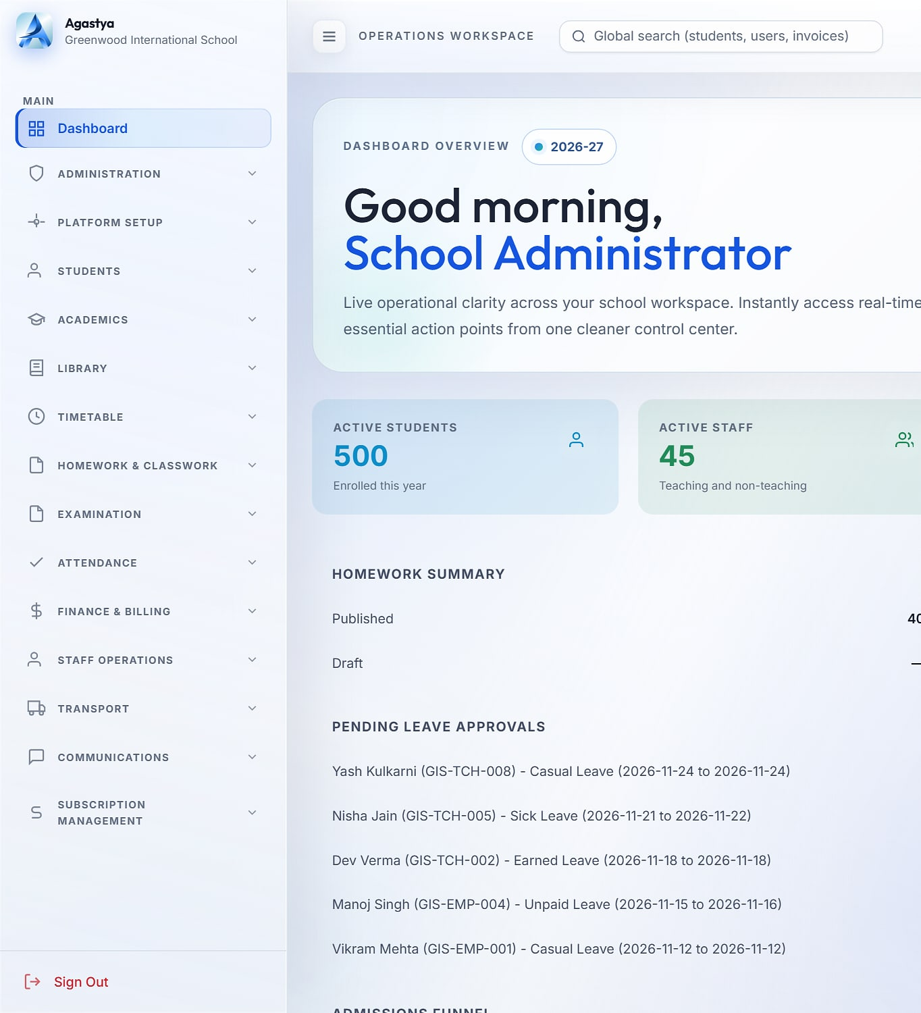
Our four flagship products, as they look today
REAL PRODUCTS, SHOWN AS THEY ARE
Vortex HRMS
ProtonNxt
PragyanNxt
Agastya
FLAGSHIP · READY
FLAGSHIP · READY
FLAGSHIP · READY
FLAGSHIP · READY
Platform overview from vortexhrms.com.
Recruitment admin dashboard (demo data).
Evaluation dashboard (demo data).
School administrator dashboard (demo data).
Notes:
Real captures with demo data from the approved decks. The Vortex HRMS image is from its public site (vortexhrms.com); in-app Vortex screenshots are an open item.

Slide 8
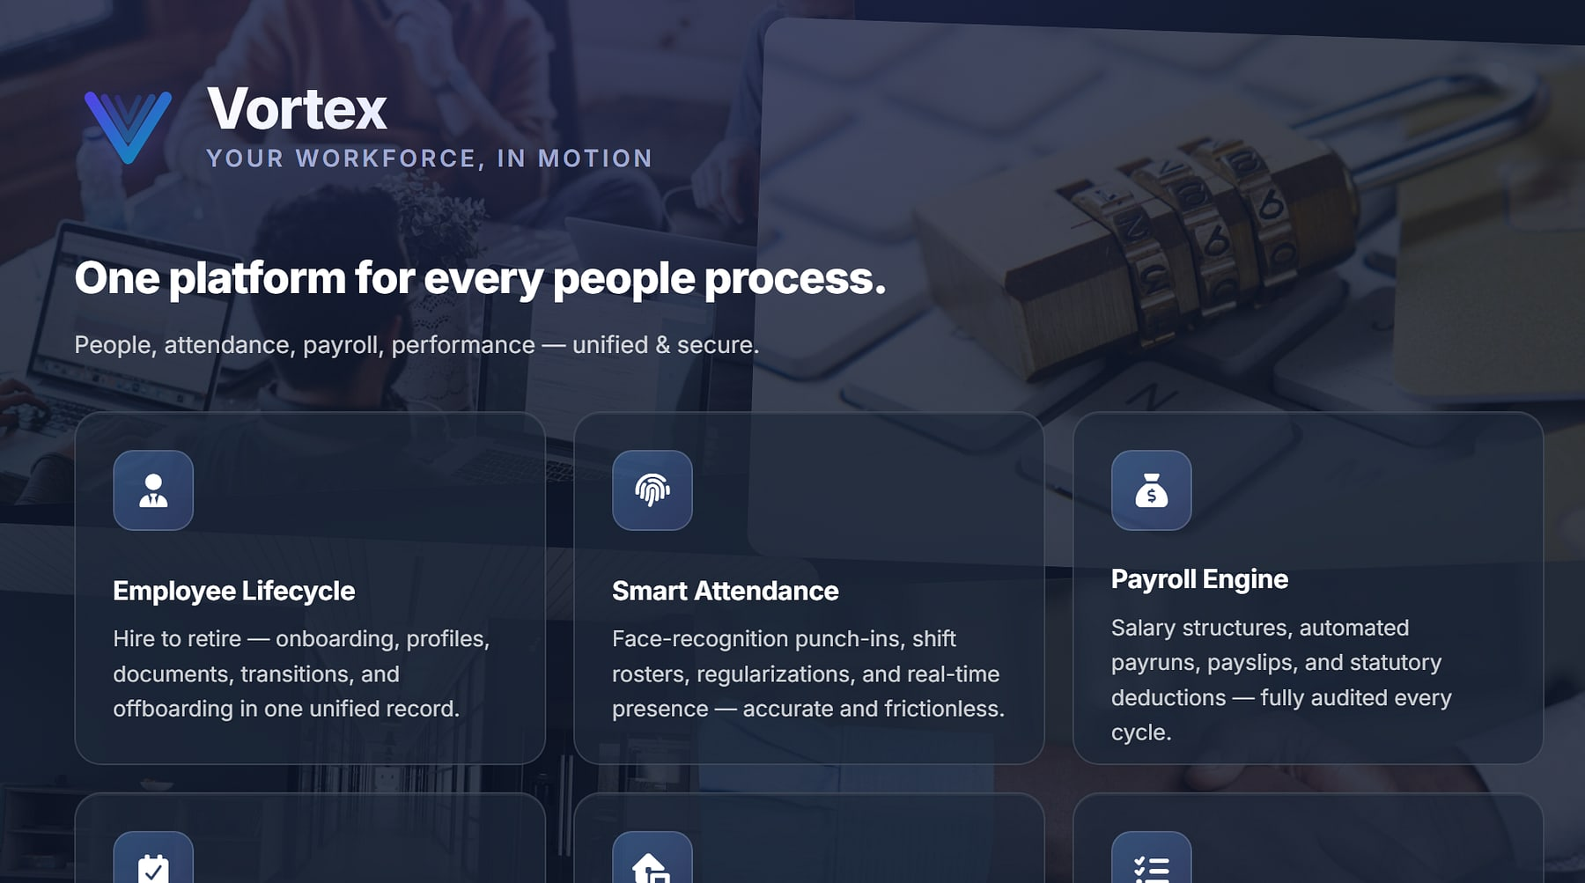

Hire to retire. Attendance to payroll. On one record.
FLAGSHIP PRODUCT · UNIFIED PEOPLE PLATFORM
Vortex HRMS
FLAGSHIP · READY
HR, payroll & finance · field and shift workforces
THE PROBLEM
HR, payroll, attendance and helpdesk live in separate tools. Finance reconciles attendance to payroll by hand, and statutory rules keep changing.
OUR ANSWER
One people platform: Face-AI attendance, policy-driven payroll, leave, approvals and employee self-service, with a database per customer.
KEY CAPABILITIES
Face-AI attendance with geo-fencing
Policy-driven payroll: PF, ESI, PT, TDS
Leave, approvals and escalations
VortexGo and SnapLens mobile apps
Platform overview from vortexhrms.com.
14
Face-AI
2
modules
attendance
mobile apps
Notes:
Vortex HRMS: flagship product, ready today (MavionTech status, 10 Nov 2026). Content from the approved catalogue vNext showcase and the approved Vortex HRMS deck. No in-app Vortex screenshots exist in the sources; the image is the public vortexhrms.com page. Prices are not shown in this send-anywhere deck.

Slide 9
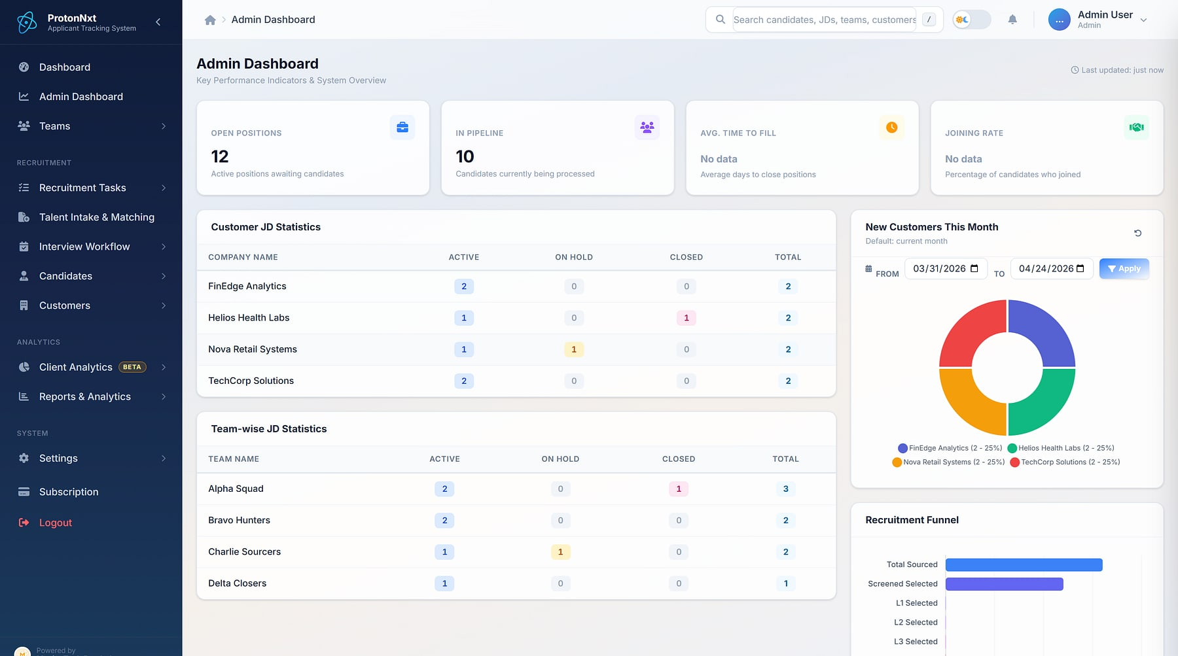

From requisition to hire, in one structured pipeline
FLAGSHIP PRODUCT · ENTERPRISE ATS
ProtonNxt
FLAGSHIP · READY
Staffing firms · talent teams · vendor agencies
THE PROBLEM
Recruiters screen résumés by hand, ownership is unclear, feedback lives in inboxes, and vendor CVs arrive with no caps, duplicates or audit.
OUR ANSWER
An AI-assisted ATS for recruitment firms and talent teams: sourcing, parsing, interviews, offers, vendors and client insight on one system.
KEY CAPABILITIES
AI résumé parsing (OpenAI or Gemini)
Pipeline from requisition to joining
L1–L3 interviews, structured feedback
Vendor portal with caps and duplicate checks
Admin dashboard: KPIs, JD statistics and recruitment funnel (demo data).
15
2
L1–L3
modules in every tenant
AI parsing paths
structured interviews
Notes:
ProtonNxt: flagship product, ready today (MavionTech status, 10 Nov 2026). Content from the approved catalogue vNext showcase and the approved ProtonNxt deck. Screen is a real product capture with demo data.

Slide 10
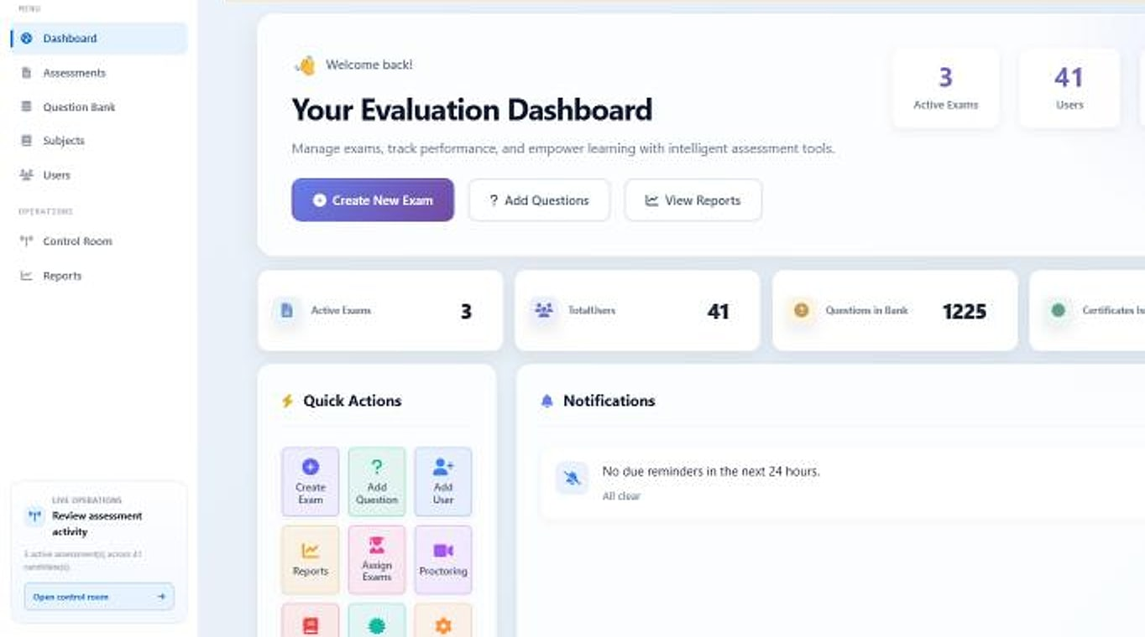

Results you can defend. Credentials anyone can verify.
FLAGSHIP PRODUCT · ASSESSMENT & CERTIFICATION
PragyanNxt
FLAGSHIP · READY
Corporate hiring teams · academic institutions · certification
THE PROBLEM
Gamed screening tests push the wrong candidates forward, unmonitored exams devalue certificates, and point tools never talk to each other.
OUR ANSWER
One platform to author, deliver, proctor, score and certify, with an integrity score on every attempt.
KEY CAPABILITIES
Question bank with AI generation
Live and AI visual proctoring
Integrity score on every attempt
Signed certificates anyone can verify
Evaluation dashboard: active exams, users and question bank (demo data).
8
Ed25519
5-step
integrated modules
signed credentials
author to certify
Notes:
PragyanNxt: flagship product, ready today (MavionTech status, 10 Nov 2026). Content from the approved catalogue vNext showcase and the approved PragyanNxt deck. Screen is a real product capture with demo data.

Slide 11
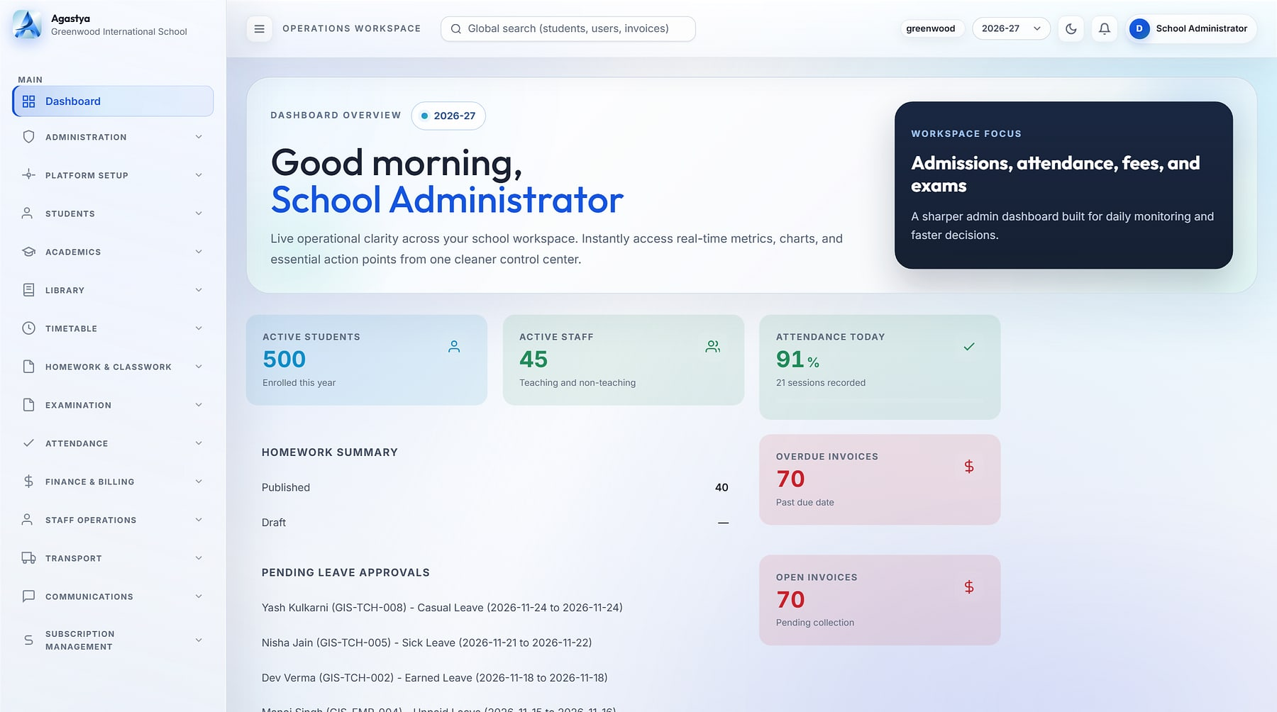

One operating system for every school in your group
FLAGSHIP PRODUCT · CLOUD SCHOOL ERP
Agastya
FLAGSHIP · READY
School groups & chains · single schools · principals
THE PROBLEM
School groups run on registers, spreadsheets and WhatsApp. Nothing reconciles, leaders wait days for numbers, and student data sits on personal phones.
OUR ANSWER
Admissions to report cards, fees to fleet: every department and campus on one governed platform, with each school's data in its own database.
KEY CAPABILITIES
Admissions to report cards on one record
Fees, invoices and daily collections
Transport, library, hostel and staff
Parent portal, student app, WhatsApp inbox
School administrator dashboard (demo data).
19
8
96
integrated modules
role cockpits
permission codes
Notes:
Agastya: flagship product, ready today (MavionTech status, 10 Nov 2026). Content from the approved catalogue vNext showcase and the approved Agastya deck. Screen is a real product capture with demo data.

Slide 12






Six reasons to build on MavionTech
WHY MAVIONTECH
01
02
03
Real products, shown as they are
Your data, isolated by design
Governed by design
Real product screens with demo data, and no invented customers.
A database per customer in seven products; organisation scoping in Vyaas AI.
Role-based access, audit trails and session controls you can inspect.
04
05
06
Configurable without code
Built for how India does business
One partner, eight platforms
Administrators shape dashboards, fields, workflows and branding.
GST, statutory payroll, INR pricing and local payment and messaging rails.
One engineering standard and one point of contact across the portfolio.
Notes:
As in the approved catalogue vNext, slide 60. Certifications, uptime and support hours are not claimed; they are confirmed in each proposal.

Slide 13



From a first conversation to go-live, step by step
HOW WE WORK WITH YOU
1 Demo
2 Pilot
3 Proposal
See the product on scenarios that match yours.
Prove value on your own data with one team, outlet or campus.
Scope, plan and commercials confirmed in writing.
IMPLEMENTATION METHOD
Discover
Configure
Validate
Go live
Requirements, process mapping, design and kickoff
Setup, configuration, integrations and data migration
User acceptance, performance testing and security review
Training, launch support, documentation and handover
Cloud SaaS
On-premise or self-hosted
Managed hosting & support
Multi-tenant, for every product
Available for selected products
Backup, recovery and continuous updates
Indicative method; timelines are confirmed during scoping.
Notes:
Engagement path and four-phase method from the MavionTech company profile, as used in the approved catalogue (slide 53). Deployment options from maviontech.com and the approved decks: on-premise or self-hosted for MavionLearn, PragyanNxt, HeeLIKS and Vyaas AI.

Slide 14

Tell us where work feels hardest. We'll show you the fix.
LET'S BUILD MOMENTUM TOGETHER
MavionTech Pvt. Ltd.
Enterprise Business Applications
SALES & SUPPORT
communications@maviontech.com
PHONE
+91 91580 08002
Book a 30-minute demo on scenarios that match yours, or ask for the full Corporate Product Catalogue.
WEB
www.maviontech.com
OFFICE
Office 505, Zen Business Center, Bhumkar Chowk, Wakad, Pune, Maharashtra 411057 (visits by appointment)
Book a demo
Get the catalogue
Notes:
Contact details from maviontech.com (Contact page and footer). The '30-minute demo' is a suggested format, not a published offer; adjust as needed.

