Slide 1
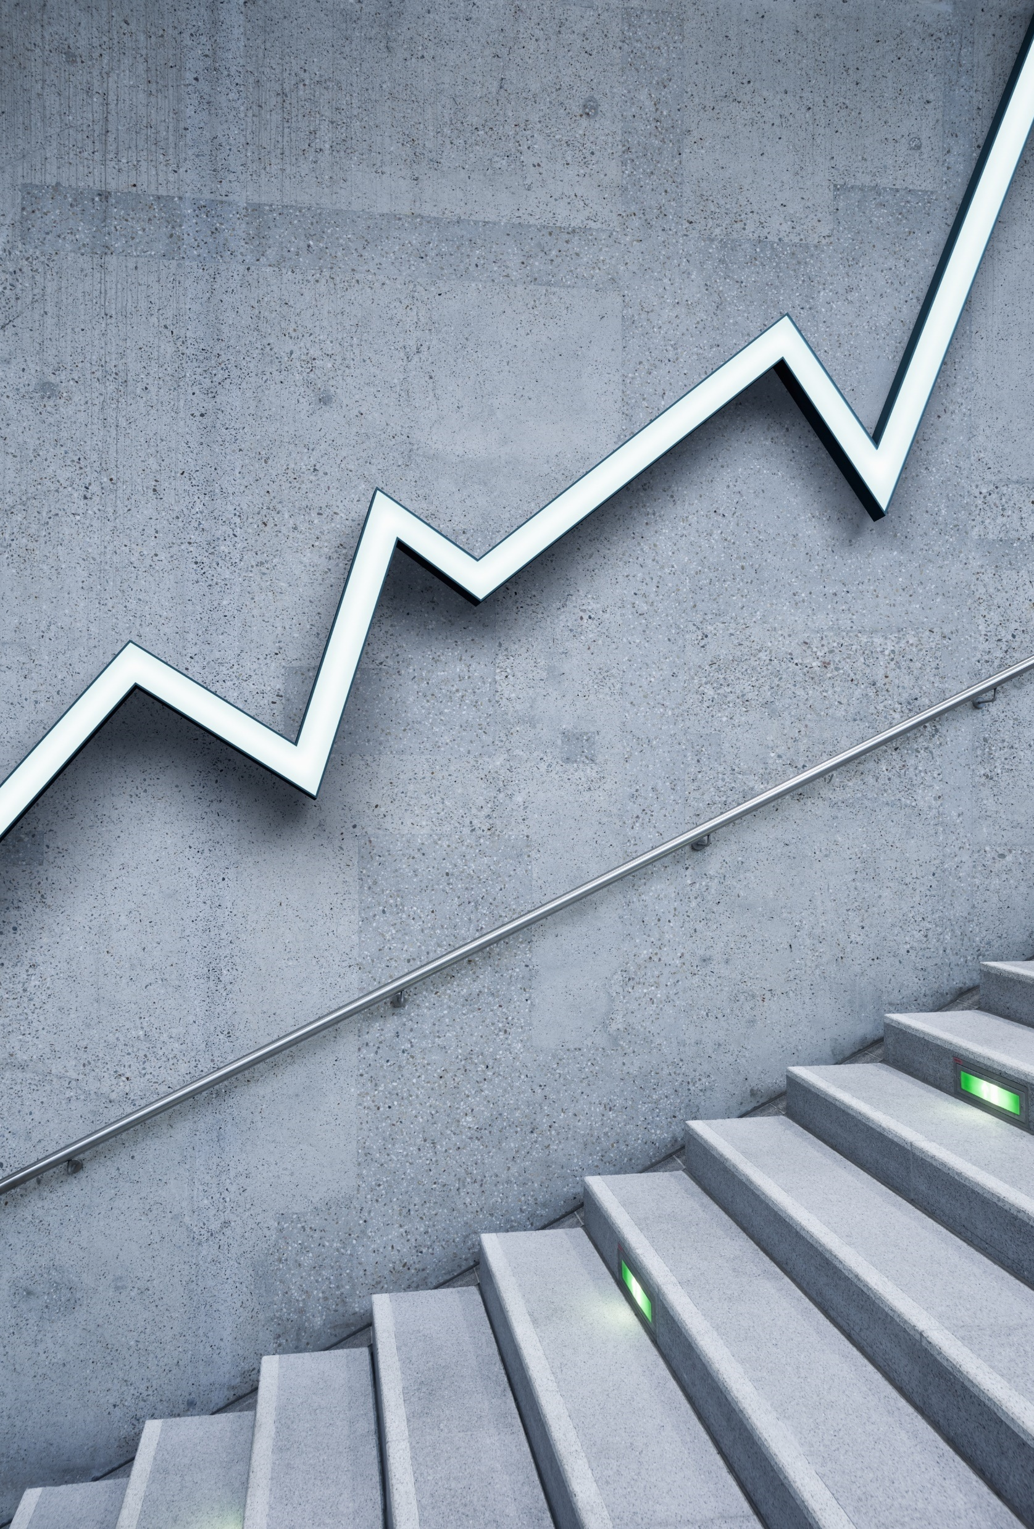
Master-Thesis on REAL TIME PRODUCT DETECTION Under supervision of Prof.Dr.Swati Chandna Dr.Simon Ziegler MILESTONE - 1 UPDATE (01-APR-2021 to 21-APR-2021)
Presented By:
Mavis monica dsilva

Slide 2
DATA COLLECTION AND STORAGE
RESEARCH QUESTION: “How to extract data for analysis?”
Data required:
Images for classification
Calories
Product cost

Slide 3
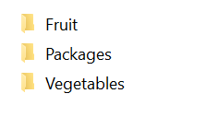
DATA COLLECTION AND STORAGE
IMAGES FOR CLASSIFICATION
Freiburg dataset(existing)
25 categories
Grocerystore dataset
https://github.com/marcusklasson/GroceryStoreDataset/tree/master/sample_images/natural

Slide 4
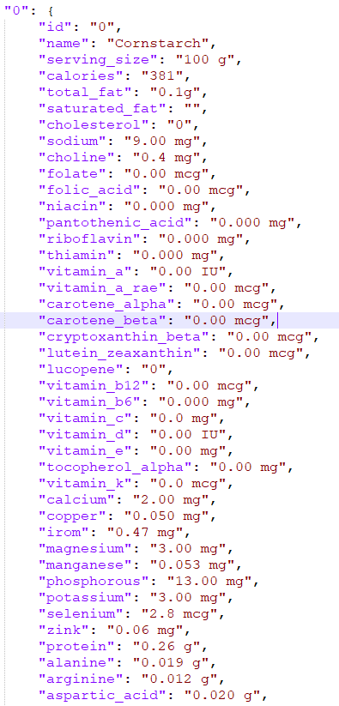
DATA COLLECTION AND STORAGE
CALORIES
Nutrients dataset from Kaggle
Further the data is to be stored in mongodb
Converted .csv to .json using python

Slide 5
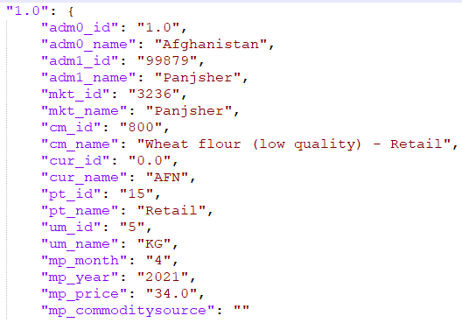
DATA COLLECTION AND STORAGE
PRODUCT COST
Cost of grocery products dataset from Kaggle
Further the data is to be stored in mongodb
Converted .csv to .json using python

Slide 6
FOR MILESTONE – 2
(21-APR-2021 to 15-MAY-2021)
DATA PREPROCESSING

Slide 7
THANK YOU

