Slide 1


Master-Thesis on
REAL TIME PRODUCT DETECTION
Under supervision of Prof.Dr.Swati Chandna Dr.Simon Ziegler
05-MAY-2021
Presented By:
Mavis Monica Dsilva
Notes:
My master thesis is on…… lets move to the agenda for today

Slide 2
Agenda
Introduction
Motivation
Problem statement
Research objective
Research methodology
Current status
Current impediments
Future work
Notes:
Short intro on the topic, then what motivated me to select this topic
Then we will look into problem statement and research objective
After that I am going to give a short overview on How am I planning to implement this i.e the research methodology
Then we will look into current status and impedimens
At the end I will talk about the future work

Slide 3
Introduction
Object detection/recognition is a trending topic
Detection of grocery items is less explored
The main aim is to detect an object and then classify it into a particular category
Notes:
1. Object detection/recognition is a trending topic
2. There is a lot of work done in detection of number plates or colors etc.
But detection of grocery items is less explored

Slide 4
MOTIVATION
Technology can be used for the betterment of the society
The elderly people or the physically challenged have always had the problem of going around the supermarket and buying items
A well-trained machine will surely identify the required items and help people
Notes:
I believe that technology must be used for betterment of society than using for individual purposes
The elderly……..
There are less chances that these people know to use apps and do online shopping

Slide 5
PROBLEM STATEMENT
Few dataset’s available covering most of the categories
Mis-classification of items/products
Less accuracy
Multi-class classification failure
Display calorie content and costs of various product brands
Notes:
1. Currently there are few datasets available publicly as most of them are privately owned
2. Since there is less data and fewer categories, there is mis-classification of products. Therefore, the model has less accuracy
3. The products that belong to more than one class are not handled well
4. If a user wants to know the calorie content present in a product or how is the cost varied for various brands or whant to know about the cost of product at different stores? There is no much work in this area.

Slide 6
RESEARCH OBJECTIVE
Extract more data for analysis
Increase the performance of the model
Handle multi-class classification
Visually represent
Calorie content of each product
Price comparisons of brands or price comparison at different locations
Notes:
2. This can be done by hyper parameter tuning. It is not done in the previous works. if we do so, the performance of the model will increase and thereby having accurate predictions
3. As mentioned in prob stmt, the products that belong to 2 or more classes are not classified properly. Therefore handling this would be one of the objective

Slide 7
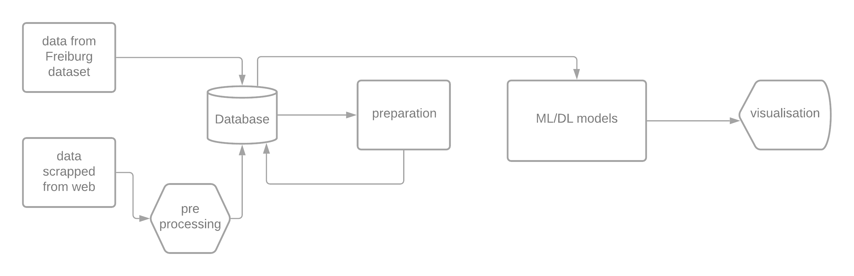
RESEARCH METHODOLOGY
Old methodology

Slide 8
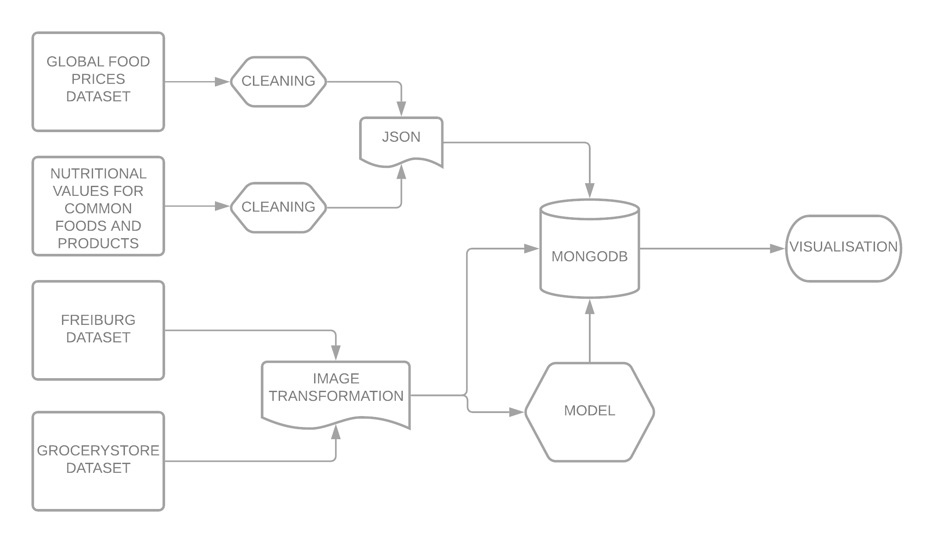
RESEARCH METHODOLOGY
New methodology
DATA PREPROCESSING + PREPARATION
DATA COLLECTION
DATA STORAGE
MODELING

Slide 9
CURRENT STATUS
Completed:
Data collection
Data cleaning of csv’s
Conversion of csv’s to json
Image storage
Tutorials
Gridfs
Node.js
Modeling
Tutorial
keras

Slide 10
CURRENT impediments
Image storage
Gridfs
Node.js

Slide 11
Future work
Image storage
Modeling
Once done with it,
Feature selection
Report

Slide 12
Thank you
for your attention

