Slide 1
Sedation and Analgesia- Pharmacology

Slide 2
Topics:
Sedative drugs
Analgesics
Combinations

Slide 3

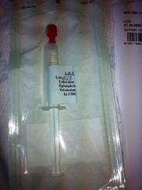
Sedatives and analgesics use in the pediatric ED
Topical
Oral
IN/SL
Rectal
IM
IV
INH
EMLA
Ametop Gel
LAT
Elamax
Midazolam
Chloral hydrate
Midazolam Fentanyl Dexmedet.
Midazolam Methohexital Pentob.
Thiopental Chloral hy.
Midazolam Ketamine
Midazolam Ketamine Fentanyl Propofol Etomidate Pentob Dexmedet
Nitrous Oxide
Atomizer Intra nasal analgesics
Fentanyl (via atomizer) Diamorphine nasal spray (Ayendi)
Oral analgesics
Oral Morphine (Oramorph) Oxycodone
Tramadol
LAT gel

Slide 4
Sedative medications:
May work in various mechanisms
Simple anxiolysis -→Deep hypnotic sedation
Same medication may cause different effects in sedation level (Continuum)
Different routes and different dose = different sedation level expected.
Knowing the pharmacology helps plan the needs for achieving a successful sedation for a successful procedure.
Titration

Slide 5
Drug
Mechanism of action:
Drug class:
Possible routes:
Doses:
Onset time
Duration:
Side Effects:
Contraindications:
Antidotes:

Slide 6
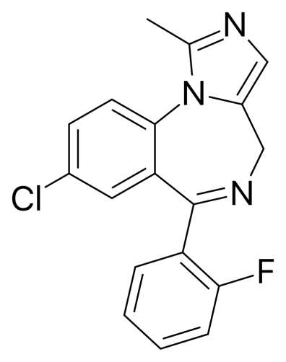
Midazolam (Benzodiazepines)
Mechanism of action: GABA enhancer
Drug class: Anxiolysis, Muscle relaxant, Amnestic (ANTEROGRADE), Anticonvulsant
Possible routes: PO (0.5-0.75mg/kg) IN (0.3-0.5) IV/IM (0.1) PR(?)
Doses:
Onset time: PO- 10-15min/IN-5min/IV-2 min
Duration:30-45 minutes
Side Effects: hypotension-rare, resp depression, paradoxical reaction
Contraindications: ? (excreted by the kidney)/careful with opiates!
Antidotes: Flumazenil (Annexate) -0.01 mg/kg (max 0.2mg/dose)

Slide 7
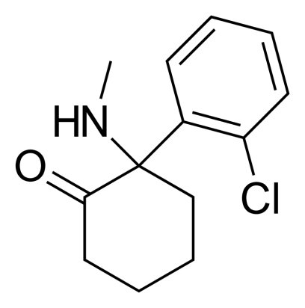
Ketamine
בחולים עם רקע פסיכיאטרי רצוי להמנע עקב הגברת האפקט
Mechanism of action: NMDA receptor antagonist
Drug class: Dissociative (unique!)/Analgesic
Possible routes: IV/IM IN/PO(?)-noninferior to midazolam
Doses:IV- 1mg/kg (pain 0.2-0.5mg/kg) IM- 2-3mg/kg PO-5-10mg/kg
Onset time: IV- 1-5min IM- 5-10 min
Duration:20-30 minutes
Side Effects: Salivation, Laryngospasm, Emergence reaction (Bronchodilation),
Hypertension
Contraindications: Increased ICP (?)- NO!! Increased IOP (?)- probably not
Antidotes:

Slide 8
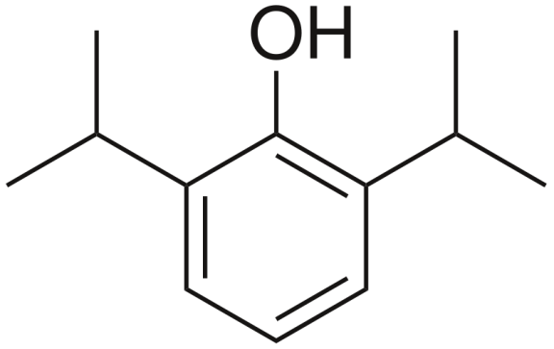
Propofol
מועדף לסדציה בסטטוס אפילפטי
Mechanism of action: GABA receptor agonist
Drug class: Hypnotic sedative
Possible routes: IV
Doses: 0.5-1 mg/kg
Onset time: 30 seconds
Duration:5 min
Side Effects: Apnea, resp depression, Hypotension, pain on injection
Contraindications:
Antidotes:

Slide 9
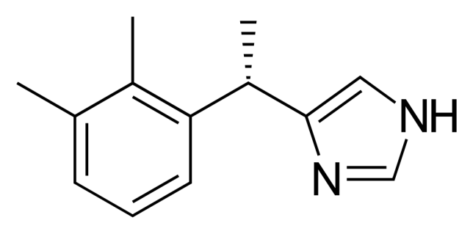
Dexmedetomidine (Precedex)
Mechanism of action: A2 receptor agonist (similar to clonidine)
Drug class: Sedative and analgesic
Possible routes: IV IN
Doses:IV- 0.5-1mcg/kg IN 2mcg/kg
Onset time: IV- 1 minute IN 5 minutes
Duration: IV- 5-10 minutes IN- 20-30 minutes
Side Effects: bradycardia, hypotension/hypertension
Contraindications:
Antidotes:

Slide 10
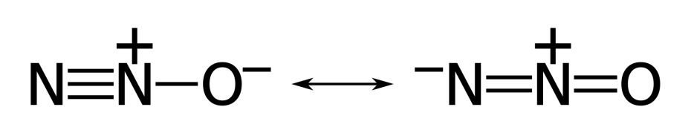
Nitrous Oxide(laughing gas)
Mechanism of action: mild NMDA antagonist and GABA agonist
Drug class: sedative, anxiolysis and analgesia (mild)
Possible routes: INH
Doses: 50-70%
Onset time: 1-2 minutes
Duration: dispersed immediately
Side Effects: dizziness, vomiting, hallucinations
Contraindications: open space diseases (Bowel/Ear etc)
Antidotes:

Slide 11
Analgesics
Opiates:
Morphine Fentanyl
Oxycod
Tramadol
Ketamine Intranasal 1mg/kg has similar analgesic effect as Fentanyl 2 mcg/kg

Slide 12
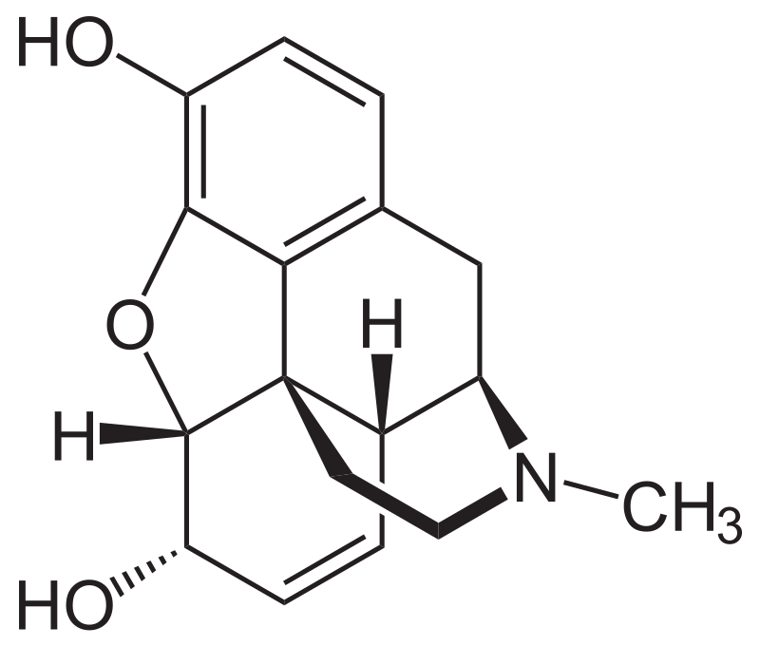
Opiates
Morphine-
IV/IM
0.1 mg/kg max dose 10 mg.
Onset- 5 minutes
Peak-20 minutes
Duration 3-4 hours
S/E- nausea/vomiting, constipation
Antidote: Naloxone 0.1 mg/kg

Slide 13
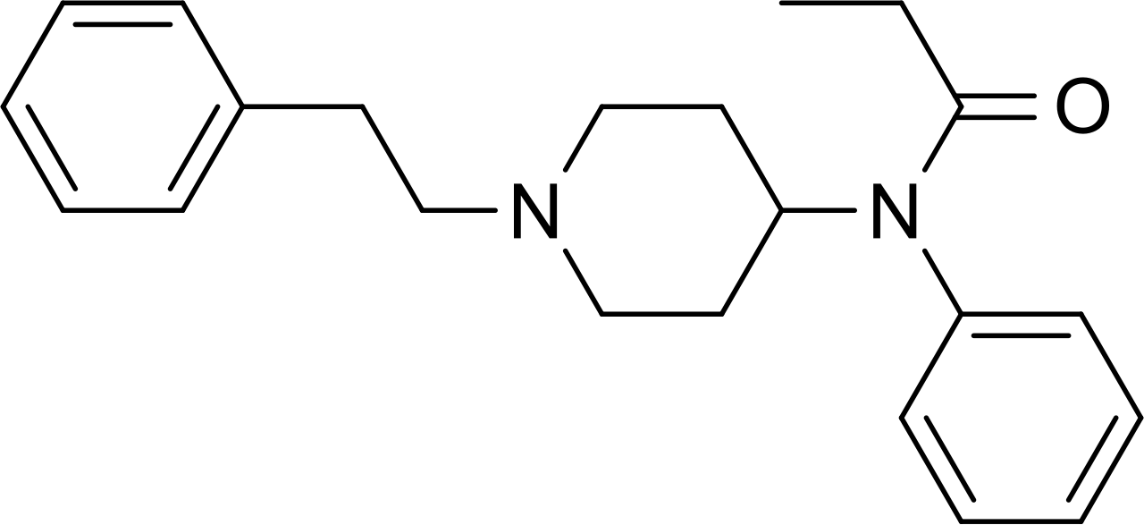
Opiates
Fentanyl
IV IN
IV- 1 mcg/kg IN 1.5-2mcg/kg
Onset- IV- 30 seconds IN- 5 minutes
Duration IV- 20-30 minutes IN 45 minutes
S/E -Rigid chest, resp depression

Slide 14
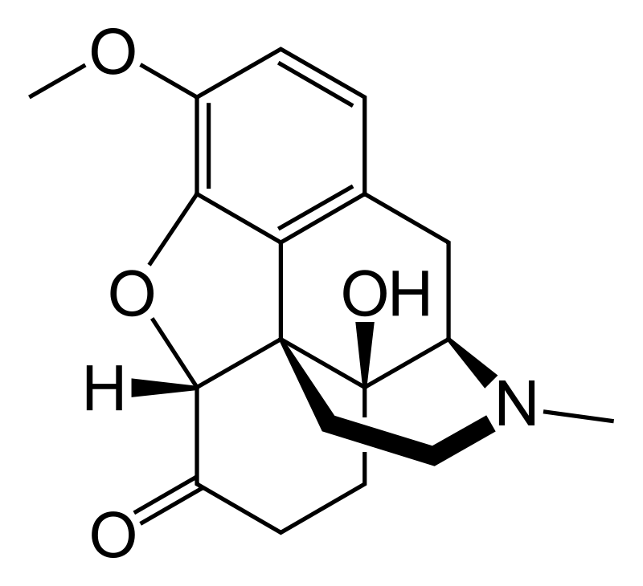
Opiates
Oxycodone
PO
0.1-0.2 mg/kg max dose 10 mg
Onset: 20 minutes
Duration: 3-4 hours
Naloxone (?)
S/E similar to all opiates

Slide 15
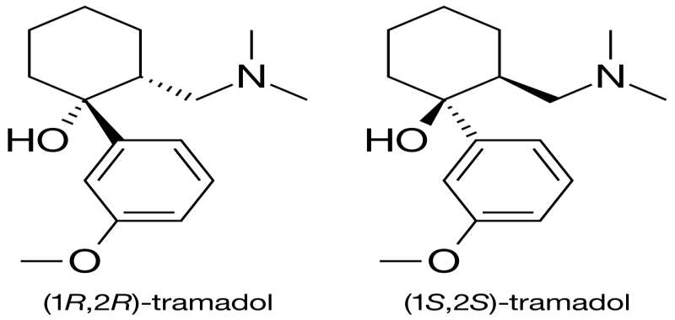
Tramadol
Opiod receptor agonist, Serotonin reuptake inhibitor
IV PO
Dose: IV/PO 1mg/kg
Duration: 3-4 Hours
S/E nausea/vomiting
PO approved only over 14 yo! IV approved over 1 yo

Slide 16
Combinations:
Ketamine+Midazolam
Ketamine+Propofol
Midazolam+Fentanyl
Nitrous+Fentanyl
Propofol+Fentanyl

Slide 17
Drug | Route | Dose (mg/kg) | Onset | Duration | Side Effect | Sedation Level
Midazolam | PO | 0.5-0.75 | 15' | 45' | Paradoxical reaction | Mild
 | IN | 0.3-0.5 | 5' | 45' | -"- | Moderate
 | IV/IM | 0.1 | 2' | 30-45' | -"- | Mod-deep
Ketamine | IV | 1 | 1' | 20-30' | Salivation, vomiting, emergence reaction | Deep/dissociation
 | IM | 2-3 | 5-10' | 30' | -"- | -"-
 | IN | 1 | 10-15' | 20-30' | -"- | Mild-mod sedation
Propofol | IV | 1 | 0.5' | 5-10' | Resp depression, Apnea | Deep/Hypnotic
Dexmedetomidine | IV | 0.5-1 mcg/kg | 1' | 5-10' | Bradycardia, HTN | Deep
 | IN | 2mcg/kg | 5' | 20-30' | -"- | Mod sedation
Nitrous | INH | 50-70% | 1-2' | Immediat e | Dizziness, vomiting | Mild-Mod

Slide 18
Drug | Route | Dose | Onset | Duration |  | S/E
Morphine | IV | 0.1 mg/kg | 5' | 3-4 | hours | Nausea/con stipation
Fentanyl | IV | 1mcg/kg | 0.5' | 20-30' |  | -"-, resp depression
 | IN | 1.5- 2mcg/kg | 5' | 30-45'
Oxycod | PO | 0.15-0.2 mg/kg (max 10 mg) | 20' | 3-4 | hours | Nausea/dizz iness
Tramadol | IV | 1 mg/kg | 5' | 3-4 | Hours | Nausea
 | PO | 1mg/kg | 20' | 3-4 | hours | -"-

