Slide 1
FUNNEL ANALYSIS

Slide 2
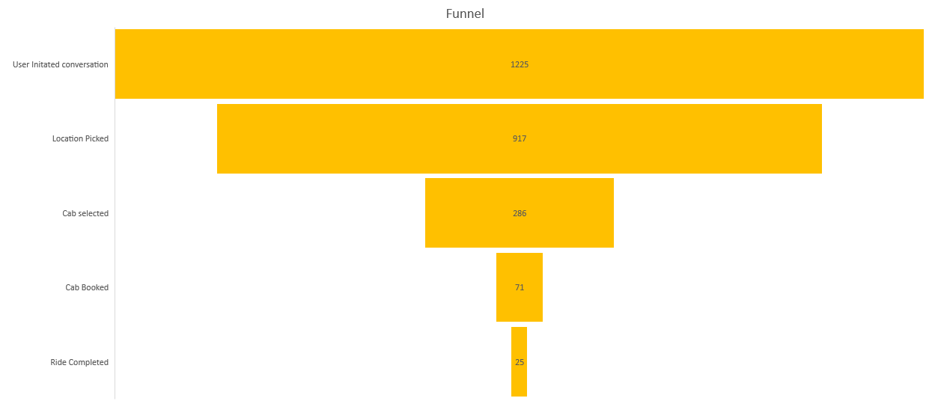
FUNNEL

Slide 3
ANALYSIS
From the funnel it is easily visible that most of the commited customers are dropped in the last three stages.
Next look at the stage success rate chart where the conversion % of customer from one stage to the next is shown.

Slide 4
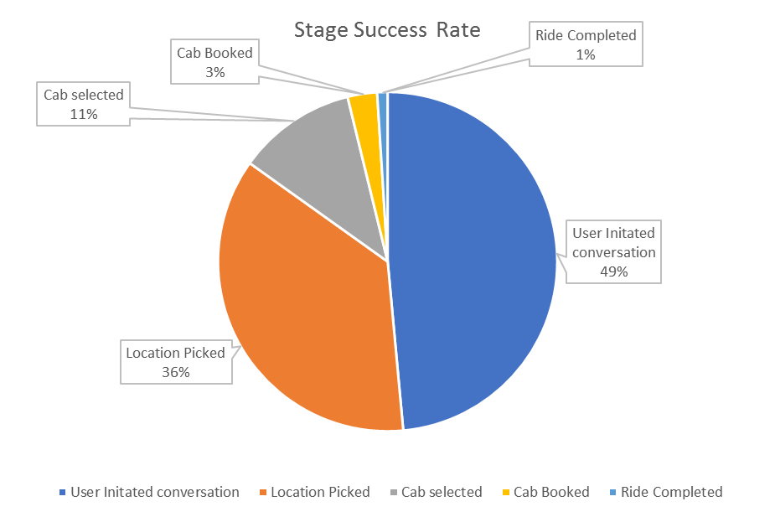
Stage Success Rate

Slide 5
As visible in the chart the problem lies within the stages when customer actually begins with the cab selection and booking after the location has been fetched.

Slide 6
Proposed Improvemnts
Improvenments can be made in small cities where the service frequency of ola/uber is less as compared to that of the tier 1 cities, from the available data the nunber of cases where niki gets confused between the pickup and drop location and abruptly ends the process.
The ola and Uber app is availabe for everyone that is having a smartphone so when they use niki instead of their APP the user must be provided with offers and discount on the fare as compared to the rates cited by the service company.
At the end for the ride along with the feedback the customer must be asked wether of not niki should remember their cab type preference this will ease the process for frequent users.

