Slide 1

Tests from outer space

Slide 2

About me
Максим Выпов
Java Developer
Пишу код и тесты

Slide 3
Agenda
Intro
BASICS
DATA DRIVEN
interactions
extensions
CONCLUSION

Slide 4

About Spock
CONFIDENTIAL | © 2019 EPAM Systems, Inc.

Slide 5

About Spock
Testing framework for Java and Groovy applications
Tests are written in Groovy
Based on junit runner Sputnik
CONFIDENTIAL | © 2019 EPAM Systems, Inc.

Slide 6
New framework?
CONFIDENTIAL | © 2019 EPAM Systems, Inc.

Slide 7
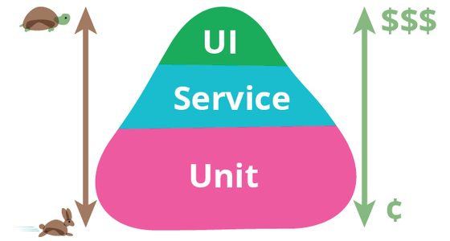
Disclaimer – watch your testing pyramid
CONFIDENTIAL | © 2019 EPAM Systems, Inc.

Slide 8
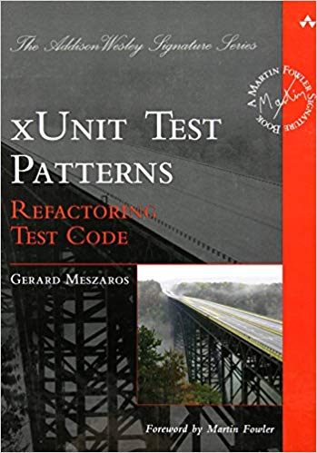
Disclaimer – watch your test code
CONFIDENTIAL | © 2019 EPAM Systems, Inc.

Slide 9
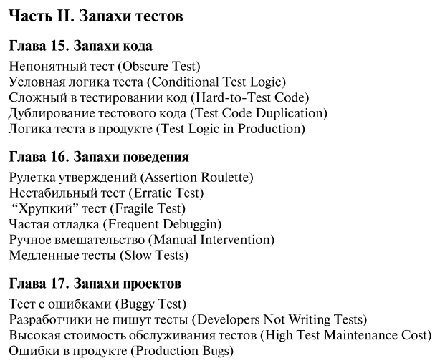
Disclaimer – watch your test code
CONFIDENTIAL | © 2019 EPAM Systems, Inc.

Slide 10
How to configure
<dependency> <groupId>org.spockframework</groupId> <artifactId>spock-core</artifactId> <version>${spock.version}</version> <scope>test</scope> </dependency> <dependency> <groupId>org.codehaus.groovy</groupId> <artifactId>groovy-all</artifactId> <version>${groovy.version}</version> <scope>test</scope> </dependency>
CONFIDENTIAL | © 2019 EPAM Systems, Inc.

Slide 11
How to configure
<build> <plugins> <plugin> <groupId>org.codehaus.gmavenplus</groupId> <artifactId>gmavenplus-plugin</artifactId> <version>${gmavenplus.version}</version> <executions> <execution> <goals> <goal>compile</goal> <goal>testCompile</goal> </goals> </execution> </executions> </plugin> </plugins> </build>
CONFIDENTIAL | © 2019 EPAM Systems, Inc.

Slide 12
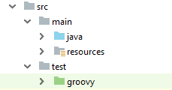
Project structure
CONFIDENTIAL | © 2019 EPAM Systems, Inc.

Slide 13
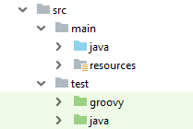
Project structure
CONFIDENTIAL | © 2019 EPAM Systems, Inc.

Slide 14
Terminology
Spock | JUnit
Specification | Test class
Feature | Test
Feature method | Test method
System Under Specification | System Under Test
CONFIDENTIAL | © 2019 EPAM Systems, Inc.

Slide 15
Specification
import spock.lang.Specification
class FirstSpecification extends Specification {
}
CONFIDENTIAL | © 2019 EPAM Systems, Inc.

Slide 16
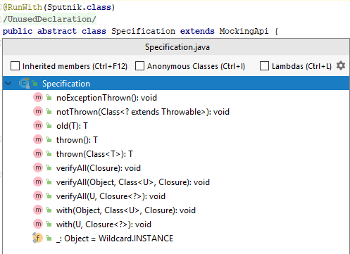
Specification base class
CONFIDENTIAL | © 2019 EPAM Systems, Inc.

Slide 17
Specification internals
class FirstSpecification extends Specification {
// fields
// fixture methods
// feature methods
// helper methods
}
CONFIDENTIAL | © 2019 EPAM Systems, Inc.

Slide 18
Fields
class FirstSpecification extends Specification {
def obj = new ClassUnderSpecification()
def coll = new Collaborator()
@Shared res = new VeryExpensiveResource()
}
CONFIDENTIAL | © 2019 EPAM Systems, Inc.

Slide 19
Fixture methods
def setupSpec() {}
def setup() {}
def cleanup() {}
def cleanupSpec() {}
@BeforeClass
@Before
@After
@AfterClass
CONFIDENTIAL | © 2019 EPAM Systems, Inc.

Slide 20
Feature method
class FirstSpecification extends Specification {
def "one plus one should equal two"() { expect: 1 + 1 == 2 }
}
CONFIDENTIAL | © 2019 EPAM Systems, Inc.

Slide 21
Blocks
AAA pattern
CONFIDENTIAL | © 2019 EPAM Systems, Inc.

Slide 22
Blocks
AAA pattern – TDD - Arrange Act Assert
CONFIDENTIAL | © 2019 EPAM Systems, Inc.

Slide 23

Blocks
AAA pattern – TDD - Arrange Act Assert
CONFIDENTIAL | © 2019 EPAM Systems, Inc.

Slide 24
Blocks
GWT – pattern
CONFIDENTIAL | © 2019 EPAM Systems, Inc.

Slide 25
Blocks
GWT – pattern BDD – Given When Then
CONFIDENTIAL | © 2019 EPAM Systems, Inc.

Slide 26

Blocks
GWT – pattern BDD – Given When Then
CONFIDENTIAL | © 2019 EPAM Systems, Inc.

Slide 27
Junit GWT blocks
@Test public void two_plus_two_should_equal_four() { // Given int left = 2; int right = 2; // When int result = left + right; // Then assertTrue(result == 4); }
CONFIDENTIAL | © 2019 EPAM Systems, Inc.

Slide 28
Junit GWT blocks Spock GWT blocks
@Test public void two_plus_two_should_equal_four() { // Given int left = 2; int right = 2; // When int result = left + right; // Then assertTrue(result == 4); }
def "two plus two should equal four"() { given: int left = 2 int right = 2 when: int result = left + right then: result == 4 }
CONFIDENTIAL | © 2019 EPAM Systems, Inc.

Slide 29
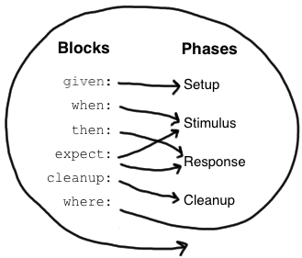
Blocks and phases
CONFIDENTIAL | © 2019 EPAM Systems, Inc.

Slide 30
Given is optional
given: def stack = new Stack() def elem = "push me"
CONFIDENTIAL | © 2019 EPAM Systems, Inc.

Slide 31
When and Then
given: int left = 2 int right = 2 when: int result = left + right then: result == 4
when: result = left - right then: result == 0
CONFIDENTIAL | © 2019 EPAM Systems, Inc.

Slide 32
Conditions
when: stack.push(elem) then:
!stack.isEmpty()
stack.size() == 1 stack.peek() == elem
CONFIDENTIAL | © 2019 EPAM Systems, Inc.

Slide 33
Conditions are implicit in then and expect blocks
when: stack.push(elem) then:
!stack.isEmpty()
stack.size() == 1 stack.peek() == elem
when: stack.push(elem) then:
assert !stack.isEmpty()
assert stack.size() == 1 assert stack.peek() == elem
CONFIDENTIAL | © 2019 EPAM Systems, Inc.

Slide 34
Explicit condition outside expect and then blocks
def setup() {
stack = new Stack() assert stack.empty }
CONFIDENTIAL | © 2019 EPAM Systems, Inc.

Slide 35
Exception conditions
when: stack.pop() then:
thrown(EmptyStackException)
stack.isEmpty()
CONFIDENTIAL | © 2019 EPAM Systems, Inc.

Slide 36
Exception conditions
when: stack.pop() then:
thrown(EmptyStackException)
stack.isEmpty()
when: stack.pop() then:
def e = thrown(EmptyStackException)
e.cause == null
CONFIDENTIAL | © 2019 EPAM Systems, Inc.

Slide 37
Exception conditions
when: stack.pop() then:
thrown(EmptyStackException)
stack.isEmpty()
when: stack.pop() then:
def e = thrown(EmptyStackException)
e.cause == null
when: stack.pop() then:
EmptyStackException e = thrown()
e.cause == null
CONFIDENTIAL | © 2019 EPAM Systems, Inc.

Slide 38
Expect block
when: def x = Math.max(1, 2) then:
x == 2
CONFIDENTIAL | © 2019 EPAM Systems, Inc.

Slide 39
Expect block
when: def x = Math.max(1, 2) then:
x == 2
expect: Math.max(1, 2) == 2
CONFIDENTIAL | © 2019 EPAM Systems, Inc.

Slide 40
Data Driven Testing
def "maximum of two numbers"() { expect: Math.max(1, 3) == 3 Math.max(7, 4) == 7 Math.max(0, 0) == 0 }
CONFIDENTIAL | © 2019 EPAM Systems, Inc.

Slide 41
Data Driven Testing
def "maximum of two numbers"() { expect: Math.max(1, 3) == 3 Math.max(7, 4) == 7 Math.max(0, 0) == 0 }
def "maximum of two numbers"(int a, int b, int c) { expect: Math.max(a, b) == c where: a | b | c 1 | 3 | 3 7 | 4 | 7 0 | 0 | 0 }
CONFIDENTIAL | © 2019 EPAM Systems, Inc.

Slide 42
Data Driven Testing
def "maximum of two numbers"() { expect: Math.max(1, 3) == 3 Math.max(7, 4) == 7 Math.max(0, 0) == 0 }
def "maximum of two numbers"(int a, int b, int c) { expect: Math.max(a, b) == c where: a | b | c 1 | 3 | 3 7 | 4 | 7 0 | 0 | 0 }
def "maximum of two numbers"() { expect: Math.max(a, b) == c where: a | b || c 1 | 3 || 3 7 | 4 || 7 0 | 0 || 0 }
CONFIDENTIAL | © 2019 EPAM Systems, Inc.

Slide 43
Data Driven Testing Failure report
def "maximum of two numbers"() { expect: Math.max(a, b) == c where: a | b || c 1 | 3 || 3 7 | 4 || 4 0 | 0 || 0 }
CONFIDENTIAL | © 2019 EPAM Systems, Inc.

Slide 44
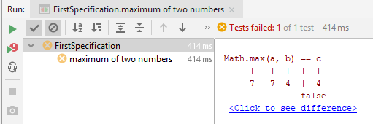
Data Driven Testing Failure report
def "maximum of two numbers"() { expect: Math.max(a, b) == c where: a | b || c 1 | 3 || 3 7 | 4 || 4 0 | 0 || 0 }
CONFIDENTIAL | © 2019 EPAM Systems, Inc.

Slide 45
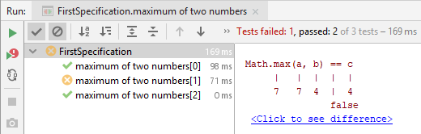
Data Driven Testing @Unroll
@Unroll
def "maximum of two numbers"() { expect: Math.max(a, b) == c where: a | b || c 1 | 3 || 3 7 | 4 || 4 0 | 0 || 0 }
CONFIDENTIAL | © 2019 EPAM Systems, Inc.

Slide 46
Data Driven Testing variables values
@Unroll
def "maximum of #a and #b is #c"() { expect: Math.max(a, b) == c where: a | b || c 1 | 3 || 3 7 | 4 || 4 0 | 0 || 0 }
CONFIDENTIAL | © 2019 EPAM Systems, Inc.

Slide 47
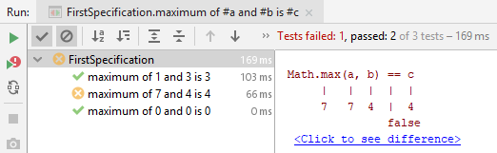
Data Driven Testing variables values
@Unroll
def "maximum of #a and #b is #c"() { expect: Math.max(a, b) == c where: a | b || c 1 | 3 || 3 7 | 4 || 4 0 | 0 || 0 }
CONFIDENTIAL | © 2019 EPAM Systems, Inc.

Slide 48

Parameterized test with Junit4
CONFIDENTIAL | © 2019 EPAM Systems, Inc.

Slide 49
Parameterized test with Junit4 System Under Test
public class Calculator { public int sum(int first, int second) { return first + second; } }
CONFIDENTIAL | © 2019 EPAM Systems, Inc.

Slide 50
Parameterized test with Junit4 add Parameterized runner
import org.junit.runner.RunWith; import org.junit.runners.Parameterized;
@RunWith(Parameterized.class) public class Junit4CalculatorTest {
}
CONFIDENTIAL | © 2019 EPAM Systems, Inc.

Slide 51
Parameterized test with Junit4 add @Parameters method
import java.util.Arrays; import java.util.Collection;
import org.junit.runner.RunWith; import org.junit.runners.Parameterized;
import org.junit.runners.Parameterized.Parameters;
@RunWith(Parameterized.class) public class Junit4CalculatorTest {
@Parameters public static Collection<Object[]> data() { return Arrays.asList(new Object[][] { { 0, 0, 0 }, { 1, 1, 2 } }); }
}
CONFIDENTIAL | © 2019 EPAM Systems, Inc.

Slide 52
Parameterized test with Junit4 add fields
import java.util.Arrays; import java.util.Collection;
import org.junit.runner.RunWith; import org.junit.runners.Parameterized;
import org.junit.runners.Parameterized.Parameters;
@RunWith(Parameterized.class) public class Junit4CalculatorTest {
private final int first; private final int second; private final int expectedSum;
@Parameters public static Collection<Object[]> data() { return Arrays.asList(new Object[][] { { 0, 0, 0 }, { 1, 1, 2 } }); }
}
CONFIDENTIAL | © 2019 EPAM Systems, Inc.

Slide 53
Parameterized test with Junit4 add constructor
import java.util.Arrays; import java.util.Collection;
import org.junit.runner.RunWith; import org.junit.runners.Parameterized;
import org.junit.runners.Parameterized.Parameters;
@RunWith(Parameterized.class) public class Junit4CalculatorTest {
private final int first; private final int second; private final int expectedSum;
@Parameters public static Collection<Object[]> data() { return Arrays.asList(new Object[][] { { 0, 0, 0 }, { 1, 1, 2 } }); }
public Junit4CalculatorTest(int first, int second, int expectedSum) { this.first = first; this.second = second; this.expectedSum = expectedSum; }
}
CONFIDENTIAL | © 2019 EPAM Systems, Inc.

Slide 54
Parameterized test with Junit4 add test
import static org.junit.Assert.assertEquals;
import java.util.Arrays; import java.util.Collection;
import org.junit.Test;
import org.junit.runner.RunWith; import org.junit.runners.Parameterized;
import org.junit.runners.Parameterized.Parameters;
@RunWith(Parameterized.class) public class Junit4CalculatorTest {
private final int first; private final int second; private final int expectedSum;
@Parameters public static Collection<Object[]> data() { return Arrays.asList(new Object[][] { { 0, 0, 0 }, { 1, 1, 2 } }); }
public Junit4CalculatorTest(int first, int second, int expectedSum) { this.first = first; this.second = second; this.expectedSum = expectedSum; }
@Test public void shouldReturnCorrectSum() { // given Calculator calculator = new Calculator(); // when int actualSum = calculator.sum(first, second); // then assertEquals(expectedSum, actualSum); }
}
CONFIDENTIAL | © 2019 EPAM Systems, Inc.

Slide 55

Parameterized test with Junit4 add test
import static org.junit.Assert.assertEquals;
import java.util.Arrays; import java.util.Collection;
import org.junit.Test;
import org.junit.runner.RunWith; import org.junit.runners.Parameterized;
import org.junit.runners.Parameterized.Parameters;
@RunWith(Parameterized.class) public class Junit4CalculatorTest {
private final int first; private final int second; private final int expectedSum;
@Parameters public static Collection<Object[]> data() { return Arrays.asList(new Object[][] { { 0, 0, 0 }, { 1, 1, 2 } }); }
public Junit4CalculatorTest(int first, int second, int expectedSum) { this.first = first; this.second = second; this.expectedSum = expectedSum; }
@Test public void shouldReturnCorrectSum() { // given Calculator calculator = new Calculator(); // when int actualSum = calculator.sum(first, second); // then assertEquals(expectedSum, actualSum); }
}
CONFIDENTIAL | © 2019 EPAM Systems, Inc.

Slide 56

Parameterized test with Junit4 and JUnitParams
CONFIDENTIAL | © 2019 EPAM Systems, Inc.

Slide 57
Parameterized test with Junit4 and JUnitParams
Parameterised tests that don't suck
CONFIDENTIAL | © 2019 EPAM Systems, Inc.

Slide 58
Parameterized test with Junit4 and JUnitParams
<dependency> <groupId>pl.pragmatists</groupId> <artifactId>JUnitParams</artifactId> <version>${junitparams.version}</version> <scope>test</scope> </dependency>
CONFIDENTIAL | © 2019 EPAM Systems, Inc.

Slide 59
Parameterized test with Junit4 and JUnitParams
@RunWith(JUnitParamsRunner.class) public class JunitParamsCalculatorTest { @Test @Parameters({ "0, 0, 0", "1, 1, 2" }) public void shouldReturnCorrectSum(int first, int second, int expectedSum) { // given Calculator calculator = new Calculator(); // when int actualSum = calculator.sum(first, second); // then assertEquals(expectedSum, actualSum); } }
CONFIDENTIAL | © 2019 EPAM Systems, Inc.

Slide 60
Parameterized test with Junit4 and JUnitParams
@RunWith(JUnitParamsRunner.class) public class JunitParamsCalculatorTest { @Test @Parameters({ "0, 0, 0", "1, 1, 2" }) public void shouldReturnCorrectSum(int first, int second, int expectedSum) { // given Calculator calculator = new Calculator(); // when int actualSum = calculator.sum(first, second); // then assertEquals(expectedSum, actualSum); } }
CONFIDENTIAL | © 2019 EPAM Systems, Inc.

Slide 61
Parameterized test with Junit4 and JUnitParams
@RunWith(JUnitParamsRunner.class) public class JunitParamsCalculatorTest { @Test @Parameters({ "0, 0, 0", "1, 1, 2" }) public void shouldReturnCorrectSum(int first, int second, int expectedSum) { // given Calculator calculator = new Calculator(); // when int actualSum = calculator.sum(first, second); // then assertEquals(expectedSum, actualSum); } }
CONFIDENTIAL | © 2019 EPAM Systems, Inc.

Slide 62
Parameterized test with Junit4 and JUnitParams
@RunWith(JUnitParamsRunner.class) public class JunitParamsCalculatorTest { @Test @Parameters({ "0, 0, 0", "1, 1, 2" }) public void shouldReturnCorrectSum(int first, int second, int expectedSum) { // given Calculator calculator = new Calculator(); // when int actualSum = calculator.sum(first, second); // then assertEquals(expectedSum, actualSum); } }
CONFIDENTIAL | © 2019 EPAM Systems, Inc.

Slide 63

Parameterized test with Junit5
CONFIDENTIAL | © 2019 EPAM Systems, Inc.

Slide 64
Parameterized test with Junit5
<dependency> <groupId>org.junit.jupiter</groupId> <artifactId>junit-jupiter-params</artifactId> <version>${junit-jupiter.version}</version> <scope>test</scope> </dependency>
CONFIDENTIAL | © 2019 EPAM Systems, Inc.

Slide 65
Parameterized test with Junit5
public class Junit5CalculatorTest { @ParameterizedTest @CsvSource({ "0, 0, 0", "1, 1, 2" }) public void shouldReturnCorrectSum(int first, int second, int expectedSum) { // given Calculator calculator = new Calculator(); // when int actualSum = calculator.sum(first, second); // then assertEquals(expectedSum, actualSum); }
}
CONFIDENTIAL | © 2019 EPAM Systems, Inc.

Slide 66
Parameterized test with Junit5
public class Junit5CalculatorTest { @ParameterizedTest @CsvSource({ "0, 0, 0", "1, 1, 2" }) public void shouldReturnCorrectSum(int first, int second, int expectedSum) { // given Calculator calculator = new Calculator(); // when int actualSum = calculator.sum(first, second); // then assertEquals(expectedSum, actualSum); }
}
CONFIDENTIAL | © 2019 EPAM Systems, Inc.

Slide 67
Parameterized test with Junit5
public class Junit5CalculatorTest { @ParameterizedTest @CsvSource({ "0, 0, 0", "1, 1, 2" }) public void shouldReturnCorrectSum(int first, int second, int expectedSum) { // given Calculator calculator = new Calculator(); // when int actualSum = calculator.sum(first, second); // then assertEquals(expectedSum, actualSum); }
}
CONFIDENTIAL | © 2019 EPAM Systems, Inc.

Slide 68
Parameterized test with Junit5
public class Junit5CalculatorTest { @ParameterizedTest @CsvSource({ "0, 0, 0", "1, 1, 2" }) public void shouldReturnCorrectSum(int first, int second, int expectedSum) { // given Calculator calculator = new Calculator(); // when int actualSum = calculator.sum(first, second); // then assertEquals(expectedSum, actualSum); }
}
CONFIDENTIAL | © 2019 EPAM Systems, Inc.

Slide 69

Parameterized test with Spock
CONFIDENTIAL | © 2019 EPAM Systems, Inc.

Slide 70
Parameterized test with Spock
class CalculatorSpec extends Specification { def "Should return correct sum"() { given: def calculator = new Calculator() when: def actualSum = calculator.sum(first, second) then: actualSum == expectedSum where: first | second || expectedSum 0 | 0 || 0 1 | 1 || 2 } }
CONFIDENTIAL | © 2019 EPAM Systems, Inc.

Slide 71
Parameterized test with Spock
class CalculatorSpec extends Specification { def "Should return correct sum"() { given: def calculator = new Calculator() when: def actualSum = calculator.sum(first, second) then: actualSum == expectedSum where: first | second || expectedSum 0 | 0 || 0 1 | 1 || 2 } }
CONFIDENTIAL | © 2019 EPAM Systems, Inc.

Slide 72
Parameterized test with Junit4 and Spock
@RunWith(Parameterized.class) public class Junit4CalculatorTest {
private final int first; private final int second; private final int expectedSum;
@Parameters public static Collection<Object[]> data() { return Arrays.asList(new Object[][] { { 0, 0, 0 }, { 1, 1, 2 } }); }
public Junit4CalculatorTest(int first, int second, int expectedSum) { this.first = first; this.second = second; this.expectedSum = expectedSum; }
@Test public void shouldReturnCorrectSum() { // given Calculator calculator = new Calculator(); // when int actualSum = calculator.sum(first, second); // then assertEquals(expectedSum, actualSum); }
}
class CalculatorSpec extends Specification { def "Should return correct sum"() { given: def calculator = new Calculator() when: def actualSum = calculator.sum(first, second) then: actualSum == expectedSum where: first | second || expectedSum 0 | 0 || 0 1 | 1 || 2 } }
CONFIDENTIAL | © 2019 EPAM Systems, Inc.

Slide 73
Parameterized test with Junit5 and Spock
public class Junit5CalculatorTest { @ParameterizedTest @CsvSource({ "0, 0, 0", "1, 1, 2" }) public void shouldReturnCorrectSum(
int first, int second, int expectedSum) { // given Calculator calculator = new Calculator(); // when int actualSum = calculator.sum(first, second); // then assertEquals(expectedSum, actualSum); }
}
class CalculatorSpec extends Specification { def "Should return correct sum"() { given: def calculator = new Calculator() when: def actualSum = calculator.sum(first, second) then: actualSum == expectedSum where: first | second || expectedSum 0 | 0 || 0 1 | 1 || 2 } }
CONFIDENTIAL | © 2019 EPAM Systems, Inc.

Slide 74
Parameterized test with Junit5 and Spock
public class Junit5CalculatorTest { @ParameterizedTest @CsvSource({ "0, 0, 0", "1, 1, 2" }) public void shouldReturnCorrectSum(
int first, int second, int expectedSum) { // given Calculator calculator = new Calculator(); // when int actualSum = calculator.sum(first, second); // then assertEquals(expectedSum, actualSum); }
}
class CalculatorSpec extends Specification { def "Should return correct sum"() { given: def calculator = new Calculator() when: def actualSum = calculator.sum(first, second) then: actualSum == expectedSum where: first | second || expectedSum 0 | 0 || 0 1 | 1 || 2 } }
CONFIDENTIAL | © 2019 EPAM Systems, Inc.

Slide 75
Parameterized test with Junit5 and Spock
public class Junit5CalculatorTest { @ParameterizedTest @CsvSource({ "0, 0, 0", "1, 1, 2" }) public void shouldReturnCorrectSum(
int first, int second, int expectedSum) { // given Calculator calculator = new Calculator(); // when int actualSum = calculator.sum(first, second); // then assertEquals(expectedSum, actualSum); }
}
class CalculatorSpec extends Specification { def "Should return correct sum"() { given: def calculator = new Calculator() when: def actualSum = calculator.sum(first, second) then: actualSum == expectedSum where: first | second || expectedSum 0 | 0 || 0 1 | 1 || 2 } }
CONFIDENTIAL | © 2019 EPAM Systems, Inc.

Slide 76
Parameterized test with Junit5 and Spock
public class Junit5CalculatorTest { @ParameterizedTest @CsvSource({ "0, 0, 0", "1, 1, 2" }) public void shouldReturnCorrectSum(
int first, int second, int expectedSum) { // given Calculator calculator = new Calculator(); // when int actualSum = calculator.sum(first, second); // then assertEquals(expectedSum, actualSum); }
}
class CalculatorSpec extends Specification { def "Should return correct sum"() { given: def calculator = new Calculator() when: def actualSum = calculator.sum(first, second) then: actualSum == expectedSum where: first | second || expectedSum 0 | 0 || 0 1 | 1 || 2 } }
CONFIDENTIAL | © 2019 EPAM Systems, Inc.

Slide 77
Parameterized test with Junit5 and Spock
public class Junit5CalculatorTest { @ParameterizedTest @CsvSource({ "0, 0, 0", "1, 1, 2" }) public void shouldReturnCorrectSum(
int first, int second, int expectedSum) { // given Calculator calculator = new Calculator(); // when int actualSum = calculator.sum(first, second); // then assertEquals(expectedSum, actualSum); }
}
class CalculatorSpec extends Specification { def "Should return correct sum"() { given: def calculator = new Calculator() when: def actualSum = calculator.sum(first, second) then: actualSum == expectedSum where: first | second || expectedSum 0 | 0 || 0 1 | 1 || 2 } }
CONFIDENTIAL | © 2019 EPAM Systems, Inc.

Slide 78
Parameterized test with Junit5 and Spock
public class Junit5CalculatorTest { @ParameterizedTest @CsvSource({ "0, 0, 0", "1, 1, 2" }) public void shouldReturnCorrectSum(
int first, int second, int expectedSum) { // given Calculator calculator = new Calculator(); // when int actualSum = calculator.sum(first, second); // then assertEquals(expectedSum, actualSum); }
}
class CalculatorSpec extends Specification { def "Should return correct sum"() { given: def calculator = new Calculator() when: def actualSum = calculator.sum(first, second) then: actualSum == expectedSum where: first | second || expectedSum 0 | 0 || 0 1 | 1 || 2 } }
CONFIDENTIAL | © 2019 EPAM Systems, Inc.

Slide 79
Parameterized test with Junit5 and Spock
public class Junit5CalculatorTest { @ParameterizedTest @CsvSource({ "0, 0, 0", "1, 1, 2" })
@DisplayName("Should return correct sum") public void shouldReturnCorrectSum(
int first, int second, int expectedSum) { // given Calculator calculator = new Calculator(); // when int actualSum = calculator.sum(first, second); // then assertEquals(expectedSum, actualSum); }
}
class CalculatorSpec extends Specification { def "Should return correct sum"() { given: def calculator = new Calculator() when: def actualSum = calculator.sum(first, second) then: actualSum == expectedSum where: first | second || expectedSum 0 | 0 || 0 1 | 1 || 2 } }
CONFIDENTIAL | © 2019 EPAM Systems, Inc.

Slide 80
Parameterized test with Junit5 and Spock with imports
import static org.junit.Assert.assertEquals; import org.junit.jupiter.api.DisplayName; import org.junit.jupiter.params.ParameterizedTest; import org.junit.jupiter.params.provider.CsvSource;
public class Junit5CalculatorTest { @ParameterizedTest @CsvSource({ "0, 0, 0", "1, 1, 2" })
@DisplayName("Should return correct sum") public void shouldReturnCorrectSum(
int first, int second, int expectedSum) { // given Calculator calculator = new Calculator(); // when int actualSum = calculator.sum(first, second); // then assertEquals(expectedSum, actualSum); }
}
import spock.lang.Specification
class CalculatorSpec extends Specification { def "Should return correct sum"() { given: def calculator = new Calculator() when: def actualSum = calculator.sum(first, second) then: actualSum == expectedSum where: first | second || expectedSum 0 | 0 || 0 1 | 1 || 2 } }
CONFIDENTIAL | © 2019 EPAM Systems, Inc.

Slide 81

Parameterized test with Junit5 and Spock
CONFIDENTIAL | © 2019 EPAM Systems, Inc.

Slide 82

Parameterized test with Junit5 and Spock
CONFIDENTIAL | © 2019 EPAM Systems, Inc.

Slide 83



Interaction based Testing
CONFIDENTIAL | © 2019 EPAM Systems, Inc.

Slide 84
Interaction based Testing SUS
public class Publisher { List<Subscriber> subscribers = new ArrayList<>(); private int messageCount = 0; public void send(String message){ subscribers.forEach(s -> { s.receive(message); messageCount++; }); } }
CONFIDENTIAL | © 2019 EPAM Systems, Inc.

Slide 85
Interaction based Testing SUS
public class Publisher { List<Subscriber> subscribers = new ArrayList<>(); private int messageCount = 0; public void send(String message){ subscribers.forEach(s -> { s.receive(message); messageCount++; }); } }
interface Subscriber { void receive(String message); }
CONFIDENTIAL | © 2019 EPAM Systems, Inc.

Slide 86
Interaction based Testing Junit
@RunWith(MockitoJUnitRunner.class) public class PublisherTest { private Publisher publisher = new Publisher(); @Mock private Subscriber subscriber; @Mock private Subscriber subscriber2; @Before public void setUp() { publisher.subscribers.add(subscriber); publisher.subscribers.add(subscriber2); } @Test public void shouldSendMessagesToAllSubscribers() { // When publisher.send("hello"); // Then verify(subscriber, times(1)).receive("hello"); verify(subscriber2, times(1)).receive("hello"); } }
CONFIDENTIAL | © 2019 EPAM Systems, Inc.

Slide 87
Interaction based Testing Junit and Spock
@RunWith(MockitoJUnitRunner.class) public class PublisherTest { private Publisher publisher = new Publisher(); @Mock private Subscriber subscriber; @Mock private Subscriber subscriber2; @Before public void setUp() { publisher.subscribers.add(subscriber); publisher.subscribers.add(subscriber2); } @Test public void shouldSendMessagesToAllSubscribers() { // When publisher.send("hello"); // Then verify(subscriber, times(1)).receive("hello"); verify(subscriber2, times(1)).receive("hello"); } }
class PublisherSpec extends Specification {
Publisher publisher = new Publisher() Subscriber subscriber = Mock() Subscriber subscriber2 = Mock() def setup() { publisher.subscribers << subscriber
publisher.subscribers << subscriber2
// << is a Groovy shorthand for List.add() } def "should send messages to all subscribers"() { when: publisher.send("hello") then: 1 * subscriber.receive("hello") 1 * subscriber2.receive("hello") }
CONFIDENTIAL | © 2019 EPAM Systems, Inc.

Slide 88
Interaction based Testing
def "should send messages to all subscribers"() { when: publisher.send("hello") then: 1 * subscriber.receive("hello") 1 * subscriber2.receive("hello") }
1 * subscriber.receive("hello") | | | | | | | argument constraint | | method constraint | target constraint cardinality
CONFIDENTIAL | © 2019 EPAM Systems, Inc.

Slide 89
Interaction based Testing Cardinality
1 * subscriber.receive("hello") // exactly one call 0 * subscriber.receive("hello") // zero calls (1..3) * subscriber.receive("hello") // between one and three calls (inclusive) (1.._) * subscriber.receive("hello") // at least one call (_..3) * subscriber.receive("hello") // at most three calls _ * subscriber.receive("hello") // any number of calls, including zero
CONFIDENTIAL | © 2019 EPAM Systems, Inc.

Slide 90
Interaction based Testing Target Constraint
1 * subscriber.receive("hello") // a call to 'subscriber' 1 * _.receive("hello") // a call to any mock object
CONFIDENTIAL | © 2019 EPAM Systems, Inc.

Slide 91
Interaction based Testing Method Constraint
1 * subscriber.receive("hello") // a method named 'receive' 1 * subscriber./r.*e/("hello") // a method whose name matches the given regular expression // (here: method name starts with 'r' and ends in 'e')
CONFIDENTIAL | © 2019 EPAM Systems, Inc.

Slide 92
Interaction based Testing Argument Constraints
1 * subscriber.receive("hello") // an argument that is equal to the String "hello" 1 * subscriber.receive(!"hello") // an argument that is unequal to the String "hello" 1 * subscriber.receive() // the empty argument list (would never match in our example) 1 * subscriber.receive(_) // any single argument (including null) 1 * subscriber.receive(*_) // any argument list (including the empty argument list) 1 * subscriber.receive(!null) // any non-null argument 1 * subscriber.receive(_ as String) // any non-null argument that is-a String 1 * subscriber.receive(endsWith("lo")) // any non-null argument that is-a String 1 * subscriber.receive({ it.size() > 3 && it.contains('a') }) // an argument that satisfies the given predicate, meaning that // code argument constraints need to return true of false // depending on whether they match or not // (here: message length is greater than 3 and contains the character a)
CONFIDENTIAL | © 2019 EPAM Systems, Inc.

Slide 93
Interaction based Testing Stubbing
interface Subscriber { String receive(String message); }
CONFIDENTIAL | © 2019 EPAM Systems, Inc.

Slide 94
Interaction based Testing Stubbing
interface Subscriber { String receive(String message); }
subscriber.receive(_) >> "ok"
CONFIDENTIAL | © 2019 EPAM Systems, Inc.

Slide 95
Interaction based Testing Stubbing
interface Subscriber { String receive(String message); }
subscriber.receive(_) >> "ok"
when(subscriber.receive(any())).thenReturn("ok");
CONFIDENTIAL | © 2019 EPAM Systems, Inc.

Slide 96
Interaction based Testing Stubbing
interface Subscriber { String receive(String message); }
subscriber.receive(_) >> "ok" | | | | | | | response generator | | argument constraint | method constraint target constraint
CONFIDENTIAL | © 2019 EPAM Systems, Inc.

Slide 97
Interaction based Testing Stubbing
subscriber.receive("message1") >> "ok" subscriber.receive("message2") >> "fail"
CONFIDENTIAL | © 2019 EPAM Systems, Inc.

Slide 98
Interaction based Testing Stubbing
subscriber.receive("message1") >> "ok" subscriber.receive("message2") >> "fail"
subscriber.receive(_) >>> ["ok", "error", "error", "ok"]
CONFIDENTIAL | © 2019 EPAM Systems, Inc.

Slide 99
Interaction based Testing Stubbing
subscriber.receive("message1") >> "ok" subscriber.receive("message2") >> "fail"
subscriber.receive(_) >>> ["ok", "error", "error", "ok"]
subscriber.receive(_) >> { String message -> message.size() > 3 ? "ok" : "fail" }
CONFIDENTIAL | © 2019 EPAM Systems, Inc.

Slide 100
Interaction based Testing Stubbing
subscriber.receive("message1") >> "ok" subscriber.receive("message2") >> "fail"
subscriber.receive(_) >>> ["ok", "error", "error", "ok"]
subscriber.receive(_) >> { String message -> message.size() > 3 ? "ok" : "fail" }
subscriber.receive(_) >> { throw new InternalError("ouch") }
CONFIDENTIAL | © 2019 EPAM Systems, Inc.

Slide 101
Interaction based Testing Stubbing
subscriber.receive("message1") >> "ok" subscriber.receive("message2") >> "fail"
subscriber.receive(_) >>> ["ok", "error", "error", "ok"]
subscriber.receive(_) >> { String message -> message.size() > 3 ? "ok" : "fail" }
subscriber.receive(_) >> { throw new InternalError("ouch") }
subscriber.receive(_) >>> ["ok", "fail", "ok"] >> { throw new InternalError() } >> "ok"
CONFIDENTIAL | © 2019 EPAM Systems, Inc.

Slide 102
Interaction based Testing Other Mock Objects
MockingApi.Mock
MockingApi.Stub
MockingApi.Spy
CONFIDENTIAL | © 2019 EPAM Systems, Inc.

Slide 103
Built-In Extensions
@Ignore @Ignore("reason") @IgnoreRest @IgnoreIf({ spock.util.environment.Jvm.isJava5() }) @Requires({ os.windows }) @Timeout(5) @Timeout(value = 100, unit = TimeUnit.MILLISECONDS) @Retry @Retry(count = 5) @Retry(exceptions=[IOException]) @Retry(condition = { failure.message.contains('foo') }) @Title("This tests if...") @Narrative("some detailed explanation") @Issue("http://redmine/23432")
@See("http://spockframework.org/spec") @Subject @Stepwise @PendingFeature
CONFIDENTIAL | © 2019 EPAM Systems, Inc.

Slide 104
Conclusion
Pros
Cons
More readable tests
More compact
Beautiful parameterized tests
Less 3rd party (built-in assertions, mocking)
Learn spock and groovy
CONFIDENTIAL | © 2019 EPAM Systems, Inc.

Slide 105

Conclusion
CONFIDENTIAL | © 2019 EPAM Systems, Inc.

