Slide 1

C.1:Confirmation
A.1:Start checkout
<<interface>>
Customer Screen
Successful Transaction Case
A.2:Scan Items
B.8:Confirm Transaction
C.12:Receipt
B.7:List of items&total
B.1: Scan Items
C.14:Receipt
C.2:Checkout
C.11:Confirmation
C.13:Confirmation
<<interface>>
Scanner System
B.2:Item Codes
<<Control>>
Control Hub
B.3:Item Codes
<<Entity>>
Product Transaction data
B.4:Item List
C.12:Update inventory Confirmation
B.5:List of items
C.8:Update inventory Confirmation
C.6:Payment Confirmation (CASH)
OR
C.10:Payment Confirmation (CARD)
B.6:Total
C.7:Inventory update
C.11:Inventory update
C.3: Get Payment
<<Entity>>
Manage Inventory
<<logic>>
Payment System
<<Entity>>
Financial Transaction Data
C.4:Get Payment
C.4:Get Payment
C.9:Add to Log
<<Interface>>
Bank
C.11:Add to Log
C.10:log confirmation
C.5:Payment Conf
<<Interface>>
Cash
<<Entity>>
Transaction Log
C.12:log confirmation
C.9:Payment Conf
<<Interface>>
Card
<<logic>>
Payment Verification
C.5:Payment info
C.7:Payment Confirmation
C.6:Payment info
C.8:Payment Confirmation

Slide 2
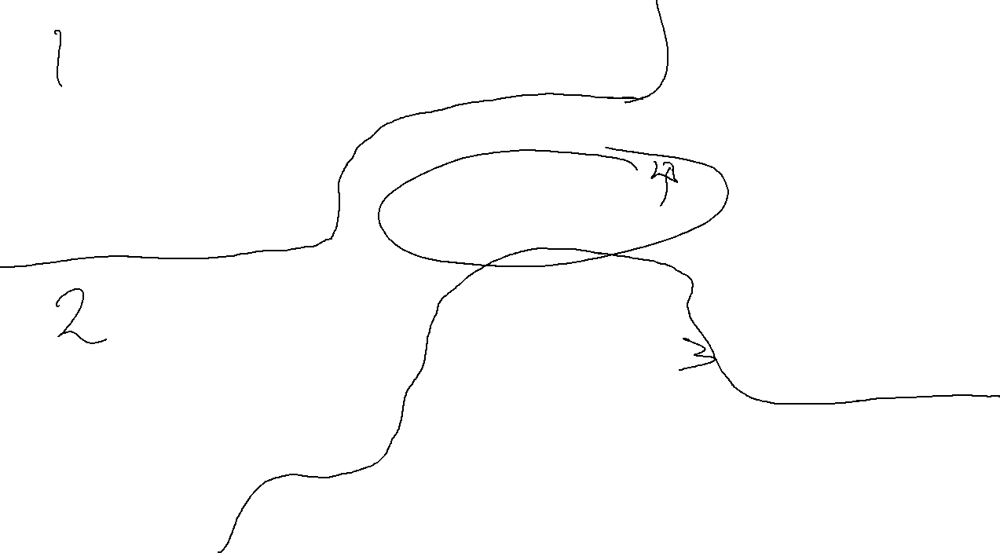
C.1:Confirmation
A.1:Start checkout
<<interface>>
Customer Screen
Successful Transaction Case
A.2:Scan Items
B.8:Confirm Transaction
C.12:Receipt
B.7:List of items&total
B.1: Scan Items
C.14:Receipt
C.2:Checkout
C.11:Confirmation
C.13:Confirmation
<<interface>>
Scanner System
B.2:Item Codes
<<Control>>
Control Hub
B.3:Item Codes
DEAD
B.4:Item List
C.12:Update inventory Confirmation
B.5:List of items
C.8:Update inventory Confirmation
C.6:Payment Confirmation (CASH)
OR
C.10:Payment Confirmation (CARD)
B.6:Total
C.7:Inventory update
C.11:Inventory update
C.3: Get Payment
<<Entity>>
Manage Inventory
<<logic>>
Payment System
<<Entity>>
Financial Transaction Data
C.4:Get Payment
C.4:Get Payment
C.9:Add to Log
<<Interface>>
Bank
C.11:Add to Log
C.10:log confirmation
C.5:Payment Conf
<<Interface>>
Cash
<<Entity>>
Transaction Log
C.12:log confirmation
C.9:Payment Conf
<<Interface>>
Card
<<logic>>
Payment Verification
C.5:Payment info
C.7:Payment Confirmation
C.6:Payment info
C.8:Payment Confirmation

Slide 3
C.1:Confirmation
A.1:Start checkout
<<interface>>
Customer Screen
Payment Failure Case
A.2:Scan Items
B.8:Confirm Transaction
C.8:Show payment Failure
B.7:List of items&total
B.1: Scan Items
C.2:Checkout
C.7:Payment Failure
<<interface>>
Scanner System
B.2:Item Codes
<<Control>>
Control Hub
B.3:Item Codes
<<Entity>>
Product Transaction data
B.4:Item List
B.5:List of items
C.3: Get Payment
C.6:Payment FAILURE
B.6:Total
<<logic>>
Payment System
<<Entity>>
Financial Transaction Data
C.4:Get Payment
C.4:Get Payment
C.5:Payment FAIL
C.5:Payment FAIL
<<Interface>>
Card
<<Interface>>
Cash

Slide 4
C.1:Confirmation
D.1:New Payment
A.1:Start checkout
<<interface>>
Customer Screen
Alternate Payment Case
A.2:Scan Items
B.8:Confirm Transaction
B.7:List of items&total
C.8:Show payment Failure
B.1: Scan Items
D.9: Receipt
C.2:Checkout
C.7:Payment Failure
D.8:Confirmation
<<interface>>
Scanner System
B.2:Item Codes
<<Control>>
Control Hub
B.3:Item Codes
<<Entity>>
Product Transaction data
B.4:Item List
D.5:Update inventory Confirmation
B.5:List of items
C.6:Payment FAILURE
B.6:Total
D.4:Inventory update
D.7:Payment WIN
C.3: Get Payment
<<Entity>>
Manage Inventory
<<logic>>
Payment System
<<Entity>>
Financial Transaction Data
C.4:Get Payment
D.6:Transaction
C.4:Get Payment
<<Interface>>
Bank
<<Entity>>
Transaction Log
D.7:Log confirmation
C.5:Payment Fail
<<Interface>>
Cash
C.5:Payment FAIL
D.6:Payment WIN
<<Interface>>
Card
<<logic>>
Payment Verification
D.2:Payment info
D.4:Payment Confirmation
D.3:Payment info
D.5:Payment Confirmation

Slide 5
C.1:Cancel
A.1:Start checkout
<<interface>>
Customer Screen
Cancel Transaction Case
A.2:Scan Items
B.8:Output Item List
C.8:Reset screen
B.7:List of items&total
B.1: Scan Items
C.2:Cancel
C.7:Transaction canceled
<<interface>>
Scanner System
<<Control>>
Control Hub
C.3:Clear Items
<<Entity>>
Product Transaction data
B.2:Item Codes
B.3:Item Codes
B.4:Item List
C.4:Clear Items done
B.5:List of items
B.6:Total
C.5:Clear totals
C.6:Clear Confirm
<<Entity>>
Financial Transaction Data

Slide 6
A.1:Press Manager Button
B.1:Code
<<interface>>
Restocker Screen
C.1:Select Menu
Restocking Case
A.2:Ask for code
B.4:Select Menu
C.6:Show Changes
B.2:Code
B.3:Code Confirm
C.2:Selection
C.5:Confirm Changes
<<Control>>
Control Hub
C.4:Change Inventory Confirmation
C.3:Change Inventory
<<Entity>>
Manage Inventory

Slide 7
<<interface>>
Timer
Print Inventory Case
A.1:Time to Print
<<Control>>
Control Hub
A.3:Inventory List
<<interface>>
Printer
A.2:List Inventory
A.3:Inventory List
<<Entity>>
Manage Inventory

Slide 8
A.1:Press Manager Button
B.1:Code
<<interface>>
Manager Screen
C.1:Select Menu
Print Transaction Log Case
A.2:Ask for code
B.4:Select Menu
B.2:Code
B.3:Code Confirm
C.2:Selection
<<Control>>
Control Hub
C.5:Transaction log
<<interface>>
Printer
C.4:Print Confirmation
C.3:Print Log
<<Entity>>
Transaction Log

Slide 9
A.1:Press Manager Button
B.1:Code
<<interface>>
Manager Screen
C.1:Select Menu
Manage Product Transaction Case
A.2:Ask for code
B.4:Select Menu
C.6:Show Changes
B.2:Code
B.3:Code Confirm
C.2:Selection
C.5:show Changes
<<Control>>
Control Hub
C.3:Change Transaction data
<<Entity>>
Product Transaction data
C.4:Show transaction changes

Slide 10
A.1:Press Manager Button
B.1:Code
<<interface>>
Manager Screen
C.1:Select Menu
Manage Financial Transaction Case
A.2:Ask for code
B.4:Select Menu
C.6:Show Changes
B.2:Code
B.3:Code Confirm
C.2:Selection
C.5:show Changes
<<Control>>
Control Hub
C.3:Update total
C.4:Updated Total
<<Entity>>
Financial Transaction Data

Slide 11
A.1:Press Manager Button
B.1:Code
<<interface>>
Manager Screen
C.1:Select Menu
Manage Payment System Case
A.2:Ask for code
B.4:Select Menu
C.6:Show Changes
B.2:Code
B.3:Code Confirm
C.2:Selection
C.5:show Changes
<<Control>>
Control Hub
C.3: Manage Payment system
C.6:Payment System Changes
<<logic>>
Payment System
C.4:Push Update
C.4:Push Update
C.5:Update conf
C.5:Update Conf
<<Interface>>
Card
<<Interface>>
Cash

Slide 12
<<interface>>
Customer Screen
<<interface>>
Scanner System
<<interface>>
Cash Acceptor
<<interface>>
Card Reader
+Print Receipt
+Add Product
+Remove Product
+Add Product Barcode
+Wrinkly Bill
-Total Due
-Remaining Total
-Total Due
-Credit Card #
-Type (Credit or Debit)
-PIN
Graphical User Interface that the customer and interacts with to check out.
Scanning device to allow customers to scan products and add them to the transaction and remove them from inventory
Cash accepting device that the customer interacts with after inputting to use cash payment type that really hates wrinkly bills
Card reading device that the customer interacts with after inputting to use card payment type and then can use either debit or credit
<<interface>>
BANK
<<interface>>
Manager Screen
<<interface>>
Restocker Screen
<<interface>>
Timer
+Auth Credit
+Auth Debit
+Add Product
+Remove Product
+Age verification (Buy BOOOOOOZ)
+Manager Verification (enter Konami code)
+Add Product (Database)
+Remove Product (Database)
+Restocker Verification (enter Konami code)
+Print Report
+Print inventory
BANK to verify the credit or debit card.
Graphical User Interface that the manager interacts with to check out and manage inventory
Graphical User Interface that the restoker interacts with to change out and manage inventory
Timer for printing out the inventory list

Slide 13
<<entity>>
Product Information
<<entity>>
Financial Transaction Data
<<logic>>
Payment Verification
-Product ID
-Name
-Price
+Calculate Subtotal
+Calculate Tax
+Calculate Total
+Approval
+Generate Confirmation #
-Credit Card #
-Confirmation #
-PIN
Entity that holds product information
Entity that maintains financial data for current transaction, calculate running totals including tax
Logic that verifies card information with the bank and receives and sends data from bank for card approval
<<logic>>
Payment System
<<logic>>
Manage Inventory
<<entity>>
Transaction Log
<<control>>
Control Hub
+View Inventory
+Update Inventory Quantity /
+Add New Product /
+Remove Product /
-Product ID
-Product Description
-Product Quantity
+Print Daily Log
+Upload Transaction Data to database
-Time stamp of transaction
-Transaction Log Vector
+Verify Valid Product Barcode
+Confirm Product Removal
+Request Product ID
+Select Payment Method
Central processing location where data requests are maintained and passed through to other classes
Logic that prompts user to select a payment type and then proceeds to pass the customer to card or cash interface
Logic that allows the manager to update and modify product information such as adding a new product and changing quantity
Entity that stores every transaction throughout the day and prints the daily log when requested by manager or at end of day routine

Slide 14
<<entity>>
Restocking Message
<<entity>>
verify
<<interface>>
Printer
+Return Restcking message
+Send CC info to bank
+Send DC info to bank
+Print Inventory
Holds restocking message
Interacts with the bank.
Prints product inventory to the real world

