Slide 1


EMPLOYEE ATTRITION PREDICTION

Slide 2

OVERVIEW
Designing a predictive model to identify employees at risk of leaving the organization

Slide 3

INTRODUCTION
Losing valuable employees is costly for organizations.
High costs of recruiting, training, and onboarding.
Impact on productivity and morale.
USING MACHINE LEARNING, WE AIM TO
Predict employee attrition.
Help HR teams take proactive measures to retain employees.

Slide 4

PROBLEM STATEMENT
Challenge Traditional methods rely on intuition, not data
Solution: Predict employee attrition using data-driven insights.

Slide 5
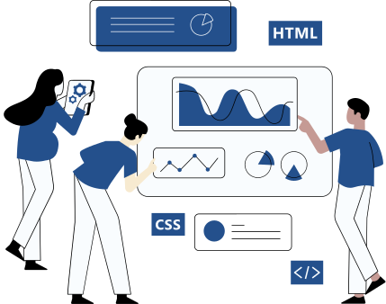
GOALS
Predict Employee Attrition
Build a model to predict employees at risk of leaving.
Inform Data-Driven Decision Making
Provide insights to HR teams for effective retention strategies.
Enhance Organizational Performance
Improve employee satisfaction and reduce turnover.
Optimize Resource Allocation
Improve employee satisfaction and reduce turnover.
Key Attrition Drivers Identification
Pinpoint the root causes of attrition (e.g., job dissatisfaction, recognition issues).

Slide 6

RELATED WORK
HTTPS://WWW.RESEARCHGATE.NET/PUBLICATION/326029536_EMPLOYEE_ATTRITION_PREDICTION
HTTPS://WWW.RESEARCHGATE.NET/PUBLICATION/354703174_UNDERSTANDING_EMPLOYEE_ATTRITION_USING_MACHINE_LEARNING_TECHNIQUES
HTTPS://WWW.RESEARCHGATE.NET/PUBLICATION/308043155_PREDICTION_OF_EMPLOYEE_TURNOVER_IN_ORGANIZATIONS_USING_MACHINE_LEARNING_ALGORITHMS
HTTPS://WWW.MDPI.COM/2076-3417/12/13/6424
HTTPS://WWW.SCIENCEDIRECT.COM/SCIENCE/ARTICLE/ABS/PII/S095741742202382X

Slide 7

PROPOSED METHODOLOGY
Overview of the machine learning workflow:
Data preprocessing and cleaning (handling missing values and outliers).
Visualizing categorical and numerical features (e.g., pie charts, histograms).
Analyzing attrition trends by demographic and job-related factors.
Predictive insights.

Slide 8
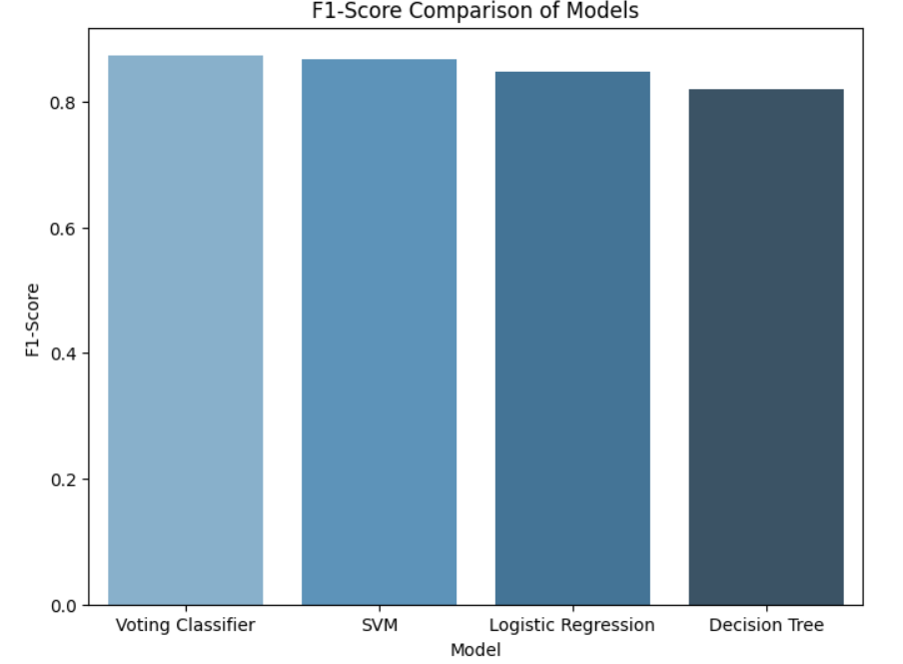
RESULTS
Logistic regression model
0.84
Decesion Tree
0.81
SVM
0.86
voting classifier
0.87
The target variable values are imbalanced so instead of using accuracy metric
We will be using the f1_score

Slide 9
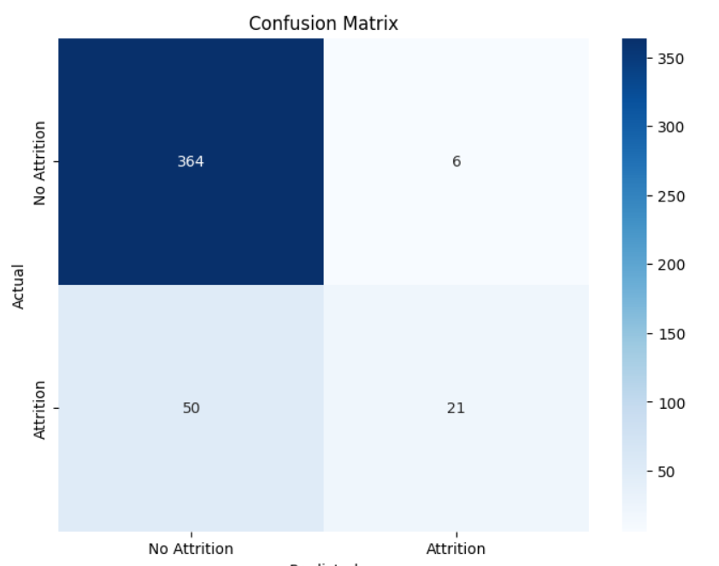
CONCLUSION
voting classifier demonstrated strong predictive accuracy (87%)

Slide 10

MEET THE TEAM
This project was a collaborative effort by our talented team.
shrouq osama
shahd tarek
merna elsayed
mawada alsayed

Slide 11

THANK
YOU

