Slide 1
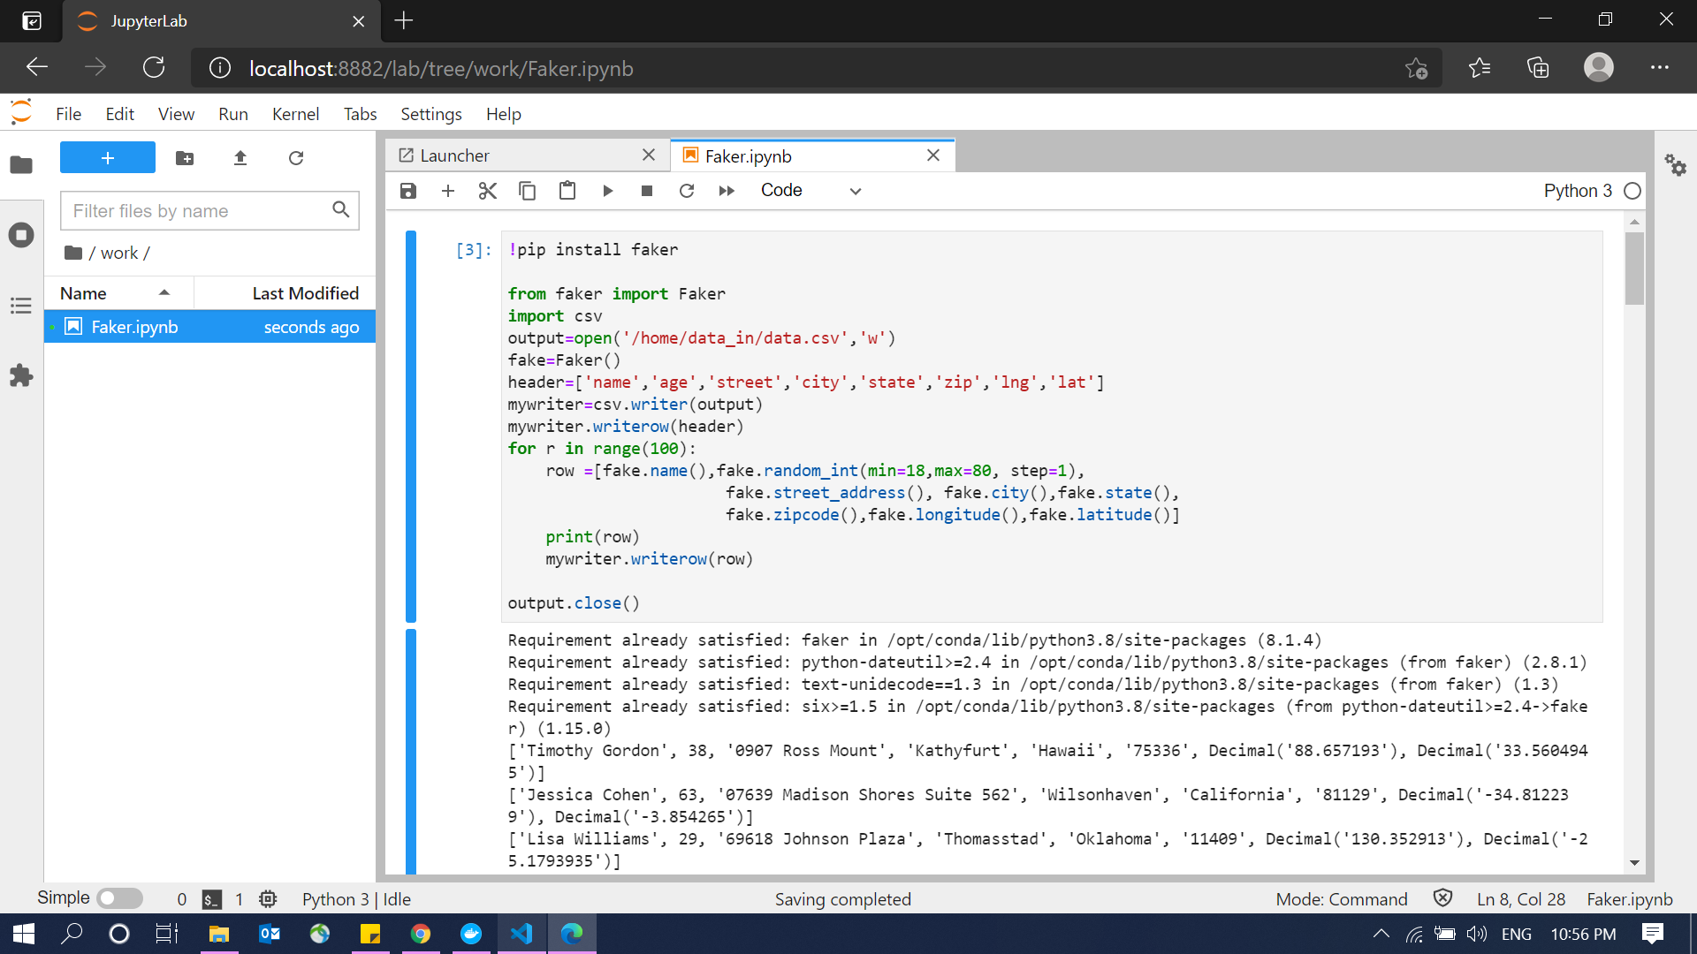
Faker to generate data and save it in data_in file

Slide 2
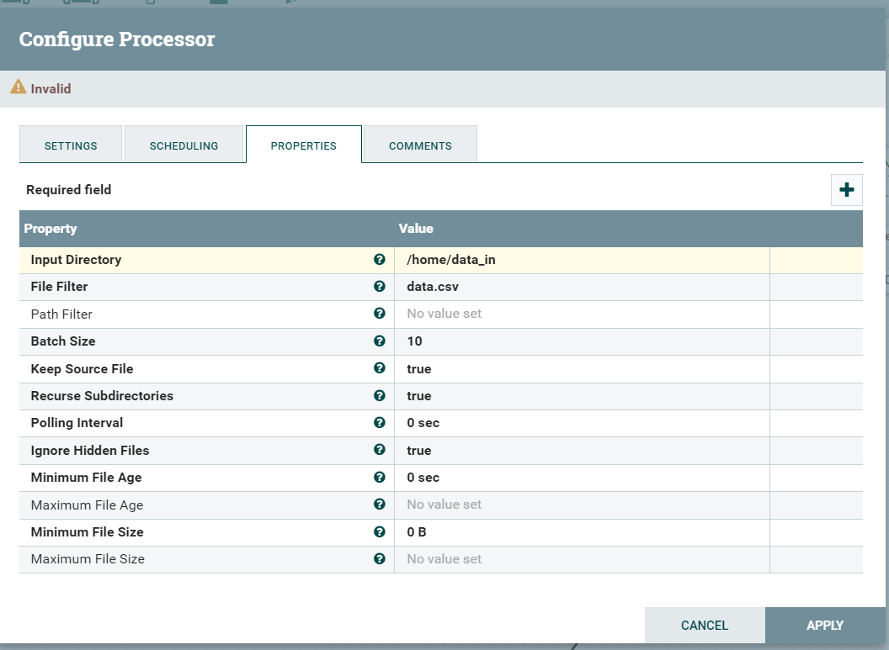
Extract Data from file data_in

Slide 3
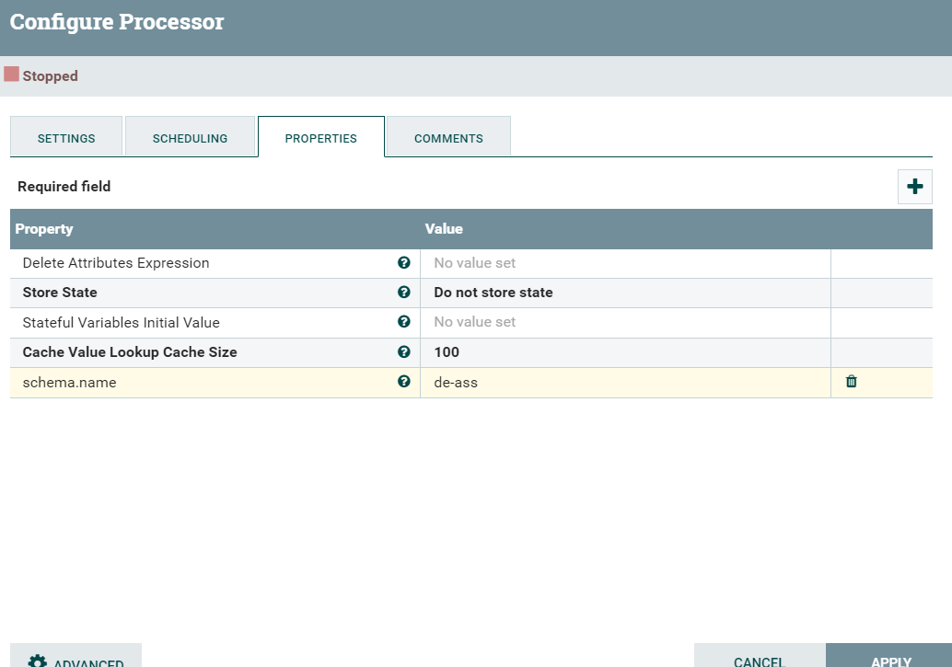
Add Shema.name to identify my schema

Slide 4
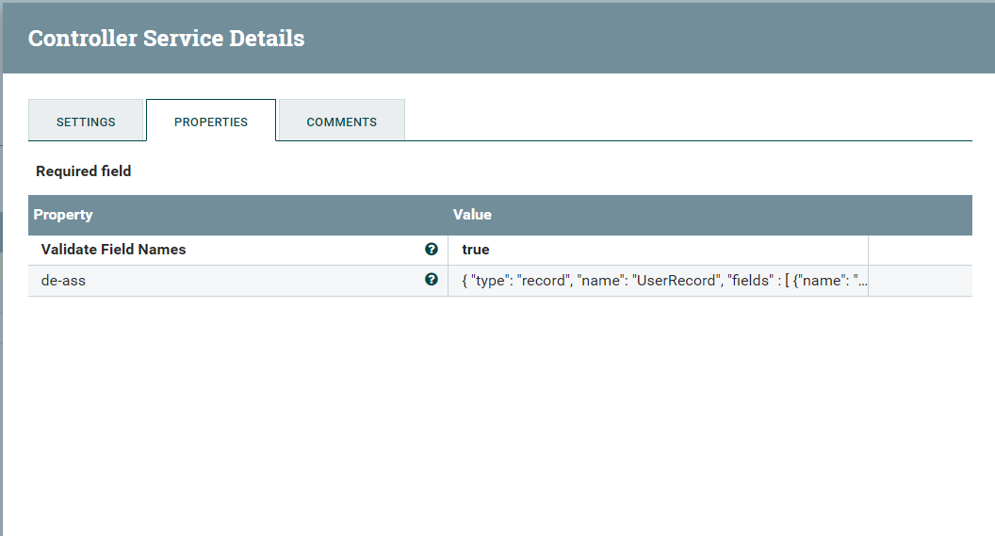
Add property to identify the schema

Slide 5
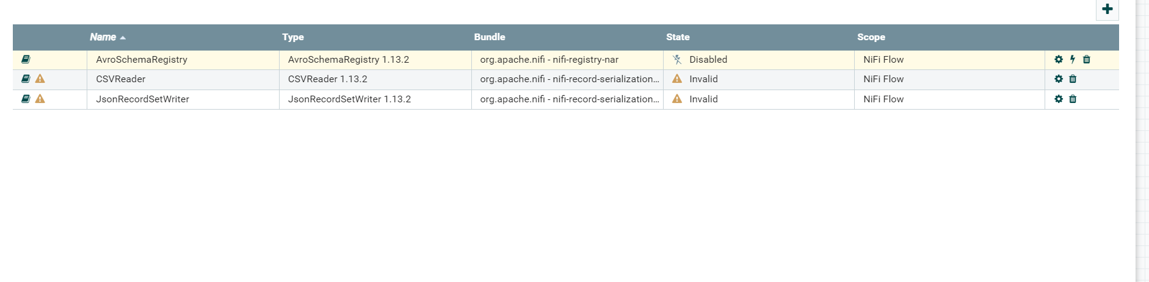
Convert Csv to JSON (enable buttons)

Slide 6
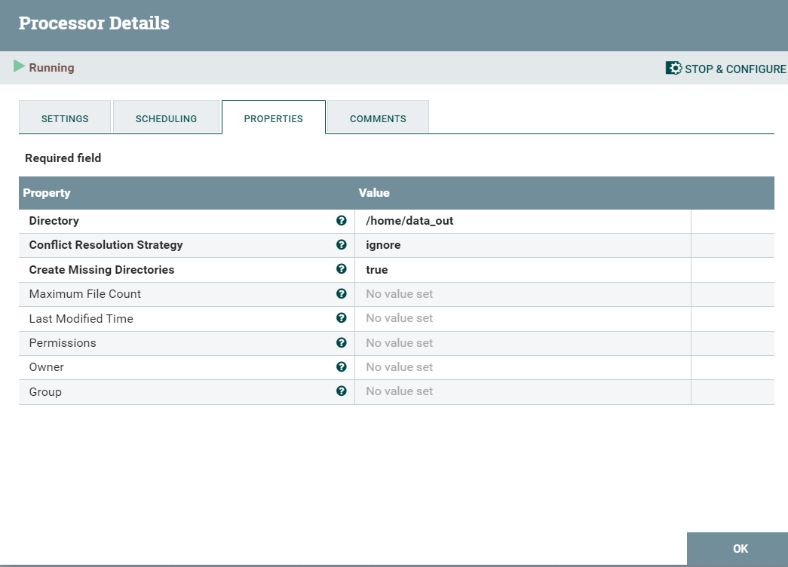
Load Data and save it in data_out file

