Slide 1
Elastic Compute Cloud (EC2)

Slide 2
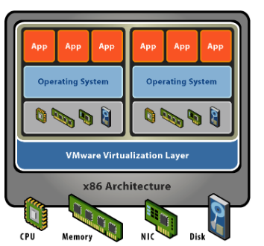

Slide 3
EC2 Instance families
General Purpose
- Balanced memory and CPU
- Suitable for most applications
- Ex. M3. M4. T2

Slide 4
EC2 Instance families
Memory Optimized
- More RAM/Memory
- Memory Intensive Apps,DB & Caching
- Ex. R3,R4

Slide 5
EC2 Instance families
Compute Optimized
- More CPU than Memory
- Compute & HPC intensive use
- Ex. C2,C4

Slide 6
EC2 Instance families
GPU Compute Instances
- Graphics Optimized
- High performance and parallel computing
- Ex. G2
Storage Optimized
- Very high, Low latency, I/O
- I/O intensive apps, data warehousing, Hadoop
- Ex. I2,D2

Slide 7
Elastic Compute Cloud (EC2)
To access an EC2 Instance you require a Key pair
When you launch a new EC2 Instance you can create a private public key pair
You can download the private key Only Once

Slide 8
Elastic Compute Cloud (EC2)
EC2 service provides resizable compute capacity in the cloud
You get root/administrative access to your EC2 instance (SSH/RDP)
EC2 SLA is 99.95% for each region during any monthly period

Slide 9
NAT Instance & NAT Gateway
NAT Instance & NAT Gateway

Slide 10
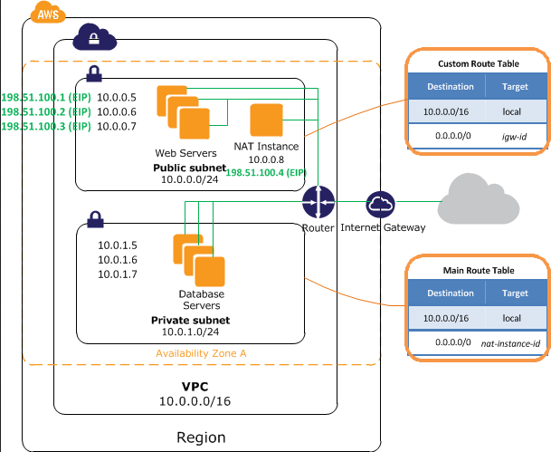

Slide 11
NAT Instance
NAT Instance allows private subnet EC2 instance to get to internet (proxy)
Inbound: Receiving http/https request from Private subnet
Outbound: Forwarding http/https request to Inernet
The NAT instance is configured in public subnet
NAT instance to be assigned to security group
Source Destination check must be disabled

Slide 12
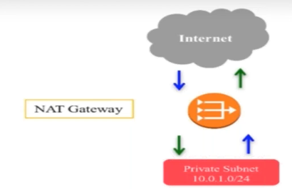
NAT Gateway

Slide 13
NAT Gateway
Its AWS managed service
NAT Gateway works only on Elastic IP Add
Cannot be assigned to security groups
AWS is resposible for Securing/patching, etc

