Slide 1
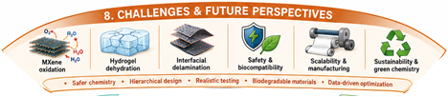


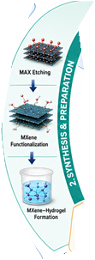


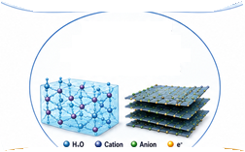


MXene–Hydrogel
Nanomaterials for
Flexible Energy Storage
in Soft Mechatronics
Notes:
Source: user-provided attachment 1.

