Slide 1
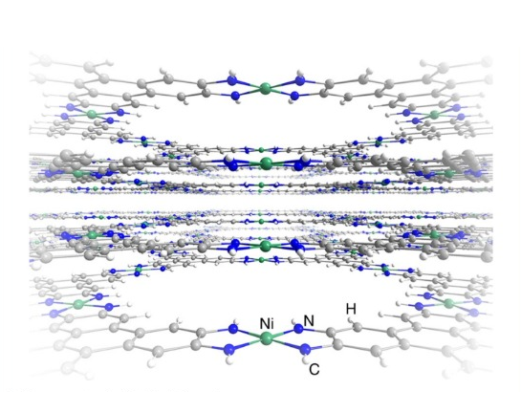
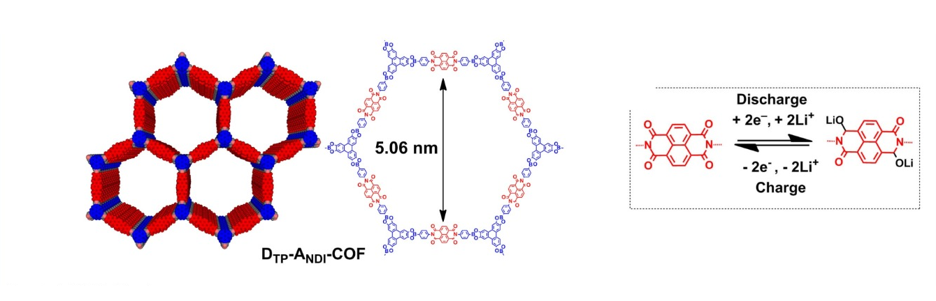
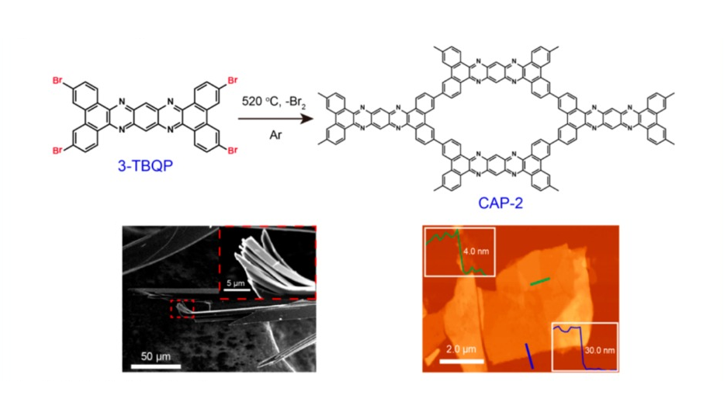
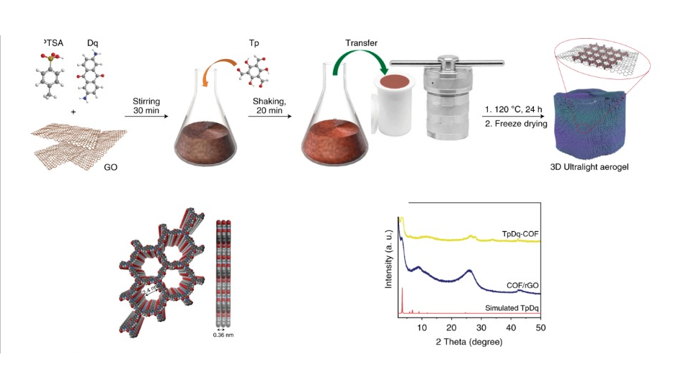
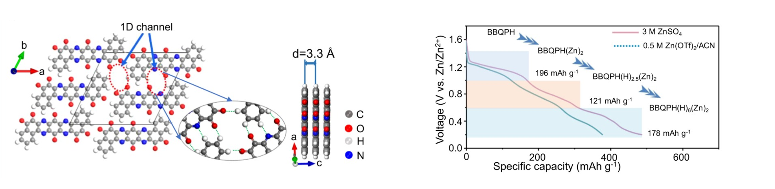
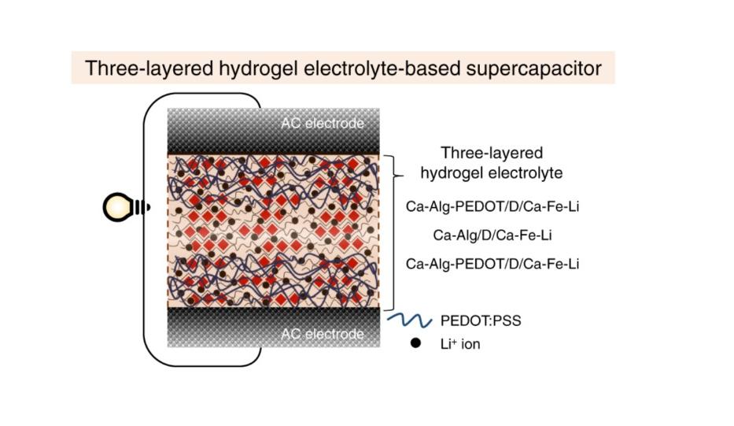
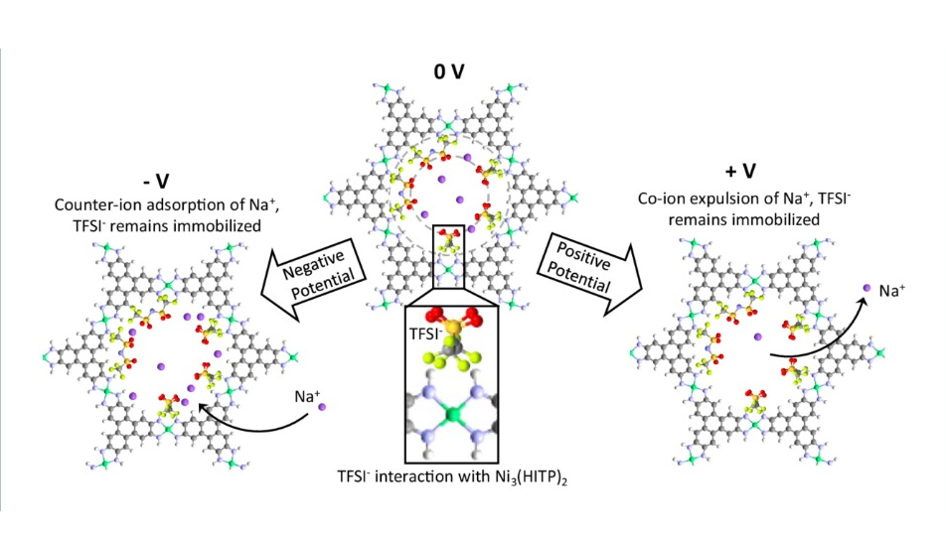
a)
2D MOF layers
b)
COF structure, linkages and redox
c)
CAP-2 synthesis and nanosheet evidence
d)
COF/rGO synthesis and structural evidence
e)
Hydrogen-bonded assembly and electrolyte-specific ion storage
f)
Hydrogel supercapacitor architecture
g)
Electrolyte-specific pore charging

