Slide 1
Diabetes Patients Readmit Prediction
Mohammed Awan
Seth Jones

Slide 2
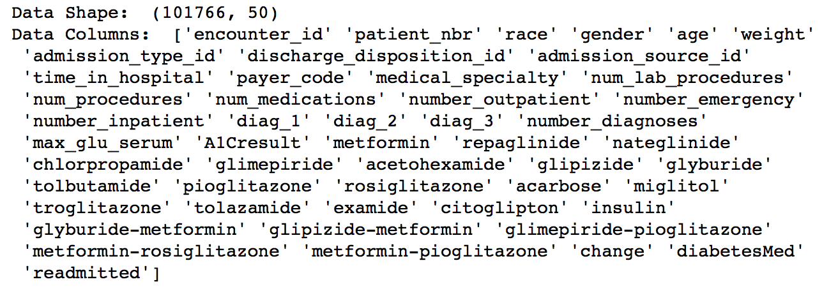
Dataset Information
50 Attributes, 101,766 Records
37 Nominal attributes, 13 Numerical attributes
3 Classes for target attribute ‘readmitted’. >30, <30, NO

Slide 3
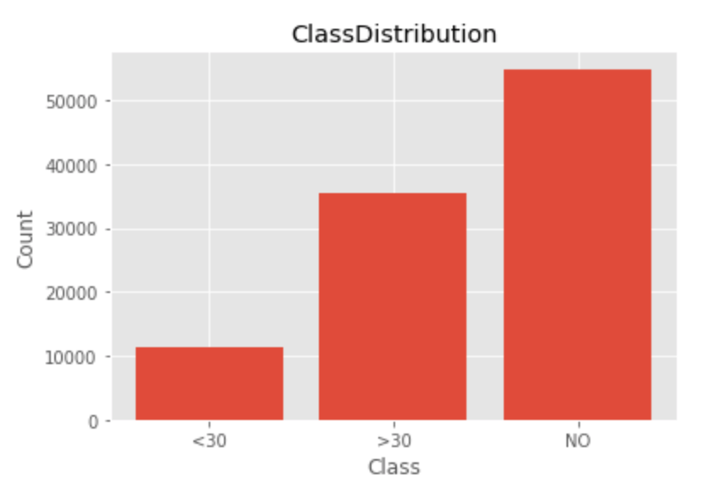
Class Distribution
The data is skewed towards the is skewed towards the ‘NO’ class.
We have to ensure that the model chosen isn’t affected heavily.

Slide 4
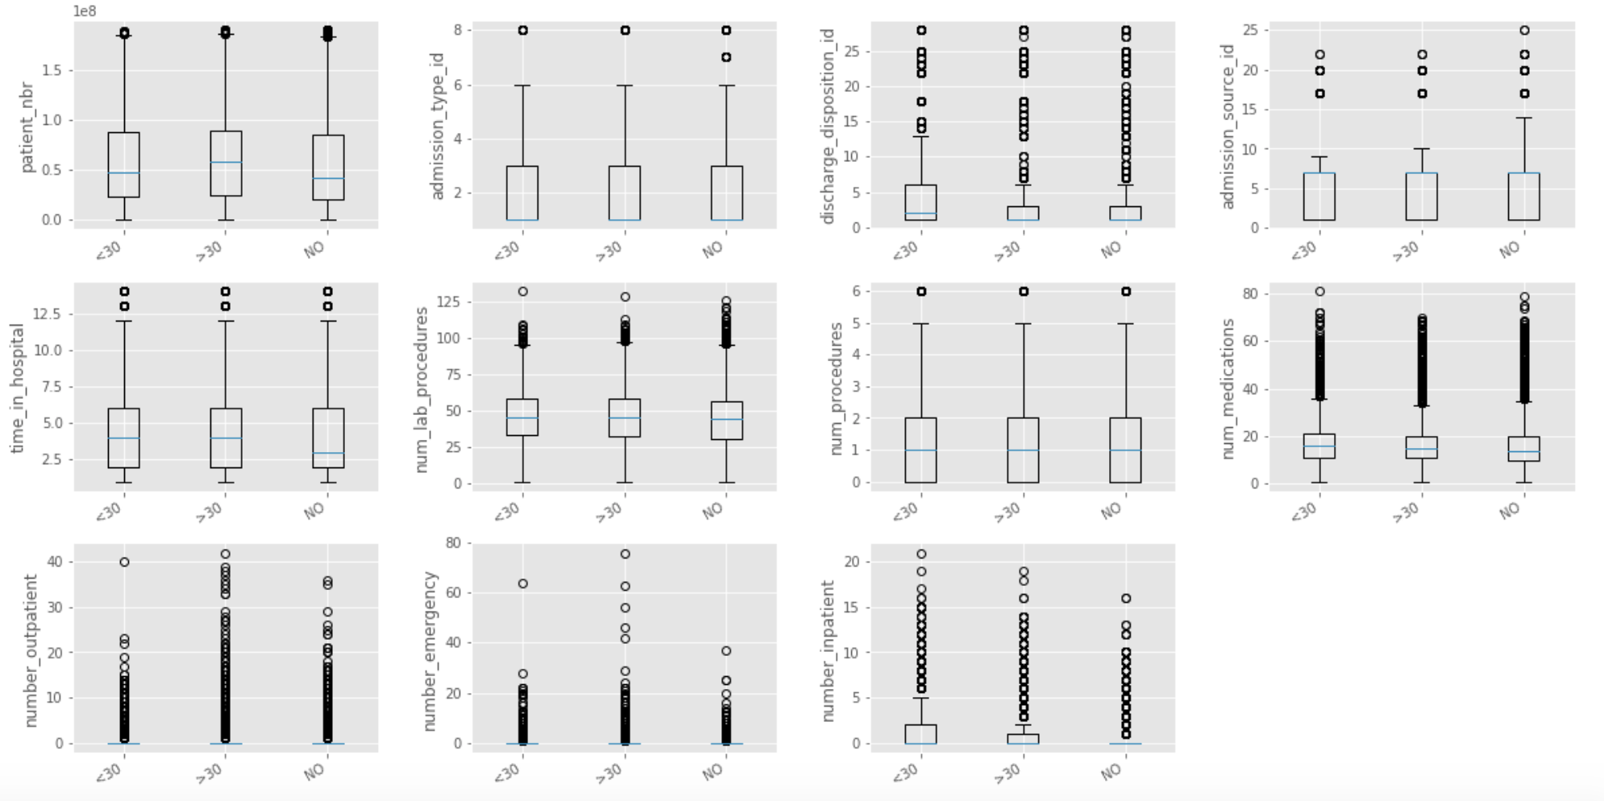
Numerical Data

Slide 5
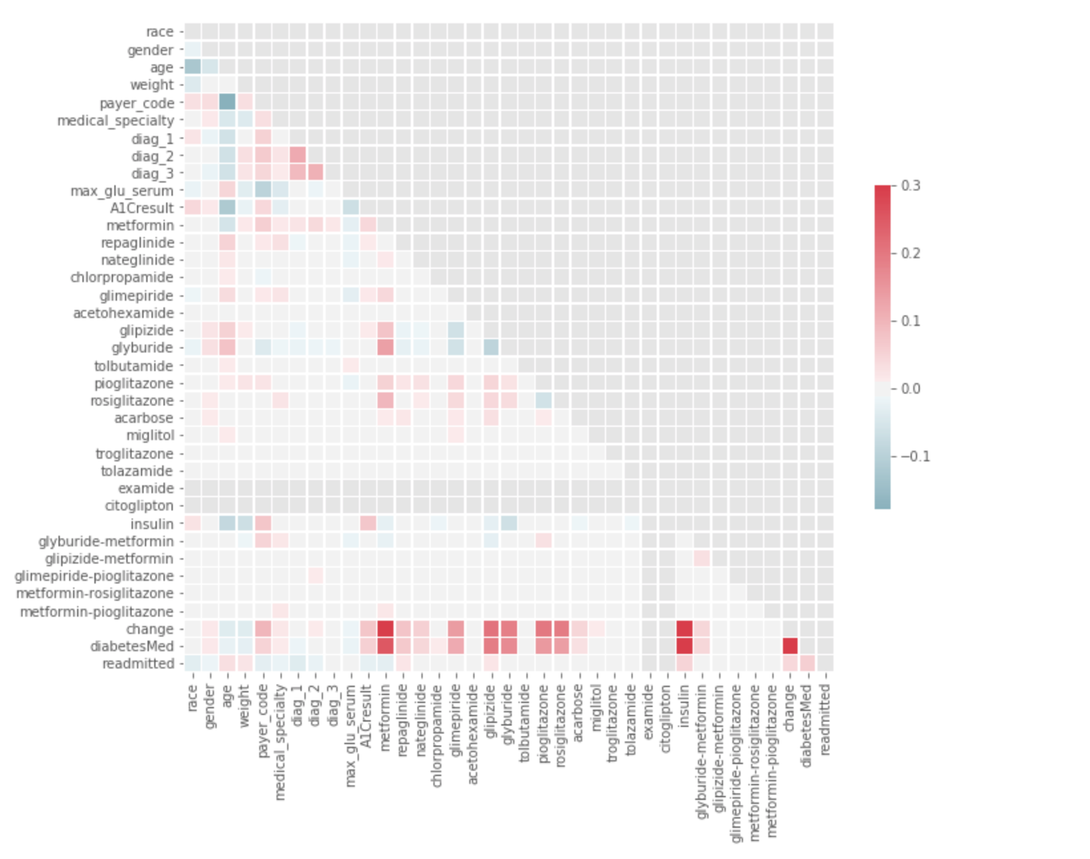
Nominal Data

