Slide 1
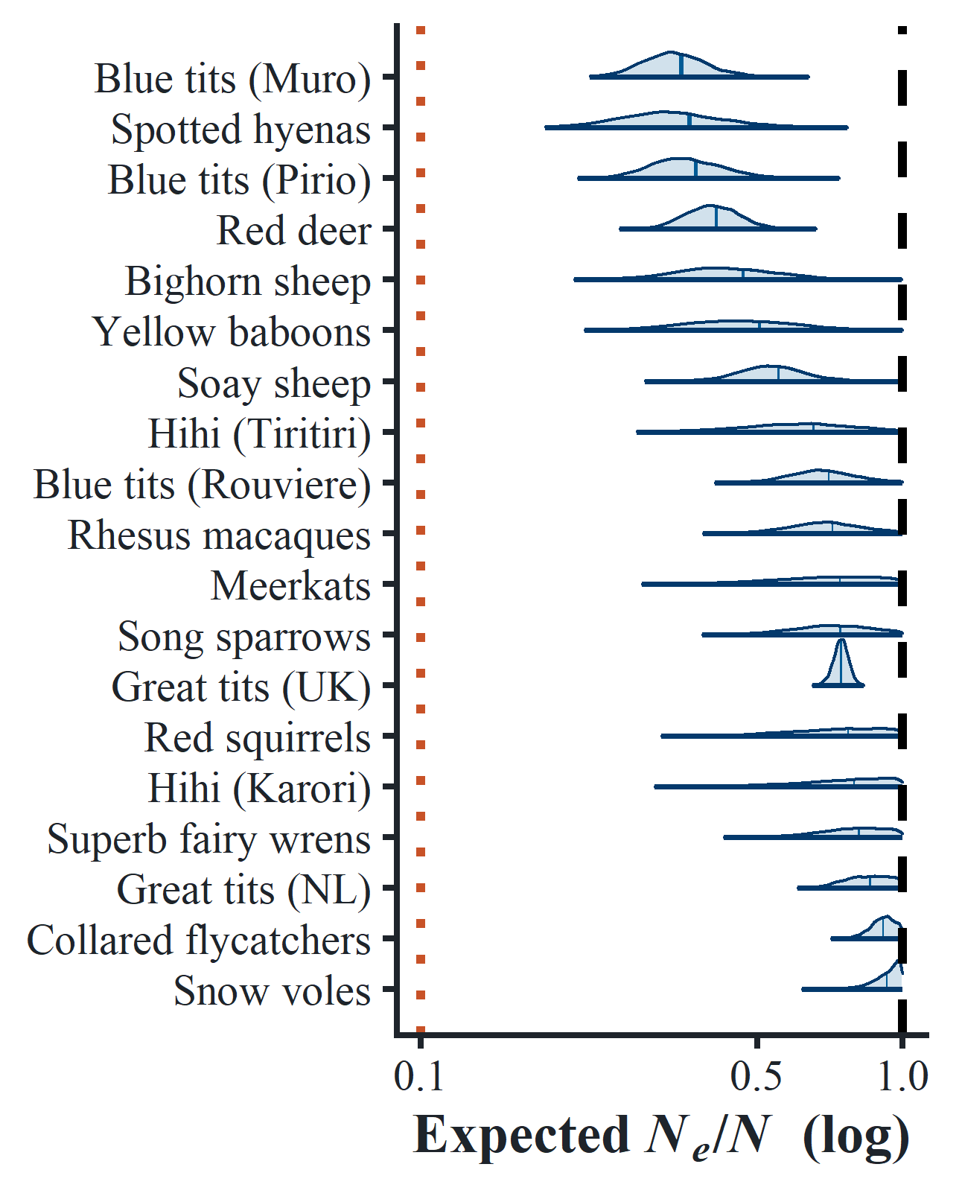
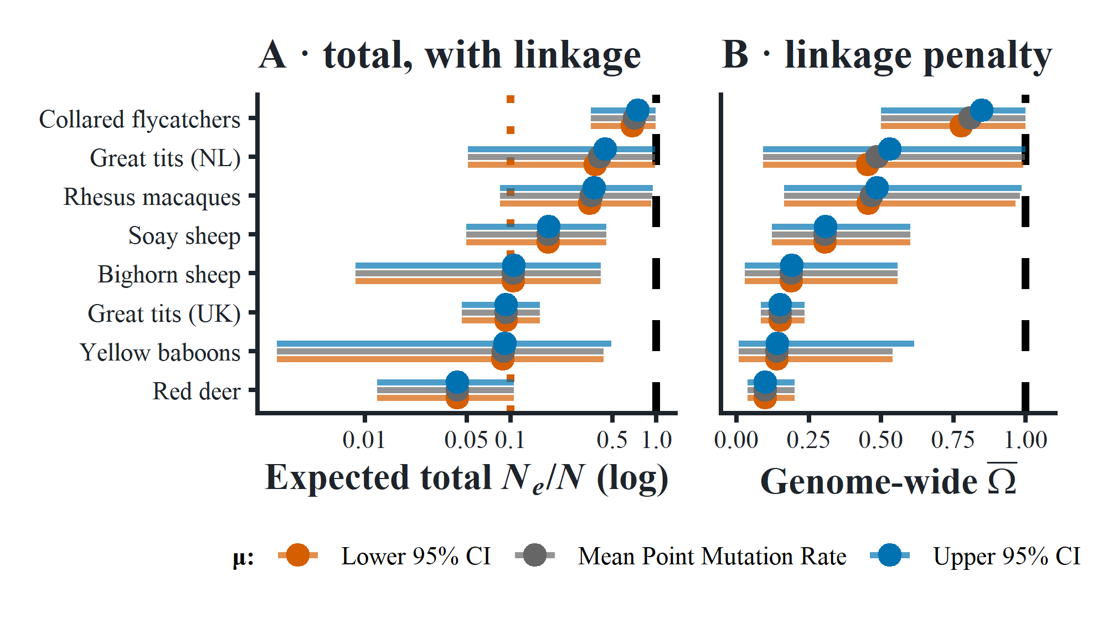
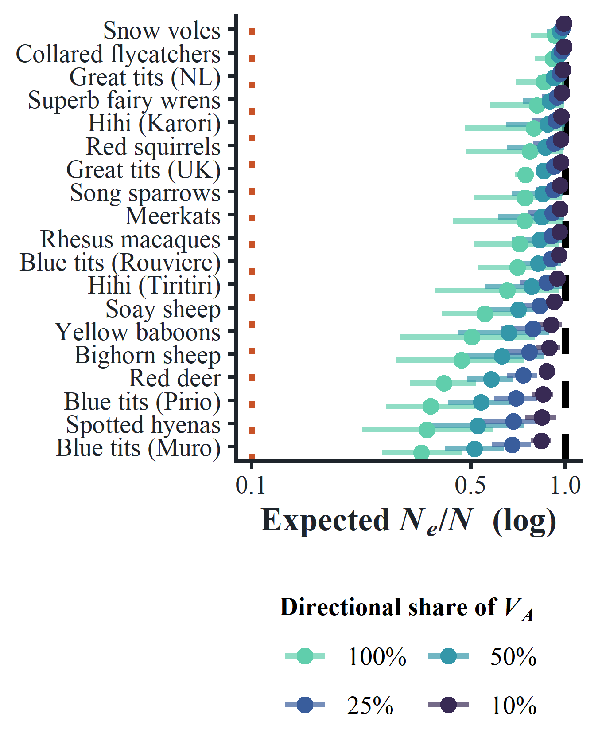
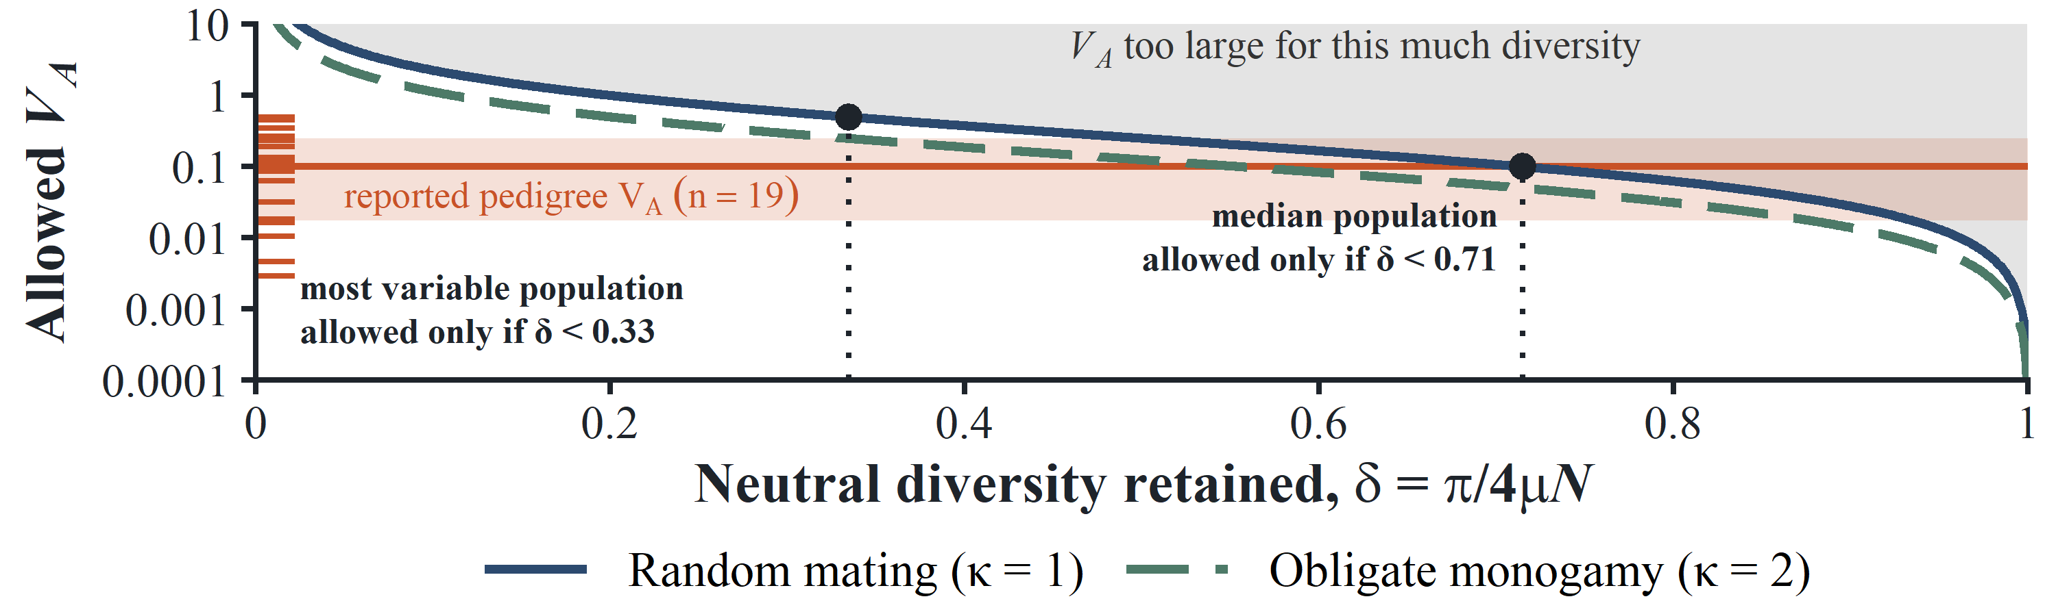
Measured Fitness Variance Is Too Weak to Explain the Missing Diversity
Walid Mawass
Human Genetics Department · University of Chicago · mawass@uchicago.edu
THE CLAIM
Heritable variance in fitness erodes neutral diversity, and a pedigree measures that variance without touching a single base. The 19 published estimates remove at most twentyfold of it. The deficit these species carry runs far deeper.
Diversity also sets an upper limit on sustained fitness variance. Every value reported so far stays under it.
A
Diversity erodes without linkage
C
Linkage only tightens it
MAP-DEPENDENT
N_{e}/N = 1 / (1 + 4κV_{A})
Near a selected site that association survives far longer than one generation of recombination allows. Adding recombination maps and functional target sizes at the chromosome level only tightens the estimate: a further 1.2 to 10×.
Because a neutral site's association with its background halves each generation rather than vanishing, heritable differences in offspring number erode diversity under free recombination. No linkage map, no annotation, no equilibrium assumption.
At most 3×; 1.4× at the median
Fig. A · Diversity kept, against no selection at the same census size (log). Dashed: 1. Dotted: 0.1. No input is calibrated on diversity.
Fig. C · (left) Diversity kept with the linked term, across the 95% interval on $μ$. (right) Genome-wide linkage penalty $\overline{Ω}$. Needs maps and annotations; Panel A needs neither.
B
Diversity sets the upper limit
D
Far short of the missing diversity
Inverting the same expression gives that limit: V_{A,max} = (1−δ)/(4κδ), where δ is the fraction of neutral diversity still standing. Any estimate of fitness variance has to come in under it.
Even counting all of the reported V_{A} as sustained, the prediction stays above the diversity these populations actually keep. Counting less of it widens the gap rather than closing it.
Whatever is depleting their diversity, this is not it.
The gap widens. It does not close.
Fig. B · Curves: the largest V_{A} each mating system allows, with N the number of breeding adults. Rust: reported pedigree V_{A}, quartiles and one tick per population (n = 19).
At δ = 0.1 the limit is 2.25; nothing reaches it.
Fig. D · Diversity kept when 100 / 50 / 25 / 10% of reported V_{A} is counted as sustained.
What these models need V_{A} to be
The calculation above and Fisher's theorem draw on one quantity: fitness variance that is transmitted and sustained.
WHAT THE EQUATIONS NEED
A SECOND ROUTE, NO DIVERSITY NEEDED
TAKEAWAY FOR THE FIELD
Any estimate of fitness variance, from a pedigree or from sequence, has to come in under (1 − δ)/(4κδ). That limit is the reusable part of this.
Diversity-calibrated estimates of linked selection already fell short of Lewontin's paradox. Twentyfold falls short as well, and none of it came from diversity data.
Large measured V_{A} gets read as large adaptive potential. Yet that reading needs the variance to persist, and nothing here shows it does — a discussion point, not a claim.
sustained over many generations
mutation and selection alone
Neutral diversity responds only to fitness variance maintained over coalescent time. A pedigree gives you a few decades.
Mutation and selection can sustain only so much variance. That route asks the same question with no diversity data, once the scales are reconciled.
▸ A pedigree cannot show it.
▸ Independent of everything left.
Robertson 1961 · Santiago & Caballero 1995 · Bonnet et al. 2022 · Corbett-Detig et al. 2015 · Buffalo 2021 · Lewin & Eyre-Walker 2026 · Charlesworth 2026 · Eyre-Walker & Keightley 2007
Midwest Population Genetics Meeting 2026 · University of Chicago

