Slide 1
Everything Java
Lesson 11 – JavaFX – Matt weeks

Slide 2
Coming up today
Application
Stages
Scenes
Controls
Alerts
Multiple scenes
Layout panes
Complex UIs
Stylesheets

Slide 3
Application
To create a UI using JavaFX your class needs to extend the Application class and override the start method.
This won’t show anything visible but is the initial step to creating a UI.
import javafx.application.Application;
import javafx.stage.Stage;
public class TempMain extends Application {
public static void main(String[] args) {
launch(args);
}
@Override
public void start(Stage primaryStage) {
}
}

Slide 4
Stages
Stages are the base elements used for creating a UI in JavaFX
Creating a stage on it’s own will create window without any content
@Override
public void start(Stage primaryStage) {
primaryStage.setTitle("Test UI");
primaryStage.show();
}

Slide 5
Scenes
Scenes allow you to configure configure your UI
They are the object that the visual elements of your UI get added to.
You can switch between multiple scenes very easily within one Stage
@Override
public void start(Stage primaryStage) {
primaryStage.setTitle("Test UI");
StackPane root = new StackPane();
primaryStage.setScene(new Scene(root, 300, 300));
primaryStage.show();
}

Slide 6
Controls
Controls are the components used to create a user interface, these include:
Label
Button
CheckBox
RadioButton
ListView
TextField
FileChooser
They cannot be added to a Scene, they have to be added to a Pane.

Slide 7
Controls – button
@Override public void start(Stage primaryStage) { primaryStage.setTitle("Test UI"); Button btn = new Button(); btn.setText("Hello world"); btn.setOnAction(new EventHandler<ActionEvent>() { @Override public void handle(ActionEvent event) { System.out.println("Hello World!"); } }); StackPane root = new StackPane(); root.getChildren().add(btn); primaryStage.setScene(new Scene(root, 300, 300)); primaryStage.show(); }

Slide 8
Task 036 – Basic UI
Create a basic UI with a button that prints to console when clicked.
Extensions:
How else can you modify / configure your button?

Slide 9
Alerts
Alerts are very easy to use in JavaFX
Create an alert variable, specifying the alert type
Set the alert values
setTitle(“sample text”)
setHeaderText(“sample text”)
setContentText(“sample text”)
Call the method to show the alert
showAndWait()

Slide 10
Alerts
Alert alert = new Alert(Alert.AlertType.INFORMATION);
alert.setTitle("Information Dialog");
alert.setHeaderText(null);
alert.setContentText(text);
alert.showAndWait();

Slide 11
Task 037 – Alerts
Create an alert when you click your button.
Extensions:
How else can you modify / configure alerts?

Slide 12
Multiple Scenes
Multiple scenes can be used to change the content within a stage quickly without losing the previous scene.
Once created, you can switch between them using one line of code
primaryStage.setScene(myScene);

Slide 13
Layout panes
Layout panes are used to control how objects are displayed on the within the Scene
The most common layout panes are:
BorderPane
HBox
VBox
GridPane
StackPane
To create more complicated UIs you can nest layout panes within other layout panes. E.g. a VBox inside a BorderPane to create a menu

Slide 14
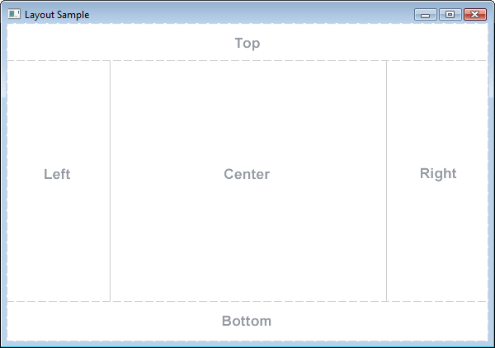
Layout panes - BorderPane

Slide 15

Layout panes - HBox

Slide 16

Layout panes - VBox

Slide 17
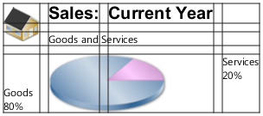
Layout panes - GridPane

Slide 18
Complex UIs

Slide 19
Stylesheets

Slide 20
UI Links
https://www.tutorialspoint.com/javafx/javafx_ui_controls.htm
http://code.makery.ch/blog/javafx-dialogs-official/
https://docs.oracle.com/javafx/2/layout/builtin_layouts.htm

