Slide 1
Everything Java
Lesson 10 – Error Handling – Matt weeks

Slide 2
Coming up today (and the next sessions…)
Subclasses
BlueJ
Casting
Error Handling
Unit tests
Recursion
And much more…

Slide 3
Inheritance
Inheritance allows you to share common code / methods between classes while keeping them in your classes
When using inheritance you have a super class and a sub class
Super class methods and variables are useable in the sub class
A sub class can only extend one super class
A super class can be extended by many classes
A class can be both a super class and a sub class

Slide 4
Inheritance
Vehicle
Bike
Car
Lorry

Slide 5
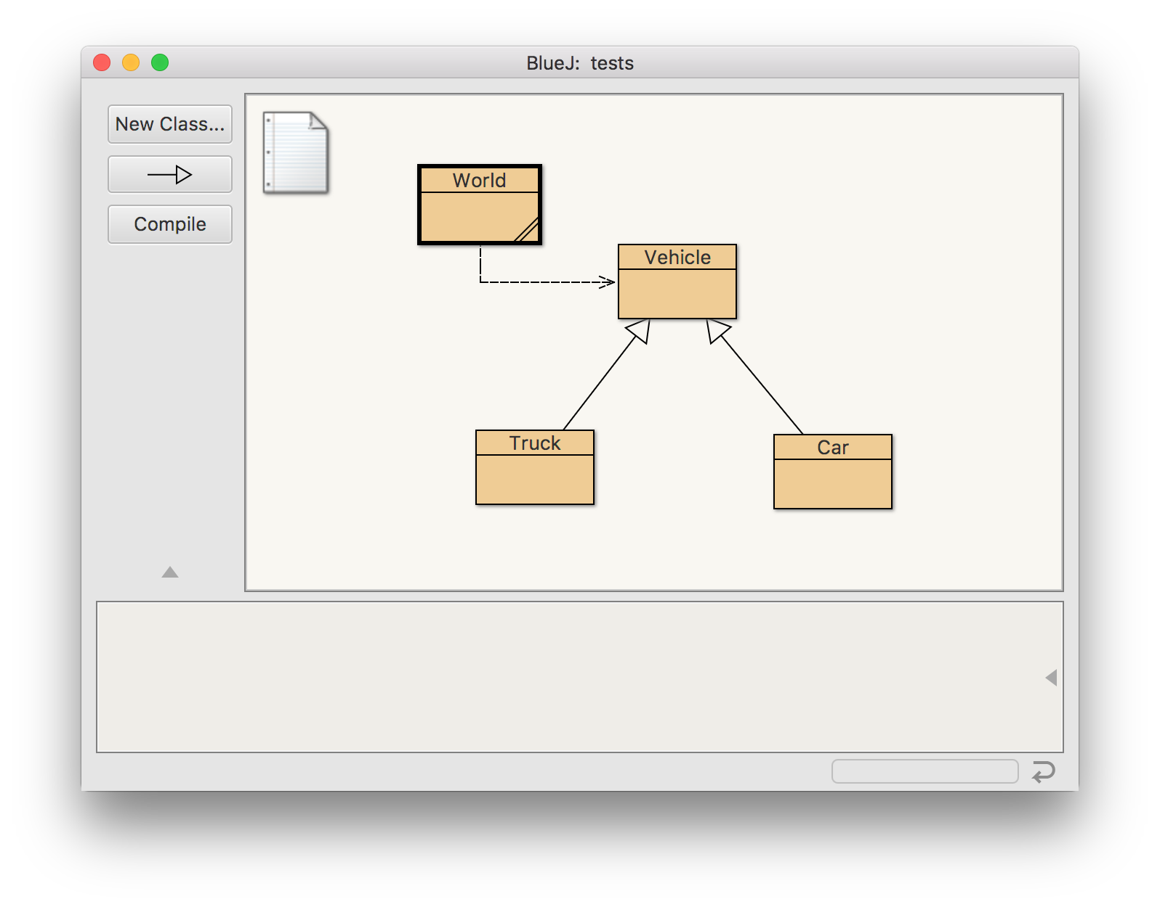
BlueJ

Slide 6
BlueJ Demo

Slide 7
Task 033 - Inheritance
Create a class and two or more subclasses and use them to store information
E.g. “Animal” with subclasses of “Dog” and “Fish”
Extension:
Create a class that is a sub class and a super class and modify your program to use that.
E.g. “Mammal” to go between “Animal” and “Dog”
Modify your shop to have multiple item sub classes that store extra information about the products
Move your code to BlueJ and look at the class diagram

Slide 8
Casting
Casting allows you to turn one variable type into another
You can cast in both directions
Super class --> sub class
Sub class --> super class
Example casting an Animal to a Dog type
Animal animalVariable = …;
Dog newDog = (Dog) animalVariable;
Example casting an Dog to a Animal type
Dog newDog = new Dog();
Animal newAnimal = (Animal) newDog;

Slide 9
Casting- demo

Slide 10
Task 034 - Casting
Add some methods to you previous task that use casting.
E.g. printDogsList()
Extension:
What happens when you cast to the wrong type? Is it an issue?

Slide 11
Error handling
Error handling allows your program to keep running when things go wrong.
The easiest way to do error handling in java is a try / catch statement.
Animal a = new Fish();
try {
Dog d = (Dog) a;
} catch (ClassCastException e) { System.out.println(e); }

Slide 12
Error handling - demo

Slide 13
Task 035 – Error handling
Add a try catch for trying to access position in an array that doesn’t exist.
Add a try catch for casting incorrectly.
Extension:
Figure out how to save a string to a text file.

