Slide 1
FAKE NEWS DETECTION USING MACHINE LEARNING
Guide- Dr. Ashish Kumar Sahu
Team members- Navjyot Wig 17BCE10001
Bhupendra singh yaduvanshi 17BCE10076
Mohd.Avesh Husain 17BCE10174

Slide 2
Introduction
Fake news has quickly become a society problem, being used to propagate false or rumour information in order to change people's behaviour.
It has been shown that propagation of fake news has a deep impact on society .
This project could be practically used by any media company to automatically predict whether the circulating news is fake or not.
News Content Features: When we start to look at news content, it can be seen that it is made of four principal raw components:
Source: Where does the news come from, who wrote it, is this source reliable or not.
Headline: Short summary of the news content that try to attract the reader.
Body Text: The actual text content of the news.
Image/Video: Usually, textual information is paralleled with visual information such as images, videos or audio.

Slide 3
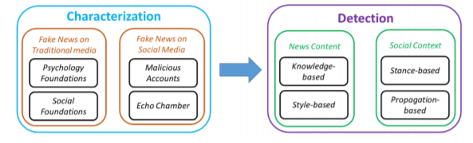
Fake News Characterization
Fake news definition is made of two parts:
Authenticity: It means that fake news content (false information) that can be verified as such, meaning that conspiracy theory is not included in fake news.
Intent: The false information has been written with the goal of misleading the reader.

Slide 4
Proposed work
In our project we will develop and train a learning model to detect fake news from a given news corpus.
NOVELTY of our project:
We have seen in the existing works that most of the related works focus on improving the prediction quality by adding additional features.
The fact is that these features are not always available, for instance some article may not contain images.
There is also the fact that using social media information is problematic because it is easy to create a new account on these media and fool the detection system.
That’s why we chose to focus on the article body only(text corpus) and see if it is possible to accurately detect fake news.

Slide 5
Real Time Usage
This project could be practically used by any media company to automatically predict whether the circulating news is fake or not.
The process could be done automatically without having humans manually review thousands of news related articles.

Slide 6
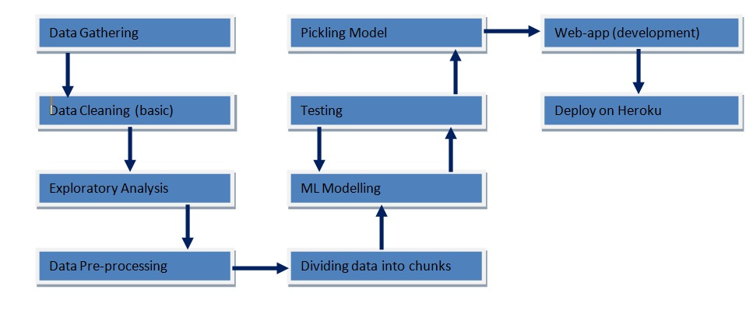
Overall System Architecture

Slide 7
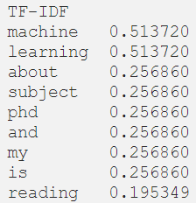
Methodology
These TFID and count vectors are nothing but help in transforming texts to feature vectors .
We can then use these vectors as inputs with the aim to express the importance of a word to a document.
These values represent the frequency of words.
The next part left is our project will be to train the ML algorithms using our cleaned data sets and test the accuracy and precision of each algo.

Slide 8
MODULES
Understand the problem statement and business case.
Data gathering.
Perform data cleaning.
Perform Exploratory data analysis.
Data pre-processing.
Data preparation.
Train various supervised learning Model (random forest/decision tree /logistic regression).
Hyper parameter tuning and cross validation.
Comparing trained model performance(AUC,F1).
Testing on unknown data(raw).

Slide 9
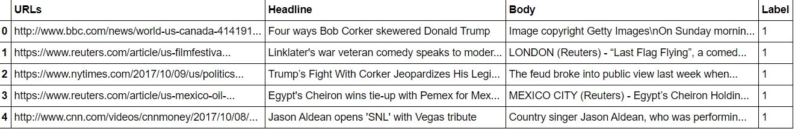
DATA GATHERING
TRAINING DATA
https://www.kaggle.com/clmentbisaillon/fake-and-real-news-dataset
https://www.kaggle.com/jruvika/fake-news-detection
TESTING DATA
AS OUR TRAINING DATA IS QUITE LARGE, WE DIVIDED THE LARGE DATASET INTO CHUNKS OF DATA (_TRAIN AND _TEST)

Slide 10
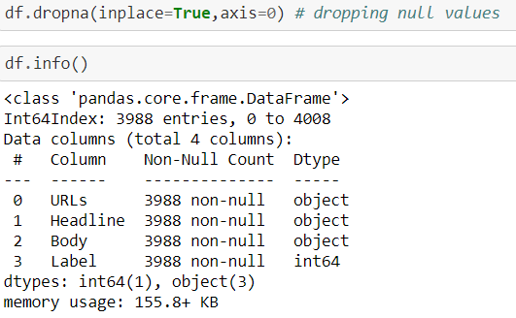
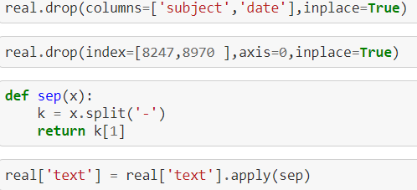
DATA CLEANING
CHECKING AND DROPPING NULL VALUES.
DROPPING IRRELEVANT COLUMNS.

Slide 11
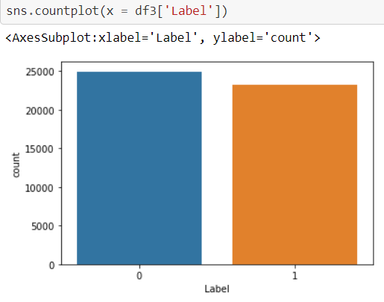
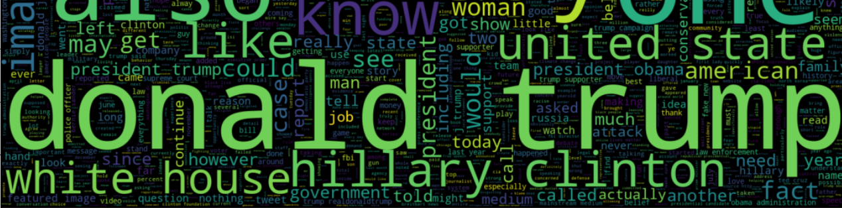
EXPLORATORY DATA ANALYSIS
CALCULATING WORD COUNTS
PLOTTING FAKE NEWS WORD COUNT
PLOTTING REAL NEWS WORD COUNT
CHECKING CLASS IMBALANCES
GENERATING WORD CLOUD

Slide 12
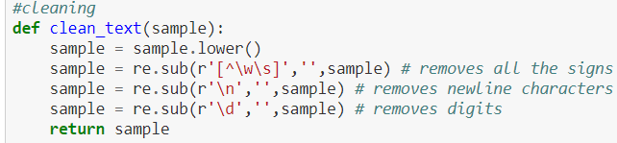
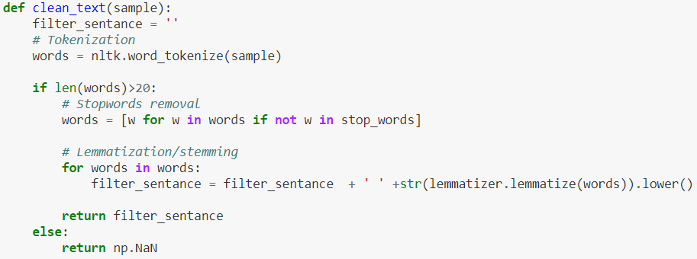
DATA PREPROCESSING
REMOVING SPECIAL CHARACTERS AND DIGITS .
CONVERTING TEXT DATA INTO LOWER CASE.
TOKENIZING AND REMOVING STOP WORDS.
LEMMATIZATION

Slide 13
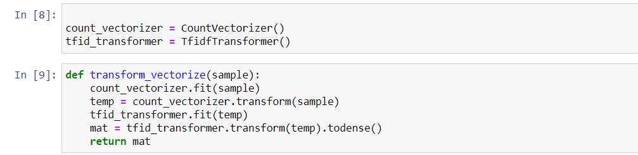
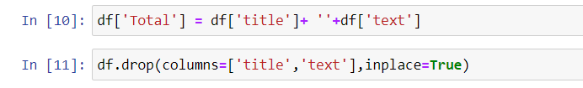
data preparation
Taking 70 % of Data from the available Dataset.
Checking for Class Imbalances.
Vectorizing Data (Countvectorizer)
Fitting TFID Transformer.
Splitting Data into Train and Test Data.

Slide 14
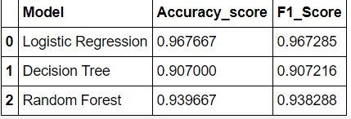

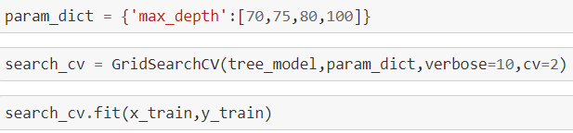

Hyper parameter tuning and cross validation.
LOGISTIC - CHECKING C VALUE(INVERSE OF REGULARIZATION METHOD -LASSO)
DECISION TREE- CROSS VALIDATION(GRIDSEARCHCV), SEARCHING FOR MAXIMUM DEPTH
RANDOM FOREST-CROSS VALIDATION (GRIDSEARCHCV), SEARCHING FOR OPTIMAL MAXIMUM DEPTH AND N_ESTIMATORS
SELECTING THE MODELS

Slide 15
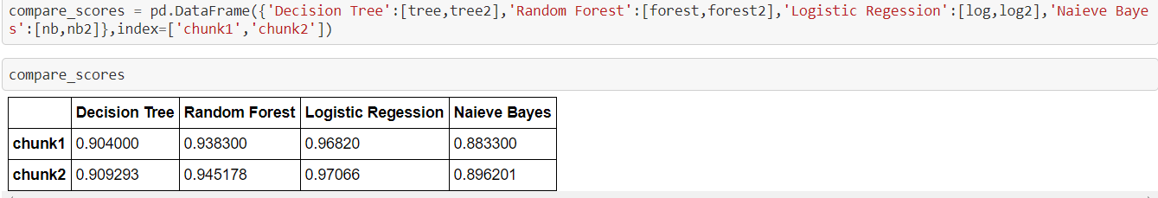
Test results
ALGORITHM USED AND SCORES-
 | Decision Tree | Random Forest | Logistic Reg | Naieve Bayes
Test_data1 | .904000 | .938300 | .96820 | .883300
Test_data2 | .909293 | .945178 | .97066 | .896201

Slide 16
REMAINING work
TRAINING A DEEP LEARNING MODEL(ANN,RNN).
DEPLOYMENT

Slide 17
THANK YOU

