Slide 1
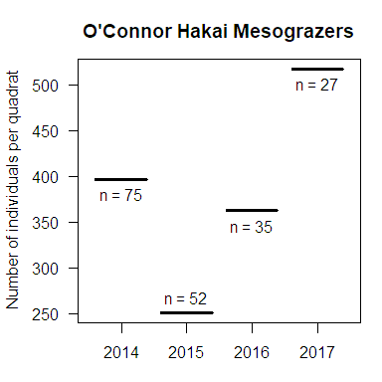
O’Connor Hakai Seagrass
mesograzers
average number of individuals per quadrats, and number of quadrats

Slide 2
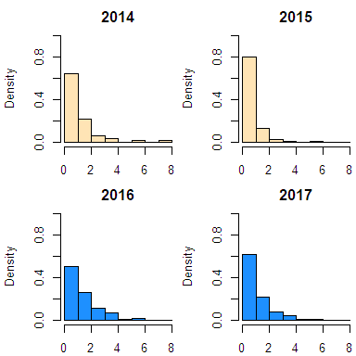
O’Connor Hakai Seagrass
mesograzers
size distribution across years
measuring sizes directly instead of using sieves (2014 and 2015) shifts the size distribution over a bit

Slide 3
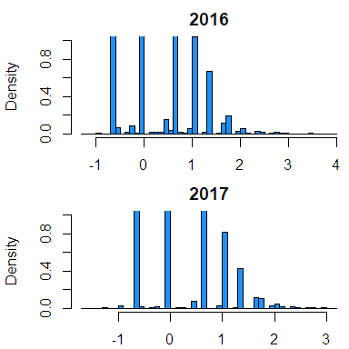
O’Connor Hakai Seagrass
mesograzers
size distribution across years
Full distribution for 2016 and 2017
ln(size)

