Slide 1

Website galitos
Marta Condeço 112903
Henrique Oliveira 113515
João Gaspar 114514

Slide 2
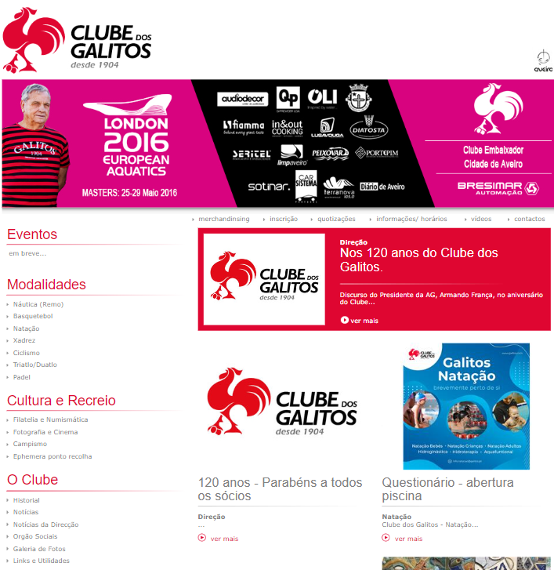
Product description
The website has the purpose of showing the club, the sport sections, some important informations and even sell merchandise
Their target users are club members and/or their family who wish to keep up with the club
The website can also be used by those who seek to join Galitos club and/or find more information about it

Slide 3

Evaluating methods
Heuristic evaluation:
Based on Neil’s 10 Usability Heuristics for UI design
The severity of problems was rated on a 0 to 4 scale
Cognitive walkthrough:
Based on Spenser’s streamlined cognitive walktrough

Slide 4
He general results
 | Marta | Henrique | João
 | Severity
Font size is not consistent nor reading-adequate | 3 | 3 | 3
Errors/notes on forms aren’t normalized to real-world view | 4 | 3 | 3
Links aren’t styled consistently throughout the site | 3 | 3 | 4
Menu items show unconsistent interaction | 3 | 2 | 2
Titles/Images of news, button labels and links aren’t interactable | 2 | 2 | 3
Badly formulated, unnecessary or redundant pages | 3 | 4 | 3

Slide 5
He general results (continuation)
 | Marta | Henrique | João
 | Severity
Club/Sponsors logo sizes/appearance aren’t consistent on Header/Footer | 1 | 3 | 1
Insufficient form validation and lack of clear error messaging | 4 | 4 | 4
Poor presentation and/or separation of content | 2 | 1 | 3
Non-obvious navigation bar | 2 | 2 | 1
Small buttons that make usage burdensome | 3 | 2 | 2
Seemingly mandatory buttons that are actually optional | 3 | 1 | 3

Slide 6
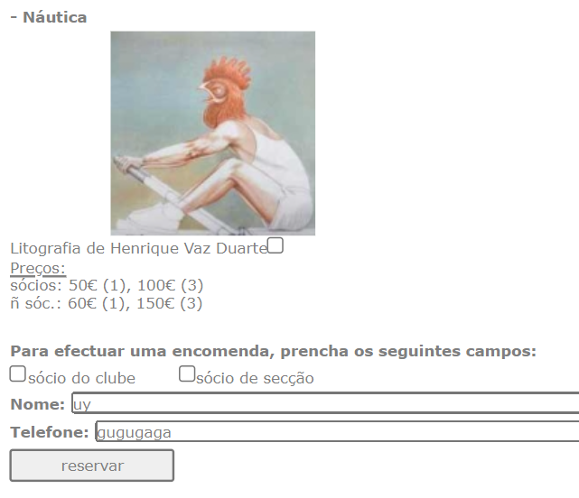
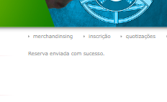


insufficient form validation
Error Prevention - 4
Unnecessary pages
Aesthetic and Minimalist Design - 2

Slide 7
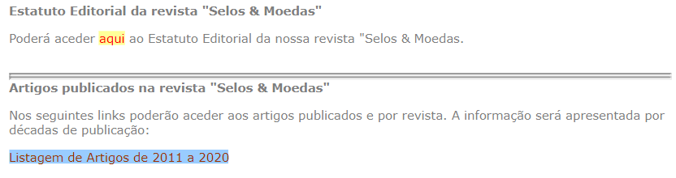
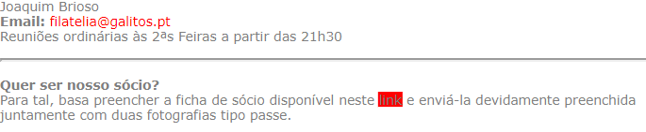
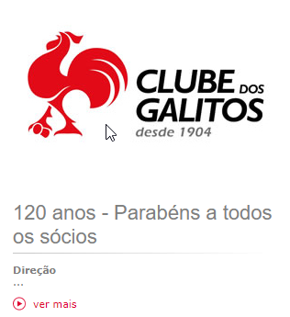
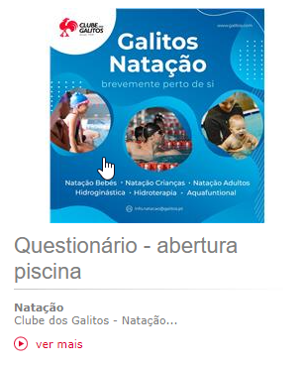
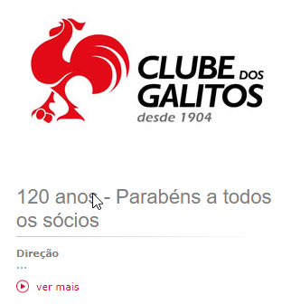
Inconsistent link’s style
Consistency and Standards - 1
Titles/Images of news, button labels and links aren’t interactable
Consistency and Standards - 3

Slide 8
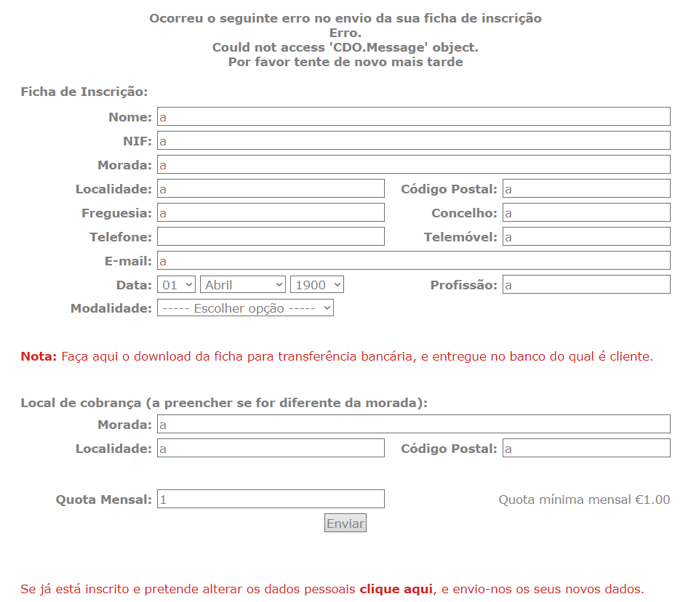
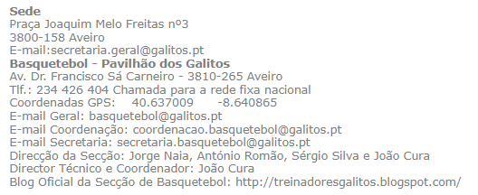
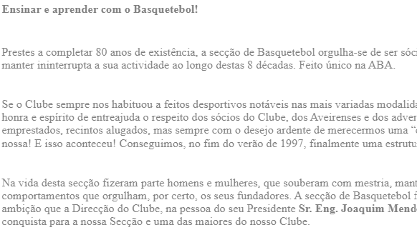
Confusing Form error
Help Users Recognize, Diagnose, and Recover from Errors - 4
Inconsistent and Unreadable text
Consistency and Standards - 3

Slide 9
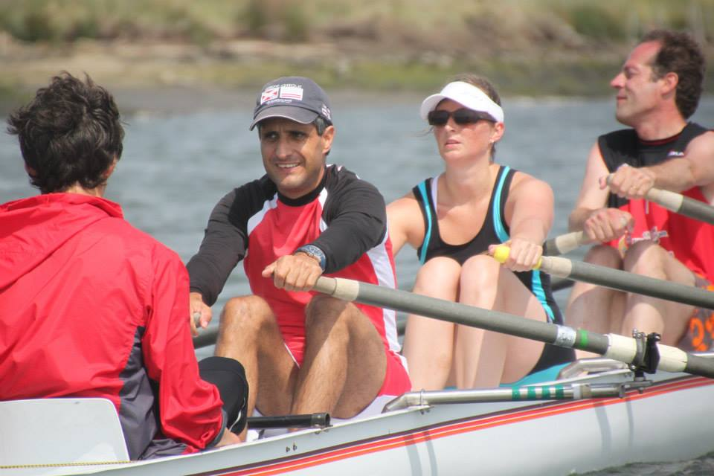
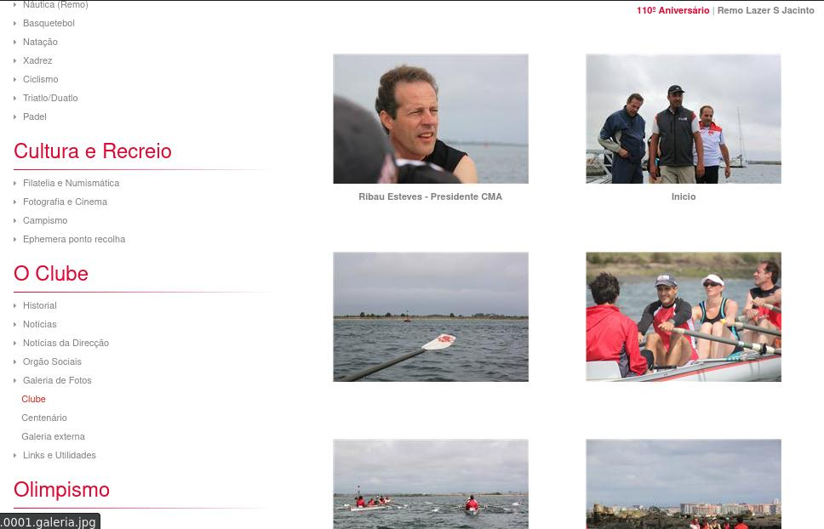
Cognitive walkthrough
User's Objective
Find this photo:
Photo's Location
O Clube -> Galeria de Fotos -> Remo Lazer S. Jacinto

Slide 10
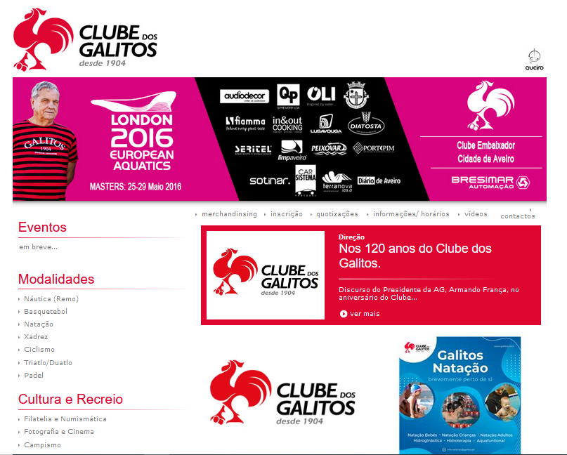
Cognitive
walkthrough
Will the user know what to do at this step?
Probably not, since there are pages in the website that the user is more likely to visit because they have relevant names towards the user's goal.
If the user does the right thing, will they know that they did the right thing, and are making progress towards their goal?
Maybe. If the user scrolls down and finds "Galeria de Fotos" under "O Clube" they might click on it (since the name is allusive towards their goal) and if so, by seeing all the photos on that pages, they might know they are on the right path, even though the images aren't related to rowing.

Slide 11
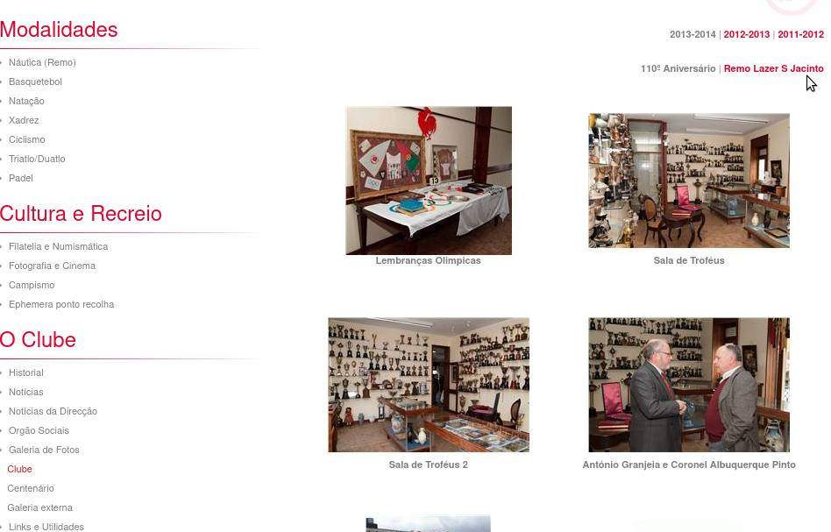
Cognitive
walkthrough
Will the user know what to do at this step?
If they were on the right path:
Answer -> Maybe
Highlighted-text button
The button is small
If they were on the wrong path:
Answer ->Probably not
Dead-end(s)
Got Lost
If the user does the right thing, will they know that they did the right thing, and are making progress towards their goal?
Answer -> Almost Certainly
They will find the photo

Slide 12
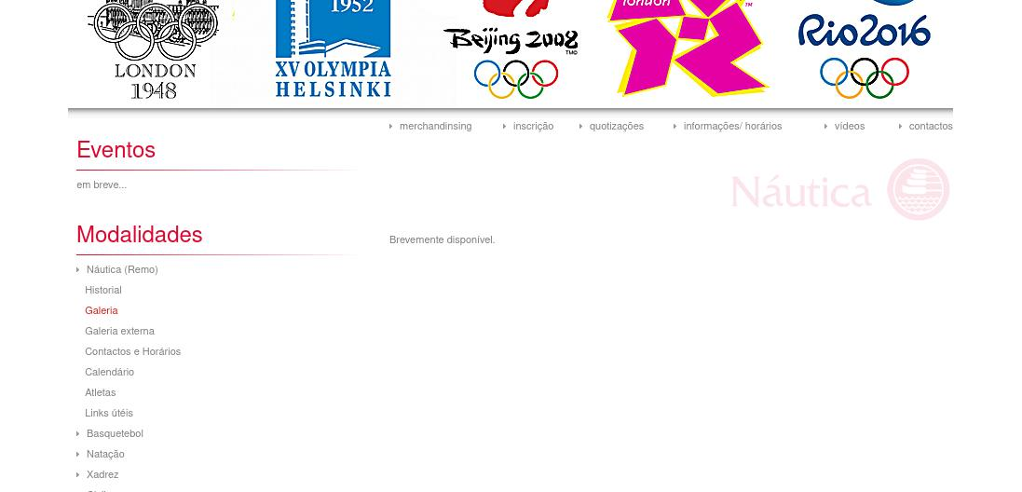
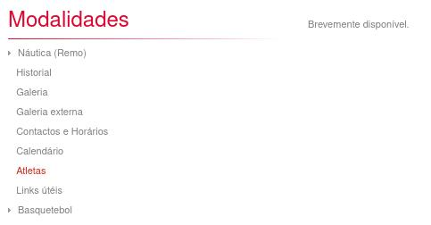
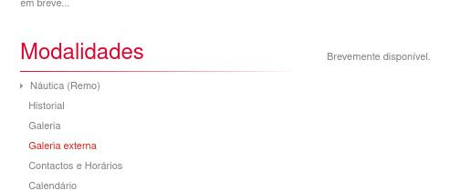
Cognitive
walkthrough
Possible outcomes:
Possible Dead-ends:
Photo Found ( Ideal , Unlikely )
Got Lost but Found Photo
( Not Ideal , Somewhat likely )
Got Lost and Gave Up ( Worst Outcome , Most Likely )
(
(

Slide 13
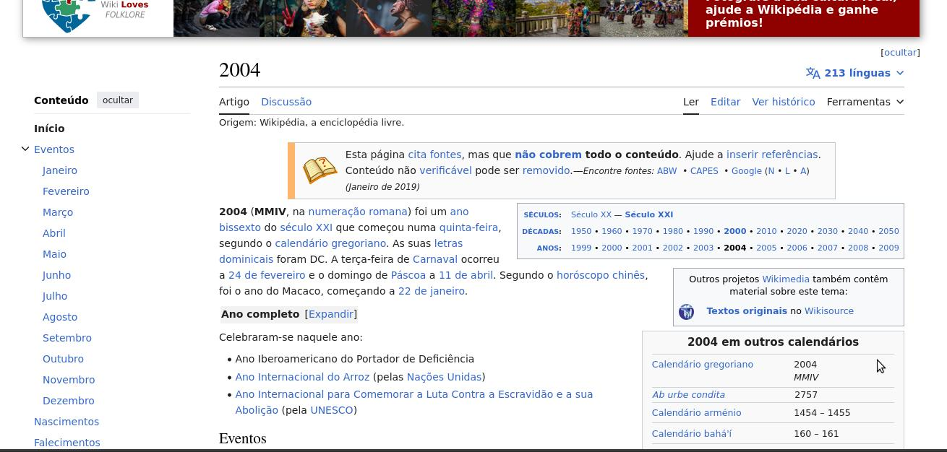
(in)Cognitive walkthrough
User's Objective
Find year 2004's wikipedia page:
It Is
Possible
…

Slide 14
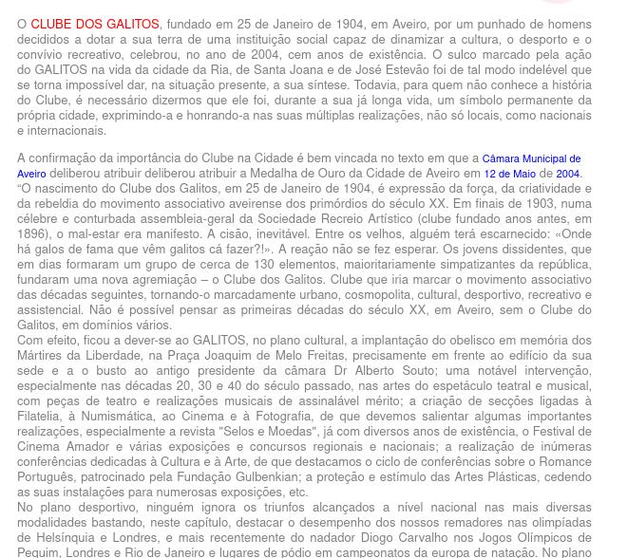
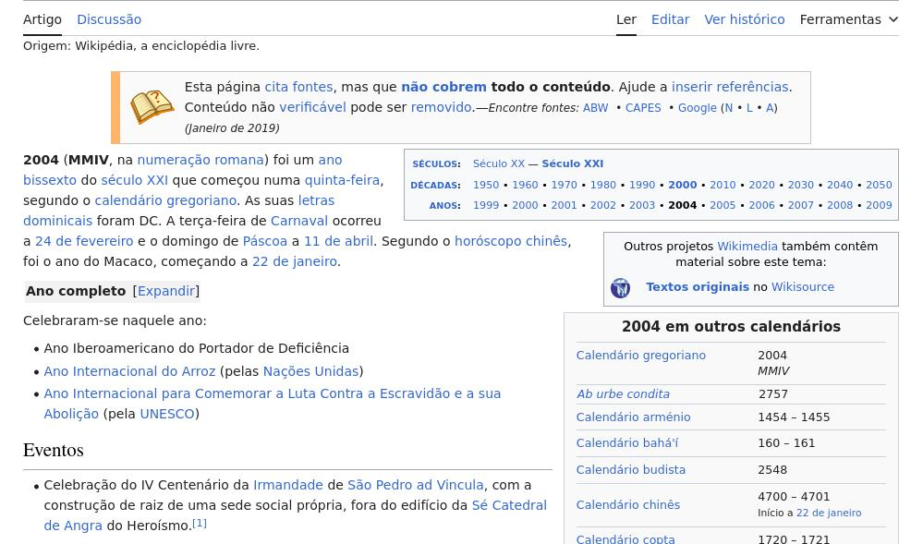
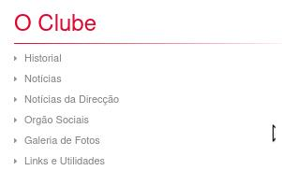
(in)Cognitive walkthrough
Just Follow:
O Clube -> Historial -> 2004

Slide 15
Conclusion
Considerable potential for enhancement
Good and organized Layout
Significantly deficient in content

