Slide 1
Learning representations by back-propagating errors (1986 Nature)

Slide 2
About 35 year ago..

Slide 3
We want to build self-organising neural networks that can develop an internal structure appropriate for a particular task domain.

Slide 4
If the input units are directly connected to the output units it is relatively easy to find learning rules that iteratively adjust the relative strengths of the connections so as to progressively reduce the difference between the actual and desired output vectors. Learning becomes more difficult when we introduce hidden units whose actual or desired states are not specified by the task…

Slide 5
Back-propagation is a breakthrough (c. 1986!) algorithm that allows us to build and train neural networks with hidden layers.

Slide 6
“This amounts to deciding what these units should represent”.

Slide 7
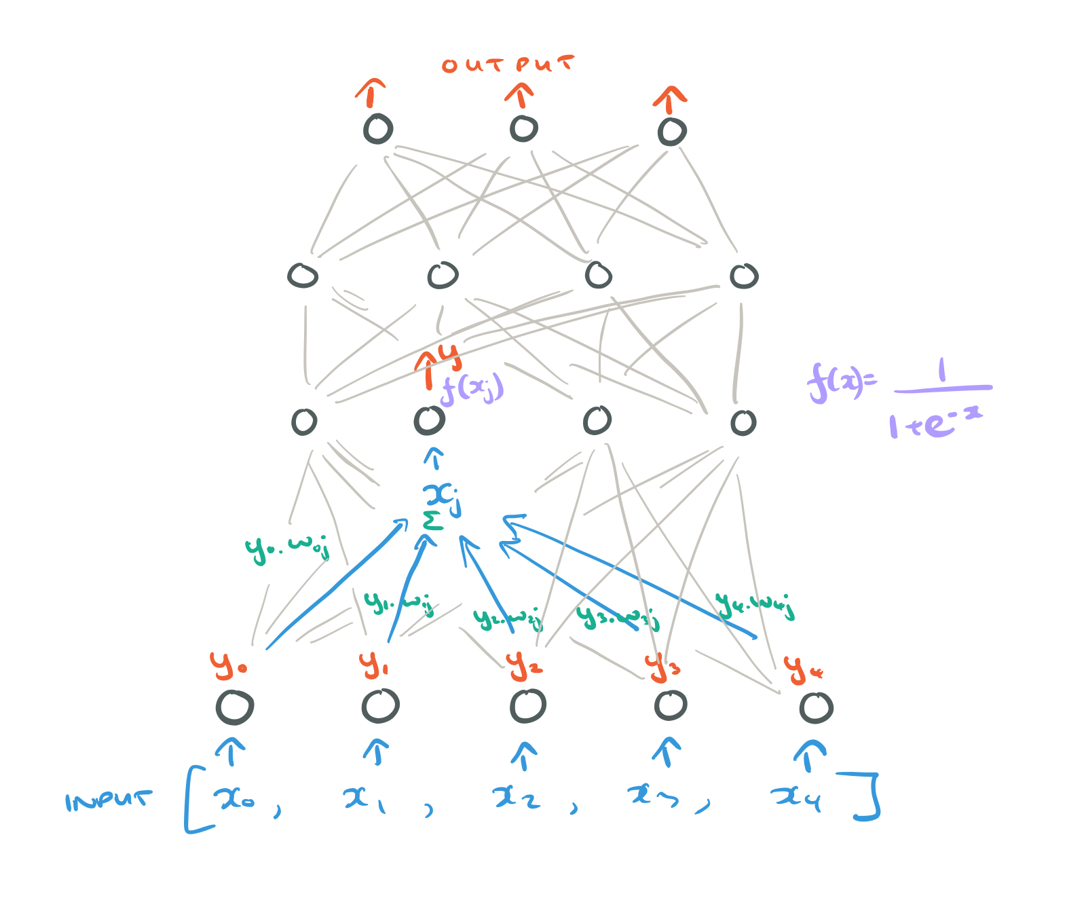
1. Feed Forwarding
https://blog.acolyer.org/2018/02/01/learning-representations-by-back-propagating-errors/

Slide 8
By repeating this procedure, starting with the input layer, we can feed-forward through the network layers and arrive at a set of outputs for the output layer.

Slide 9
Patching things up
We can now compare the calculated outputs to the desired output vector.

Slide 10
For a given input-output case, the error is given by:

Slide 11
We’d like to make the total error as small as possible (minimise it). To do that, we need to adjust the weights (the only parameters we have available to play with). But how should we adjust them to achieve our goal?

Slide 12
We’d like to know how the error changes as we change the weights, We don’t know that straight away, but we do know how the error changes as we change the outputs as E and y are directly related in the equation for E

Slide 14
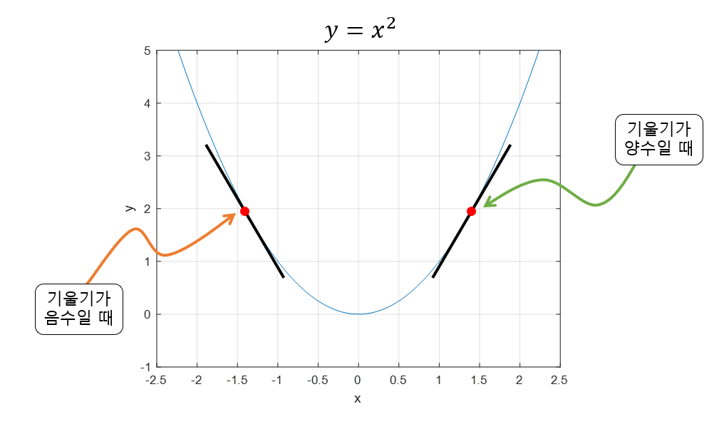
Optimal point를 찾아간다.

