Slide 1
CDE2313 · MOBILE APPLICATION DEVELOPMENT · ASSESSMENT 2
TDM Insight
A native Android vancomycin therapeutic drug monitoring calculator
Mowlid Haibe
Abdinaazir Mustafe
Elham Ahmedngus
Albukhary International University
Lecturer: Ts. Mohd Zulkifli Mohd Zaki
Semester 3, 2025/2026
Academic prototype — not a clinically validated system. All demonstration cases are fictional.

Slide 2
AGENDA
What we will cover
1 · The problem
2 · The solution
3 · Architecture
Why vancomycin dosing is calculated by hand today, and what goes wrong.
What TDM Insight does, for whom, and what it deliberately leaves out.
Layered MVVM, the component map and the technology stack.
4 · Behaviour
5 · The engine
6 · Evidence
Use cases, activity, sequence and data-flow models.
Three pharmacokinetic pathways, validation, and worked examples.
Interface, testing, a known defect, limitations and conclusion.
TDM Insight · CDE2313 · Albukhary International University
2 / 40

Slide 3
01
The problem
Vancomycin has a narrow therapeutic index and is still dosed with a paper worksheet.
TDM Insight · CDE2313 · Albukhary International University
3 / 40

Slide 4
PROBLEM STATEMENT
A calculation that has to be right
Vancomycin is first-line therapy for MRSA, and its effective dose sits close to its toxic dose.
Too little
Too much
Highly individual
Treatment failure. The MRSA infection is not cleared and resistance is encouraged.
Nephrotoxicity. Exposure above the target band is associated with acute kidney injury.
Clearance depends on renal function, which varies enormously between patients. A fixed mg/kg dose is not adequate.
Rybak et al. (2020) moved monitoring from trough alone to AUC₂₄, target 400–600 mg·h/L — clinically better founded, but it cannot be read off a single laboratory value.
TDM Insight · CDE2313 · Albukhary International University
4 / 40

Slide 5
PROBLEM STATEMENT
Four weaknesses in current practice
Hospital pharmacy performs these calculations on paper worksheets or a general-purpose calculator.
▪ Method selection is left to memory. Which equations apply depends on which samples the laboratory returned. Nothing on a worksheet enforces the right choice.
▪ There is no input validation. A worksheet accepts a serum creatinine of 9.8 µmol/L as readily as 98. A transposed decimal reaches the dose recommendation silently.
▪ Cross-field inconsistencies go undetected. A trough recorded as drawn before the peak yields a negative elimination rate constant — meaningless, but still displayed.
▪ There is no audit trail. Worksheets are discarded, so no one can review how a past recommendation was reached.
TDM Insight · CDE2313 · Albukhary International University
5 / 40

Slide 6
TARGET USERS
Who this is for
Clinical pharmacist
Pharmacy student
Prospective user
Needs to turn a laboratory report into an AUC₂₄ estimate and a dose recommendation at the bedside — and to justify it afterwards.
Needs to see which equation produced which intermediate value, not just the final answer.
Reaches the project through the public landing page and wants to understand it before installing.
No user of any kind may enter real patient data. The restriction is surfaced on first launch, on every input screen, and in the About screen.
TDM Insight · CDE2313 · Albukhary International University
6 / 40

Slide 7
PROPOSED SOLUTION
TDM Insight in one flow
01
02
03
04
05
06
Sign in
›
Create case
›
Choose workflow
›
Enter & validate
›
Review
›
Result
Clerk email + password
Fictional patient details
Pre / Post / Pre + Post
Only the required fields
Read-only confirmation
AUC₂₄ + verdict + explanation
The whole calculation path is on-device and synchronous. Persistence and identity are optional layers on top — remove the credentials and the calculator still works.
TDM Insight · CDE2313 · Albukhary International University
7 / 40

Slide 8
PROPOSED SOLUTION
Objectives
Each objective maps to a mandatory requirement of the lecturer's case study.
# | Objective | Delivered as
1 | Native Android application in Kotlin | Jetpack Compose + Material 3, 18 screens, minSdk 26
2 | All three vancomycin sampling workflows | calculatePre · calculatePost · calculatePrePost
3 | Dynamic input forms | Field groups rendered conditionally on the selected workflow
4 | Validation beyond emptiness | Range, cross-field and math-safety checks; errors vs. warnings
5 | Engine separated from the UI | domain/engine/VancoEngine.kt — no Android imports
6 | Intermediate and final results | ke · t½ · Vd · Vd/kg · CL · AUC₂₄ · dose · Cmin · Cmax
7 | Explainable results | Four-phase Explanation screen with substituted formulas
8 | Material 3 light and dark themes | Two hand-authored colour schemes, selectable in Settings
TDM Insight · CDE2313 · Albukhary International University
8 / 40

Slide 9
PROPOSED SOLUTION
Main features
Three PK pathways
Dynamic forms
Two-tier validation
Cockcroft–Gault, Newton–Raphson fit, and Sawchuk–Zaske two-point regression.
Only the fields the chosen workflow needs are ever rendered.
Red blocks the calculation; amber advises and does not.
Live CrCl feedback
Explainable output
Per-user case history
Cockcroft–Gault recomputed on every keystroke on the patient screen.
Four phases: inputs → ke derivation → parameters → final result.
Twenty most recent saved cases, from PostgreSQL.
3
9
18
31
2
sampling workflows
PK values per result
application screens
unit tests
database tables
TDM Insight · CDE2313 · Albukhary International University
9 / 40

Slide 10
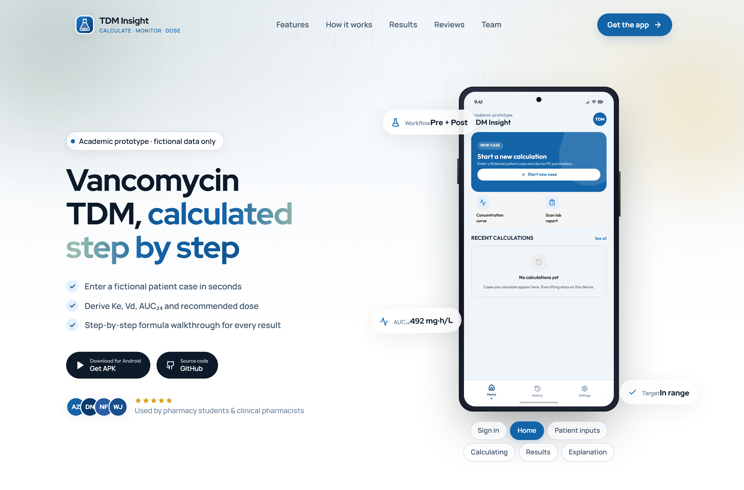
USER INTERFACE
The landing page
A static React site that introduces the product before installation.
Hero section — proposition, headline capabilities and download links
TDM Insight · CDE2313 · Albukhary International University
10 / 40

Slide 11
IMPLEMENTATION
Technology stack
Every version below is read from the project's own build files.
Android
Networking & data
Identity
Kotlin 2.0 · Jetpack Compose (BOM 2024.08) · Material 3 · Navigation Compose 2.7.7 · Lifecycle ViewModel 2.8.4 · Coroutines 1.8.1 · compileSdk 35, minSdk 26
Ktor 2.3.12 with the OkHttp engine · kotlinx-serialization 1.7.1 · supabase-kt postgrest-kt 2.6.1 · hosted PostgreSQL with PostgREST
Clerk Frontend API called directly over REST · session JWT persisted in private SharedPreferences · publishable key injected through BuildConfig
Landing page
Testing
Tooling
React 19.1 · Vite 6.3 · TypeScript 5.9 · Tailwind CSS 4.1 · React Router 7.6 · lucide-react · built with Bun
JUnit 4.13.2 — 31 unit tests over the engine and the validators, run with ./gradlew :app:test
Android Studio · Gradle Kotlin DSL · Git and GitHub · Supabase SQL editor · Claude Code as a declared AI assistant
The landing page makes no network call to any backend. apiClient.ts is unused template scaffolding and is not reachable from App.tsx — the architecture diagram records this.
TDM Insight · CDE2313 · Albukhary International University
11 / 40

Slide 12
02
System architecture
Layered MVVM, with the calculation engine isolated from everything Android.
TDM Insight · CDE2313 · Albukhary International University
12 / 40

Slide 13
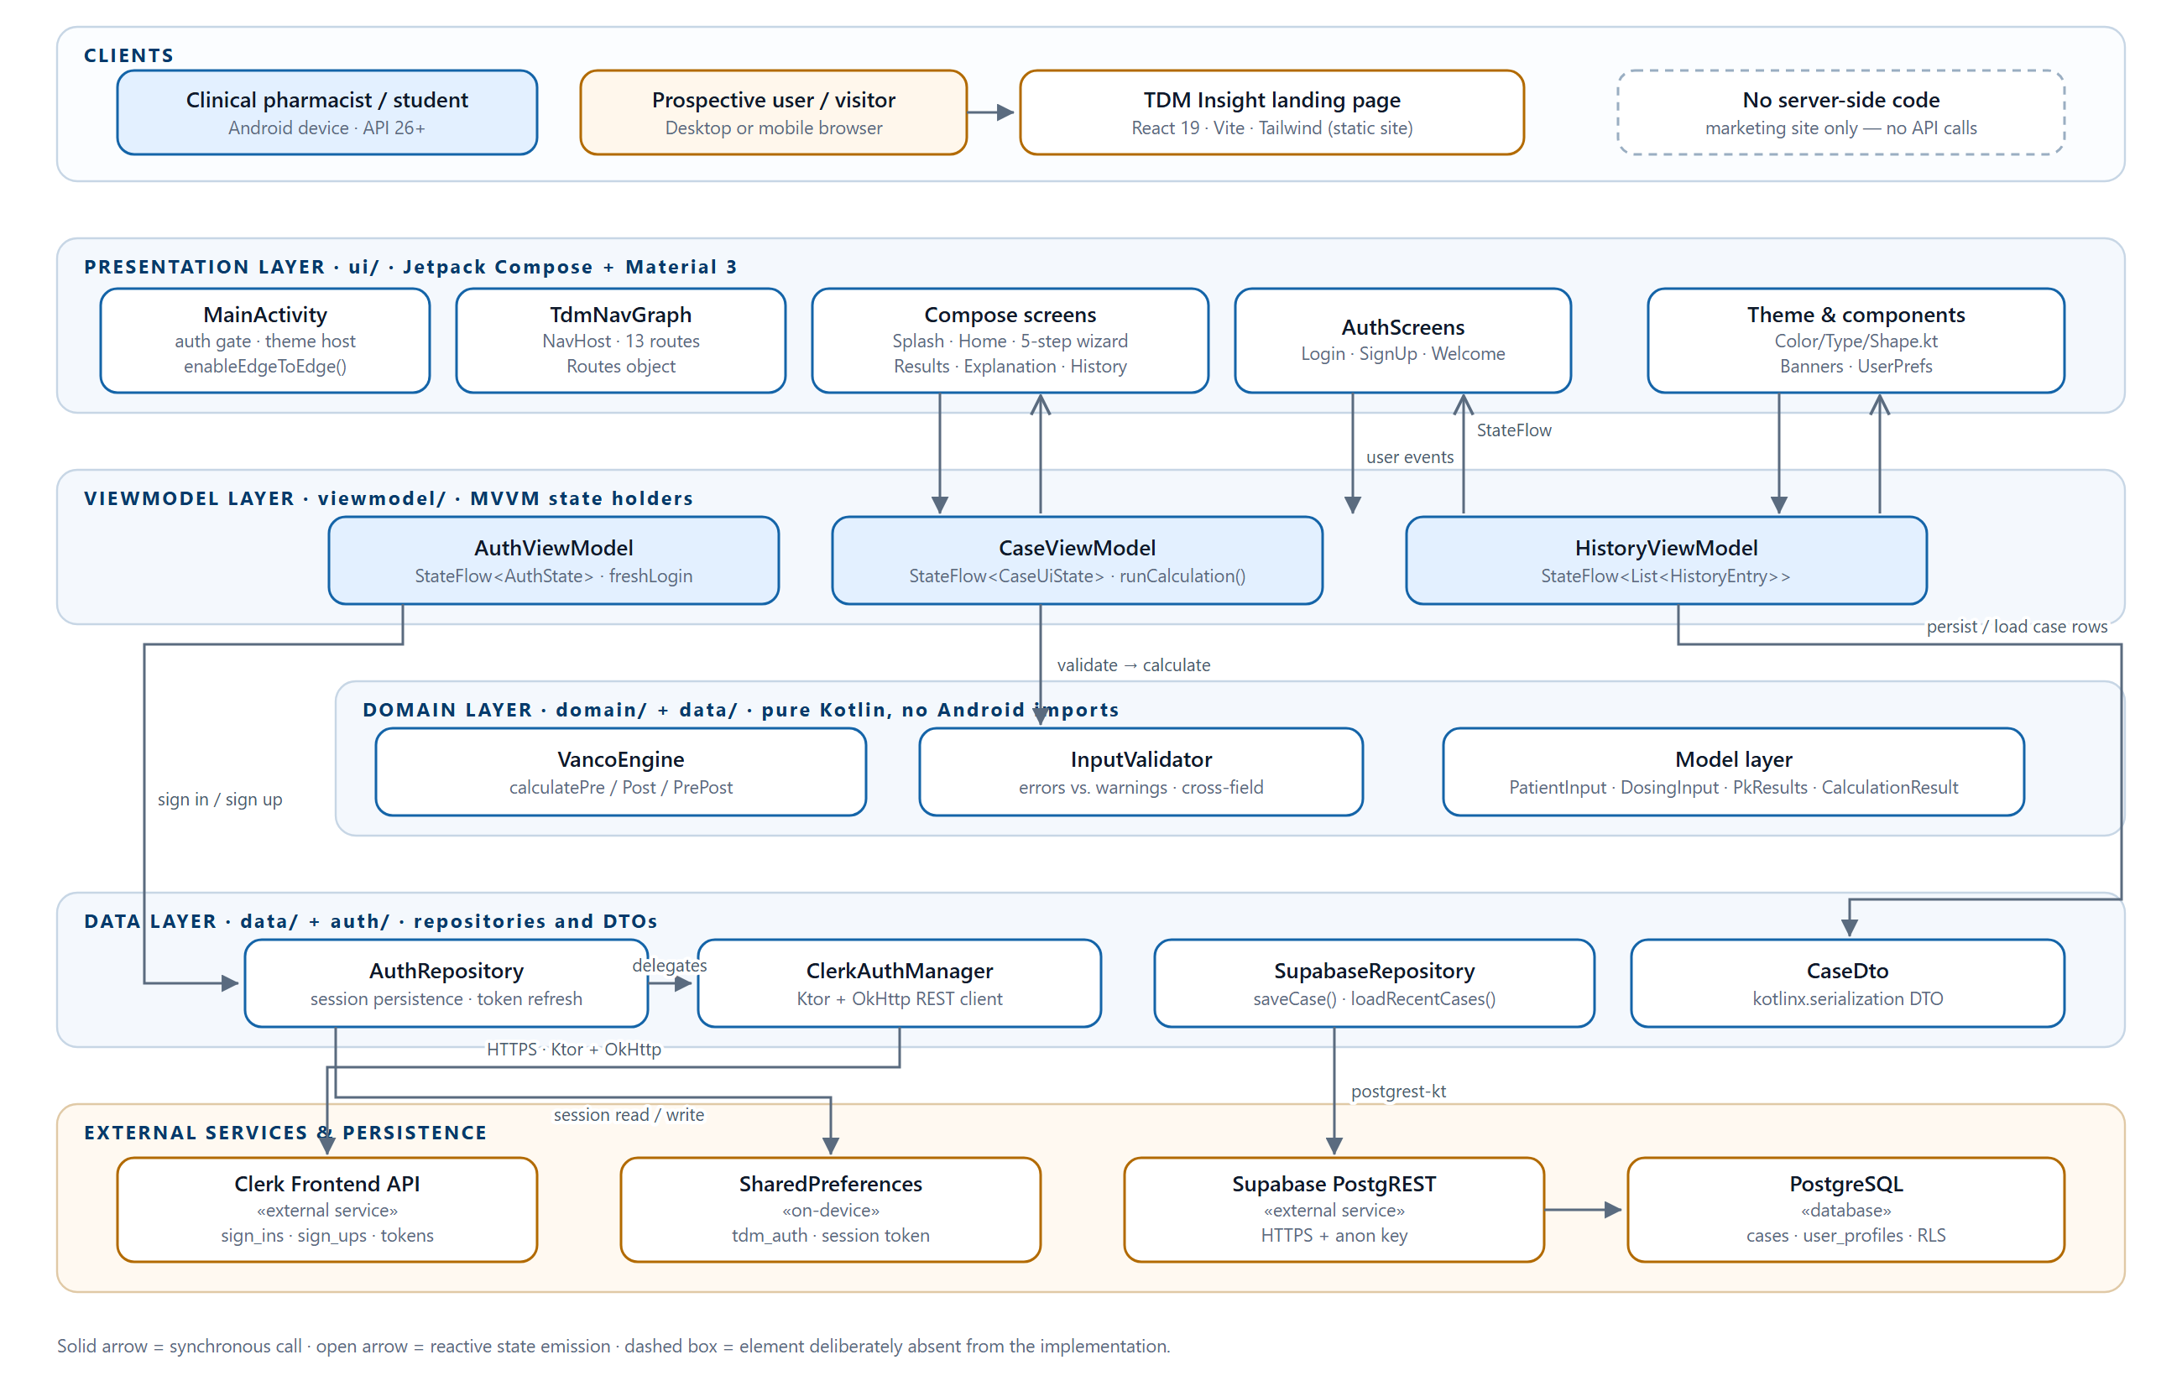
ARCHITECTURE
Layered system architecture
Solid arrows are synchronous calls; open arrows are reactive state emissions
TDM Insight · CDE2313 · Albukhary International University
13 / 40

Slide 14
ARCHITECTURE
Why MVVM
Testability of the engine
Natural fit with Compose
A layer with no Android dependency can be exercised by plain JVM unit tests in under a second — no emulator.
StateFlow consumed through collectAsState(); recomposition is driven by state, not by imperative view updates.
Survives rotation
No massive activity
ViewModels outlive activity recreation, so the five-step wizard never loses the user's input.
A single activity of roughly 260 lines whose only jobs are theming and the authentication gate.
Dependency injection is manual: TdmApplication holds four lazy singletons. For four objects that is simpler and more defensible in a viva than adding Hilt or Koin.
TDM Insight · CDE2313 · Albukhary International University
14 / 40

Slide 15
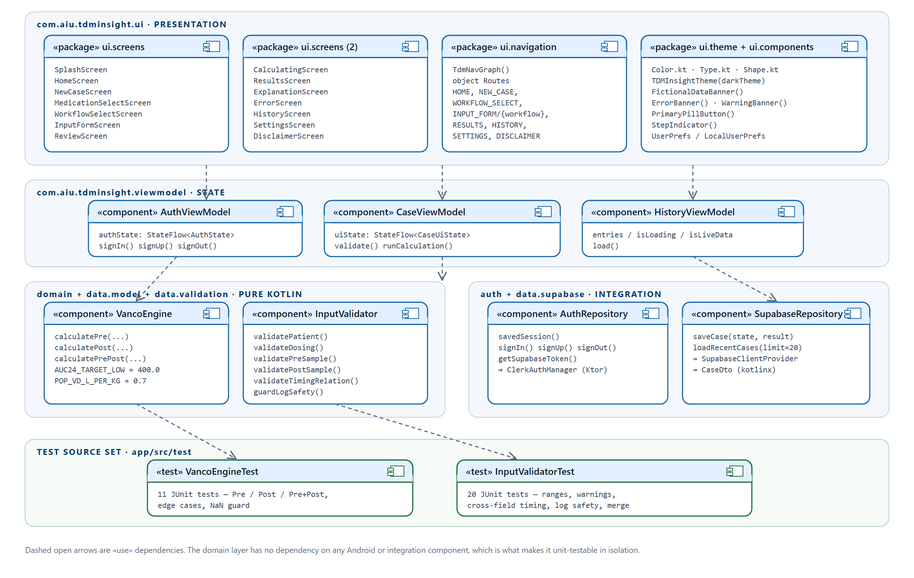
ARCHITECTURE
Component and package structure
No arrow enters the domain layer from the data or presentation layers
TDM Insight · CDE2313 · Albukhary International University
15 / 40

Slide 16
03
How the system behaves
Use cases, activity, sequence and data-flow models — all traced from the source.
TDM Insight · CDE2313 · Albukhary International University
16 / 40

Slide 17
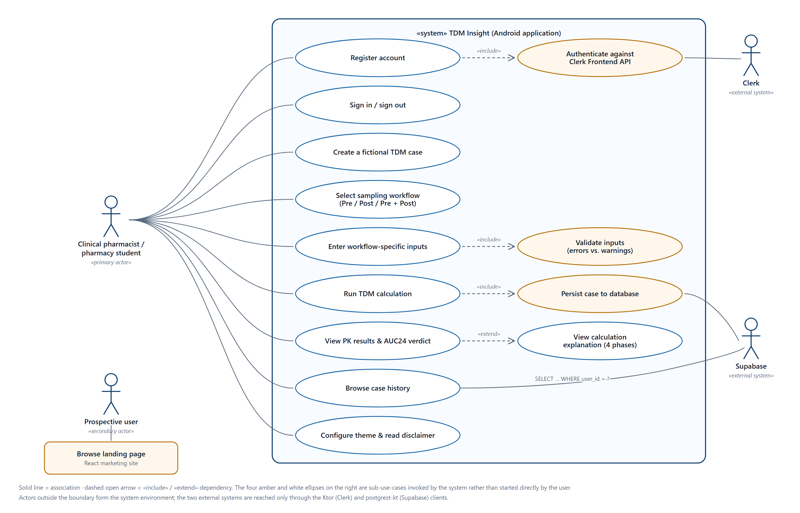
BEHAVIOUR
Use case model
Two human actors, two external system actors, thirteen use cases
TDM Insight · CDE2313 · Albukhary International University
17 / 40

Slide 18
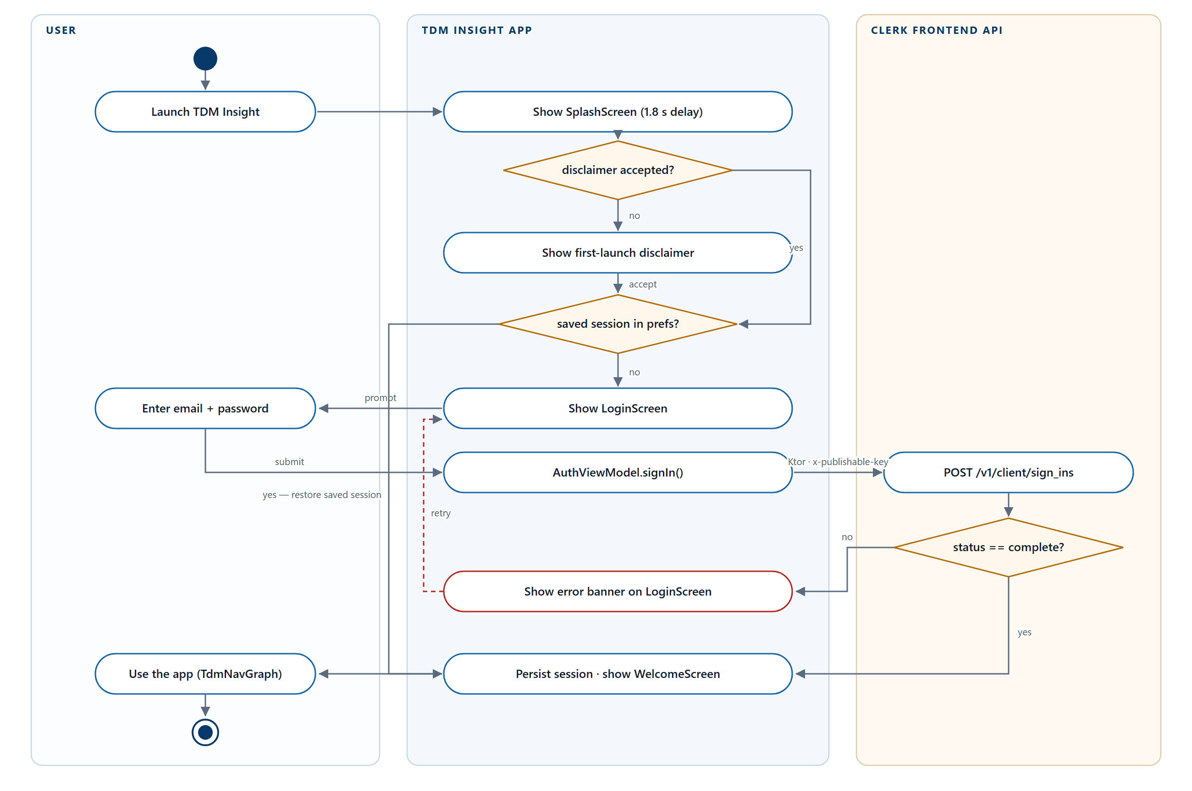
BEHAVIOUR
Activity — entry and authentication
The eight-branch gate in MainActivity, from splash to navigation graph
TDM Insight · CDE2313 · Albukhary International University
18 / 40

Slide 19
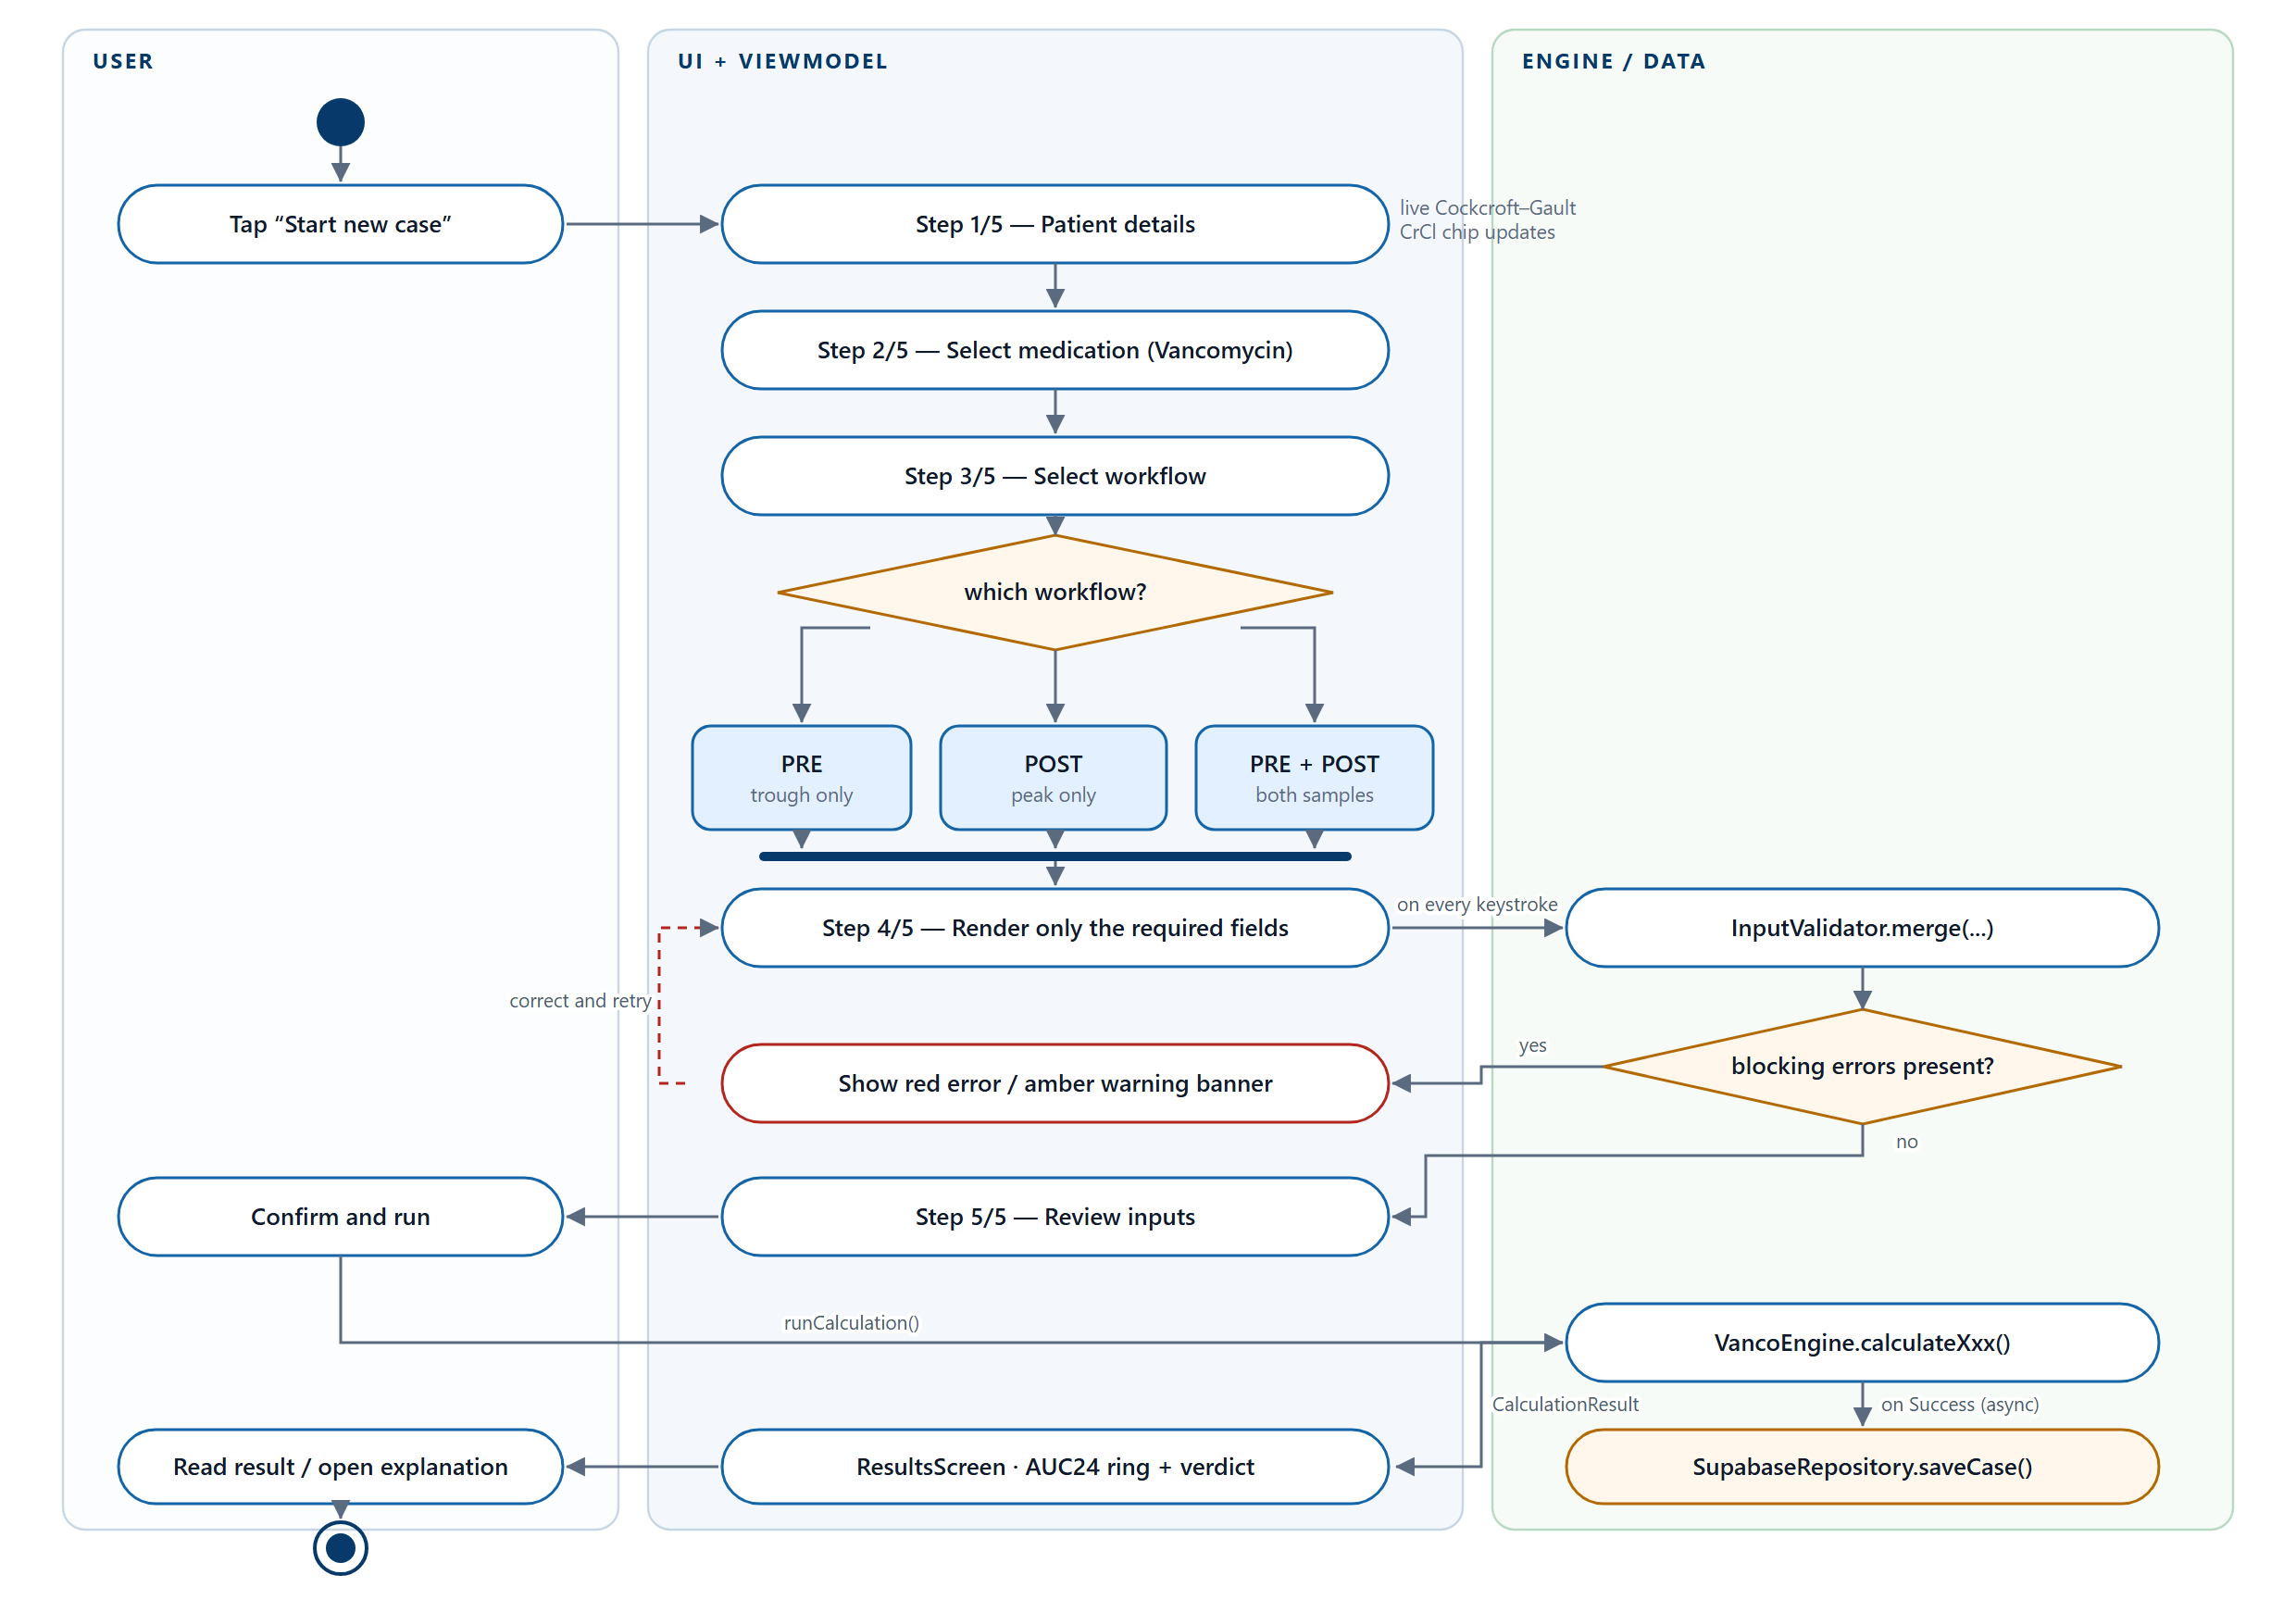
BEHAVIOUR
Activity — the five-step calculation workflow
The selected workflow decides which fields are rendered and which engine function runs
TDM Insight · CDE2313 · Albukhary International University
19 / 40

Slide 20
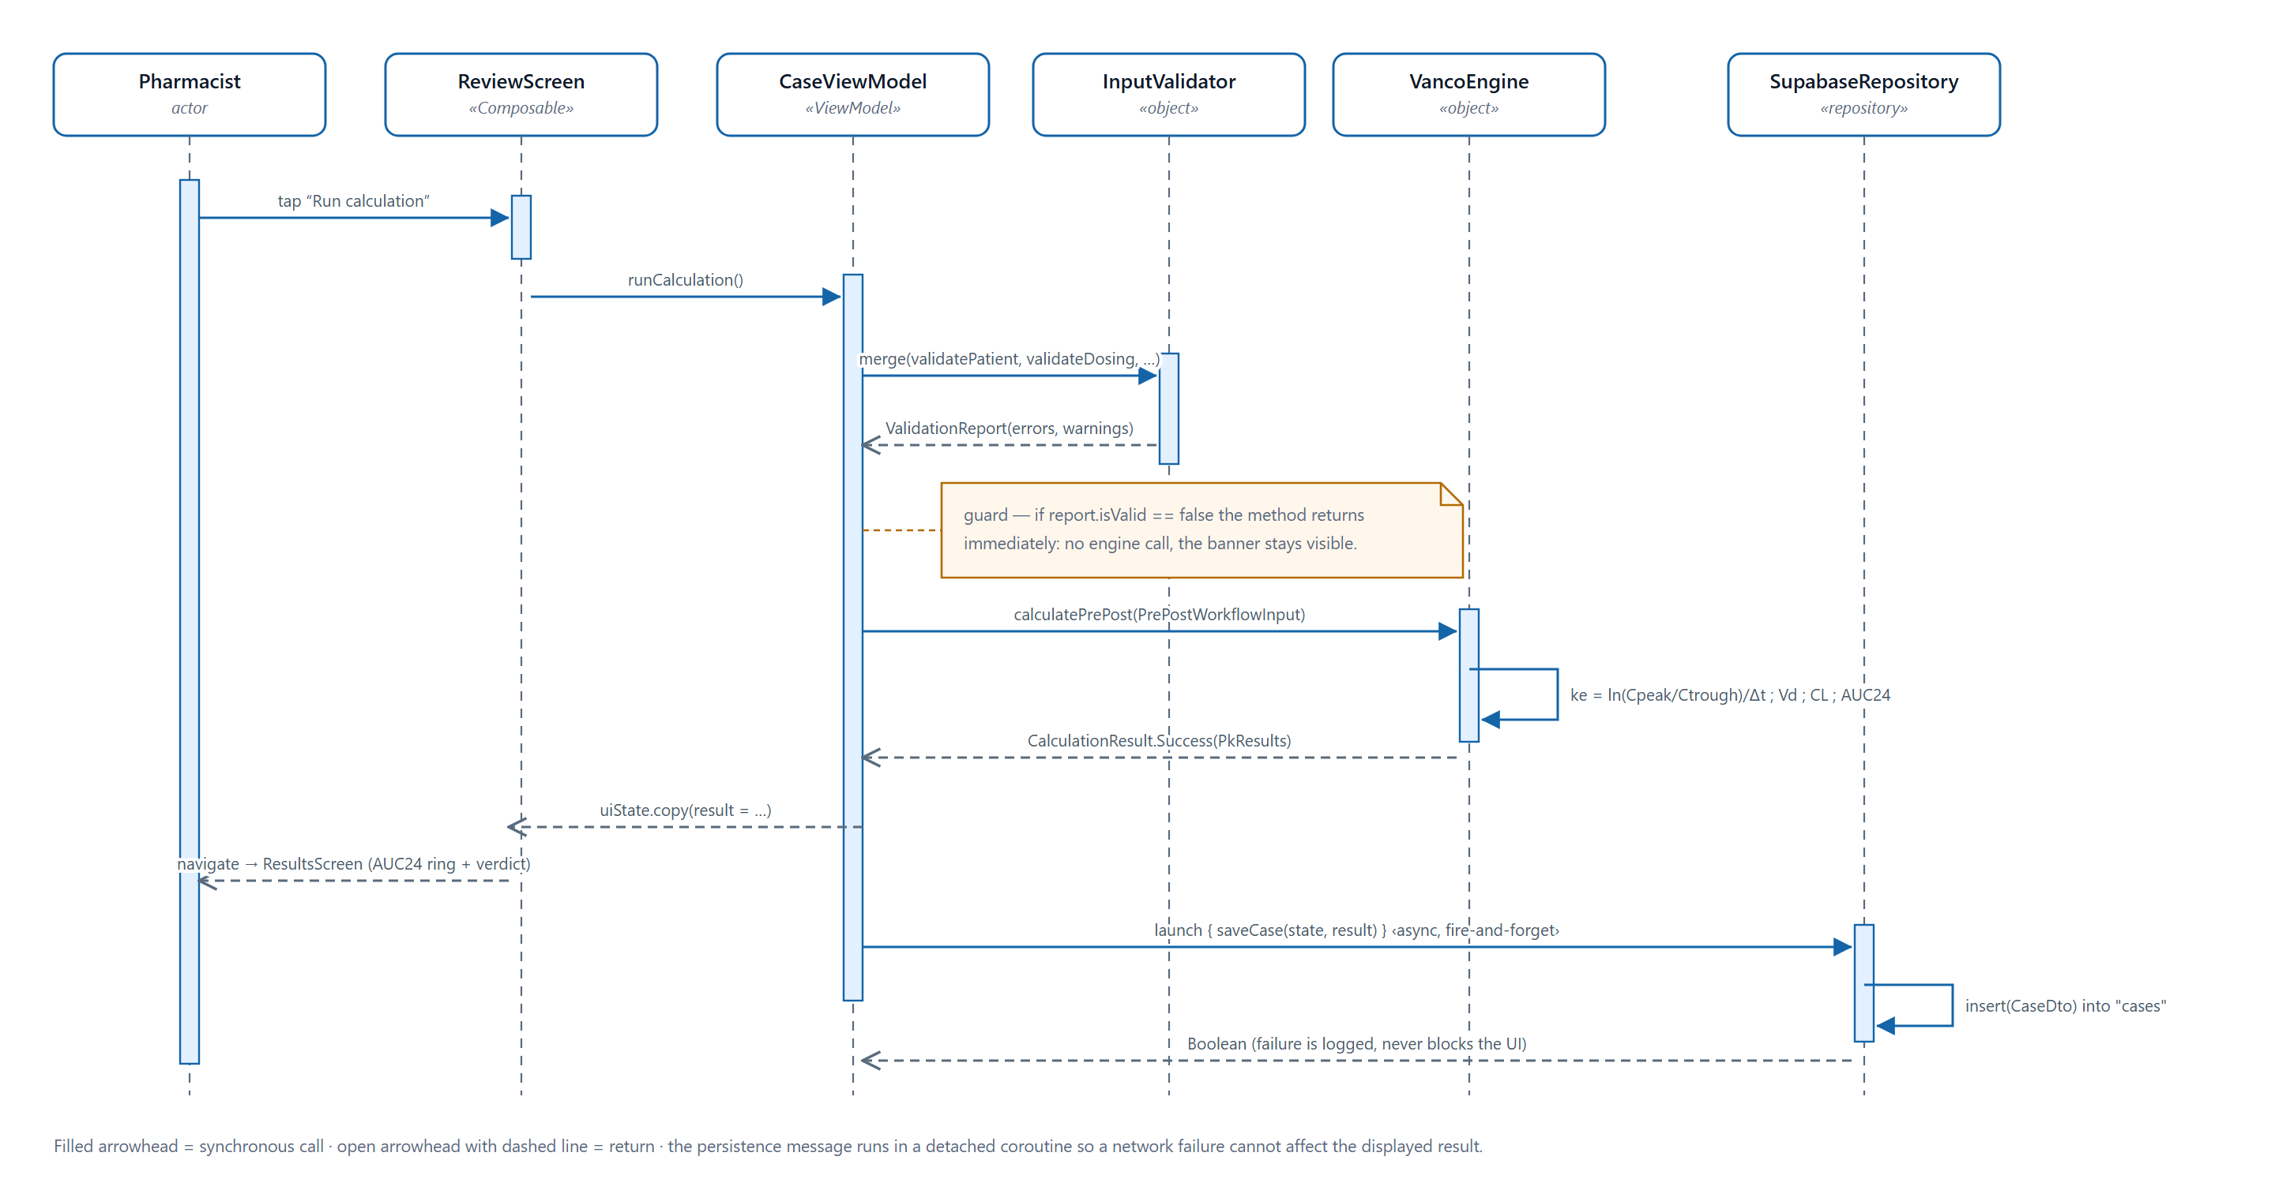
BEHAVIOUR
Sequence — running and persisting a calculation
Validation precedes the engine call; persistence is dispatched after the result is displayed
TDM Insight · CDE2313 · Albukhary International University
20 / 40

Slide 21
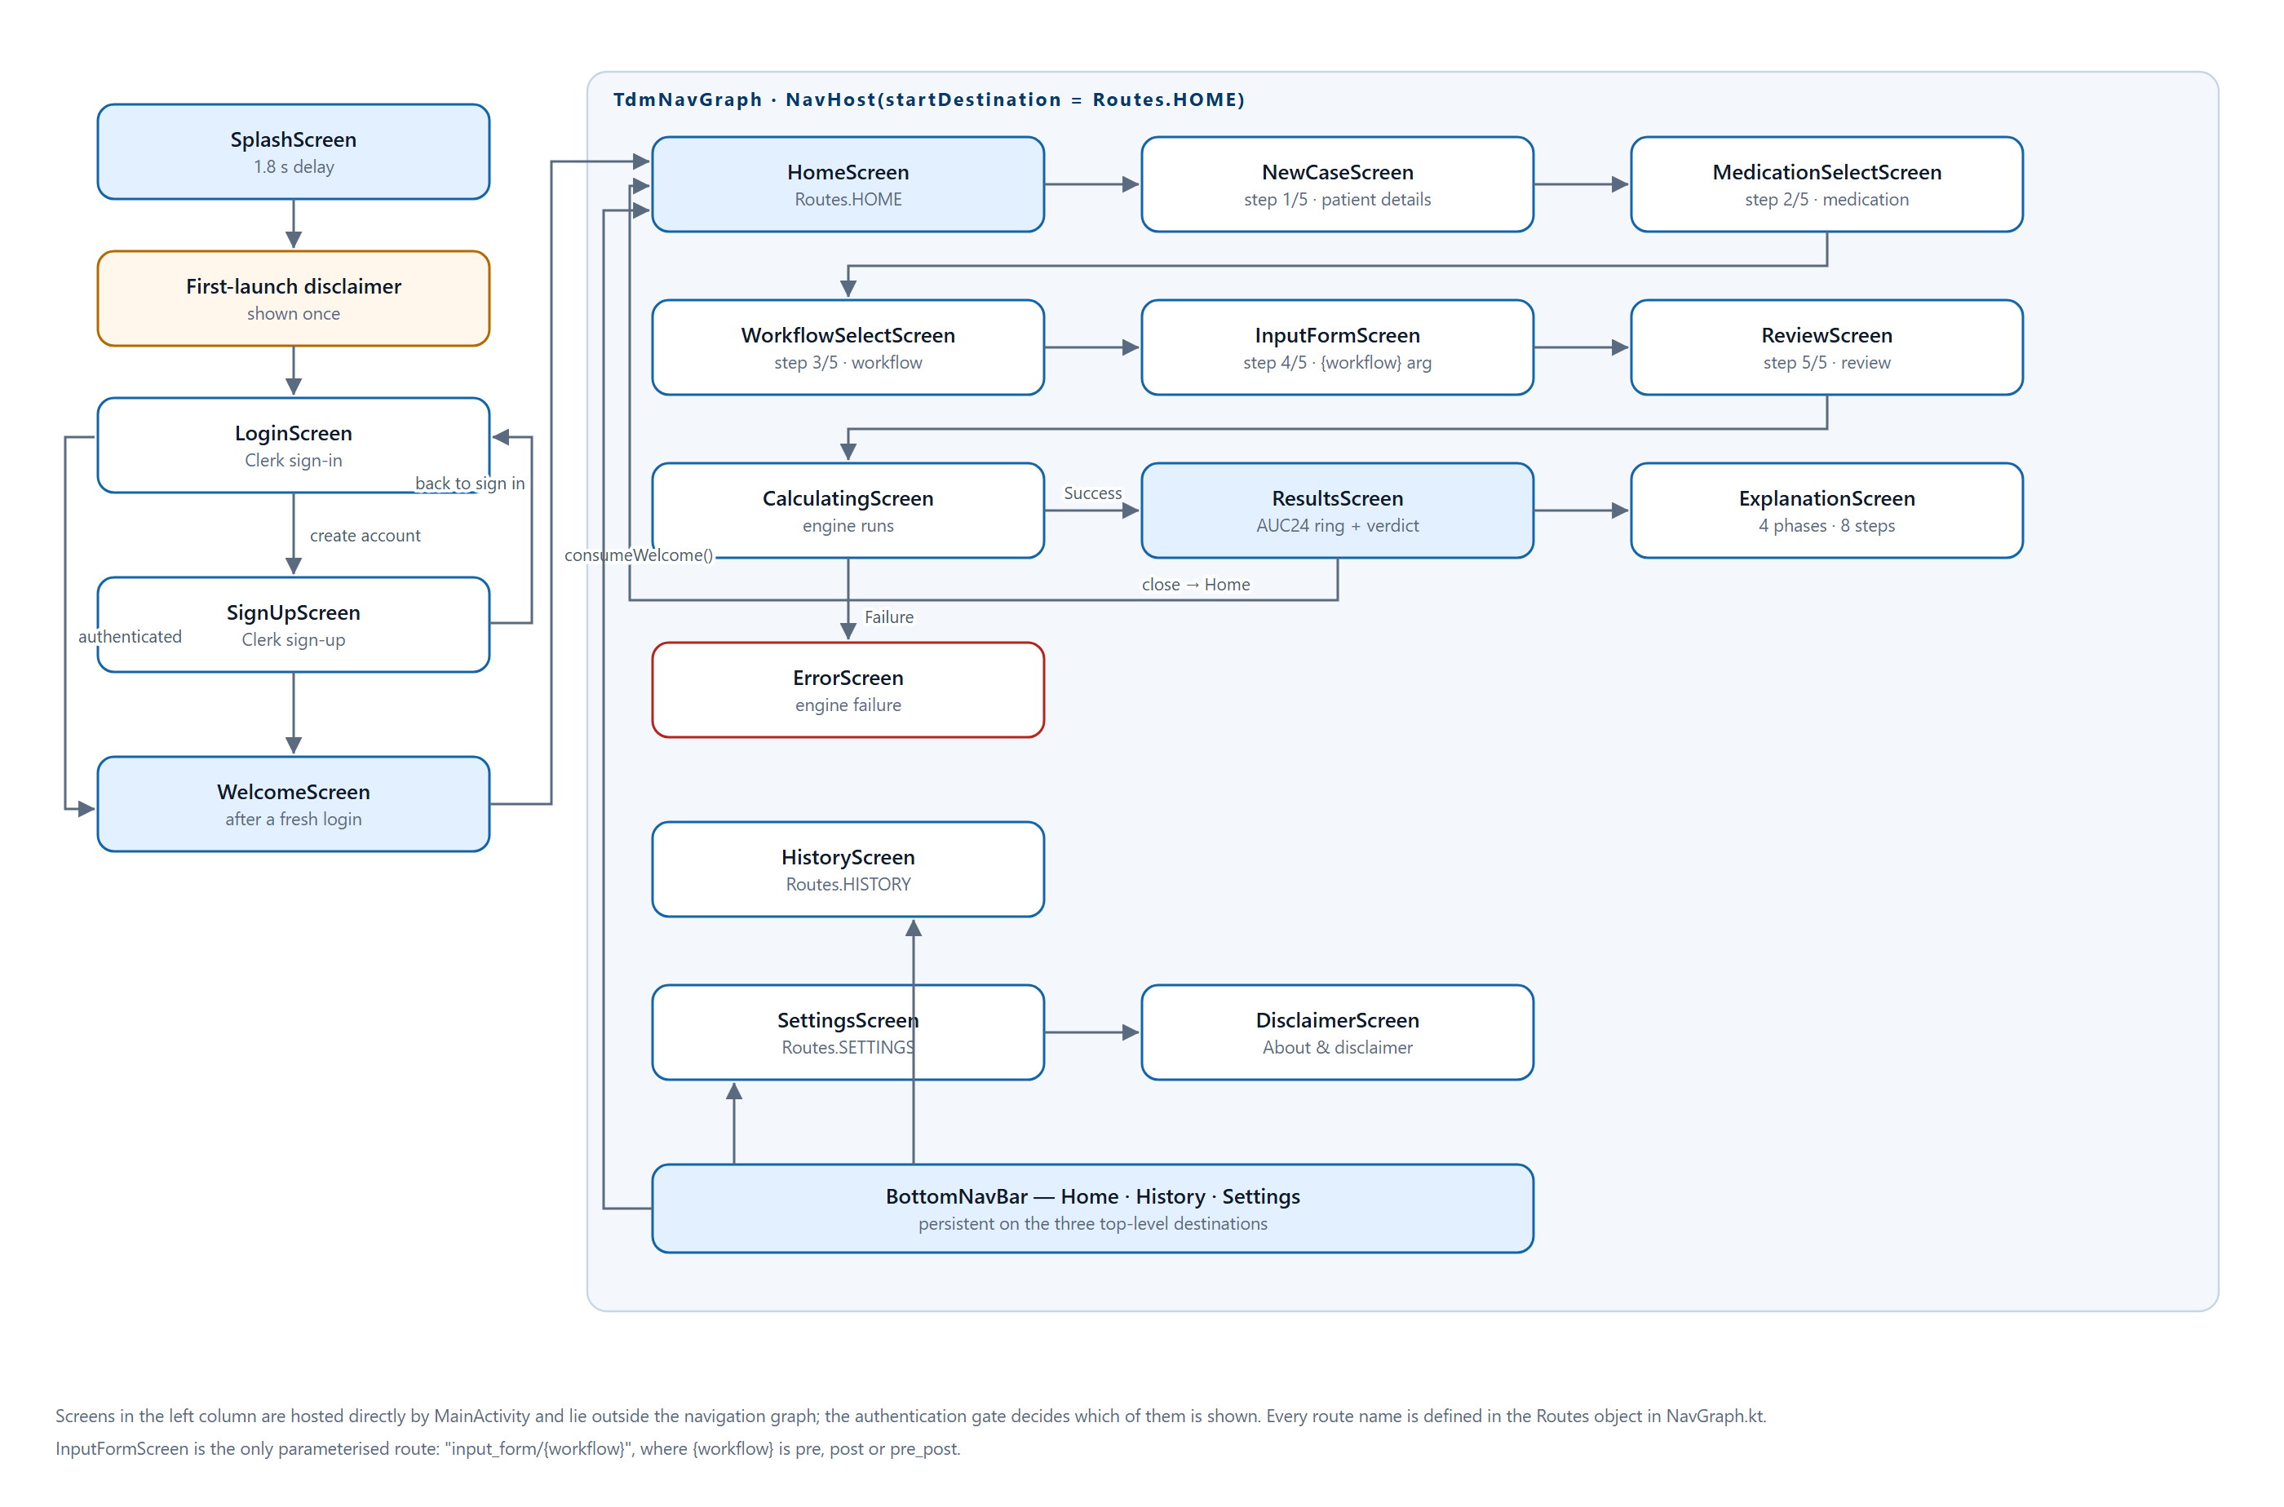
BEHAVIOUR
Navigation and screen map
Five gate screens outside the graph; thirteen routes inside it, one parameterised
TDM Insight · CDE2313 · Albukhary International University
21 / 40

Slide 22
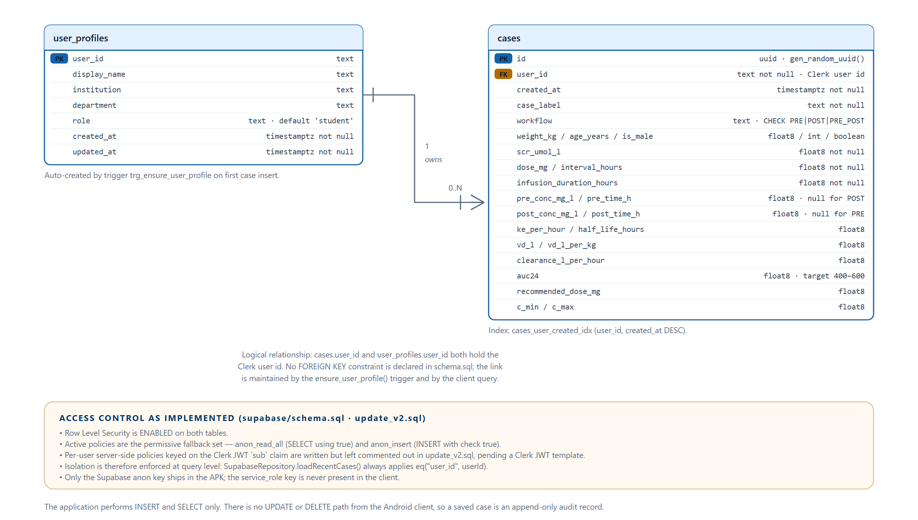
DATA ARCHITECTURE
Database design
Two tables, one index, one trigger and five Row Level Security policies
TDM Insight · CDE2313 · Albukhary International University
22 / 40

Slide 23
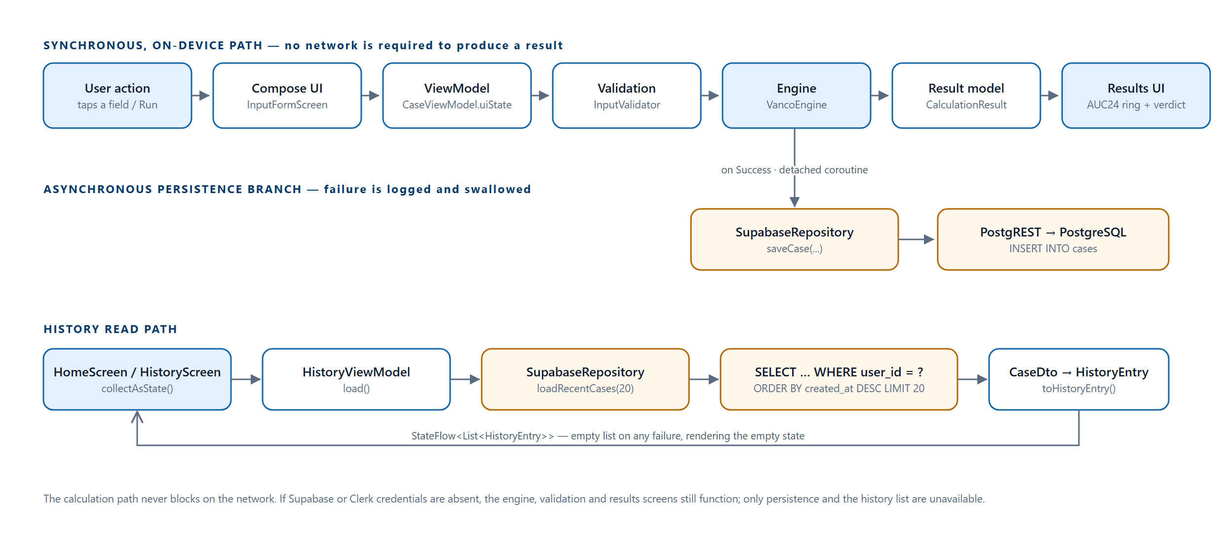
DATA ARCHITECTURE
End-to-end data flow
Three paths with different reliability characteristics — only the top one must never fail
TDM Insight · CDE2313 · Albukhary International University
23 / 40

Slide 24
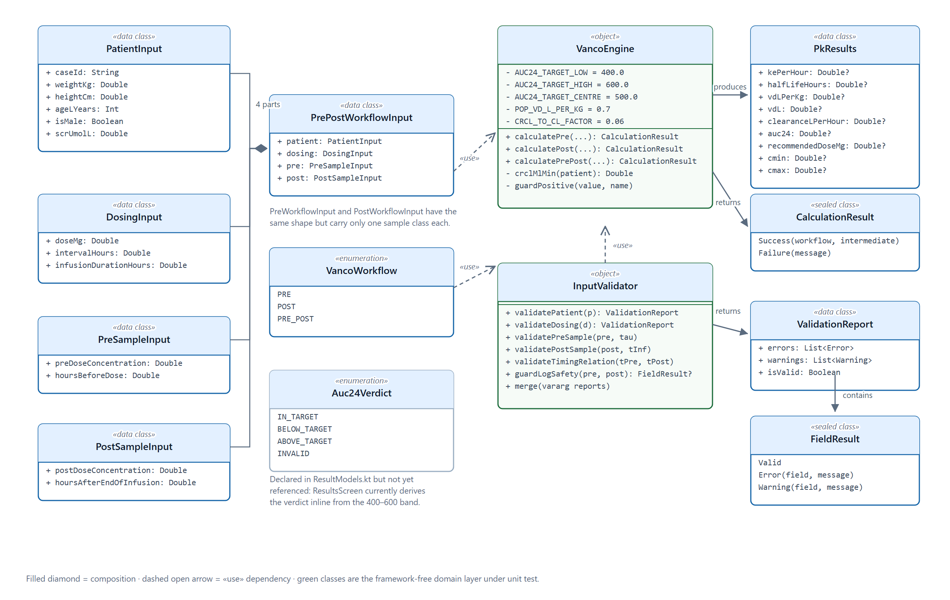
DATA ARCHITECTURE
Domain class model
Immutable data classes and sealed result types; the compiler forces failure to be handled
TDM Insight · CDE2313 · Albukhary International University
24 / 40

Slide 25
CALCULATION ENGINE
Three pharmacokinetic pathways
One function per pathway, all returning the same sealed result type.
Pre-dose only
Post-dose only
Pre + Post
Cockcroft–Gault + population Vd. CrCl estimates clearance; Vd is the 0.7 L/kg prior. Least individualised of the three.
Newton–Raphson fit. Solves the one-compartment infusion model for ke from a single measured concentration, k₀ = 0.3, at most 50 iterations.
Sawchuk–Zaske two-point. Derives both ke and an individualised Vd from the patient's own two samples. Preferred when both are available.
ke = ln(C_peak / C_trough) / (t_pre - t_post) # Pre + Post
Vd = D x (1 - e^(-ke*T)) / (ke x T x C_peak)
CL = ke x Vd
AUC24 = (Dose / tau) x 24 / CL target: 400-600 mg*h/L
Dose_recommended = (500 x CL x tau) / 24
TDM Insight · CDE2313 · Albukhary International University
25 / 40

Slide 26
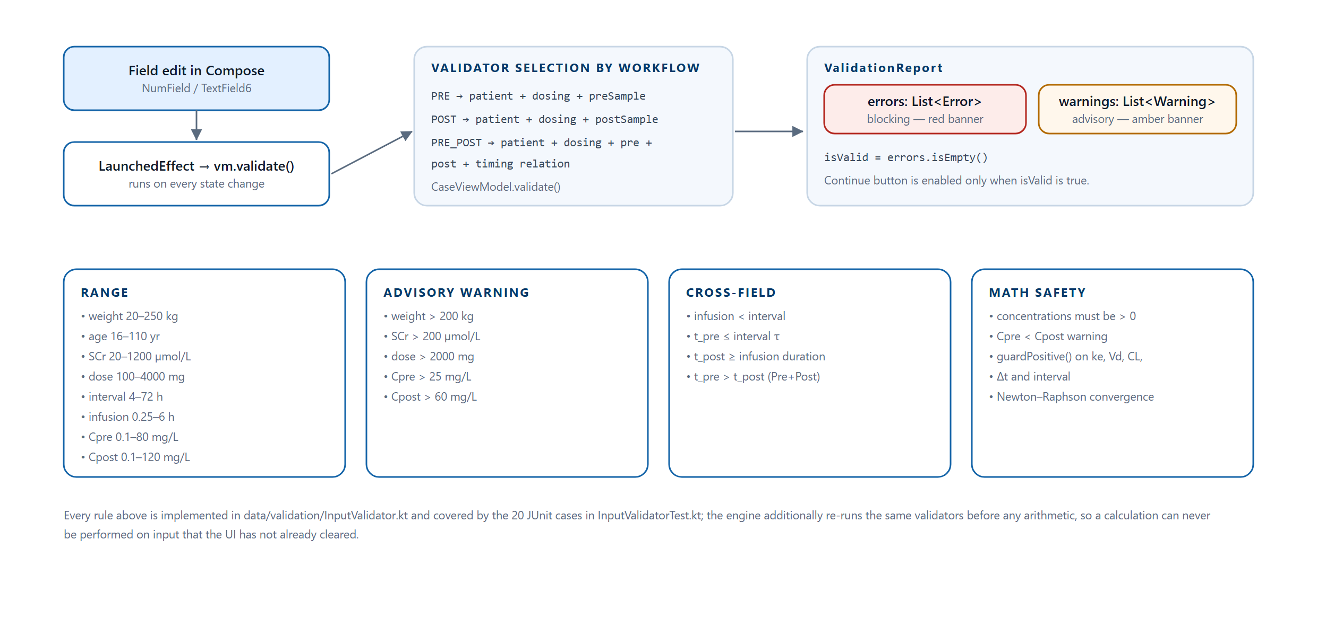
CALCULATION ENGINE
Validation is part of the type system
ValidationReport carries errors and warnings in separate lists; isValid = errors.isEmpty()
The case study requires that an error be distinguishable from information that merely needs review. Making that a type distinction, not a rendering choice, means warnings can never accidentally block a calculation.
TDM Insight · CDE2313 · Albukhary International University
26 / 40

Slide 27
CALCULATION ENGINE
Worked examples — one per pathway
Computed with the engine's exact arithmetic. All three patients are fictional.
 | Pre-dose only | Post-dose only | Pre + Post
Patient | 72 kg, 50 y, male, SCr 88 | 70 kg, 60 y, male, SCr 95 | 68 kg, 62 y, male, SCr 98
Regimen | 1000 mg q12h over 1 h | 1000 mg q12h over 1 h | 1000 mg q12h over 1 h
Samples | Trough 10.2 mg/L | Peak 15.0 mg/L at 4 h | Peak 26.0 at 2 h; trough 12.5 at 10.5 h
ke (h⁻¹) | 0.1076 | 0.0881 | 0.0862
t½ (h) | 6.44 | 7.87 | 8.04
Vd (L) | 50.4 (0.70 L/kg, population) | 49.0 (0.70 L/kg, population) | 36.9 (0.54 L/kg, derived)
CL (L/h) | 5.425 | 4.315 | 3.175
AUC₂₄ | 368.7 — below target | 463.5 — in target | 629.9 — above target
Recommended | 1356 mg q12h | 1079 mg q12h | 794 mg q12h
The Pre + Post column shows why two samples are better: the derived Vd of 0.54 L/kg is well below the 0.7 L/kg prior, so the single-point pathways would have understated this patient's exposure.
TDM Insight · CDE2313 · Albukhary International University
27 / 40

Slide 28
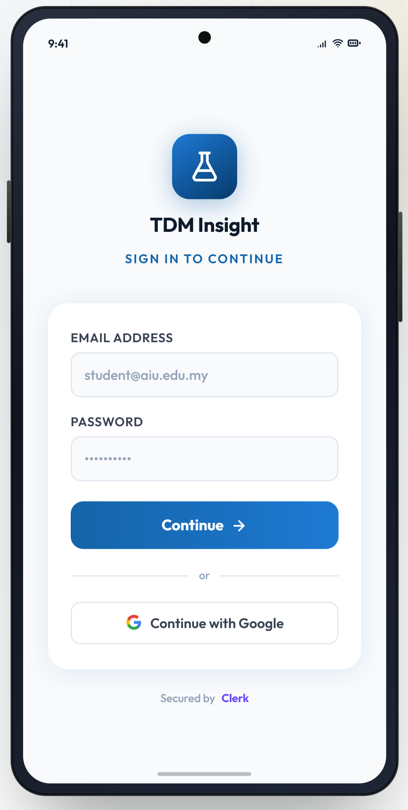
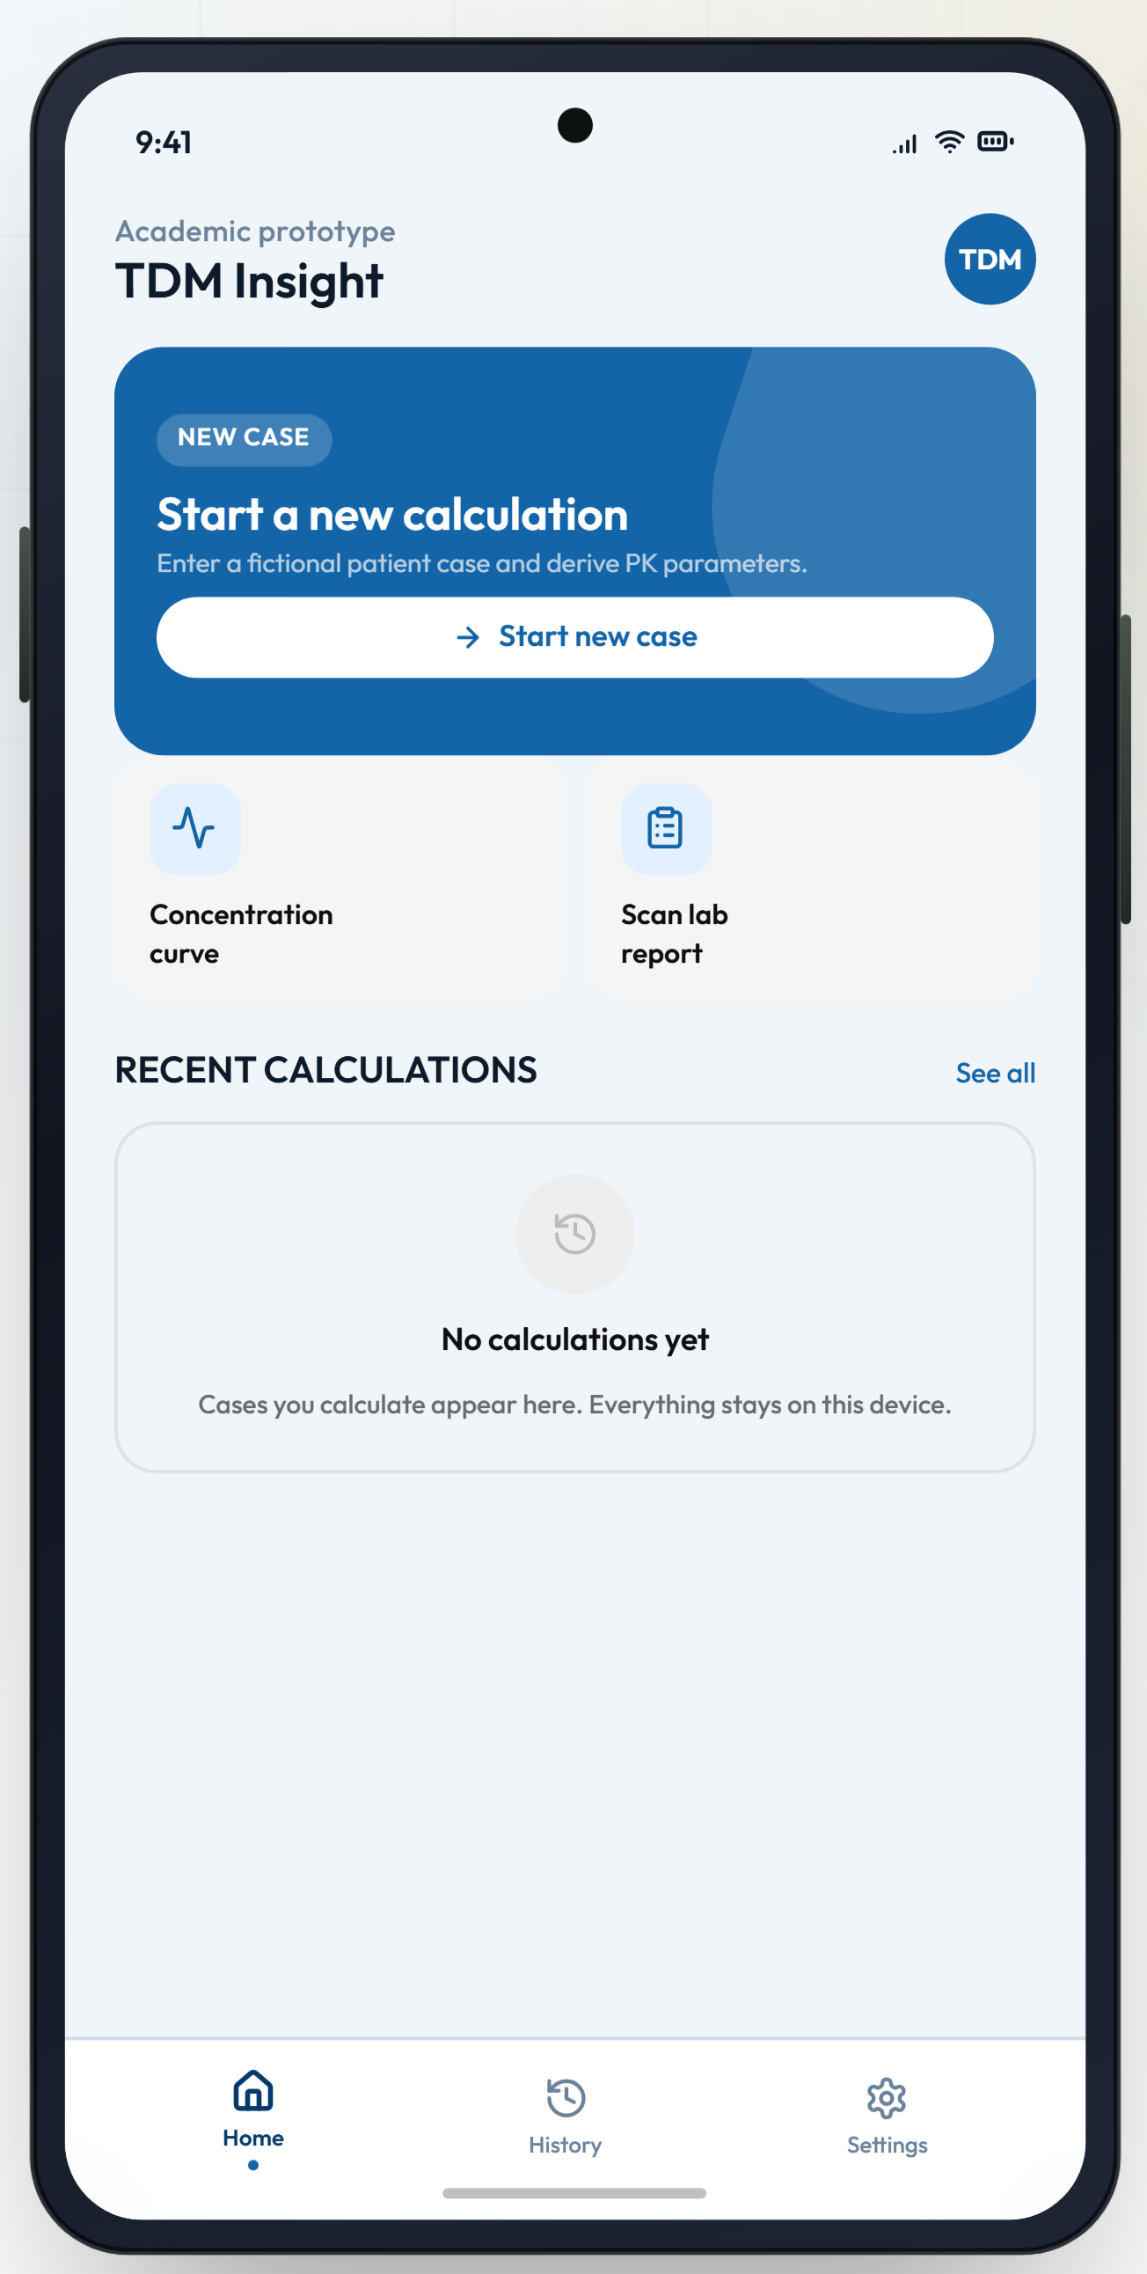
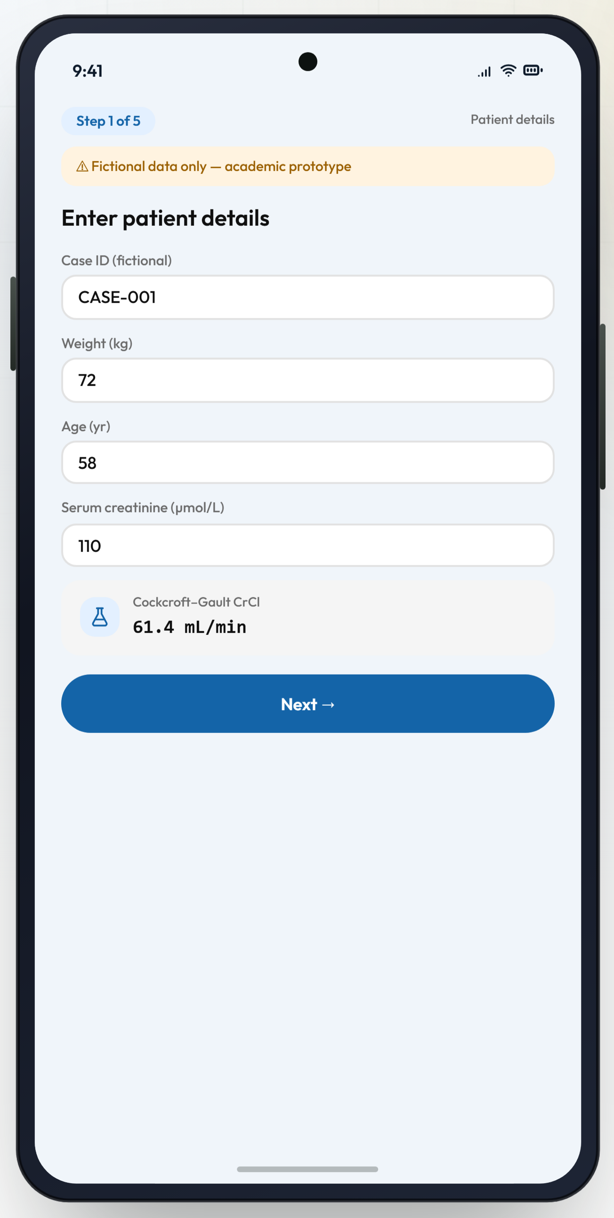
APPLICATION SCREENS
Authentication, home and patient details
Sign in — Clerk
Home — new case + recent
Step 1/5 — live CrCl chip
TDM Insight · CDE2313 · Albukhary International University
28 / 40

Slide 29
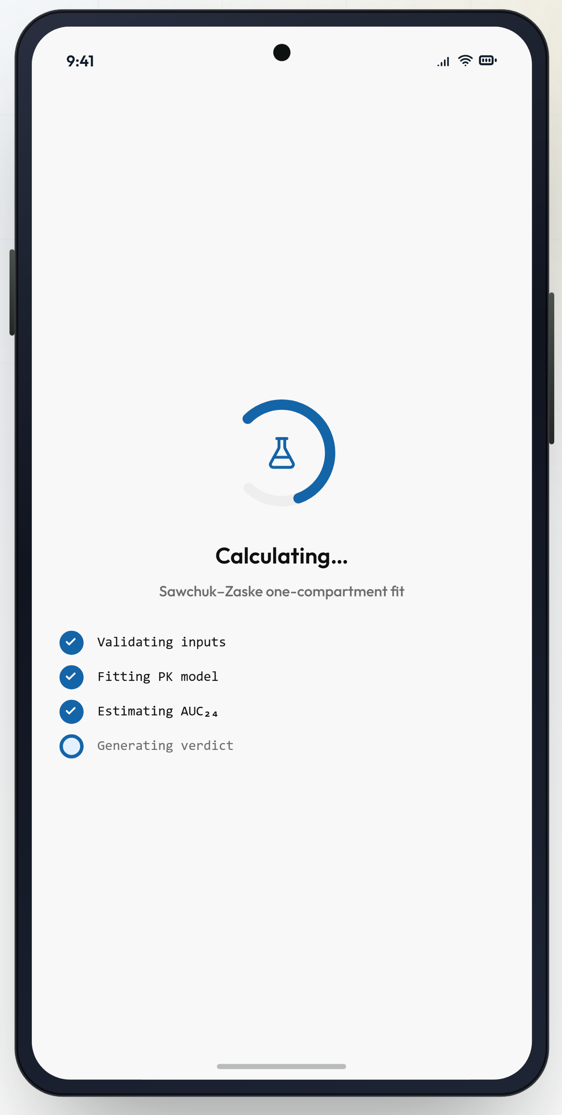
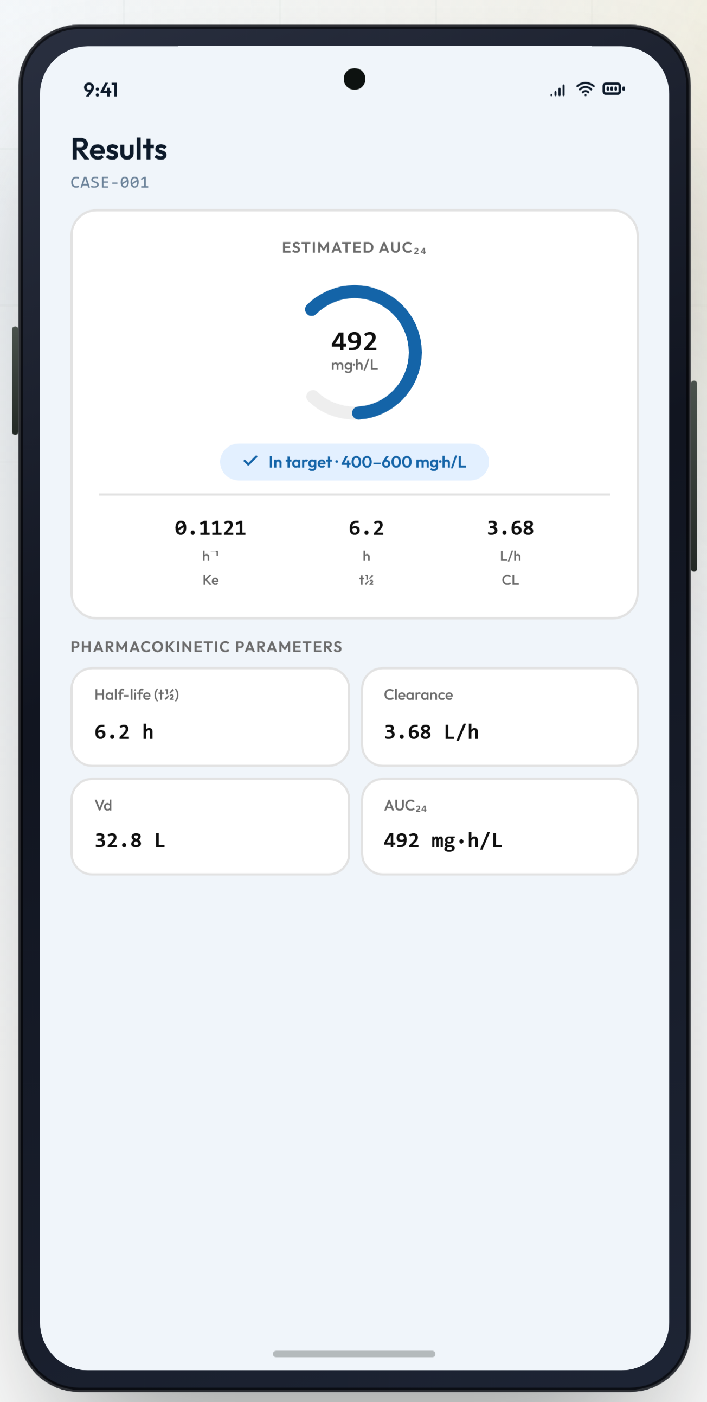
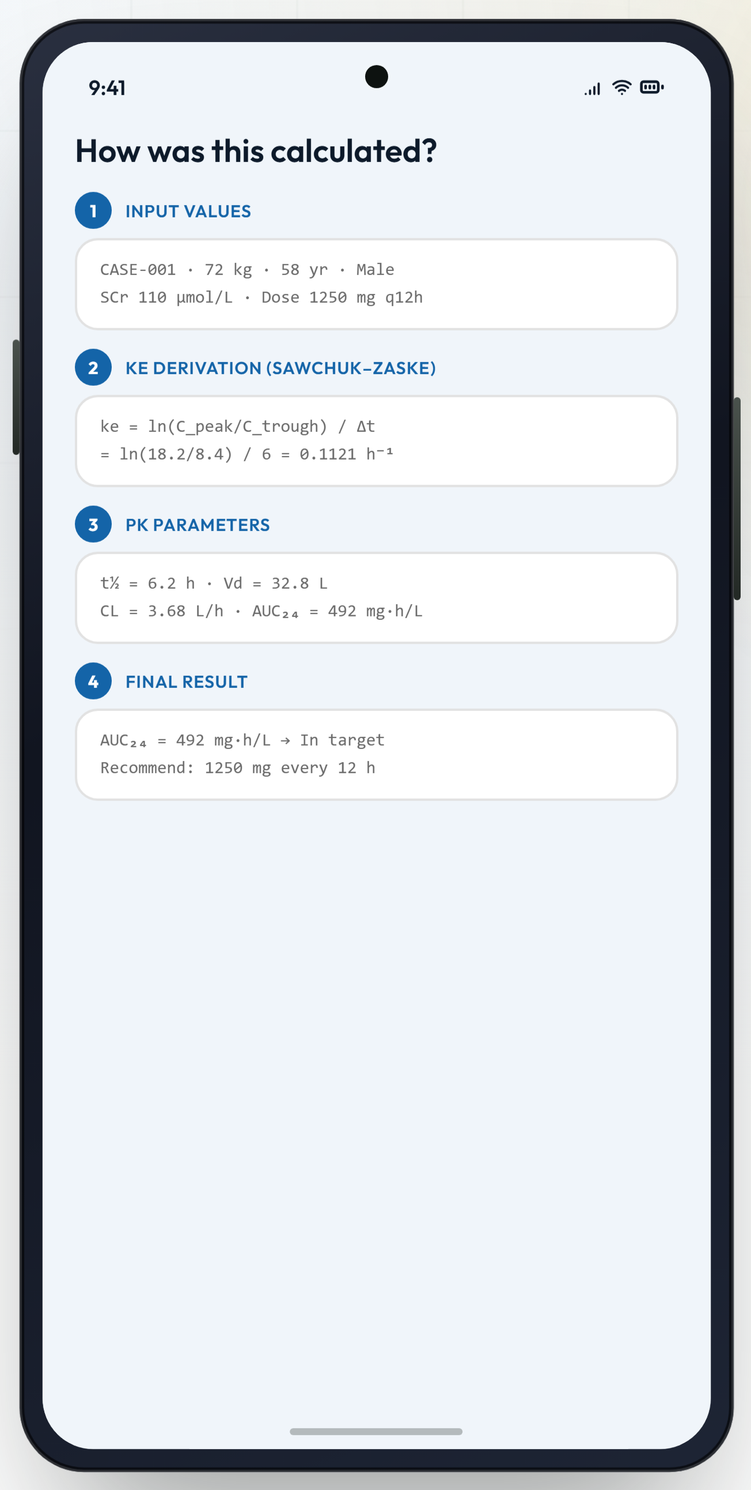
APPLICATION SCREENS
Calculating, results and explanation
Fitting the model
AUC₂₄ ring + verdict
Four-phase explanation
TDM Insight · CDE2313 · Albukhary International University
29 / 40

Slide 30
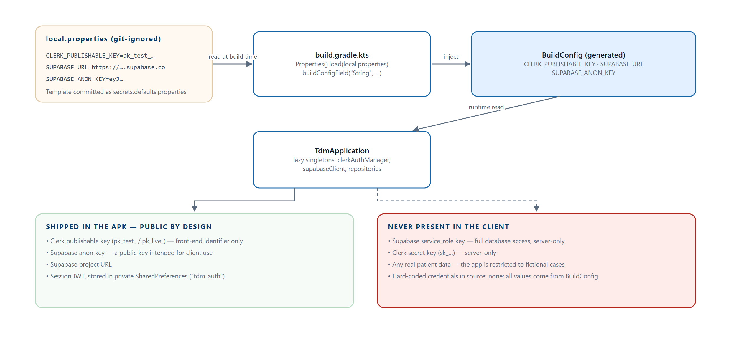
SECURITY
Authentication and credential model
Credentials reach the app through BuildConfig; nothing sensitive is committed
Only public keys ship in the APK. The Supabase service_role key and the Clerk secret key are never referenced anywhere in the project. The app declares one permission: INTERNET.
TDM Insight · CDE2313 · Albukhary International University
30 / 40

Slide 31
04
Testing, honesty and next steps
What we verified, what we found, and what remains.
TDM Insight · CDE2313 · Albukhary International University
31 / 40

Slide 32
EVIDENCE
Testing
Effort was concentrated where defects would be most costly and least visible.
31
11
20
14
JUnit unit tests
engine tests
validator tests
manual end-to-end scenarios
▪ Every blocking rule has a test asserting the calculation is refused — a validator that silently passes bad input is worse than none.
▪ Several tests assert a value produces a warning and not an error, because collapsing the two tiers would break an explicit case-study requirement.
▪ engine never produces NaN on edge inputs exists because a NaN would render as a plausible-looking dash rather than an obvious failure.
▪ Manual scenarios cover all three workflows, rotation, back-navigation, theme switching, sign-out and offline use.
TDM Insight · CDE2313 · Albukhary International University
32 / 40

Slide 33
EVIDENCE
A defect we found — and are reporting
Discovered while verifying the worked examples for the report.
▪ The one-compartment model has a ceiling: as ke → 0, the modelled concentration tends to Dose ÷ Vd_population.
▪ When the measured peak exceeds that ceiling, no positive root exists. Newton–Raphson drives ke down, coerceAtLeast(1e-6) clamps it, two iterations compare equal — and the loop declares convergence.
▪ guardPositive passes because 1e-6 > 0, so the engine returns Success with CL ≈ 4.6 × 10⁻⁵ L/h and AUC₂₄ ≈ 4 × 10⁷ mg·h/L.
68 kg patient, 1000 mg over 1 h, measured 22.5 mg/L
Vd = 0.7 x 68 = 47.6 L ceiling = 1000 / 47.6 = 21.0 mg/L < 22.5
The existing test post workflow handles plausible two-point-like data uses exactly these values and passes — it asserts only that the result is a Success. A weak assertion concealed the defect. Fix: reject the input before iterating, and treat a clamped ke as non-convergence.
TDM Insight · CDE2313 · Albukhary International University
33 / 40

Slide 34
EVIDENCE
Limitations we are not hiding
Not clinically validated
Post-dose defect
Database isolation
An academic prototype. The equations have not been validated for patient care and must never drive a real prescription.
Degenerate fit above the model ceiling. The Pre and Pre + Post pathways are unaffected.
Per-user RLS policies are written but commented out; isolation is currently enforced by the client query.
Model scope
Three inert controls
No Compose UI tests
One compartment, fixed 0.7 L/kg prior for the single-sample pathways.
Concentration-curve tile, lab-report scan row and share icon are placeholders for optional enhancements.
Dependencies are declared but the instrumented source set is empty.
TDM Insight · CDE2313 · Albukhary International University
34 / 40

Slide 35
EVIDENCE
Future work
Priority | Item | Why it is tractable
1 | Correct the Post-dose fit and add a regression test | A ceiling check before the loop; a few lines
2 | Enable per-user Row Level Security | Policies are already written; getSupabaseToken() already exists
3 | Wire the concentration–time graph | PkCurveGraph is already implemented as a Canvas Composable
4 | Camera capture with confirm-before-use OCR | Two interface entry points already exist
5 | Export or share a calculation summary | Replaces the inert share icon
6 | Compose UI tests for the wizard | Dependencies already declared
7 | Extend to a second medication | One function per pathway; no architectural change needed
TDM Insight · CDE2313 · Albukhary International University
35 / 40

Slide 36
COMPLIANCE
Every mandatory requirement, traced
Case study requirement | Implemented in | Status
Native Android · Kotlin · Compose · Material 3 | Kotlin_app/ · compileSdk 35 · minSdk 26 | Met
Pre, Post and Pre + Post workflows | VancoEngine — three public functions | Met
Dynamic input forms | InputFormScreen conditional field groups | Met
Input and cross-field validation | InputValidator — 7 public functions | Met
Engine separated from the UI | domain/engine/ — no Android imports | Met
Intermediate and final PK results | PkResults — nine values | Met
Explainable results | ExplanationScreen — four phases | Met
Material 3 light and dark mode | Color.kt + Theme.kt + Settings selector | Met
Mandatory academic disclaimer | First-launch gate · banners · About screen | Met
TDM Insight · CDE2313 · Albukhary International University
36 / 40

Slide 37
PROFESSIONAL PRACTICE
Repository and responsible AI
Repository structure
Credentials
Commits
Follows the prescribed layout: Kotlin_app/, docs/, apk/, landingPage/, with a README carrying all thirteen required sections.
local.properties is git-ignored; secrets.defaults.properties is the committed template. No key has ever entered version history.
Scoped to one logical change, with conventional prefixes. Authorship still needs distributing across all three members before submission.
AI — where it helped
AI — where it did not
AI — full disclosure
Learning Compose APIs, drafting layouts, a refactor, and one debugging session. Output was reviewed and frequently modified.
No clinical formula, constant or target came from a language model. Every equation is cited and commented with its source.
The drafting of the project report surfaced the Post-dose defect. We reported it rather than removing the example.
TDM Insight · CDE2313 · Albukhary International University
37 / 40

Slide 38
WRAPPING UP
Conclusion
▪ TDM Insight turns a paper worksheet into a guided, validated and explainable mobile workflow — all nine mandatory requirements are implemented.
▪ The calculation engine is framework-free and covered by 31 unit tests. Remove the network layer entirely and it still compiles and passes.
▪ Two optional enhancements — identity and persistent history — were added without compromising the core. No credentials? The calculator still works.
▪ We document our own defects. A weak assertion hid a bug in the Post-dose fit; it is reported in full, with a reproduction and a fix.
For a system that models a clinical calculation, that honesty is not incidental — it is the difference between a teaching aid and a liability.
TDM Insight · CDE2313 · Albukhary International University
38 / 40

Slide 39
APA 7TH EDITION
References
Burden, R. L., & Faires, J. D. (2010). Numerical analysis (9th ed.). Brooks/Cole.
Cockcroft, D. W., & Gault, M. H. (1976). Prediction of creatinine clearance from serum creatinine. Nephron, 16(1), 31–41.
Google. (2024). Guide to app architecture. Android Developers. https://developer.android.com/topic/architecture
Mohd Zaki, M. Z. (2026). CDE2313 project case study description: TDM Insight [Course case study]. Albukhary International University.
Rybak, M. J., Le, J., Lodise, T. P., et al. (2020). Therapeutic monitoring of vancomycin for serious methicillin-resistant Staphylococcus aureus infections: A revised consensus guideline. American Journal of Health-System Pharmacy, 77(11), 835–864.
Sawchuk, R. J., & Zaske, D. E. (1976). Pharmacokinetics of dosing regimens which utilize multiple intravenous infusions. Journal of Pharmacokinetics and Biopharmaceutics, 4(2), 183–195.
Sommerville, I. (2016). Software engineering (10th ed.). Pearson.
Supabase. (2024). Row Level Security. https://supabase.com/docs/guides/database/postgres/row-level-security
TDM Insight · CDE2313 · Albukhary International University
39 / 40

Slide 40
Thank you
Questions, and a live demonstration of all three workflows.
TDM Insight · CDE2313 Mobile Application Development · Albukhary International University Academic prototype — all demonstration cases are fictional.

