Slide 1





Information Systems that evolve.
Continuity that never breaks.
How can digital continuity be guaranteed in an ultra-complex, evolving information system, using agentic AI?
48 hours to build a Proof of Concept
HACKATHON · 2026

Slide 2

Welcome to the jungle of industrial information systems!
Imagine a company capable of designing ultra-connected vehicles... whose engineering tools do not always talk to one another.
The legacy system
The new system
20 years of historical data, a proprietary language, closed interfaces
A modern platform, promises of a revolution... and a gap to bridge
In between
Excel files, copy-paste operations, costly interfaces, and engineers re-entering data

Slide 3

THE PROBLEM
Hundreds of tools, no common language
In automotive, aerospace, defense, and beyond, information systems comprise hundreds of highly specialized, interdependent tools!
Each specialized tool has its own data model, reference systems, and technologies, sometimes obsolete and often not designed from the origin to interoperate.
Upgrading or replacing even one of these tools is always a complex, high-risk project.
⚡ Propagation risk
🔗 Traditional approaches fail
A different reference, a misinterpreted unit... and the entire chain begins to crack
Interfaces, integration buses, centralization: insufficient when faced with real-world complexity

Slide 4
This could be the most useful hackathon of your life!
Your mission: explore a radically different approach, using AI agents to build intelligent bridges between tools.
Agentic AI
Data & Migration
Autonomous agents that observe, understand, and decide
Transform and align heterogeneous data in real time
IT Architecture
Industrial impact
Design systems capable of absorbing the existing landscape without disruption
Solve real problems in automotive, aerospace, and industry in general.
Every large company faces the need to evolve its information systems while maintaining digital continuity.

Slide 5

The “Strangler Fig”: nature as a model
In nature, the strangler fig gradually grows around an existing tree until it completely replaces it, without ever destroying it abruptly.
The AI agent encapsulates the legacy system
Continuity is maintained
The new system takes over
It understands, controls, and gradually transfers its data
The legacy tool remains the system of record during the transition
As the data is analyzed, corrected, and aligned

Slide 6
HACKATHON MISSION
Your objective in 48 hours
Build a complete demonstrator capable of simulating the gradual migration from a legacy system to a modern system, without any break in continuity.
Client APP / Web Service…
Client APP / Web Service…
Client APP / Web Service…
Client APP / Web Service…
Orchestrator Agent (business need/request)
Orchestrator Agent (business need/request)
Orchestrator Agent (business need/request)
Orchestrator Agent (business need/request)
API Agent
API Agent
API Agent
API Agent
API Agent
API Agent
API Agent
API Agent
API
API
API
API
API
API
API
API
API
API
Legacy
system A
Legacy
System B
Legacy
system A
New
system A
Legacy
system B
Legacy
system A
New
system A
Legacy
system B
New
system A
Legacy
system B
Agentic digital continuity
Legacy tool replacement, legacy system remains master, gradual realignment of the new tool until cutover. Digital continuity maintained
Each phase represents an essential building block of the agentic architecture to be built and demonstrated live.

Slide 7

HACKATHON MISSION
Your objective in 48 hours
Build a complete demonstrator capable of simulating the gradual migration from a legacy system to a modern system, without any break in continuity.
Extract the data
Transform the flows
The API agent reads and understands the legacy system.
The orchestrator aligns and corrects the data.
Simulate the systems
Switch over gradually
Legacy and new models running in parallel.
Controlled transition with human validation.
Each phase represents an essential building block of the agentic architecture to be built and demonstrated live.

Slide 8

What your demonstrator must do
1
2
Simulate two systems
Create an API agent
Legacy and new systems with different data models
Understand and extract data from the legacy system
3
4
Orchestrate the transformation
Detect inconsistencies
Manage data alignment and transfer
Identify ambiguous or conflicting data
5
6
Involve a human
Demonstrate the cutover
Only when the AI cannot decide with confidence
A gradual transition with no break in continuity
🏆 Bonus: Make your agent capable of explaining its decisions, including why data was corrected, rejected, or submitted for human validation.
Also identify and document the key drivers of performance and execution cost (tokens, etc.).

Slide 9

This challenge is for you!
You will not simply develop a chatbot. You will build a system capable of observing, understanding, deciding, transforming, and collaborating with humans.
🧠 You love coding
🏭 You want real-world impact
Manipulate data and design autonomous agents
Solve real, high-impact industrial problems
⚡ You thrive under pressure
48 hours to prototype, demonstrate, and convince

Slide 10

In 48 hours, do not erase the past. Invent how tomorrow's systems will intelligently absorb yesterday's.
Build your team
Choose your technologies
Enter the jungle

Slide 11
Practice
HACKATHON · 2026

Slide 12



Simulate a (fictional) legacy database replacement by a new one
USING AGENTIC AI
From
Check
Fix, or ask
Transform
Log & justify
To
Legacy Excel based database
2 historical versions merged in 1 file
100,000 records
Fed manually and by several tools
Poor data quality
Structured database
Cleansed data
Only useful data
Note: Use the DB technology you want

Slide 13
Purpose of system
For a particular vehicle uniquely identified by its VIN (Vehicle Identification Number) and its model name,
document executed ECU (Electronic Control Units) diagnosis operations identified by a unique ID and a timestamp,
Identify diagnosis tool used,
Record diagnosis result value and its description.
Legacy database was extracted in the form of an excel file.
Transform into target datamodel and load database
Look for likely data quality issues
Fix automatically, when possible, log change and related reasoning
Ask human when no obvious solution found, explain why not able to fix
…. We have inserted some “easter eggs” ;-)
non-respect of datamodel cardinalities, missing values, multiple spellings of the same data (eg: BCM , B-CM)
Expect circa 10% of records to contain abnormalities. Agent can be trained to recognize them
Tip : Don’t forget data migration is never a one-shot operation, your solution shall be able to accommodate several successive trials without creating unwanted records in the target system.
BONUS : offer the possibility to question the loaded database in natural language (in order to query the database)

Slide 14
Expected hackathon results
Minimum viable demo
Your demonstrator must:
ingest the provided legacy data;
understand and apply the migration rules;
detect anomalies;
automatically correct obvious cases;
escalate ambiguous cases to a human;
explain every decision in a log;
load valid data into the target model;
provide migration statistics.
Your demonstrator shall generate a summary once executed such as (example)
100,000 records analysed
─────────────────────────
94,820 migrated automatically
3,450 automatically corrected
1,120 rejected
610 requiring human decision
100% decisions traced
Estimated AI consumption : 1,243 tokens
Processing time: 2 min 43 sec
BONUS : chat with database : ideally another agent asks questions to the system to serve another tool (digital continuity)
Evaluation criteria
Agentic architecture and justification of choices 25 %
Demonstrator
  Data migration correctness 15 %
  Detection / resolution of unexpected anomalies 15 %
  Explainability & traceability 10 %
  Human-in-the-loop quality 10 %
  Performance & cost 5 %
  Demo / UX 5 %
Lessons learnt 10%
Perspectives (going further) 5%
Bonus (chat with database)
Use AI where it makes sense. You will not get extra points for using AI where a deterministic rule would be better.

Slide 15
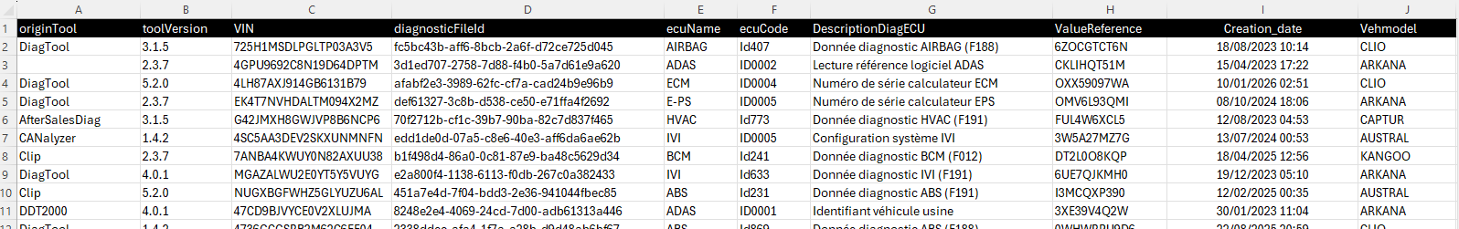
Source data
Field/column Purpose what to do with it
originTool : Tool used for diagnosis operation (TO CHECK & MIGRATE)
toolVersion : Version of tool used for the diagnosis operation (TO CHECK & MIGRATE)
VIN : Vehicle Identification Number (TO CHECK & MIGRATE)
diagnosticField : Unique diagnosis operation identification number (TO CHECK & MIGRATE)
ecuName: Electronic Control Unit type name (TO CHECK & MIGRATE)
ecuCode: DescriptionDiagECU (USE TO DETERMINE TARGET ValueDescription AND
THE VALIDATION RULE FOR ValueReference )
ValueReference : Diagnosis Result TO RECONSIDER as per mapping rules (see later)
Creation_date : Diagnosis operation timestamp (TO CHECK & MIGRATE)
Vhmodel : Model name of vehicle (TO CHECK & MIGRATE)

Slide 16
target data model
ECUDico
BCM
AIRBAG
TCM
BMS
OBC
ECM
ABS
ADAS
HVAC
IVI
VCU
EPS
VehicleModelsDico
KANGOO
MASTER
CLIO
SCENIC E-TECH
ARKANA
CAPTUR
TRAFIC
AUSTRAL
MEGANE E-TECH
RAFALE
Vehicle
@ VIN
@ VehicleModel
DiagnozedECU
@ ecuName
1,*
1,*
1
1
*
*
DiagnosticOperation
@ diagnosticOpID
@ creationDate
DiagValueResult
@ ValueReference
@ ValueDescription
1
1
*
1
DiagToolsVersions
@ DiagToolName
@ DiagToolVersion
ValueDescription
ID0001: Vehicle VIN
ID0002: Part Number (F187)
ID0003: Hardware (F191)
ID0004: Software (F188)
ID0005: Calibration (F012)
ToolDico
DDT2000
Clip
CANalyzer

Slide 17
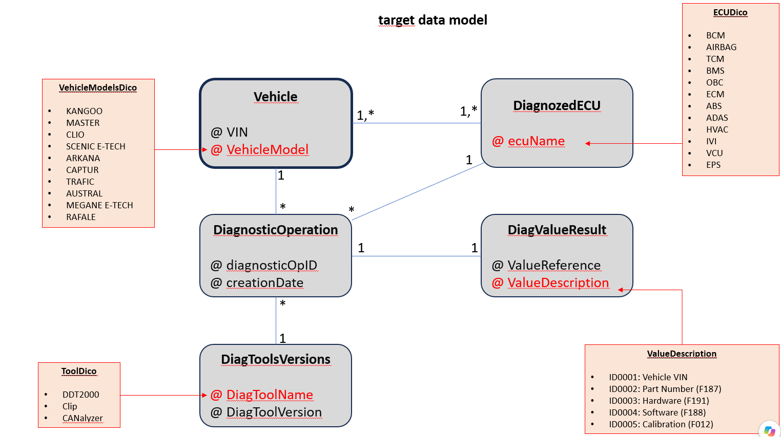
Was Mapped to
originTool : DiagToolsVersions(DiagToolName)
toolVersion : DiagToolsVersions(DiagToolVersion)
VIN : Vehicle(VIN)
diagnosticField : DiagnosticOperation(diagnosticOpID)
ecuName: DiagnozedECU(ecuName)
ecuCode: USE TO DETERMINE TARGET ValueDescription AND
THE VALIDATION RULE FOR ValueReference
ValueReference : DiagValueResult(ValueReference) as per transformation rule
Creation_date : DiagnosticOperation(creationDate)
Vhmodel : Vehicle(VehicleModel)

Slide 18
rules
Context
Two distinct processes were feeding the database. The objective is to unify them into a single, consistent target model that is easy to control.
Objective
Provide a single, normalized output with:
  Strictly normalized VINs.
  A controlled vocabulary for the originating tool (originTool).
  A clear reference list of ECU codes (ecuCode) and their associated values.
  Consistent validation rules for technical references.

Slide 19
rules
Data Normalization and Quality Rules
1. VIN
Fixed length: 20 characters.
Allowed characters: digits 0–9 and uppercase letters A–Z only.
No punctuation, spaces, accented characters, or lowercase letters.
Recommended preprocessing: trim, convert to uppercase, and remove unauthorized characters; reject the record if final validation fails.
Validation (indicative regex): ^[0-9A-Z]{20}$
2. originTool
Values allowed in the target for DiagToolName: DDT2000, CANalyzer, Clip.
Renaming/normalization rules:
  If the source value is DiagTool, the target value shall become « DDT2000 ».
  If the source value is AfterSalesDiag, the target value shall become « Clip ».
  If the source value is CANalyzer, the target value is unchanged
Any other value must be rejected or explicitly mapped before loading.

Slide 20
rules
3. ValueDescription (determined from ecuCode analysis)
Closed list of codes and descriptions:
  ID0001: Vehicle VIN
  ID0002: Part Number (F187)
  ID0003: Hardware (F191)
  ID0004: Software (F188)
  ID0005: Calibration (F012)
The ecuCode field in the source table once mapped to the target data (ValueDescription) must result only in one of these five values exclusively.

Slide 21
rules
4. Technical References (Values Associated with ecuCode)
Valid references contain 10 characters, using digits 0–9 and uppercase letters A–Z only.
This applies particularly to:
  Part Number (F187) → ecuCode = ID0002
  Hardware (F191) → ecuCode = ID0003
  Software (F188) → ecuCode = ID0004
  Calibration (F012) → ecuCode = ID0005
Validation (indicative regex): ^[0-9A-Z]{10}$
Note: the VIN (ID0001) follows its own 20-character rule and is not subject to the 10-character rule.

Slide 22
rules
Target Structure (Suggestion)
vin: string (20), with VIN regex constraint.
DiagToolName: string (allowed values: DDT2000, CANalyzer, Clip).
ValueDescription : string (allowed values: ID0001 to ID0005).
ValueReference : string containing the value associated with ecuCode:
  For ID0001: the ValueReference shall be the VIN (20 characters).
  For ID0002–ID0005: ValueReference shall contain the original technical reference (10 characters).
Optional metadata: acquisition date, raw source, ingestion timestamp, ECU identifier, etc., as required.
Control Rules
Reject any row where:
  vin does not match ^[0-9A-Z]{20}$.
  DiagToolName is not in {DDT2000, CANalyzer, Clip} after mapping.
  ValueDescription is not in {ID0001...ID0005}.
  For ValueDescription ID0002-ID0005,ValueReference does not match ^[0-9A-Z]{10}$

Slide 23
rules
Traceability in the log file:
  Retain the source_originTool field for auditing (e.g., DiagTool, AfterSalesDiag) , in addition to the normalized DiagToolName field.
  Identify unresolved cases.
  Ask the user what information is missing and why the agent could not resolve the case autonomously
Normalization Example
Source: vin = “vf1-ab12 3c4567890def0”, originTool = “AfterSalesDiag”, ecuCode = “ID0002”, ecuValue = “a1b2c3d4e5”
Target:
  vin = “VF1AB123C4567890DEF0” (after cleaning and conversion to uppercase, only if exactly 20 alphanumeric characters remain; otherwise reject).
  DiagToolName = “Clip”
  ValueDescription = “ID0002”
  ValueReference = “A1B2C3D4E5”

