Slide 1
Computer Performance Measurement and Benchmarking
Max Hawkins

Slide 2
What is performance?
Making broad generalizations:
Hardware architects: Sub-system performance
Hardware vendors: Application-agnostic system performance
Memory bandwidth, operation throughput, etc
If selling specialized systems, can focus on applications (e.g. AI)
Application developers: Application performance
Images processed per second, output tokens per second, time to first token

Slide 3
Floating-point Operations per Second (flop/s)
De-facto standard computing performance metric
Measures the operation throughput
Has integer (iop/s), posit (pop/s), and generic (op/s) version
Alternative: Instructions per second
Unit: a quantity chosen as a standard in terms of which other quantities may be expressed
E.g. flop, operation, instruction, meter, second, flop/s, bit/s, etc

Slide 4
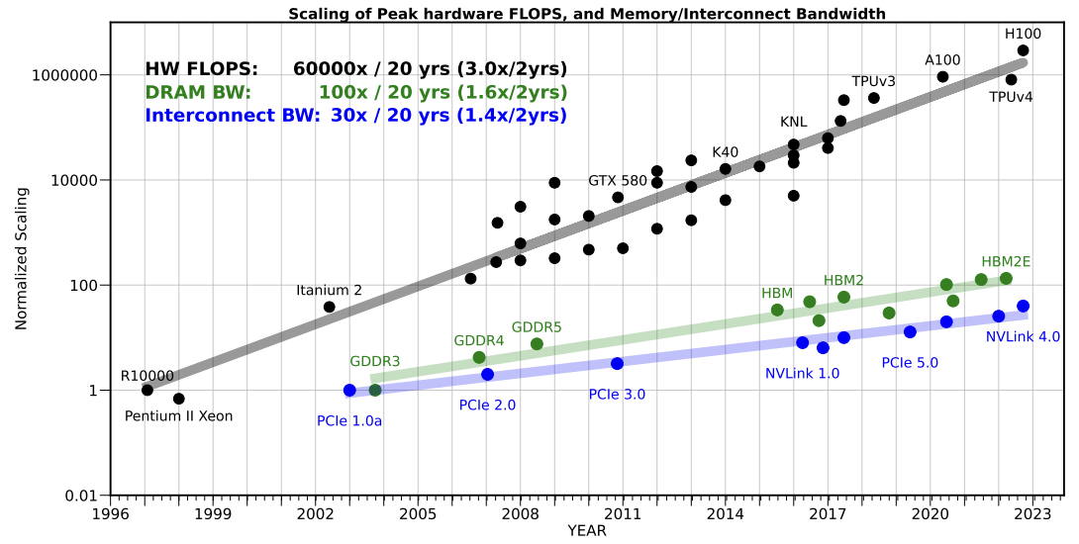
Exascale vs Exaflop
Frontier is an exaflop computer
Can perform > 1*10^18 flops per second (FP64 with HPL)
Is Frontier an exascale computer?
Exascale = Exaflop?
Memory?
Network?
Source: https://arxiv.org/pdf/2403.14123

Slide 5
What even is a flop?
Historically, IEEE-754 FP64 multiplies and adds
A narrow but concrete definition…with decreasing prevalence
Low-precision data types proliferated
FP32, 24, 16, 8, 6, 4, 2, 1, …
Quantized AI models
Operations
Just multiplies and adds? Divides?
Systolic array (tensor core/TPU) depth effect
Sparsity
Redundant encodings
Emulation
Ozaki scheme – performing FP64* arithmetic with Int8 operations

Slide 6
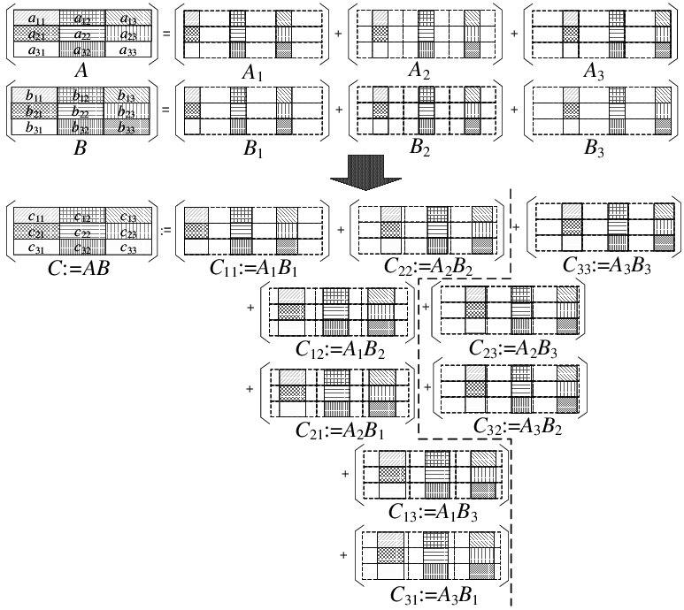
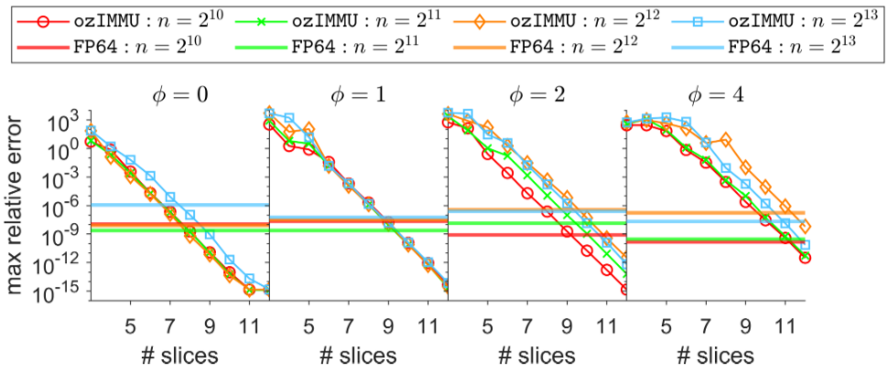
Ozaki Scheme
Source: https://arxiv.org/abs/2409.13313

Slide 7
Benchmarks
HPL – Dense linear system solver in FP64
Favors dense matmuls – tensor cores/TPUs/etc
https://www.netlib.org/benchmark/hpl/
HPCG – Sparse iterative solver in FP64
https://github.com/hpcg-benchmark/hpcg
MLPerf – Machine-learning inference
https://arxiv.org/pdf/1911.02549

Slide 8
Lists (and bragging rights)
Top500
Uses HPLinpack
Green500
Uses Top500 results normalized by power draw
Graph500
https://graph500.org
“Not all workloads are dense matmul” – Someone (probably)

Slide 9
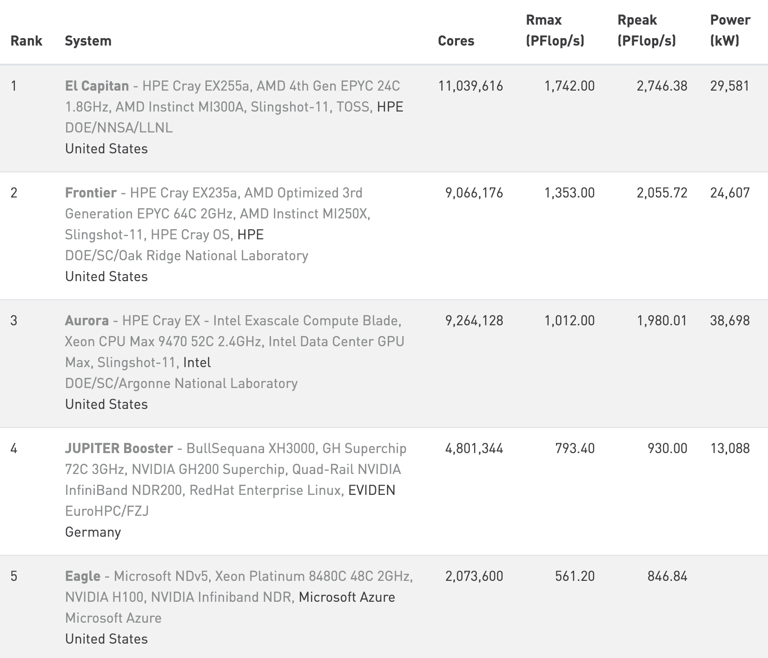
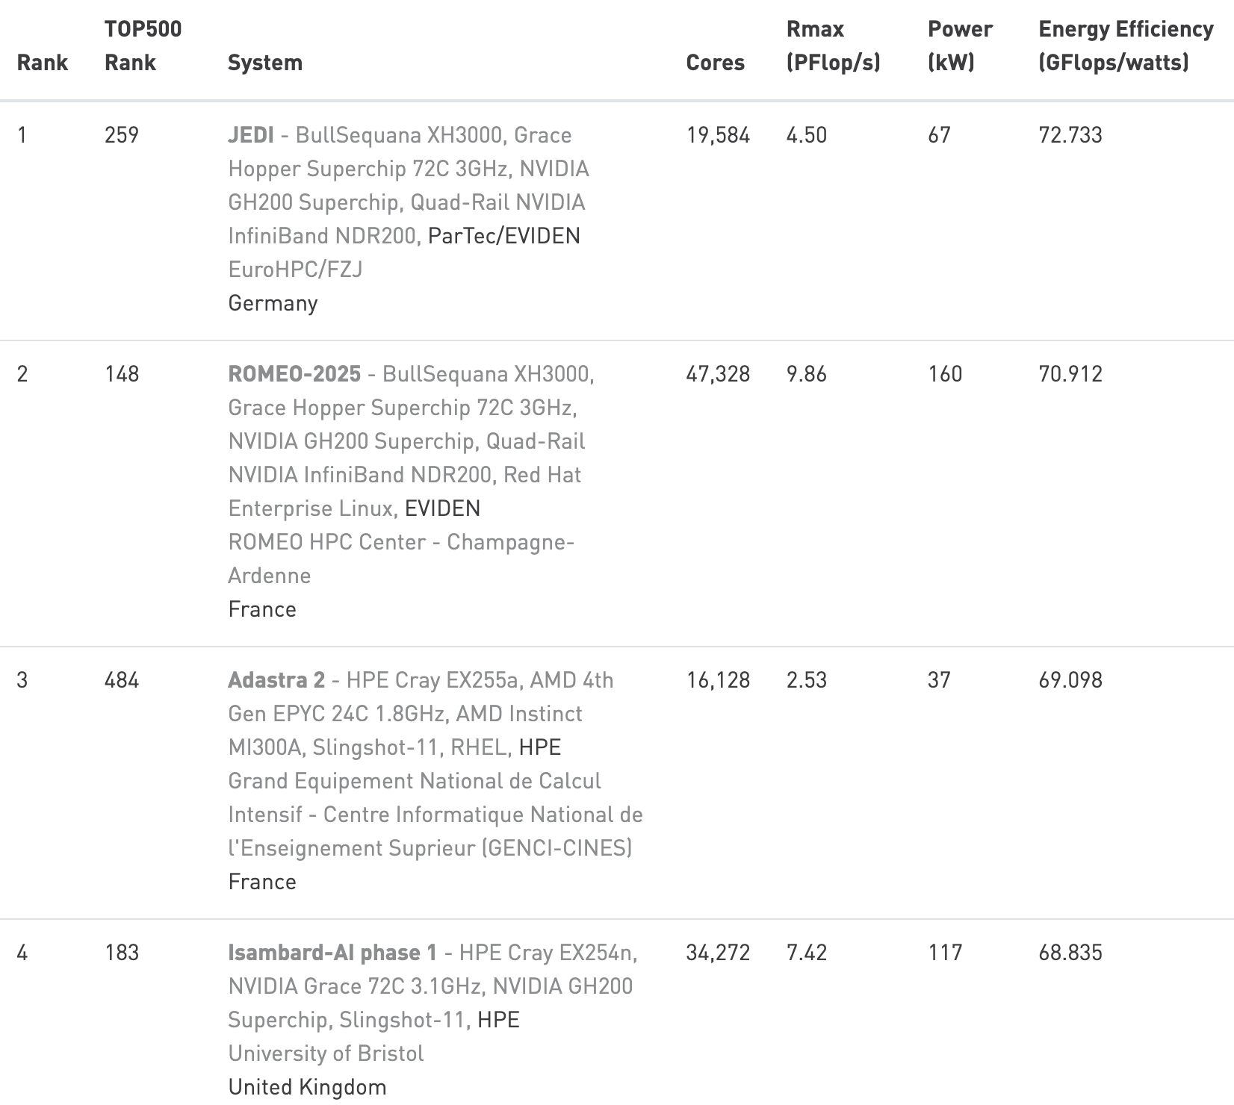
Top500 Green 500

Slide 10
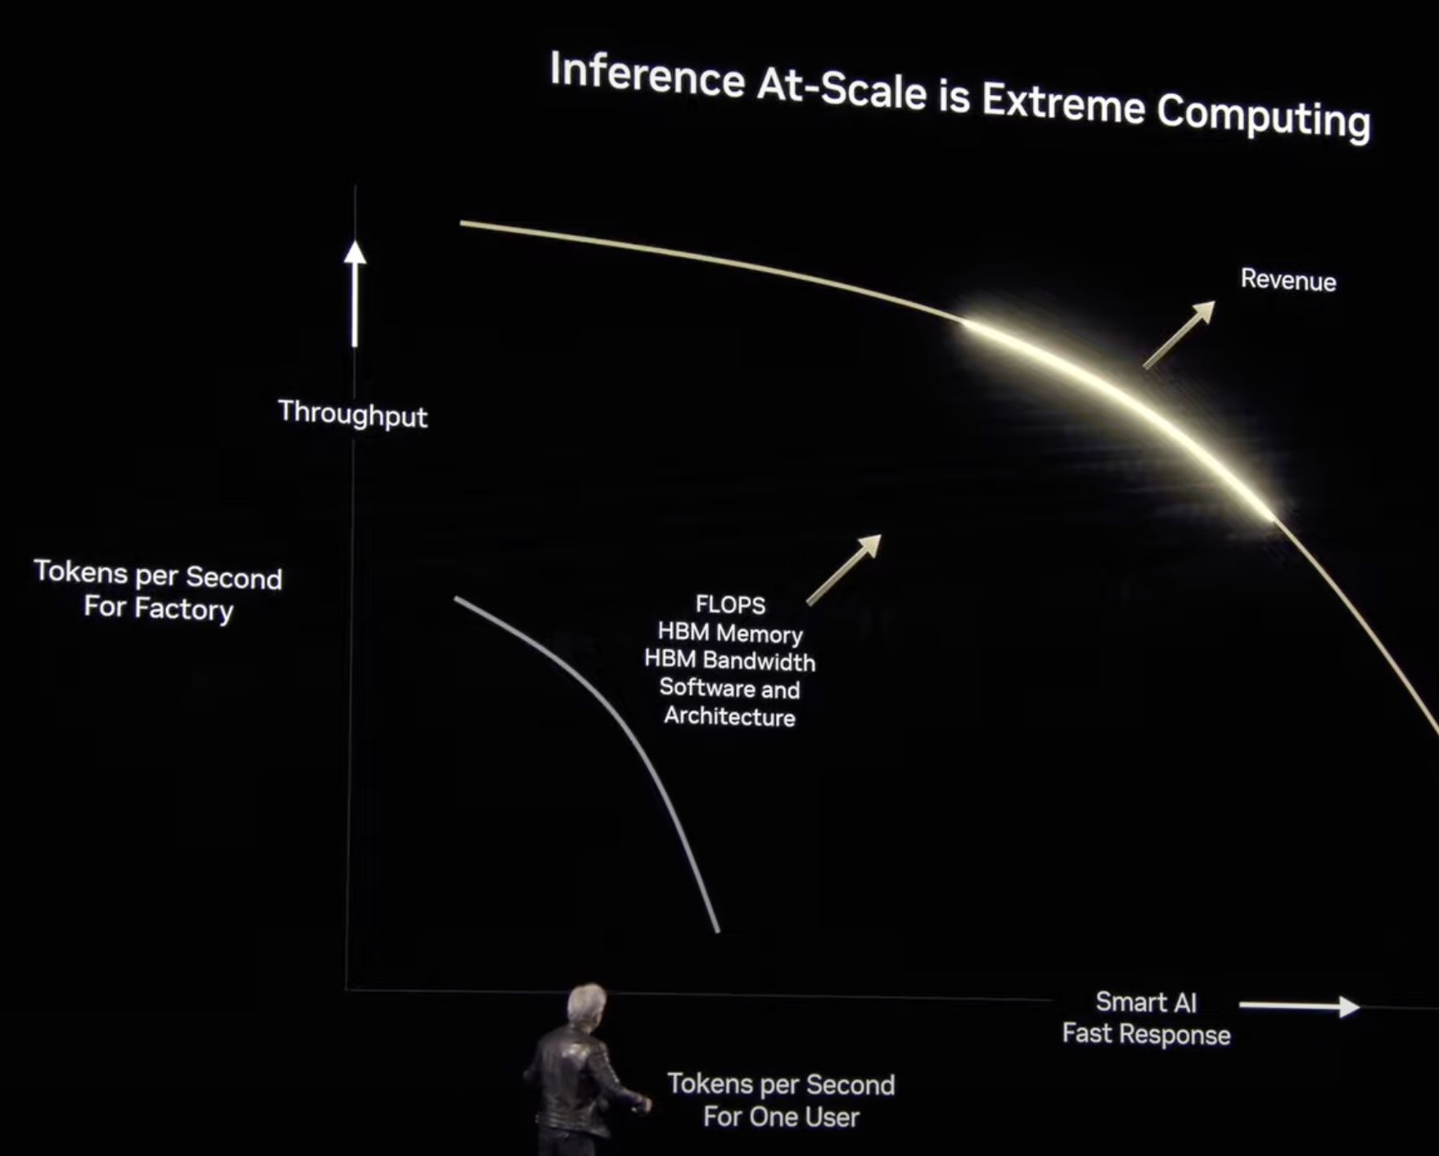
LLM Tokens as Commodities
Financial value: $ per token
Throughput: tokens per second
→ $ per second
AI factories: Converting electric power to money
“Computational alchemy”

Slide 11
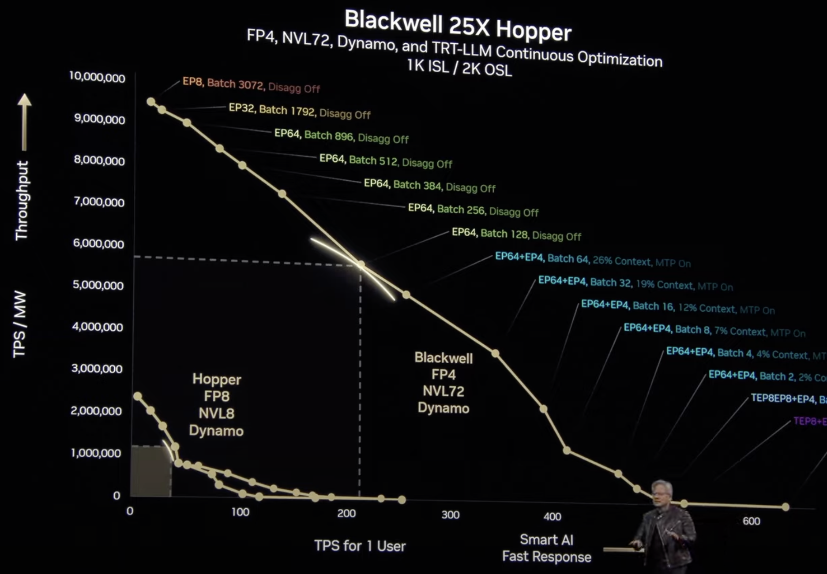

Slide 12
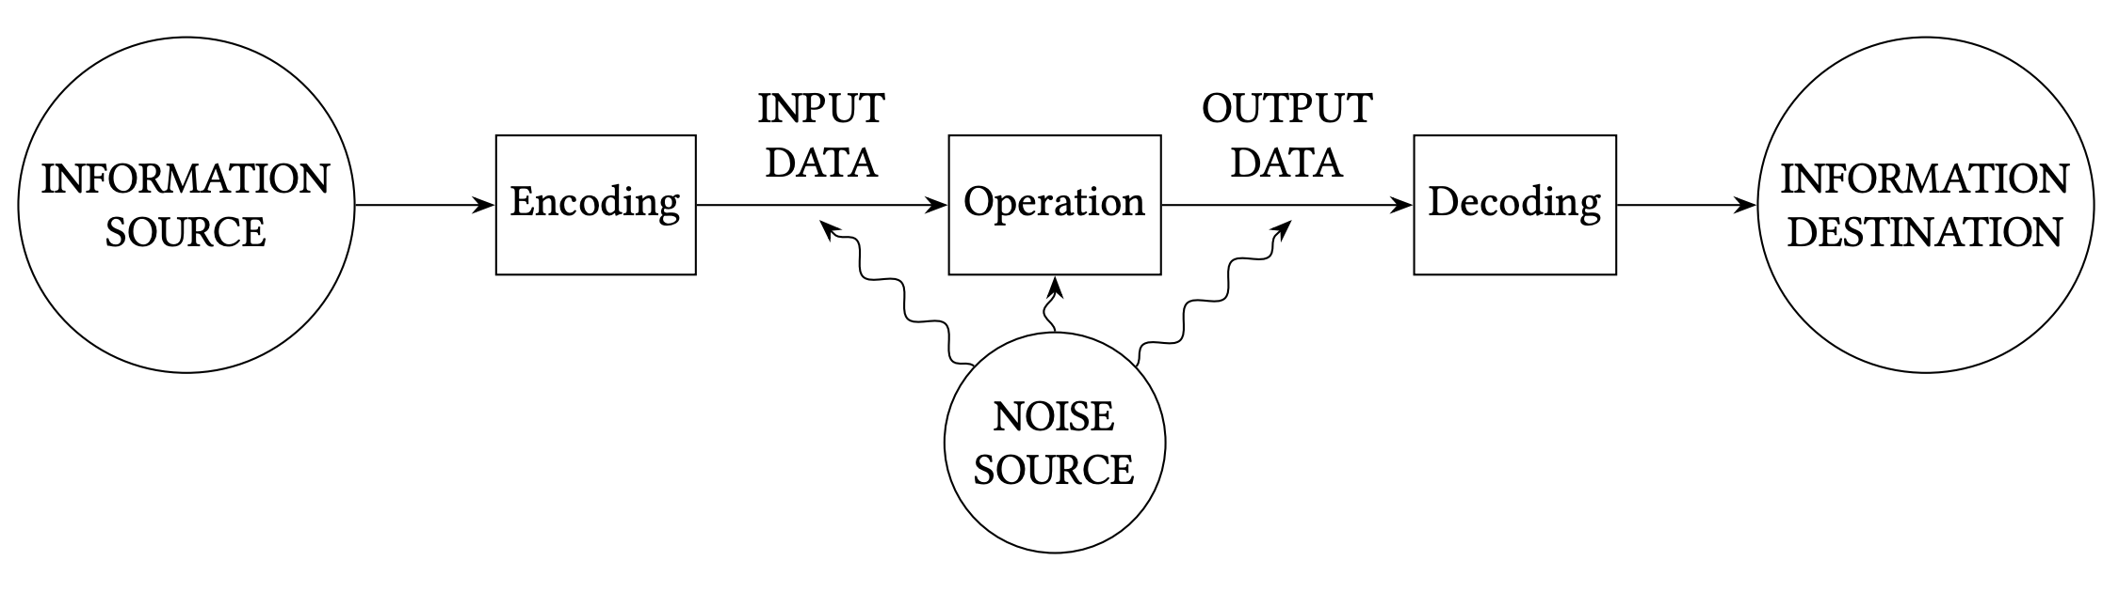
Aside: Back to bits research project

