Slide 1
Data Center Resource Consumption
Max Hawkins

Slide 2
Data Centers are Real, Physical Things
The 'Cloud' isn't abstract. Digital actions are physical processes.
Digital computing requires (among other things):
Energy to run
Water to cool*
Space and support infrastructure
The energy grid used to provide power also affects water/GHG
Global AI adoption is making these effects non-negligible

Slide 3
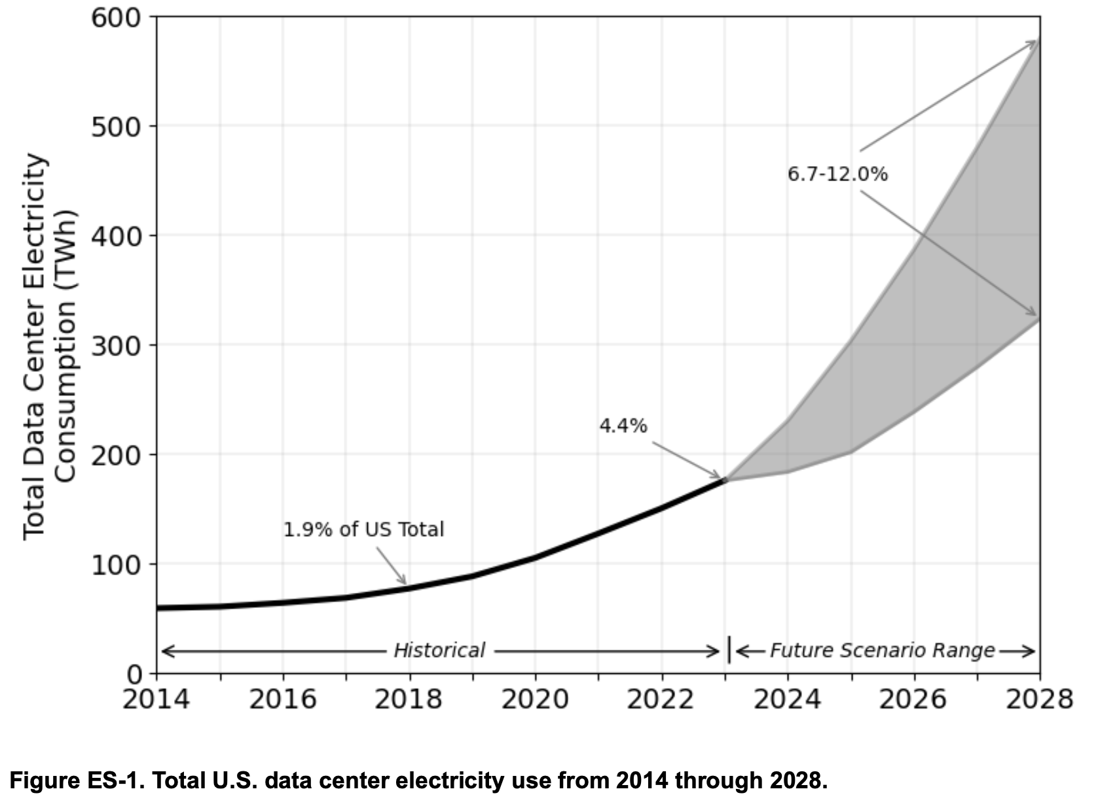
Computing and Energy
Digital electronics rely on electrical energy
Change and maintain voltage states
AI primarily using GPUs
Inefficiencies lead to wasted energy (heat)
DC energy consumption could be ~12% of US total by 2028
Source: 2024 United States Data CenterEnergy Usage Report

Slide 4
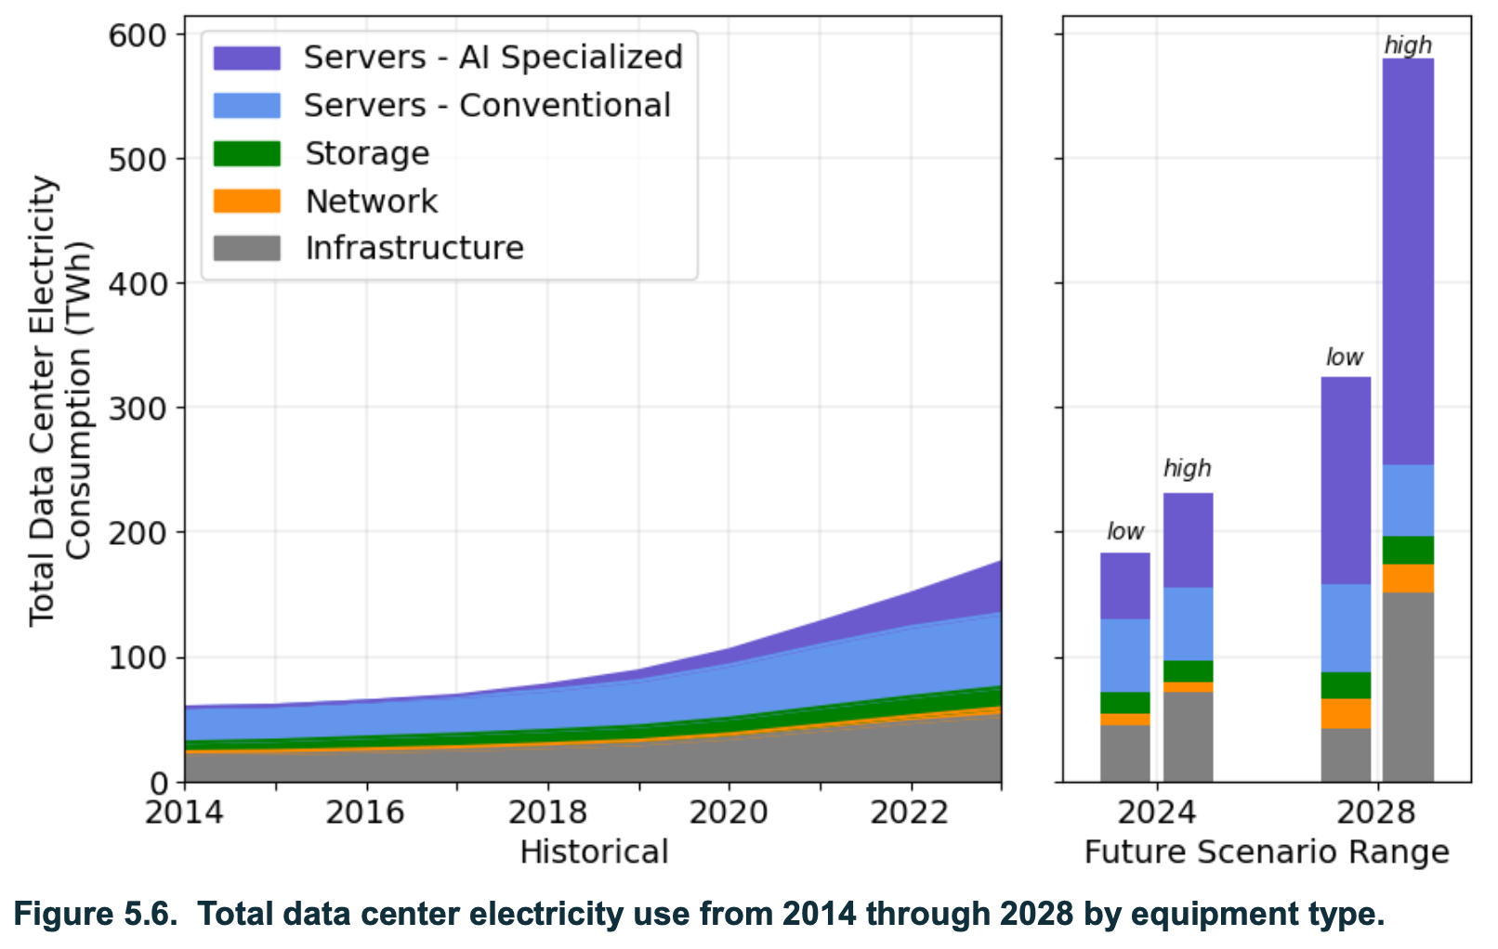
Source: 2024 United States Data CenterEnergy Usage Report

Slide 5
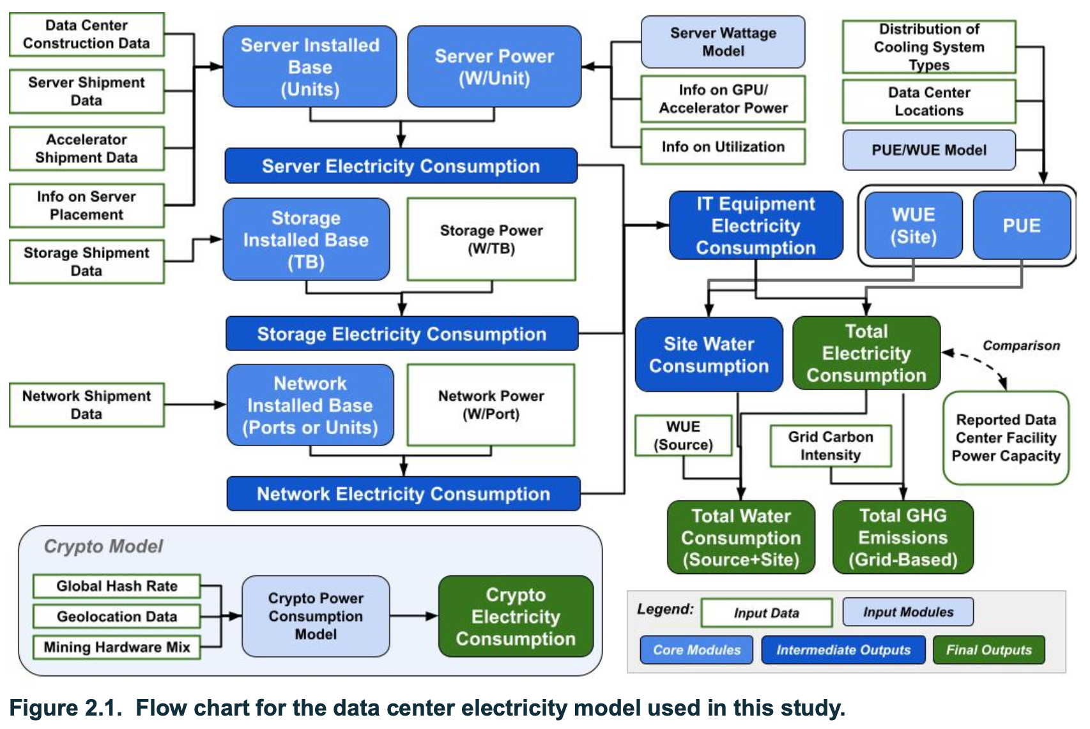
Source: 2024 United States Data CenterEnergy Usage Report

Slide 6

Importance of the Energy Grid
DCs directly use water, but also indirectly
Primarily through the energy grid that powers them
Thermoelectric power requires cooling (and water)
In the US, it's the largest consumer of water! (USGS – see next page)
Carbon footprint is heavily dependent on energy generation

Slide 7
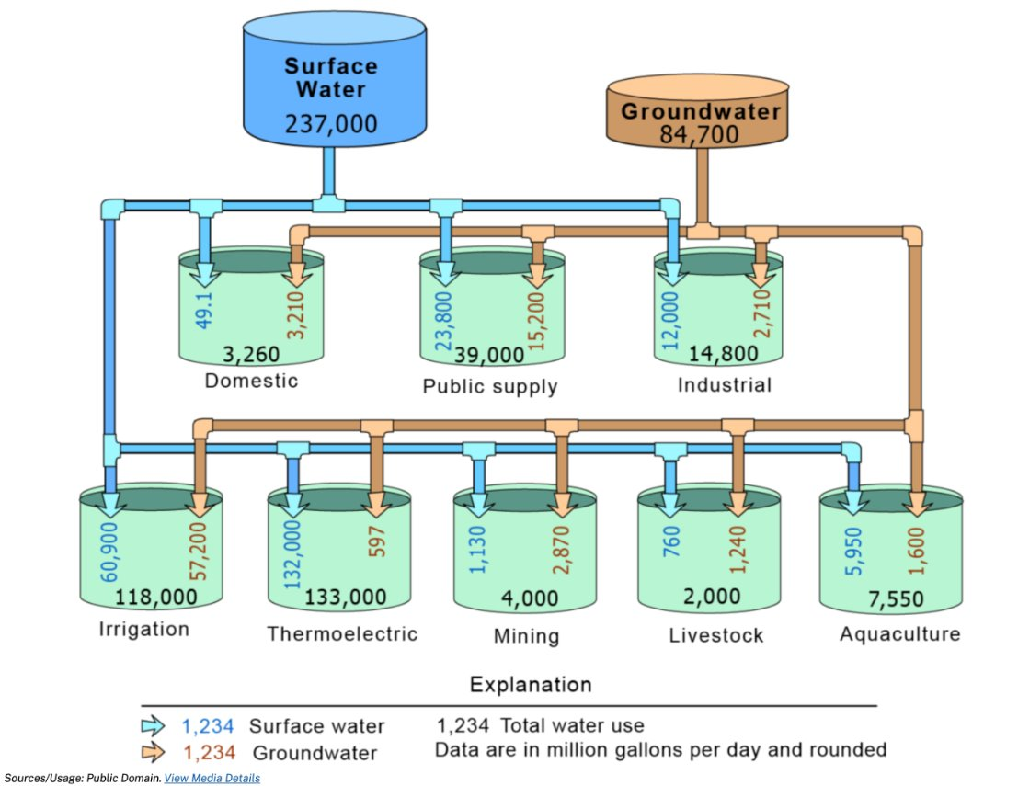
USGS 2015 Water Report Visual Summary

Slide 8
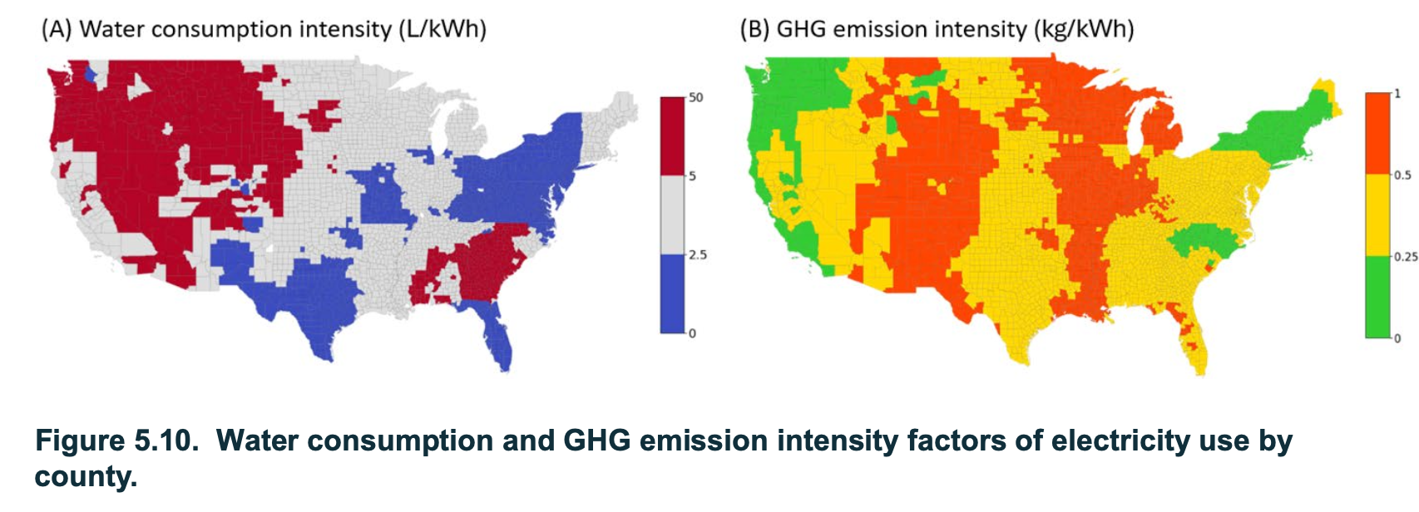
Water and GHG Impacts of the Energy Market
Source: 2024 United States Data CenterEnergy Usage Report

Slide 9
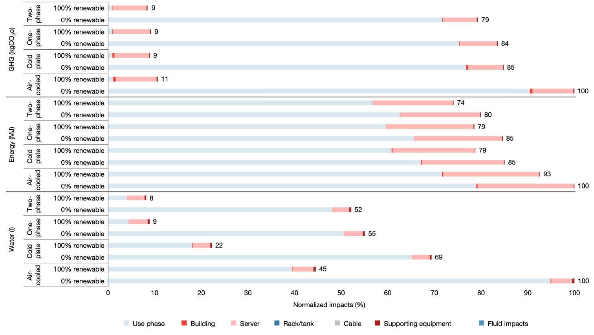
Source

Slide 10
Cost?
Monetary costs of running/paying for AI services matter
Energy prices have a large impact on AI cost
Ignore market capturing forces currently dominating (maybe)
Decreasing AI inference costs mean minimizing energy, water, and carbon costs

Slide 11
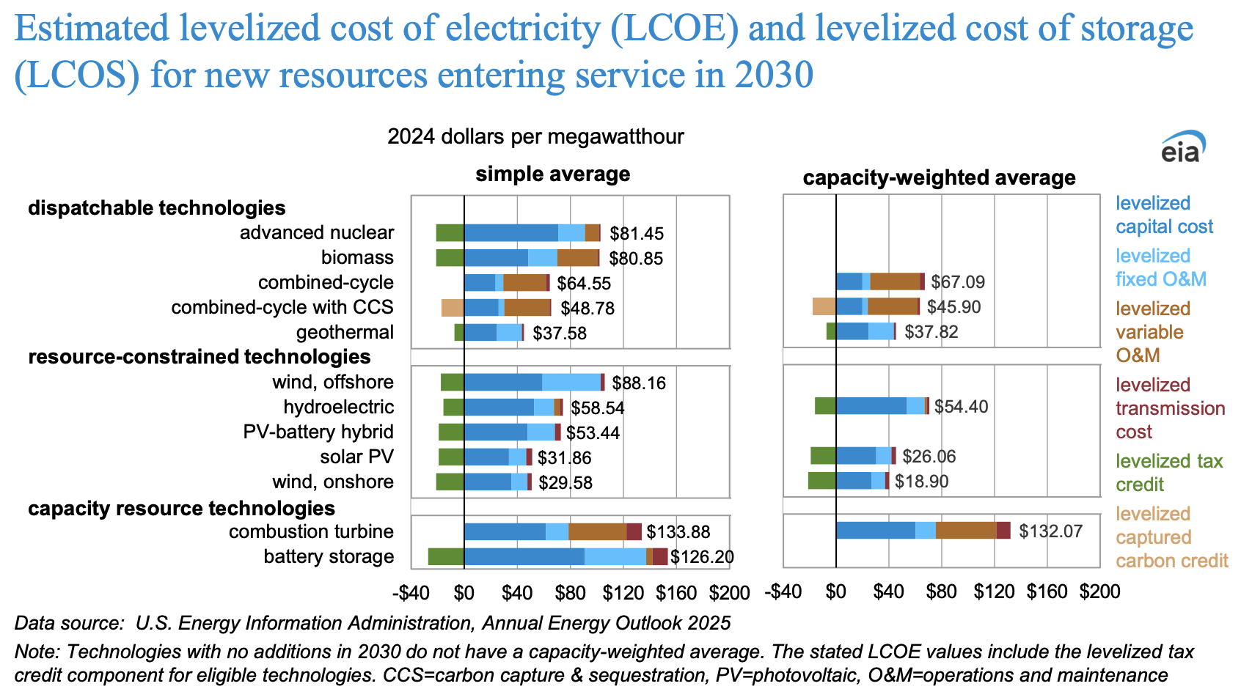
Source: U.S. Energy Information Administration

Slide 12
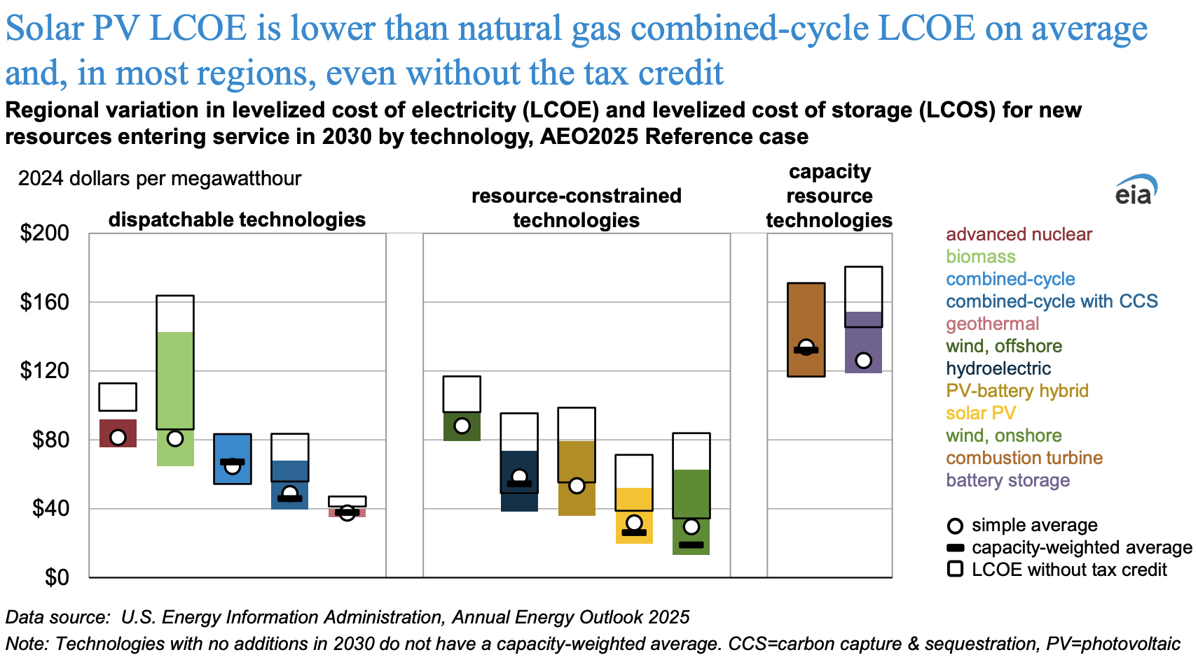
Source: U.S. Energy Information Administration

Slide 13
Renewables and Demand Flexibility
If these resources are not always available, flexibility is needed
Lack of power due to variable generation
Lack of water due to drought
Carbon capture limitations
Computing demand can be easily reduced/altered
Emerald AI – a start-up in this space

Slide 14

What is the limit of resource consumption for computing use?

