Slide 1
WomenTechWomenYes (WTWY) Annual Gala 2019
Stephen Ilhardt,
Maxwell Clarke,
Max Barry

Slide 2
Motivation 1-2 slides

Slide 3
Motivation 1-2 slides

Slide 4
Methodology 1-2 slides

Slide 5
Methodology 1-2 slides

Slide 6
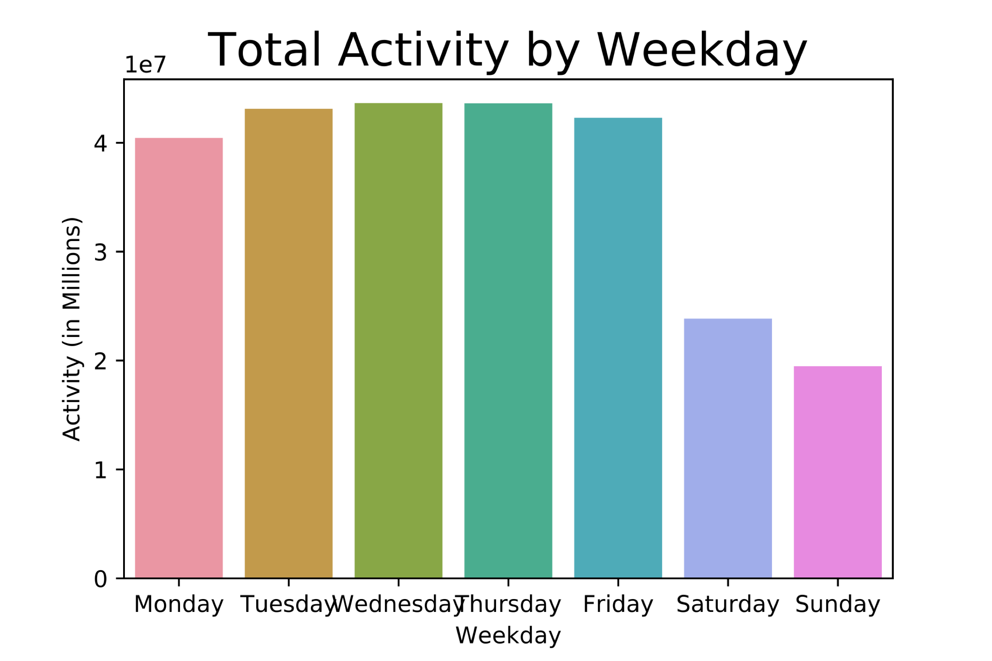
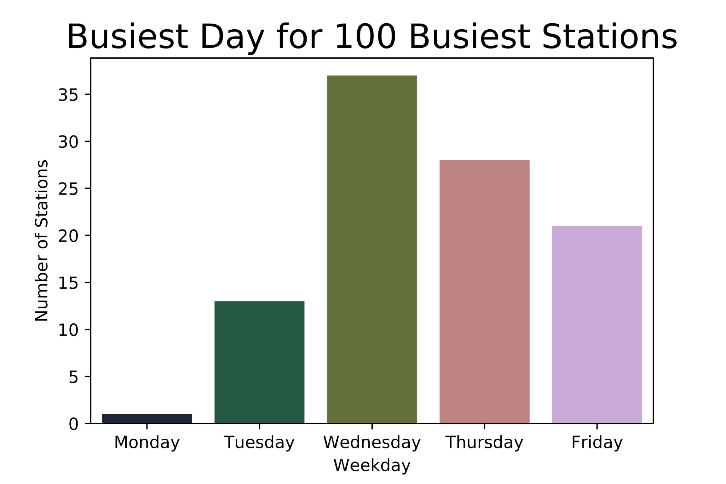
By Weekday
Weekday activity for all stations clearly exceeds weekend
Activity appears to peak mid-week
Wednesday/Thursday shows greatest activity for busiest stations

Slide 7
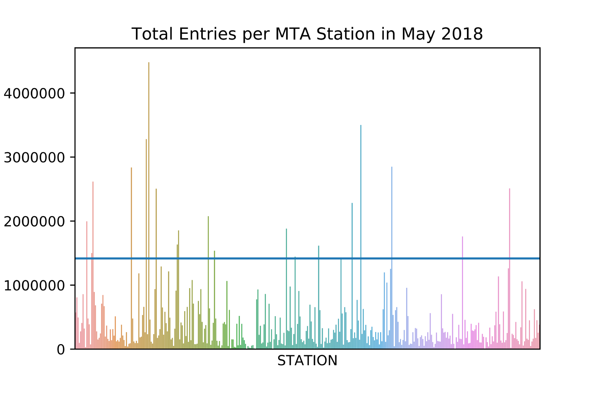
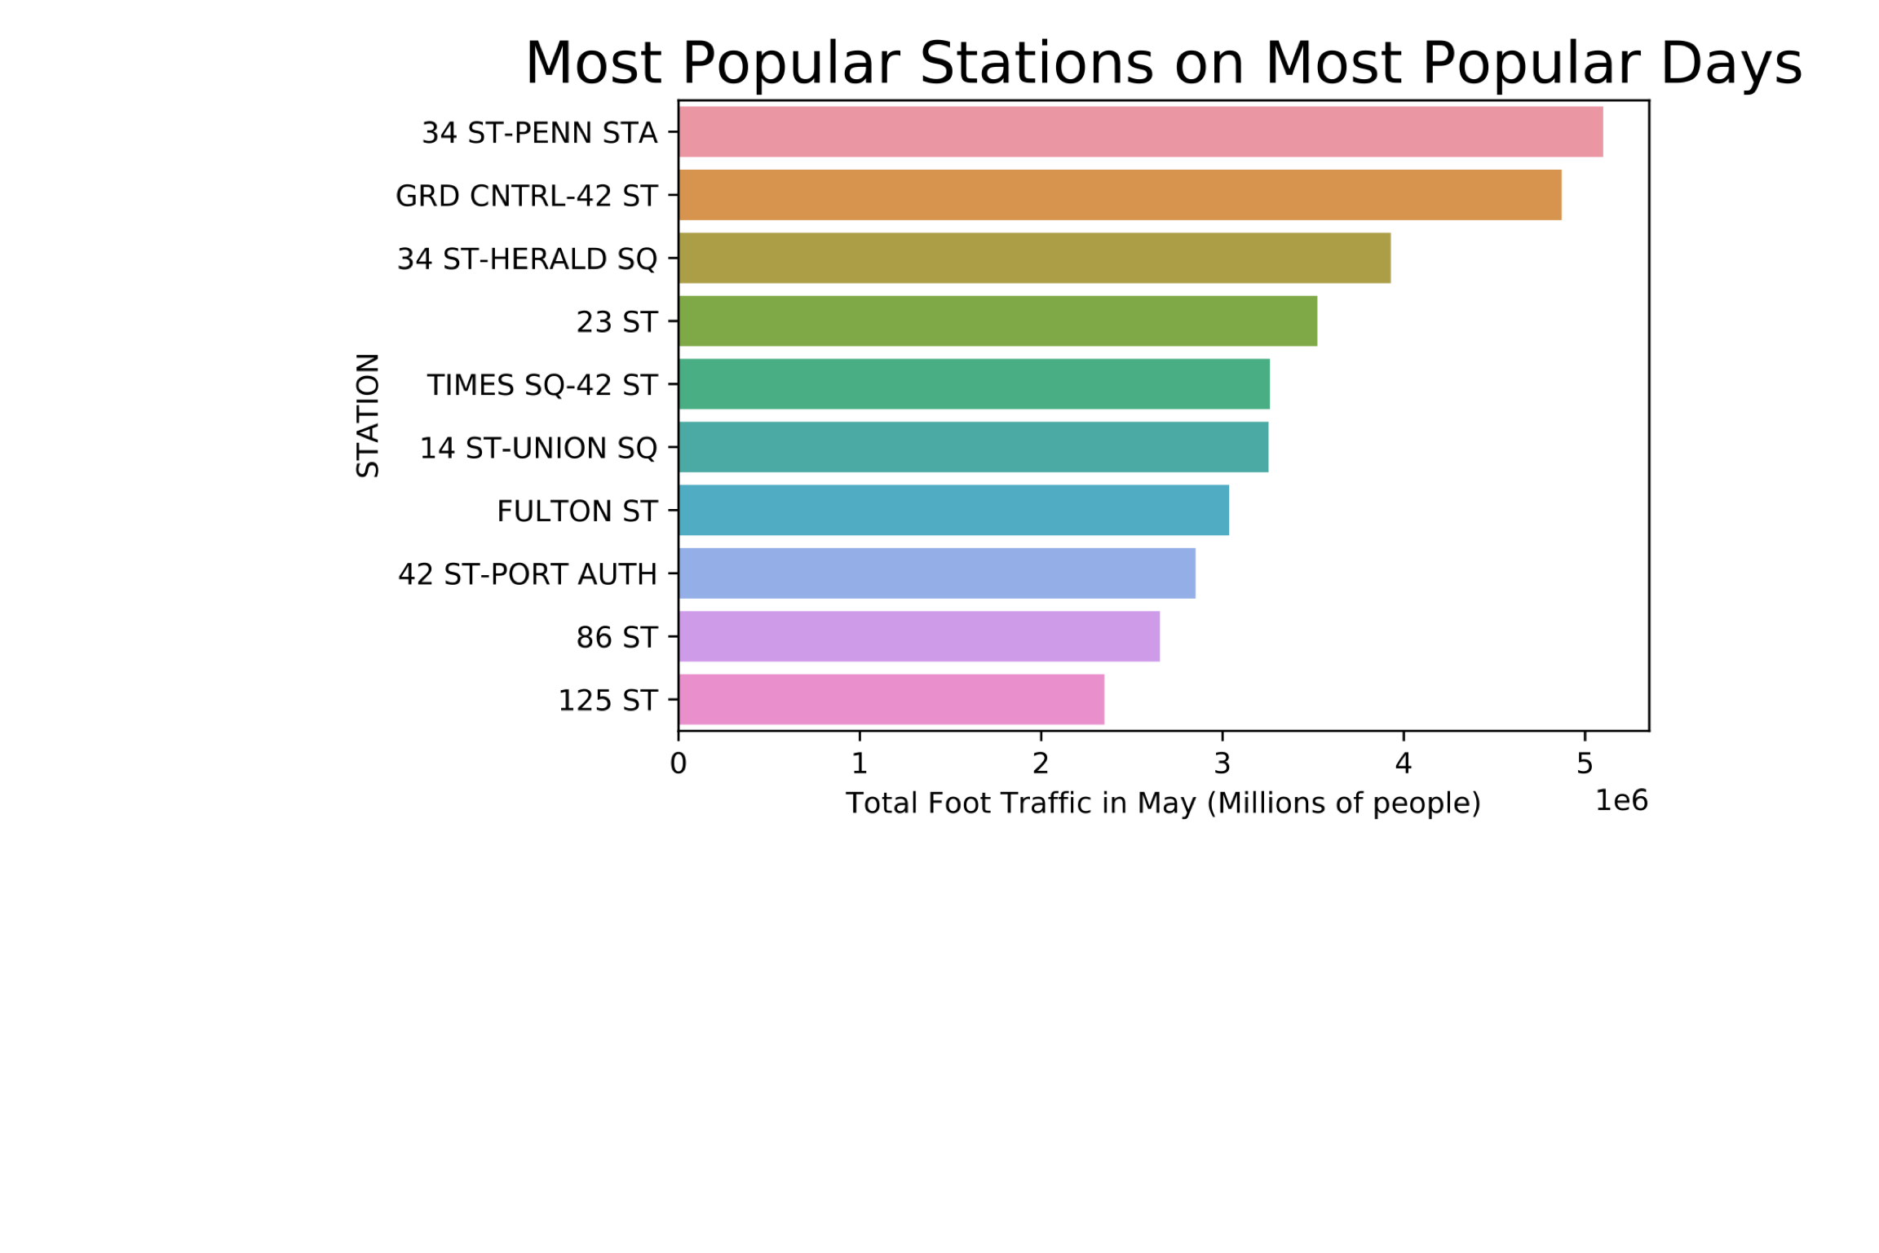
By Station
Large gap between activity for busiest stations and typical station

Slide 8
Conclusions 1-2

Slide 9
Conclusions 1-2

Slide 10
Future Work 1

Slide 11
Appendix

