Slide 1

Project 7
Real-Time Sentiment Analysis

Slide 2
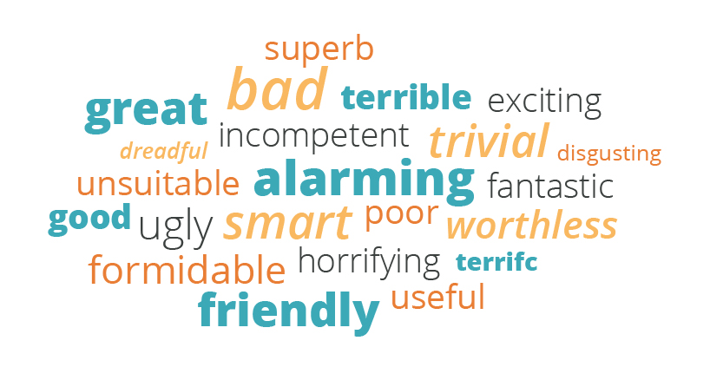

Proof of concept
Sentiment analysis (also known as opinion mining is a text analysis technique that detects polarity (e.g. a positive or negative opinion) within text, whether a whole document, paragraph, sentence, or clause
Why Is Sentiment Analysis Important?
Sentiment analysis, however, helps businesses make sense of all this unstructured text by automatically understanding, processing, and tagging it
Sentiment analysis can identify critical issues in real-time:
is a phenomenon on social media escalating? Is an angry customer about to churn? Sentiment analysis models can help you immediately identify these kinds of situations

Slide 3
Architecture
the program will be responsible for retrieving the tweets linked to specified keywords through a graphical interface, in real time, then assigning each of these tweets a score which requires knowing the polarity of the message; That is, whether the author of the tweet wanted to express a positive feeling (eg joy) or a negative feeling (such as worry),
features extraction and training using NLTK packages
API [twitter+ facebook +youtube+instagramm]
-tokenisation
-Normalisation
-suppress white noise
-Model building(classification) and testing
-results
Text ,tweet ,posts… from
The graphical interface will be carried out with the Tkinter ,Matplotlib module will be helpful in visualize data (plot of
Create a graphical interface

Slide 4
ML Performance
Supervised learning method
classification
Naïve Bayes classification

Slide 5
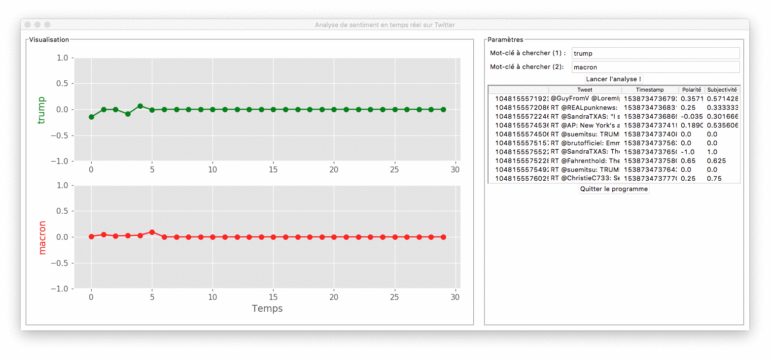
Demo
can be used for :
Social Media Monitoring
Brand Monitoring
Voice of customer
Customer Service
Market Research

