Slide 1
DEMAND extrapolation
Item 1
Purchase date
Purchase date
Purchase date
Sales
… | 1 | 0 | 0 | 0 | 0 | 0 | 0 | 1 | 0 | 0 | 0 | 0 | 0 | 0 | …
Inventory
0 | 1 | 0 | 0 | 0 | 0 | 0 | 0 | 1 | 0 | 0 | 0 | 0 | 0 | 0 | 0
Item 2
Purchase date
Purchase date
Purchase date
Продажи
… | 0 | 0 | 0 | 1 | 0 | 0 | 0 | 0 | 0 | 0 | 1 | 0 | 0 | 0 | …
Inventory
0 | 1 | 1 | 1 | 1 | 0 | 0 | 0 | 1 | 1 | 1 | 1 | 0 | 0 | 0 | 0

Slide 2

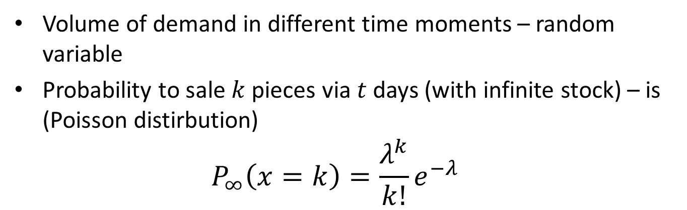

Model of BIRTH and DEATH
Volume of demand in different time moments – random variable
Probability to sale $k$ pieces via $t$ days (with infinite stock) – is (Poisson distirbution)
$$P_{∞}\left(x=k\right)=\frac{λ^{k}}{k!}e^{−λ}$$
Item 1: $λ=1$
Purchase Date
Purchase Date
Purchase Date
Спрос
… | 1 | 0 | 1 | 2 | 0 | 2 | 0 | 1 | 1 | 0 | 3 | 2 | 0 | 1 | …
Item 2: $λ=0.4231$
Purchase Date
Purchase Date
Purchase Date
Спрос
… | 0 | 0 | 0 | 1 | 0 | 1 | 0 | 0 | 0 | 0 | 1 | 0 | 2 | 0 | …

Slide 3

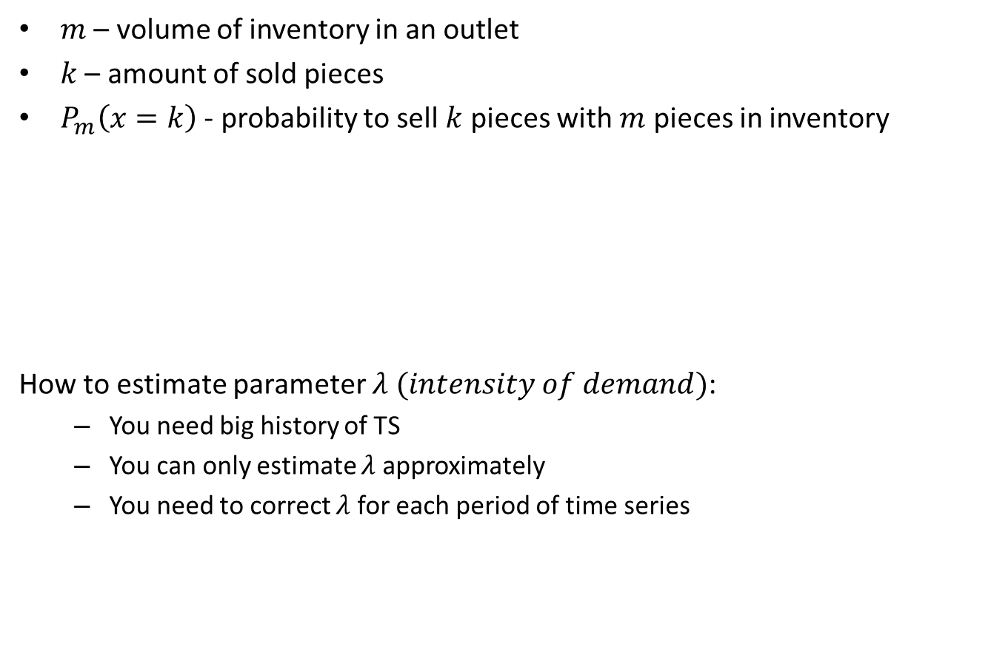
DEMAND extrapolation: Model of BIRTH and DEATH
$m$ – volume of inventory in an outlet
$k$ – amount of sold pieces
$P_{m}\left(x=k\right)$ - probability to sell $k$ pieces with $m$ pieces in inventory
How to estimate parameter $λ (intensity of demand)$:
You need big history of TS
You can only estimate $λ$ approximately
You need to correct $λ$ for each period of time series
$$P_{m}\left(x=k\right)=\left\{\begin{aligned}&\frac{{\left(λ\right)}^{k}}{k!}e^{−λ}, 0≤k<m, \\ &0, k>m или k<0, \\ &1−\sum_{l=0}^{m−1}{\frac{{\left(λ\right)}^{l}}{l!}e^{−λ} }, k=m.\end{aligned}\right.$$
Processes of birth and death http://sci.alnam.ru/book_otsp.php?id=58

Slide 4
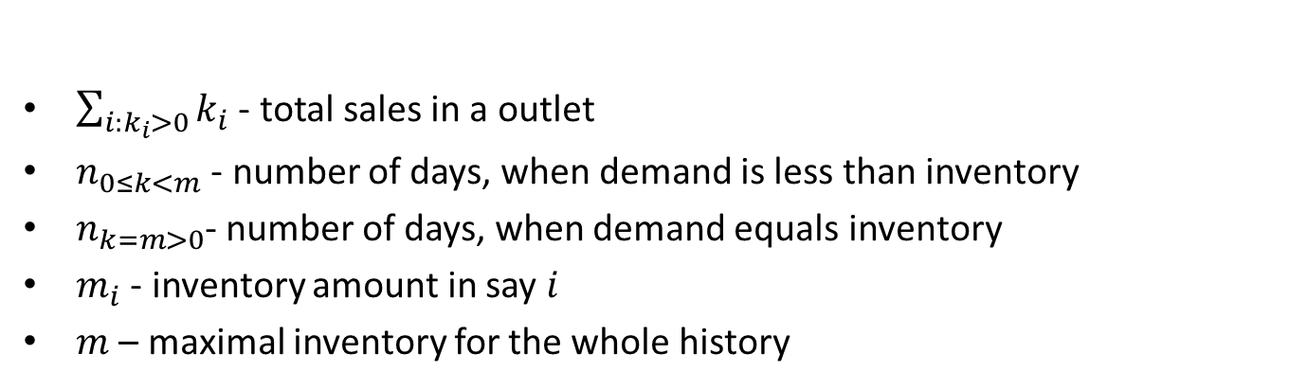
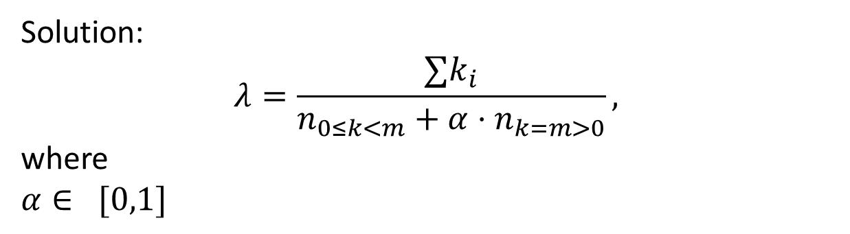
ML Estimation of demand intensity
$\sum_{i:k_{i}>0}{k_{i}}$ - total sales in a outlet
$n_{0≤k<m}$ - number of days, when demand is less than inventory
$n_{k=m>0}$- number of days, when demand equals inventory
$m_{i}$ - inventory amount in say $i$
$m$ – maximal inventory for the whole history
$$\ln{L}=\ln{λ}⋅\sum_{i:k_{i}>0}{k_{i}}−λ⋅n_{0≤k<m}+\sum_{i: k_{i}=m_{i}>0}{\left(1−\sum_{l=1}^{m_{i}}{\frac{{\left(λ\right)}^{l}}{l!}e^{−λ} }\right)}→\max_{λ>0}{ }$$
Solution:
$$λ=\frac{∑k_{i}}{n_{0≤k<m}+α⋅n_{k=m>0}},$$
where
$$α∈ [0,1]$$
Notes:
На самом деле оценка такая
$$λ=\frac{\sum_{i:{0≤k}_{i}≤m_{i}}{k_{i}}}{n_{{0≤k}_{i}<m_{i}}+\sum_{i:k_{i}= m_{i}>0}{\left(1−θ_{m_{i}, λ}\right)}}$$
Где $θ_{m_{i}, λ}$ - показатель экспоненты при оценке хвоста разложения $e^{λ}$ до $m_{i}$ члена по формуле Тейлора
Решение оптимизационной задачи:
воспользуемся разложением Тейлора:
$$1−\sum_{l=0}^{m_{i}−1}{\frac{{\left(λ\right)}^{l}}{l!}e^{−λ} }=\sum_{l=m_{i}}^{∞}{\frac{{\left(λ\right)}^{l}}{l!}e^{−λ}}=\frac{{\left(λ\right)}^{m_{i}}}{m_{i}!}e^{θλ}e^{−λ}=\frac{{\left(λ\right)}^{m_{i}}}{m_{i}!}e^{θλ}e^{−λ},$$
где $θ$ – параметр, зависящий от $λ$ и $m_{i}$.
подставим в оптимизационную задачу:
$$\ln{λ}⋅\sum_{i:{0≤k}_{i}<m_{i}}{k_{i}}−λ⋅n_{{0≤k}_{i}<m_{i}}+\sum_{i:k_{i}= m_{i}>0}{\ln\left(\frac{{\left(λ\right)}^{m_{i}}}{m_{i}!}e^{θ_{m_{i}, λ}λ}e^{−λ}\right)}=\ln{λ}⋅\sum_{i:{0≤k}_{i}<m_{i}}{k_{i}}−λ⋅n_{{0≤k}_{i}<m_{i}}+\sum_{i:k_{i}= m_{i}>0}{\left(k_{i}⋅\ln{λ}+\left(θ_{m_{i}, λ}−1\right)⋅λ\right)}+C$$
$$\ln{L}= \ln{λ}⋅\sum_{i:{0≤k}_{i}≤m_{i}}{k_{i}}− λ⋅\left(n_{{0≤k}_{i}<m_{i}}+\sum_{i:k_{i}= m_{i}>0}{\left(1−θ_{m_{i}, λ}\right)}\right)+C$$
$$\frac{∂\ln{L}}{∂λ}=\frac{\sum_{i:{0≤k}_{i}≤m_{i}}{k_{i}}}{λ}−\left(n_{{0≤k}_{i}<m_{i}}+\sum_{i:k_{i}= m_{i}>0}{\left(1−θ_{m_{i}, λ}\right)}\right)=0$$
$$λ=\frac{\sum_{i:{0≤k}_{i}≤m_{i}}{k_{i}}}{n_{{0≤k}_{i}<m_{i}}+\sum_{i:k_{i}= m_{i}>0}{\left(1−θ_{m_{i}, λ}\right)}},$$
где $n_{{0≤k}_{i}<m_{i}}$ – это количество дней, где был ненулевой остаток и при этом не весь остаток был распродан, но при этом остаток на складе был равен 1.

Slide 5
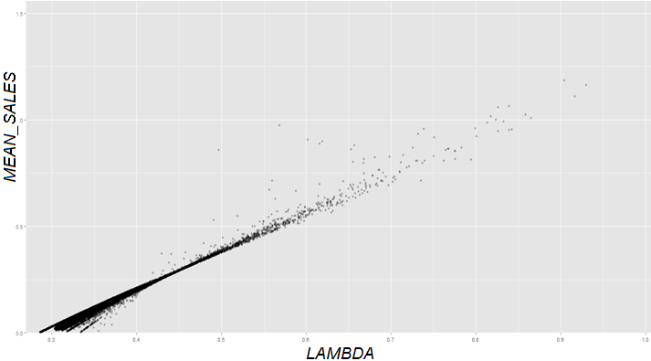
Intensity of DEMAND VS MEAN SALES

Slide 6
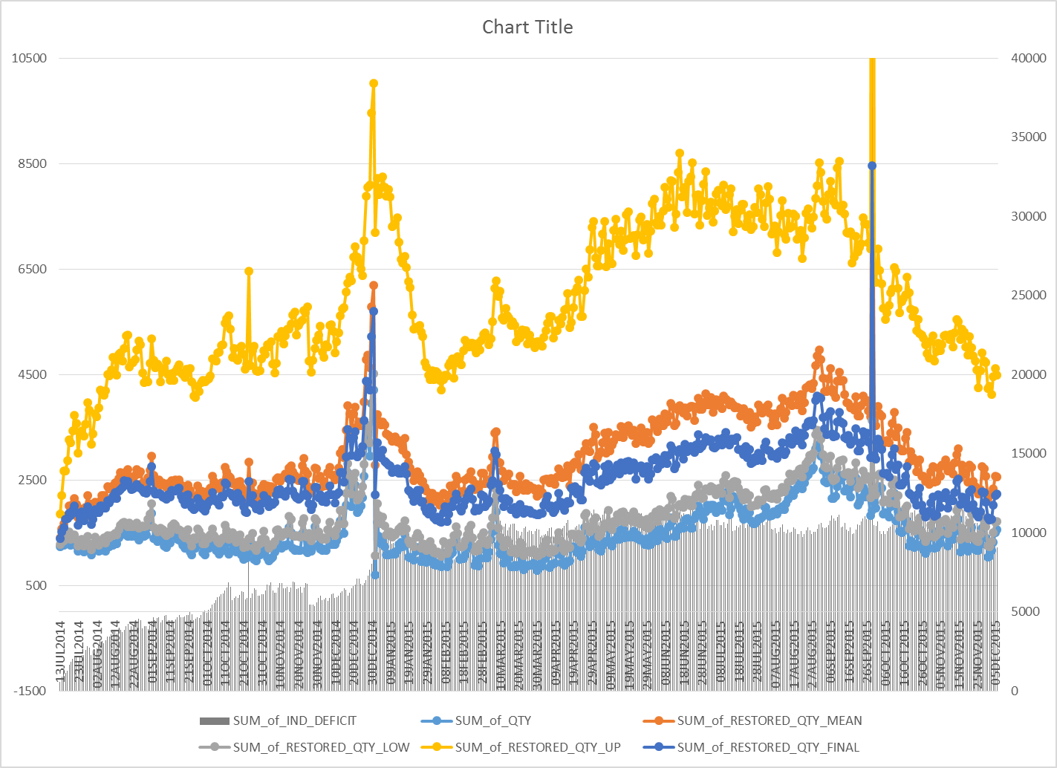
EXTRAPOLATED DEMAND VS SALES
Notes:
Реальные продажи и восстановленный спрос в зависимости от разных оценок параметра \alpha

