Slide 1


Principles & Practices
of Open Research
An online module for undergraduate and
Masters students

Slide 2

What is
pre-registration

Slide 3



What is pre-registration?
Time-stamped
A time-stamped record of research processes and decisions
Created in advance
Created and shared before data are collected or become accessible
Made publicly available
The pre-registration document should be publicly available on a registry or repository

Slide 4





How is this different to an ethics application?
For many research projects you will need to submit an ethics application
This is typical for studies involving people, existing data, and in the sciences
How is a pre-registration different to an ethics application?
Pre-registrations and ethics applications contain much of the same information, but they serve different aims

Slide 5


Slide 6
Principles & Practices
of Open Research
An online module for undergraduate and
Masters students

Slide 7
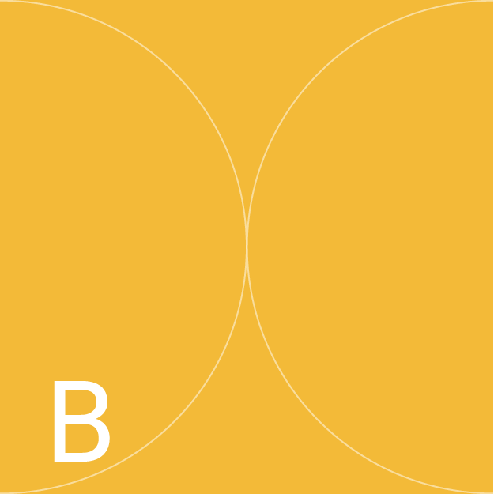
Why is
pre-registration important?

Slide 8
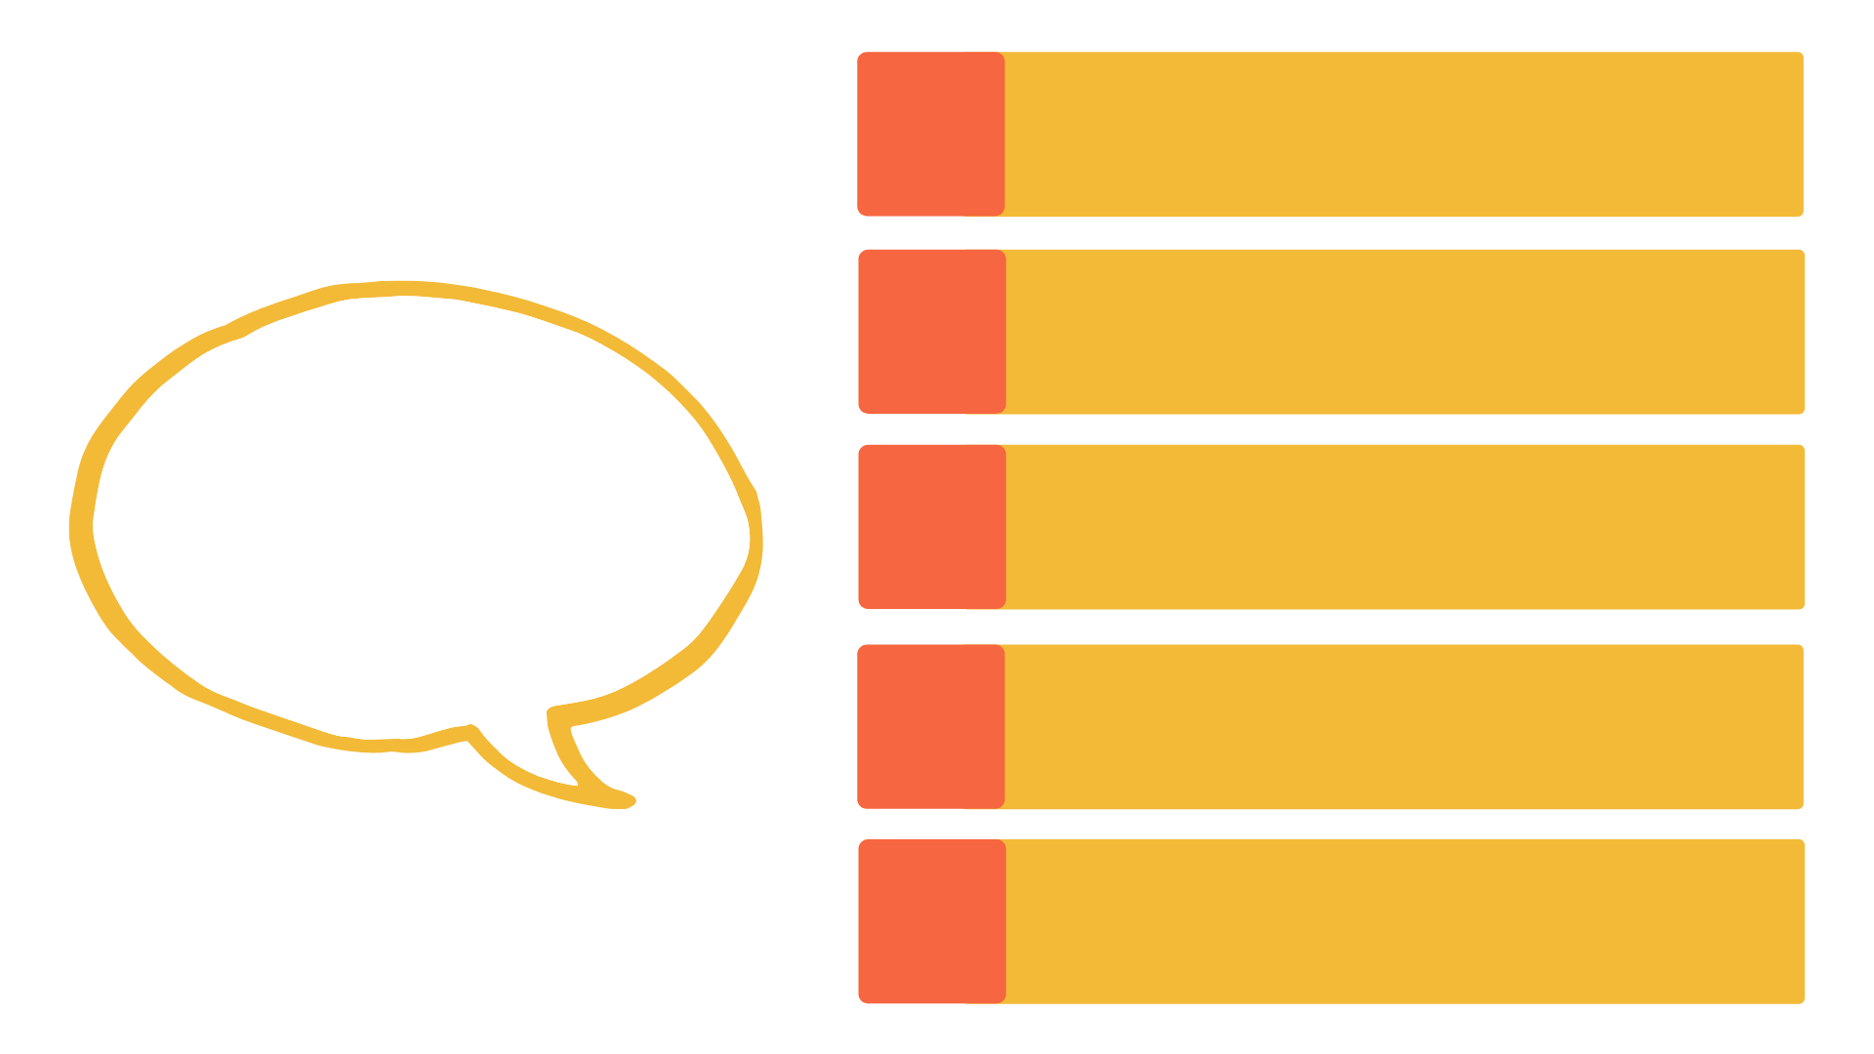
Why is pre-registration important?
It encourages researchers to identify the goals of their project before collecting data or starting analysis
1
2
It creates accountability in research
Why is
pre-registration important?
Why is
pre-registration important?
It discourages researchers from conducting after-the-fact analyses to find significant/novel/exciting results
3
4
It helps researchers manage the personal biases that might influence their research
5
It makes research findings easier to locate

Slide 9
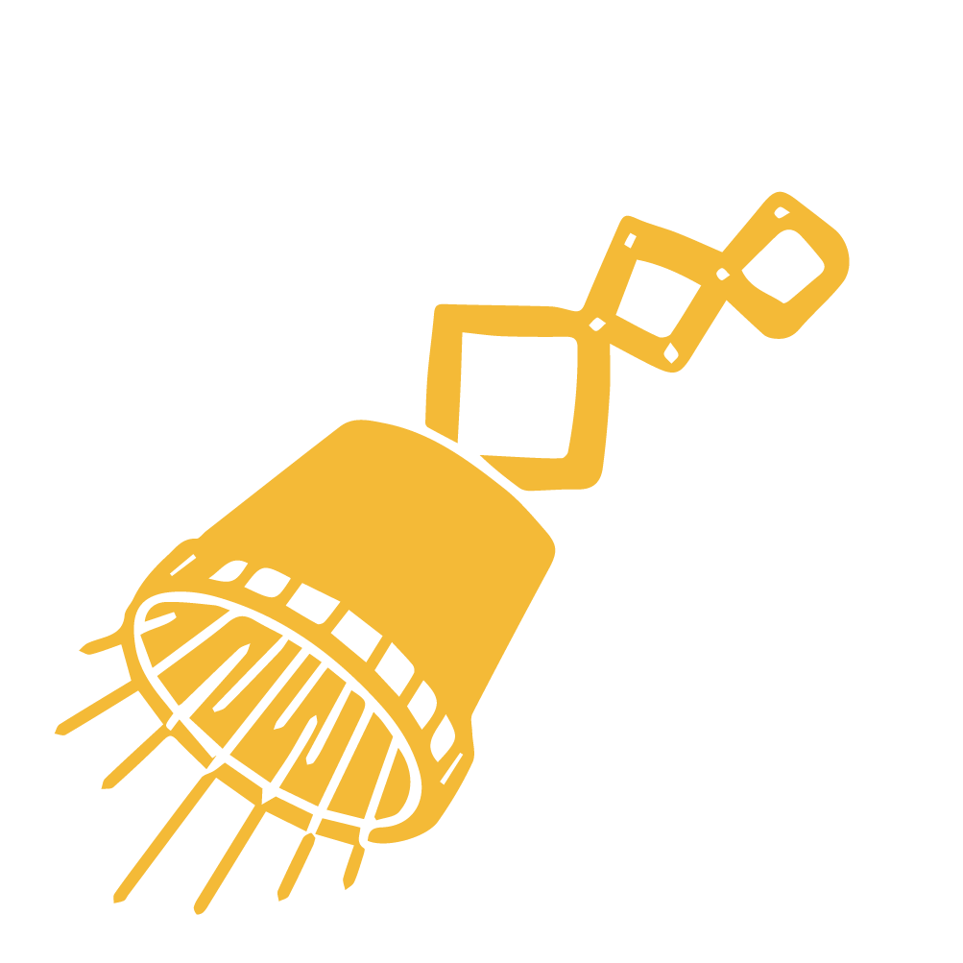




Why should you pre-register your study?
It builds your
reputation as a researcher and allows you to take credit for your ideas and plans
Pre-registration is easy once you have learnt how to do it
You may also be able to earn a digital badge for pre-registering your study!
These are offered by
over 60 research journals in multiple disciplines

Slide 10


Why aren’t all studies pre-registered?
But challenges do not mean it can’t be done!
Pre-registration might
present challenges for some types of research, like exploratory research or secondary analyses

Slide 11




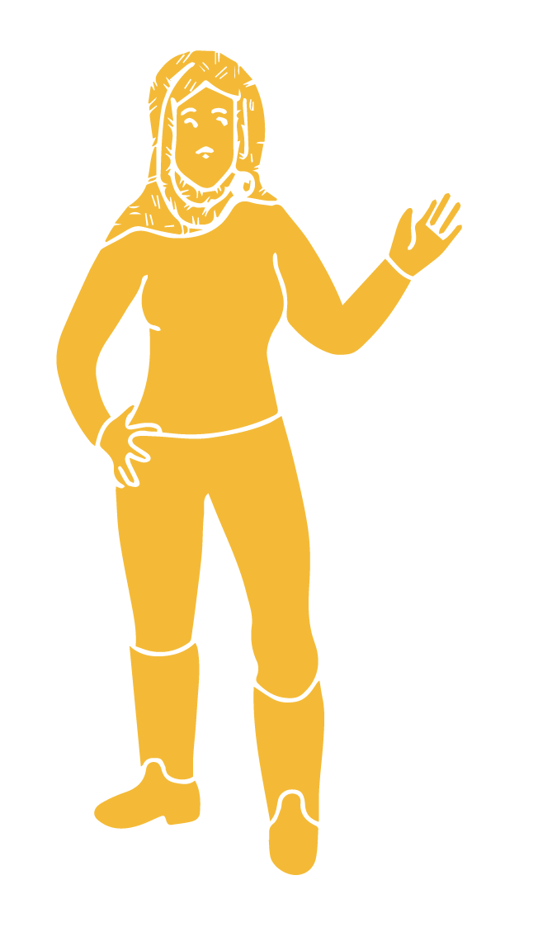
Why aren’t all studies pre-registered?
Pre-registration takes time, planning and figuring out requirements for pre-registration for the target repository
Some researchers think pre-registration is not applicable or appropriate for more constructivist research
But being transparent about what we plan to do before we begin our research projects is important for any type of research

Slide 13
Principles & Practices
of Open Research
An online module for undergraduate and
Masters students

Slide 14

How do you pre-register a study?

Slide 15

Pre-registering Your Study
And what if I want to change my research plan?
It sounds like a lot of work

Slide 16



Pre-registering Your Study
Your pre-registration is
the research plan you will put together with your supervisor and/or for ethics approval
There are lots of
resources and templates you can use to pre-register; this makes it much easier!
So, you will be doing much of the work anyway!

Slide 17


Pre-registering Your Study
You can also update
your pre-registration up until you begin data analysis.
Your pre-registration will outline how you plan to conduct your study, and can be amended- up to a point

Slide 18


Pre-registering Your Study
Okay, sounds good -- so how do I
actually do it?

Slide 19





How do you pre-register a study?
To pre-register your study you need to decide the following in advance
  Your study design and methods
  How you will collect your data
  How you will analyse your data

Slide 20
How do you pre-register a study?
1
You should have a clear plan including all the relevant information and details
2
You then need to decide where you are going to pre-register your study
Different pre-registration platforms will provide templates for pre-registering your study
3
Templates are meant to serve as a guide because pre-registration may require some flexibility
4

Slide 21
How do you pre-register a study?
Different disciplines may require different methods for pre-registration
A list of discipline-specific templates is included in the Additional Resources section
This is not an exhaustive list and there may be other applicable templates

Slide 22



Pre-registering on OSF
OSF (Open Science Framework) is a popular repository (platform) for pre-registering projects
For this reason, PaPOR TRaIL focuses on OSF for pre-registration

Slide 23
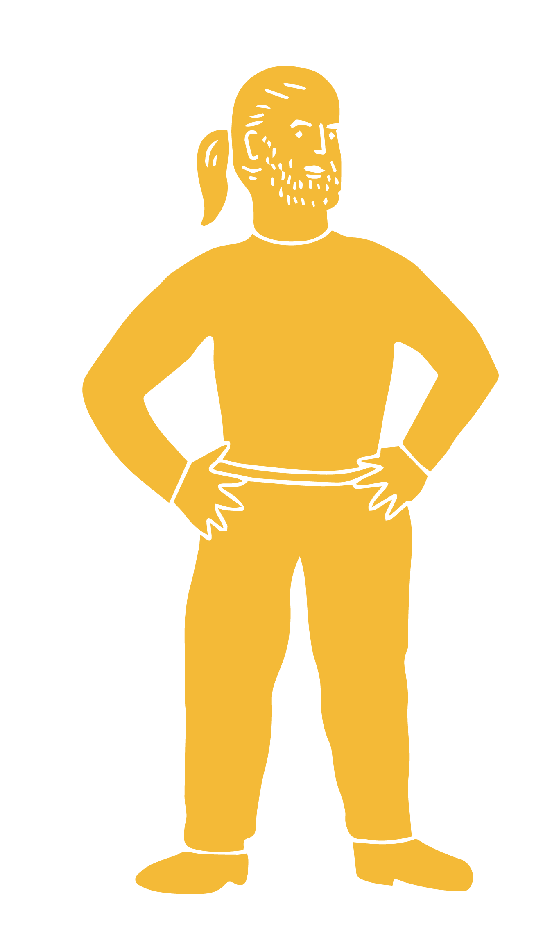
Pre-registering on OSF
A complete guide to pre-registering projects on OSF is available on their website here
A brief overview is presented on the next slide
Remember, another platform may be more suitable for you, but for this course we are just focusing on OSF

Slide 24
Pre-registering on OSF
Include your research plan. This is your research design/approach, and how
you will collect and
analyse data
Preview and review your pre-registration
Select to ‘start a new-pre-registration
1
2
3
4
5
6
7
Set up an account on the Open Science Framework
Include your project title and a description
(this is called your ‘metadata’)
Register it and make it public. You can make it immediately public or public at a later date.
You can add attachments if you need more space or have additional components to share

Slide 25
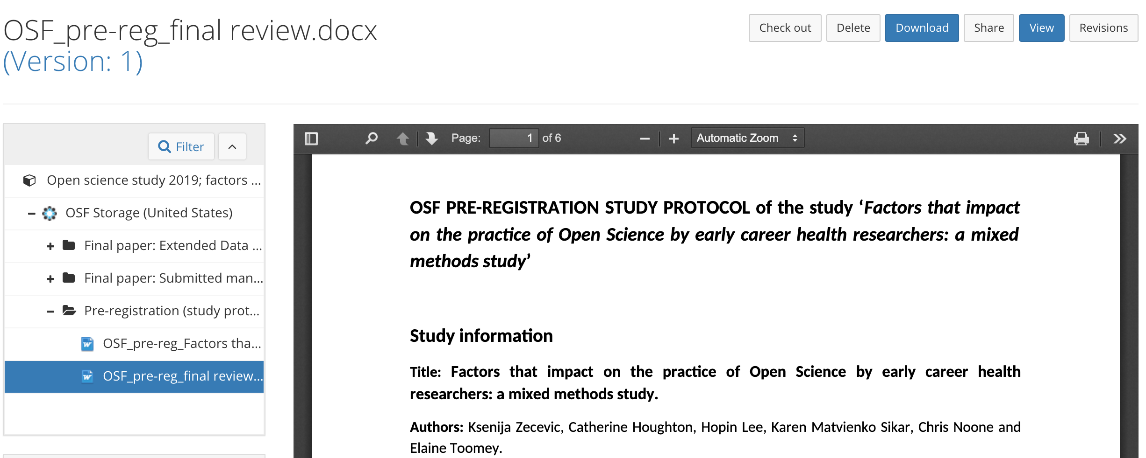
Pre-registering on OSF: The finished project
The full pre-registration of this study is included in the resources for your reference

Slide 27
Principles & Practices
of Open Research
An online module for undergraduate and
Masters students

Slide 28

What is a registered report?

Slide 29


What is a registered report?
Typically when we want to publish a paper we submit it to a journal after the study is finished
There is evidence that studies with significant, novel or exciting findings are more likely to get published
The journal and its peer-reviewers then decide if the study can be published in that journal

Slide 30
What is a registered report?
Registered reports are research papers outlining the proposed study methods and approach
1
What are registered reports?
The potential for publication of these papers is evaluated by the journal before any data collection
2
This means they are evaluating the proposed study methods, rather than the findings
3

Slide 31
What is a registered report?
Stage 1
Stage 2
Stage 2
Researchers submit their research question(s), theory, hypotheses, detailed methods, analysis plans, and any existing data.
Studies are then reviewed.
If the review is favourable, the study receives an in-principle acceptance and is registered in a repository.
Researchers then submit completed manuscripts, including:
1. A justification for the work
2. The approved protocol from Stage 1
3. Results, discussion, and any exploratory analyses
The research is conducted

Slide 32
How do you publish a registered report?
Plan your study
Submit study proposal to journal
Proposal will be reviewed
Do the study
Publish the final paper in the journal
Receive and respond to feedback
If accepted

Slide 33
Why are registered reports important?
They put the focus on the research question and the methodological quality of the study
1
Why are registered reports important?
They alleviate perceived pressures to obtain significant or exciting results, and to publish
2
Many journals are starting to adopt registered reports as standard practice
3

Slide 34

Complete an activity on Canvas.
There are 3 to choose from depending on what research stage you are currently at.
You must complete at least one activity, but you can complete more if you like!

Slide 36
Principles & Practices
of Open Research
An online module for undergraduate and
Masters students

Slide 37
Additional Resources

Slide 38
Want to know more about...
The purpose of pre-registering a study?
Take a look at this short introductory video on pre-registration: Introduction to Pre-registration
Read this newspaper article titled: Trust in science would be improved by study pre-registration
Read about: Seven Selfish Reasons for Pre-registration
And this brief outline of why pre-registration is “A Plan, Not a Prison”

Slide 39
Want to know more about...
How to pre-register?
Pre-registration and Registered Reports: A primer from UKRN
Additional resources on Pre-registration are also available through the Center for Open Science
What journals give a digital badge for pre-registration?
See OSF-Badges for this list
How to navigate OSF?
This short video on Getting started with OSF: Sign up, navigate OSF, register your study

Slide 40
Supplemental Reading
The benefits of registered reports and pre-registration, including for students:
Pownall, M. (2020, February 24). Pre-Registration in the Undergraduate Dissertation: A Critical Discussion. https://doi.org/10.31234/osf.io/egbcv
Hobson, H. (2019). Registered reports are an ally to early career researchers. Nature Human Behaviour, 3, 1010.
Nosek, B.A., Beck, E.D., Campbell, L., Flake, J.K., Hardwicke, T.E., Mellor, D.T., van 't Veer, A.E., & Vazire, S. (2019). pre-registration Is Hard, And Worthwhile. Trends in Cognitive Sciences, 23(10), 815-818. https://doi.org/10.1016/j.tics.2019.07.009

Slide 41
Supplemental Reading
On the uses, pitfalls, and potential successors to the Pre-registration model:
Yamada, Y. (2018). How to Crack Pre-registration: Toward Transparent and Open Science. Frontiers in Psychology, 9, 1831. https://doi.org/10.3389/fpsyg.2018.01831
On the role of pre-registration in improving the integrity of research, even when data is pre-existing:
Nosek, B. A., Ebersole, C. R., DeHaven, A. C., & Mellor, D. T. (2018). The Pre-registration revolution. Proceedings of the National Academy of Sciences of the United States of America, 115(11), 2600–2606. https://doi.org/10.1073/pnas.1708274114

Slide 42
Supplemental Reading
On the benefits and appropriateness of pre-registration in qualitative studies:
Haven, T.L., & Van Grootel, L. (2019). pre-registering qualitative research. Policies and Quality Assurance, 26(3), 229-244. https://doi.org/10.1080/08989621.2019.1580147
On the role of pre-registration in improving the integrity of research, even when data is pre-existing:
Nosek, B. A., Ebersole, C. R., DeHaven, A. C., & Mellor, D. T. (2018). The Pre-registration revolution. Proceedings of the National Academy of Sciences of the United States of America, 115(11), 2600–2606. https://doi.org/10.1073/pnas.1708274114

