Slide 1


Principles & Practices
of Open Research
An online module for undergraduate and Masters students

Slide 2

Module 3 – Research Data Management
What is research data?

Slide 3
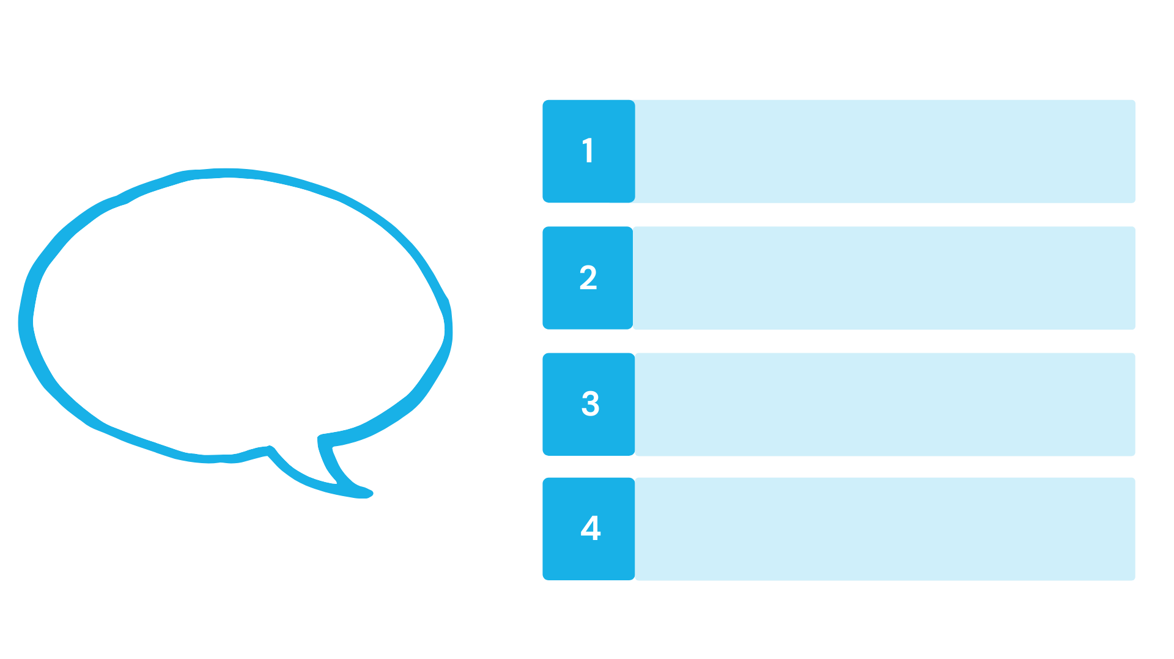





What is research data?
Research data is the information underlying research findings.
  It is all information
  collected, observed, recorded or created throughout the research process

Slide 4

What is research data?
Data can be quantitative or qualitative and can exist in different formats
Notes
Videos
Applications
Audio
Spreadsheets
Dialogue/
spoken word
Images
Code
Performances
Algorithms
Music
Artefacts

Slide 5


Slide 6
Principles & Practices
of Open Research
An online module for undergraduate and Masters students

Slide 7
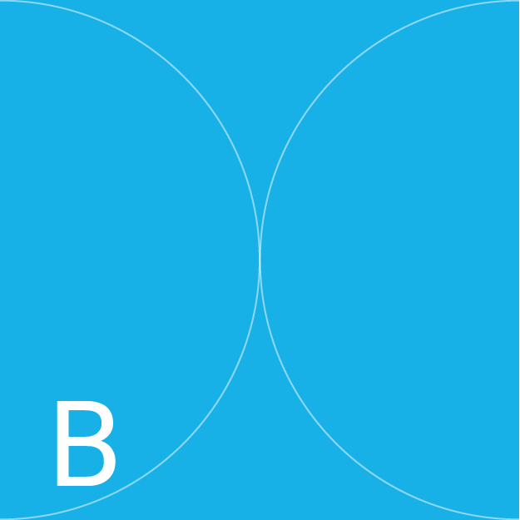
Module 3 – Research Data Management
Open Research Data: What, Why & How?

Slide 8





What is open research data?
  Open data is data that is made publicly available without any restrictions
  It is data that is available to anyone to access, use and share
  The FAIR Principles and data management plans enable open data sharing
  Making data openly available reinforces the principles of open research

Slide 9

What is open research data?
1
It enables others to verify and/or reuse your data
2
You may be able to use openly available data in your own research
Why is open data important?
3
When you make your data available on an online repository it has a Digital Object Identifier (DOI) that you can cite as an output of your research
4
Making data open and/or using open data enhances opportunities for collaborations
5
Research funders and journals are increasingly adopting open research practices- so this may be important for you in the future

Slide 11
Principles & Practices
of Open Research
An online module for undergraduate and Masters students

Slide 12

Module 3 – Research Data Management
How can I make my data open?

Slide 13
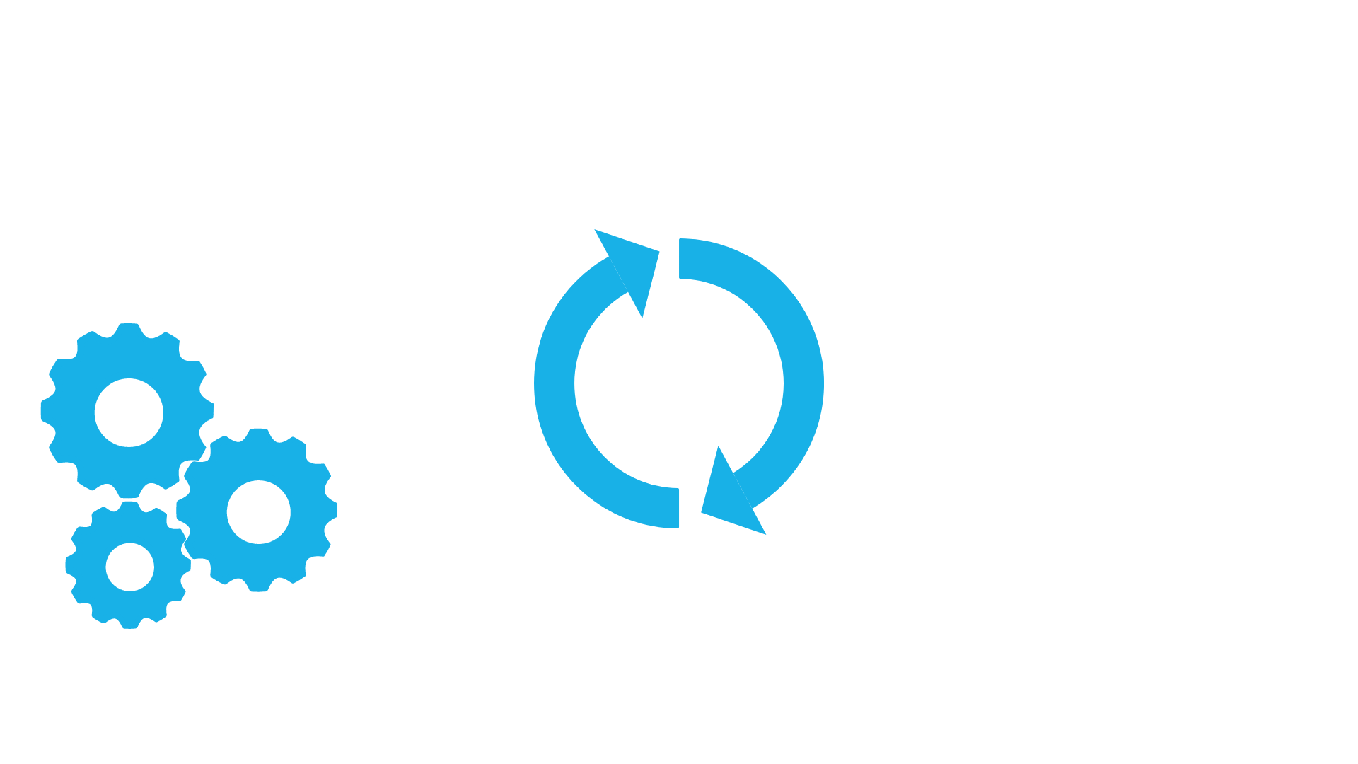
How can I make my data open?
A good place to start is the FAIR Data Principles
The FAIR principles outline the importance of making data:
Findable
Accessible
Interoperable
Reusable

Slide 14




The FAIR Principles
This enables and supports sharing of research data
The FAIR principles provide a framework for research data management
They also facilitate control over access to datasets that need to be protected
Where required, data can be as open as possible but also as closed as necessary

Slide 15



The FAIR Principles
The best way to implement FAIR principles is to develop a data management plan yourself!
With FAIR you can make your data Findable, Accessible and Reusable by yourself
Making it Interoperable will require additional supports

Slide 16
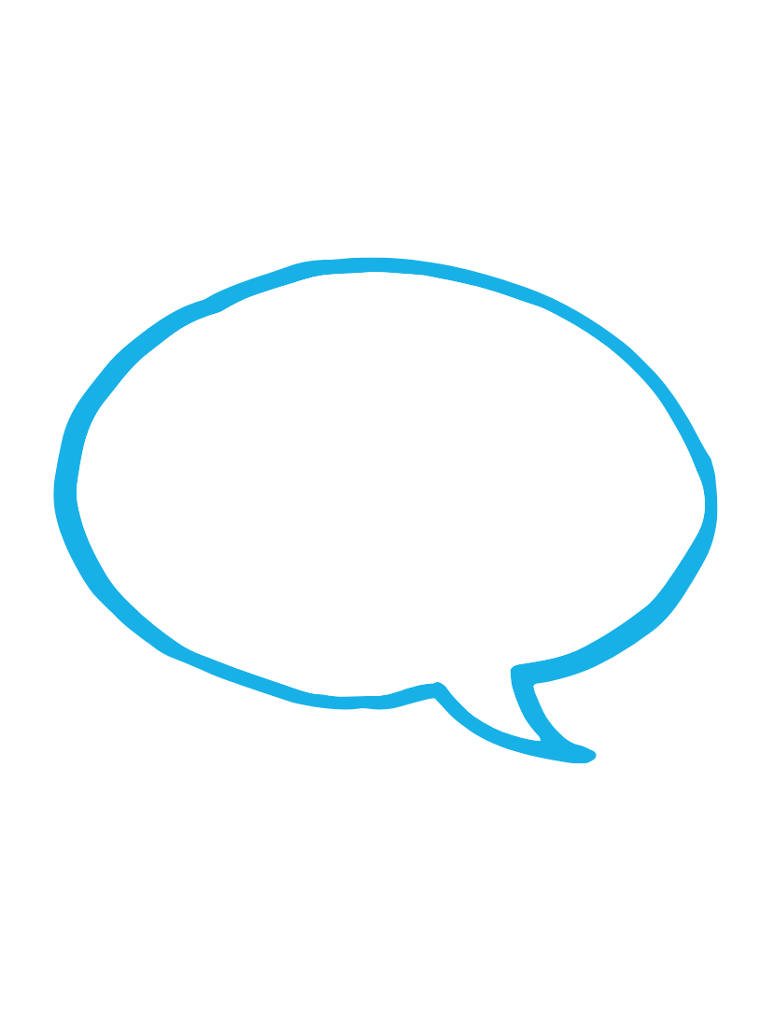

Why are the FAIR Principles important?
Sharing data according to FAIR Principles helps ensure that others have enough information to verify or reuse your data
1
Why are FAIR Principles important?
2
They help to make your data more transparent
3
They help to make your data more reusable
4
They help to make your research more reproducible (see module 4)

Slide 17



Why isn’t all research data open?
Data may be sensitive
in nature (i.e. the location of endangered species) or it may be impossible to completely anonymise. It may also not be appropriate for reuse.
Data might also not be
made open because the researcher did not get informed consent to use participant data in this way.
Not all data can be made publicly available due to ethical, privacy, safety or legal considerations

Slide 18


Why isn’t all research data open?
With this in mind, the FAIR Principles allow for ‘closed’ data...
...and include the caveat
that data should be ‘as open as possible but as closed as necessary’

Slide 19



What about qualitative data?
Qualitative data, from interviews for instance, can be of an intimate nature, and sensitive information may
be disclosed
In addition, the public
are not always clear about or comfortable with qualitative data sharing
So it is important to
clearly outline data sharing procedures when gaining informed consent

Slide 20

What about qualitative data?
It is also important to
practice data minimisation. This means not collecting more information than is strictly needed
And it is important to replace information that could be used to identify individuals with a pseudonym

Slide 22
Principles & Practices
of Open Research
An online module for undergraduate and Masters students

Slide 23

Module 3 – Research Data Management
Data Management

Slide 24
What is data management?
Data management is a series of processes employed throughout the research cycle to manage data.
Plan
Re-use
Create
Data
Life-cycle
Share
Process
Preserve
Analyse

Slide 25
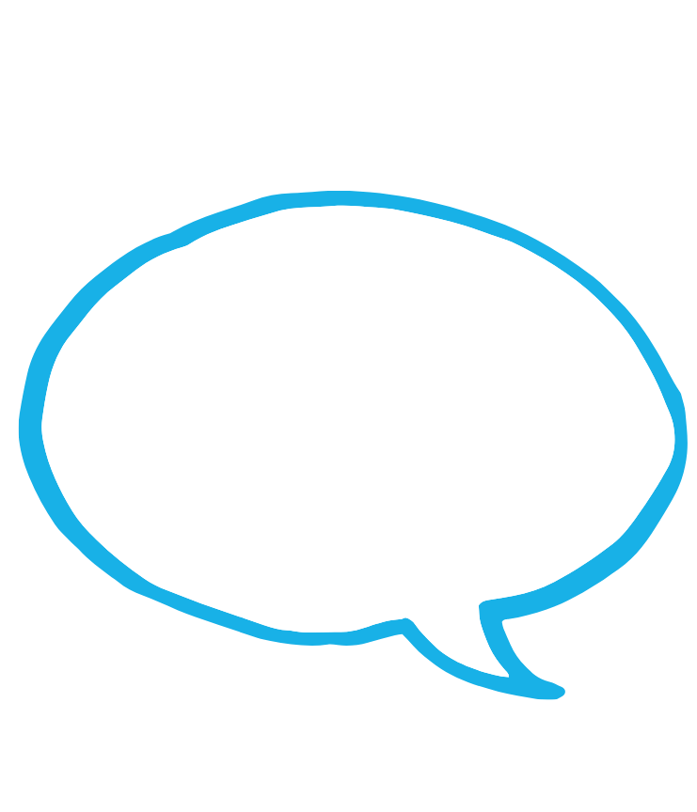
Why is data management important?
1
It helps you keep track of your own work and
protect against data loss
2
It increases research efficacy
Why is data management important?
3
It minimises errors and data omission
4
There are funding and publishing incentives
for good data management
5
There are institutional and legal requirements for good data management
6
Data management enables and facilitates sharing of research data as FAIR and open data

Slide 26
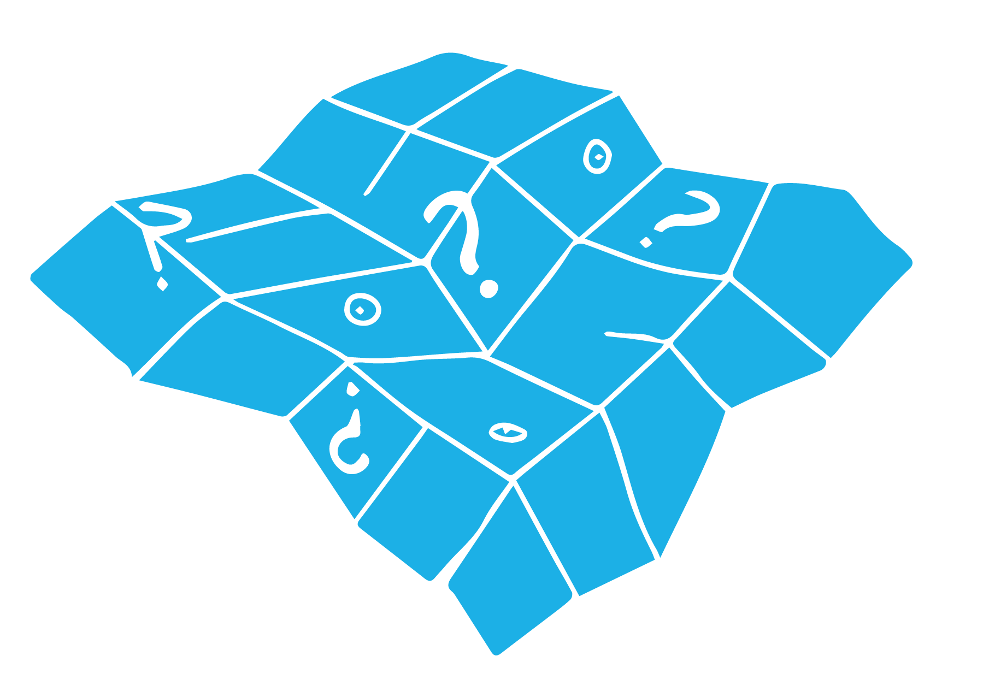

What is a data management plan?
  It is a living document which is developed at the outset of a research project and updated throughout
  It details how data will be organised, managed, stored while the project is active and how it will be preserved and shared (if relevant) once the study is over
It is a core “good research practice” and ensures research reproducibility
It is important to familiarise yourself with data management plans early in your research journey

Slide 27
Why is data management important?
1
They set out transparent data practices for the
research project
2
They make it easy to find and understand your data when you need to use it
Why are data management plans important?
They help to avoid unnecessary duplication (e.g. recollecting data)
3
4
They help you to maintain your data so it can
be validated by other researchers
5
They help you remember what you did and
what you plan to do with your data
6
Well-managed research data can also be another output from a project - which is good for your CV!

Slide 28
Things to Consider When Making a Data Management Plan
What are the ethical requirements for your data?
Can/will you share your data, and if so, how?
How will you collect your data?
Data Management Plan
How will you store and back up your data?
What metadata and/or other documentation can go with your data?

Slide 29


Think About the Data Before Collecting Any
Think in terms of the type, volume and frequency of data
The first question you should think about is what type of data will I be collecting during my project?

Slide 30


What is metadata?
  Metadata is data about your data
  It can be contextual information provided with your data (i.e. variable names, types of measurement)
abc
It can include things like keywords to help people find your data
These give your data meaning and make them findable and reusable

Slide 31
How do you create a data management plan?
Use these 6 headings to begin drafting a data management
plan:
1
Data Collection
4
Legal & Ethical Considerations
2
Documentation and Metadata
5
Data Sharing & Long-term Preservation (FAIR & Open Data)
3
Storage and Back-up during Active Research
6
Data Management Responsibilities

Slide 32
How do you create a data management plan?
Take a look at our data management template to get a sense of what is required.

Slide 33

Where can I share my data?
Research data can be shared openly in many repositories worldwide
There are lots of examples of repositories where you can make your data openly available
Some are general, e.g:
  Zenodo
  Figshare
  Software Heritage

Slide 34
Where can I share my data?
For specialist data repositories FAIRsharing.org is a good place to start!
Here you can search data repositories according to the kind of data you are working with.

Slide 35
Steps Towards Open Data
Then develop and implement
a data management plan
which includes provision and
plans for making data FAIR
and open
An essential first step
is to discuss what is possible and appropriate for your data with your supervisor

Slide 36

Steps Towards Open Data
Once your data is
collected and the project is finished, review your data and metadata for completeness and quality
Then choose your data repository and upload your data!

Slide 38
Principles & Practices
of Open Research
An online module for undergraduate and Masters students

Slide 39
Additional Resources

Slide 40
Want to know more about. . .
Open data and data repositories?
Take a look at this handy guide on selecting a data repository: OpenAIRE Guide for Researchers: How to Select a Data Repository​
You can read about some concerns and challenges of using open data repositories here: Open data repositories: current risks and opportunities
One researcher’s experience of sharing data?
Don’t worry, its not as scary as the name of this blogpost suggests: Open Science is really scary y’all​

Slide 41
Want to know more about. . .
On the challenges of open data sharing:
This article discusses some perceived barriers to open data sharing in psychology (but is relevant across disciplines):
Houtkoop, B. L., Chambers, C., Macleod, M., Bishop, D. V., Nichols, T. E., & Wagenmakers, E. J. (2018). Data sharing in psychology: A survey on barriers and preconditions. Advances in methods and practices in psychological science, 1(1), 70-85. https://doi.org/10.1177/2515245917751886

Slide 42
Want to know more about. . .
Data management and archiving for qualitative data?
This paper outlines how software like NVivo can be used to manage your qualitative data
You can also check out the Irish Qualitative Data Archive, which provides lots of useful information and resources
Or take a look at the Qualitative Data Repository

Slide 43
Want to know more about. . .
Data management and archiving for qualitative data?
This paper outlines some challenges with making some qualitative data open:
Chauvette et al. (2019). Open data in qualitative research. International Journal of Qualitative Methods, 18; https://doi.org/10.1177/1609406918823863
This paper presents an examination of repository guidelines for sharing qualitative data:
Antes et al. (2018). Examining data repository guidelines for qualitative data sharing. Journal of Empirical Research on Human Research Ethics, 13(1), 61-73. https://doi.org/10.1177/1556264617744121

Slide 44
Want to know more about. . .
Use of spreadsheets for data management?
This is a handy article outlining practical recommendations for organizing spreadsheet data
Broman, K. & Woo, K (2018). Data organization in spreadsheets. The American Statistician, 72(1), 2-10. https://doi.org/10.1080/00031305.2017.1375989

Slide 45
Want to know more about. . .
Discipline-specific Research Data Management?
Take a look at the Science Europe Guidance Document: Presenting a Framework for Discipline-specific Research Data management. This looks like a long document but there is an over-all section, followed by discipline-specific sections that will be of more, or less, relevance to you.

Slide 46
Want to know more about. . .
The use of FAIR Principles?
This article clarifies what FAIRness is, and what it is not:
Mons et al.(2017) ‘Cloudy, Increasingly FAIR; Revisiting the FAIR Data Guiding Principles for the European Open Science Cloud’. Information Services and Use, 49 – 56. https://doi.org/10.3233/ISU-170824
​This article discusses the FAIR principles and presents useful examples of their use:
Wilkinson et al. The FAIR Guiding Principles for scientific data management and stewardship. Sci Data 3, 160018 (2016). https://doi.org/10.1038/sdata.2016.18​

Slide 47
Want to know more about. . .
How research data management, FAIR and Open are related to each other?
This article clarifies presents the overlaps and distinctions between these three concepts:
Higman R, Bangert D and Jones S, “Three camps, one destination: the intersections of research data management, FAIR and Open”, Insights, 2019, 32: 18, 1–9; DOI: http://doi.org/10.1629/uksg.468

Slide 48
Want to know more about. . .
Resources for data management in University College Cork?
The UCC Research Data Service provides information, including videos and resources

