Slide 1


Principles & Practices
of Open Research
An online module for undergraduate and
Masters students

Slide 2

Module 4 – Reproducible Practices
What is reproducibility?

Slide 3

What is research reproducibility?
It means that research is conducted and reported so that another researcher could reach the same results and conclusions using the same approaches
1
What is research reproducibility?
2
It does not mean enabling others to copy research
It is instead intended to allow people to confirm or correct findings through reproducing the methods
3

Slide 4

What is research reproducibility?
If another researcher cannot reproduce the research, this does not necessarily mean the findings aren’t valid
This is because reproducibility does not equal truth
But lack of reproducibility does raise questions about a study’s validity and reliability

Slide 5
What is research reproducibility?
Reproducibility can also be understood as
Methods reproducibility: enough information is
provided about the study methods for it to be repeated
1
2
Results reproducibility: An independent study
obtains the same results using the original methods
3
Inferential reproducibility: Similar conclusions are reached from replicated findings

Slide 6



Reproducible Research Practices
Reproducible research involves:
Sharing data and research procedures
Making these available for public/peer evaluation
Taking steps in the study design process to minimize bias

Slide 7





Reproducibility Across Disciplines
The concept of reproducibility
was developed in science and is primarily orientated around quantitative data
It has traditionally focused on how we can go from a data set, visualise the information, and demonstrate the analyses that are applied
All of which can be achieved using reproducible, scripted workflows
So reproducibility may reflect scientific assumptions that do not translate easily to other disciplines

Slide 8



Reproducibility Across Disciplines
So what about qualitative
research, and/or research conducted in social sciences,
arts and the humanities?
Exact data replication may not be possible or even advantageous in some cases.
Ethical commitments may prevent the sharing of complete datasets.

Slide 9

Reproducibility Across Disciplines
The relationship between researcher and participant
Sample characteristics
The amount and kinds
of data that can be disclosed in qualitative and social research may depend on a variety of factors
The research setting
The information being documented (e.g., interview data)

Slide 10


Reproducibility Across Disciplines
There are
still approaches that can be taken in non-science disciplines
This type of
research should prioritise transparency by providing details about how the research was conducted

Slide 11



“Crisis” vs. “Renaissance”
This is resulting in new
ways of thinking about and conducting research, and is
leading to improvements
in research
There is an argument that what is currently being described as a reproducibility ‘crisis’ is actually a ‘renaissance’
and that the focus on reproducibility has highlighted existing problems, and proposes ways to
address them

Slide 12
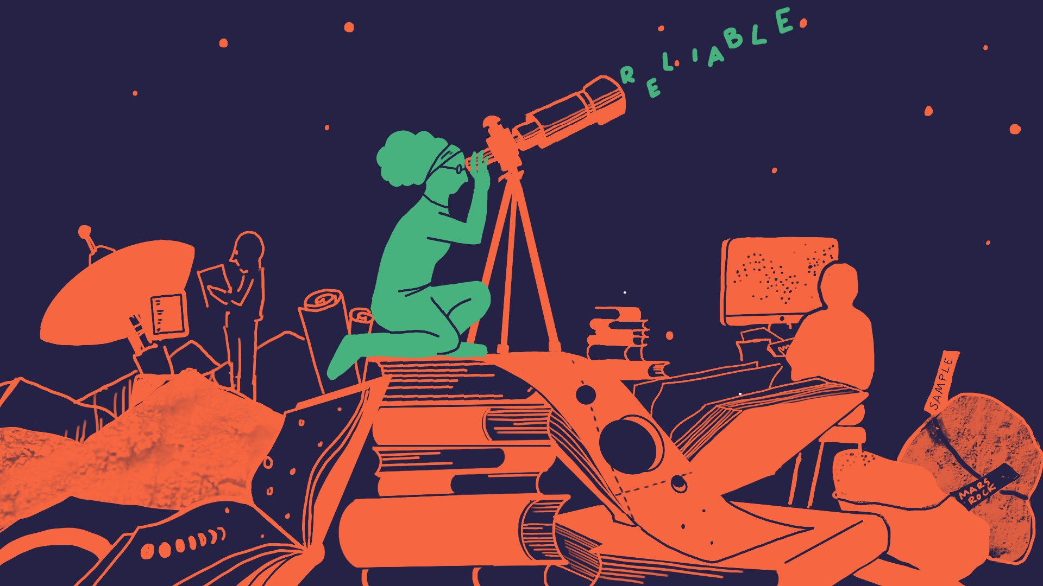

Slide 13
Principles & Practices
of Open Research
An online module for undergraduate and
Masters students

Slide 14

Module 4 – Reproducible Practices
Reproducibility examples

Slide 15




Reproducibility Examples
Often the mistakes made inadvertently lie hidden -- never to be found
To err is to be human
Through the incorporation
of reproducible practices within our work we can identify and correct these mistakes after the event, improving the quality of our reporting
Check out
the next four slides for examples

Slide 16

Example 1: Identifying Reproducibility Issues in a Clinical Trial
Clinical trials are studies that examine (typically) treatments on human health outcomes
In 2018 a major medical journal retracted an important clinical trial after a serious error was detected in how the trial data was processed

Slide 17


Example 1: Identifying Reproducibility Issues in a Clinical Trial
In this trial, the treatment and controls groups had their coding reversed
This means that what researchers thought was data from the treatment group was actually data from the control group, and vice versa!

Slide 18

Example 1: Identifying Reproducibility Issues in a Clinical Trial
This was an inadvertent mistake that invalidated the trial results
The mistake was only found because the code underlying the results was published and so could be examined
  Someone who examined the code spotted the mistake
In this way, reproducible research practices saved the day!

Slide 19

Example 2: Power Posing
In 2010, researchers published results from a psychological study suggesting that power posing (standing or adopting an assertive posture) can improve confidence
These findings were disseminated widely, and the
concept of power posing quickly found its way into
popular culture

Slide 20

Example 2: Power Posing
Two years later however, the results of the study were called into question when a replication study failed to find the same results
This was particularly the case for changes that the original researchers had reported for certain hormones as a result of power posing
In addition, increased scrutiny of the original
research revealed that the statistical significance
values associated with the work were barely
significant

Slide 21
Example 2: Power Posing
The research was, for a time, dismissed as pseudoscience
However preregistered and robust replication studies have supported that power posing is linked to people’s feeling of confidence now
This reaffirms a link between posture and confidence
It also demonstrates the importance of being able to
reproduce studies to determine potentially erroneous
and/or valid findings

Slide 23
Principles & Practices
of Open Research
An online module for undergraduate and
Masters students

Slide 24

Module 4 – Reproducible Practices
Why is reproducibility important?

Slide 25
Why is reproducibility important?
1
It ensures research can be assessed, verified, and confirmed by other researchers
Why is reproducibility important?
It helps identify and correct situations where researchers have engaged in questionable research practices
2
Creating a culture of reproducibility can ​
discourage researchers from reporting only ​
those findings that are significant/exciting ​
3

Slide 26


How does this impact you?
Engaging in reproducible practices minimises the likelihood of questionable research practices, no matter what discipline you are in
It can make
research better by reducing bias and/or teasing out other flaws in research
The assessors/markers
of your final research project can see how thorough and transparent you have been
While reproducibility practices may take a bit more of your time, they pay off in the end!

Slide 27

How does this impact you?
If you want to publish
your research, journals are
now publishing more
reproduction studies
and negative results
Being able to assess
published research for
reproducibility gives you a
better understanding of
what research is reliable
(or not)

Slide 28



How does this impact you?
It also helps develop a
more reliable evidence base
for policy or practice decisions that impact society

Slide 30
Principles & Practices
of Open Research
An online module for undergraduate and
Masters students

Slide 31

Module 4 – Reproducible Practices
How do we make research more reproducible?

Slide 32

What kinds of things decrease reproducibility?
There are lots of things that can impact on reproducibility
Things like flaws in study design, researcher biases, and misunderstanding analytical approaches

Slide 33


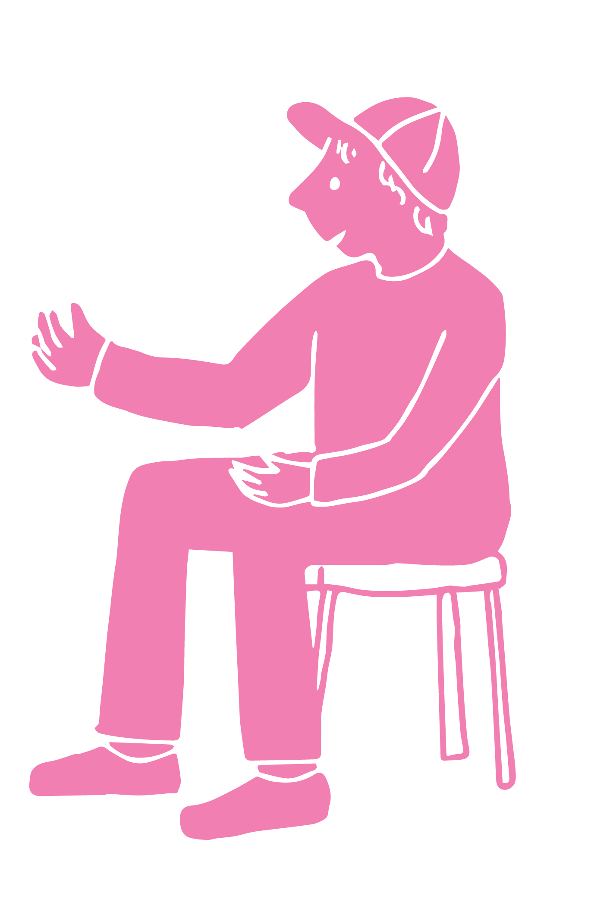
What kinds of things decrease reproducibility?
Reproducibility may also be decreased by poor record-keeping, mistakes, and lack of training
As well as poor sharing
of research approaches, selective reporting of findings and methods, and incentives to publish more
and faster, at the cost
of rigour

Slide 34




How can we make research more reliable and reproducible?
Carefully document your methods using a data management plan
Use a uniform filing system with clear folder and filing names
Store metadata alongside primary data (metadata is data about data)
Store all research materials in accordance with institutional guidelines
Consider keeping a digital notebook to share processes and steps used to generate the findings

Slide 35
How can we make research more reliable and reproducible?
If you are working with data that can be more readily made available, make your data and details of methods freely available to other researchers by
Publishing the data in a repository
Always including a data dictionary to accompany your data
Using open-source software and providing information about...
Such as OSF, which you were introduced to in Module 2
A data dictionary gives clear information about your data
Statistical tests, or other analytical approaches employed, and the arguments used

Slide 36
How can we make research more reliable and reproducible?
In some disciplines it is not as easy/possible to make data available
If it is not possible, remember the importance of enhancing transparency by providing details about how the research was conducted
These details can include:
The theoretical method adopted
The research setting
The relationship between researcher and participants
Anonymised participant characteristics

Slide 37

How can we make research more reliable and reproducible?
Strategies to make your research more reproducible are presented throughout the PaPOR TRaIL course
Research Integrity (Module 1)
Research Data Management
(Module 4)
Open Reporting
(Module 5)
Knowledge Dissemination
(Module 6)

Slide 38
There are resources available to help
Examples of resources in University College Cork include:
  A digital badge in the Responsible Conduct of Research that includes training on research reproducibility
  There are postgraduate modules on
    Reproducible Research Practices (PG6030)
    and an Introduction to Research Integrity, Ethics and Open Science (PG6015)
  The UCC Boole Library also run a variety of training sessions
Other universities may have supports, including training and workshops, to support you to develop reproducible research methods

Slide 39
There are resources available to help
There are also online networks and communities you can follow and join. E.g.,
  The UK Reproducibility Network (UKRN)
    The UKRN provides guidance and resources for methods and strategies for improving research reproducibility
  Reproducibility for Everyone
    This provides resources and webinars on strategies for reproducible research
  Reproducibilitea
    A community for early-stage researchers interested in open
    science and reproducibility

Slide 40


What efforts are universities and supervisors making to help us to make research more reproducible?
Efforts are increasing by supervisors and universities to support students

Slide 41
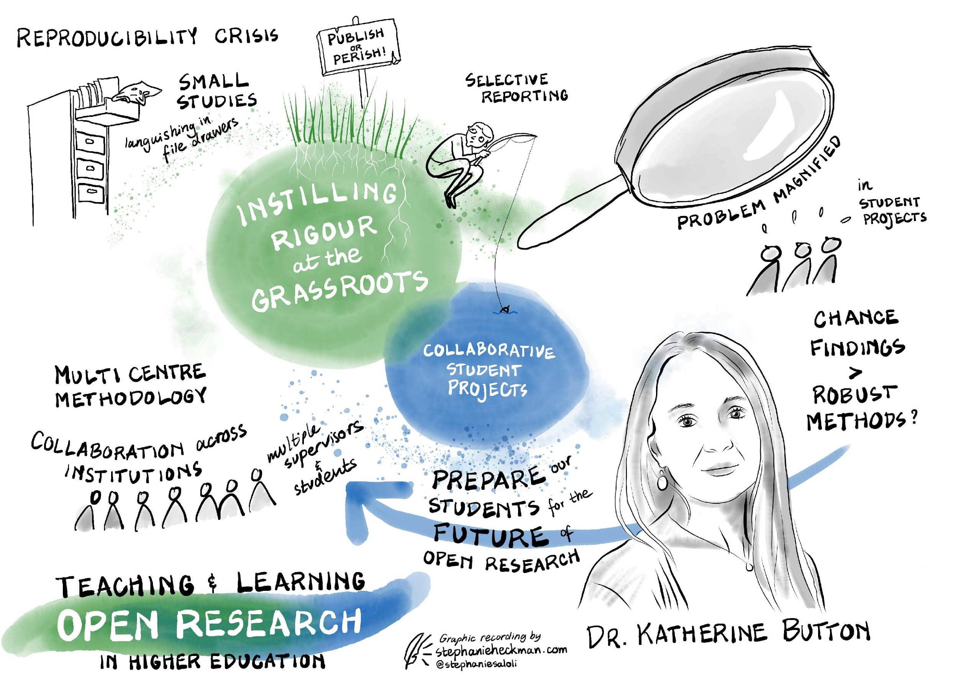
What efforts are universities and supervisors making to help us to make research more reproducible?
One example of this, being led by Dr Katherine Button (University of Bath) is a collaborative approach to open research projects
In this model, students at a number of UK universities participate in a “consortium” to complete their final year theses
The students receive extra support throughout the project to make their research reproducible

Slide 43
Principles & Practices
of Open Research
An online module for undergraduate and
Masters students

Slide 44
Additional Resources

Slide 45
Want to know more about . . .
The reproducibility crisis?
Check out this comic strip about the reproducibility crisis; it focuses on psychology but is relevant across disciplines:
Repeat After Me: A Cartoon about Reproducibility in Psychology
This blog gives a nice overview, and includes reference to the power posing study we mentioned earlier:
Failure is Moving Science Forward: The replication crisis is a sign that science is working

Slide 46
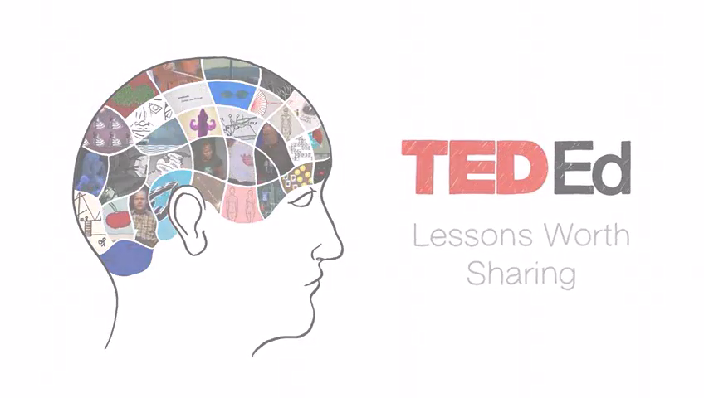
Want to know more about . . .
Take a look at this short video about the ‘reproducibility crisis’.
The focus in the video is on science but even if you are not studying science, it presents a useful overview and interesting examples of existing reproducibility issues that are relevant across research disciplines.

Slide 47
Want to know more about . . .
Reproducibility in qualitative research and the humanities?
This paper gives an overview and practical guidelines for reproducibility in the humanities:
Peels, R., Bouter, L. (2018). The possibility and desirability of replication in the humanities. Palgrave Commun 4, 95. https://doi.org/10.1057/s41599-018-0149-x
The paper outlines 12 transparency criteria for qualitative work that can help boost transparency and reproducibility:
Aguinis, H. & Solarino, A.M. (2019). Transparency and replicability in qualitative research: The case of interviews with elite informants. Strategic Management Journal, 40(8), 1291-1315. https://doi.org/10.1002/smj.3015

Slide 48
Want to know more about . . .
How to make your research more transparent and/or reproducible?
Robert Peng’s 3-part Video Checklist for Reproducible Research can help. There are three parts, about 10 minutes each: 1, 2, and 3
The relationship between registered reports and reproducibility?
We introduced registered reports in Module 2 and this video draws a link between registered reports and reproducibility
Registered Reports as a tool for improving research transparency and reproducibility

Slide 49
Want to know more about . . .
Strategies for minimising normal human biases in research:
This paper details one researchers experiences and gives tips on how we can ‘fight our own worst instincts’ in research:
Nuzzo, R. (2015). Fooling ourselves. Nature, 526(7572), 182-185.https://www.nature.com/news/how-scientists-fool-themselves-and-how-they-can-stop-1.18517
Software for reproducibility
Take a look at this ‘toolkit’, which focuses mainly on computational reproducibility:
Perkel, J.M. (2018). A toolkit for data transparency takes shape. Nature, 560(7719), 513-515. https://doi.org/10.1038/d41586-018-05990-5

Slide 50
Want to know more about . . .
Large-scale reproducibility evaluations?
The links below give an overview of some large-scale projects and let you take a look at some of the reproducibility studies that have been conducted
  Reproducibility Project: Psychology
  Many Labs Replication Project
  Replicability Index
The Power Posing example we introduced earlier?
This article gives an overview of the power posing research, including criticisms and support of the findings
Power Posing is Back: Amy Cuddy Successfully Refutes Criticism

