Slide 1


Principles & Practices
of Open Research
An online module for undergraduate and
Masters students

Slide 2

Module 5 – Open Reporting
What is Open Reporting?

Slide 3

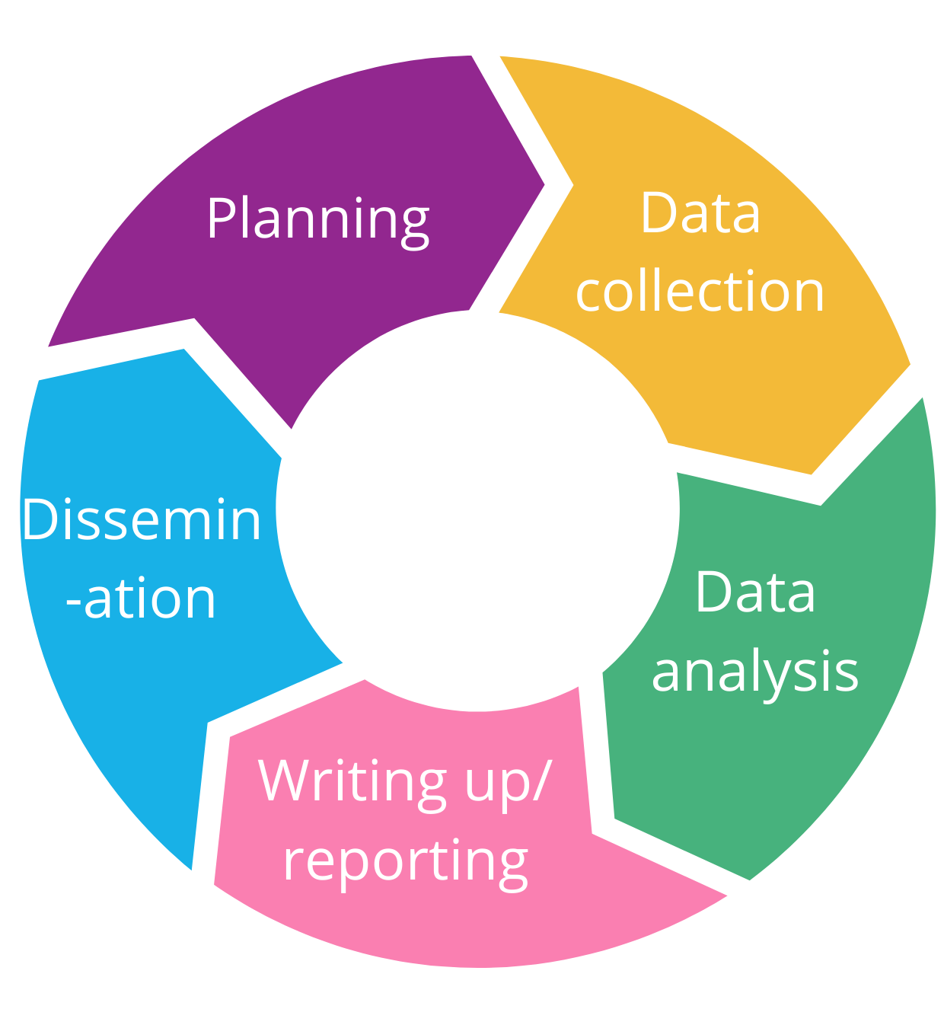
What is open reporting?
Open reporting is the practice of providing a full, clear, and specific account of how research was conducted
This is done according to a standard template or set of guidelines

Slide 4





What is open reporting?
Open reporting
applies to all stages
of the research
process
From planning . . .
. . . to dissemination
. . . to data
collection, analysis, and write-up. . .

Slide 5





What is open reporting?
But research
involves choices and
revisions at every stage of
the process
It can be easy to focus only on reporting the findings of our research
Open reporting allows
us to make our processes transparent, as well as
our findings

Slide 6



What is open reporting?
Is open reporting applicable to all disciplines, though?
Yes, but it is not currently in use in all disciplines
Most existing checklists and guidelines relate to medicine and health and related disciplines
All disciplines are on their own open research journey, developing and adapting their own version

Slide 7

What is open reporting?
It won't be the same for everyone, and currently there are lots of gaps
But it’s still important
to know what it is and how
to do it so you are prepared
to report openly
And can better understand and evaluate how others report their research

Slide 8


Slide 9
Principles & Practices
of Open Research
An online module for undergraduate and
Masters students

Slide 10

Module 5 – Open Reporting
Why is Open Reporting Important?

Slide 11





Why is open reporting important?
Traditionally, research reports place an emphasis on results
Which has meant that other parts of the research process remain opaque
  If flaws go undetected, invalid research results may still become part of the research record
This limits other researchers’ abilities to evaluate or attempt to reproduce a study’s results
This may increase research waste as other researchers attempt to reproduce or build upon flawed evidence
  It may also unduly impact both individual decisions and social policy

Slide 12

Why is open reporting important?
1
It allows researchers to detail their processes
and decisions at all stages of the research
cycle
2
It enhances other researchers’ ability to
evaluate and/or verify a study’s results
Why is open research important?
3
It enhances other researchers’ ability to reproduce a study’s results (see Module 4)
4
It facilitates researchers' ability to bring together large bodies of evidence to better understand topics
5
Benefits decision-making because decisions can be made on transparent research processes and findings

Slide 13

Why is open reporting important for me?
That all sounds great
for research more generally but what about me, as a student?
It sounds like it takes extra time and I am not sure how I will benefit.
By openly reporting
what you have done in your research, you have a transparent account of your study

Slide 14



Why is open reporting important for me?
This makes it
easier for others,
including your research supervisor, to see the steps you have taken
This can help to
spot mistakes earlier
on and correct them, and can help you get recognition for the work you put in at each step
There are also lots of tools and resources to help you to openly report. We will go through these in the next section

Slide 16
Principles & Practices
of Open Research
An online module for undergraduate and
Masters students

Slide 17

Module 5 – Open Reporting
How can we report research openly?

Slide 18

How can we research openly?
In this section,
we focus on reporting guidelines and checklists

Slide 19
How can we report research results openly?
You can also openly report using:
You can find out more about pre-registration and registered reports in Module 2
Pre-
registration
This means making your research plans and processes publicly available before you start
Registered reports
These are research papers outlining proposed study methods and approach that are submitted to journals beforehand

Slide 20

What is a reporting guideline?
It is a checklist, a structured text, or a flow diagram that guides researchers in how to report a specific type of research that has been developed using explicit methodology

Slide 21
Reporting Guidelines and Checklists
1
To help researchers create accessible and
easily understood records of their research
What is the aim of a reporting guideline?
2
To help researchers create relevant records of their research
3
To help researchers create records of their work containing sufficient detail to allow evaluation and/or reproduction (see module 4)

Slide 22


Reporting Guidelines and Checklists
When should I use an open reporting checklist?
They are typically used when writing research reports and articles
You can also use the checklists to guide your thinking and drafting of your protocol and/or ethics application
Many journals now
require you to submit a completed checklist with your submitted paper

Slide 23

Reporting Guidelines and Checklists
They are also useful to
guide your process as
well as essential to
complete when writing
up your final report
So how do I find a reporting guideline for my research, and how do I know which one is the right one to use?
This has a list of
guidelines you can use, and many are
available in many
different languages
There are resources
you can use, like the Equator Network website

Slide 25
Principles & Practices
of Open Research
An online module for undergraduate and
Masters students

Slide 26

Module 5 – Open Reporting
Examples of guidelines and checklists

Slide 27


Examples of Reporting Guidelines for Different Types of Research
Research type | Guideline/Checklist
Study protocols / Clinical trial protocols | SPIRIT; PRISMA-P
Qualitative research | COREQ; SRQR
Randomised trials | CONSORT
Observational studies | STROBE
Systematic reviews | PRISMA
Diagnostic/prognostic studies | STARD; TRIPOD
Case reports | CARE
Click on any of these links to see the checklist(s)

Slide 28
Examples of Reporting Guidelines for Different Types of Research
Research type | Guideline/Checklist
Clinical practice guidelines | AGREE; RIGHT
Animal pre-clinical research | ARRIVE
Quality improvement studies | SQUIRE
Economic evaluations | CHEERS
Case studies | Checklist for case studies
Ecology studies | TTEE
Click on any of these links to see the checklist(s)

Slide 29
Examples of Reporting Guidelines and Checklists
And more being developed in new areas and disciplines all the time!
Don’t worry if you can’t find the right one for you on the previous slide
We have included some of the most well-known
guidelines, but there
are still many more
beyond these

Slide 30


Examples of Reporting Guidelines and Checklists
Next we will take a look
at some of the guidelines and checklists in a bit
more detail
Even if the checklists we go through are not directly relevant to your study, understanding how to complete a reporting checklist is important for all studies

Slide 31
PRISMA Checklist
Preferred Reporting Items for Systematic Reviews and Meta-Analyses
A 27-item checklist representing an evidence-based minimum set of items for reporting in systematic reviews and meta-analyses
  Including the title, abstract, methods, results, discussion and funding
A useful basis for reporting systematic reviews of a range of different research approaches
  Though largely focused on reporting of reviews evaluating randomized trials

Slide 32
SRQR
Standards for Reporting Qualitative Research
A 22-item checklist with broadly applicable standards for reporting qualitative research
Allows researchers to report important aspects of qualitative studies
  Including standards on the qualitative approach and paradigm, researcher characteristics and reflexivity, study methods, analysis, synthesis and interpretations

Slide 33
STROBE
STrengthening the Reporting of OBservational studies in Epidemiology
A 22-item checklist for reporting of observational studies
  Including the title, abstract, methods, results, discussion and funding
  Focuses mainly on reporting of cross-sectional, cohort and case-control studies
Not only for epidemiological studies but for observational research in any discipline

Slide 35
Principles & Practices
of Open Research
An online module for undergraduate and
Masters students

Slide 36
Additional Resources

Slide 37
Want to know more about...
Choosing the right reporting guidelines for your research?
Take a look at the Equator Network: Selecting the appropriate reporting guidelines for your work
How reporting guidelines are developed?
The Equator Network toolkit for developing a reporting guideline shows the steps involved:
Equator Network: Developing a Reporting Guideline

Slide 38
Want to know more about...
The impact of reporting guidelines on reporting practices?
This paper outlines the impact in Public Health specifically but may be of interest more broadly:
Mannocci, A., et al. (2015). What is the impact of reporting guidelines on Public Health journals in Europe? The case of STROBE, CONSORT and PRISMA, Journal of Public Health, 37(4), 737-740. https://doi.org/10.1093/pubmed/fdu108
Strategies for reporting research decisions transparently:
This paper focuses on statistical reporting:
Wicherts, J. M., et al. (2016). Degrees of freedom in planning, running, analyzing, and reporting psychological studies: A checklist to avoid p-hacking. Frontiers in Psychology, 7, 1832. https://doi.org/10.3389/fpsyg.2016.01832

